Slide 1
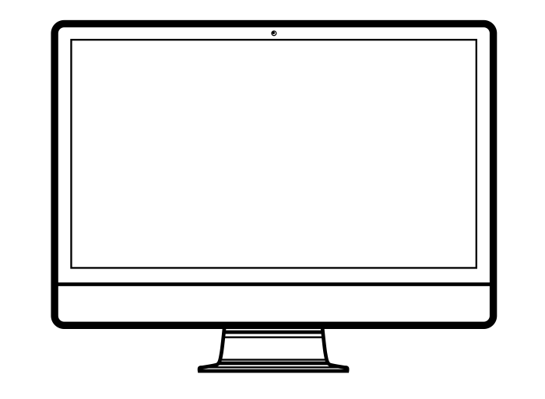
WA State Ethics Act Outside Work RCW 42.52
January 13, 2022
Richard Cordova
Internal Audit

Slide 2
RCW 42.52 – Ethics In Public Service
Sections:
.020 Activities Incompatible w/ public duties (Conflict of Interest)
.030 Financial interests in transactions
.040 Assisting in transactions
.050 Confidential information
.070 Special privileges
.080 Employment after public service
.110 Compensation for official duties or nonperformance
.120 Compensation for outside duties
.140 Gifts
.160 Use of State resources
.180 Use of State resources for political campaigns
.220 Universities – Administrative Processes
All of these are re: Conflict of Interest
All of these can relate to O/S Work

Slide 3
Conflicts of Interest
A State employee may not use their position to secure special privileges or exemptions
You cannot get “extra” or outside compensation for your official duties
Conflict of Interest involves the concepts of benefit and bias
Post-State employment restrictions are designed to ensure former employees do not obtain an advantage

Slide 4
Use of Resources
Some limited personal use is allowed if brief and no cost to the agency… De minimis
Zero Tolerance for use of State resources benefitting an o/s business or when used for campaigning
Generally, State resources are to be used only for State purposes, not private benefit or gain
One exception: research employees can make minimal use of University resources in support of commercialization of UW IP

Slide 5
Use of Resources
Research Employees Exception
May use their personally assigned University resources (office, telephone and computers) and e-mail to conduct outside work activities related to their research and technology transfer activities.
CONFLICTS OF INTEREST
GIFTS
USE OF RESOURCES
OUTSIDE EMPLOYMENT

Slide 6
Outside Work
Employees may engage in outside work or part-time employment provided that it does not conflict with or negatively impact employees' ability to fulfill their University employment obligations, and that it does not otherwise negatively impact the University.
Must be pre-approved whether or not work is for compensation.
You may receive pay, honoraria or expense reimbursement.

Slide 7
Outside Work
Legitimate and actually performed
Not part of your regular University work, or under your supervision
Cannot assist others with University transactions under your control
Not for an organization or person from whom the law prohibits receipt of gifts
Does not result in the unauthorized disclosure of confidential information
CONFLICTS OF INTEREST
GIFTS
USE OF RESOURCES
OUTSIDE EMPLOYMENT

Slide 8
Outside Work
Request for Approval of Outside Work – Professional & Classified Staff
Form 1301
Request for Approval of Outside Work for Compensation – Faculty
Form from Provost Office
Faculty – Annually must complete Form 1461
Advance review and approval of outside work or employment is required whenever the activity relates to or could conflict with the employee's University job responsibilities or status as a University employee (when in doubt, disclose)
CONFLICTS OF INTEREST
GIFTS
USE OF RESOURCES
OUTSIDE EMPLOYMENT

Slide 9
Outside Work
Who Approves?
Pro Staff/Classified Staff
Faculty
Immediate supervisor will review and recommend approval/disapproval to the Administrative Unit Head for final review and approval
Dean and Provost must
preapprove
CONFLICTS OF INTEREST
GIFTS
USE OF RESOURCES
OUTSIDE EMPLOYMENT

Slide 10
Outside Work
Conditions for approval
Is not a detriment to University obligations
Does not affect job performance
Not in conflict with discharge of employee’s official duties
Done outside employee’s normal work schedule (or vacation taken)
Must clearly identify that employee is not a representative of the University
Outside work should not be intended to be provided “back” to the University or to University employees
CONFLICTS OF INTEREST
GIFTS
USE OF RESOURCES
OUTSIDE EMPLOYMENT

Slide 11
Outside Work
If the outside work is for another State agency, all the “Outside Work for Pay” rules apply, plus:
It must result from an open competition or receive advance approval from the Ethics Board
A copy of the contract is to be filed with the Ethics Board
CONFLICTS OF INTEREST
GIFTS
USE OF RESOURCES
OUTSIDE EMPLOYMENT

Slide 12
Resources
If you have a question on WA Ethics Act, call Internal Audit – we are a resource to be used by all.
UW Internal Audit
(206) 543-4028
http://f2.washington.edu/audit

