Slide 1
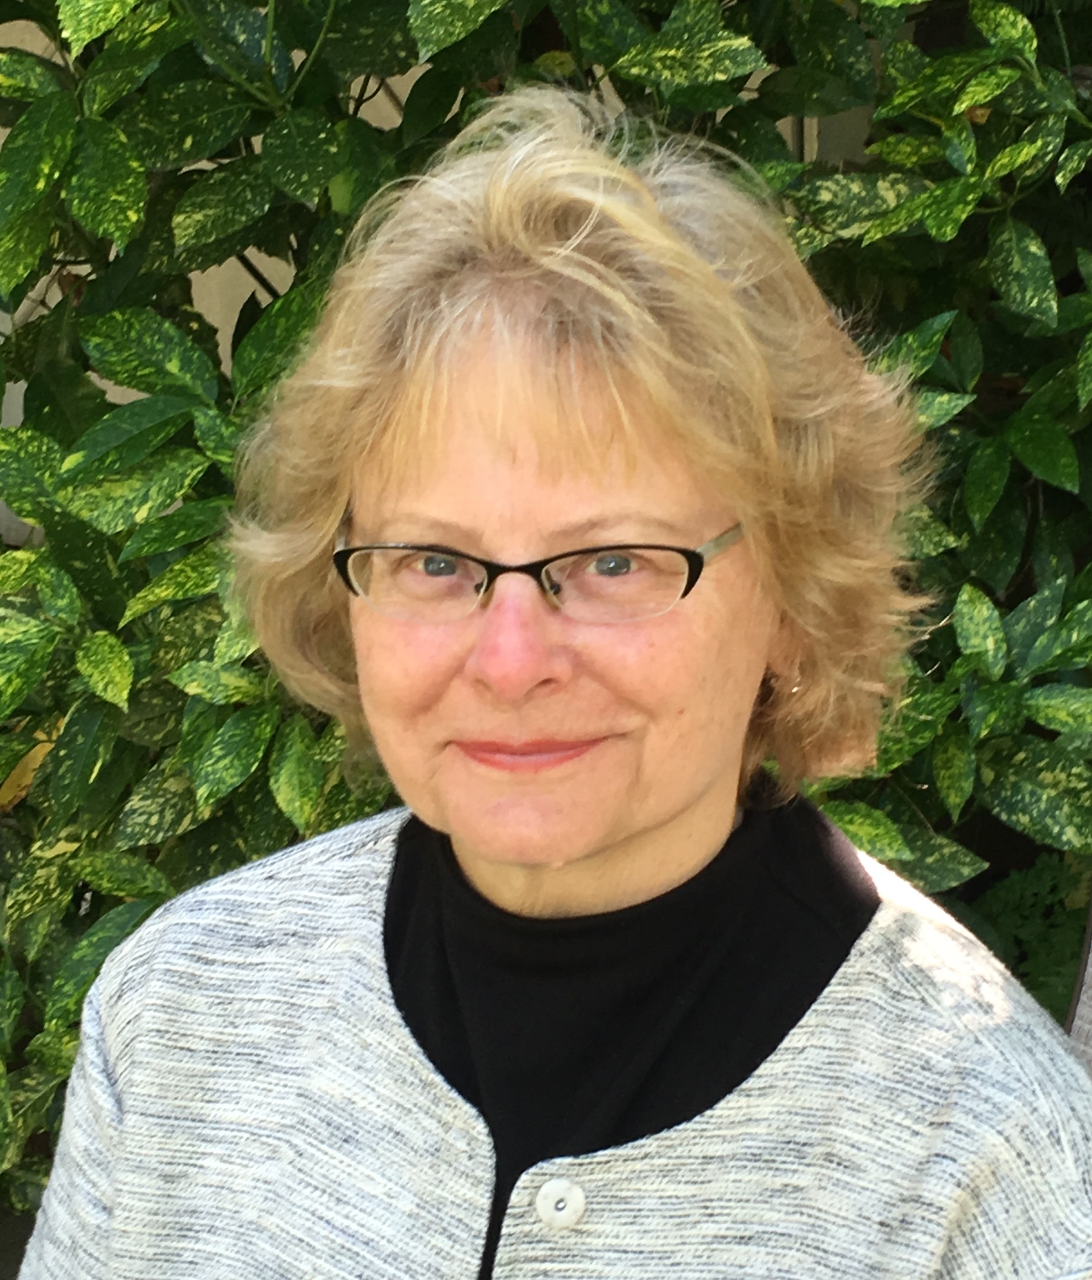
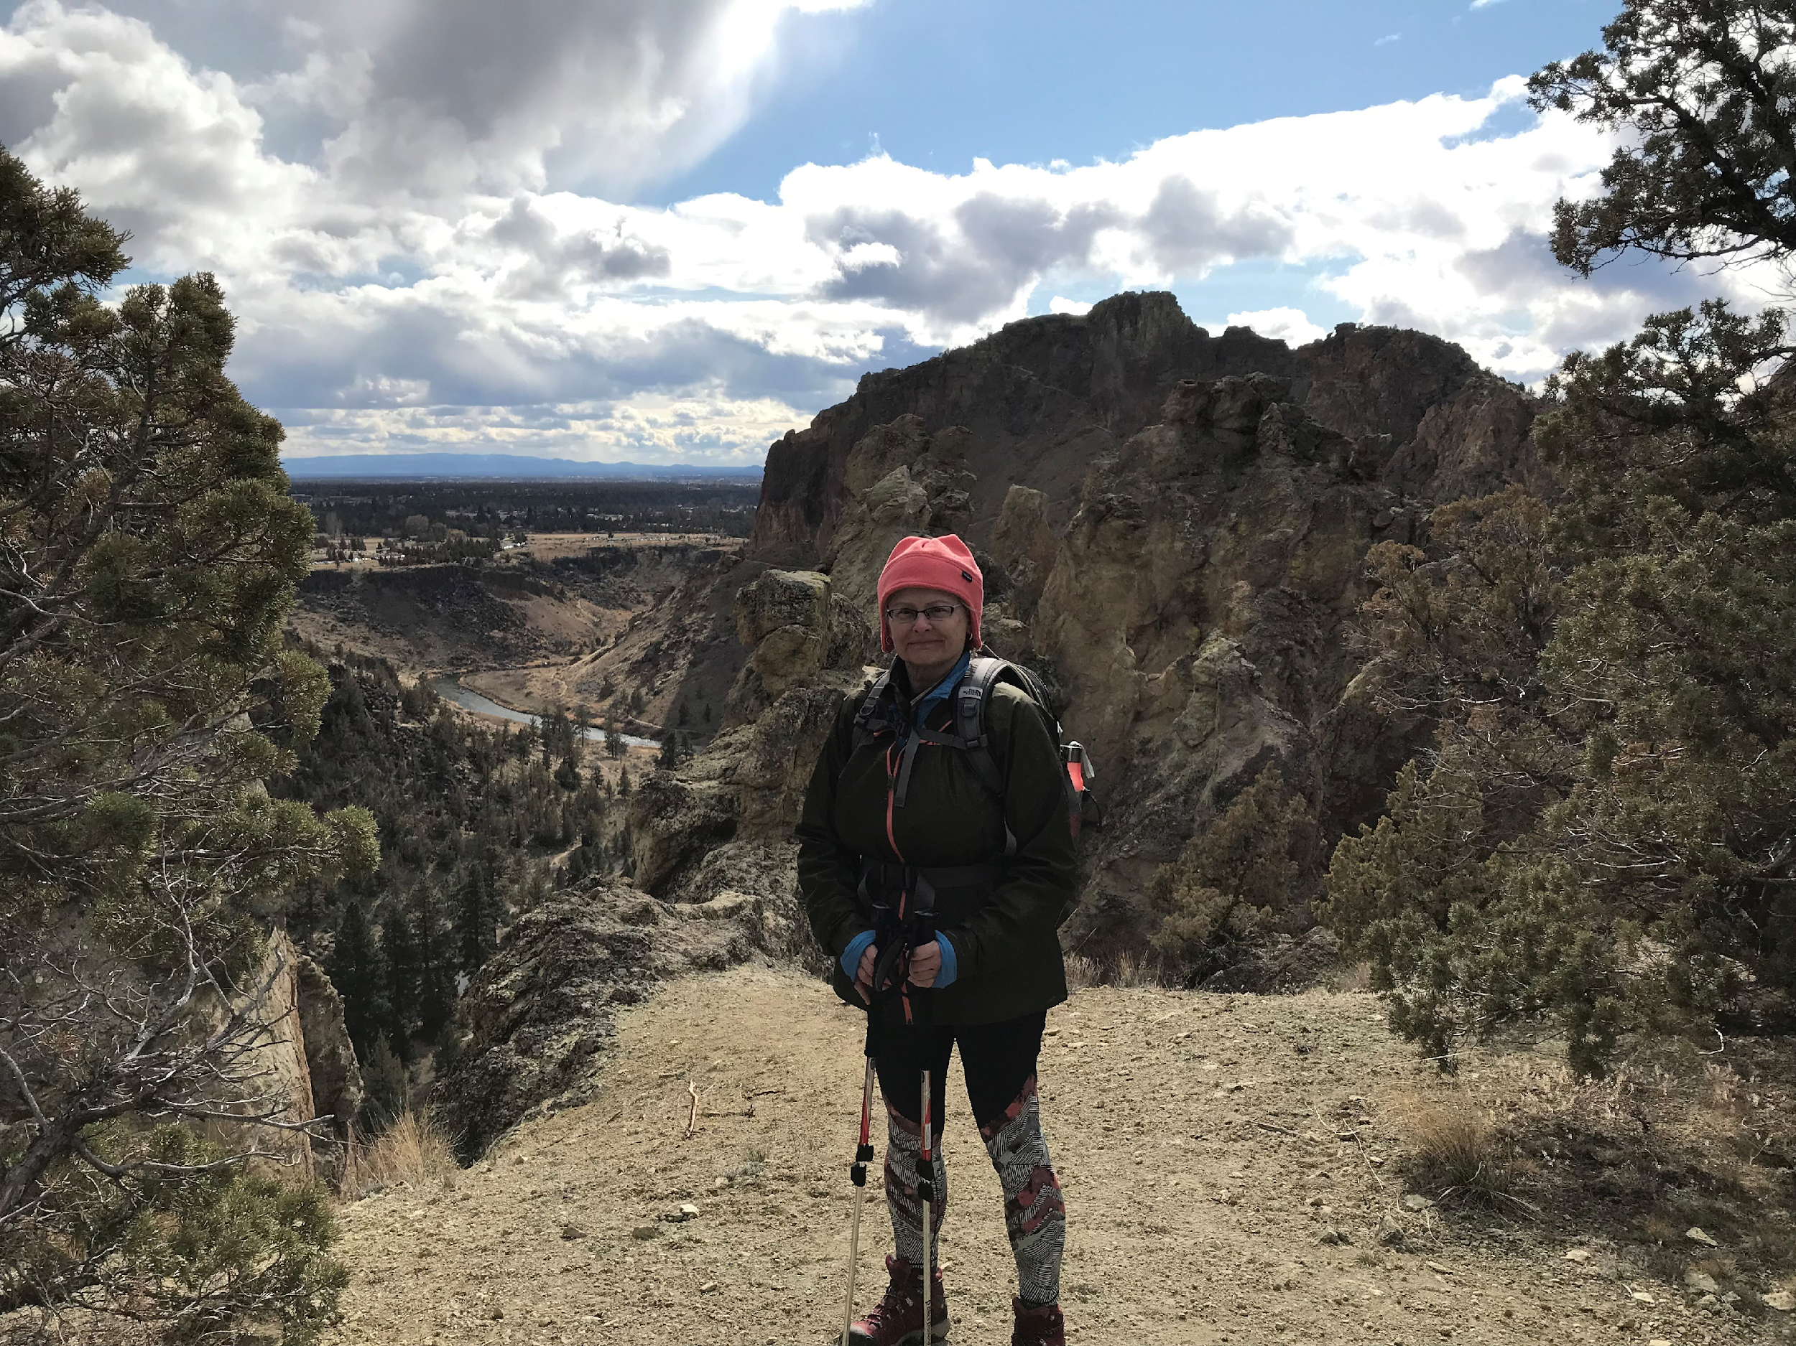
Thank You, Karen – enjoy your retirement!
13 January 2020
MRAM

