Slide 1
Foreign Influence & Related Federal Agency Policy Changes
January, 2022 MRAM
Carol Rhodes
Office of Sponsored Programs

Slide 2
Dept. of Energy (DOE): Foreign Government-Sponsored Talent Recruitment Programs (FGTRP)
All contractor personnel are prohibited from participating on a Foreign Government-Sponsored Talent Recruitment Programs (FGTRP)
There are no exceptions to this policy
All contractor personnel are restricted from Other Foreign Government Sponsored or Affiliated Activities of a Foreign Country of Risk
DOE may allow some exemptions - DOE will review requests

Slide 3
What Does This Mean?
When award terms include:
CONTRACTOR REQUIREMENTS DOCUMENT (CRD) “DOE ORDER 486.1A”, FOREIGN GOVERNMENT SPONSORED OR AFFILIATED ACTIVITIES
The PI and all participating personnel need to fill out the UW’s Foreign Government-Sponsored Talent Recruitment Programs (FGTRP) Disclosure Form, sign, and return to OSP via osp@uw.edu
OSP will hold the FA until the forms are returned

Slide 4
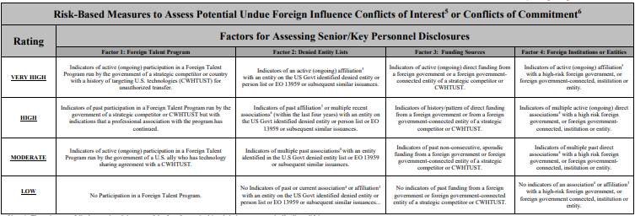
Defense Advanced Research Projects Agency (DARPA) - Foreign Interests Rubric
DARPA has a Risk Rubric they will use to review disclosures from all proposed Senior/Key Personnel. Four criteria factors at four different risk levels from low to very high.
Senior/Key Personnel Foreign Influence Risk Rubric
Countering Foreign Influence Program (DARPA Policy)
Countering Foreign Influence Program (CFIP) Frequently Asked Questions (FAQ)
DARPA for Universities
Notes:
image of risk rubric is small - 4 types of factors with 4 risk rating levels - review on DARPA site for more information

Slide 5
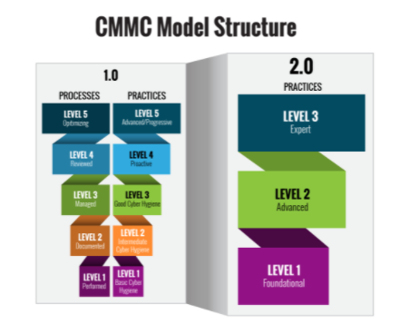
Dept. of Defense (DOD)
Cybersecurity Maturity Model Certification (CMMC) 2.0
Simplifies the CMMC security standards.
https://www.acq.osd.mil/cmmc/about-us.html

Slide 6
CMMC, con’td.
Focuses the most advanced cybersecurity standards and third-party assessment requirements on companies.
Allows all entities at Level 1 and a subset of entities at Level 2 to demonstrate compliance through self-assessments (rather than third -party).

Slide 7
CMMC in Solicitations
DoD will pursue rulemaking with the usual public comment period.
DoD suspended all CMMC Piloting efforts and will not include CMMC requirements in any DoD solicitation until the rulemaking process is completed. (9-24 months from Nov. 2021)

Slide 8
NIH - Other Support Documentation
Updated File Format for the Other Support and Biosketch required for applications on or after 1/25
Flatten these PDFs & retain the signature on file in your department
UW:
Current, Pending, and Other Support
NIH PDF Guidance as of May 2021
Foreign Interests in Sponsored Programs
NIH:
Other Support FAQs
Instructions for How to Flatten a PDF
NOT-OD-21-110

Slide 9
Questions

