Slide 1
MRAM | Monthly Research Administration Meeting
March 10, 2022 9:00 AM – 10:00 AM HOSTED REMOTELY Join the LIVE Webinar: https://washington.zoom.us/j/346891888
TOPIC | PRESENTER | EMAIL | MIN
Welcome | Kirsten DeFries Research Compliance & Operations | kirsten5@uw.edu | 2
PAFC Hot Topic: Federal Audit Trends | Matt Gardner Post Award Fiscal Compliance | gcafco@uw.edu | 10
Personnel Changes in the Office of Research | Joe Giffels Office of Research | jgiffels@uw.edu | 5
Mask Mandate and Research | Joe Giffels Office of Research | jgiffels@uw.edu | 5
SAGE Training Preference Poll | Anatoliy Klots Office of Research Information Services | klots@uw.edu | 10
NEXT MEETING April 14, 2022 9:00 AM - 10:00 AM

Slide 2
Live Closed Captioning is now available
Live transcription and closed captions are enabled via the “CC/Transcript” button in your Zoom window.
Recordings of our sessions, with manually edited closed captions, are typically available within a week after the meeting, and a link is emailed with the post-session Q&A.
If you have any issues or questions, please let us know at mramques@uw.edu

Slide 3
COMPLIANCE HOT TOPIC: FEDERAL AUDIT UPDATES
MRAM
March, 2022
Matt Gardner
Post Award Fiscal Compliance

Slide 4
NSF Audits on Covid-19 Flexibilities
In Spring 2020, in response to the Covid-19 pandemic, OMB issued three memoranda providing temporary administrative flexibilities for federal sponsored awards.
During 2021, NSF conducted 10 audits of recipients and their implementations of the OMB flexibilities.
The audits tested:
Whether recipients used the administrative flexibilities, and
Whether recipients complied with the associated guidance
MRAM – Matt Gardner – PAFC

Slide 5
NSF Audits on Covid-19 Flexibilities
The most common flexibilities implemented by the audited institutions were:
Allowability of salaries and other project activities
Allowability of costs not normally chargeable to awards (e.g. costs for cancelled travel)
Extension of financial, performance, and other reporting
MRAM – Matt Gardner – PAFC

Slide 6
NSF Audits on Covid-19 Flexibilities
Three key findings from the audits:
Recipients were not always able to implement the flexibilities due to lack of time and/or guidance
Recipients were hesitant to use the flexibilities due to lack of guidance
Recipients did not consistently track or monitor their use of the flexibilities
MRAM – Matt Gardner – PAFC

Slide 7
DHHS Audit of NIH Awards
OIG audited NIH’s process for providing oversight and monitoring of grants
Key finding: Of a 20 grant sample, 12 awards were not closed out within 120 days of the end of the period of performance
Delayed closeout can be the result of delayed/late financial reports, technical reports, or final requests for payment
MRAM – Matt Gardner – PAFC

Slide 8
DHHS Audit of NIH
Key language:
“If grantees submit final reports late, it could indicate an issue with the grantee’s ability to comply with grant requirements, including accounting for grant funds and tracking the progress and outcomes of the grant.”
MRAM – Matt Gardner – PAFC

Slide 9
DHHS Audit of NIH – Key Takeaways
All closeout actions must occur for the Award to be considered closed in the eyes of the sponsor.
Reports (financial or technical)
Deliverables
Cost Share
Final requests for payment
Federal sponsors/auditors are beginning to take a stricter approach with timely closeout
MRAM – Matt Gardner – PAFC

Slide 10
References
NSF Audit of Covid-19 Flexibilities
https://oig.nsf.gov/sites/default/files/reports/2022-01/21-6-003COVID-19CapstoneReportRedacted.pdf
OIG Audit of NIH
https://oig.hhs.gov/oas/reports/region3/32003001.pdf
MRAM – Matt Gardner – PAFC

Slide 11
Questions
Post Award Fiscal Compliance (PAFC)
gcafco@uw.edu
https://finance.uw.edu/pafc/
Matt Gardner
mgard4@uw.edu
206-543-2610
MRAM – Matt Gardner – PAFC

Slide 12
Personnel Changes in the Office of Research
Export Controls
MRAM
March 2022
Joe Giffels
Office of Research

Slide 13
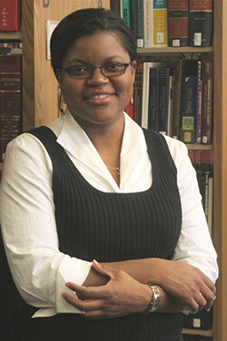
Jasmine Campbell, JD
Director, Export Controls
exports@uw.edu
Director of Regulatory Guidance
School of Medicine
2017-2022
Grant and Contract Administrator
Office of Sponsored Programs
2014-2017
Legal Associate
International regulatory compliance,
including export controls(!)
2009-2014
MRAM – Joe Giffels – Office of Research

Slide 14
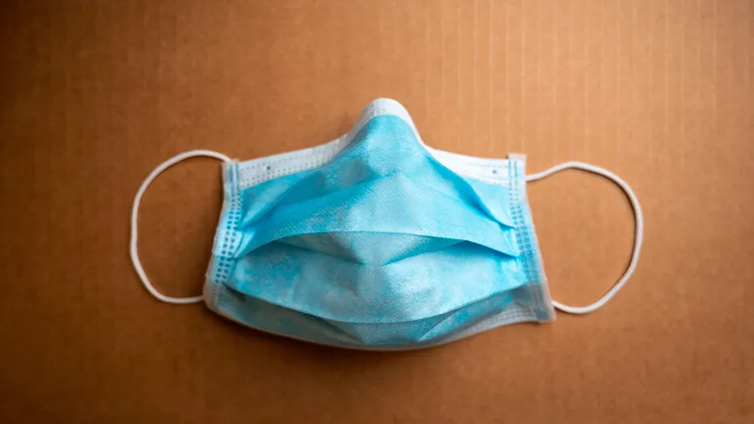
Mask Mandate and Research
MRAM
March 2022
Joe Giffels
Office of Research

Slide 15
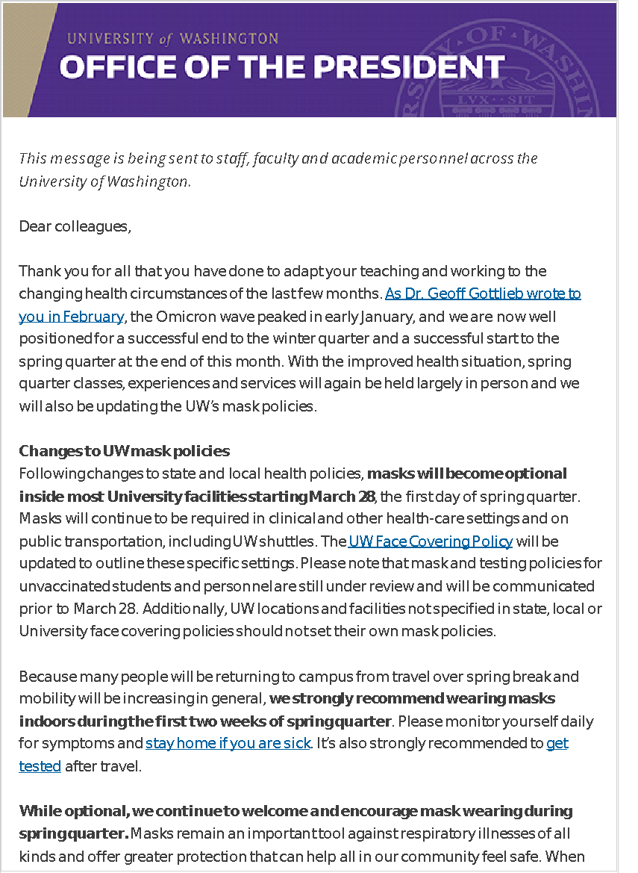
Mask on? Mask off? Indoors? Outdoors?
March 28
Masks not mandatory, but encouraged, for at least the next two weeks
Local mask mandates apply
All research may resume/begin
Future?
MRAM – Joe Giffels – Office of Research

Slide 16
SAGE TRAINING PREFERENCES SURVEY
Updates are coming to SAGE training in response to Financial Transformation
RA-specific SAGE training includes: Award Intake, eGC1s, SAGE Budget, Subawards, NIH Grant Runner
Help the ORIS team by filling out the short survey
Tell us about your training needs
Rank your preferred ways of receiving training
Join the ORIS User Research Group to share the RA community’s needs and help produce better products and training for SAGE, MyResearch, and the Research Website
MRAM – Office of Research Information Services
Notes:
Share the survey link https://forms.gle/NFVsvQX4J7ysUJrQ6

