Slide 1
Personnel Changes in the Office of Research
Export Controls
MRAM
March 2022
Joe Giffels
Office of Research

Slide 2
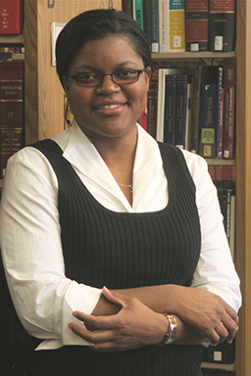
Jasmine Campbell, JD
Director, Export Controls
exports@uw.edu
Director of Regulatory Guidance
School of Medicine
2017-2022
Grant and Contract Administrator
Office of Sponsored Programs
2014-2017
Legal Associate
International regulatory compliance,
including export controls(!)
2009-2014
MRAM – Joe Giffels – Office of Research

