Slide 1
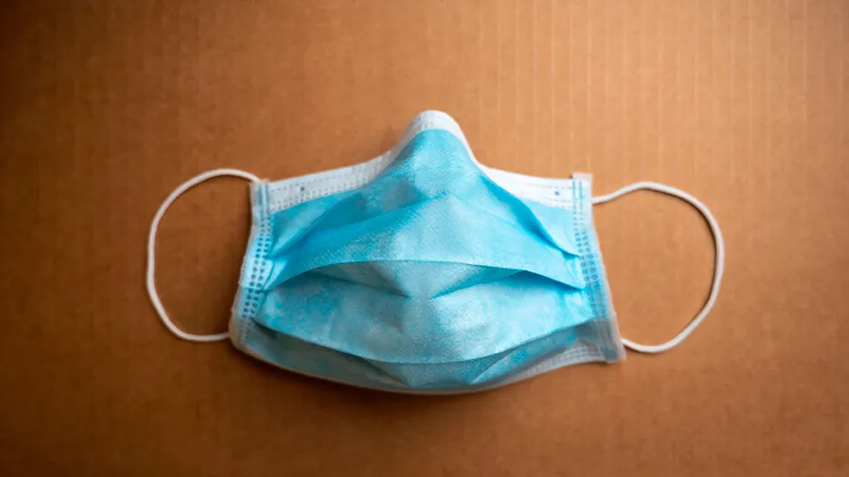
Mask Mandate and Research
MRAM
March 2022
Joe Giffels
Office of Research

Slide 2
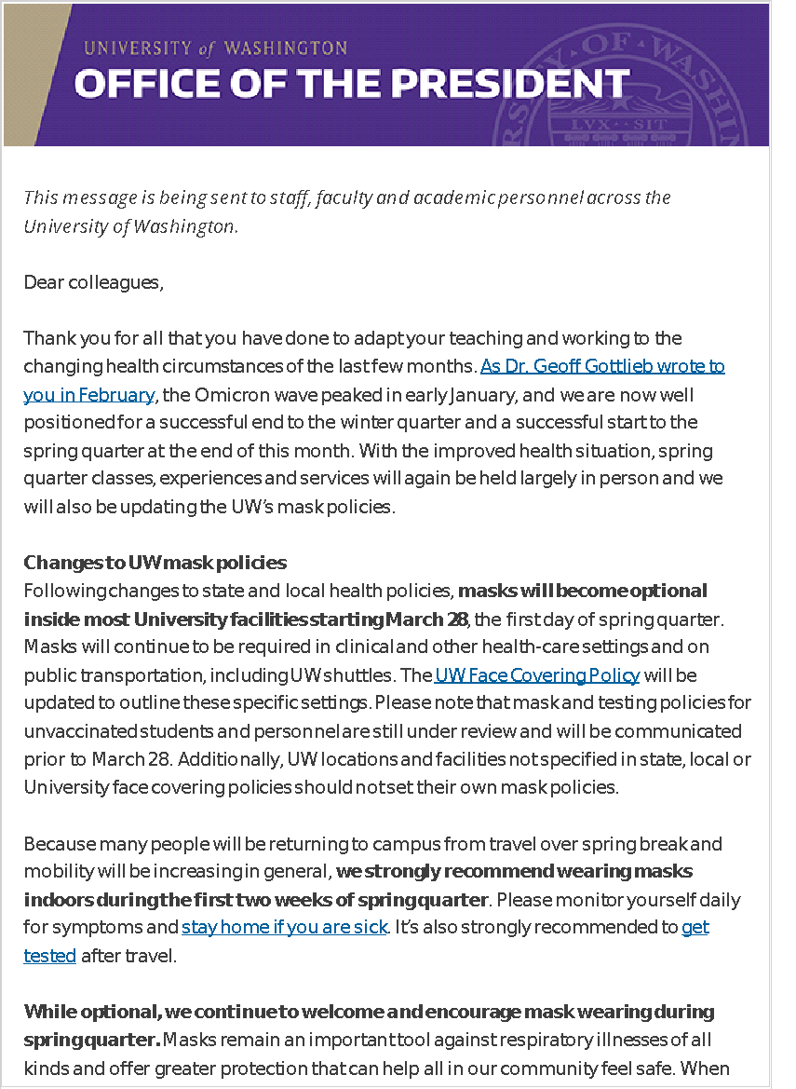
Mask on? Mask off? Indoors? Outdoors?
March 28
Masks not mandatory, but encouraged, for at least the next two weeks
Local mask mandates apply
All research may resume/begin
Future?
MRAM – Joe Giffels – Office of Research

