Slide 1
MRAM | Monthly Research Administration Meeting
April 14, 2022 9:00 AM – 10:00 AM HOSTED REMOTELY Join the LIVE Webinar: https://washington.zoom.us/j/346891888
TOPIC | PRESENTER | EMAIL | MIN
Welcome | Carol Rhodes Office of Sponsored Programs | carhodes@uw.edu | 2
PAFC: Hot Topic | Matt Gardner Post Award Fiscal Compliance | gcafco@uw.edu | 10
NSF & Research.gov | Tim Mhyre Office of Sponsored Programs | tmhyre@uw.edu | 5
Subrecipients and the new UEI | Bo Park Office of Sponsored Programs | bohyune@uw.edu | 5
UWFT Research Administration Webpage | Emily Elliott Office of Research Information Services | emilye22@uw.edu | 5
Bridge Funding Program | Karen Luetjen Office of Research | luetjen@uw.edu | 5
Crowdsourcing Services | Ray Hsu, Lynn Magill Procurement Services | rayhsu@uw.edu lmagill@uw.edu | 10
Recognition for CORE Research Administration Certificate Recipients | Laurie Stephan Collaborative On Research Education (CORE) | corehelp@uw.edu | 10
NEXT MEETING May 12, 2022 9:00 AM - 10:00 AM

Slide 2
Live Closed Captioning is now available
Live transcription and closed captions are enabled via the “CC/Transcript” button in your Zoom window.
Recordings of our sessions, with manually edited closed captions, are typically available within a week after the meeting, and a link is emailed with the post-session Q&A.
If you have any issues or questions, please let us know at mramques@uw.edu

Slide 3
COMPLIANCE HOT TOPIC:
THIRD PARTY & SUBAWARD COST SHARE
MRAM
April 2022
Matt Gardner
Post Award Fiscal Compliance

Slide 4
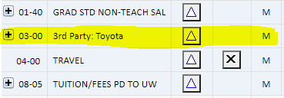
Third Party and Subaward Cost Share:
Source of Confusion
Third Party and Subaward cost share look the same in the eFECS Cost Share module.
Both types appear under 03-00 as “Third Party Cost Share”
However, there are differences in the types and how each contribution is documented.
MRAM – Matt Gardner – PAFC

Slide 5
Third Party and Subaward Cost Share:
The Differences
Third Party Cost Share:
Provided by an individual or organization other than either UW or the Award Sponsor.
Not tied to any formal agreement or financial instrument (such as a subaward).
Is voluntary and is not subject to or made as a requirement of any other agreement with the UW.
Subaward Cost Share:
A commitment made by a Subaward recipient.
Should be clearly specified in the Subaward agreement.
Discouraged unless the sponsor has a mandatory cost share requirement.
MRAM – Matt Gardner – PAFC

Slide 6
Third Party and Subaward Cost Share: Differences in Documentation
Third Party Cost Share:
At time of proposal, need a Third Party contribution letter stating the quantified contribution amount.
When the cost share contribution is complete, the entity must provide a letter confirming the quantified contribution.
The contribution cannot be documented in the Cost Share module until receipt of the confirmation letter.
Subaward Cost Share:
Cost share contributions should be stated on the subaward invoices.
Cost share does not need to be reported separately from the subrecipient.
MRAM – Matt Gardner – PAFC

Slide 7
Third Party and Subaward Cost Share: Reporting to GCA
Both Third Party and Subaward Cost Share contributions are reported on the Non-FEC Cost Share Contribution Report
Report must be sent to GCA (via Grant Tracker) in order for the contributions to be updated in the Cost Share module
Cost Share information and instructions are on the GCA webpage
https://finance.uw.edu/gca/cost-share
MRAM – Matt Gardner – PAFC

Slide 8
eFECS Unavailable 4/18 – 4/21
The eFECS suite will be down/offline beginning at 8am, Monday, April 18th.
This will impact all three eFECS applications:
Effort
Cost Share Module
Non-FEC Cost Share Tagging System
System should be up within three days.
MRAM – Matt Gardner – PAFC

Slide 9
Questions
Post Award Fiscal Compliance (PAFC)
gcafco@uw.edu
https://finance.uw.edu/pafc/
Matt Gardner
mgard4@uw.edu
206-543-2610
MRAM – Matt Gardner – PAFC

Slide 10
NSF & Research.gov
April, 2022 MRAM
Tim Mhyre
Office of Sponsored Programs

Slide 11
Research.gov Replacing FastLane
NSF is starting to require Research.gov for preparation and submission of proposals
Many National Science Foundation (NSF) program solicitations now require the use of Research.gov for proposals
FastLane will no longer be a submission option in January 2023 when the new PAPPG goes into effect
NSF Important Notice No. 147

Slide 12
Preparing NSF Proposals until Jan 2023
Use Research.gov or if you must, and still allowed, FastLane for NSF proposal submission
OSP strongly discourages Grants.gov for NSF proposal submission
Prepare proposals to NSF within Research.gov/FastLane (GIM 19)
Need access to Research.gov? Contact osp@uw.edu

Slide 13
How can I tell if Research.gov is required?
Solicitation indicates Research.gov is required
Notes:
Check often - updated frequently

Slide 14
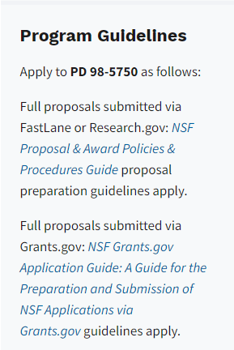
What if FastLane is still an option?
PD 98-5750 will be required to use Research.gov for proposal submission on June 15, 2022
Program Descriptions that Require Proposal Preparation and Submission in Research.gov or Grants.gov
Notes:
Check often - updated frequently

Slide 15
Why Prepare Proposals in Research.gov?
Proposal Setup Wizard
Find funding opportunities & give access to admin staff
Immediate & expanded Compliance checking
PDFs are not altered
Minimize formatting issues that lead NSF to Return without Review
On-screen references to relevant sections of PAPPG
Better management of personnel & subawards
Improved performance & less system downtime
Proposal Preparation & Submission

Slide 16
When to use Research.gov
Proposals in response to a Program Description
Program Solicitation specifies Research.gov is available or required or requires a Letter of Intent or Preliminary Proposal
Full proposal, renewal, or accomplishment-based renewal, OR
These proposal types:
Research, Planning (Research.gov submission required), RAPID, EAGER, RAISE, GOALI, Ideas Lab, FASED, Conference, Equipment, Travel, Center, Research Infrastructure
Both single submission & collaborative proposals are supported
Proposal Preparation & Submission
Notes:
Webpage has a number of links to Research.gov Proposal Submission System, Proposal Preparation Demo Site, Compliance Checks as well as information on proposal preparation, statuses, and FAQs

Slide 17
Questions

Slide 18
Subrecipients & the New Unique Entity Identifier (UEI)
April, 2022 MRAM
Bo Park
Office of Sponsored Programs

Slide 19
Subrecipient UEI required for federal funding
Effective April 4, UEI replaced DUNS
Uniform Guidance requires subrecipient UEI obtained prior to subaward issuance
OSP Subawards team confirms subrecipient UEI at subaward stage
Subrecipients already registered in SAM.gov had UEI assigned automatically
Active and/or Inactive registration status
TIP: Obtain subrecipient UEIs at proposal stage
Check sponsor requirements
Delays result if subrecipients don’t have a UEI

Slide 20
Obtaining UEI from SAM.gov
Option: ‘Full Registration’ or ‘Get UEI’
Does subrecipient only receive subawards or also direct funding from federal agencies?
Entity must have SAM.gov account
No cost for registration or getting UEI from SAM.gov

Slide 21
Questions
>Refer to the FAQs and guidance on SAM.gov
>Subawards Team: ospsubs@uw.edu

Slide 22
NEW RESEARCH WEBPAGE
UWFT for the Research Community
Emily Elliott
Communications & Marketing Specialist
Office of Research Information Services (ORIS) emilye22@uw.edu

Slide 23
GOALS
Increase Awareness and Understanding
What is UWFT (UW Finance Transformation)?
How does UWFT impact your work in the research community?
What exactly is transforming (relevant to research)?
When are these transformations happening?
How will the Office of Research support you through these transformations?
One-Stop-Shop
One source for all UWFT information and resources relevant to the research community.

Slide 24
LET’S TAKE
A LOOK

Slide 25
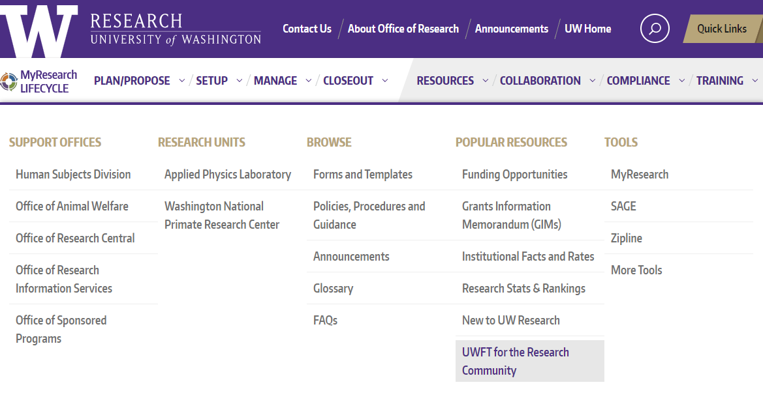
UWFT FOR THE RESEARCH COMMUNITY
washington.edu/research/uwft-for-the-research-community/
New!

Slide 26
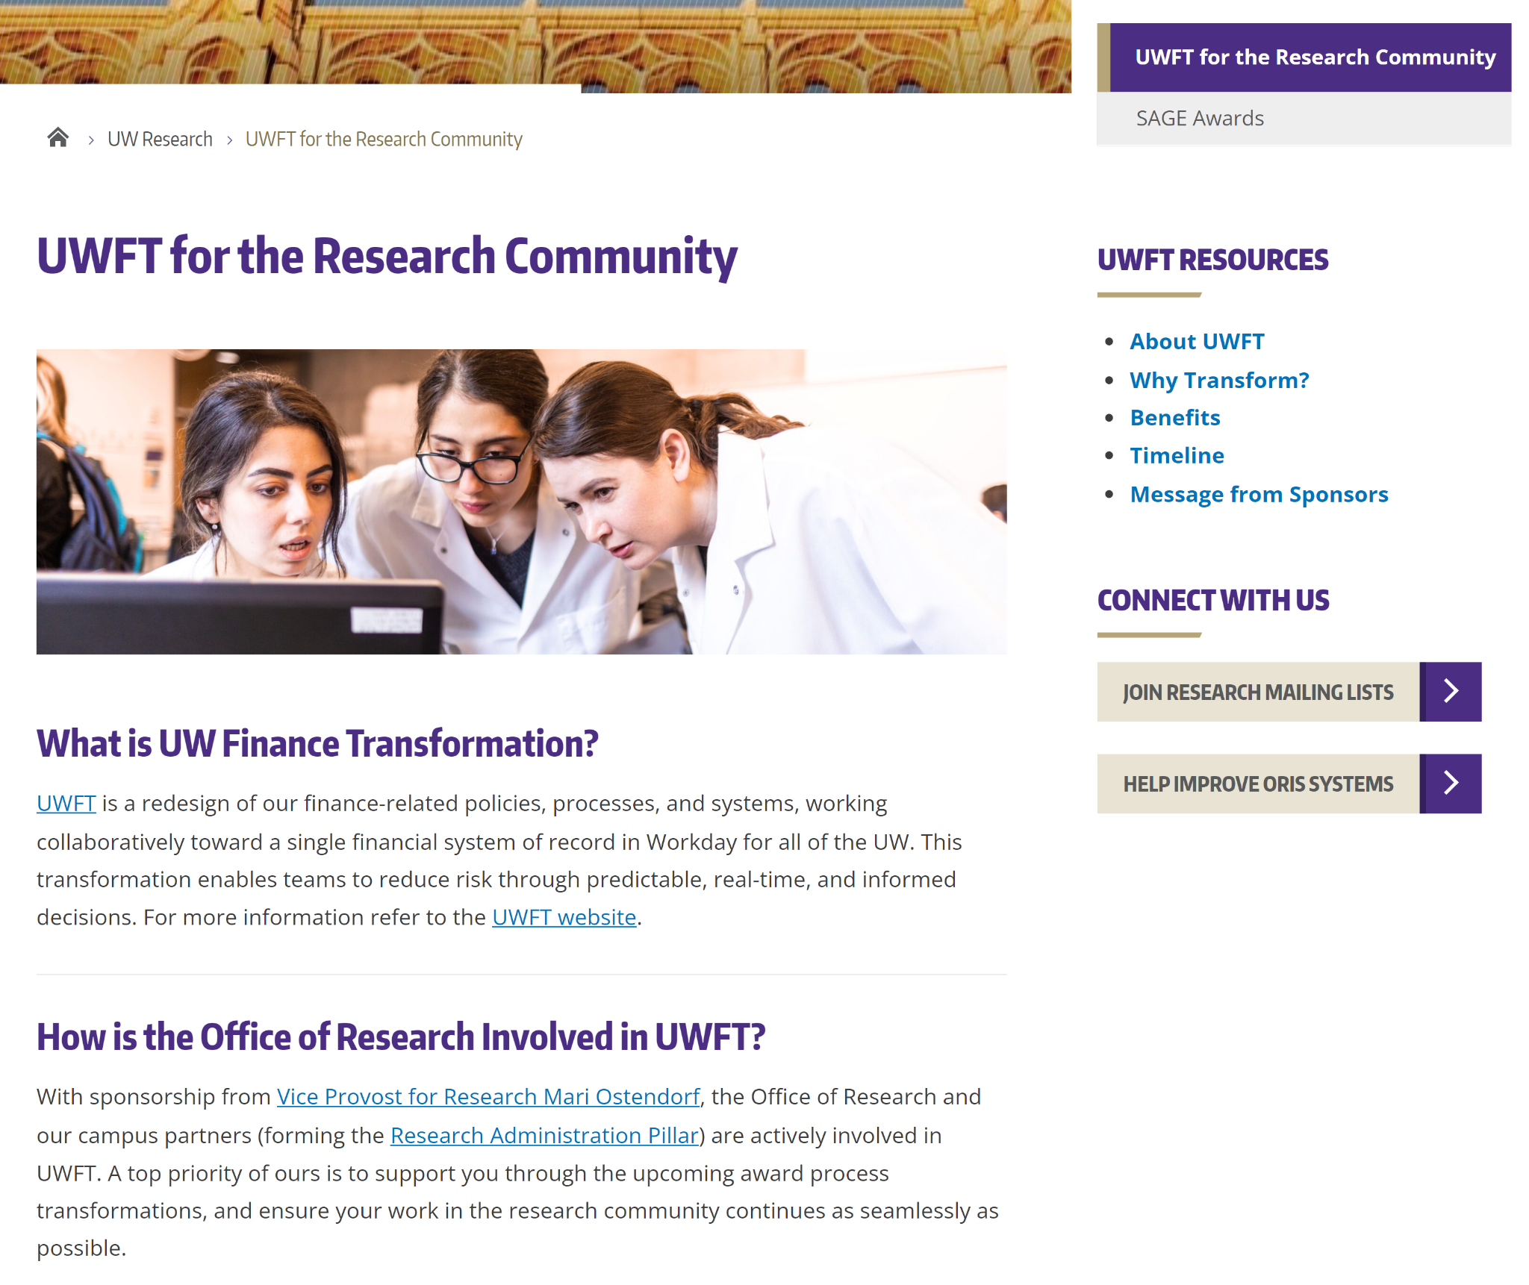
UWFT FOR THE RESEARCH COMMUNITY

Slide 27
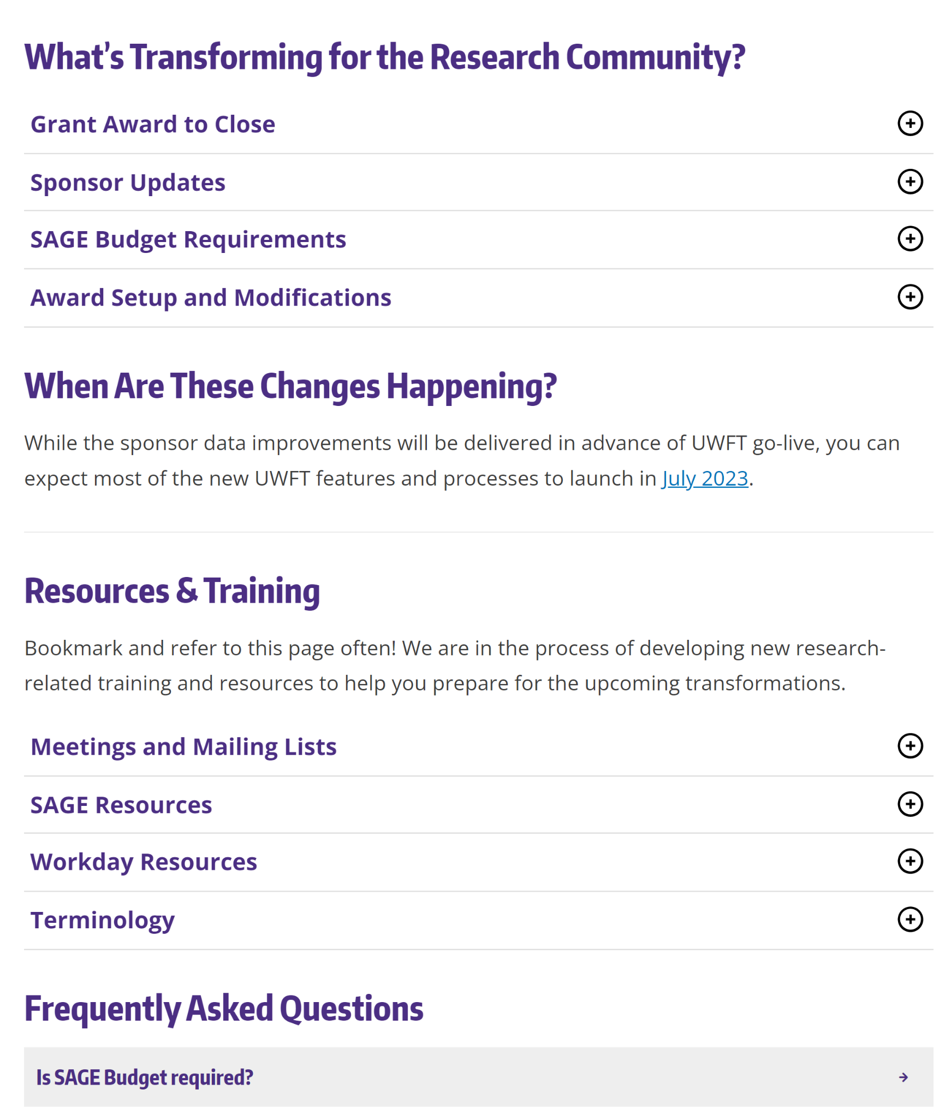
UWFT FOR THE RESEARCH COMMUNITY
Expand for more information.
New trainings and resources coming soon!
Expand for more information.

Slide 28
UWFT FOR THE RESEARCH COMMUNITY: SAGE AWARDS
New award setup and modification process in SAGE.

Slide 29
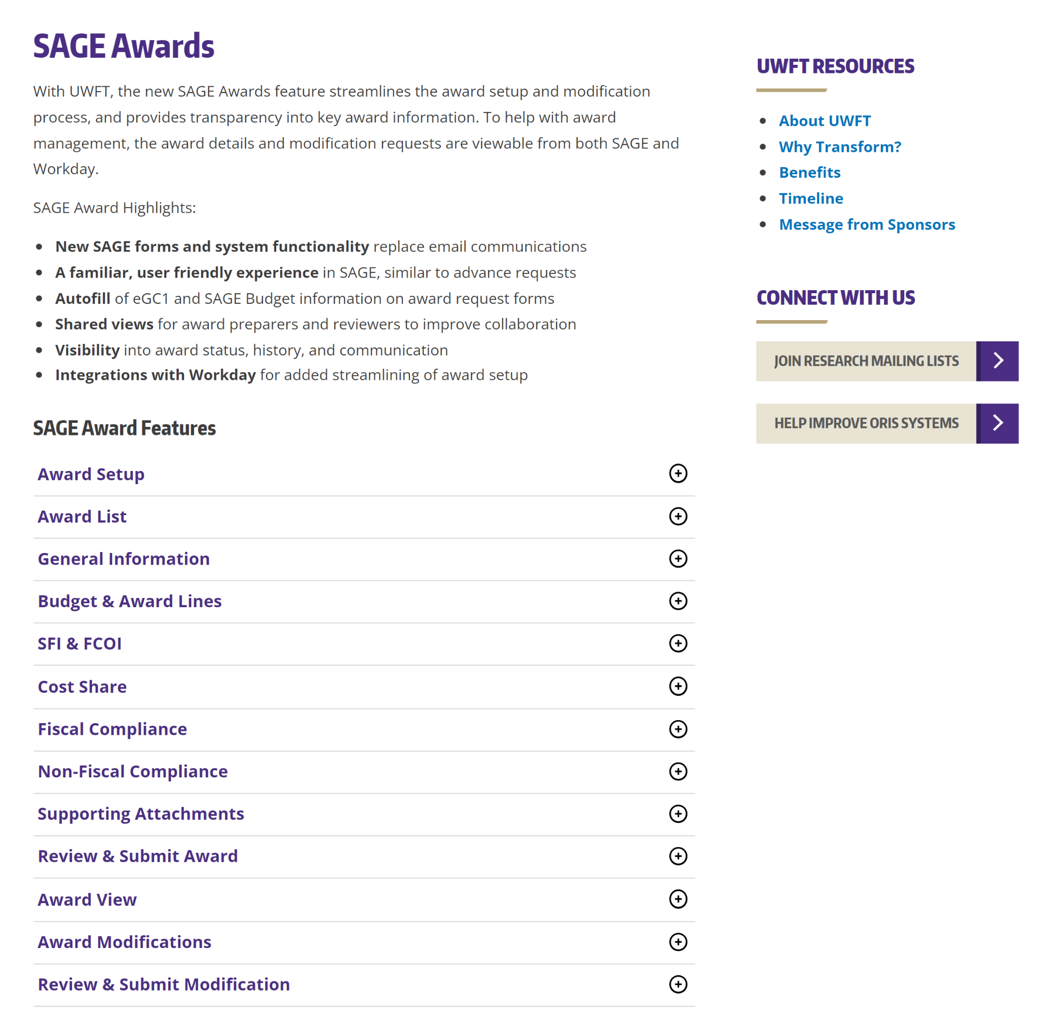
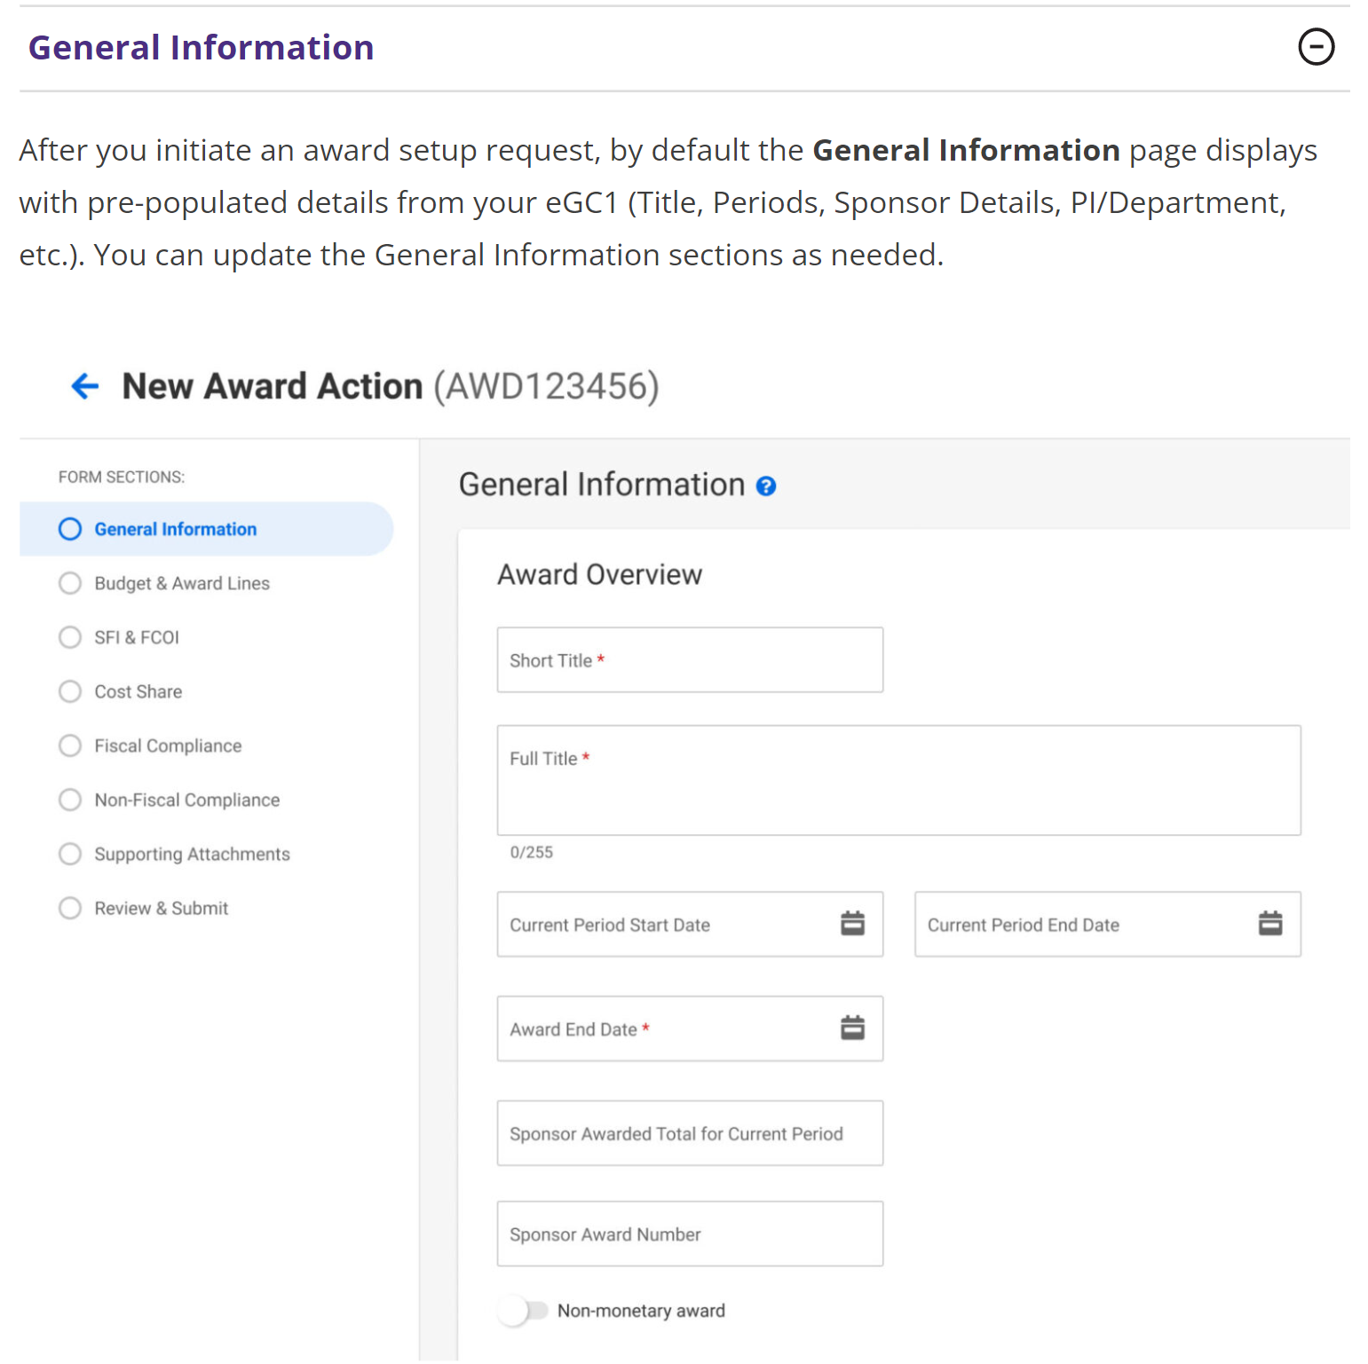
UWFT FOR THE RESEARCH COMMUNITY: SAGE AWARDS

Slide 30
QUESTIONS? FEEDBACK?
As you explore the page, what information, resources, and questions do you have that you would like answered/included?
Let us know! https://forms.gle/XYwkHk6BbhZ9Ncj6A

Slide 31
Bridge Funding Program
MRAM
April 14, 2022
Karen Luetjen
Office of Research

Slide 32
Internal Research Funding Programs
Bridge Funding program
Limited Submissions
Startup and Matching Funds
Royalty Research Fund seed grant program
Luetjen – Office of Research

Slide 33
Provost Bridge Funding Program
Provides bridge funding to support faculty to span a temporary funding gap in critical research programs
Support up to $50,000
1:1 match required from Department or School
Two deadlines per year – May 1 and November 1
Luetjen – Office of Research

Slide 34
Bridge Funding Program – eligibility
Faculty who have lost all extramural funding or who will lose all research support within 6 months
Faculty whose funding covers their salary but no research support (e.g. NIH K awards)
Junior faculty who have exhausted their startup funds but have not yet obtained research funding
A facility providing a key resource to multiple faculty that has lost extramural support
Luetjen – Office of Research

Slide 35
Bridge Funding Program – allowable expenses
Provost funds can support research expenses, such as salaries for lab personnel, supplies, equipment, travel
Salary for the PI is not allowed – the school/department match must be used
Matching funds must be a new commitment
Provost and matching funds must be spent down equally
Luetjen – Office of Research

Slide 36
Bridge Funding Program – secure the match
Obtain commitment from department or school for required match well in advance
A budget for the match must be included with the request.
The matching commitment should be confirmed by the chair or dean who provides the funds via letter or email
Luetjen – Office of Research

Slide 37
Bridge Funding Program – application
Cover sheet linked on:
https://www.washington.edu/research/or/bridge-funding-program/
CV, including a record of funding for the past 5 years
Demonstration of attempts to obtain funding
Description of proposed research
Statement of how Bridge Funding will increase the PI’s chances of future funding
Budget and justification, including the match commitment
Luetjen – Office of Research

Slide 38
Bridge Funding Program – recent changes
For the May 1 deadline, proposals may reduce the school/department match by half for applicants facing COVID caregiving challenges
FAQs updated to reflect that faculty with Acting or Teaching Professor appointments are not eligible
Luetjen – Office of Research

Slide 39
Bridge Funding Program – new funding
Use of Bridge Funding should end to coincide with any new external funding.
E.G. if R01 start date is June 1, spending on the Bridge budget should end May 31.
Luetjen – Office of Research

Slide 40
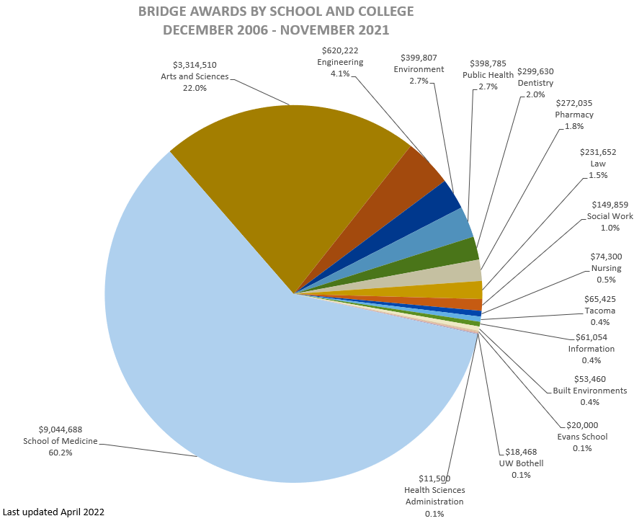
Bridge Funding Program – reach
Luetjen – Office of Research

Slide 41
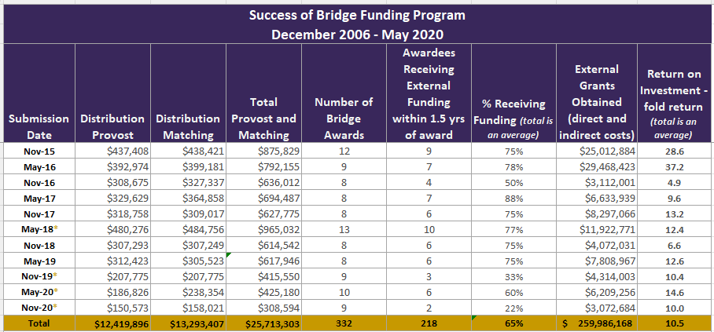
Bridge Funding Program return on investment
*asterisk indicates rounds where awards are still active
Luetjen – Office of Research

Slide 42
Bridge Funding Program
Questions?
https://www.washington.edu/research/or/bridge-funding-program/
Email: luetjen@uw.edu
Phone: 206-616-9089
Luetjen – Office of Research

Slide 43
Crowdsourcing Services
MRAM
April 2022
Ray Hsu, Lynn Magill
Procurement Services

Slide 44
Recognition!
Certificate in Research Administration Graduates
474 enrolled in the certificate
126 graduates since August 2020
34 graduates in fourth group
Notes:
And now for the fun part! Today we are recognizing the fourth group of graduates from the CORE Certificate in Research Administration. CORE launched this certificate in the fall of 2019. Since then 474 people have enrolled in the certificate program and as March 1, 2022, 126 of those enrollees have met all requirements to receive the certificate. We recognize the recipients on a semi-annual basis in the MRAM venue and today we are going to take a moment to recognize the achievements in this last round completers. Not all of them chose to include their names in today’s announcement but you all know who you are! Let’s give a shout out to some of our most recent graduates!

Slide 45
Certificate in Research Administration Program Graduates
Notes:
Here’s who they are—let’s give them a hand!

Slide 46
Maya Beal Contracts & Operations Manager I-TECH, Department of Global Health
School of Public Health
Congratulations!

Slide 47
Nancy Biehl Budget/Fiscal Analyst Lead Department of Radiology
School of Medicine
Congratulations!

Slide 48
Debra Callaway
Program Coordinator
Office of Sponsored Programs Office of Research
Congratulations!

Slide 49
Leanne Cornel Research Operations Specialist Anesthesiology & Pain Medicine School of Medicine
Congratulations!

Slide 50
Shannon Gilmore
Grants & Contracts Manager School of Oceanography College of the Environment
Congratulations!

Slide 51
Valerie Hockens Program Operations Specialist Department of Epidemiology
School of Public Health
Congratulations!

Slide 52
Kellie Holden Administrator Goodlad Institute for Educational Renewal UW Bothell
Congratulations!

Slide 53
Katia Jossa-Jouable Fiscal Specialist II Department of Chemical Engineering College of Engineering
Congratulations!

Slide 54
Morgan Keys Grants & Contracts Analyst Division of Dermatology, Department of Medicine School of Medicine
Congratulations!

Slide 55
Paula Kurose Budget Analyst Lead Department of Atmospheric Sciences College of the Environment
Congratulations!

Slide 56
Leesa Kurtz Front Office Manager Department of Chemistry
College of Arts & Sciences
Congratulations!

Slide 57
Chloe Mahar Assistant to the Chair Department of Economics College of Arts & Sciences
Congratulations!

Slide 58
Ashley T. Martin Budget/Fiscal Analyst Office of Minority Affairs & Diversity
Congratulations!

Slide 59
Mary Martha McNally Fiscal Specialist II UW Health Sciences Library
Congratulations!

Slide 60
Jacqueline Muongchanh Fiscal Specialist II Division of Allergy & Infectious Diseases Department of Medicine School of Medicine
Congratulations!

Slide 61
Amanda Nguyen Budget Fiscal Analyst Lead Deans Office College of the Environment
Congratulations!

Slide 62
Yoshie Pearce Program Operations Specialist Department of Ocean Physics Applied Physics Laboratory
Congratulations!

Slide 63
Sarah Pressl Grants Manager Department of Genome Sciences School of Medicine
Congratulations!

Slide 64
Anne D. Russell Grants & Contracts Manager Department of Laboratory Medicine & Pathology School of Medicine
Congratulations!

Slide 65
Dillon Van Rensburg Research Scientist Institute of Translational Health Sciences
Congratulations!

Slide 66
Angie Windus Budget/Fiscal Analyst Washington National Primate Center
Congratulations!

Slide 67
Thank You!
Thanks to the staff and their supervisors
who support this important training!
You help make the UW an
effectively managed research enterprise.
Notes:
And a big thank you to all who support the ongoing professional development of our research administration staff!

