Slide 1
NSF & Research.gov
April, 2022 MRAM
Tim Mhyre
Office of Sponsored Programs

Slide 2
Research.gov Replacing FastLane
NSF is starting to require Research.gov for preparation and submission of proposals
Many National Science Foundation (NSF) program solicitations now require the use of Research.gov for proposals
FastLane will no longer be a submission option in January 2023 when the new PAPPG goes into effect
NSF Important Notice No. 147

Slide 3
Preparing NSF Proposals until Jan 2023
Use Research.gov or if you must, and still allowed, FastLane for NSF proposal submission
OSP strongly discourages Grants.gov for NSF proposal submission
Prepare proposals to NSF within Research.gov/FastLane (GIM 19)
Need access to Research.gov? Contact osp@uw.edu

Slide 4
How can I tell if Research.gov is required?
Solicitation indicates Research.gov is required
Notes:
Check often - updated frequently

Slide 5
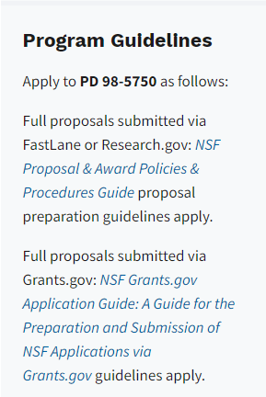
What if FastLane is still an option?
PD 98-5750 will be required to use Research.gov for proposal submission on June 15, 2022
Program Descriptions that Require Proposal Preparation and Submission in Research.gov or Grants.gov
Notes:
Check often - updated frequently

Slide 6
Why Prepare Proposals in Research.gov?
Proposal Setup Wizard
Find funding opportunities & give access to admin staff
Immediate & expanded Compliance checking
PDFs are not altered
Minimize formatting issues that lead NSF to Return without Review
On-screen references to relevant sections of PAPPG
Better management of personnel & subawards
Improved performance & less system downtime
Proposal Preparation & Submission

Slide 7
When to use Research.gov
Proposals in response to a Program Description
Program Solicitation specifies Research.gov is available or required or requires a Letter of Intent or Preliminary Proposal
Full proposal, renewal, or accomplishment-based renewal, OR
These proposal types:
Research, Planning (Research.gov submission required), RAPID, EAGER, RAISE, GOALI, Ideas Lab, FASED, Conference, Equipment, Travel, Center, Research Infrastructure
Both single submission & collaborative proposals are supported
Proposal Preparation & Submission
Notes:
Webpage has a number of links to Research.gov Proposal Submission System, Proposal Preparation Demo Site, Compliance Checks as well as information on proposal preparation, statuses, and FAQs

Slide 8
Questions

