Slide 1
Bridge Funding Program
MRAM
April 14, 2022
Karen Luetjen
Office of Research

Slide 2
Internal Research Funding Programs
Bridge Funding program
Limited Submissions
Startup and Matching Funds
Royalty Research Fund seed grant program
Luetjen – Office of Research

Slide 3
Provost Bridge Funding Program
Provides bridge funding to support faculty to span a temporary funding gap in critical research programs
Support up to $50,000
1:1 match required from Department or School
Two deadlines per year – May 1 and November 1
Luetjen – Office of Research

Slide 4
Bridge Funding Program – eligibility
Faculty who have lost all extramural funding or who will lose all research support within 6 months
Faculty whose funding covers their salary but no research support (e.g. NIH K awards)
Junior faculty who have exhausted their startup funds but have not yet obtained research funding
A facility providing a key resource to multiple faculty that has lost extramural support
Luetjen – Office of Research

Slide 5
Bridge Funding Program – allowable expenses
Provost funds can support research expenses, such as salaries for lab personnel, supplies, equipment, travel
Salary for the PI is not allowed – the school/department match must be used
Matching funds must be a new commitment
Provost and matching funds must be spent down equally
Luetjen – Office of Research

Slide 6
Bridge Funding Program – secure the match
Obtain commitment from department or school for required match well in advance
A budget for the match must be included with the request.
The matching commitment should be confirmed by the chair or dean who provides the funds via letter or email
Luetjen – Office of Research

Slide 7
Bridge Funding Program – application
Cover sheet linked on:
https://www.washington.edu/research/or/bridge-funding-program/
CV, including a record of funding for the past 5 years
Demonstration of attempts to obtain funding
Description of proposed research
Statement of how Bridge Funding will increase the PI’s chances of future funding
Budget and justification, including the match commitment
Luetjen – Office of Research

Slide 8
Bridge Funding Program – recent changes
For the May 1 deadline, proposals may reduce the school/department match by half for applicants facing COVID caregiving challenges
FAQs updated to reflect that faculty with Acting or Teaching Professor appointments are not eligible
Luetjen – Office of Research

Slide 9
Bridge Funding Program – new funding
Use of Bridge Funding should end to coincide with any new external funding.
E.G. if R01 start date is June 1, spending on the Bridge budget should end May 31.
Luetjen – Office of Research

Slide 10
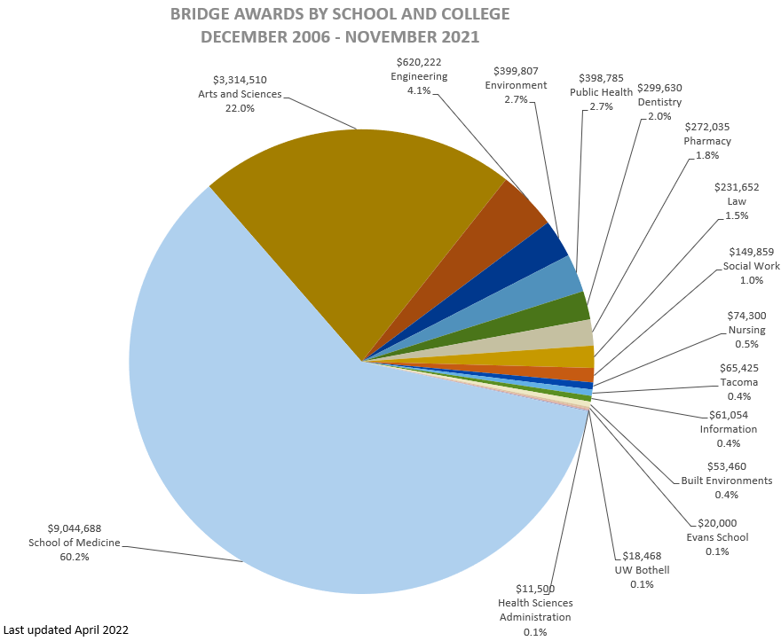
Bridge Funding Program – reach
Luetjen – Office of Research

Slide 11
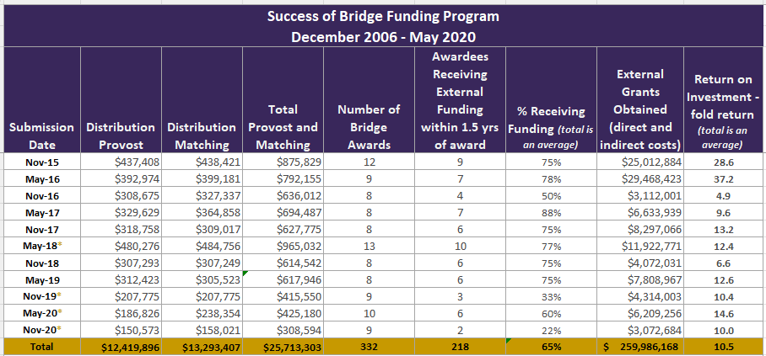
Bridge Funding Program return on investment
*asterisk indicates rounds where awards are still active
Luetjen – Office of Research

Slide 12
Bridge Funding Program
Questions?
https://www.washington.edu/research/or/bridge-funding-program/
Email: luetjen@uw.edu
Phone: 206-616-9089
Luetjen – Office of Research

