Slide 1
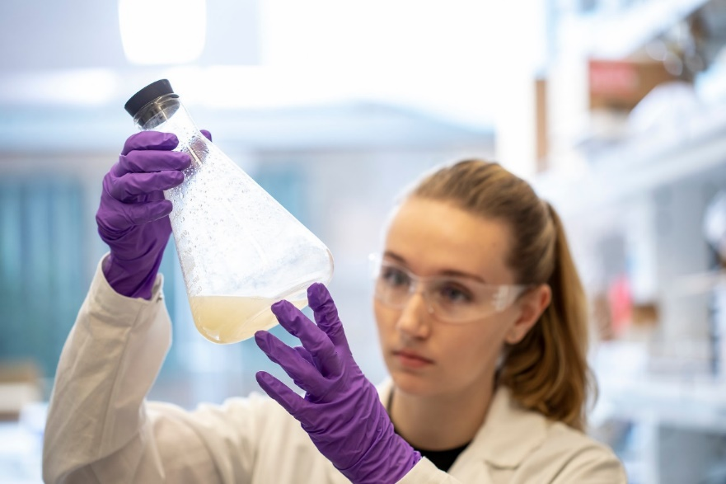
NATIONAL BIOSAFETY MONTH
Lesley Decker, Biosafety manager
Haris Malik, Biosafety officer
October 2022

Slide 2
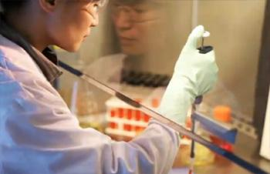
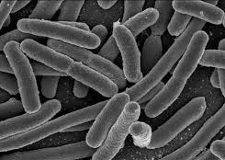
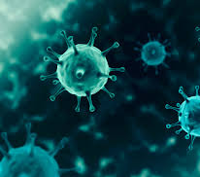
WHAT IS BIOSAFETY?
Framework for containment of biohazards
Includes safe practices, safety equipment, facilities and training
Protects the worker, community and environment
Protects the research product

Slide 3
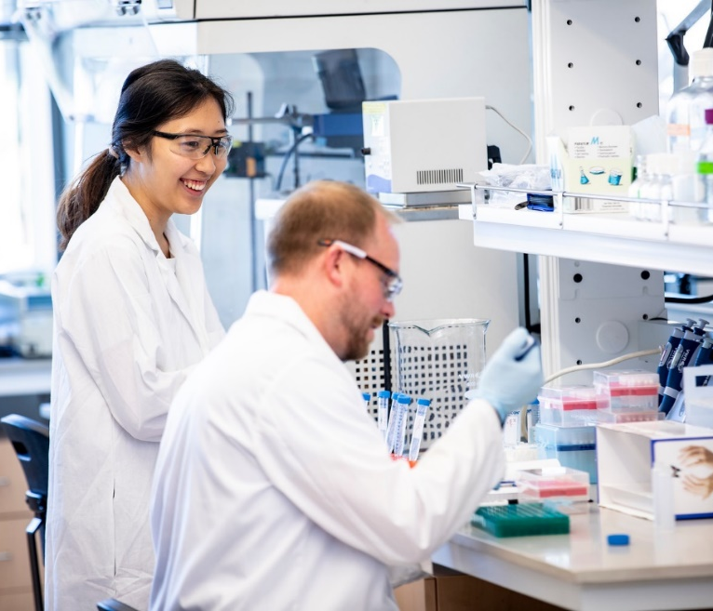
ABOUT EH&S BIOSAFETY (FY 22)
400 Biological Use Authorizations (BUAs)
22 clinical trial BUAs (recDNA into humans)
302 biosafety inspections performed for 525 individual laboratory rooms
Online trainings completed:
2749 Biosafety
4019 Bloodborne pathogens (BBP)
321 Shipping Regulated Medical Waste

Slide 4
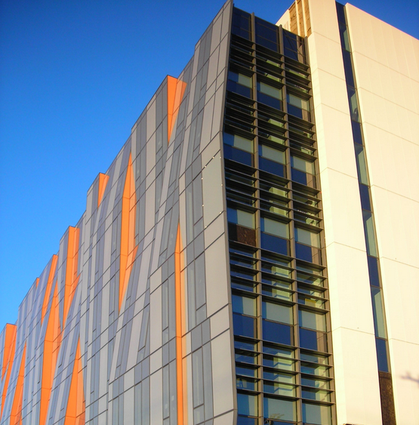
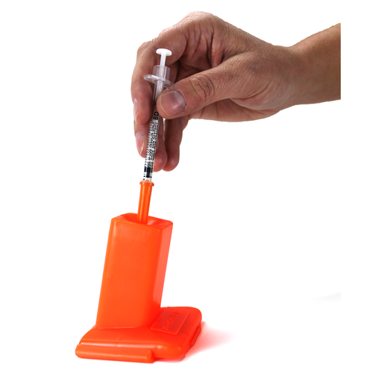
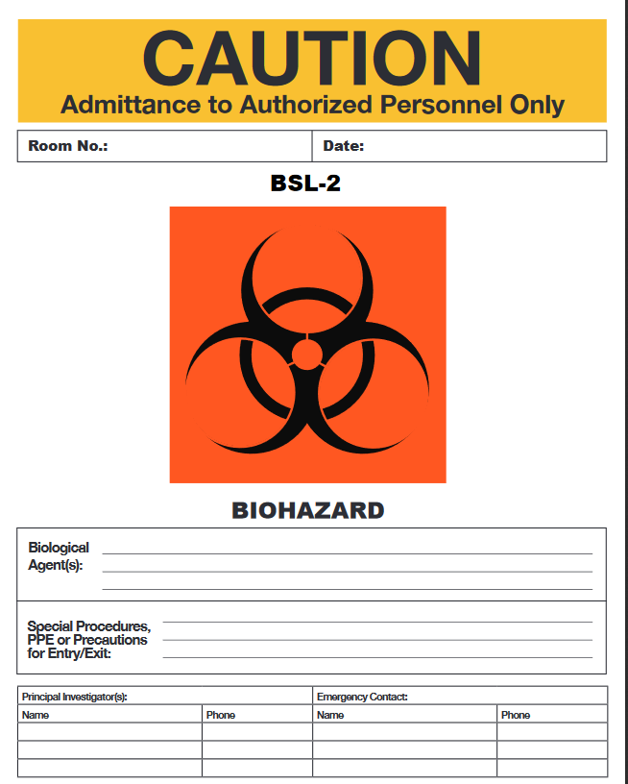
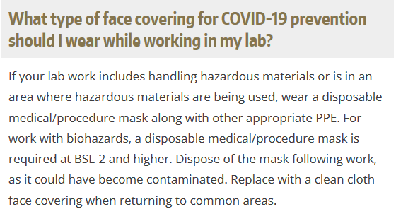
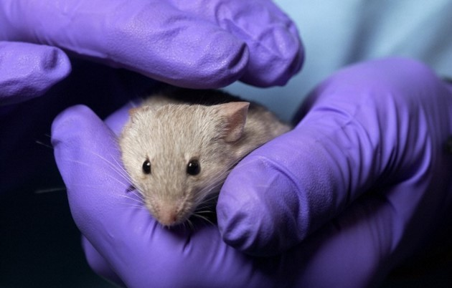
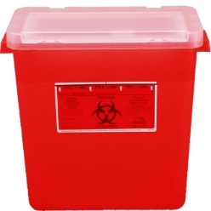
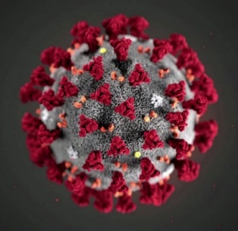
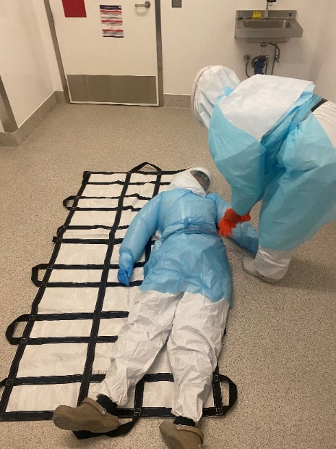
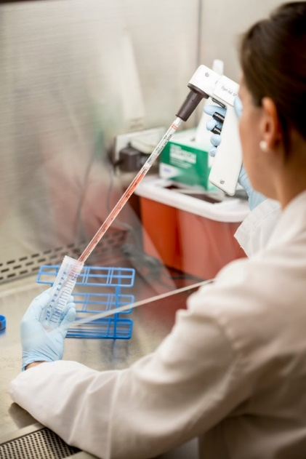
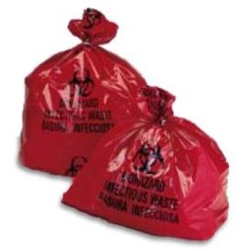
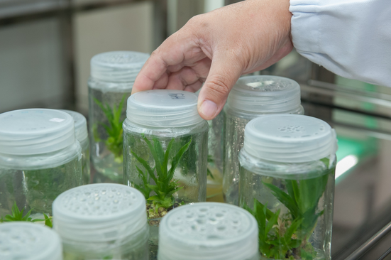
ABOUT EH&S BIOSAFETY

Slide 5
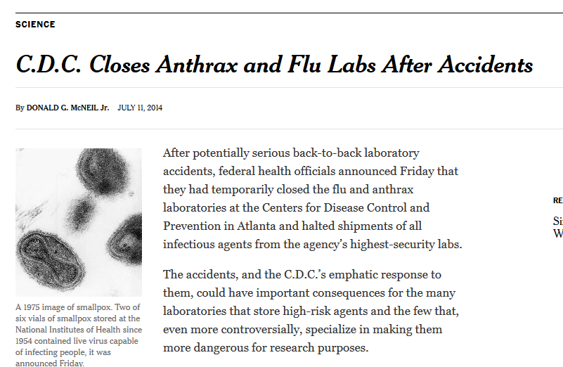
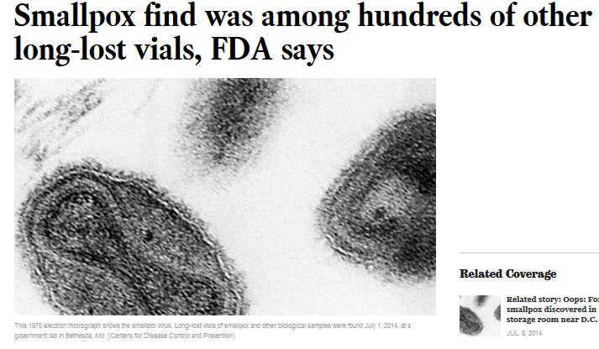
NATIONAL BIOSAFETY MONTH
Started in 2014 by the NIH Office of Science Policy
Time to focus attention to biosafety practices, policies, procedures and inventory

Slide 6
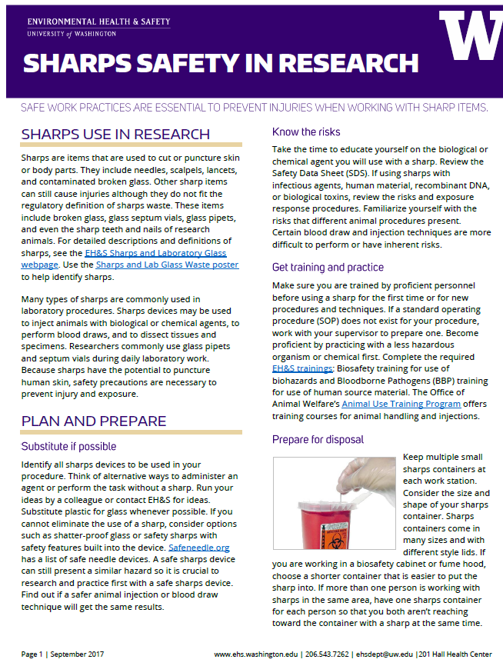
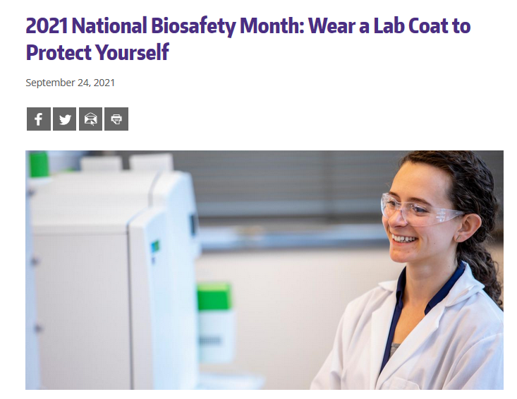
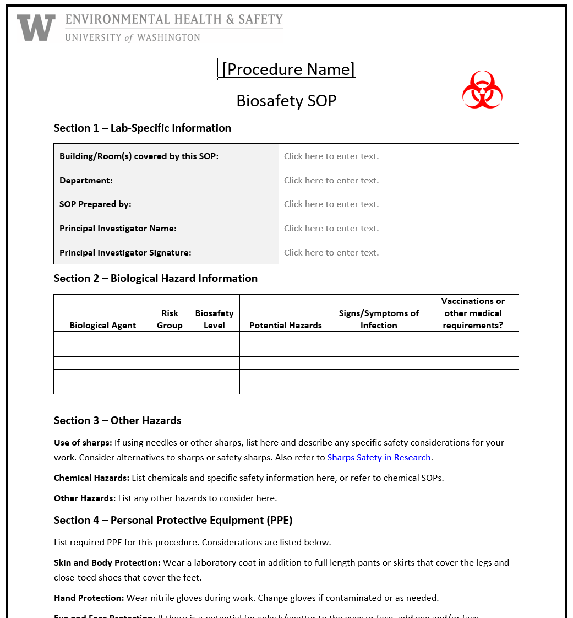
NATIONAL BIOSAFETY MONTH AT UW

Slide 7
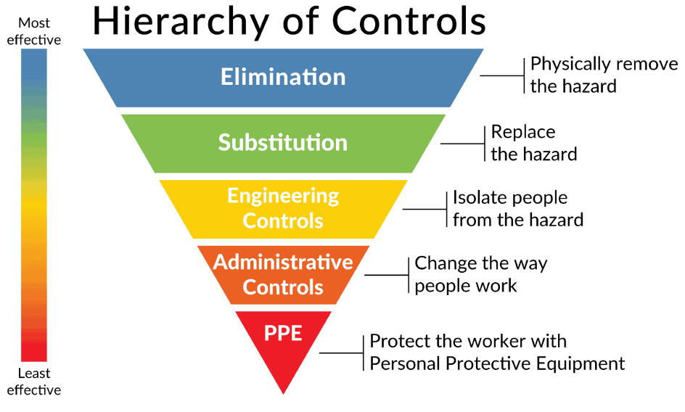
2022 BIOSAFETY MONTH AT UW
Explore opportunities to substitute hazards with safer alternatives!
Replace a hazard with a safer alternative that reduces the potential for harm while performing the same function without introducing new risks.

Slide 8
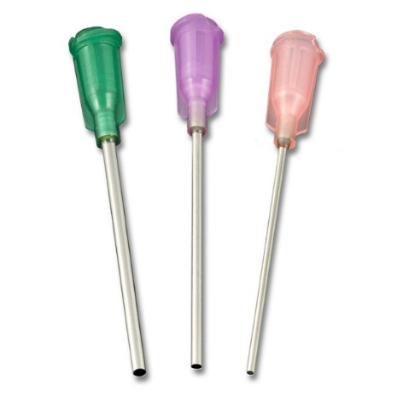
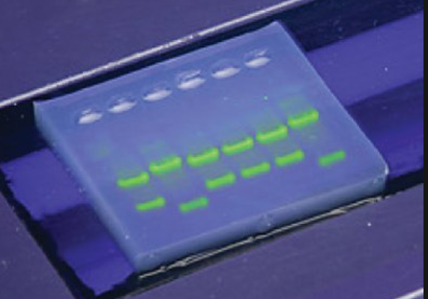
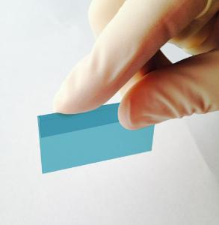
SUBSTITUTIONS YOU CAN MAKE IN THE LAB
Replace needles and razor blades with less sharp items
Replace lab glass with plastic
Use a less hazardous gene delivery method
Use a less pathogenic surrogate organism
Switch to safer chemicals for biological research

Slide 9
BIOSAFETY MONTH OUTREACH
Email to principal investigators and lab managers with BUAs
A news post featured on the EH&S website and in the EH&S newsletter
Featured on the Office of Research webpage
Present to U-WIDE Health and Safety Committee, MRAM (research administrators) and the IBC

Slide 10
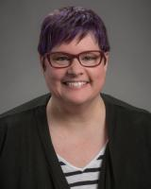
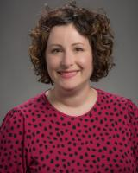
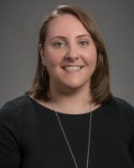
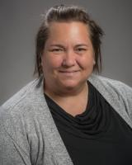
HAPPY BIOSAFETY MONTH!
Questions? Email ehsbio@uw.edu
Thanks to the biosafety team:
Jennifer Cabarrus
Lesley Decker
Tony Han
Kristi Kilgore
Zara Llewellyn
Haris Malik
Devon McMenimen
Esther Pellham
And our occupational health nurse:
Judy Cashman

