Slide 1
SAGE AWARD WORKFLOW
UWFT for the Research Community
Juan Lepez, Grant and Contract Accounting (GCA)
Amanda Snyder, Office of Sponsored Programs (OSP)
Notes:
Juan - Good morning. Amanda and I will be presenting on the SAGE award workflow. We’ll have quite a bit of information to get through so questions asked during the presentation will be answered in the post-MRAM Q&A that is sent to the MRAM mailing list next week.

Slide 2
SAGE AWARD: OVERVIEW
As a part of UW Finance Transformation (UWFT), the SAGE Award process is being designed to streamline award setup, provide greater transparency into key award information, and integrate with Workday.
The SAGE Award feature will launch in July 2023.
Notes:
Juan - Read slide as is.

Slide 3
SAGE AWARD: HIGHLIGHTS
Shared Views
Improves collaboration for award preparers and reviewers
Award Request Form
Replaces email communications
Provides a familiar, user friendly experience similar to Advance Requests
Includes autofill of eGC1 and SAGE Budget information
Award Request List & Summary
Provides transparency into status and history
Integrations with Workday
Improves accuracy
Notes:
Juan - Key highlights and expected outcomes include:

Slide 4
BUSINESS PROCESS STREAMLINING TARGETS
Moving From…
To…
Email Intake, Comms
Unclear Status
Duplicate Entry (SAGE & FIN)
SAGE Intake, Messaging
Transparent Status in SAGE
Integrations (SAGE to Workday)
Notes:
Juan
Efficiencies gained include:
Moving from email intake and communication to working directly within SAGE and having that correspondence be in SAGE.
Much clearer way of knowing the status of your award and which office it’s currently assigned to. No longer the need to investigate with OSP or GCA where the award is at as it will be clearly visible in SAGE.
No more duplicate data entry for GCA into the financial systems as SAGE will have a direct integration of data from the Funding Action into Workday. Will help prevent data entry errors.

Slide 5
SAGE AWARD WORKFLOW: HIGH LEVEL
eGC1 Approved
NOA Received
Start SAGE Award Setup Request
Link SAGE eGC1 & Budget
Complete & Submit
OSP
Workday
Create SAGE Award Budget
GCA
Receive Notification that Award is Ready!
Notes:
Juan - This is a simplified/high level version of the SAGE award workflow. The workflow will kick off with an approved eGC1 or receipt of an NOA. This will be followed by the SAGE award setup request and creating the award budget. Once that is done, campus will complete and submit to OSP. OSP will review and approve or return to campus if changes are required. If no changes, OSP will approve and send to GCA. Major change here is that during GCA review and approval, GCA will be able to return to OSP and request corrections or return directly to campus for corrections. Once no more corrections are required, GCA will move forward with integrating the data from SAGE to Workday. This completes the process and you will receive a notification that the award has been setup and ready to begin activities.
Leads to integration in Workday.

Slide 6
SAGE AWARD WORKFLOW: DEEP DIVE
What, who, where, and when?
What is the workflow of a SAGE Award?
Who is responsible for each award action?
Where (or which system) does each award action take place and when?
Notes:
Amanda - The following diagram will give a deeper dive of what the workflow looks like in SAGE and how the data finalizes into WD, who is the party responsible for completing the action, and where and when each award action takes place.

Slide 7
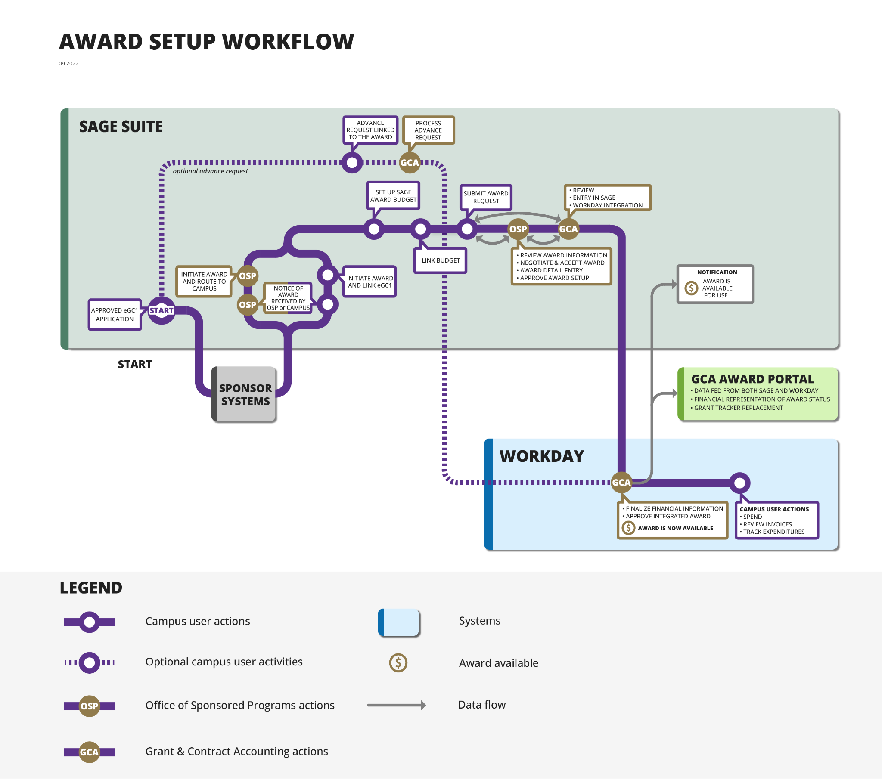
Start SAGE Award Setup Request
Location on workflow
Notes:
Amanda - High level look at the entire process of getting an award all the way through from award receipt to Workday setup . This is happy path for a standard award. Shows the collaboration that will be required between campus, OSP, and GCA. Each of these areas has more details. Foundational. Will be seeing this in different forums.

Slide 8
SAGE AWARD SETUP REQUEST
Start SAGE Award Setup Request
When?
After the eGC1 is submitted and approved
After the Notice of Award (NOA) is received
Who?
Grant Managers & OSP receive NOAs. If you receive the NOA, you will initiate the SAGE Award setup request. If OSP receives the NOA, they will initiate the SAGE Award setup request and route it to you for completion.
Where?
New Awards tab in SAGE
How?
From Awards Tab, Select CREATE NEW REQUEST
Notes:
Amanda

Slide 9
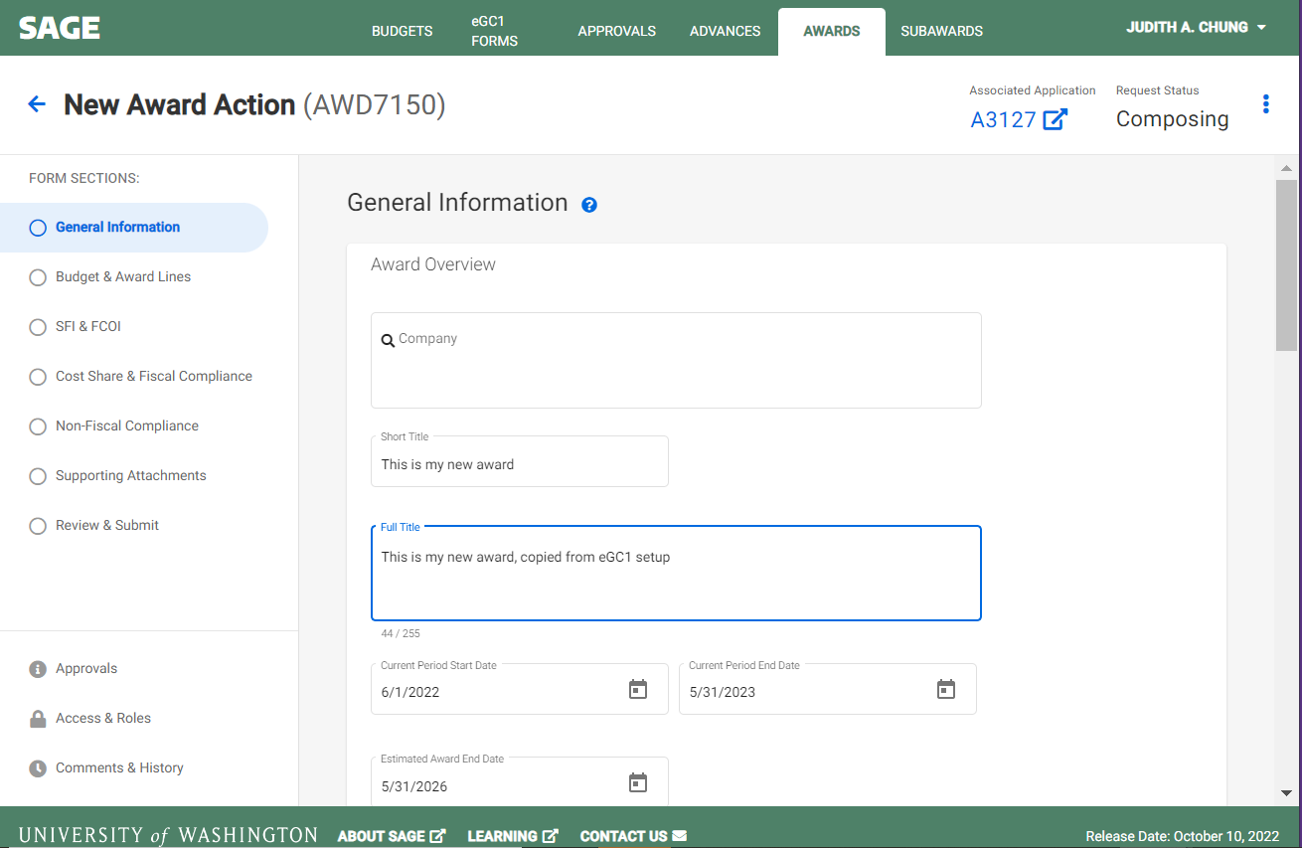
UPDATE GENERAL INFORMATION
Start SAGE Award Setup Request
Information defaults from eGC1
Update as needed
Notes:
Amanda
These will be the headers within SAGE that will need to be completed for successful setup. This will incorporate information from the eGC1 and will allow for some updates.

Slide 10
Create SAGE Award Budget
Location on workflow
Notes:
Amanda

Slide 11
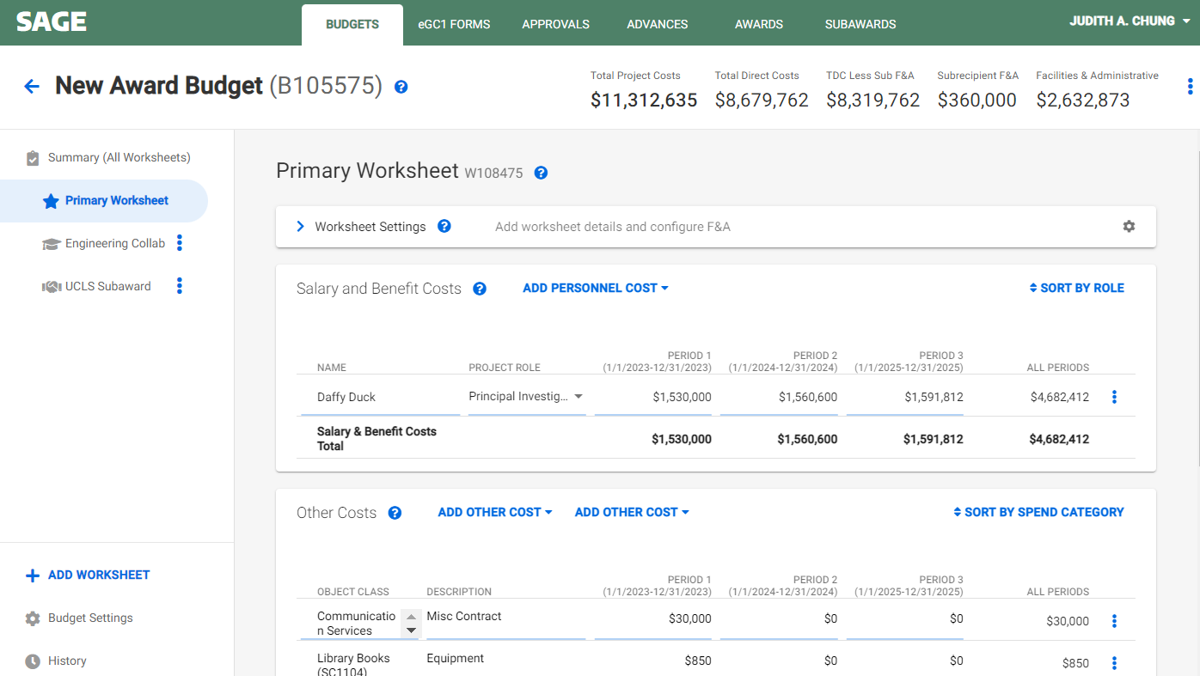
CREATE SAGE AWARD BUDGET
Create SAGE Award Budget
Create new or copy proposal SAGE Budget
Notes:
Amanda
Will either have to create a new award budget budget or copy the proposal SAGE budget at the award setup stage. The budget will be used to populate key fields (Title, F&A, Location….) from SAGE to Workday and budget totals will be validated against the award total prior to integration.

Slide 12
Link SAGE Budget
Location on workflow
Notes:
Amanda

Slide 13
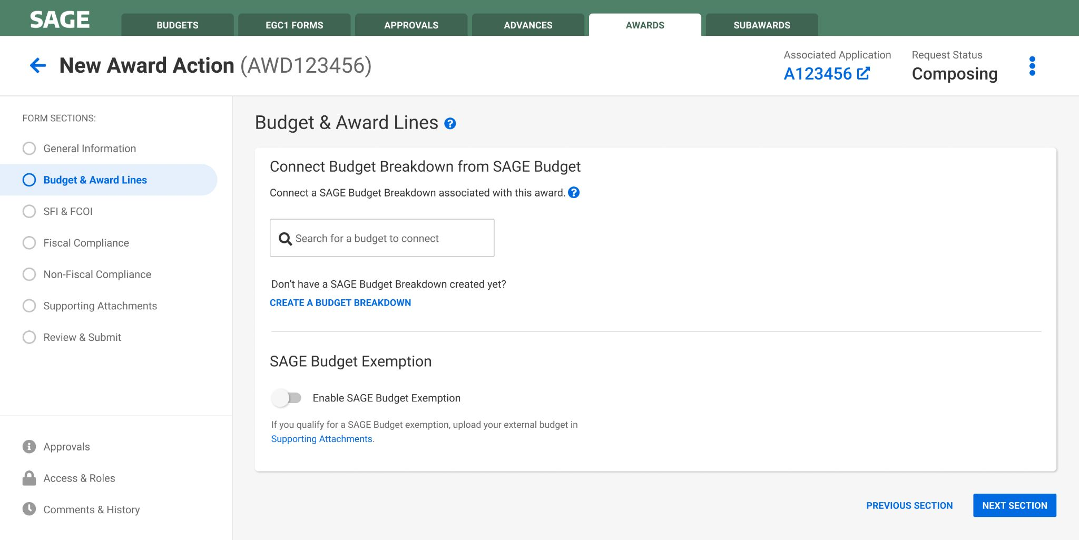
LINK SAGE BUDGET TO AWARD
Link SAGE Budget
Search and select your SAGE Award Budget
Search by eGC1, PI, or short title
Notes:
Amanda
Will have to find the right eGC1 to associate that with the correct award and also link the budget to the award.

Slide 14
SELECT AUTHORIZED PERIODS
Link SAGE Budget
Select authorized periods
SAGE Budget data synced with Award request
Notes:
Amanda
Select periods authorized by sponsor.

Slide 15
Complete & Submit Award Request
Location on workflow
Notes:
Amanda

Slide 16
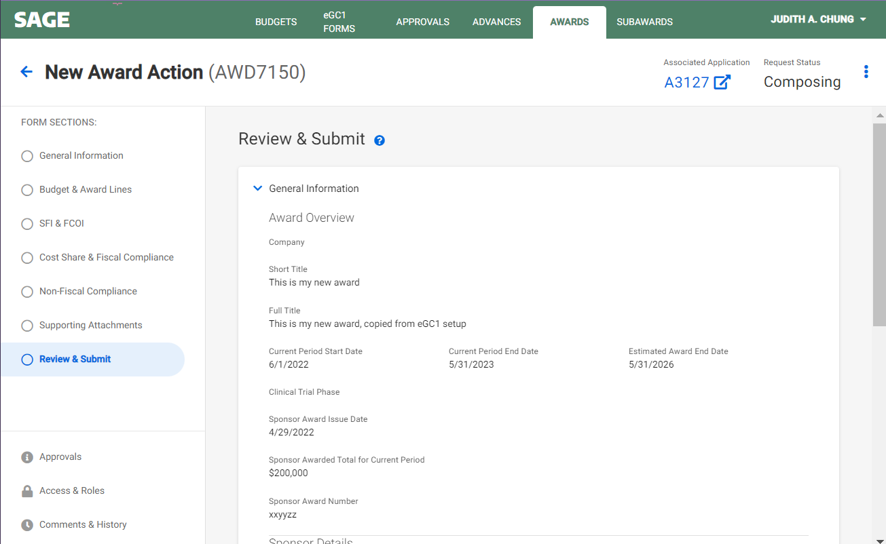
COMPLETE & SUBMIT
Link SAGE Budget
Complete & Submit Award Request
View a complete summary of the Award Setup request
Submit to OSP
Notes:
Amanda
There will also be validations that will help ensure accuracy prior to submitting the request to OSP. This hands off to OSP, which will complete our part of the process prior to approving and submitting to GCA. GCA will have actions to review and edit prior to integration to Workday which completes the setup.

Slide 17
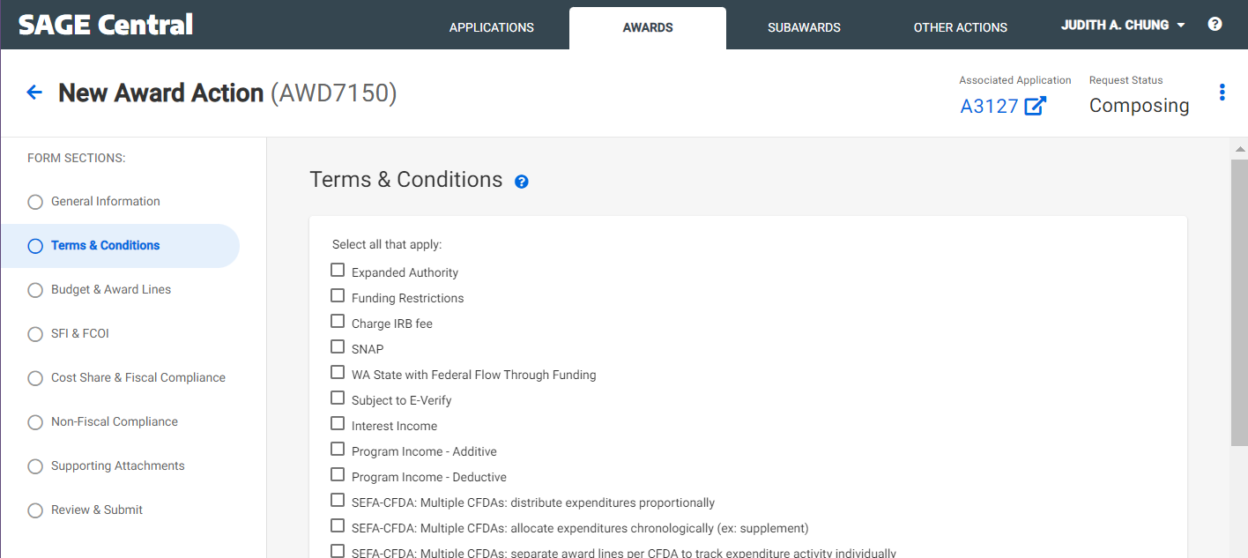
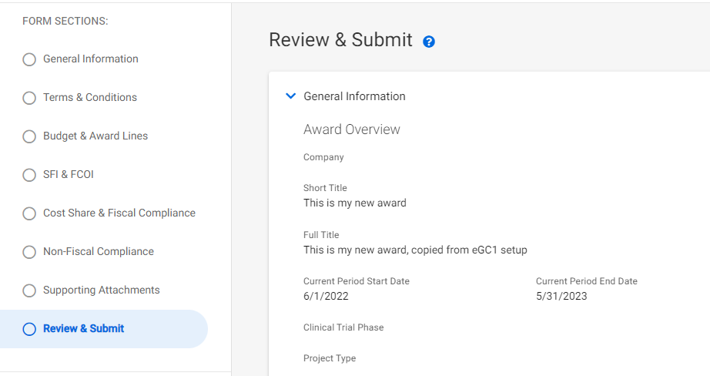
OSP & GCA REVIEW/APPROVE
OSP & GCA Review
OSP & GCA add Terms & Conditions, other setup details
OSP Review & Submit to GCA
GCA initiates integration to Workday
GCA processes award in Workday and SAGE
GCA can send award back to campus if needed
Notes:
Amanda

Slide 18
Receive Notification that Award is Ready
Location on workflow
Notes:
Juan
Campus receives notification when the award is set up and ready to be used.

Slide 19
WORKDAY ACTIONS
Workday Actions
Coming up next!
November 10 MRAM: The UWFT program will present about the Award once it lands in Workday at the upcoming MRAM on November 10.
November 15 Office Hours: Join the Research Administration Peer Network (RAPN) meeting on November 15 to ask question about the Award process/actions in Workday.
Notes:
Juan

Slide 20
GET AHEAD OF THE GAME!
Become Familiar with SAGE Budget (required for SAGE Award Setup)
Attend a SAGE Budget Class: Register to attend the next class is on November 1
SAGE Budget user guides
SAGE Budget job aid
Provide feedback on SAGE Budget usability issues, concerns
Contact us at sagehelp@uw.edu
Notes:
Juan

Slide 21
UWFT FOR THE RESEARCH COMMUNITY WEBPAGE
One-stop-shop for the latest UWFT resources, information, and training
washington.edu/research/uwft-for-the-research-community/
Notes:
Juan

Slide 22
QUESTIONS?
Notes:
If you have questions, please submit them to the Q&A/chat and we will respond in the post-MRAM Q&A email that will be sent to the MRAM mailing list next week.

