Slide 1
MRAM | Monthly Research Administration Meeting
November 10, 2022 9:00 AM – 10:30 AM HOSTED REMOTELY Join the LIVE Webinar: https://washington.zoom.us/j/346891888
TOPIC | PRESENTER | EMAIL | MIN
Welcome | Kirsten DeFries Research Compliance & Operations | kirsten5@uw.edu | 2
PAFC Hot Topic: Travel on Sponsored Awards | Matt Gardner Post Award Fiscal Compliance | gcafco@uw.edu | 15
Global Affairs Month | Muindi Muindi, Chrishon Blackwell Office of Global Affairs | muindi@uw.edu clb21@uw.edu | 10
NSF Update Highlights | Amanda Snyder Office of Sponsored Programs | acs22@uw.edu | 5
NIH Data Management & Sharing Policy FORMS-H | Carol Rhodes Office of Sponsored Programs | carhodes@uw.edu | 10
Certificates of Confidentiality and Data Sharing | Maria Savage Human Subjects Division | mcsavage@uw.edu | 5
CORE Update | Laurie Stephan Collaborative On Research Education (CORE) | corehelp@uw.edu | 10
UWFT Demo & Details - Grants | Amanda Snyder, Nicole Flagg, Jesse Rice, Liz Satwicz OSP/GCA/ORIS/UWFT | nicole@uw.edu | 5-10
NEXT MEETING December 8, 2022 9:00 AM - 10:00 AM

Slide 2
Live Closed Captioning is now available
Live transcription and closed captions are enabled via the “CC/Transcript” button in your Zoom window.
Recordings of our sessions, with manually edited closed captions, are typically available within a week after the meeting, and a link is emailed with the post-session Q&A.
If you have any issues or questions, please let us know at mramques@uw.edu

Slide 3
PAFC HOT TOPIC:
TRAVEL ON SPONSORED AWARDS
MRAM
November 2022
Matt Gardner
Post Award Fiscal Compliance

Slide 4
Travel on Sponsored Awards
Travel is a high-risk expenditure because it can be easily abused
Federal auditors frequently audit travel costs (along with food and equipment purchases)
With travel increasing in recent months, it’s a good time to refresh some basic travel compliance guidance

Slide 5
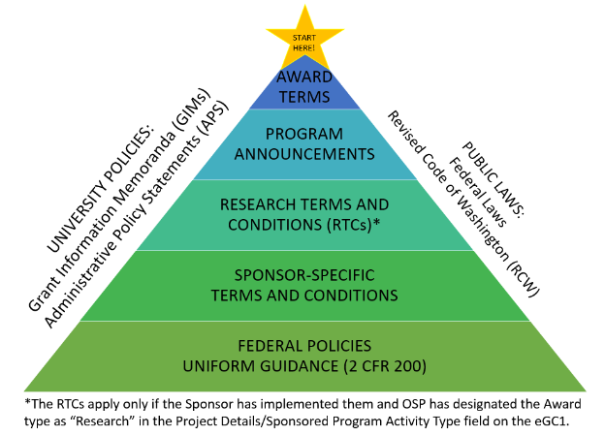
Travel on Sponsored Awards, Cont’d
Travel costs must comply with both the sponsor’s terms and conditions and UW Travel policy.
MRAM – Matt Gardner – PAFC

Slide 6
Travel on Sponsored Awards, Cont’d
Many sponsors require recipients to follow their institutions’ travel policies with respect to allowable costs
In those instances, consult UW Travel policies:
https://finance.uw.edu/travel/homepage

Slide 7
Travel on Federal Sponsored Awards
Federal regulations require recipients to follow the “written travel reimbursement policies” of the institution… with two specific exceptions:
Class of commercial air travel, and
Use of a U.S.-flag carrier (Fly America Act)
An individual federal agency or award may include additional restrictions or limitations
Always read your award and sponsor terms and conditions
MRAM – Matt Gardner – PAFC

Slide 8
Class of Travel on Federal Awards
Regulations require purchasing the least expensive class of travel – typically called “economy”
Exceptions may be found in 2 CFR 200.475(e)
The “least expensive unrestricted airfare” is allowable
Refundable tickets are an allowable cost
Non-refundable tickets are allowable if the ticket is used
If a non-refundable ticket is purchased and the travel does not occur, the cost may not be charged to the Award
MRAM – Matt Gardner – PAFC

Slide 9
The Myth of the “14-Hour Rule”
Under the Uniform Guidance (2 CFR 200), the length of the flight is not an exception to the requirement to purchase the least expensive unrestricted ticket
The Federal Travel Regulations (“FTR”) contain the “14-hour rule” but the FTR seat class rules do not apply to federal sponsored awards – the Uniform Guidance applies
There are many, many (many) federal regulations – recipients must apply the regulations specific to sponsored awards
MRAM – Matt Gardner – PAFC
Notes:
FAR Subpart 31.3 requires educational institutions which have contracts with the federal government to follow 2 CFR 200, the Uniform Guidance, with respect to the principles for determining the cost of research and development, training, and other work performed by educational institutions under contracts with the Government.”

Slide 10
The Fly America Act (“FAA”)
All airfare must comply with the FAA (domestic and international flights) requiring the use of a U.S.-flag carrier
The FAA includes allowances for itinerary-specific exemptions and for eligible flights (e.g., code-share and Open Skies agreements)
Cost of the ticket is NOT an exception to the FAA
Compliance with the FAA must be documented at the time of purchase, not retroactively. Which means…
MRAM – Matt Gardner – PAFC

Slide 11
Compliance with the FAA
Compliance for individual flights can only be determined with access to all available flight options and up to date information on Code Share and Open Skies agreements
PAFC does not have access to this information and cannot confirm if your itinerary is FAA compliant
Work with a UW-approved travel agent to ensure compliance

Slide 12
Travel Tips on Federal Awards
Approval is not required; auditors look for “notice”
Include a description of the travel in the proposal budget, along with a justification as to how the travel benefits the award
If travel was not included in the proposal, mention the travel in any subsequent progress reports to the sponsor

Slide 13
More Travel Tips for Federal Awards
The travel must benefit the objectives of the award, not the individual
If it’s not clear how the travel benefits the objectives of the award, document the justification in progress reports and other award files
Seat fees and upgrades are not an allowable cost on federal awards and must be covered by:
Non-sponsored funds (if reimbursable under UW policy), or
The traveler

Slide 14
Additional Travel Tips
Any “personal time/travel” must be removed from the total costs
Example: If an individual flies into a conference a day early to see family, the associated meals and hotel costs for the extra day do not benefit the sponsored award
All travel costs must benefit the objectives of the award; additional costs incurred due to “personal time/travel” do not benefit the award and are unallowable
All travel must occur during the period of performance

Slide 15
The Holy Grail of Travel Audit Findings!
Travel that benefited the PI, but not the award
Re-budgeting travel from $2,200 to $29,000 after NSF cut the proposed budget from $6,000(!)
Internal Audit finding of $2,477 of unallowable charges, including:
Business class airfare
Costs related to “personal time”

Slide 16
References
PAFC : https://finance.uw.edu/pafc/travel
UW Travel: https://finance.uw.edu/travel/homepage
Uniform Guidance: 2 CFR 200.475
Fly America Act: https://www.gsa.gov/policy-regulations/policy/travel-management-policy/fly-america-act

Slide 17
Questions
Post Award Fiscal Compliance (PAFC)
gcafco@uw.edu
https://finance.uw.edu/pafc/
Matt Gardner
mgard4@uw.edu
206-543-2610
Available on Teams and Zoom
MRAM – Matt Gardner – PAFC

Slide 18
Reimagining Global Affairs & Global Engagement

Slide 19
General Support Services
International agreements & partnerships
International delegation visits
Global Travel Security
Executive Office international travel & engagement
Global dashboards
Global & crisis communications
Management of UW international relations and protocols

Slide 20
Signature Initiatives & Programs
RESEARCH
TEACHING
STUDENT OPPORTUNITIES
GLOBAL INNOVATION FUND
STUDY ABROAD
COIL
UW ROME CENTER
GLOBAL ENGAGEMENT FELLOWS
GO SCHOLARSHIPS
Excellence in Global Engagement Award
UW GLOBAL MONTH

Slide 21
OGA STRATEGIC PLAN PRIORITIES 2022-2026
Priority 1: Advancing Diversity, Equity, and Inclusion
Priority 2: Innovating and Expanding Student Global Opportunities
Priority 3: Catalyzing Community Global Engagement
Priority 4: Fostering an Inclusive and Collaborative Team

Slide 22
Advancing Diversity, Equity, and Inclusion
To advance diversity, equity, and inclusion by reducing barriers to global engagement for faculty, staff, and students through building community and connection around equity and ethical global engagement.
Goals:
Create community and connection through relationships and targeted outreach across campus
Identify and reduce barriers to global engagement

Slide 23
Catalyzing Community Global Engagement
Catalyzing community global engagement by:
Convening faculty, staff, students, alumni and partners around strategic global themes and topics
Advocating for the importance of global engagement to leaders across the UW
Building a global information hub and proactively creating awareness and connection to our information, data, resources, and services.
Goals:
Advancing teaching and learning beyond study abroad
Developing and nurture partnerships with units supporting faculty research and service
Advocating for the importance of global engagement across the UW
Nurturing relationships with other UW units that are facilitators and partners in our work.

Slide 24
Global Innovation Fund
Program began in 2015
Purpose:
Seeding cross-college, cross-continent collaboration
Priorities have included:
Race & Equity Initiative
Regional: China, East Asia, Kenya
Partnerships have included:
Population Health
Center for American Indian and Indigenous Studies
Center for Global Studies

Slide 25
GIF Overview
Types of awards
Research
Study Abroad
Programming
Teaching & Curriculum
Hybrid
2015-2021
486 Total Applications
165 Total Awarded
$1,531,927 Total Awarded
Annual award averages
Research award: $14,700
Study Abroad: $7,600
Typically $150-$200K total awarded each year

Slide 26
Global Engagement Fellows
The Global Engagement Fellows (fellows) will convene new cross-disciplinary groups of faculty (referred to as “communities”) that share a common interest. The fellows will convene these communities on a pilot basis for the 2022-2023 academic year.
The purpose of the Global Engagement Fellows grant program is to increase connections and foster deeper ties among faculty across units at the UW. The grants were developed and awarded in response to the work of the Global Engagement Task Force.

Slide 27
Global Travel Security
UW GTS supports official UW travelers with travel registration, pre-travel preparation, insurance coverage and 24/7 emergency response.
International Travel has resumed after a long layoff due to the COVID-19 pandemic.
Faculty/Staff intl. trips: 48 (‘21), 190 (‘22), 837 (‘22)
Student trips: 3,500 student trips registered in ‘22
Travel restrictions have been relaxed in accordance with official guidance from the US Dept. of State and CDC.

Slide 28
NSF Update: Highlights from the new Proposal and Award Policies and Procedure Guide (PAPPG)
November, 2022 MRAM
Amanda Snyder
Office of Sponsored Programs

Slide 29
Key Highlights
Research.gov required as of January 27th, 2023
FastLane no longer an option for proposal submission
SciENcv required for all Biographical Sketches and Current and Pending Support in Oct. 2023
ORCID is encouraged
Be prepared to resubmit Current and Pending Support prior to award
Field work: new supplementary document required for proposals with field research effective January 1, 2023: Plan for Safe and Inclusive Field/Vessel/Aircraft Research (PSI-FVAR)

Slide 30
NSF - Concept Outlines
New Submission Type & System for PIs
Concept Outlines
Submitted early in the proposal process to ensure concept PI is proposing is appropriate.
Intended to help reduce admin burden associated with submitting a full proposal
New system for PIs to submit Concept Outlines
Program Suitability and Proposal Concept Tool (ProSPCT)
These will not come through OSP

Slide 31
When are Concept Outlines Used?
Planning, RAPID, EAGER, and RAISE
Funding opportunities that list as requirement
Anytime a PI wishes to share a concept/idea with a program officer
PIs can still submit unsolicited white papers or emails to program officials, but they recommend using the tool

Slide 32
Concept Outlines vs. LOIs
What’s the difference?
NSF uses LOIs to gauge number of proposals, what kind of reviewer community is required (based on topic areas), & helps NSF manage COI for reviewers
Neither Concept Outlines or LOIs are used in the proposal review process and neither are binding/require the UW or the PI to submit a full proposal.

Slide 33
Resources
Review more information from NSF’s PAPPG Summary of Changes
About Research.gov
ORCID
SciENcv
Easy Come, Easy Go: SciENcv and My Bibliography - webinar and slides from a director of NCBI, Bart Trawick
NSF Policy homepage
NSF Pre-award and Post-award Disclosures Relating to the Biographical Sketch and Current and Pending Support

Slide 34
NIH: Data Management and Sharing Policy
November 2022 MRAM
Carol Rhodes
Office of Sponsored Programs

Slide 35
What does the NIH Data Management & Sharing (DMS) Policy Cover?
When to submit a DMS Plan
Elements of a DMS Plan
DMS Plan Review
DMS Plan Changes, both pre- and post-award
Costs associated with data management and sharing
Data Sharing - Timing and Where
Data Management Best Practices

Slide 36
Data Management and Sharing (DMS) Plan
Proposal Requirement January 25, 2023
Applies to:
All research, funded or conducted in whole or in part by NIH, that result in generation of scientific data
All NIH funding mechanisms: Grants, cooperative agreements, contracts, OTAs
FOAs may also include specific requirements and may specify a repository
A DMS Plan is required with proposals for new/competing NIH applications due on or after January 25, 2023.

Slide 37
DMS Plan Elements - What are they?
No more than two pages long
NIH DMS Plan format
Should outline how scientific data and accompanying metadata will be managed and shared
Include 6 recommended elements:
Data Type
Related Tools, Software and/or Code
Standards
Data Preservation, Access, and Associated Timelines
Access, Distribution, or Reuse Considerations
Oversight of Data Management and Sharing
Can account for restrictions on sharing, such as a regulatory restriction or ethical concerns
e.g. Certificate of Confidentiality or others
Notes:
Mention HSD presentation coming up next -

Slide 38
Considerations for specialized datasets, data privacy, and human subjects protections
Genomic data: DMS Policy takes into account the 2014 Genomic Data Sharing (GDS) policy
Applications subject to both the DMS Policy and the GDS Policy will submit a single Plan
See NOT-OD-22-198 for details and other considerations
Human subjects participant data protections:
Informed Consent
De-identification
Certificate of Confidentiality
Any restrictions on sharing:
Regulatory restrictions (e.g. HIPAA, GDPR)
Tribal laws, policies and tribal sovereignty
Ethical considerations

Slide 39
Selecting a Data Repository
Review the NIH guidance for Selecting a Repository for Data Resulting from NIH-Supported Research
Funding Opportunity Announcements (FOAs) may designate a specific Data Repository which needs to be used
NIH maintains a list of NIH- supported Repositories
There are some non-federal repository tools and guidance:
Nature’s Data Repository Guidance
Registry of Research Data Repositories
UW Libraries has a listing of repositories

Slide 40
Budgeting Costs: Data Management & Sharing
Can be included as a direct cost in the proposal budget
Label as “Data Management and Sharing Costs
Address in budget justification
Must be incurred before end of the project period
Review Forecasting Costs for Preserving, Archiving, and Promoting Access to Biomedical Data
Cost Examples:
Curating & formatting data for transmission to & storage at a selected repository for long-term preservation & access, including de-identifying data
Preparing metadata to foster discoverability, interpretation, and reuse
Preserving & sharing data through established repositories, e.g. data deposit fee
Notes:
NIH is not awarding more to cover these costs; still within any total award cost limit.
OSP not reviewing whether such costs in budget or if adequate; discretionary and up to PI.

Slide 41
DMS Plan - Who reviews?
NIH application component:
New NIH FORMS-H includes an attachment section for including the DMS Plan in proposals
Plans are assessed by NIH Institute/Center Program staff
Ensure elements adequately addressed
Not reviewed by peer reviewers as part of Overall Impact score
OSP is not reviewing content of DMS plans.
Notes:
More specific instructions can come from GMS, rather than generic JIT notification.

Slide 42
DMS Plan - Pre-Award Changes?
If Changes are needed, applicants will be notified via Just-in-Time (JIT)
Revisions should be submitted as part of the JIT response (e.g. via OSP to Grants Management Specialist or in eRA Commons)
Defer to instructions from NIH GMS
Notes:
More specific instructions can come from GMS, rather than generic JIT notification.

Slide 43
DMS Plan - Post-Award Changes?
Plans can be updated or revised over course of a project
If any changes occur during the award or support period that affects how data is managed or shared, investigators should update the Plan to reflect the changes
NIH will need to approve the updated Plan
NIH staff will monitor compliance with approved DMS Plans during the annual RPPR process as well
We may see more Data Access Requests & NIH Data Use Certification Agreements

Slide 44
Timeframe for Sharing Data
Shared scientific data should be made accessible as soon as possible, and no later than the time of an associated publication, or the end of performance period, whichever comes first.

Slide 45
NIH Resources
Data Management and Sharing Policy
NIH Data Management guidance describes principles, techniques, and methods to keep in mind
NIH Writing a DMS Plan
Specific I/C requirements for DMS Plans
High Level Changes to application forms (Forms H) - for due dates on/after January 25, 2023
NOT-21-013: Final Data Management and Sharing Policy
NIH Scientific Data FAQs

Slide 46
UW Resources
UW Libraries Open Scholarship Commons: Research Data Management
UW Libraries: Research Data Management Guide
UW Libraries offers a free, online workshop for those new to data management and stewardship
Research Data Management Planning Workshop
UW Policy Research Data GIM 37
UW Need a Data Use Agreement? Information on DUAs at the UW and who needs to review them

Slide 47
FORMS - H
Use ASSIST for all NIH proposals due on or after January 25th.
FORMS-H Availability & Resources
NIH FORMS-H: Instructions, Forms, Handy Checklist

Slide 48
Questions

Slide 49
Certificates of Confidentiality and the NIH Data Management and Sharing Policy
Maria Savage, Associate Director, Human Subjects Division

Slide 50
What is a Certificate of Confidentiality (CoC)?
It is a legal protection that some federal agencies can issue to protect identifiable sensitive information collected as part of a study. It allows researchers to refuse to disclose identifiable information about the research subjects in response to legal demands, such as a subpoena or Public Records request.
Notes:
It is a protection that is especially useful when research will collect information from research participants that could present legal risks, like research on drug abuse or abortion.

Slide 51
What is identifiable sensitive information?
Information that is about an individual and that is gathered or used during the research:
Through which an individual is identified; or
Where there is at least a very small risk, that some combination of the information and other available data sources could be used to deduce the identity of an individual.

Slide 52
How do I get a Certificate of Confidentiality (CoC)?
Automatic Certificate
Apply For Certificate
Issued as a term of the grant or contract by:
NIH
CDC
FDA
Studies that are not funded by a federal agency can apply to:
NIH
FDA
For complete list, see HSD Guidance Question: Who issues a CoC?
Notes:
If you have an NIH funded study that collects identifiable information, then you have a CoC. HSD will point this out in the IRB review process to ensure that the requisite consent language is included and advise researchers of their responsibilities with regard to the certificate.
Sometimes the IRB will require researcher to apply for a CoC as an added protection when a study does not already have one.

Slide 53
Limitations to CoC protections
Researchers can disclose information if required by other laws (e.g. communicable diseases)
Subject can disclose information about their own participation
Subject can consent to disclosure of information
(e.g. medical providers)
Research records

Slide 54
Does a CoC prevent sharing of data as required by the new NIH Data Management and Sharing policy?
No.
But data sharing must be consistent with human subjects regulations
Notes:
Data sharing for research purposes is permitted by CoC requirements provided that it is consistent with human subjects regulations. For the most part, this just means that researchers should obtain IRB review and include a description of the sharing and future use of a subjects information in the consent form (which is an element of consent required by human subjects regulations).

Slide 55
Things to keep in mind when sharing CoC protected data…
NIH does not consider summary results to be covered by the CoC
Repositories should be informed when data are covered by a CoC
Protected data can be shared on an unrestricted access repository only with explicit consent from the subject
Notes:
Summary results are not considered to be identifiable and are therefore not protected by the CoC. In other words, it is not a disclosure that requires consent from the participant.
Repositories should be informed when data are covered by a certificate to ensure downstream protection
Sharing data through an unrestricted (public access) repository IS generally considered to be a disclosure of protected information. This can only be done with subject consent.

Slide 56
Resources
HSD INFORMATION SHEET Certificate of Confidentiality
HSD GUIDANCE Certificates of Confidentiality
HSD Consent Template (will be updated end of November to include language about data sharing)
Supplemental Information to the NIH DMS Policy: Protecting Privacy When Sharing Human Research Participant Data
Notes:
Recently converted our COC guidance into a webpage from a word document as part of an ongoing effort to turn all of our guidance documents into webpages to make them easier to find.
HSD will be incorporating language about data sharing into CF template. Will be available at the end of November and announced in HSD newsletter beginning of December.

Slide 57
Questions? Email the Human Subjects Division at: hsdinfo@uw.edu

Slide 58
Recognition!
Certificate in Research Administration Graduates
535 enrolled in the certificate
140 graduates since August 2020
16 graduates in fourth group
Notes:
And now for the fun part! Today we are recognizing the fifth group of graduates from the CORE Certificate in Research Administration. CORE launched this certificate in the fall of 2019. Since then 535 people have enrolled in the certificate program and as November 1, 2022, 140 of those enrollees have met all requirements to receive the certificate. We recognize the recipients on a semi-annual basis in the MRAM venue and today we are going to take a moment to recognize the achievements in this last round completers. Not all of them chose to include their names in today’s announcement but you all know who you are!

Slide 59
Certificate in Research Administration Program Graduates
Notes:
Let’s give a shout out to some of our most recent graduates and give them a hand!

Slide 60
Mike Bartley Post Award Grant Manager School of Nursing
Congratulations!

Slide 61
Charlie Gregor Manager of the Hub Liaison Team Institute of Translational Health Sciences
School of Medicine
Congratulations!

Slide 62
Heather C. Hopkins
Program Operations Specialist
Department of Laboratory Medicine and Pathology School of Medicine
Congratulations!

Slide 63
Lauren Lederer
Administrator
AI Institute in Dynamic Systems College of Arts & Sciences
Congratulations!

Slide 64
Cara Sucher Program Manager The eDNA Collaborative School of Marine and Environmental Affairs
Congratulations!

Slide 65
Thank You!
Thanks to all these staff and their supervisors in supporting the UW as a strong and effectively managed research enterprise!
Notes:
And a big thank you to all who support the ongoing professional development of our research administration staff!

Slide 66
Monthly Research Administration Meeting
Workday Finance-Grants Focus
November 10, 2022
Amanda Snyder, Associate Director, Office of Sponsored Programs
Nicole Flagg, Grant Award to Close Lead, UW Finance Transformation
Jesse Rice, Grant Award to Close Business Analyst, UW Finance Transformation
Liz Satwicz, Change Manager, UW Finance Transformation

Slide 67
AGENDA
MRAM:
October MRAM Recap-SAGE Workflow
Key Grants-related Systems
MRAM Extension:
Grant Award to Close Overview/Day in the Life: Grants Manager in Workday
Demo
RAPN announcement/Q&A submission
Notes:
Recap of MRAM from Amanda. MRAM likely to run over and push our pres into 30 min extension. Drop full Q&A but let folks know will respond and have opp at RAPN. Make slides accessible in the Appendix. Change Impact Overview

Slide 68
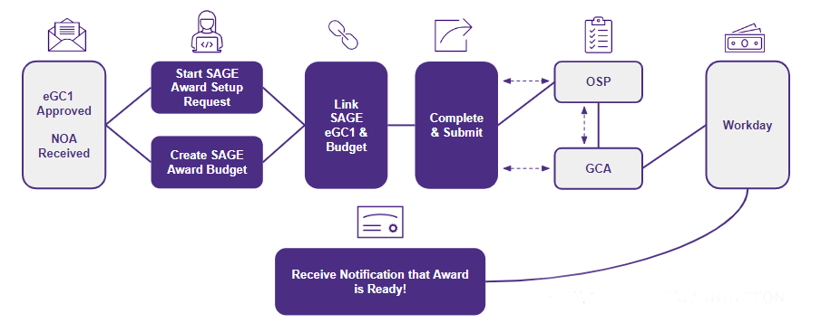
HIGH-LEVEL WORKFLOW
Notes:
In October, will share a flow chart visual to show award intake workflow. May try to depict a two-column who does what where view of actions in SAGE and Workday. Could start with this as an establishing shot/refresher at MRAM.
Amanda or Juan as potential presenters

Slide 69
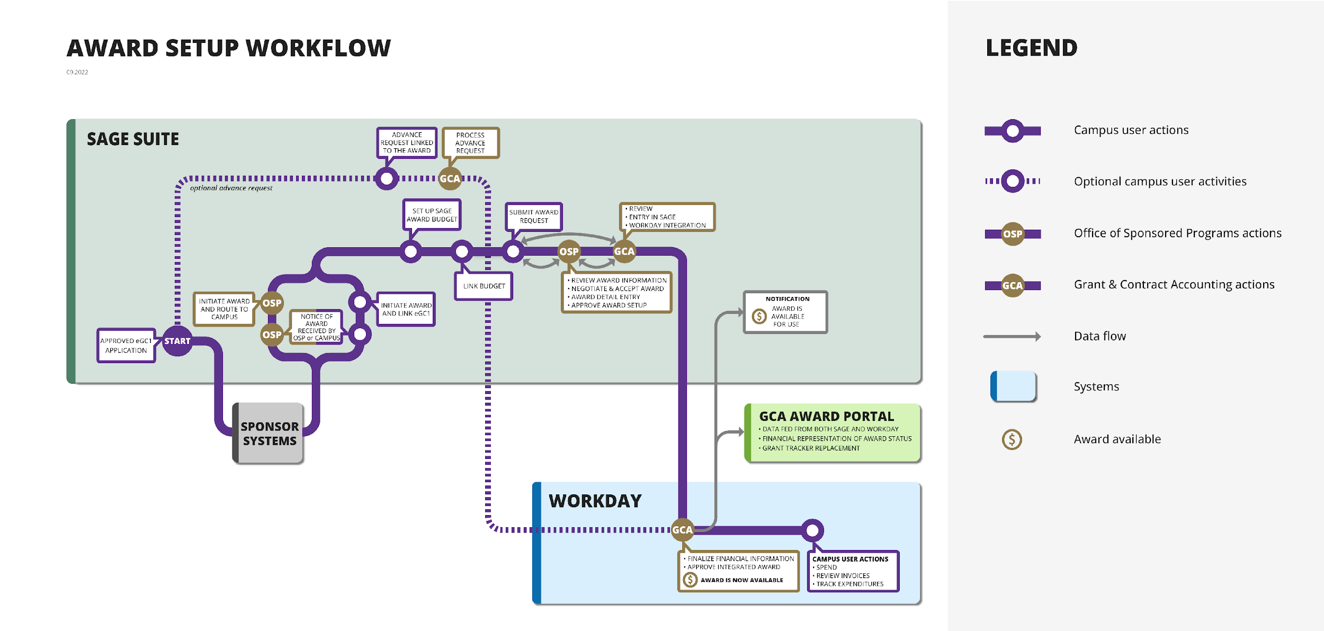
AWARD SETUP WORKFLOW
Notes:
In October, will share a flow chart visual to show award intake workflow. May try to depict a two-column who does what where view of actions in SAGE and Workday. Could start with this as an establishing shot/refresher at MRAM.
Amanda or Juan as potential presenters

Slide 70
KEY GRANTS-RELATED SYSTEMS
Workday
Finance
Replacing FIN/FAS, MyFD, and Ariba​
ECC
(Employee Compensation Compliance)
*Replaces current effort reporting
Award Portal
Replacing Grant Tracker
SAGE
Including the new Award Setup Workflow
UW Connect
Web-based support tool
*Replaces eFECS, Grant & Contract Certification Report and effort reports for HMC and APL
Notes:
You’ve heard about SAGE. List five systems: SAGE, WD, ECC, Award Portal which replaces Grant Tracker, UW Connect. Where am I going to go and how am I going to do my work? What do I do in each system? What are the benefits. What will be different. Appease people's’ fears by explaining the where.

Slide 71
DAY IN THE LIFE: GRANTS MANAGER IN WORKDAY

Slide 72
SPONSORED AWARD COMPONENTS
The sponsor’s Notice of Award (NOA) can be broken down into these main objects.
1
Award
Defines the business rules to correctly bill, collect, and report activities related to the award.
4
Award Budget
Workday automatically builds the periods based on the award schedule.
2
Sponsor, Flow Through Sponsor
Award Line
Manages award details and ties Grant to Award.
Award Date
Reimbursement Method
Award Line Attributes
Award Schedule
Award Schedule
F&A Rule
Budget Breakdown
3
Award Amounts
Grant
Collects costs
Start and End Dates
Grant
(Worktag)
Award Attributes
Sub-recipient
Grant
(Worktag)
Notes:
Remind we won’t have time for questions. Please submit. Explain terms, e.g. a tenant. Orient the audience to where you are and your role in time and space. WD award components:
The Award - is the like the Umbrella it contains information supporting overall award activities - the sponsor, dates, amounts, and a number of attributes
The Award Line - allows us to get more granular with the details of the award and captures additional information and attributes such as reimbursement method (cost reimbursable, Fixed Amount); F&A rules which allow us to manage awards that are issued with multiple F&A rates
The Award Line also links the Grant Worktag with the Award
The Grant Worktag - is used to collect the costs and will be reflected on transactions within the system
Award Budget - used to monitor, reporting, and invoice (sponsors often want financial reports to show expenses compared to the budget.)
Award Schedule defines the periods we want to provide budgets for (Pre-Award, Award Period, Separate years- year 1, year 2) and allows us to define the Contract Start/End dates (Sponsor defined)

Slide 73
DEMO

Slide 74
THANK YOU!

Slide 75
RESOURCES/ENGAGEMENT
Notes:
Future video that walks thru sections/tabs in WD
RAPN Q&A promo
Stay tuned for more information
Remind of availability of finance classes – Accting Mechanics, GA
Other communications pushes related to Grants, next Roadshow in January

Slide 76
RESOURCES/ENGAGEMENT
RAPN Session / Q&A submission — November 15
Finance Literacy Seminars — November 15/16
Core Concepts — November 17/29
Future State Focus video
Roadshow #5 — January 18
UWFT for the Research Community
UWFT Newsletter; Transformation Insights blog
Change Network

Slide 77
CONTACTS
UWFT Help: If you have general questions about UWFT and Workday Finance, email the program at UWFTAsk@uw.edu.
SAGE Help: If you have questions or concerns about SAGE Budget or SAGE Awards, please reach out to sagehelp@uw.edu.
Notes:
Qs from managers needing to know where to find reports and how to restructure their units. A lot of this is still under development. Even giving a timeline could allay fears. Training info.

Slide 78
APPENDIX

Slide 79
GRANT AWARD TO CLOSE OVERVIEW
Notes:
Orientation/Context setting.

Slide 80
GRANT AWARD TO CLOSE
What is Grant Award to Close?
Grant Award to Close refers to business processes involved from the time a grant or contract is awarded through grant close-out. This includes facilities and administration (F&A) activities, sub-award and sub-recipient activities, billing and reporting to sponsors, cost-share, effort reporting, and other post-award grant management activities.
Transformation Goals include:
Sponsored agreement data flows automatically from pre-award to post-award systems
Streamline grant/contract set up process
Provide robust grant tracking (financial/administrative) across the enterprise
Consolidate post-award grants management in Workday
Increase granular tracking of expenditure types within a grant
Provide automated exception reporting

Slide 81
CHANGE IMPACT OVERVIEW
Notes:
Orientation/Context setting. We’ve been talking about change impacts. Here’s one that we will follow through. Connect between change impacts we’ve been collecting and walk through/demo.
Can we create a condensed set of slides that intros to the tool and big changes that are coming as context. But jump into demo as quickly as possible.
Benefit of this

Slide 82
CHANGE IMPACT OVERVIEW
Change impacts allow the Organizational Change Management (OCM) team to collect and analyze changes that will impact end users as a result of finance transformation, for use across OCM activities (e.g., stakeholder engagement, training).
A Change Impact…
Is a narrow statement of what will be different as a result of UW Finance Transformation and the associated impact to people, processes, technology and policies
Includes an assessment of the extent to which these impacts affect each stakeholder role and unit (high, medium, or low impact)
Serve as a source of foundational knowledge for the OCM Team to construct tailored communications and training to mitigate impacts and prepare each for go-live and beyond
OCM has been collecting, refining, and validating Change Impacts from stakeholders and the UWFT Design team and their partners for over two years.
Notes:
Direct to change impacts v. these slides – too much to include this. Could book time in Dec MRAM?
Could we condense to a couple of slides. And you will get to hear more about this and see on the Change Network.

Slide 83
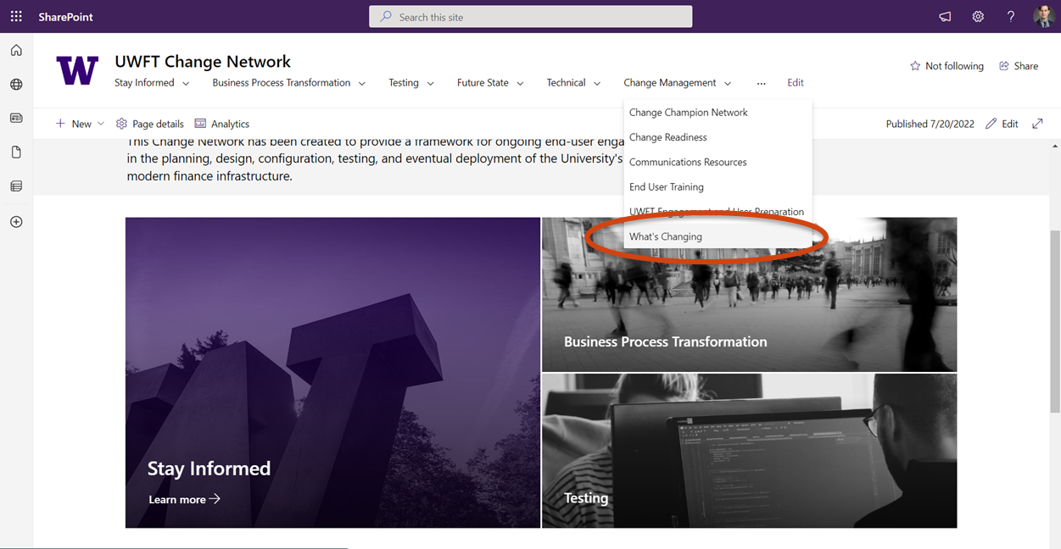
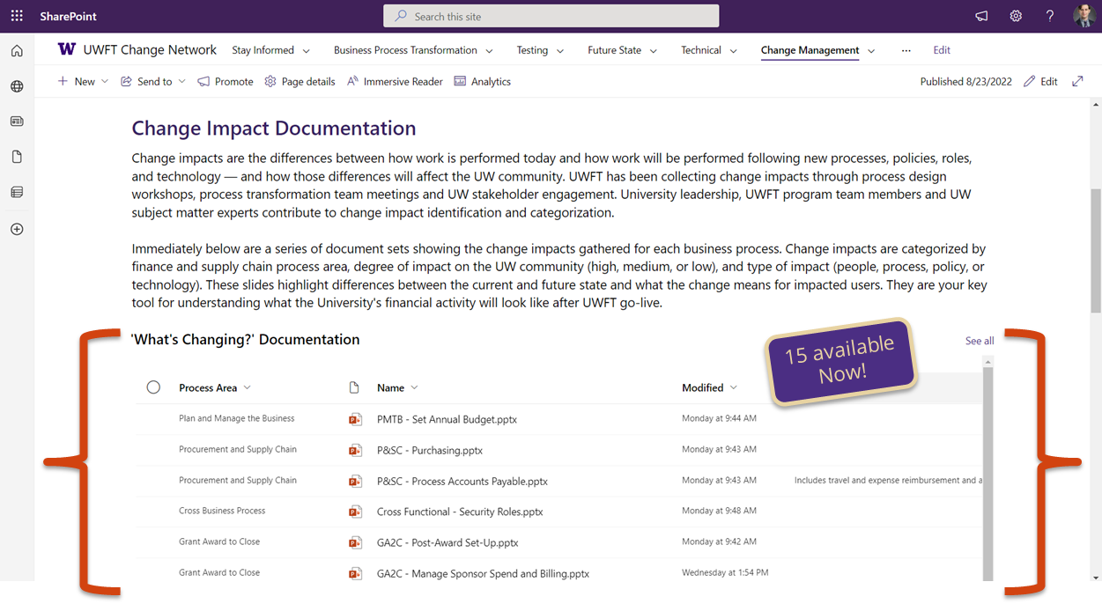
OCM IS CREATING ‘WHAT’S CHANGING’ SLIDE-SETS FOR EACH BUSINESS SUB-PROCESS

Slide 84
GA2C TAXONOMY

Slide 85
GRANT AWARD TO CLOSE Post-Award Set-Up | GA2C-030
KEY
UW Medicine
UW Academy
Updated: 9.02.22
CURRENT STATE
Full information need for set-up requires using a variety of communication methods which do not connect (e.g., email, in-systems communications)
Set-up requires multiple rounds of manual data entry into multiple systems (e.g., SAGE, Grant Tracker, BGT)
Award structure is often complex, and difficult to record
FUTURE STATE
Award setup initiated in SAGE by campus, consolidating data collection and reducing back and forth
SAGE to Workday integration to reduce manual entry
Awards encompass a competitive segment of activity and are visible in both Workday and SAGE
VIEW THE PROCESS FLOW:
WHO IS MOST IMPACTED?
WHAT DOES THIS CHANGE MEAN?
SAGE integration with Workday will reduce manual data entry needs, re-work, and errors/typos, which will lead to increased compliance
Remediation of SAGE & SAGE Budget has new, standardized intake forms for greater visibility of status and consistency regarding how to communicate updated data
Workday allows for greater granularity in recording sponsor details and auto-calculation of F&A
UW Medicine
UW Academy
HMC Grant Accounting
OSP and GCA
Grant Managers
Grant Managers
Principal Investigators
EXPECTED BENEFITS
Increased proactive partnership across the organization
Clearer roles & responsibilities
Increased consistency in global processes, policies, and/or procedures
Elimination of manual steps through Workday automation
Ability to focus on higher complexity transactions with wider business impact
Notes:
Stripped down version of this? What’s Changing series. Liz owns this.

Slide 86
GRANT AWARD TO CLOSE Post-Award Set-Up | GA2C-030
KEY
UW Medicine
UW Academy
Updated: 9.02.22
NEW AWARDS SECTION IN SAGE
SAGE Awards will be the place to go to initiate award activity or view latest award status and details.
Campus units will request new award setup through SAGE Awards
This section will expand over time to include award modification requests and other helpful features informed by you!
RESOLVING DEFICIT (ex. COST TRANSFERS)
Staff in Shared Environments will complete transfers. This shift will improve compliance for UW.
SAGE BUDGET REQUIRED FOR AWARD BUDGETS AT TIME OF AWARD SETUP
Provides a consistent budget format used to support integration and setup in Workday. Will result in increased visibility, data quality, and consistency.
SAGE Budget will not be required for proposal budgeting
Clinical trials that use CTMS for billing will not need to use a SAGE Budget.
TRACKING NON-FINANCIAL TASKS
Grant awardees at the unit level can input ad-hoc non-financial tasks into Workday (e.g. progress and inventory reports). This will allow for fewer side-systems and increased visibility.
SPONSOR ATTRIBUTE FACILITATES REPORTING
Use of new attribute for sponsor identification.
Fewer revenue categories will be needed.
Greater granularity available in reporting.
Sponsor management will be its own discipline.
SUBAWARD F&A WILL BE AUTO-CALCULATED
Workday will apply Facilities and Administration (F&A) on subawards automatically until the remainder of the F&A basis limit is consumed.
Different award lines for each subaward will improve F&A management.
This will result in a reduction in manual work and use of side systems
Notes:
Could delete first two SAGE ones. Could be in the Appendix.

Slide 87
Grant Award to Close Post-Award Set-Up | GA2C-030
KEY
UW Medicine
UW Academy
Updated: 9.2.22
COST-SHARE TRACKING IN REAL TIME
A unique award line will be established in the financial system to track cost share expenses instead of tagging after the fact.
CONSOLIDATED SUB-RECIPIENT COST-SHARE TRACKING
There will only be one system (both technology and process) for cost-share so there will no longer be an issue keeping them in sync.
A unique Spend Category will be created for Subrecipient Cost-Share.
Notes:
DELETE – Jan or Feb timeframe

Slide 88
KEY CHANGES IN POST-AWARD PROCESSES
* Full scope of activities not shown, to see more information on the levels of shared and future state processes, please see the individual business process sections
**Processes differ across units in the current state, these notes may apply differently to various units
KEY STEPS IN POST-AWARD – IMPACTS TO CURRENT UNIT ACTIVITIES*
Process Notes Specific to UWA
Receive Notice of Award
Award Set Up and Award Maintenance
Manage Sponsored Program Spend
Sponsor Billing and Financial Reporting
Effort
Reporting
Award
Closeout
Work Changing
Work Automated
Work Moving to Shared
Work Automated
Work Changing
Work Automated
All award intake within SAGE
SAGE Integration to initiate Awards, Award Lines, Award Schedules, Award Budgets, and to create Grant worktags
Receive, review, and process requests for non-payroll cost transfers
Cost Reimbursable transactions outside award period not eligible for Sponsor Billing
All cost share will be in Workday, and we will use a new third-party solution for effort reporting
Award Closeout Task Notifications and Lifecycle status updates
Work Changing
Use of SAGE budget to standardize and facilitate Award integrations
Work Changing
Work Changing
Work Changing
Work Moving to Shared
Cost share established as a unique award line (companion account); Cost Share funding sources identified at time of award
All cost transfers completed in Workday and payroll accounting adjustments (payroll expense transfers) completed by units
Visibility into Award Billing Information in Workday Award (also visible in Award Portal)
Work Moving to Shared
Work Changing
Review all effort reports for compliance before certification
Assist local units with the final award reconciliation before working with Grant and Contract Accounting to close out the award in Workday
Award structure is changing – an award will equal a SAGE cycle, which is equal to a sponsor-awarded competitive segment
Work Changing
Work Changing
Work Changing
Ability to connect milestone -based Sponsor billing with award tasks to facilitate task completion communication and timely billing
Work Changing
Unique award line for each subaward with spend restrictions to allow only subaward related spend and to support automated F&A with basis limits
Each eligible direct cost will generate an individual F&A cost transaction, rather than one summary per day
Faculty effort cost share requires costing allocations as it is no longer assumed within the pool of non-sponsored support
Work Automated
F&A calculations subject to F&A basis limit (1st $25k on subaward posting real-time)
Key
Work Changing**
Work Moving to Shared
Work Automated
Notes:
APPENDIX

Slide 89
GRANT AWARD TO CLOSE Post-Award Set-Up | GA2C-030
Current State
Future State
Full information needed for set-up requires using a variety of communication methods which do not connect (e.g., email, in-systems communications)​
Award setup initiated in SAGE by campus, consolidating data collection and reducing back and forth
Set-up requires multiple rounds of manual data entry into multiple systems (e.g., SAGE, Grant Tracker, BGT)​
SAGE to Workday integration will reduce manual entry
Award structure is often complex, and difficult to record
Awards encompass a competitive segment of activity and are visible in both Workday and SAGE
Notes:
Stripped down version of this? What’s Changing series. Liz owns this.
Some benefits of these changes are:
SAGE integration with Workday will reduce manual data entry needs, re-work, and errors/typos, which will lead to increased compliance
Remediation of SAGE & SAGE Budget has new, standardized intake forms for greater visibility of status and consistency regarding how to communicate updated data
Workday allows for greater granularity in recording sponsor details and auto-calculation of F&A

Slide 90
GRANT AWARD TO CLOSE Post-Award Set-Up | GA2C-030
SUBAWARD F&A WILL BE AUTO-CALCULATED
Workday will apply Facilities and Administration (F&A) on subawards automatically until the remainder of the F&A basis limit is consumed.
Different award lines for each subaward will improve F&A management.
This will result in a reduction in manual work and use of side systems
RESOLVING DEFICIT (ex. COST TRANSFERS)
Staff in Shared Environments will complete transfers. This shift will improve compliance for UW.
TRACKING NON-FINANCIAL TASKS
Grant awardees at the unit level can input ad-hoc non-financial tasks into Workday (e.g. progress and inventory reports). This will allow for fewer side-systems and increased visibility.
SPONSOR ATTRIBUTE FACILITATES REPORTING
Use of new attribute for sponsor identification.
Fewer revenue categories will be needed.
Greater granularity available in reporting.
Sponsor management will be its own discipline.
Notes:
Could delete first two SAGE ones. Could be in the Appendix.

Slide 91
KEY GRANTS-RELATED SYSTEMS
Notes:
Orientation/Context setting. We’ve been talking about change impacts. Here’s one that we will follow through. Connect between change impacts we’ve been collecting and walk through/demo.
Can we create a condensed set of slides that intros to the tool and big changes that are coming as context. But jump into demo as quickly as possible.
Benefit of this

Slide 92
GRANT SYSTEM LANDSCAPE
The following two tables provide details of the future state grants related systems, what they are and how PIs and Grant Managers will use them.
 | SAGE | Workday | ECC | Award Portal | UW Connect
System Description | The System to Administer Grants Electronically (SAGE) is the web-based system used to submit and route funding applications for consideration and approval, create accurate and detailed budgets, request advance budgets, and initiate subawards. With UWFT launch in July 2023, SAGE will also host the award setup request form, to be completed after the Notice of Award (NOA) is received. | Workday is a cloud-based finance and supply chain system UW will use to manage all financial processes and procurement and inventory management activities. It allows for transactions and analytics to be unified in a single system, where all data is stored in-memory, enabling real-time transaction processing, consolidation, and reporting of financial data in one place. | Employee Compensation Compliance (ECC) is a third-party solution, provided by Huron Consulting, which supports the effective management of effort reporting, project certification, and payroll confirmation. | The Award Portal will replace functionality for current state system Grant Tracker. Award Portal will be used for grant management and communications tasks by users across campus and the Grant Contract and Accounting team within UW Finance. Award Portal is a resource for UW depts. working with grant and contract budgets. Award Portal is a custom-built application that will interface with Workday sourced data and provide rich links that fill Workday “gaps”, maintain the current fast response rate and provide an authoritative source for grant data. | UW Connect Finance is the web-based ServiceNow tool in use at UW today. Workday Finance users will find Workday Finance self-help content: process documentation, job aids, training videos, etc. Users will be able to submit forms to request support and initiation of processes. Shared Environments and UW Finance central offices will be UW Connect licensed users to enable routing and resolution of customer support tickets
What is it replacing or is it changing? | NEW: A new Awards section in SAGE will be introduced in July 2023. Users will be able to request setup of a new award, and monitor award details, status, terms and conditions, and history of award activity. The award setup request form will replace email communication, provide a familiar user experience (similar to advances), autofill of eGC1 and SAGE Budget information, and integration with Workday for streamlined setup. NEW: A new sponsor lookup and request process will be implemented in SAGE prior to UWFT launch, connecting SAGE to a new sponsor/donor database. The new simplified form improves data quality, allows for a connection between the sponsor and donor, and tracking of previous and related sponsor names. CHANGING: The Advanced Budget Request process in SAGE was launched in June 2021 in preparation for UWFT and will be updated in 2023 to streamline the transition from Advance to Award. | REPLACING: FAS My Financial Desktop eFECS Cost Share Summary Ariba (for outgoing Subawards) | REPLACING: eFECS Effort Reporting GCCR reports | REPLACING: Grant Tracker Aged Database (GCA only) Workflow Sheets (GCA only) | REPLACING: Some email accounts (not external) Phone calls Potentially other ticketing and routing systems used by units for unit-level approvals (e.g. TREQ, Purchase Path)

Slide 93
GRANT SYSTEM LANDSCAPE (cont.)
The following two tables provide details of the future state grants related systems, what they are and how PIs and Grant Managers will use them.
 | SAGE | Workday | ECC | Award Portal | UW Connect
What tasks will a PI do in this system? | PIs with administrative staff will review and approve applications and complete SFI disclosures as usual. The existing SFI disclosure requirements will continue to apply via FIDS. PIs who do not have administrative staff will communicate their award budget setup using SAGE Budget and will complete the Award Setup Request form in SAGE. | Standard for all PIs: Review award setup upon notification Approve receipt of subrecipient invoices prior to payment (varies by PI) Run Grant related reports Varies by unit: Approve additional procurement related transactions (ad hoc approvals added by unit Grant Managers, includes high risk/sensitive items and items where PIs have not delegated authority per GIM 02) Approve award tasks (ad hoc award tasks added by unit Grant Managers, includes non-financial award tasks such as programmatic reports) PIs without administrative staff: PIs who do not have administrative staff are assigned the Grant Manager role to perform Grant Manager tasks in the system. Approve all procurement related spend transactions on Grants Create and Complete award tasks Run Grant related reports | Review and certify project effort | Self service view grant financial information Submit tickets to Grant Contract and Accounting Monitor tasks assigned in Award Portal (e.x. progress and scientific reports) | Self-help content Get help for general Workday Finance questions Request that Workday Finance processes be initiated by SEs or other individuals/units will address
This system interfaces with… | NEW: SAGE will integrate with Workday Existing SAGE integrations will be maintained | Integration from SAGE to Create award in Workday Integration to ECC Integration from OnCore (Clinical Trial Management System) for clinical trial Sponsor invoicing | Interfaces with Workday | Interfaces with Workday

Slide 94
PI JOURNEY MAP
Plan / Propose
Setup
Manage
Closeout
Create an eGC1
Create a SAGE Budget
Complete compliance questions
Submit an application for routing and approval
Approve an eGC1 or SAGE Budget
Complete FCOI disclosure (FIDS)
Submit an advance budget request
Submit an award setup request
Submit a subaward request
Update investigators list as needed
Update SAGE Award Budget
Update FCOI/SFI as needed (FIDS)
Update compliance responses if changed (may be post release)
Update investigators list as needed
Request award modifications, including renewals (may be post release)
Update investigators list as needed
Request award modifications, including renewals (may be post release)
SAGE
Workday
Review award setup upon notification
Approve receipt of subrecipient invoices prior to payment
(varies by unit) Approve additional procurement related transactions
(varies by unit) Complete award tasks
(optional) Run Grant related reports
(varies by unit) Complete award tasks
(optional) Run Grant related reports
Review own effort report
Notify Coordinator/Grant Manager of issues (PAA, Proxy, etc.) – outside ECC
Certify own effort report
Review Project statement (others charging time to their grant)
Notify Coordinator/Grant Manager of issues (PAA, Designee, etc.) – outside ECC
Certify Project statement
Run reports on their projects
ECC
Award
Portal
Submit ticket communications and view its history to/from GCA
See up-to-date status on outstanding requests
View of outstanding Award Tasks by due date
Links to Pre-award systems
Links to invoice PDFs in EDMS
Links to sponsor/financial reports
View of outstanding Award Tasks by due date
UW
Connect
Submit an intake form (structured case) to request initiation of various E2E Workday Finance processes, including requests to set up cost centers, awards, etc. Note that intake forms are not required if PIs choose to use Award Portal to make these requests.
Submit an intake form (structured case) to request initiation of various E2E Workday Finance processes, including funds transfer requests. Note that intake forms are not required if PIs choose to use Award Portal to make these requests.
Notes:
Hard to read. Disjointed in placement in pres.

