Slide 1
PAFC HOT TOPIC:
TRAVEL ON SPONSORED AWARDS
MRAM
November 2022
Matt Gardner
Post Award Fiscal Compliance

Slide 2
Travel on Sponsored Awards
Travel is a high-risk expenditure because it can be easily abused
Federal auditors frequently audit travel costs (along with food and equipment purchases)
With travel increasing in recent months, it’s a good time to refresh some basic travel compliance guidance

Slide 3
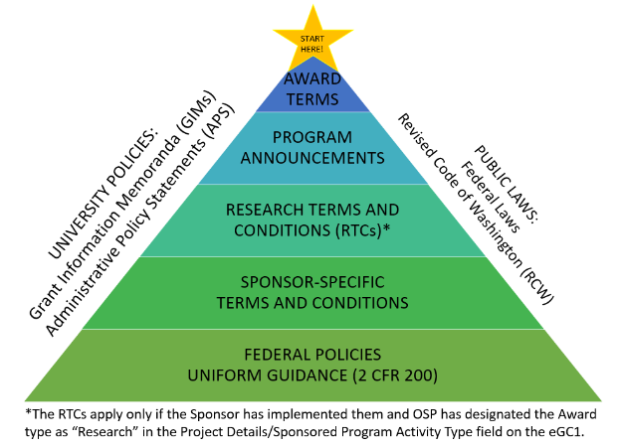
Travel on Sponsored Awards, Cont’d
Travel costs must comply with both the sponsor’s terms and conditions and UW Travel policy.
MRAM – Matt Gardner – PAFC

Slide 4
Travel on Sponsored Awards, Cont’d
Many sponsors require recipients to follow their institutions’ travel policies with respect to allowable costs
In those instances, consult UW Travel policies:
https://finance.uw.edu/travel/homepage

Slide 5
Travel on Federal Sponsored Awards
Federal regulations require recipients to follow the “written travel reimbursement policies” of the institution… with two specific exceptions:
Class of commercial air travel, and
Use of a U.S.-flag carrier (Fly America Act)
An individual federal agency or award may include additional restrictions or limitations
Always read your award and sponsor terms and conditions
MRAM – Matt Gardner – PAFC

Slide 6
Class of Travel on Federal Awards
Regulations require purchasing the least expensive class of travel – typically called “economy”
Exceptions may be found in 2 CFR 200.475(e)
The “least expensive unrestricted airfare” is allowable
Refundable tickets are an allowable cost
Non-refundable tickets are allowable if the ticket is used
If a non-refundable ticket is purchased and the travel does not occur, the cost may not be charged to the Award
MRAM – Matt Gardner – PAFC

Slide 7
The Myth of the “14-Hour Rule”
Under the Uniform Guidance (2 CFR 200), the length of the flight is not an exception to the requirement to purchase the least expensive unrestricted ticket
The Federal Travel Regulations (“FTR”) contain the “14-hour rule” but the FTR seat class rules do not apply to federal sponsored awards – the Uniform Guidance applies
There are many, many (many) federal regulations – recipients must apply the regulations specific to sponsored awards
MRAM – Matt Gardner – PAFC
Notes:
FAR Subpart 31.3 requires educational institutions which have contracts with the federal government to follow 2 CFR 200, the Uniform Guidance, with respect to the principles for determining the cost of research and development, training, and other work performed by educational institutions under contracts with the Government.”

Slide 8
The Fly America Act (“FAA”)
All airfare must comply with the FAA (domestic and international flights) requiring the use of a U.S.-flag carrier
The FAA includes allowances for itinerary-specific exemptions and for eligible flights (e.g., code-share and Open Skies agreements)
Cost of the ticket is NOT an exception to the FAA
Compliance with the FAA must be documented at the time of purchase, not retroactively. Which means…
MRAM – Matt Gardner – PAFC

Slide 9
Compliance with the FAA
Compliance for individual flights can only be determined with access to all available flight options and up to date information on Code Share and Open Skies agreements
PAFC does not have access to this information and cannot confirm if your itinerary is FAA compliant
Work with a UW-approved travel agent to ensure compliance

Slide 10
Travel Tips on Federal Awards
Approval is not required; auditors look for “notice”
Include a description of the travel in the proposal budget, along with a justification as to how the travel benefits the award
If travel was not included in the proposal, mention the travel in any subsequent progress reports to the sponsor

Slide 11
More Travel Tips for Federal Awards
The travel must benefit the objectives of the award, not the individual
If it’s not clear how the travel benefits the objectives of the award, document the justification in progress reports and other award files
Seat fees and upgrades are not an allowable cost on federal awards and must be covered by:
Non-sponsored funds (if reimbursable under UW policy), or
The traveler

Slide 12
Additional Travel Tips
Any “personal time/travel” must be removed from the total costs
Example: If an individual flies into a conference a day early to see family, the associated meals and hotel costs for the extra day do not benefit the sponsored award
All travel costs must benefit the objectives of the award; additional costs incurred due to “personal time/travel” do not benefit the award and are unallowable
All travel must occur during the period of performance

Slide 13
The Holy Grail of Travel Audit Findings!
Travel that benefited the PI, but not the award
Re-budgeting travel from $2,200 to $29,000 after NSF cut the proposed budget from $6,000(!)
Internal Audit finding of $2,477 of unallowable charges, including:
Business class airfare
Costs related to “personal time”

Slide 14
References
PAFC : https://finance.uw.edu/pafc/travel
UW Travel: https://finance.uw.edu/travel/homepage
Uniform Guidance: 2 CFR 200.475
Fly America Act: https://www.gsa.gov/policy-regulations/policy/travel-management-policy/fly-america-act

Slide 15
Questions
Post Award Fiscal Compliance (PAFC)
gcafco@uw.edu
https://finance.uw.edu/pafc/
Matt Gardner
mgard4@uw.edu
206-543-2610
Available on Teams and Zoom
MRAM – Matt Gardner – PAFC

