Slide 1
MRAM | Monthly Research Administration Meeting
January 12, 2023 9:00 AM – 10:30 AM Join the meeting remotely: https://washington.zoom.us/j/346891888
TOPIC | PRESENTER | EMAIL | MIN
Welcome | Kirsten DeFries Research Compliance & Operations | kirsten5@uw.edu | 2
SAGE training resources/highlights | Emily Elliot Office of Research Information Services | emilye@uw.edu | 5
Reopening Awards for Late Costs | Azalea Vasquez Grant & Contract Accounting | gcahelp@ue.edu | 10
Update on the F&A Rate Base Year | Colleen Bettis Management Accounting & Analysis | mcbettis@uw.edu | 10
Updates: Outside Activities, FCOI, and Foreign Influence | Melissa Petersen Office of Research | petermm@uw.edu | 5
CORE Update | Laurie Stephan Collaborative On Research Education (CORE) | corehelp@uw.edu | 2
UWFT Demo and Q&A: Cost Share Reports in Workday | Jesse Rice, Nicole Flagg UW Finance Transformation | jrice19@uw.edu nicole@uw.edu | 60
NEXT MEETING February 9, 2023 9:00 AM - 10:00 AM

Slide 2
Live Closed Captioning is now available
Live transcription and closed captions are enabled via the “CC/Transcript” button in your Zoom window.
Recordings of our sessions, with manually edited closed captions, are typically available within a week after the meeting, and a link is emailed with the post-session Q&A.
If you have any issues or questions, please let us know at mramques@uw.edu

Slide 3
NEW SAGE BUDGET RESOURCES
UWFT for the Research Community
Emily Elliott, Office of Research Information Services (ORIS)

Slide 4
SAGE BUDGET VIRTUAL OFFICE HOURS
Bring your beginner, advanced, and everything in between SAGE Budget-related questions. Our SAGE experts will be on-hand twice a month for office hours starting this afternoon!
January
1/12/23, 1-2 pm
1/26/23, 11-noon
March
3/9/23, 1-2 pm
3/23/23, 11-noon
February
2/9/23, 1-2 pm
2/23/23, 11-noon
April
4/6/23, 1-2 pm
4/20/23, 11-noon
The office hours schedule and Zoom links are available on the Research Website.

Slide 5
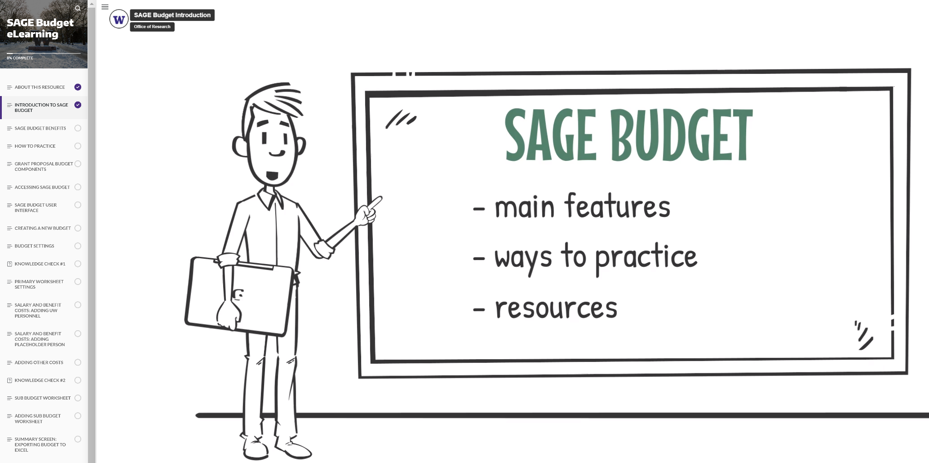
SAGE BUDGET ELEARNING
A new self-paced SAGE Budget eLearning resource is now available for your exploration. This companion piece to the live SAGE Budget course allows you to focus on specific content when you need it!
This resource is not a substitution for the live course and does not count toward fulfilling certificate requirements.

Slide 6
SAGE BUDGET LIVE CLASSES
SAGE Budget live classes (via Zoom) are typically offered quarterly through CORE. Mark your calendar and register for an upcoming class.
January
1/29/23, 1:30-3:30 pm (waitlist)
February
2/21/23, 1:30-3:30 pm
March
3/16/23, 1:30-3:30 pm

Slide 7
Reopening Awards for Late Costs
Azalea Vasquez, Grant and Contract Accounting
MRAM
January 12, 2023

Slide 8
NIH Closeout Compliance
July 2013 - NIH announces PMS Subaccounts.
Allowing NIH to monitor draws by award, and to enforce close-out deadlines
June 2021 – Notice Number NOT-OD-21-128 is released
Guidance for revising an FFR for a closed PMS subaccount

Slide 9
Requests to Reopen PMS Subaccounts
The UW has submitted numerous requests to NIH since the change in June 2021 to reopen closed PMS Subaccounts
NIH has noticed and is starting to deny these requests
Our justifications are being scrutinized

Slide 10
What is at Stake?
Our reputation
Not meeting grant requirements
Cannot account for grant funds properly
Expanded Authorities
Waiver of prior approvals can be revoked

Slide 11
Request to Reopen Awards after FAD
Effective Immediately, requests to reopen (or keep open) a budget after the Final Action Date will require additional justification:
Why is this charge posting late?
How will this situation be avoided in the future?
Department budget to transfer the deficit to if the request is denied

Slide 12
Request to Reopen Awards after FAD
If your justification cites low staffing or lack of training as the reason, your request will be denied.
NIH is denying our requests when we list this as a reason for late posting charges.

Slide 13
GCA Final Report and Final Invoice Process
If we reopen your budget the late charges/credits must post by the new deadline.
Initial final Financial Report and/or Invoice will be submitted on time by GCA.
We will not hold for pending charges
Reduce the risk of:
Non-compliance with grant terms
Non-payment by sponsor

Slide 14
In Conclusion
Sponsors do not like late posting charges
Expenditures must post by the Final Action Date if they need to be included on a Final Financial Report and/or Final Invoice
Additional justification is now required to reopen or keep open a budget past the Final Action Date

Slide 15
Questions
Please contact GCA at gcahelp@uw.edu

Slide 16
F&A Rate Proposal Project Update
MRAM
January 12, 2023
Colleen Bettis, Director MAA
Sponsored Programs Finance
UW Finance

Slide 17
Agenda
Project Update
Year in Review
Space Inventory
Financials Validation
Timeline
Next Steps
Training
Space Survey
Questions

Slide 18
Project Update
Practice Year in Review
Outcomes
Reconciled to financial statements
Updated cost pool algorithm
Developed SQL code for base year data
Established space survey threshold
Lessons Learned
Revised data mapping since FY13
Refined inventory processes: InVision/WebSpace

Slide 19
Project Update
Base Year: Space Inventory - Complete
8-week initiative, concluded 11/30
InVision vs. WebSpace
Partnership with Facilities

Slide 20
Project Update
Base Year: Space Inventory - Outcomes
Participation
70 departments from 11 Schools/Colleges
124 system users
Room Updates
9,736 rooms, or 11% of all UW space was updated
951 previously unclassified rooms were assigned primary use
Assignable Square Feet
221,500 additional square feet identified as research space
Represents 10% increase

Slide 21
Project Update
Base Year: Financials Validation
Cost Pools
990 assigned since OCT
709 budgets assigned during practice year
Refining Practice Year Model
Refining cost pools
Updating allocation methods for costs

Slide 22
Timeline

Slide 23
Next Steps
Space Survey
WebSpace Training
Inventory Training
Early January 2023
Survey Training
Late January 2023
Survey
Completed in Webspace
Feb-April 2023

Slide 24
Questions?
Thank you for your time!
fahelp@uw.edu

Slide 25
Outside Activities,
Financial Conflicts of Interest, and Foreign Influence
MRAM
January 2023
Melissa Petersen
Office of Research

Slide 26
Outside Activities – Policy Reminder
Faculty, Librarians, and Other Academic Personnel (Residents and fellows, Postdoctoral scholars, Academic staff). Approvals required annually.
Executive Order No. 57
Professional Staff, Classified Staff (both Contract Classified and Classified Non-Union), Student Employees, Academic Student Employees, and Other Staff Exempt from Civil Service. Administrative Policy Statement 47.3
MRAM – Melissa Petersen – Office of Research

Slide 27
Financial Conflicts of Interest (FCOI)
UW policy (GIM 10) and guidance updates coming soon.
NIH announced areas of emphasis for oversight in 2023, subrecipient compliance and FCOI included.
We may still see more changes…
MRAM – Melissa Petersen – Office of Research

Slide 28
Foreign Influence (yes, it’s still a ‘thing’)
Science (Nature) Global science must not be treated as a diplomatic pawn
Government (U.S. Senate) Senate Passes Peters and Grassley Bipartisan Legislation to Help Prevent Foreign Influence in U.S. Policy
MRAM – Melissa Petersen – Office of Research

Slide 29
Example & Contact
Example: NIH Notice of Award indicated that an Investigator was restricted pending submission documents in support of a consulting position listed only on their Biosketch – caused a 2-week delay.
Office of Research – SFI and Outside Work
research@uw.edu / work1460@uw.edu
Office of Sponsored Programs – Biosketch; Other Support; Other, Current, & Pending Support (resource)
osp@uw.edu, Contact Us
MRAM – Melissa Petersen – Office of Research

Slide 30
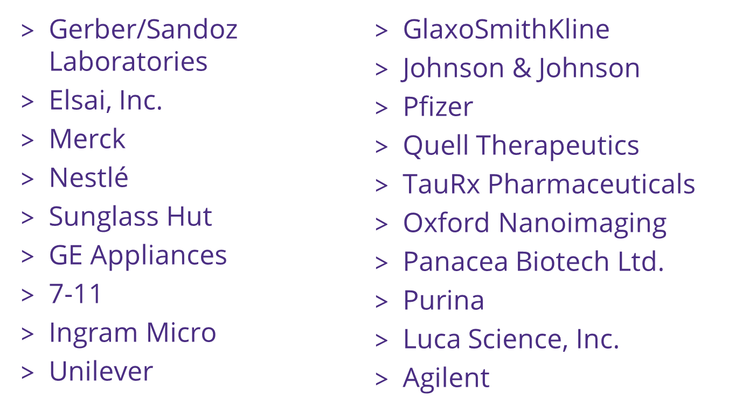
Foreign or Domestic?
MRAM – Melissa Petersen – Office of Research

Slide 31
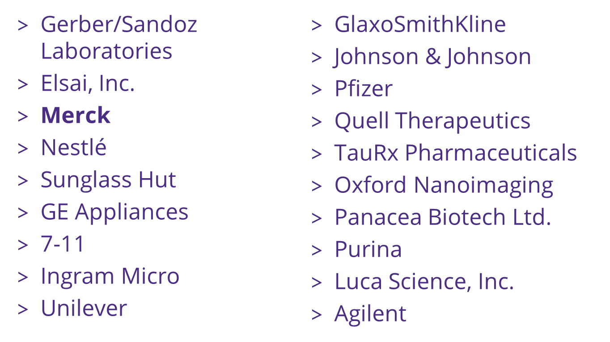
Foreign or Domestic?
MRAM – Melissa Petersen – Office of Research

Slide 32
Updates
Winter 2023 schedule published
All live courses scheduled
All offered via Zoom, be sure to take advantage of these courses offered once a quarter
FT and the CORE curriculum
Analysis of FT impacts underway
Compliance focused courses little change
Process/systems courses significant change
CORE Registration:
https://uwresearch.gosignmeup.com/public/course/browse
CORE Home: https://www.washington.edu/research/training/core/

Slide 33
COST SHARE & REPORTING IN WORKDAY
Presenters:
Nicole Flagg, Business Analyst, UWFT
Jesse Rice, Systems Analyst, UWFT

Slide 34
Agenda
Cost Share Overview with Matt Gardener
Demo in Workday
Q&A

Slide 35
Cost Share Defined
A quantified portion of the costs of an Award that are not paid by the sponsor, but paid instead using resources within a department, school/college, or other party outside of the UW.
Cost Share is a commitment, either required by the Sponsor or proposed (volunteered) by the PI, to use resources other than the Award itself for completion of the Award objectives.
MRAM – Matt Gardner – PAFC

Slide 36
Cost Share Defined
Mandatory if required by the sponsor
Voluntary if included in the proposal
Today’s discussion of cost share in Workday concerns Mandatory and Voluntary cost share only
MRAM – Matt Gardner – PAFC

Slide 37
What is not a part of today’s demo?
Salary Cap compliance
K Award effort requirements
Shifts in Funding Sources
Leveraging
MRAM – Matt Gardner – PAFC

Slide 38
Changes when Cost Share moves to Workday
The current eFECS systems will be retired
Faculty effort cost share will not be linked to the FEC process
The “tagging” process will no longer exist for non-FEC cost share
Non-FEC cost share contributions will be documented in Workday

Slide 39
Cost Share Demo

Slide 40
Examples in Workday
Award Structure
AWD-008626
Budget vs. Actual
AWD-000923
GR021820
View Project
PJ020006
View Funding Source Rule
PJ100033
PJ020006
Faculty Costing Allocation
Dan Fu

Slide 41
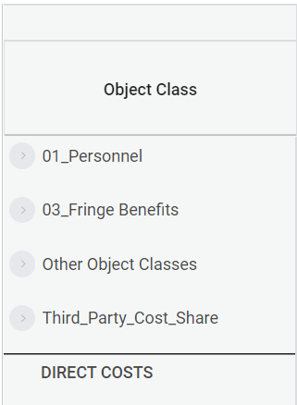
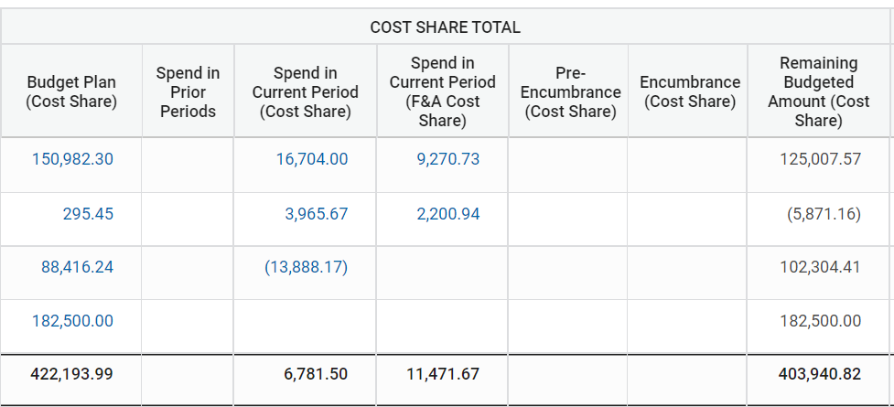
Cost Share on Budget Vs. Actual
5,000.91
2,775.51
80,639.82
25,670.58
14,247.18
382,276.23

Slide 42
Costing Allocation

Slide 43
Q&A

