Slide 1
NEW SAGE BUDGET RESOURCES
UWFT for the Research Community
Emily Elliott, Office of Research Information Services (ORIS)

Slide 2

SAGE BUDGET VIRTUAL OFFICE HOURS
Bring your beginner, advanced, and everything in between SAGE Budget-related questions. Our SAGE experts will be on-hand twice a month for office hours starting this afternoon!
January
1/12/23, 1-2 pm
1/26/23, 11-noon
March
3/9/23, 1-2 pm
3/23/23, 11-noon
February
2/9/23, 1-2 pm
2/23/23, 11-noon
April
4/6/23, 1-2 pm
4/20/23, 11-noon
The office hours schedule and Zoom links are available on the Research Website.

Slide 3
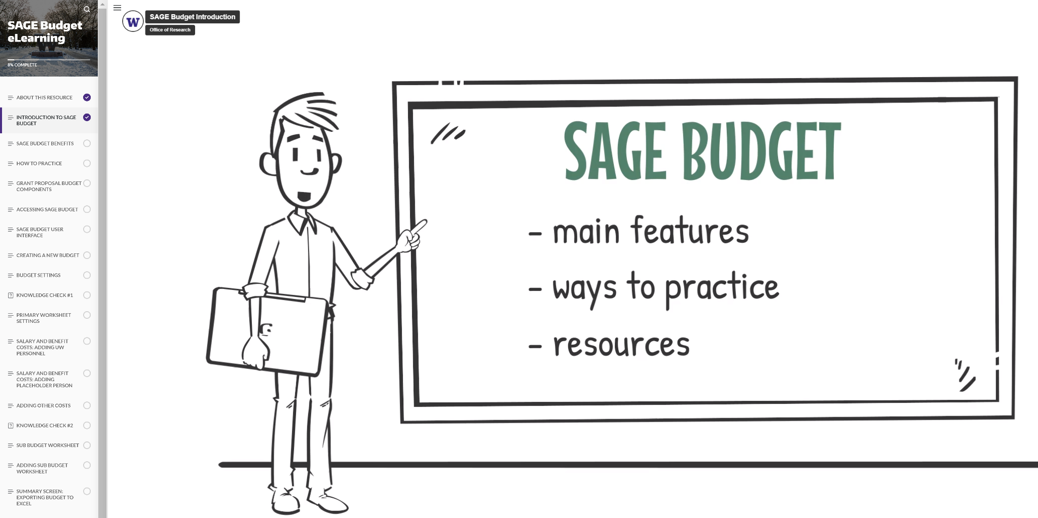
SAGE BUDGET ELEARNING
A new self-paced SAGE Budget eLearning resource is now available for your exploration. This companion piece to the live SAGE Budget course allows you to focus on specific content when you need it!
This resource is not a substitution for the live course and does not count toward fulfilling certificate requirements.

Slide 4

SAGE BUDGET LIVE CLASSES
SAGE Budget live classes (via Zoom) are typically offered quarterly through CORE. Mark your calendar and register for an upcoming class.
January
1/29/23, 1:30-3:30 pm (waitlist)
February
2/21/23, 1:30-3:30 pm
March
3/16/23, 1:30-3:30 pm

