Slide 1
Outside Activities,
Financial Conflicts of Interest, and Foreign Influence
MRAM
January 2023
Melissa Petersen
Office of Research

Slide 2
Outside Activities – Policy Reminder
Faculty, Librarians, and Other Academic Personnel (Residents and fellows, Postdoctoral scholars, Academic staff). Approvals required annually.
Executive Order No. 57
Professional Staff, Classified Staff (both Contract Classified and Classified Non-Union), Student Employees, Academic Student Employees, and Other Staff Exempt from Civil Service. Administrative Policy Statement 47.3
MRAM – Melissa Petersen – Office of Research

Slide 3
Financial Conflicts of Interest (FCOI)
UW policy (GIM 10) and guidance updates coming soon.
NIH announced areas of emphasis for oversight in 2023, subrecipient compliance and FCOI included.
We may still see more changes…
MRAM – Melissa Petersen – Office of Research

Slide 4
Foreign Influence (yes, it’s still a ‘thing’)
Science (Nature) Global science must not be treated as a diplomatic pawn
Government (U.S. Senate) Senate Passes Peters and Grassley Bipartisan Legislation to Help Prevent Foreign Influence in U.S. Policy
MRAM – Melissa Petersen – Office of Research

Slide 5
Example & Contact
Example: NIH Notice of Award indicated that an Investigator was restricted pending submission documents in support of a consulting position listed only on their Biosketch – caused a 2-week delay.
Office of Research – SFI and Outside Work
research@uw.edu / work1460@uw.edu
Office of Sponsored Programs – Biosketch; Other Support; Other, Current, & Pending Support (resource)
osp@uw.edu, Contact Us
MRAM – Melissa Petersen – Office of Research

Slide 6
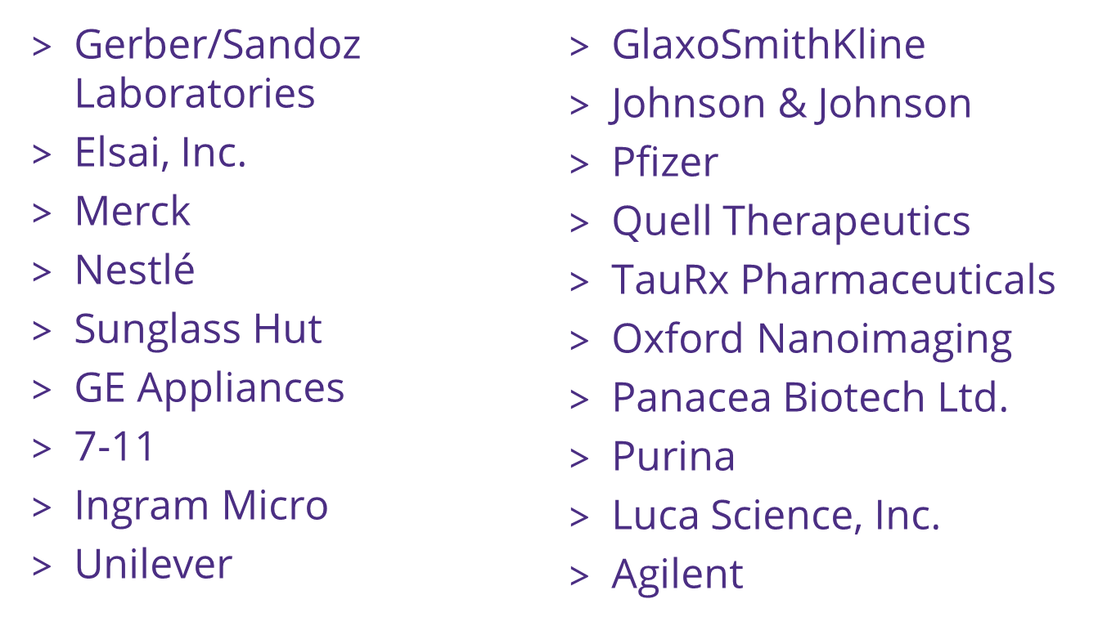
Foreign or Domestic?
MRAM – Melissa Petersen – Office of Research

Slide 7
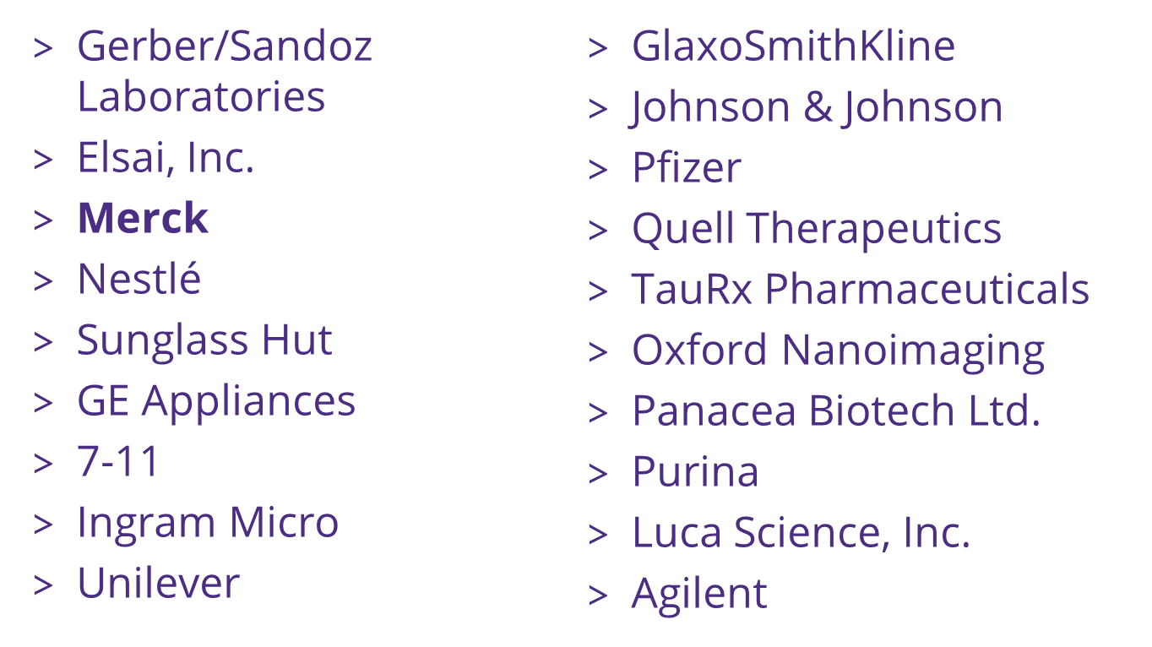
Foreign or Domestic?
MRAM – Melissa Petersen – Office of Research

