Slide 1
COST SHARE & REPORTING IN WORKDAY
Presenters:
Nicole Flagg, Business Analyst, UWFT
Jesse Rice, Systems Analyst, UWFT

Slide 2
Agenda
Cost Share Overview with Matt Gardener
Demo in Workday
Q&A

Slide 3
Cost Share Defined
A quantified portion of the costs of an Award that are not paid by the sponsor, but paid instead using resources within a department, school/college, or other party outside of the UW.
Cost Share is a commitment, either required by the Sponsor or proposed (volunteered) by the PI, to use resources other than the Award itself for completion of the Award objectives.
MRAM – Matt Gardner – PAFC

Slide 4
Cost Share Defined
Mandatory if required by the sponsor
Voluntary if included in the proposal
Today’s discussion of cost share in Workday concerns Mandatory and Voluntary cost share only
MRAM – Matt Gardner – PAFC

Slide 5
What is not a part of today’s demo?
Salary Cap compliance
K Award effort requirements
Shifts in Funding Sources
Leveraging
MRAM – Matt Gardner – PAFC

Slide 6
Changes when Cost Share moves to Workday
The current eFECS systems will be retired
Faculty effort cost share will not be linked to the FEC process
The “tagging” process will no longer exist for non-FEC cost share
Non-FEC cost share contributions will be documented in Workday

Slide 7
Cost Share Demo

Slide 8
Examples in Workday
Award Structure
AWD-008626
Budget vs. Actual
AWD-000923
GR021820
View Project
PJ020006
View Funding Source Rule
PJ100033
PJ020006
Faculty Costing Allocation
Dan Fu

Slide 9
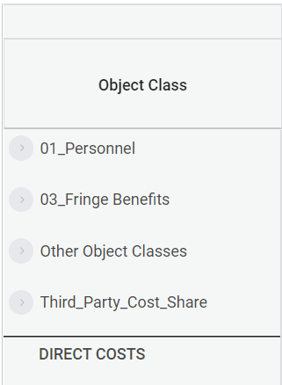
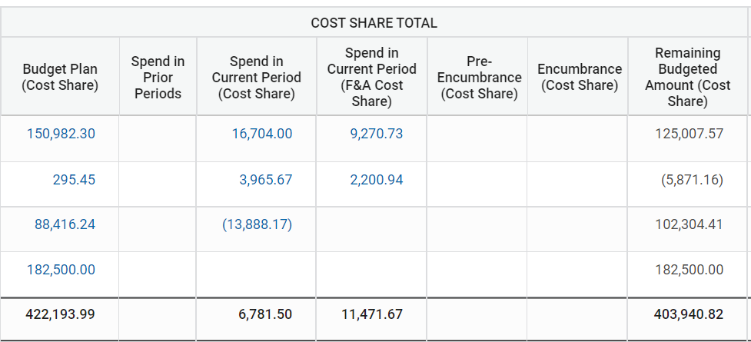
Cost Share on Budget Vs. Actual
5,000.91
2,775.51
80,639.82
25,670.58
14,247.18
382,276.23

Slide 10
Costing Allocation

Slide 11
Q&A

