Slide 1
MRAM | Monthly Research Administration Meeting
February 9, 2023 9:00 AM – 10:00 AM Join Webinar: https://washington.zoom.us/j/346891888
TOPIC | PRESENTER | EMAIL | MIN
Welcome | Carol Rhodes Office of Sponsored Programs | carhodes@uw.edu | 2
PAFC Hot Topic: Program Income, Federal Closeout Requirements | Matt Gardner Post Award Fiscal Compliance | gcafco@uw.edu | 10
Subaward Invoices | Josy Combs Office of Sponsored Programs | combsj3@uw.edu | 5
Affiliate Faculty | Joe Giffels Office of Research | jgiffels@uw.edu | 5
Integrity of Peer Review | Joe Giffels Office of Research | jgiffels@uw.edu | 5
SAGE Award - Demo | Amanda Snyder Office of Sponsored Programs | acs229@uw.edu | 20
NEXT MEETING March 9, 2023 9:00 AM - 10:00 AM

Slide 2
Live Closed Captioning is now available
Live transcription and closed captions are enabled via the “CC/Transcript” button in your Zoom window.
Recordings of our sessions, with manually edited closed captions, are typically available within a week after the meeting, and a link is emailed with the post-session Q&A.
If you have any issues or questions, please let us know at mramques@uw.edu

Slide 3
COMPLIANCE HOT TOPIC: PROGRAM INCOME
MRAM
February 2023
Matt Gardner
Post Award Fiscal Compliance

Slide 4
Program Income Defined
Gross income earned by the non-Federal entity that is directly generated by a supported activity or earned as a result of the Federal award during the period of performance.
Applicable to Federal Awards only
MRAM – Matt Gardner – PAFC

Slide 5
Program Income – Key Concepts
Program Income belongs to the federal sponsor – not the UW, PI, Dept., etc.
Program Income can be used to:
Offset expenditures related to the generation of the income, or
Can be used towards the award objectives, subject to the same cost principles, terms and conditions.
MRAM – Matt Gardner – PAFC

Slide 6
Program Income – Key Concepts
How to view Program Income:
Earning a dollar of Program Income should be viewed the same as if the federal sponsor awarded an additional dollar to your budget.
MRAM – Matt Gardner – PAFC

Slide 7
Program Income – Key Concepts
Federal regulations require recipients to disburse funds earned from Program Income before requesting payments (2 CFR 200.305(b)(5))
Translation: Surplus program income may be used to support the award or must be used to offset the federal share of expenditures.
MRAM – Matt Gardner – PAFC

Slide 8
Program Income Closeout
In order to ensure separate and accurate accounting:
If there is a non-competing continuation budget, the Program Income budget may become a sub budget under the continuation parent
Program Income sub budget is closed out, with the parent, at the end of the Award or a competing segment
New program income sub budgets are required at the start of a new competitive segment
MRAM – Matt Gardner – PAFC

Slide 9
Revised Program Income Request Form
Form is required any time a new Program Income sub budget is needed
New Question:
“If rates were determined by a departmental study, have the rates been reviewed by Management Accounting & Analysis (MAA) in the last two years?”
If the answer is “no,” then a rate review by the MAA Recharge team is required.

Slide 10
References
PAFC: https://finance.uw.edu/pafc/program-income
GCA: https://finance.uw.edu/gca/award-lifecycle/budget-setup/program-income-guidelines
Program Income Request Form (on GCA Program Income webpage):
https://finance.uw.edu/gca/award-lifecycle/budget-setup/program-income-guidelines#request-form
Uniform Guidance (2 CFR 200):
200.180
200.305(b)(5)
200.370
MRAM – Matt Gardner – PAFC

Slide 11
FEDERAL CLOSEOUT REQUIREMENTS

Slide 12
Uniform Guidance Requirements
2 CFR 200.344 Closeout
“(a) The recipient must submit, no later than 120 calendar days after the end date of the period of performance, all financial, performance, and other reports as required by the terms and conditions of the Federal award…”
Reports include:
SF425 Financial Report
Progress or technical reports
Invention statements
Any other report required by the sponsor
MRAM – Matt Gardner – PAFC

Slide 13
2 CFR 200.344(a) Closeout (Continued)
200.344(a) (Continued)
“…A subrecipient must submit to the pass-through entity, no later than 90 calendar days (or an earlier date as agreed upon by the pass-through entity and subrecipient) after the end date of the period of performance, all financial, performance, and other reports as required by the terms and conditions of the Federal award…”
The federal regulations also cover sub closeout.
A sub agreement can state a shorter closeout period (e.g. 60 days).
MRAM – Matt Gardner – PAFC

Slide 14
2 CFR 200.344(a) Closeout (Continued)
200.344(a) (Continued)
“…The Federal awarding agency or pass-through entity may approve extensions when requested and justified by the non-Federal entity, as applicable.”
The proper way to manage delays in closeout is to request a No-Cost Extension from the sponsor.
If a NCE is not available or not approved, it is up to the recipient to closeout the Award in compliance with the regulations and the sponsor’s terms and conditions.
MRAM – Matt Gardner – PAFC

Slide 15
Reminders
A federal agency can impose stricter closeout conditions than the Uniform Guidance.
Always read/understand your Notice of Award, along with the applicable agency terms and conditions
All closeout actions must occur for the Award to be considered closed in the eyes of the sponsor.
Reports (financial or technical)
Deliverables
Cost Share
MRAM – Matt Gardner – PAFC

Slide 16
Questions
Post Award Fiscal Compliance (PAFC)
gcafco@uw.edu
https://finance.uw.edu/pafc/
Matt Gardner
mgard4@uw.edu
206-543-2610
MRAM – Matt Gardner – PAFC

Slide 17
Subaward Invoices
February 2023 MRAM
Josy Combs, Manager Subaward Team
Office of Sponsored Programs

Slide 18
Subrecipient Monitoring
OSP is aware that late subrecipient invoices have been an issue.
Reminders and best practices:
Project-level subrecipient monitoring is responsibility of PI
Subrecipient invoices are a key tool in project level monitoring
Timely submission and review of invoices is important

Slide 19
What is timely?
FDP subawards
Monthly, but at least quarterly
Final - 60 days after end date
UW template
At least quarterly
higher-risk organizations - monthly
Final - 60 days after end date
If your project requires other invoicing terms, mention need for alternate invoicing terms in the SAGE Subaward Request form.

Slide 20
What to do about late subrecipient invoices
Follow up and work with the subrecipient to catch up on late invoices.
If late invoices continue to be an issue, reach out to the OSP Subawards team.
ospsubs@uw.edu

Slide 21
Questions

Slide 22
Heads Up:
-Affiliate Faculty
-International Invitations
-Peer Review Breaches
MRAM
February 2023
Joe Giffels
Office of Research

Slide 23
Affiliate Faculty
Principal employment responsibilities lie outside the University (>0.5 UW FTE)
Typically hold faculty appointments at other academic institutions or work in industry
Compliance liabilities
For UW activities
For non-UW activities

Slide 24
International Invitations
Foreign Talent Programs

Slide 25
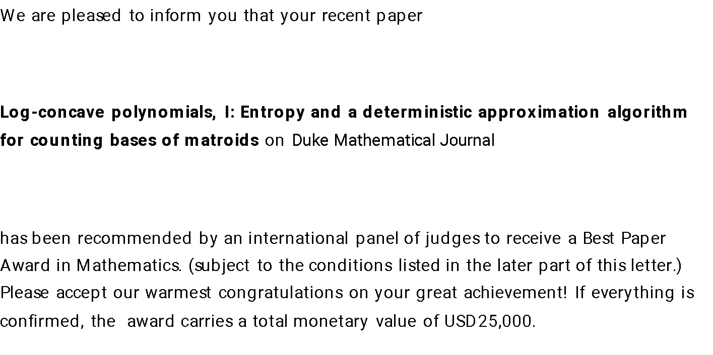
International Invitations
Paper or conference prizes

Slide 26
International Invitations
Foreign Talent Programs
Paper or Conference Prizes

Slide 27
Peer Review Breaches (NIH)
Study Sections / Scientific Review Groups
Maintaining Security and Confidentiality in NIH Peer Review: Rules, Responsibilities and Possible Consequences Notice Number: NOT-OD-22-044
Integrity and Confidentiality in NIH Peer Review
Applies to reviewers and applicants
Requirements and Prohibitions
Certifications (Confidentiality Agreement)
Penalties
Consequences
NIH is increasingly reaching out to institutions to investigate and respond to alleged breaches

Slide 28
SAGE AWARD DEMO
February 9, 2023
Amanda Snyder
Office of Sponsored Programs

Slide 29
AGENDA
Terminology
Benefits of SAGE Award Setup Request
Award Setup Request Overview
Demo
Awards Management
SAGE Award Training & Help Resources
Q&A: Use the Q&A button in Zoom

Slide 30
TERMINOLOGY
Award: In the context of SAGE and Workday, an award is defined as a sponsored program competitive segment of funding.
Award Setup Request: This is a form available in SAGE that collects information about the award after the Notice of Award (NoA) is received and funding is granted for a specific award.
SAGE Suite: The web-based system used by faculty, Principal Investigators, administrators, and staff to submit funding applications for consideration, route them electronically for approval, prepare budgets, request advance budget numbers, and initiate subawards. With the UW Finance Transformation, the SAGE Suite will also be used to set up and manage awards.
Notes:
Alternate Award definition: An agreement that memorializes the terms and conditions between the University and the sponsor, in which the sponsor supports a specific scope of work carried out by the University for organized research, instruction, or other sponsored activity in exchange for something of value, such as data, results, IP rights or technical reporting. (Knowledge Base)

Slide 31
AWARD SETUP REQUEST OVERVIEW

Slide 32
SAGE AWARD SETUP REQUEST | BENEFITS
New SAGE form and system functionality replaces email communications
A familiar, user-friendly experience in SAGE, similar to advance requests
Autofill of eGC1 and SAGE Budget information on award request forms
Shared views for award preparers and reviewers improves collaboration between campus, OSP, and GCA
Integrations with Workday streamlines award setup
Visibility into award status, history, and communication

Slide 33
AWARD SETUP REQUEST | HIGH-LEVEL OVERVIEW
NOA Received
(OSP)
Create SAGE Award Setup Request (OSP)
eGC1 Approved
Create/Update SAGE Award Setup Request (Campus)
Link SAGE eGC1 & Budget
Complete & Submit
OSP
Workday
NOA Received
(Campus)
Create SAGE Award Budget
GCA
LEGEND
Central Offices
Optional Returns
Receive Notification that Award is Ready!
Campus Units
Award Flow

Slide 34
AWARD SETUP REQUEST DEMO

Slide 35
SAGE AWARD SETUP REQUEST
Please Note
All screenshots in this presentation reflect works in progress. Details and final functionality may change during the course of implementation.

Slide 36
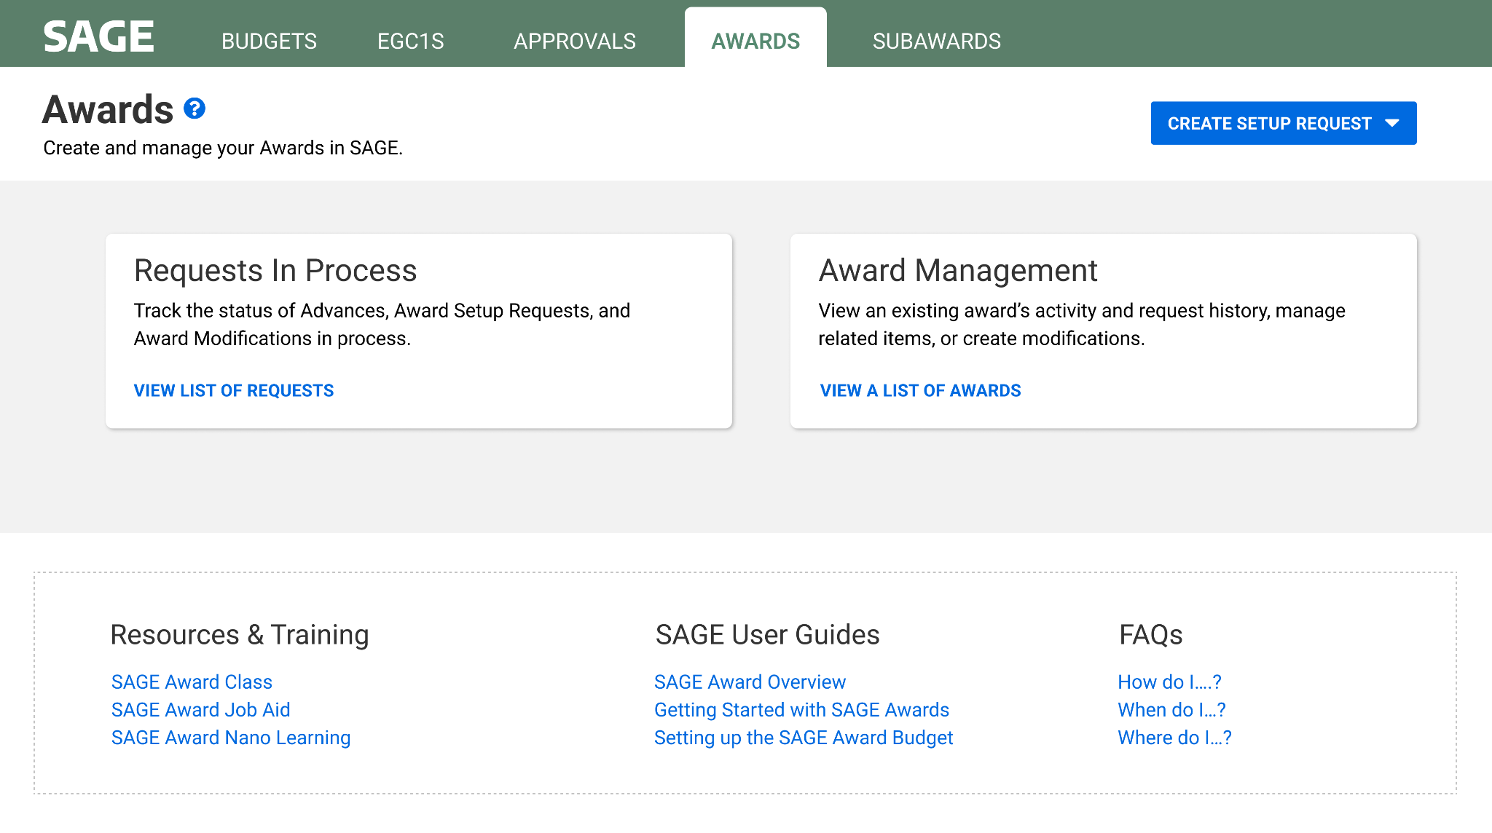
SAGE AWARD SETUP REQUEST | LANDING PAGE
Create an award setup request
Monitor existing awards and requests in process
Access links and resources

Slide 37
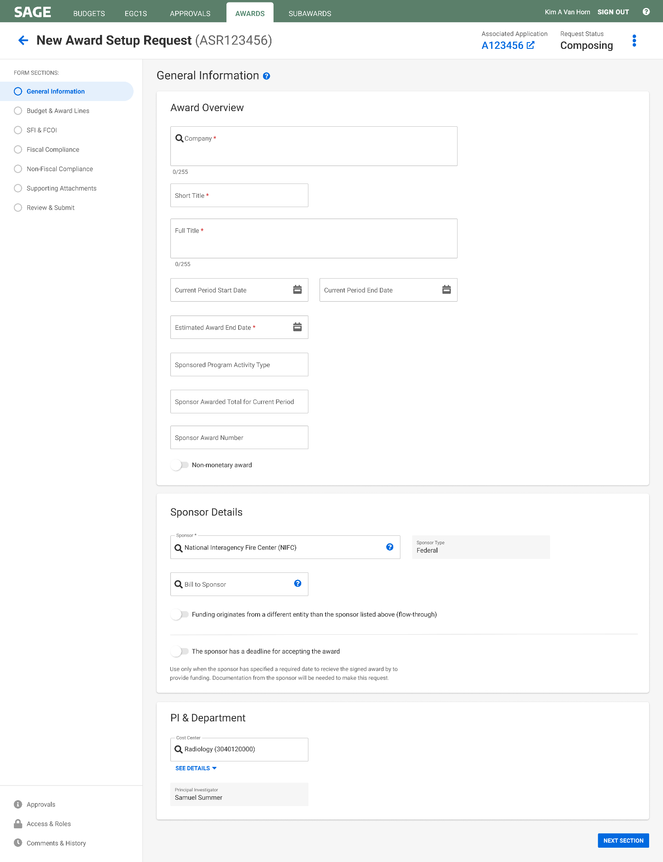
SAGE AWARD SETUP REQUEST | GENERAL INFORMATION
Fields will be pre-filled with information from linked eGC1
Navigation in SAGE Award is similar to SAGE Advances

Slide 38
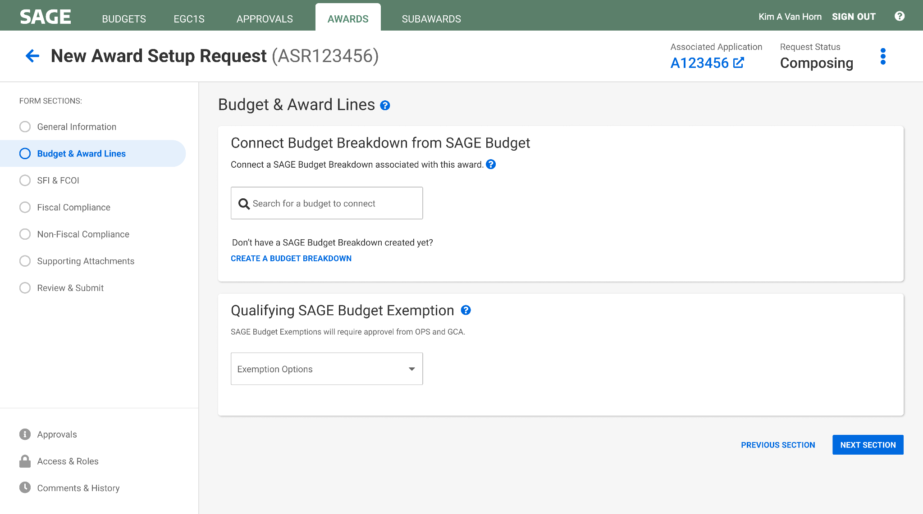
SAGE AWARD SETUP REQUEST | CREATE & LINK BUDGET

Slide 39
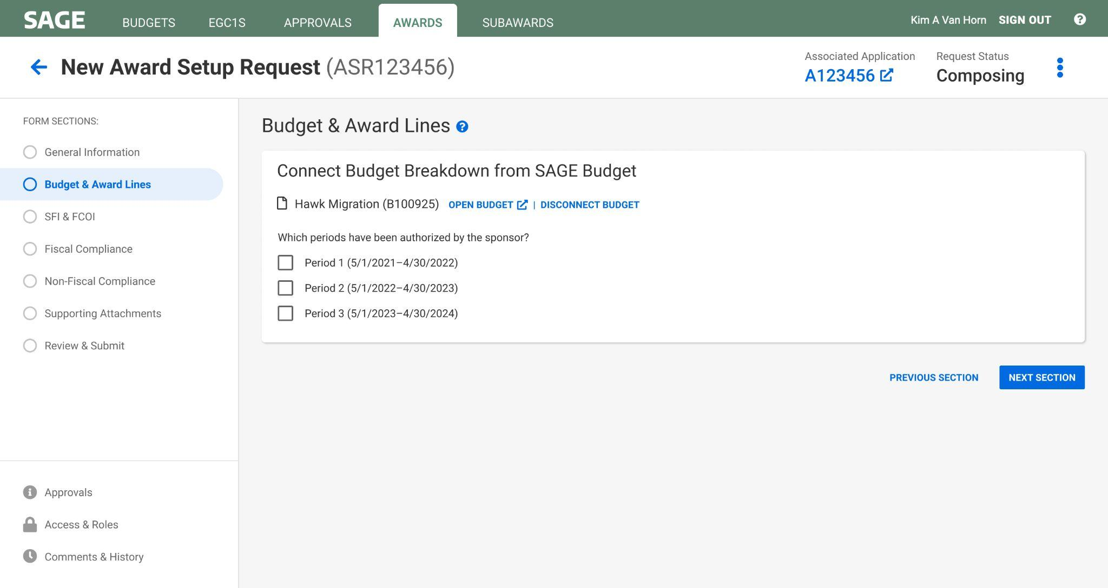
SAGE AWARD SETUP REQUEST | CREATE & LINK BUDGET

Slide 40
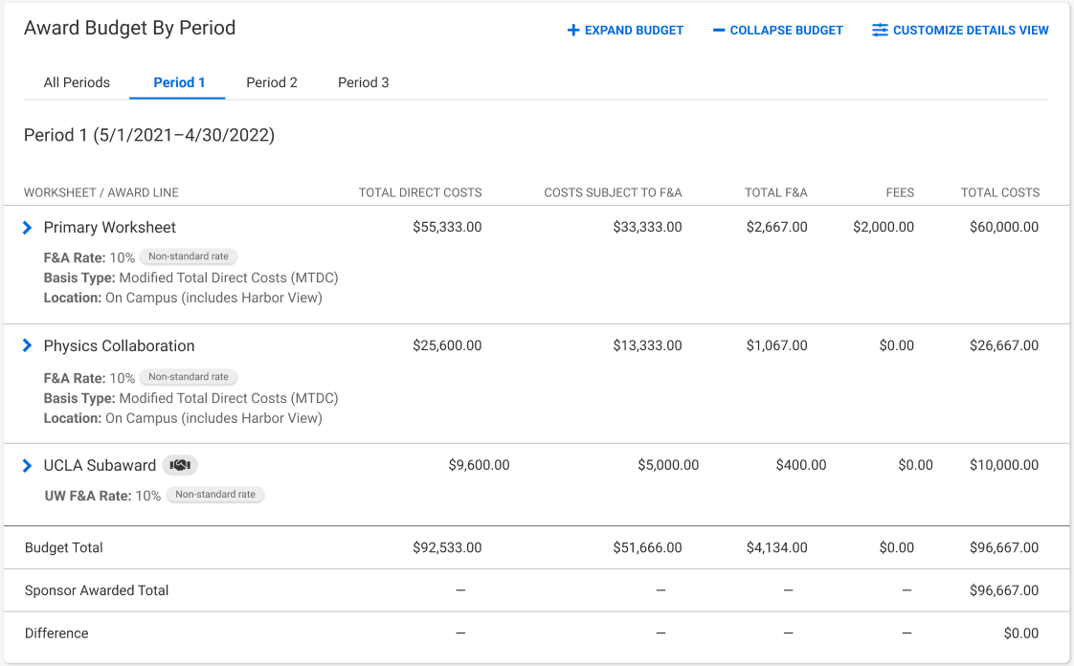
SAGE AWARD SETUP REQUEST | CREATE & LINK BUDGET

Slide 41
SAGE AWARD SETUP REQUEST | SFI & FCOI

Slide 42
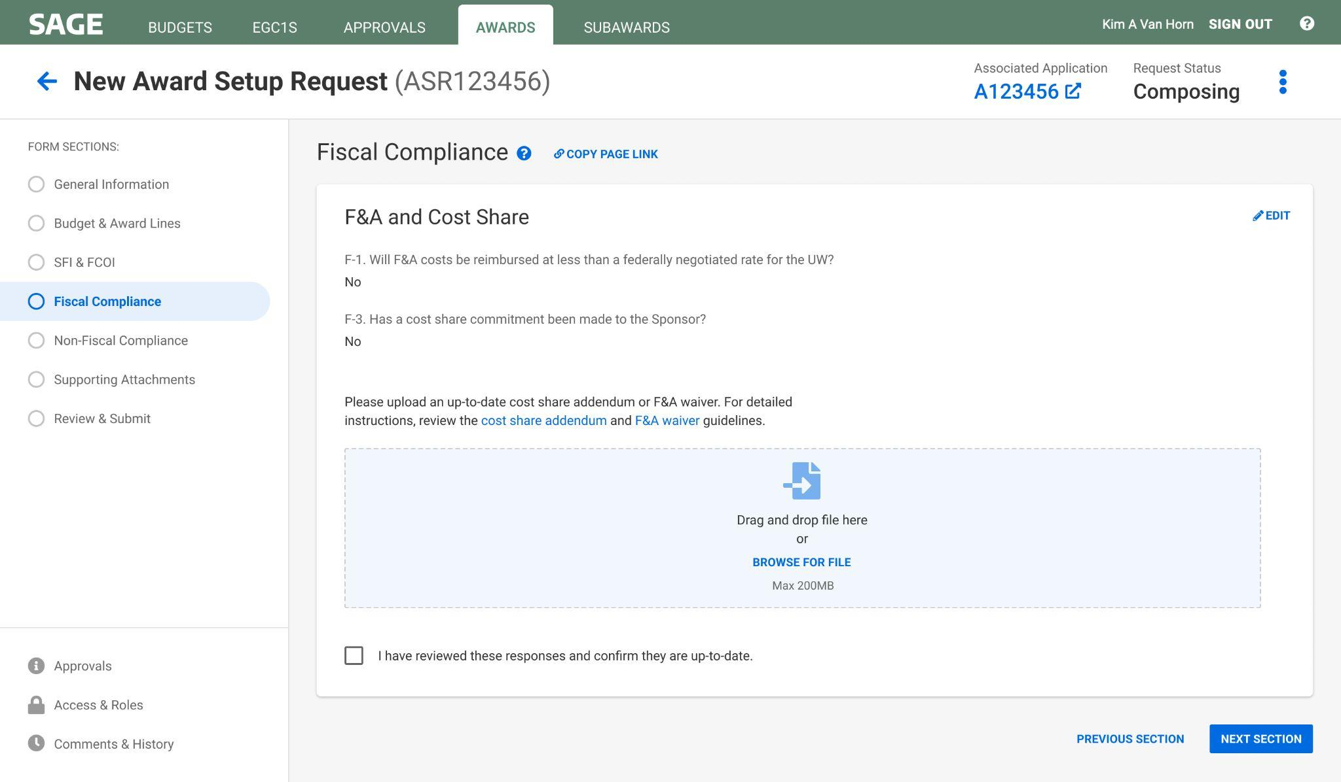
SAGE AWARD SETUP REQUEST | FISCAL COMPLIANCE

Slide 43
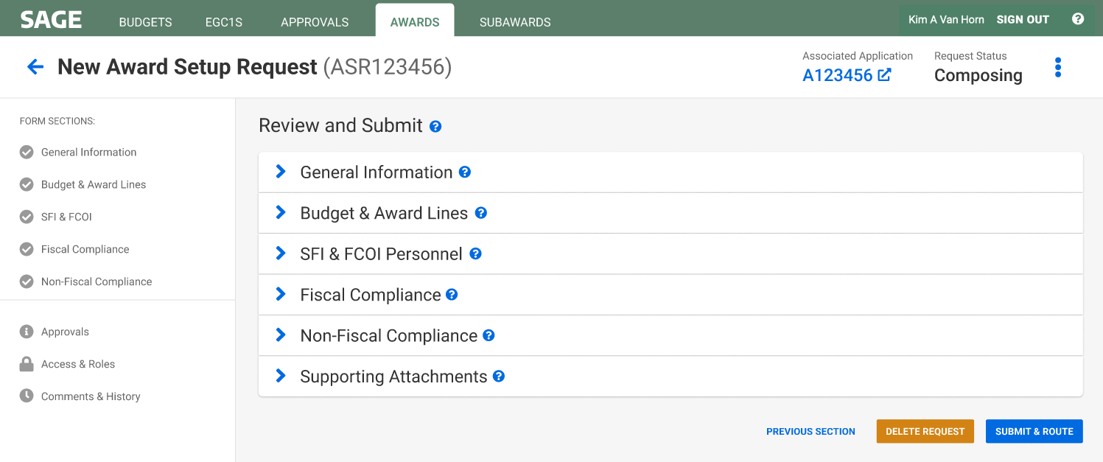
SAGE AWARD SETUP REQUEST | REVIEW & SUBMIT AWARD TO OSP

Slide 44
MANAGING YOUR AWARDS

Slide 45
MANAGING YOUR AWARDS | REQUESTS IN PROCESS
Monitor requests
in process

Slide 46
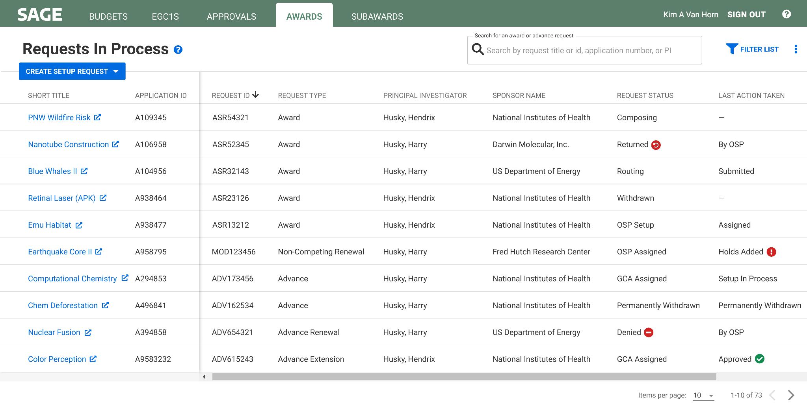
MANAGING YOUR AWARDS | REQUESTS IN PROCESS

Slide 47
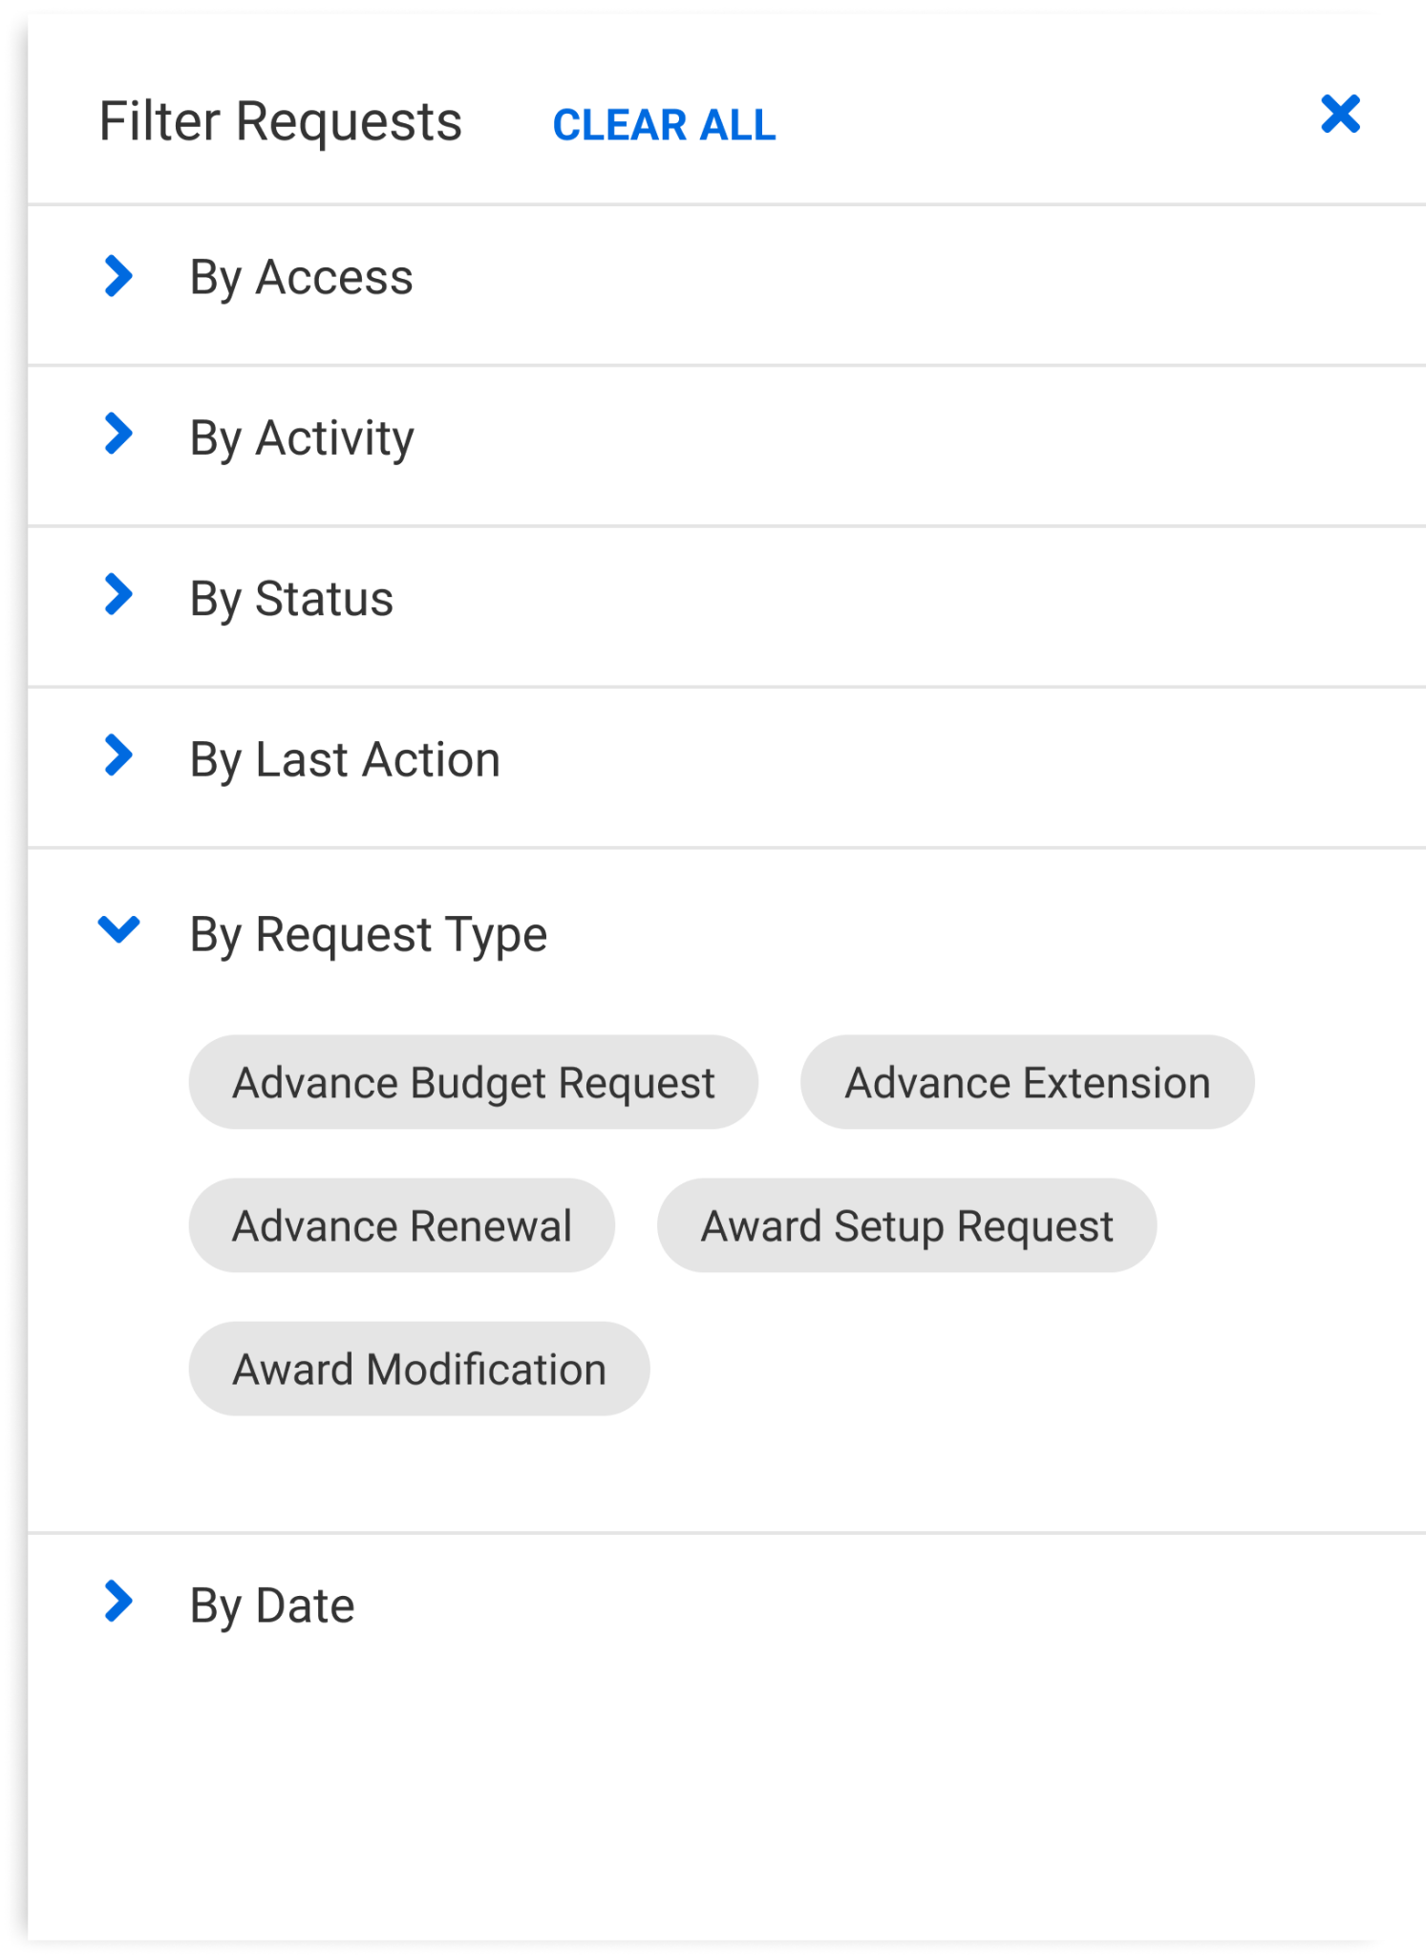
MANAGING YOUR AWARDS | FILTER REQUESTS IN PROCESS

Slide 48
MANAGING YOUR AWARDS | EXISTING AWARDS
Monitor existing awards

Slide 49
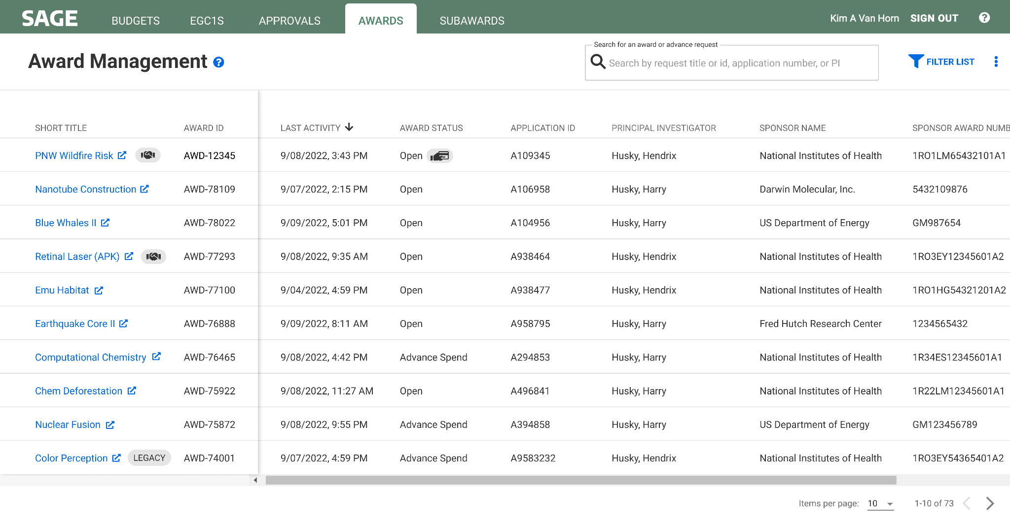
MANAGING YOUR AWARDS | AWARD MANAGEMENT
Links to Award Activity Record

Slide 50
MANAGING YOUR AWARDS | AWARD ACTIVITY RECORD
Screenshot 1 of 3. Scrolling down will show the “Actions & Requests” information on the following slide.

Slide 51
MANAGING YOUR AWARDS | AWARD ACTIVITY RECORD
Screenshot 2 of 3. Scrolling down will show the “Award Details” information on the following slide.

Slide 52
MANAGING YOUR AWARDS | AWARD ACTIVITY RECORD
Screenshot 3 of 3. This section concludes the Award Activity Record.

Slide 53
RESOURCES

Slide 54
RESOURCES
Subscribe to the MRAM mailing list
Bookmark the UWFT for the Research Community webpage
SAGE Award user guides are in development
Enroll in a SAGE Budget live training, visit our drop-in Virtual Office Hours, or review SAGE Budget eLearning
Contact the SAGE Support Desk at sagehelp@uw.edu with questions

Slide 55
THANK YOU!

