Slide 1
Heads Up:
-Affiliate Faculty
-International Invitations
-Peer Review Breaches
MRAM
February 2023
Joe Giffels
Office of Research

Slide 2
Affiliate Faculty
Principal employment responsibilities lie outside the University (>0.5 UW FTE)
Typically hold faculty appointments at other academic institutions or work in industry
Compliance liabilities
For UW activities
For non-UW activities

Slide 3
International Invitations
Foreign Talent Programs

Slide 4
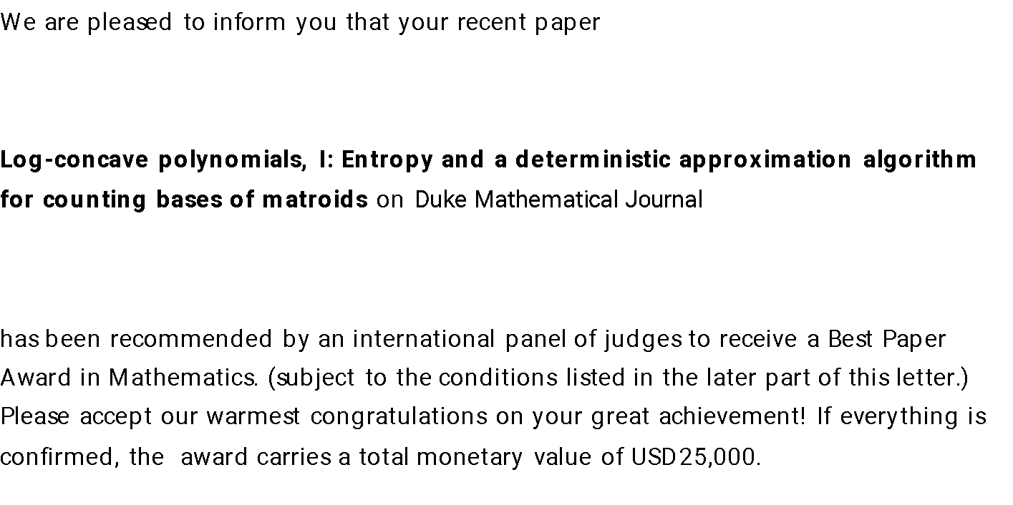
International Invitations
Paper or conference prizes

Slide 5
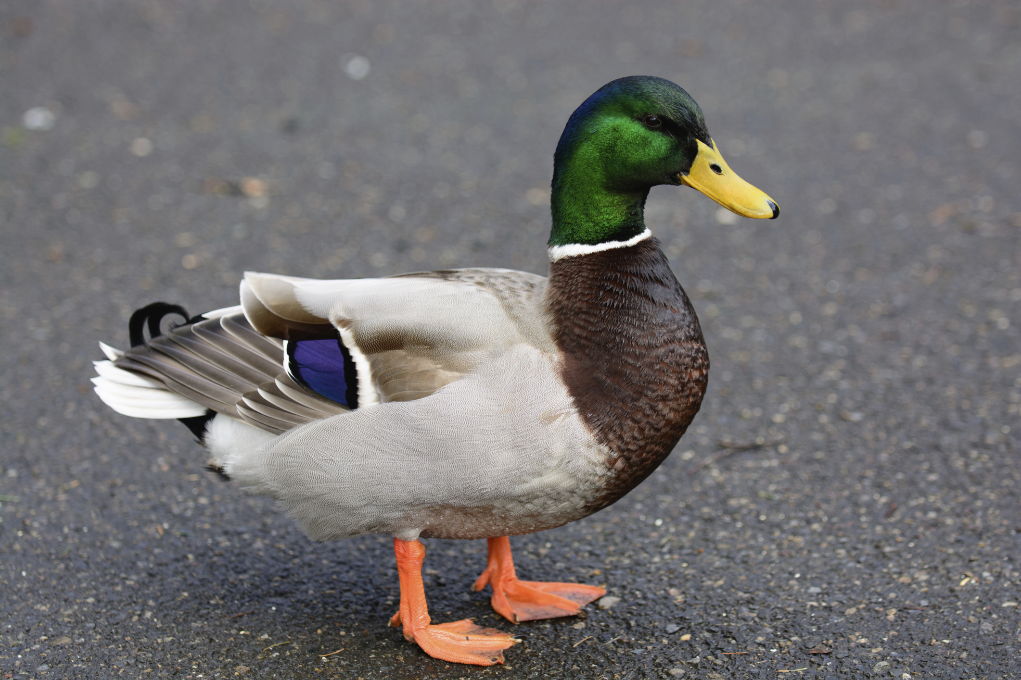
International Invitations
Foreign Talent Programs
Paper or Conference Prizes

