Slide 1
SAGE AWARD DEMO
February 9, 2023
Amanda Snyder
Office of Sponsored Programs

Slide 2
AGENDA
Terminology
Benefits of SAGE Award Setup Request
Award Setup Request Overview
Demo
Awards Management
SAGE Award Training & Help Resources
Q&A: Use the Q&A button in Zoom

Slide 3
TERMINOLOGY
Award: In the context of SAGE and Workday, an award is defined as a sponsored program competitive segment of funding.
Award Setup Request: This is a form available in SAGE that collects information about the award after the Notice of Award (NoA) is received and funding is granted for a specific award.
SAGE Suite: The web-based system used by faculty, Principal Investigators, administrators, and staff to submit funding applications for consideration, route them electronically for approval, prepare budgets, request advance budget numbers, and initiate subawards. With the UW Finance Transformation, the SAGE Suite will also be used to set up and manage awards.
Notes:
Alternate Award definition: An agreement that memorializes the terms and conditions between the University and the sponsor, in which the sponsor supports a specific scope of work carried out by the University for organized research, instruction, or other sponsored activity in exchange for something of value, such as data, results, IP rights or technical reporting. (Knowledge Base)

Slide 4
AWARD SETUP REQUEST OVERVIEW

Slide 5
SAGE AWARD SETUP REQUEST | BENEFITS
New SAGE form and system functionality replaces email communications
A familiar, user-friendly experience in SAGE, similar to advance requests
Autofill of eGC1 and SAGE Budget information on award request forms
Shared views for award preparers and reviewers improves collaboration between campus, OSP, and GCA
Integrations with Workday streamlines award setup
Visibility into award status, history, and communication

Slide 6
AWARD SETUP REQUEST | HIGH-LEVEL OVERVIEW
NOA Received
(OSP)
Create SAGE Award Setup Request (OSP)
eGC1 Approved
Create/Update SAGE Award Setup Request (Campus)
Link SAGE eGC1 & Budget
Complete & Submit
OSP
Workday
NOA Received
(Campus)
Create SAGE Award Budget
GCA
LEGEND
Central Offices
Optional Returns
Receive Notification that Award is Ready!
Campus Units
Award Flow

Slide 7
AWARD SETUP REQUEST DEMO

Slide 8
SAGE AWARD SETUP REQUEST
Please Note
All screenshots in this presentation reflect works in progress. Details and final functionality may change during the course of implementation.

Slide 9
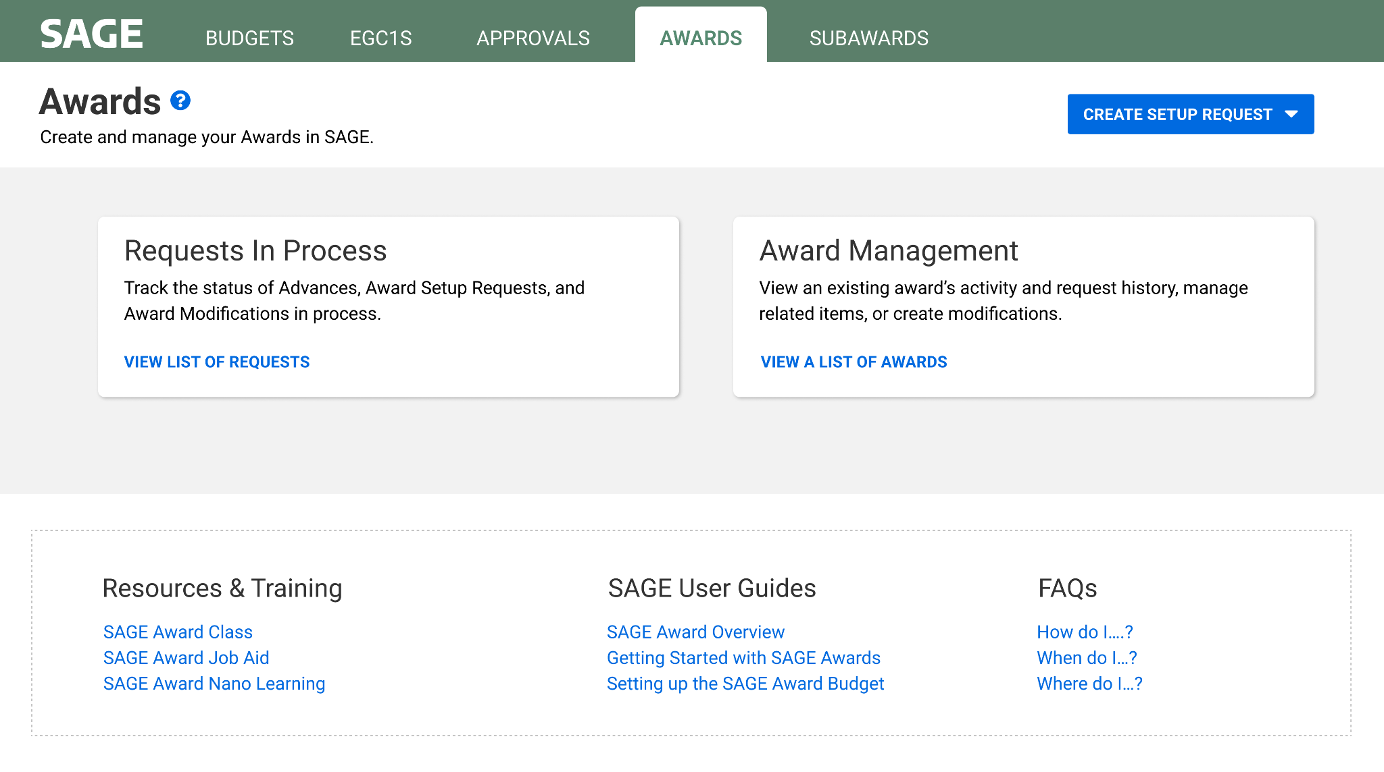
SAGE AWARD SETUP REQUEST | LANDING PAGE
Create an award setup request
Monitor existing awards and requests in process
Access links and resources

Slide 10
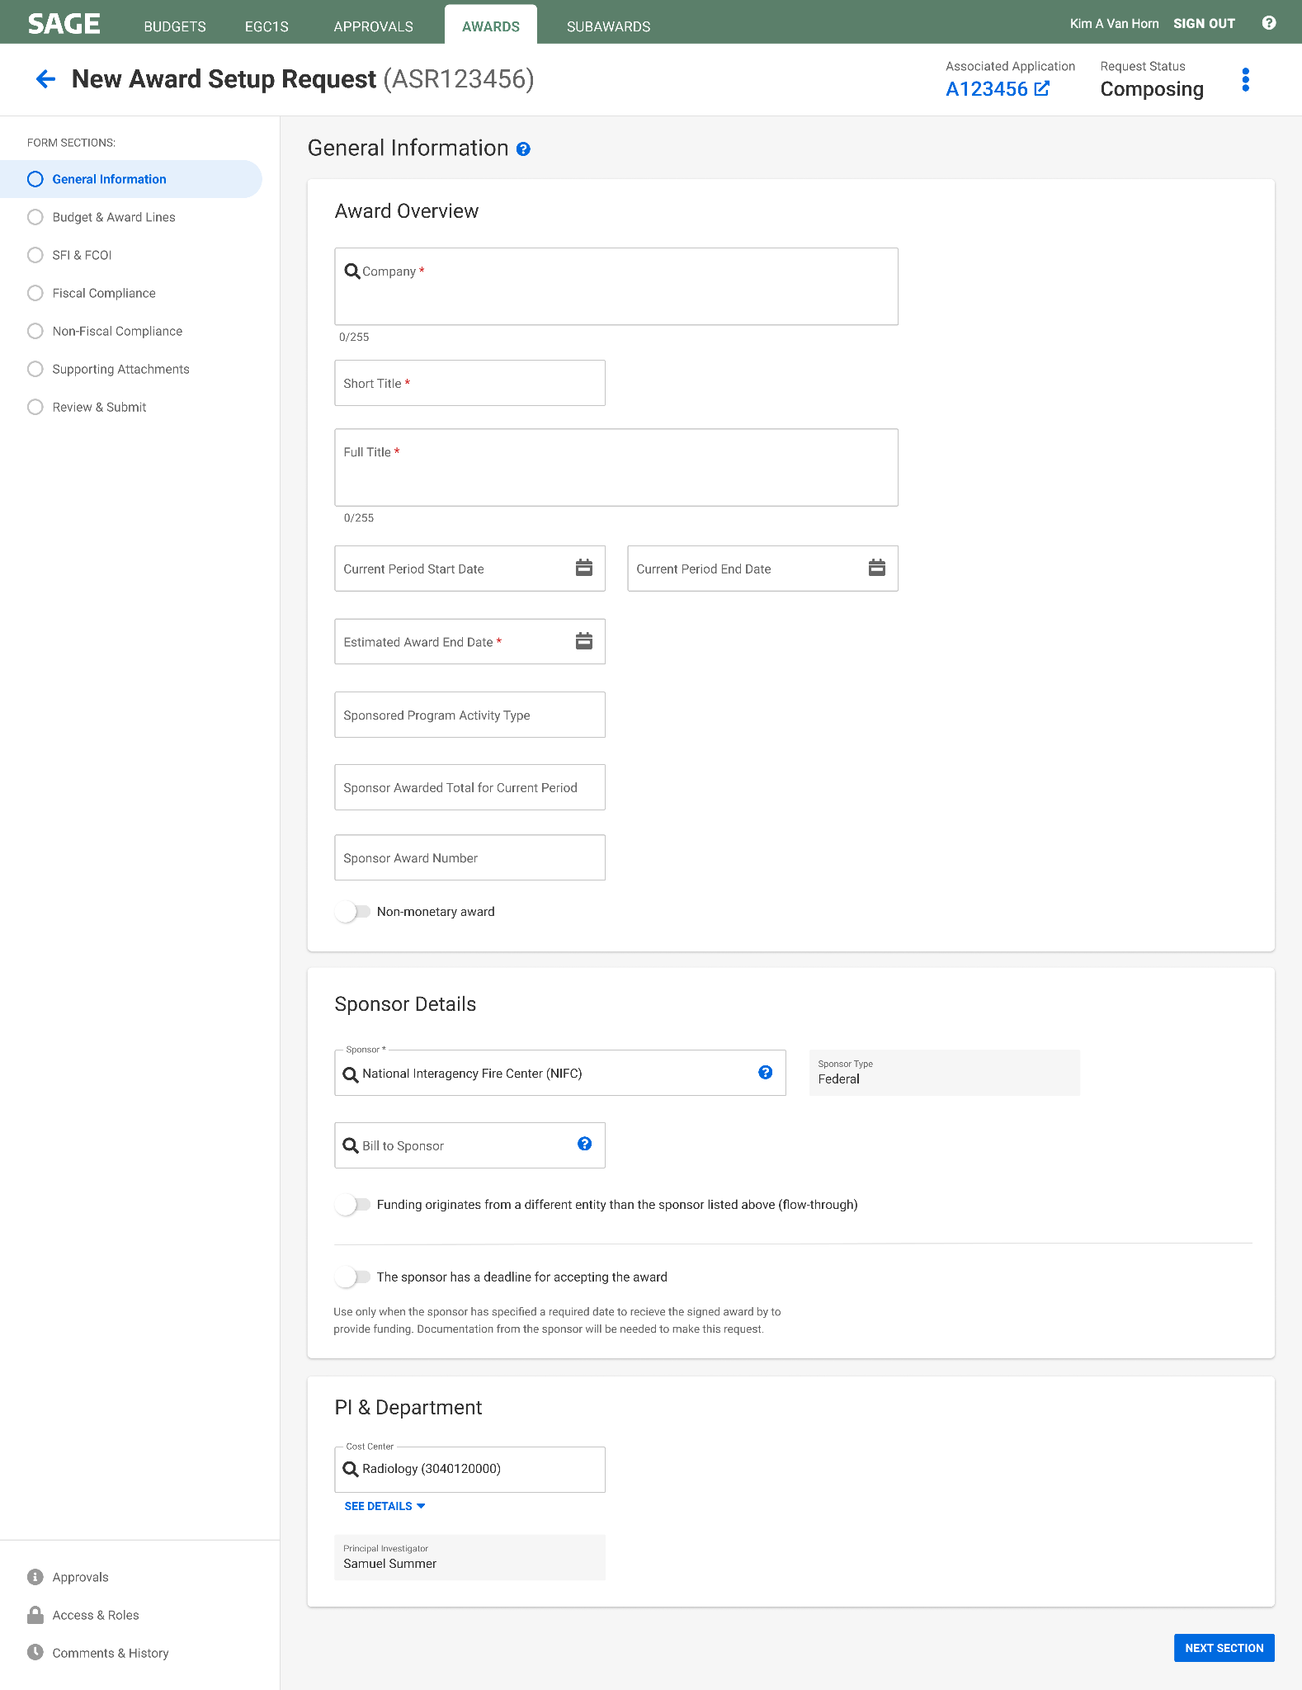
SAGE AWARD SETUP REQUEST | GENERAL INFORMATION
Fields will be pre-filled with information from linked eGC1
Navigation in SAGE Award is similar to SAGE Advances

Slide 11
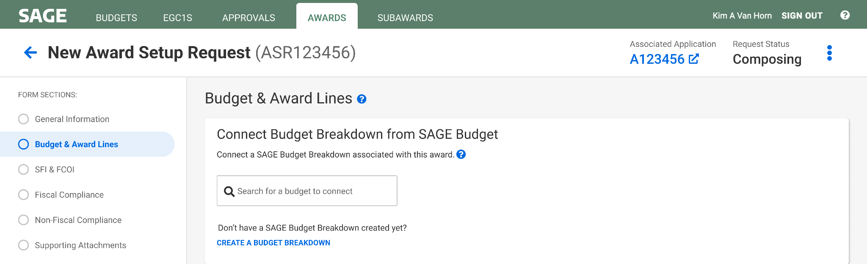
SAGE AWARD SETUP REQUEST | CREATE & LINK BUDGET

Slide 12
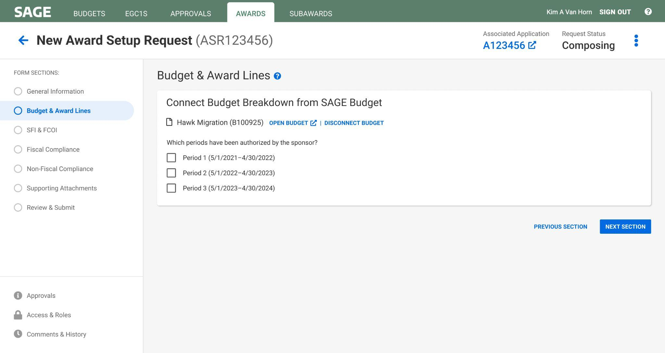
SAGE AWARD SETUP REQUEST | CREATE & LINK BUDGET

Slide 13
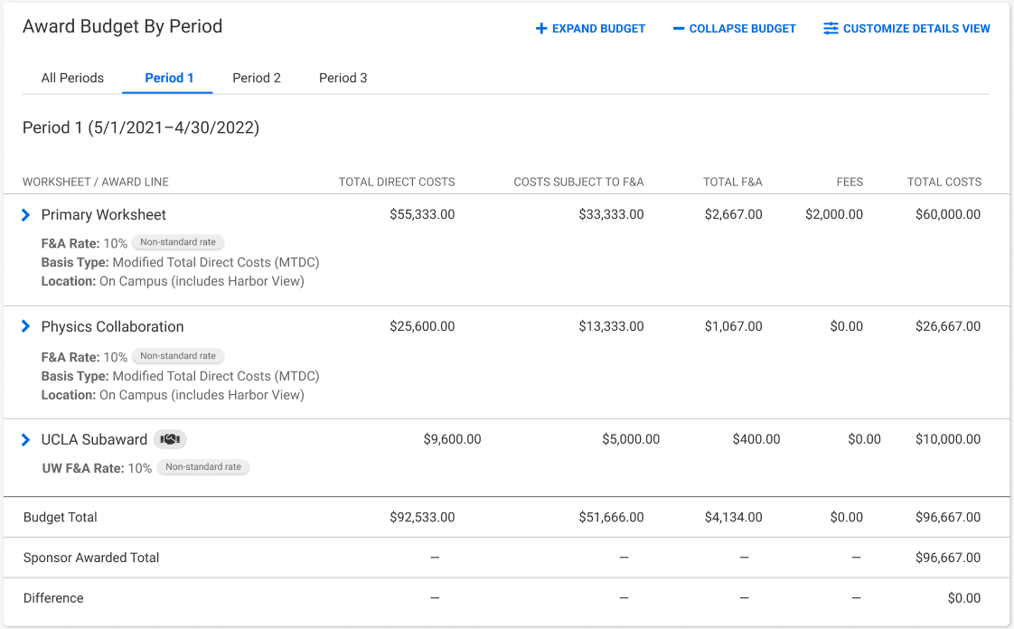
SAGE AWARD SETUP REQUEST | CREATE & LINK BUDGET

Slide 14
SAGE AWARD SETUP REQUEST | SFI & FCOI

Slide 15
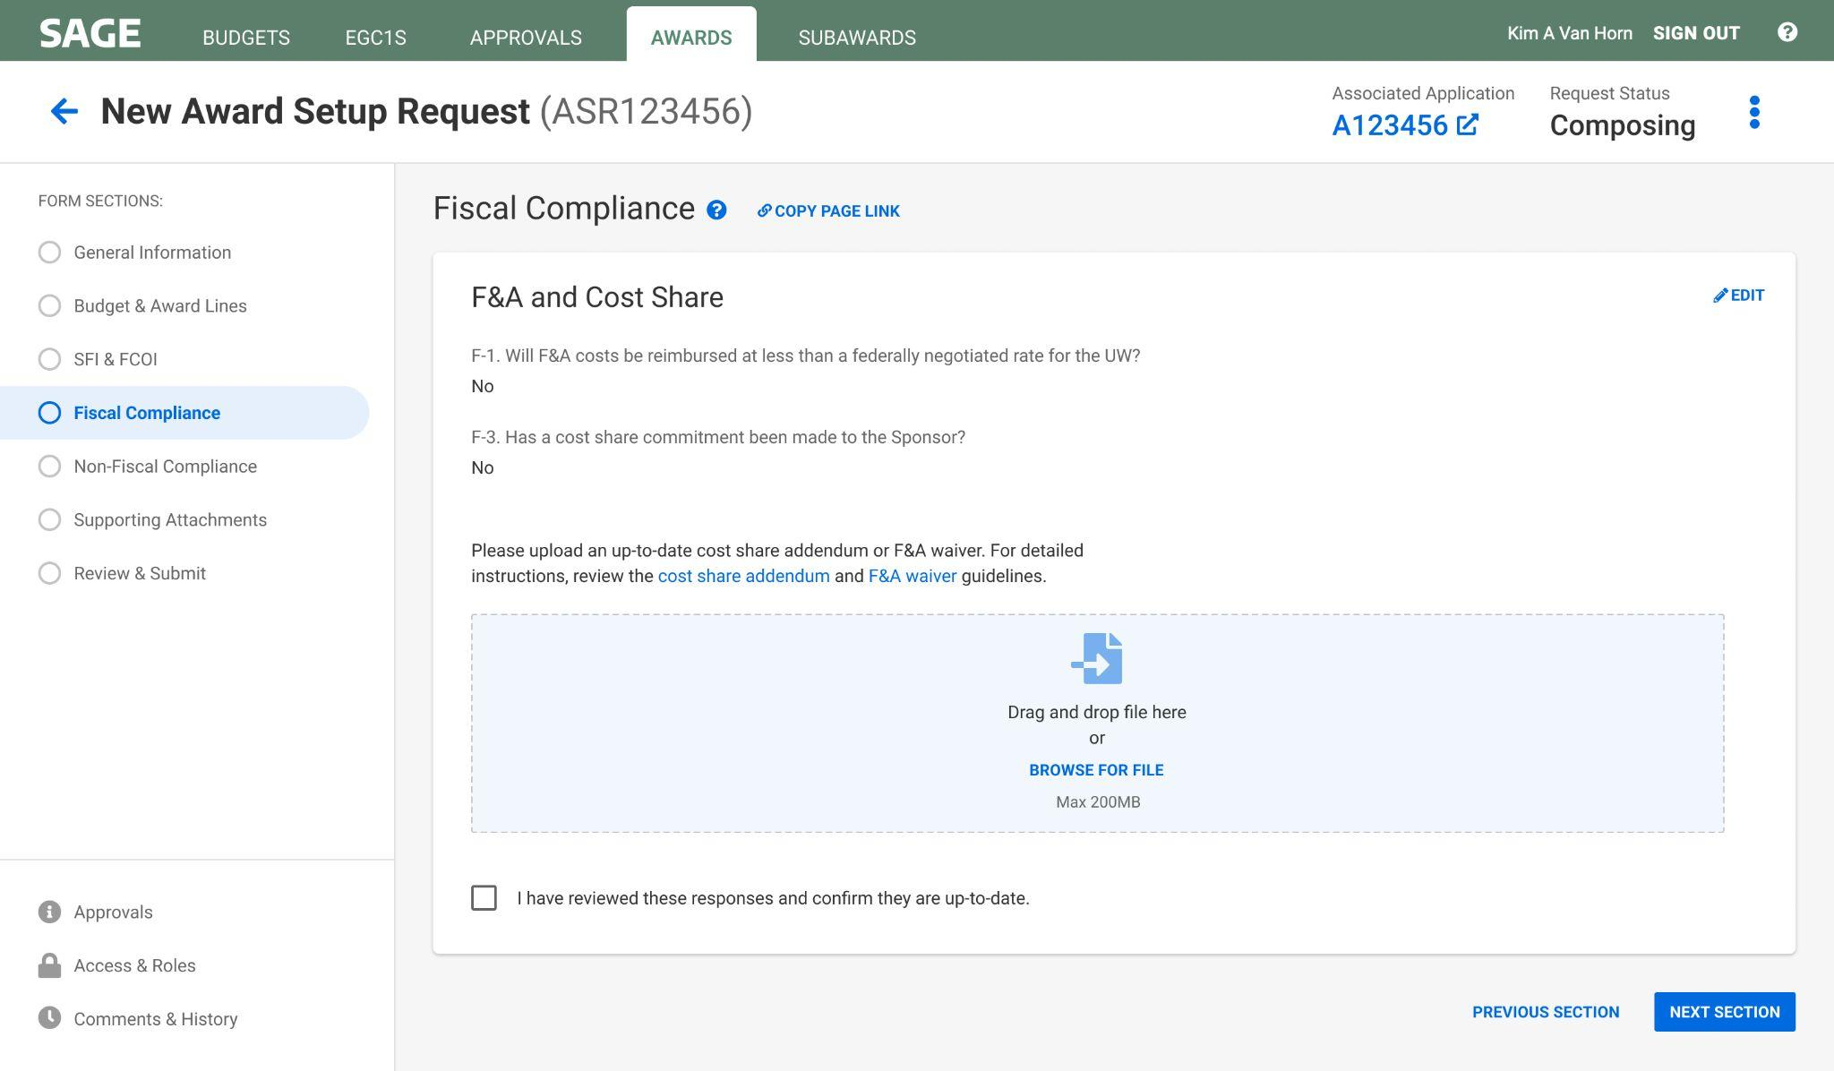
SAGE AWARD SETUP REQUEST | FISCAL COMPLIANCE

Slide 16
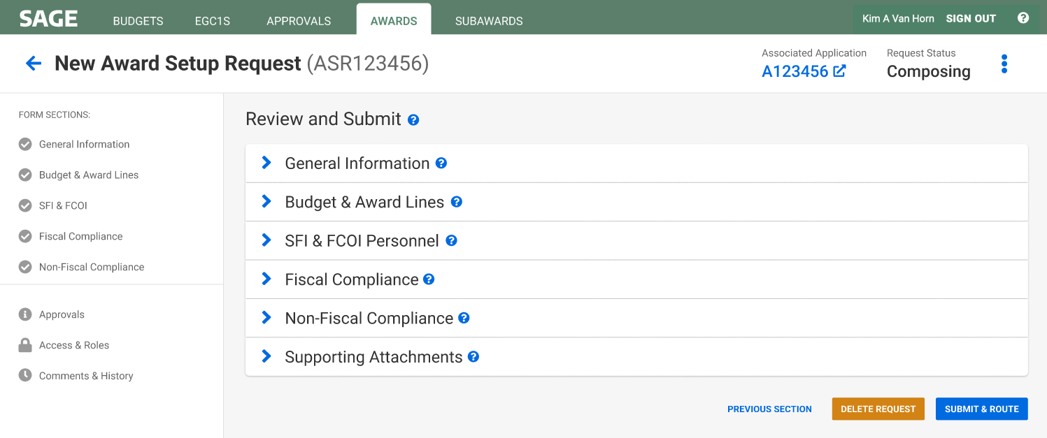
SAGE AWARD SETUP REQUEST | REVIEW & SUBMIT AWARD TO OSP

Slide 17
MANAGING YOUR AWARDS

Slide 18
MANAGING YOUR AWARDS | REQUESTS IN PROCESS
Monitor requests
in process

Slide 19
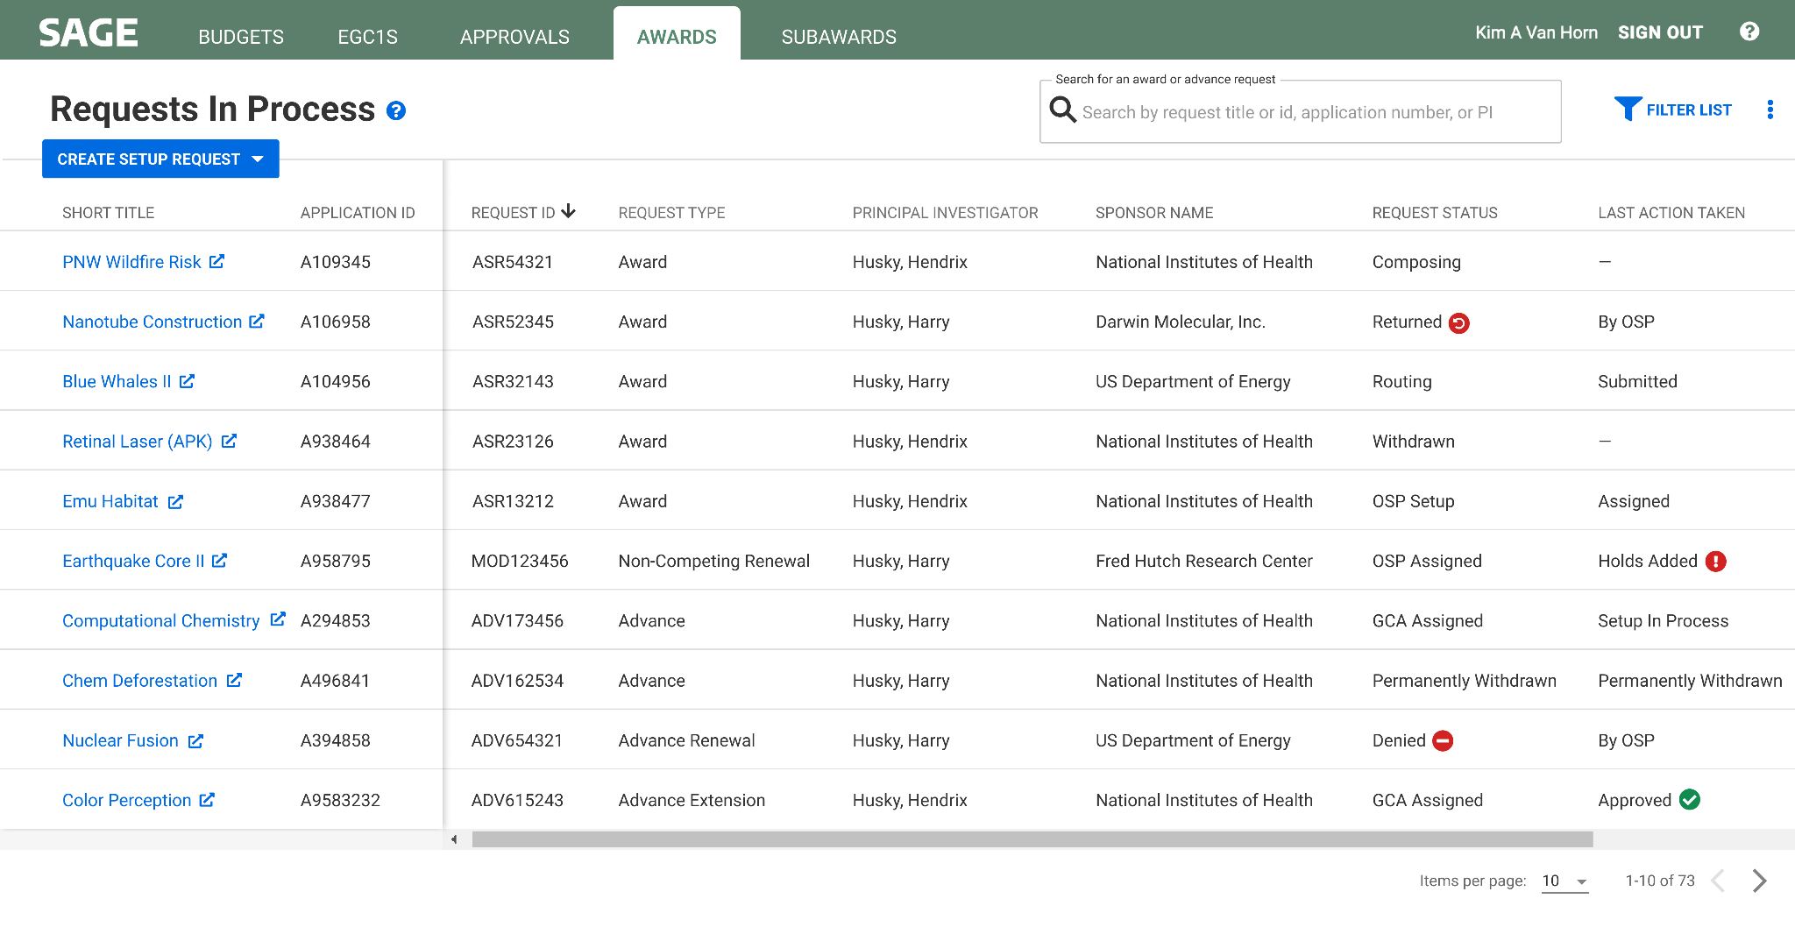
MANAGING YOUR AWARDS | REQUESTS IN PROCESS

Slide 20
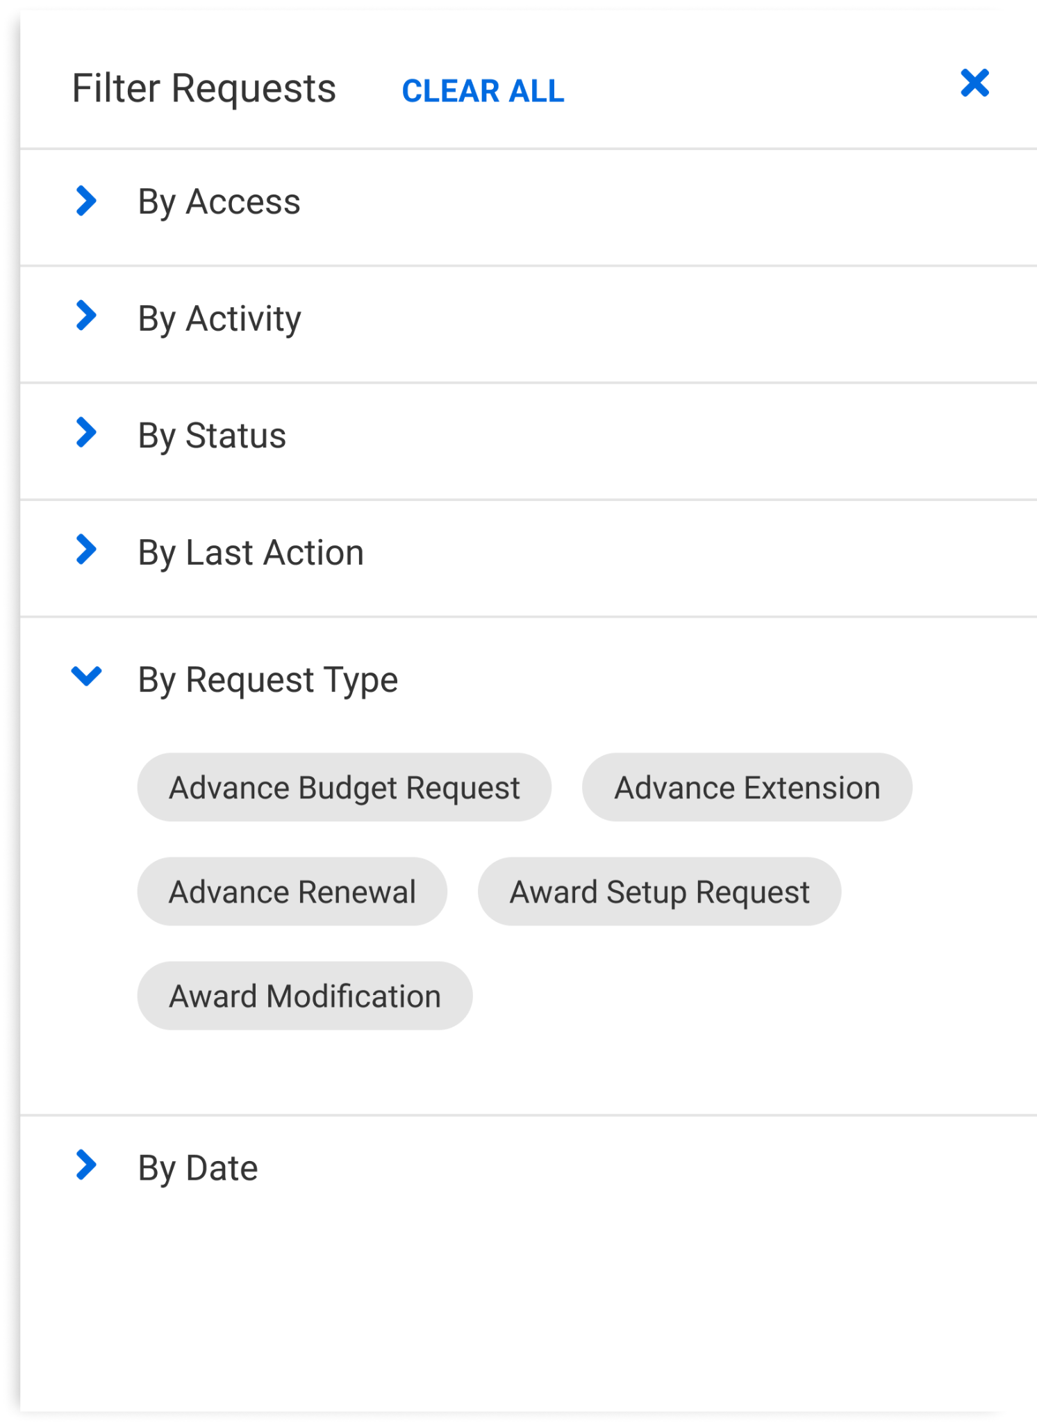
MANAGING YOUR AWARDS | FILTER REQUESTS IN PROCESS

Slide 21
MANAGING YOUR AWARDS | EXISTING AWARDS
Monitor existing awards

Slide 22
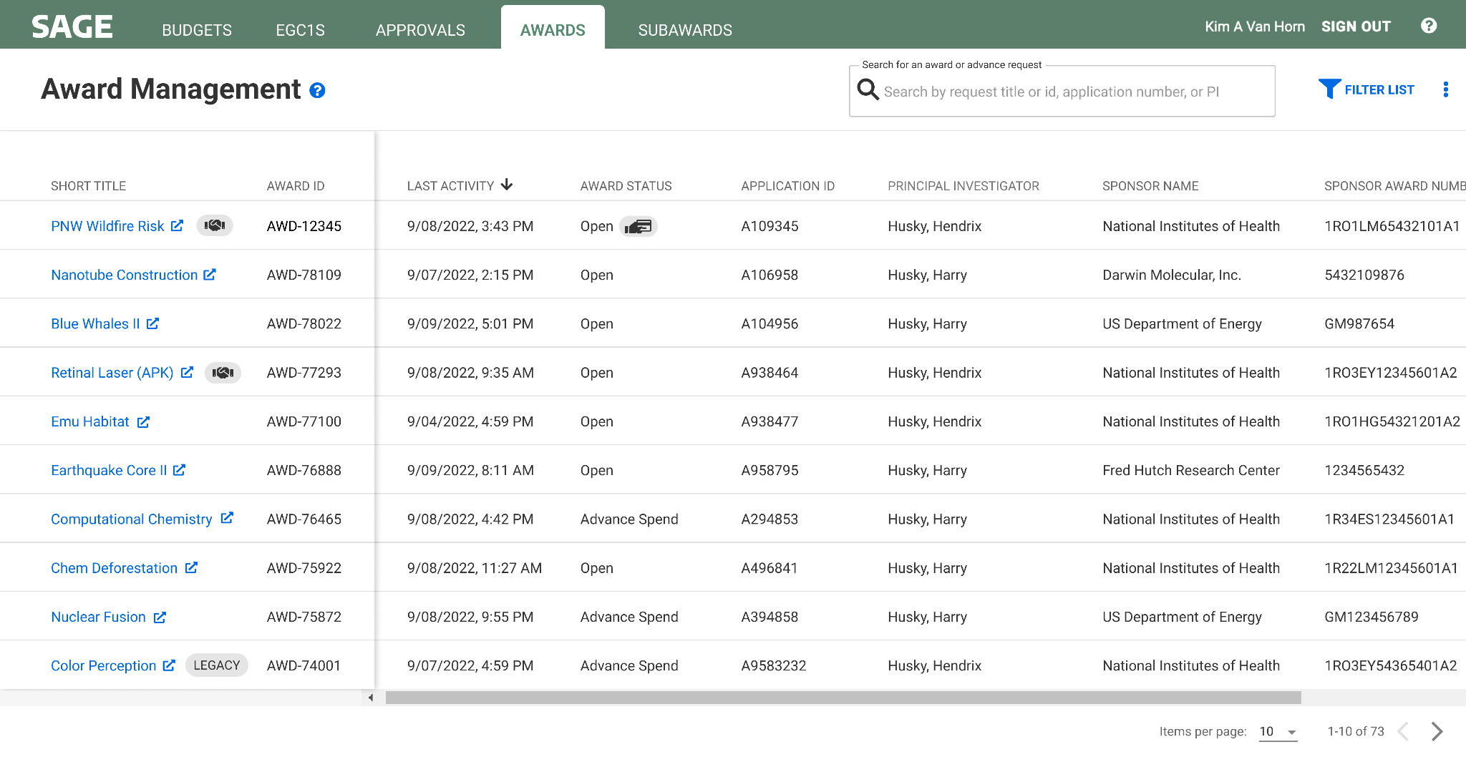
MANAGING YOUR AWARDS | AWARD MANAGEMENT
Links to Award Activity Record

Slide 23
MANAGING YOUR AWARDS | AWARD ACTIVITY RECORD
Screenshot 1 of 3. Scrolling down will show the “Actions & Requests” information on the following slide.

Slide 24
MANAGING YOUR AWARDS | AWARD ACTIVITY RECORD
Screenshot 2 of 3. Scrolling down will show the “Award Details” information on the following slide.

Slide 25
MANAGING YOUR AWARDS | AWARD ACTIVITY RECORD
Screenshot 3 of 3. This section concludes the Award Activity Record.

Slide 26
RESOURCES

Slide 27
RESOURCES
Subscribe to the MRAM mailing list
Bookmark the UWFT for the Research Community webpage
SAGE Award user guides are in development
Enroll in a SAGE Budget live training, visit our drop-in Virtual Office Hours, or review SAGE Budget eLearning
Contact the SAGE Support Desk at sagehelp@uw.edu with questions

Slide 28
THANK YOU!

