Slide 1
MRAM | Monthly Research Administration Meeting
March 9, 2023 9:00 AM – 10:00 AM Join Webinar: https://washington.zoom.us/j/346891888
TOPIC | PRESENTER | EMAIL | MIN
Welcome | Kirsten DeFries Research Compliance & Operations | kirsten5@uw.edu | 2
Workday Demo: Budget vs. Actual Report | Jesse Rice, Shraddha Mittal, Lindell Thomas UW Finance Transformation | jrice19@uw.edu | 15
PAFC Hot Topic: Stipends, Wages, Fellowships | Matt Gardner Post Award Fiscal Compliance | gcafco@uw.edu | 10
NIH Behavioral Code of Conduct NSF Off-Site Research: Certification of Safe & Inclusive Work Environment | Carol Rhodes Office of Sponsored Programs | carhodes@uw.edu | 5
UWFT Transitions - Sponsored Programs Cutover Planning (OSP/GCA/ORIS) | Carol Rhodes & Juan Lepez Office of Sponsored Programs Grant & Contract Accounting | carhodes@uw.edu kabah12@uw.edu | 10
Advance Budget Numbers | Juan Lepez Grant & Contract Accounting | kabah12@uw.edu | 5
Revisions to GIM 36, Human Embryonic Stem Cell Research Policy and Guidelines | Kim Blakemore Chip Muller Office of Research | kblakemo@uw.edu | 10
CORE Update | Laurie Stephan Collaborative On Research Education (CORE) | corehelp@uw.edu | 2
NEXT MEETING April 13, 2023 9:00 AM - 10:00 AM

Slide 2
Live Closed Captioning is now available
Live transcription and closed captions are enabled via the “CC/Transcript” button in your Zoom window.
Recordings of our sessions, with manually edited closed captions, are typically available within a week after the meeting, and a link is emailed with the post-session Q&A.
If you have any issues or questions, please let us know at mramques@uw.edu

Slide 3
REPORTING IN WORKDAY
Presenters:
Jesse Rice, Business Systems Analyst, UWFT
Lindell Thomas, Workday Report Developer, UWFT
Shraddha Mittal, Workday Report Developer, UWFT

Slide 4
Most Important Reports in Workday
Budget vs. Actual
Find Grants by Principal Investigator
Cost Reimbursable Line Status
Fixed Amount Line Status

Slide 5
Reports that will be available in Workday
Deferred Revenue Subtotals by Budget
Grant Budget and Contract Status
Non-CR Unbilled Report (MILE and SP)
Interest Due for Closing Budgets
IDC Rate Change Exceptions
Subrecipient Cost Share
Sponsor Report Format
SEFA
Sponsor Attributes - MBEWBE
Aging by Award
Award Trend Analysis

Slide 6
Reports that will be available in Workday
Award Contract (Audit Trail Report)
PDC Calculation - APL
Awarded Activity by Sponsor
Institutional Reporting
Fixed Amount Line Status
View Award
Find Grants by Principal Investigator
Subaward Status
Late Posted Expenditures
Award Tasks
Find Awards - Custom
Find Sponsor Invoice for Company
Cost Reimbursable Line Status

Slide 7
Budget vs. Actual Scenario Example
I’m a grant manager
I just started work on an award in February and I already set up salary on it. It’s now March and I want to look and see if my expenses are charging correctly
I notice there is an unfamiliar supplies and materials charge
I investigate the charge
I can then work with whoever made the charge to either reverse it or move it off of my award and onto another one

Slide 8
Reporting Demo

Slide 9
Q&A

Slide 10
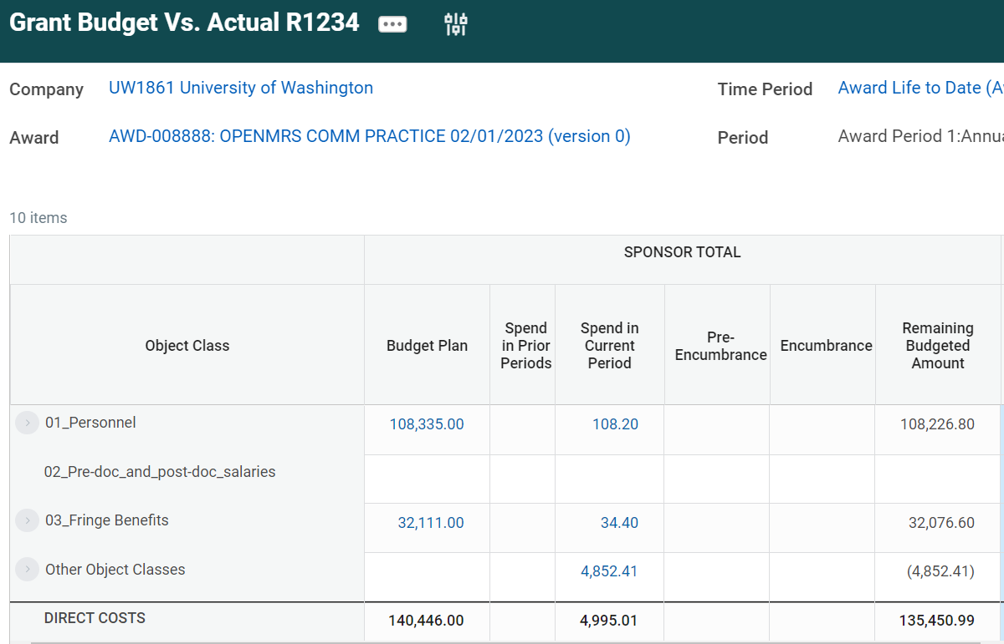
Appendix: BvA Screenshot

Slide 11
COMPLIANCE HOT TOPIC:
WAGES VS. STIPENDS
MRAM
March 2023
Matt Gardner
Post Award Fiscal Compliance

Slide 12
Wages vs. Stipends: What’s the difference?
Wages:
Compensation to employees in exchange for effort
Based on a rate of pay, effort, and/or number of hours worked
Taxation and benefits considerations
Stipends:
Fixed amount paid to offset living expenses for an individual in training
Not considered compensation in exchange for effort
Not dependent on number of hours worked
Taxation and benefits considerations
MRAM – Matt Gardner – PAFC

Slide 13
Wages vs. Stipends: In Practice
If an individual is working on a research award, they must be paid a wages, not a stipend.
Why?
Stipends aren’t compensation for effort performed
The compensation must be documented via the University’s effort reporting process (GCCRs)
Stipends, because they are not compensation, are not captured on GCCRs
MRAM – Matt Gardner – PAFC

Slide 14
Wages vs. Stipends: In Practice (cont’d)
If an individual receives a fellowship or training award, should they be paid a wage or a stipend?
Typically, the payment method is a stipend, but we must follow the terms and conditions of the sponsor
Some sponsors have strict requirements to pay a stipend, others do not
Read your award and understand your sponsor’s terms and conditions
MRAM – Matt Gardner – PAFC

Slide 15
Wages vs. Stipends: In Practice (cont’d)
Could we pay an individual a wage that is on a fellowship or training award?
Yes, if…
It is in accordance with the sponsor’s terms and conditions, and
The payment of wages is consistently applied to all similarly situated individuals
Can’t be based on budgetary convenience

Slide 16
Other Stipend Scenarios
Stipends can be allowable as a Participant Support cost
Participant support costs are stipends, subsistence allowances, travel allowance, or registration fees paid to an individual (non-UW employee) in connection with a sponsored-funded conference or training project.

Slide 17
Wages vs. Stipends: Key Takeaways
“Wages” and “Stipends” are NOT synonymous terms
The nature of the activity, and sponsor requirements, determines the appropriate payment:
Stipends are not an appropriate payment method for an individual working on non-fellowship/training awards
Stipends are an appropriate payment to support individuals on a fellowship or research training
Know your sponsor’s terms and conditions

Slide 18
References
Wages:
https://finance.uw.edu/pafc/salary
Stipends:
https://finance.uw.edu/pafc/stipends
Participant Support:
https://finance.uw.edu/pafc/participant-support

Slide 19
CHANGES TO PAFC

Slide 20
Effort Reporting is now under PAFC
Effective January 1, 2023
No changes to contact information
Information on Effort Reporting webpage regarding changes coming this summer
https://finance.uw.edu/maa/ecc
https://finance.uw.edu/maa/faq/202
We’ll have additional information regarding the new effort system at the April MRAM with timelines and training framework

Slide 21
Questions
Post Award Fiscal Compliance (PAFC)
gcafco@uw.edu
https://finance.uw.edu/pafc/
https://finance.uw.edu/maa/effort-reporting
Matt Gardner
mgard4@uw.edu
206-543-2610
David Parks (Effort Reporting)
efecs@uw.edu
MRAM – Matt Gardner – PAFC

Slide 22
NIH Behavioral Code of Conduct
NSF: Safe & Inclusive Working Environment Plan for Off-site Research
MRAM
March 2023
Carol Rhodes
Office of Sponsored Programs

Slide 23
NIH Internal Controls & Codes of Conduct
NIH Grants Policy Statement (GPS) was recently updated to require a grantee to have internal controls regarding behavioral codes of conduct.
These help assure safe and healthful working conditions for their employees and foster work environments conducive to high-quality research.

Slide 24
Internal Controls in this context:
Policies
Training
Awareness/Culture
Reporting Avenues
Investigatory Avenues
Resolution Paths
Disciplinary Actions
Some UW specific internal controls include: Title IX Protocol, Executive Order 70, Required Employee Training, Violence Prevention and Response, Safecampus, UCIRO, Executive Order 31, Executive Order 54, Faculty Code: 25-71 Process
Notes:
Nothing needs to be turned in with proposal. UW already can certify it has internal controls in place.

Slide 25
NSF - Off-Site Research
Safe and Inclusive Working Environment Plan
Effective January 30, 2023, NSF proposals with off-campus or off-site work must certify a Safe and Inclusive Working Environments for Off-Campus & Off-Site Research Plan will be in place for that project.
For this requirement, NSF defines off-campus or off-site research as data/information/samples being collected off-campus or off-site, such as fieldwork and research activities on vessels and aircraft.
As a reminder, all UW personnel are subject to UW policies, regardless of location of UW work, including but not limited to:
Title IX Protocol
Executive Order 70
Required Employee Training
Violence Prevention and Response
Safecampus
UCIRO
Executive Order 31
Executive Order 54
25-71 Process

Slide 26
Required Components of Plan (1 of 2)
For any off-site or field work on a proposed NSF project, the Principal Investigator (PI)/Project team must establish a Safe and Inclusive Working Environment Plan.
Include how the following behaviors, if occur, will be addressed:
Abuse of any person, including, but not limited to, harassment, stalking, bullying, or hazing of any kind, whether the behavior is carried out verbally, physically, electronically, or in written form; or
Conduct that is unwelcome, offensive, indecent, obscene, or disorderly.

Slide 27
Required Components of Plan (2 of 2)
List steps the PI and other leadership will take to nurture an inclusive off-campus or off-site working environment for this project, such as: training, mentor/mentee support mechanisms, codes of conduct, etc.
List how communications within team will be carried out in order to minimize a singular point within the communications pathway (e.g., a single person overseeing access to a single satellite phone).
Please address communication methods wherever a third party or other organization is involved with UW personnel.

Slide 28
Developing the Plan &
Submitting with Proposals
PIs should develop this Plan at time of NSF proposal.
Why?
UW is certifying, at time of proposal, that we have a plan in place specific to the project
Some NSF Directorates require at time of proposal
When required by the specific Funding Opportunity (FOA) this plan should be submitted to NSF at time of proposal.
PIs may develop their own plan that meets NSF requirements, or use fillable UW template.

Slide 29
Distribution Before Off-site Work Commences
In all cases, even if not required at time of proposal, the PI is responsible for ensuring any individuals working at an off-site or off-campus location receive a copy of the plan before work begins at the location.
This is also true for any NSF project that adds an off-site / off-campus component later.

Slide 30
Resources
NIH
NIH Grants Policy Statement (GPS)
Open Mike Blog
NSF:
Safe and Inclusive Working Environments for Off-Campus & Off-Site Research Plan
UW Fillable Template & guidance

Slide 31
UWFT Transitions -
Sponsored Programs Cutover Planning
March, 2023 MRAM
Carol Rhodes, Office of Sponsored Programs
Juan Lepez, Grant and Contract Accounting

Slide 32
What?
Cutover: planning & execution of activities required to successfully transition the UW Finance processes to the new ecosystem (that includes Workday) in a specific timeframe with minimal disruption of day-to-day operations.

Slide 33
Why?
Current state data must be converted from legacy financial systems to Workday.
Cutover will ensure clean data once Workday goes live so we can accurately process financial items with minimal disruption.
Data conversion happens in phases during cutover so as data is passed through, it can be validated.
Data must not change so what is validated is what is converted. Therefore, we require a freeze period on setting up new activity.

Slide 34
When?
Sponsored Programs Cutover Timeline (so far)
6/09: Last day OSP will send final and ready to be approved Funding Actions, financial-related Post Award Changes, this includes Budget Extensions, to GCA for processing
6/13: Last Day GCA will process final and ready to be processed advance budgets, advance extensions, Transpasus, as well as items that arrive from OSP
6/15 after 5PM: Items that could not be processed will need to be reprocessed after UWFT & SAGE Awards Go-Live

Slide 35
OSP - Business as usual?
Proposals & eGC1 submission
NIH 7/05 deadline, no impact
Preaward notifications such as Just-in-Time
Non-Award Agreements
Post Award Changes that do not impact a budget number
Can awards arrive in OSP during cutover?
YES!

Slide 36
SAGE - Business as usual?
Continued functionality for all areas, up until anticipated SAGE Awards release window
eGC1s, Advances, Subawards will continue to use the same existing modules
After release - new awards (formerly new FAs) will be entered into the Award Setup Request form

Slide 37
Not business as usual?
What does cutover mean for GCA?
GCA will be:
Completing training
Validating data for cutover
Expect more information on Closeout activities

Slide 38
Stay tuned for more details via
March MRAM Q&A follow up email
Final UWFT program cutover dates & information
Coordinated Sponsored Program email with more details
We’ll also return in April!

Slide 39
Questions

Slide 40
Announcement from GCA
GCA will be closed on Tuesday, March 14 as we attend an all-day Sponsored Programs Finance staff meeting.
The GCA Help phone line will be closed, and our responses to email and Grant Tracker inquiries will be delayed. For matters where a response is needed by March 15, please notify GCA by EOD Friday, March 10.

Slide 41
Advance Budget Required for Cutover:
Benefits & Best Practices
March, 2023 MRAM
Juan Lepez, Grant and Contract Accounting

Slide 42
What is an Advance Budget?
When a sponsor has approved funding but the award agreement is delayed, GCA recommends setting up an advance budget, guaranteed by department funds.

Slide 43
Advance Budget and Cutover
Cutover will require a frost of new setup and modifications of existing awards. Fully executed agreements that would have normally been processed during this window will be held until go-live.
Please request an Advance budget if you anticipate your pending agreement will begin work, and therefore require activity to be posted in FY23.

Slide 44
Why is an Advance Budget Required for Cutover?
Impact if Advance is not set up:
FY23 activity will be understated or misclassified if expenditures are “parked” on a non-grant budget
Do not “hold” expenditures if they are attributable to work conducted 6/30 or prior
Risk
Misstatement of financials for FY23 and FY24
Possible audit findings

Slide 45
Why Establish an Advance Budget?
Ensures costs are allocated to correct funding source at time of expenditure
Reduces expense transfers and possible red flags/audit risks
Reduces the risk of late posted expense transfers and potential write-offs
Timely invoicing and reimbursement of posted expenses following setup of the award

Slide 46
Advance Budgets in Future State
The advance budget setup mechanism will continue into future state with Workday Implementation.
We recommend using Advance Budgets to reduce the volume of unnecessary expense transfers and increase compliance.
Advance Budget Guidance

Slide 47
Questions

Slide 48
Human Embryo and Embryonic Stem Cell Research Oversight (ESCRO)
MRAM
February, 2023
Charles “Chip” Muller, PhD, ESCRO Chair
Male Fertility Lab, Dept of Urology
Kim Blakemore, ESCRO Program Manager
Office of Research

Slide 49
Human Embryo and Embryonic Stem Cell Research Oversight
(ESCRO)
Topics we will cover
Introduction
ESCRO Committee
Where can I get more information?
Does funding matter?
How does approval affect awards?
Contact info and ESCRO webpage
Questions
MRAM – Kim Blakemore, Office of Research and Chip Muller, Male Fertility Lab

Slide 50
Introduction
Kim Blakemore, ESCRO Program Manager
ESCRO program is part of UW Office of Research
I have supported program for 15 years and am face behind escro@uw.edu
Terms mentioned in our presentation are defined in “Research Terms and Definitions” – a document on ESCRO webpage.
GIM 36 - Human Embryonic Stem Cell Research Policy and Guidelines…more from Chip Muller, our fearless ESCRO Chair.
ESCRO is a specialized committee looking at unique ethical considerations
Charles “Chip” Muller, ESCRO Chair, Director, Male Fertility Lab
Thoughts to keep in mind:
No need to be an expert in stem cell research or oversight.
We are here to:
let you know about ESCRO,
Explain why it exists and what we oversee’
MRAM – Kim Blakemore, Office of Research and Chip Muller, Male Fertility Lab

Slide 51
ESCRO Committee
Charge: Review UW proposals using pluripotent human stem cells for scientific merit and ethical concerns. hESC hiPSC
Membership: Scientists, Bio-Ethicist, ISCRM & Human Subjects representatives, non-UW public members.
Brief history. 2007 Federal restrictions (use of human embryos) 2009 hESC lines registry. In vitro culture vs transplantation . Other examples.
Updates Dec 2022. Embryo models; embryo culture; brain or gonad organoids.

Slide 52
Where can I get more information?
Human Embryo and Embryonic Stem Cell Research Oversight (ESCRO) webpage https://www.washington.edu/research/embryonic-stem-cell-research-oversight-escro/
Content:
Purpose, policy, guidance
Committee process
Forms for new research, their renewals, etc.
Resource documents for guidance and detailed information.
Examples include:
Terms and definitions
Examples of research and types of ESCRO review.

Slide 53
Does Funding Matter?
YES!!!
Why?
Some stem cell research can be supported with federal funding, and some cannot. For example:
Research involving human embryonic stem cell lines listed on NIH human embryonic stem cell registry generally is eligible for federal funding, depending on the intended research.
Some research not eligible for federal funding can occur but using private funding.
Institute for Stem Cell & Regenerative Medicine, otherwise known as ISCRM, is the UW operated and privately funded facility for this type of research.
Details describing funding considerations are forthcoming and will be published on the ESCRO webpage.

Slide 54
How does the need for ESCRO approval affect access to awards?
How does ESCRO fit in the overall award process?
Once you’ve received notification for intent or to award
Complete an ESCRO application or contact escro@uw.edu with questions.
Concurrently, work with other compliance offices (e.g., EH&S, OAW, HSD, etc.), as normal.
ESCRO will work with other compliance offices to achieve congruence….however...
Principal Investigators are responsible for ensuring proper oversight and necessary approvals are in place.

Slide 55
Contact
escro@uw.edu
Questions, philosophical discussions
Guidance
Presentations to your unit/office/department
ESCRO webpage https://www.washington.edu/research/embryonic-stem-cell-research-oversight-escro/

Slide 56
QUESTIONS?

Slide 57
Updates
Spring 2023 schedule published
All live courses scheduled
All offered via Zoom, be sure to take advantage of these courses offered once a quarter
FT and the CORE curriculum
Analysis of FT impacts underway
Compliance focused courses little change
Process/systems courses significant change
CORE Registration:
https://uwresearch.gosignmeup.com/public/course/browse
CORE Home: https://www.washington.edu/research/training/core/

