Slide 1
MRAM | Monthly Research Administration Meeting
June 8, 2023, 9:00 AM – 10:00 AM Join Webinar: https://washington.zoom.us/j/346891888 Click “CC” to Show Captions in your Zoom Controls
TOPIC | PRESENTER | EMAIL | MIN
Welcome | Kirsten DeFries Research Compliance & Operations | kirsten5@uw.edu | 2
GIM Updates | Carol Rhodes, Matt Gardner OSP & PAFC | carhodes@uw.edu gcafco@uw.edu | 10
GIM 39 Update | Adelia Yee Office of Sponsored Programs | ayee@uw.edu | 5
When a PI Departs - Reminders | Adelia Yee Office of Sponsored Programs | ayee@uw.edu | 5
Agreement Types & New Decision Tree tool | Jennifer Lopez Office of Sponsored Programs | jjlopez@uw.edu | 15
CORE Update | Laurie Stephan Collaborative On Research Education (CORE) | corehelp@uw.edu | 5
NEXT BONUS UWFT MRAM Jun 16, 2023 9:00 AM - 10:30 AM NEXT MRAM July 13, 2023, 9:00 AM - 10:00 AM Questions about MRAM? email mramques@uw.edu

Slide 2
GIM Updates
June, 2023 MRAM
Carol Rhodes & Matt Gardner
Office of Sponsored Programs, Post Award Fiscal Compliance

Slide 3
Which GIMs will be updated soon?
GIM 2 - Sponsored Awards: Acceptance and Fiscal Compliance
GIM 3 - Fringe Benefit Rates and Sponsored Programs
GIM 9 - Advance Spending on Sponsored Awards
GIM 15 - Accounting Adjustments on Sponsored Awards
GIM 21 - Cost Share on Sponsored Awards
GIM 23 - Sponsored Award Costing Policy
GIM 39 - Closeout
Notes:
Carol

Slide 4
Which GIMs will be updated next?
GIMs still under review…
GIM 7 - Subaward Administration
GIM 8 - Subrecipient Monitoring
GIM 13 - Facilities and Administrative (F&A) Rates
GIM 35 - Effort Reporting
GIM 38 - Reduced Responsibility
Notes:
Carol

Slide 5
What’s changing & what can we expect?
Terminology
Process change alignment
Improved readability
Provide more clarity
Notes:
Carol

Slide 6
GIM 2
Updated Responsibilities section:
Removed signature delegation requirement for effort reporting form this GIM and added it to GIM 35 - Effort Reporting
Clarified Dean/Dept Chair are responsible for ensuring internal controls
Added bullet to clarify both OSP & GCA can take administrative actions needed to keep an award in compliance with sponsor & other regulatory needs
PI: Responsible for adhering to internal controls that are established by their unit for each award.
Added detailed actions that might result from non-compliance
Added line for deficit resolution responsibilities
Moved list of “other fiscal GIMs” to resource section and include a link from the purpose of the GIM
Subaward invoice delegation policy has not changed.
WD Finance handles a little different & PI’s are required to approve
subaward invoices within WD Finance.
Notes:
Carol

Slide 7
GIM 3
Updated policy statement to encompass not just proposals, but rates used on awards
Added a statement that benefit rates are automatically calculated based on payroll classification assigned to individual within payroll system
Moved specific explanation of elements of fringe benefits (e.g. separation leave) out of GIM since this is already covered by the Financial Accounting site
Responsibilities section
Added GCA responsibilities
OSP: Removed bullet on reviewing benefit rates
Notes:
Carol

Slide 8
GIM 9
Title changed from Advance Budget Numbers to Advance Spending on Sponsored Awards
Removed references to budget number
Notes:
Matt

Slide 9
GIM 15
Updated effort reporting references to reflect future state process & better align GIM 35 (Effort Reporting) and this GIM
Updated responsibilities sections to explain more clearly what the responsibilities are
Removed “A single cost is not to be transferred more than once.”
If the cost is really not charged to the right budget, it needs to be corrected regardless of how many times a transfer has already taken place.
Removed procedures and guidance around minimum threshold cost transfers
Notes:
Matt

Slide 10
GIM 21
Provide clarity that sponsors must indicate voluntary cost share is an element of merit review
When costs incurred on one award will be used as cost share on a different award - both benefiting and contributing sponsors must approve
previously referred to only federal sponsors for approval on both sides
PI responsibility now includes:
Ensure all cost share commitments are met and documented in UW systems
Assume responsibility for unmet cost share commitments
GCA responsibility now includes:
Take actions to resolve unmet cost share at award close out, which may include deobligation of award funding to cover the required cost share contributions.
Notes:
Matt

Slide 11
GIM 23
Removed procedural guidance hosted on central unit web pages
Added links to them within the GIM Resources section
Example: Distribution of Costs Across Two or More Sponsored Programs - Links to this PAFC web content
Removed section on costs requiring prior approval
This can be dependent on the award and isn’t standard across the board for all sponsors
Responsibilities section
Removed some general overall roles which did not seem relevant in this GIM
Changed order of responsibilities so PI appears first
Removed OSP role around budget review at proposal stage, given OSP role is limited, as reflected in GIM 1
Notes:
Matt

Slide 12
GIM 39
Being covered in the next presentation
Notes:
Carol

Slide 13
When will this happen?
Most of these GIM updates will be published around the first week of July
Those still under final review will happen later this year - stay tuned for more updates on those
Notes:
Carol

Slide 14
Questions

Slide 15
GIM 39
June, 2023 MRAM
Adelia Yee
Office of Sponsored Programs

Slide 16
Updates to GIM 39
OSP no longer:
sends reminders
retains copies of final technical reports
units should retain these within their award files
Clarifies GCA can also take administrative actions when reports are delinquent
Publication scheduled in early July

Slide 17
Questions

Slide 18
When a PI Departs
June, 2023 MRAM
Adelia Yee
Office of Sponsored Programs

Slide 19
Discovered a PI is departing UW?
Plan ahead:
Identify all of their sponsored awards
Moving to another institution?
Relinquish award to sponsor
Keeping project at the UW?
Request a Change of PI
Award ending soon?
Make sure current PI submits final reports
If not, determine who will complete and submit
Notes:
45 days - 3 months before a PI leaves when possible

Slide 20
Questions

Slide 21
Agreements
June, 2023 MRAM
Jennifer Lopez
Office of Sponsored Programs

Slide 22
Contracts Team
Assistant Director:
Jennifer Lopez
Senior Contracts Specialist Lead:
Elizabeth Walker-Tilley
Senior Contracts Specialists:
Autumn Eck, Vali Gazula, Vanessa Mendoza, Karl Neumann, Rebecca Parisi, Hogan Ricks, Claire Stamm
Contracts Specialists:
Dahra Latham, Jerri McKellar, Michelle Monroe

Slide 23
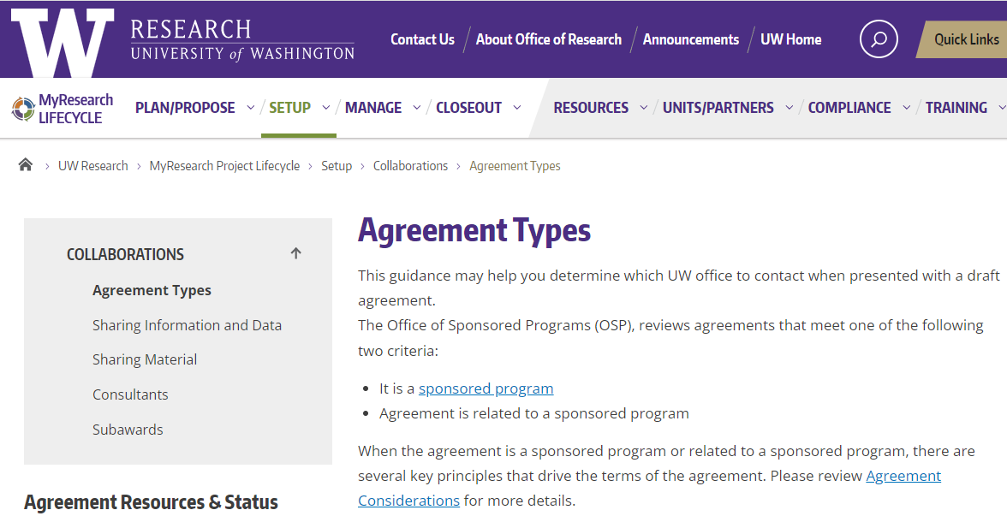
Web Updates
Refreshed Agreement Types
https://www.washington.edu/research/myresearch-lifecycle/setup/collaborations/agreement-types/
Notes:
Updated descriptions, more agreement type information & a new decision tree tool
https://www.washington.edu/research/myresearch-lifecycle/setup/collaborations/agreement-types/

Slide 24
New Agreements Decision Tree
https://forms.office.com/r/3tGMiuTKG0
Notes:
https://forms.office.com/r/3tGMiuTKG0

Slide 25
Questions

Slide 26
Updates
FT and the CORE certificate
Some required classes on hold for a few months until updates clarified
Some required and elective classes may be retired
Courses will be pulled effective July 6, registration no longer available
Completing courses prior to July 6 still encouraged
Go to the Curriculum Guide webpage to get most up-to-date information about course status
ALL on-demand courses will be republished in the fall and will require learners to restart if have not completed prior to July 6
CORE Registration
https://uwresearch.gosignmeup.com/public/course/browse
CORE Home https://www.washington.edu/research/training/core/
Notes:
People are continuing to take courses up to this point which is not a waste of time for learning concepts and compliance, but understand that any systems information you are learning will be outdated. Allowing this leeway because there is still so much valuable information in them, but they do need to be updated once systems information becomes obvious.

Slide 27
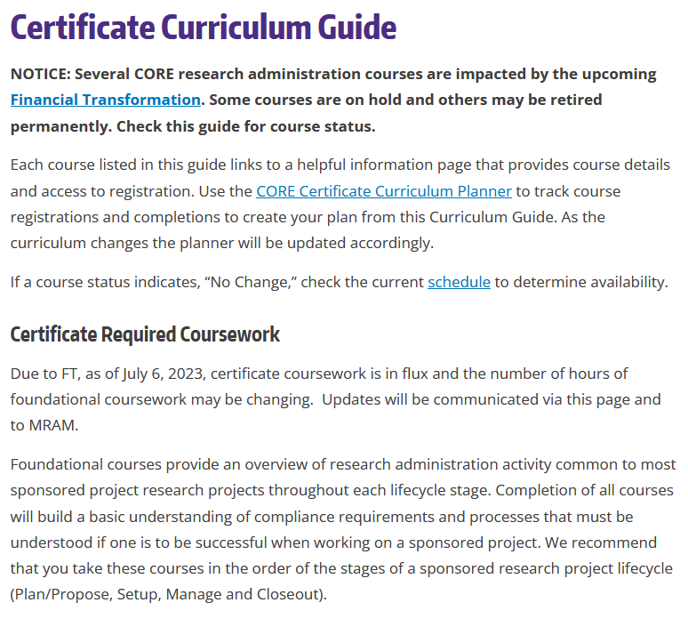
Changes coming to the certificate
CORE Registration
https://uwresearch.gosignmeup.com/public/course/browse
CORE Home https://www.washington.edu/research/training/core/
Notes:
Note that after July 6 several courses will become inaccessible. Some courses may not return and this will impact the required coursework. All of this is in flux right now so please stay tuned. Check this page for updates. Updates will also be sent to the MRAM email list.

Slide 28
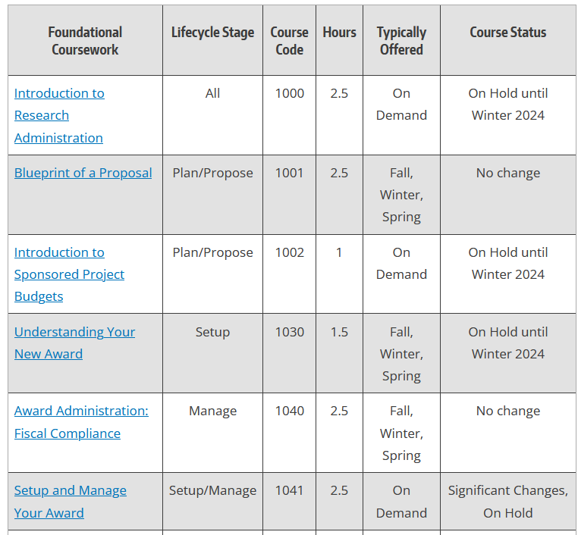
Changes coming to the certificate
CORE Registration
https://uwresearch.gosignmeup.com/public/course/browse
CORE Home https://www.washington.edu/research/training/core/
Notes:
On hold with target release date are courses we increasingly know what the updates are and can make them relatively quickly once transparency is reach with go-live. The courses with no change status indicate course where any changes required are minor and should be able to be completed by fall quarter. These course should be republished and ready to take in the fall, or will be offered live, depending on instructor availability. Course with significant changes, on hold indicate courses that may be replaced or totally retired, depending on what systems remediation brings to light in the next year.

Slide 29
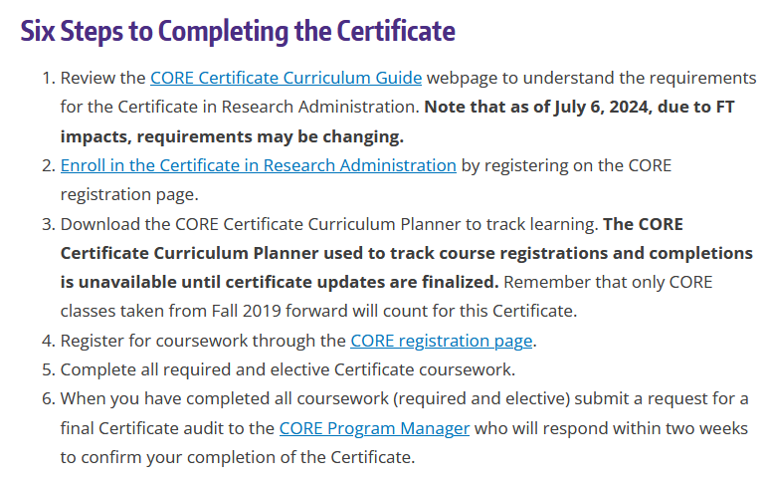
Changes coming to the certificate
CORE Registration
https://uwresearch.gosignmeup.com/public/course/browse
CORE Home https://www.washington.edu/research/training/core/
Notes:
Changes notes have been made to the process for completing the certificate. We will be finalizing certificate changes in early 2024.

Slide 30
Reminder -
BONUS UWFT MRAM

Slide 31
Next Bonus UWFT Focused MRAM
9 a.m. - 10:30 a.m., June 16
Webinar link will be unique to that session.
Stay tuned for email invitation with links & agendas

