Slide 1
AWARD SETUP & MODIFICATION REQUEST UPDATES
October 4, 2023
Judy Chung
Office of Research Information Services

Slide 2
AWARD SETUP: TOP QUESTIONS WE HEAR
Who initiates the Award Setup Request (ASR)?
How do permissions and access work?
What information is required?
How much detail should I enter into SAGE Budget?
What do I do when an Award Setup Request is returned?
When should I begin an Award Setup vs. a Modification Request?
When can I delete a request?

Slide 3
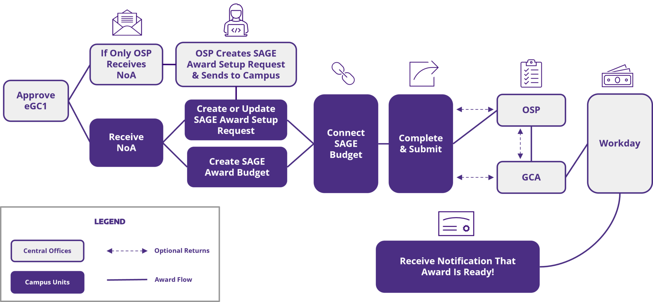
AWARD SETUP REQUEST WORKFLOW REVIEW: RECEIVING AN NoA

Slide 4
WHO INITIATES AWARD SETUP REQUESTS?
When… | ASR Created By | Notes
NoA is sent to the PI and/or unit (with or without OSP copied) | Campus Unit | Campus unit completes the Award Setup Request
NoA is sent to OSP but not to the PI or other unit contact | OSP | OSP completes basic information and sends to campus Email notification that the award has been set up by OSP is sent to the owners on the proposal eGC1 assigned to the Award Setup Request

Slide 5
EGC1 SEARCH TIPS FOR AWARD SETUP REQUESTS
If you do not find your eGC1 in the Create a Request search, that means either:
There is already an award started or processed for that eGC1
The eGC1 is not in “Approved” status
Note: You must also be listed as an eGC1 contact to initiate a request.

Slide 6
PERMISSIONS & ACCESS
Permissions are shared between the eGC1 and the Award requests
You can add new user permissions from either location
ASR/MOD Access & Roles – eGC1 Contacts & Access
All prior permissions issues are now fixed!

Slide 7
AWARD SETUP REQUEST WORKFLOW REVIEW: CREATING AN ASR

Slide 8
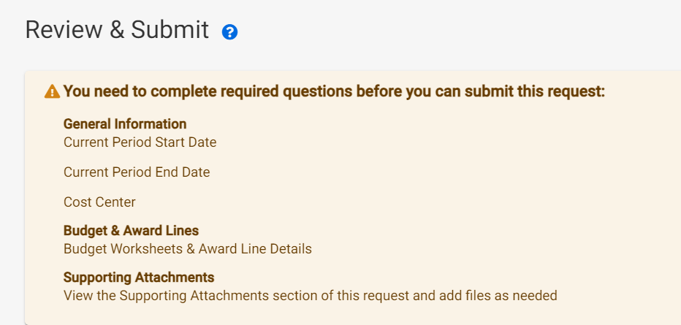
AWARD SETUP REQUEST REQUIRED ENTRY
All missing required entry by campus is highlighted in the yellow header of the Review & Submit page
Refer to OSP guidance on which attachments are needed, since that is award-specific

Slide 9
AWARD SETUP REQUEST WORKFLOW REVIEW: SAGE BUDGET CREATION & INFORMATION ENTRY

Slide 10
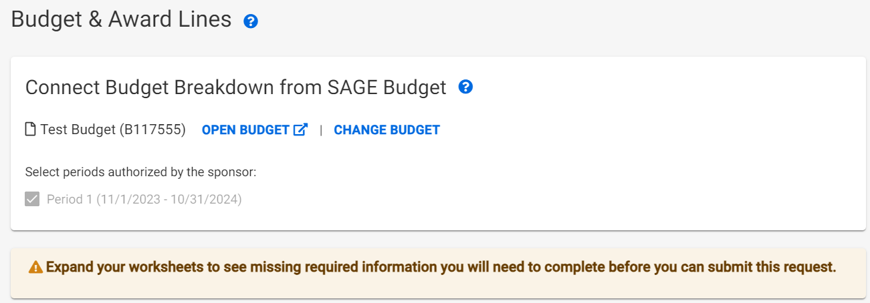
AWARD SETUP REQUEST REQUIRED ENTRY: BUDGET FIELDS
All missing required SAGE Budget entry is noted on the ASR Budget & Award lines page, by expanding the award line where you see the yellow indicator
Recent Updates!
Recent Updates!
Notes:
Note that there is still a backlog of items in GCA that will have missing information, and will still need to be returned for update, until caught up.

Slide 11
COMING SOON! SAGE BUDGET:
REQUIRED FIELD INDICATORS
Required indicators will be added to Worksheet Settings for:
Cost Center
Security Grant Hierarchy
Activity Location
Sponsored Program Activity Category
Sponsored Program Activity Type
Notes:
These will be soft alerts only on the SAGE Budget side, since these are not required for proposal budgets. The validations on the ASR will be what prevents submission until the fields are updated.

Slide 12
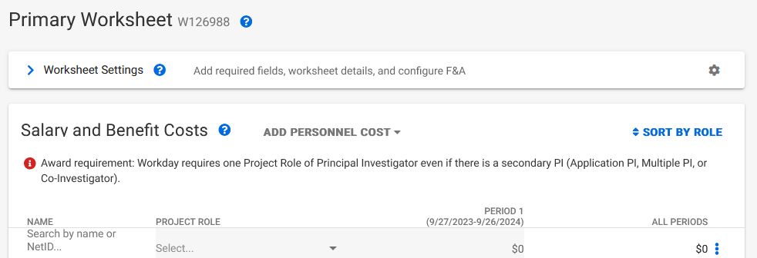
COMING SOON! SAGE BUDGET
REQUIRED FIELD INDICATORS (CONT.)
Instructional text will be added to Salary and Benefit Costs section for PI Project Role requirement

Slide 13
SAGE BUDGET: HOW MUCH DETAIL
IS REQUIRED?
Quick answer:
As much as the sponsor requires for reporting or invoicing
Can I enter a total “unallocated” amount?
YES, if detail not required by sponsor
Can I enter all salary & benefit totals in one row?
YES, but we don’t (yet) make it easy
PI entry & role needed separately, to send to Workday (even if no effort)
Future enhancements targeted to allow lump sum entry of salary & benefits

Slide 14
AWARD SETUP REQUEST WORKFLOW REVIEW: RETURNS

Slide 15
AWARD SETUP REQUEST RETURNS:
COMMON REASONS
Budget updates needed
Missing fields (New validations will help!)
Periods or amounts don’t match the NoA
Incorrect F&A
Review: Guidelines for a Budget Difference Between the SAGE Award Budget and the Sponsor Award
Attachments needed
Award Document & supporting correspondence
Documentation when there is a sponsor deadline for accepting an award
Compliance documentation (IRB/IACUC)
Tips for success- ASRs & MODs
Notes:
SAGE Budget class is offered today, 10/4, from 1 - 3 p.m.

Slide 16
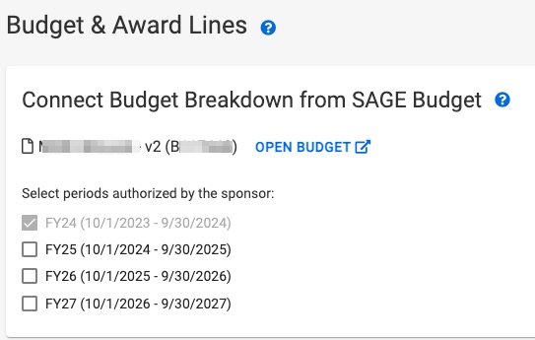
AWARD SETUP REQUEST RETURNS:
COMMON REASONS
Authorized Periods selected on Award Setup Request form do not match the NoA
Note: If you know you routed an ASR with missing budget information, GCA would suggest to let it route and they’ll address it with you when they review

Slide 17
AWARD SETUP REQUEST
RETURNS: WHAT DO I DO?
Look for a comment from OSP or GCA in the Comments & History section of the ASR

Slide 18
ASR VS. A MOD REQUEST?
Submit an Award Setup Request when:
New funding to initiate a project
Competing renewal funding
Submit a OSP/GCA Modification Request when:
Change to an existing award requires sponsor approval
Temporary internal extension
Submit a GCA Only Modification Request when:
Change to an existing award doesn’t require sponsor approval

Slide 19
WHEN CAN I DELETE A REQUEST?
You can delete an ASR or MOD request:
When you (campus) create it, and
Request has not been routed to OSP/GCA yet
OSP & GCA can deny a request:
If it’s already been submitted by campus
Notes:
Mention why we protect items OSP setup. Don’t want to lose attachments, history.

Slide 20
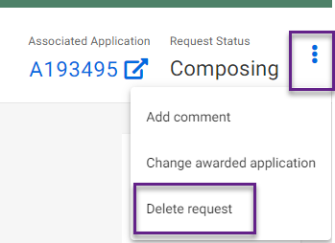
DELETING A REQUEST
Click 3 dots in upper right of request

Slide 21
FILTER TIPS
Use status filters to focus in on just your Composing or Returned items
To retain filters as you go in and out of requests, open the request in a new tab by:
Right clicking the Request ID or Short Title and selecting “Open link in a new tab”
Holding down CTRL then clicking on the Request ID or Short Title

Slide 22
REMINDER: RECENT UPDATES
Reminder that the following updates have been released for Award Requests:
Ability to delete a request
Ability to change an eGC1
Ability to change the connected budget
Validations for all campus-required fields

Slide 23
OCT/NOV RELEASE PRIORITIES
Search & filter enhancements
Restructuring to avoid performance issues
Display more data on Award Requests list
Modifications in particular
Apply holds (OSP & GCA)
Subaward request updates to connect to Workday awards
Priority bug fixes

