Slide 1
MRAM | Monthly Research Administration Meeting
November 9, 2023, 9:00 AM – 10:00 AM Join Webinar: https://washington.zoom.us/j/346891888 Click “CC” to Show Captions in your Zoom Controls
TOPIC | PRESENTER | EMAIL | MIN
Welcome | Kirsten DeFries Research Compliance & Operations | kirsten5@uw.edu | 2
PAFC Hot Topic: Cost Share | Matt Gardner Post Award Fiscal Compliance | gcafco@uw.edu | 10
SAGE Updates & Tips | Judy Chung Office of Research Information Services | sagehelp@uw.edu | 10
Award & Modification Requests - Tips for Comments & Budgets | Carol Rhodes & Vince Gonzalez Office of Sponsored Programs Grant & Contract Accounting | carhodes@uw.edu vinceg@uw.edu | 10
GCA Update | Vince Gonzalez Grant & Contract Accounting | vinceg@uw.edu | 10
Workday Grant Budget to Actual Report | Dinah Millikin Stepanka Sirotek Bilguun Davaasuren UW DATAGroup | datagrp@uw.edu | 10
NEXT MEETING December 14, 2023 9:00 AM - 10:00 AM Questions about MRAM? email mramques@uw.edu

Slide 2
COMPLIANCE HOT TOPIC:
COST SHARE IN WORKDAY
MRAM
November 2023
Matt Gardner
Post Award Fiscal Compliance

Slide 3
Cost Share in Workday – Current State
Cost Share is now 100% documented in Workday
eFECS data is in the archiving process and cannot be changed going forward
All eFECS Cost Share data now resides in Workday for active Awards
MRAM – Matt Gardner – PAFC

Slide 4
To Document Cost Share in Workday
Expenditures incurred after July 1, 2023:
Wages: Payroll must be allocated to the applicable Cost Share Award Line Worktags
Non-Wages: The costs must be charged to the applicable Cost Share Award Line Worktags
3rd Party CS: Submit contribution letters to GCA (same as old process)
Subaward CS: Submit sub invoices with cost share amounts to GCA (same as old process)
Unrecovered Indirect Costs (UIDC): GCA updates amount based on Award spend (same as old process)
MRAM – Matt Gardner – PAFC

Slide 5
To Document Cost Share in Workday
Expenditures incurred prior to July 1, 2023 (Pre-Workday)
Must process a Pre-Workday Expense Transfer
Transfer can be used for Payroll or Non-Payroll
Must transfer the cost to the Cost Share Award Line Worktags
Information on process Pre-Workday Transfers:
UW Connect Finance > Knowledge Bases > Accounting > Job Aids
https://uwconnect.uw.edu/finance?id=kb_article_view&sys_kb_id=fa1fb8ee9706f950e88df7300153afe0
MRAM – Matt Gardner – PAFC

Slide 6
Cost Share in Workday –
Things to Consider
Certifying or re-certifying an FEC will not automatically update Cost Share in Workday
Due to eFECS retirement, FECs are now done via a manual process
A Pre-Workday Journal Entry will be required to move the faculty’s salary to the Cost Share Aware Line Worktags
The old tagging process no longer exists
The only way to document cost share in Workday is either:
Cost Share Award Line Worktags for salary and non-salary costs
Submission of 3rd Party contribution letters and subaward invoices to GCA
GCA reconciliation of Unrecovered indirect Costs
MRAM – Matt Gardner – PAFC

Slide 7
Cost Share in Workday –
More Things to Consider
The Cost Share Commitment and Contributions Report in BI Portal will not longer update with post-7/1 Cost Share
It will remain available to view pre-7/1 Cost Share
There is not an available replacement report; we hope to have one developed in the future
MRAM – Matt Gardner – PAFC

Slide 8
Cost Share in Workday –
Old vs. New: Non-Wages
Example: Purchase of $100 in supplies to be used to meet a cost share commitment.
Old process:
$100 in supplies charged to a Gift, RCR, or Department budget
Supplies “tagged” in the Non-FEC system and sent to GCA to update Cost Share Contributions
Cost Share displayed in eFECS Cost Share Module
New process:
Cost Share Award line set up in Workday
Gift, RCR, or Department budget assigned as the “Funding Source”
$100 in supplies charged to the Cost Share Award Line Worktags
Cost Share displayed in Workday on Cost Share Award Line
MRAM – Matt Gardner – PAFC

Slide 9
Cost Share in Workday –
Old vs. New: Wages
Example: 20% of non-faculty Employee A’s time to be used as a Cost Share contribution
Old process:
20% of Employee A’s salary is charged to a Gift, RCR, or Departmental budget
Department “tags” Employee A’s salary in the Non-FEC System and submits report to GCA
GCA updates Cost Share Contributions
Cost Share displayed in eFECS Cost Share Module
New process:
Cost Share Award line set up in Workday
Gift, RCR, or Department budget assigned as the “Funding Source”
Payroll allocation of 20% of Employee A’s salary to the Cost Share Award Line Worktags
Cost Share displayed in Workday on Cost Share Award Line
The New Process is the same for Faculty salary – a payroll allocation of x% of the faculty’s time to the Cost Share Award Line Worktags
MRAM – Matt Gardner – PAFC

Slide 10
Cost Share in Workday - Issues
The R1234 Report used to view is not working properly
A ticket has been submitted for the issue and a team is working on a fix
You may see discrepancies between Cost Share totals in Award Portal and the R1234 Report
The initial discrepancy was with the display of Third-Party Cost Share
MRAM – Matt Gardner – PAFC

Slide 11
Questions
Post Award Fiscal Compliance (PAFC)
gcafco@uw.edu (Compliance/Cost Share questions)
effortreporting@uw.edu (Effort Questions)
efecs@uw.edu (Old Effort System/Effort Reporting Questions)
https://finance.uw.edu/pafc/
Matt Gardner
mgard4@uw.edu
206-543-2610
MRAM – Matt Gardner – PAFC

Slide 12
SAGE UPDATE & TIPS
November 9, 2023 MRAM
Judy Chung, Office of Research Information Services

Slide 13
RELEASE TIMING
Thursday, November 9, 5:30 - 7:30 p.m. PST
Release notes will be sent following the release window, covering subawards, holds, and other significant updates.
Guidance:
SAGE User Guides
Holds & Subawards sections will be updated post-release
GCA’s Holds guidance
Notes:
GCA will speak more about Holds in their update.

Slide 14
SUBAWARDS | SEARCH FOR AN AWARD
Subawards can now be submitted via SAGE.
1. First, search for your award.
Notes:
Subawards are now associated with Awards rather than Funding Actions.

Slide 15
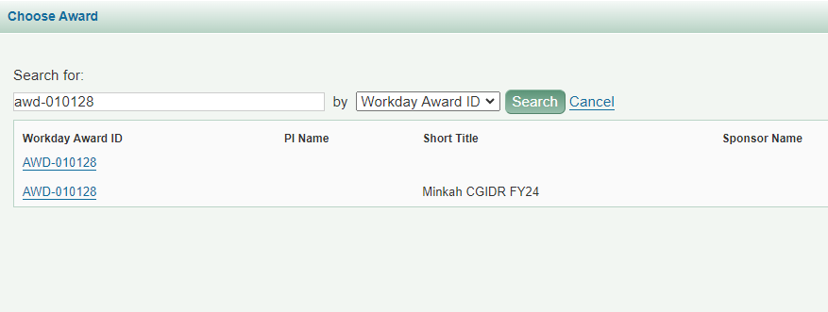
SUBAWARDS | SEARCH RESULTS
2. Select the award.
PI and Sponsor Name coming end of Nov.
May see 2 rows if there are both an ADV and ASR. Either can be selected.

Slide 16
SUBAWARDS | EGC1 DATA
3. The associated eGC1 data will auto-populate.

Slide 17
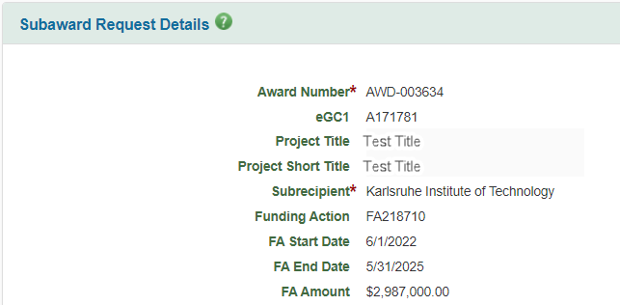
SUBAWARDS | FUNDING ACTION
Funding Action (FA) validation and lookup is removed.
For legacy subawards, the FA fields will display for reference.

Slide 18
HOLDS | CAMPUS VIEW
OSP and GCA can now set holds on both Award Setup and Modification Requests.
Campus users will see a blue banner at the top of requests if holds are applied.
Notes:
Holds do not change the status of an item at this time.

Slide 19
HOLDS | DETAILS
View hold details in the Comments & History section of the request.
Future release: Display a hold indicator on request list

Slide 20
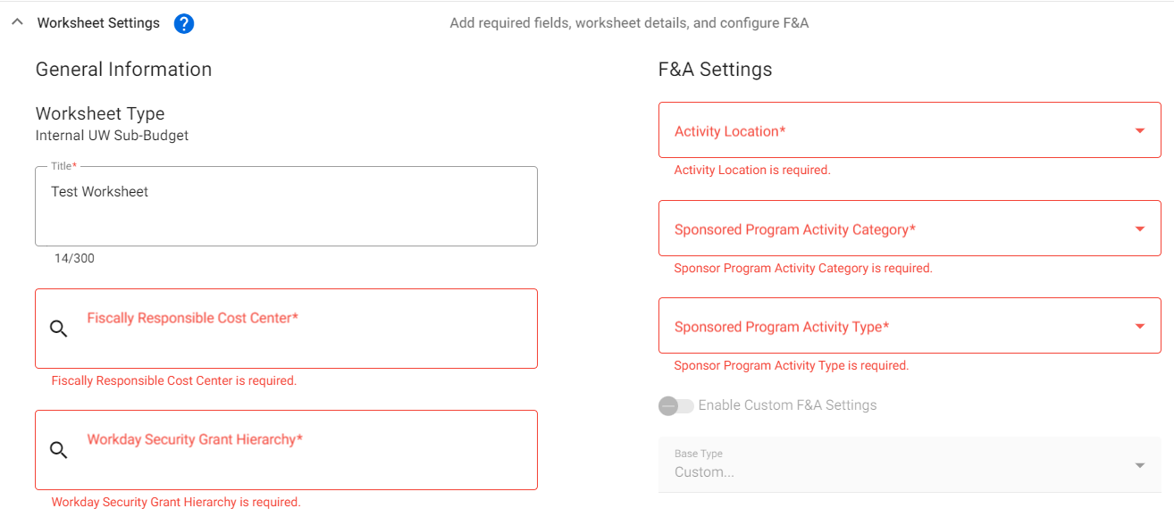
REQUIRED FIELDS: SAGE BUDGET
Required fields in SAGE Budget worksheet settings now display an asterisk and highlighting when left blank.
Notes:
Coming Nov 30 - budget export will include more information GCA requires.

Slide 21
REQUIRED FIELDS: SAGE BUDGET
A validation message now reminds users to add a Principal Investigator to each Worksheet.

Slide 22
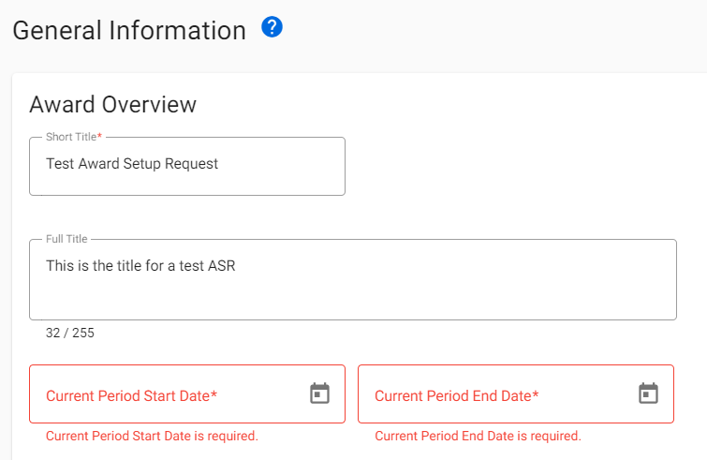
REQUIRED FIELDS: AWARD SETUP REQUESTS
Required ASR information is also now indicated with an asterisk and red highlighting if left blank.
Sample:

Slide 23
MISCELLANEOUS UPDATES
eGC1 status now changes from “Approved” to “Awarded” when an ASR is updated to “Processed.”
Accessibility improvements, including increased font size, implemented.
Various bug fixes addressed.

Slide 24
WHAT’S NEXT?
Additional SAGE release: November 30
Award search and expanded filtering capabilities
Display of more helpful detail in Award Request lists
PI, short title, Workday award number, cost center, sponsor
Advance Extension fix
SAGE Budget export to include cost center, worksheet PI, and security grant hierarchy for worksheets
Infrastructure improvements to improve stability and performance
Reference the SAGE Prioritized Issues & New Features page
Notes:
GCA will share the current workaround for advance extensions in a following presentation.

Slide 25
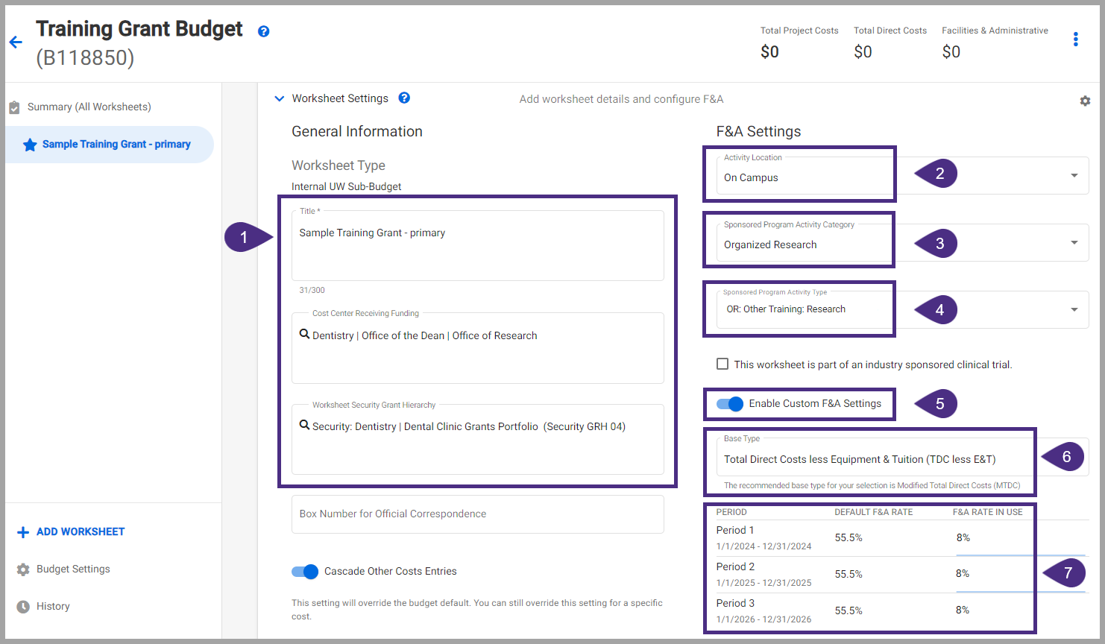
TRAINING UPDATES
New! How to Set Up Training Grants in SAGE Budget Job Aid
Notes:
This job aid walks through setting up a training grant budget in SAGE, including how to set F&A rates, salary and benefit costs, and other direct costs like stipends.

Slide 26
Award & Modification Requests - Tips for Comments & Budgets
November 2023 MRAM
Vince Gonzalez, Associate Director, Grant and Contract Accounting
Carol Rhodes, Director, Office of Sponsored Programs

Slide 27
COMMENTS & HISTORY
Location to provide information to OSP and GCA
Bottom left side of Advance Requests, Award Setup Requests, and Modifications
Notes:
Carol

Slide 28
COMMENTS & HISTORY
Character Limit Awareness
Be aware of character limits!
Comments allow for 1000 characters
Returns and Resubmitted
When GCA returns an item, 300 character limit
When campus resubmits an item, 300 character limit
Text entered into pop-up windows appears in Comments & History
Notes:
Carol

Slide 29
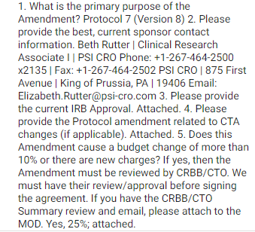
SAMPLE COMMENTS
Clinical Trial Amendments
Providing OSP with Required Information
Information required for OSP to review and approve any Changes to Clinical Trials:
Primary purpose of change
Current sponsor contact info.
Do changes add or subtract $$?
If yes, indicate modified sponsor total all spending periods
Budget changes greater than 10%?
If yes, UW Clinical Trials Office review & their approval attached to MOD
firstname last
(425(123-444
contact@xyzfg.edu
Notes:
Carol-
Proactively include required information that facilitates OSP review e.g. Clinical Trial Amendments always needs this information included for OSP review and approval.

Slide 30
EXAMPLE COMMENTS -
MODIFICATIONS
“I revised the SAGE Budget to match the initial awarded increment of $4,538,270. I also attached the approval email. See link to SAGE Budget snapshot”
“When the Mod request is forwarded to GCA please include the note that a CI is needed in order to claim the first payment in the amount of $112,500, ACH #903710050306813, received 10/5/23.”
Notes:
Carol
Modification requests that include changes to a budget should always include a link to the SAGE Budget Snapshot detailing changes you need GCA to make and a brief description of what the change is.

Slide 31
AWARD SETUP REQUESTS CREATED BY OSP
FAQ will be Linked in Comments
What do I do when I receive an Award Setup Request created by OSP?
OSP setup includes
eGC1 selection, attaching award document, total amount
Campus completes remainder visible to them
Including SAGE budget data
When you (campus) complete the fields available to you on the ASR, OSP (& GCA) reviewers have more work to do, such as completing fields for OSP/GCA use, not visible to you until processed.
Notes:
Carol - Speaking of comments… new comment on ASRs created by OSP will be a link to a new FAQ

Slide 32
QUESTIONS ABOUT RETURNED ITEMS
Have a question about a returned item?
Read the comments first. Still have questions?
Item returned by GCA? Email gcahelp@uw.edu or send Award Portal ticket
Item returned by OSP?
Email OSP reviewer who returned the item to you
Find your OSP Reviewer name in the Comments & History or in the Award Requests List
Notes:
Carol

Slide 33
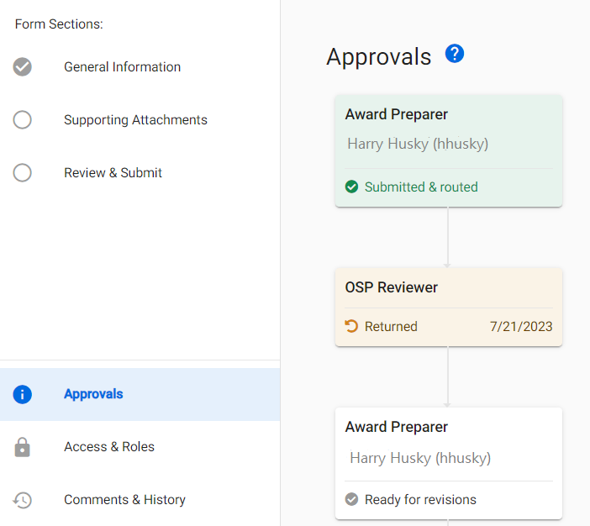
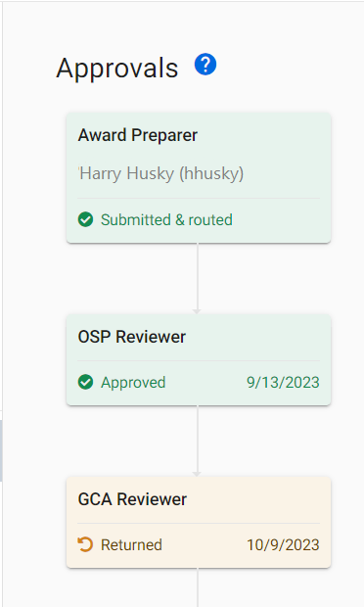
ITEM RETURNED BY GCA OR OSP?
Check the Approvals graph for whether OSP or GCA returned the item
Notes:
Carol

Slide 34
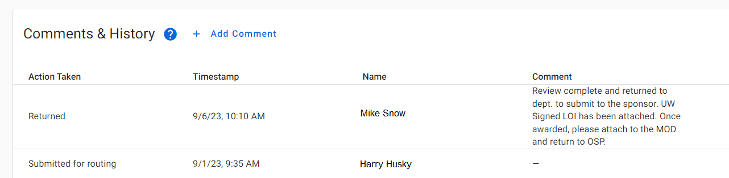
FINDING YOUR OSP REVIEWER
Find your OSP reviewer in the Comments & History Section or in the Award Requests list
Notes:
Carol

Slide 35
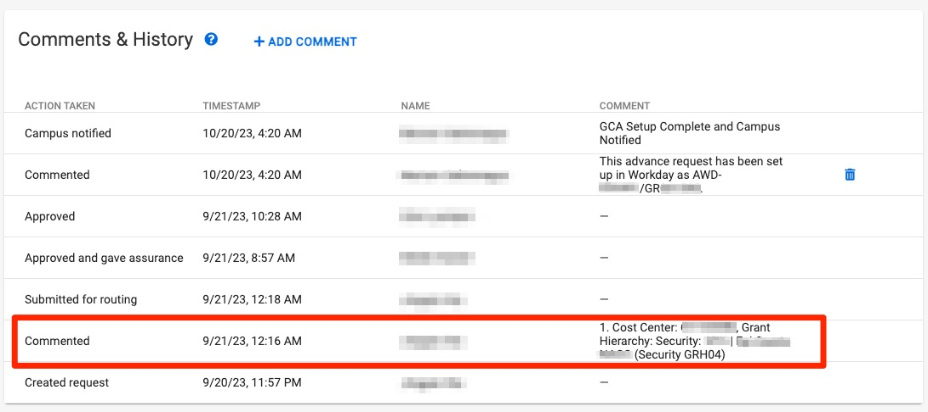
TIPS FOR ADVANCE REQUESTS
Include the Grant Security Hierarchy in the Comments & History
Notes:
Vince

Slide 36
COMMUNICATING YOUR BUDGETS
Use the SAGE Budget Snapshot
Include all information GCA needs to update Workday
Grant Security Hierarchy
Cost Center
Principal Investigator (Grant)
Excel export does not include Grant Security Hierarchy and Cost Center
Review SAGE Budget Snapshot:
How to Make a SAGE Budget Snapshot
How to Include Your SAGE Budget Snapshot on a SAGE Modification Request
Notes:
Vince

Slide 37
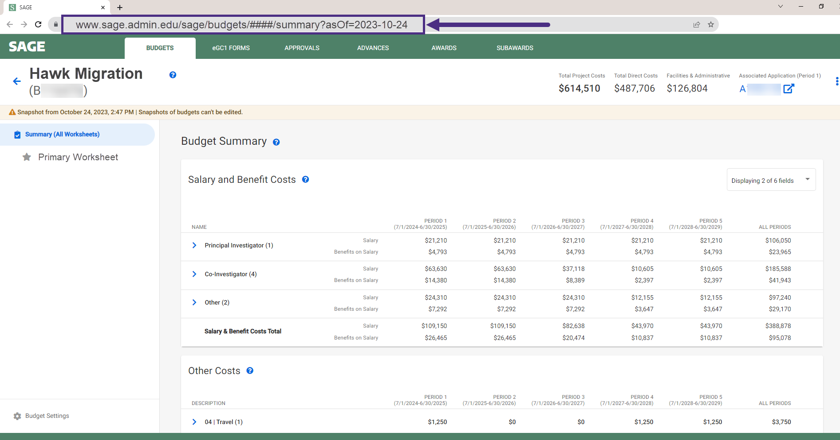
COMMUNICATING YOUR BUDGETS:
BUDGET SNAPSHOT EXAMPLE
Notes:
Vince

Slide 38
COMMUNICATING YOUR BUDGETS:
PRIMARY WORKSHEET EXAMPLE
Reminder: Your Primary Worksheet title will be the name of the corresponding Award Line in Workday
Cost Center Receiving Funding
Workday Security Grant Hierarchy
Notes:
Vince

Slide 39
RESOURCES
Updated - Tips for Success: Award Setup & Modification Requests
New - What do I do when I receive an Award Setup Request from OSP?
SAGE BUDGET SNAPSHOTS
How to Make a SAGE Budget Snapshot
How to Include Your SAGE Budget Snapshot on a SAGE Modification Request
Notes:
Vince

Slide 40
GCA UPDATE
Vince Gonzalez
Associate Director, Grant & Contract Accounting
November 9, 2023 MRAM

Slide 41
TOPICS
GCA Status Update
Urgent Requests for Award Setup
New webpage for known issues
Advance Extension Temporary Process
Holds on Award Setup Requests and Modification Requests

Slide 42
STATUS UPDATE: BACKLOGS
As of Monday, November 6:
Award Setup: 1,682 unprocessed items
Invoicing: Working on metrics
Reporting: 419 backlog reports
Closing: 3,405 backlog closings
Customer Service: 5 day response time
All backlog volumes are now posted weekly to GCA Homepage

Slide 43
STATUS UPDATE: BY PROCESS
Award Setup:
Advance requests are current (except clinical trials)
Prioritizing extensions on MODs with schedule changes
Invoicing: Submitted first invoice batch for Office of Naval Research
Reporting: Fiscal reports are more manual now and are taking longer to complete
Closing: Paused while focusing on SAGE Modification Requests

Slide 44
URGENT REQUESTS FOR AWARD SETUP
Urgent Award Setup requests are often missing a key document or piece of information
Effective Monday, November 13, urgent requests must have the SAGE Modification Request Checklist attached if related to a MOD
The urgent request process and what constitutes an urgent request can be found on the GCA Urgent Requests webpage

Slide 45
NEW WEBPAGE: KNOWN ISSUES
New webpage to capture identified issues, status, and workarounds:
https://finance.uw.edu/gca/known-issues
This replaces the GCA Finance Transformation webpage
Recommend bookmarking and checking weekly
Processes GCA no longer manages has been moved to the Resources tab

Slide 46
ADVANCE EXTENSION TEMPORARY PROCESS
Create a new Award Portal ticket with the following information:
Subject: Award Setup
Topic: Advance Extension Request
Description: Please include:
Requested Advance Budget End Date
Reason for Extension
Information available on GCA Advance Awards webpage

Slide 47
GCA HOLDS ON ASRS AND MODS
GCA will have the ability to place a hold on Award Setup Request or Modification Request
New webpage has been created: https://finance.uw.edu/gca/award-lifecycle/award-setup/holds
GCA will contact campus preparer via email or Award Portal if “Campus Input Required”

Slide 48
GCA FORUM
Next GCA Forum will be Wednesday, November 29, 2023 at 11:00-12:00 PM

Slide 49
QUESTIONS
Please send questions to gcahelp@uw.edu

Slide 50
Workday Grant Budget to Actual Report
MRAM
November 2023
Stepanka Sirotek, Dinah Millikin, Bilguun Davaasuren
UW DATA Group

