Slide 1
SAGE UPDATE & TIPS
November 9, 2023 MRAM
Judy Chung, Office of Research Information Services

Slide 2
RELEASE TIMING
Thursday, November 9, 5:30 - 7:30 p.m. PST
Release notes will be sent following the release window, covering subawards, holds, and other significant updates.
Guidance:
SAGE User Guides
Holds & Subawards sections will be updated post-release
GCA’s Holds guidance
Notes:
GCA will speak more about Holds in their update.

Slide 3
SUBAWARDS | SEARCH FOR AN AWARD
Subawards can now be submitted via SAGE.
1. First, search for your award.
Notes:
Subawards are now associated with Awards rather than Funding Actions.

Slide 4
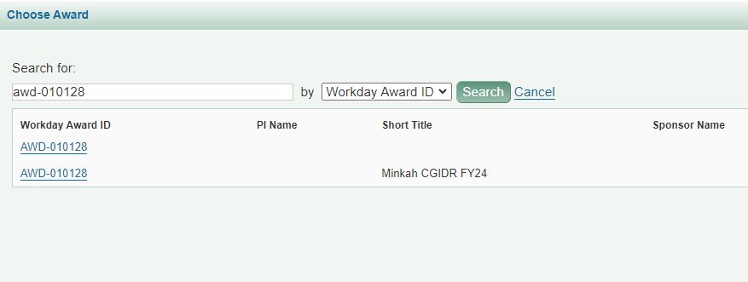
SUBAWARDS | SEARCH RESULTS
2. Select the award.
PI and Sponsor Name coming end of Nov.
May see 2 rows if there are both an ADV and ASR. Either can be selected.

Slide 5
SUBAWARDS | EGC1 DATA
3. The associated eGC1 data will auto-populate.

Slide 6
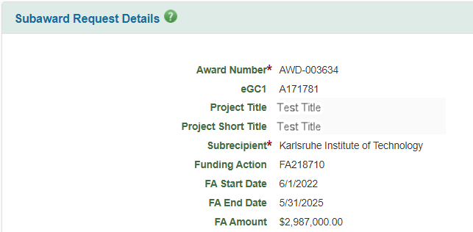
SUBAWARDS | FUNDING ACTION
Funding Action (FA) validation and lookup is removed.
For legacy subawards, the FA fields will display for reference.

Slide 7
HOLDS | CAMPUS VIEW
OSP and GCA can now set holds on both Award Setup and Modification Requests.
Campus users will see a blue banner at the top of requests if holds are applied.
Notes:
Holds do not change the status of an item at this time.

Slide 8
HOLDS | DETAILS
View hold details in the Comments & History section of the request.
Future release: Display a hold indicator on request list

Slide 9
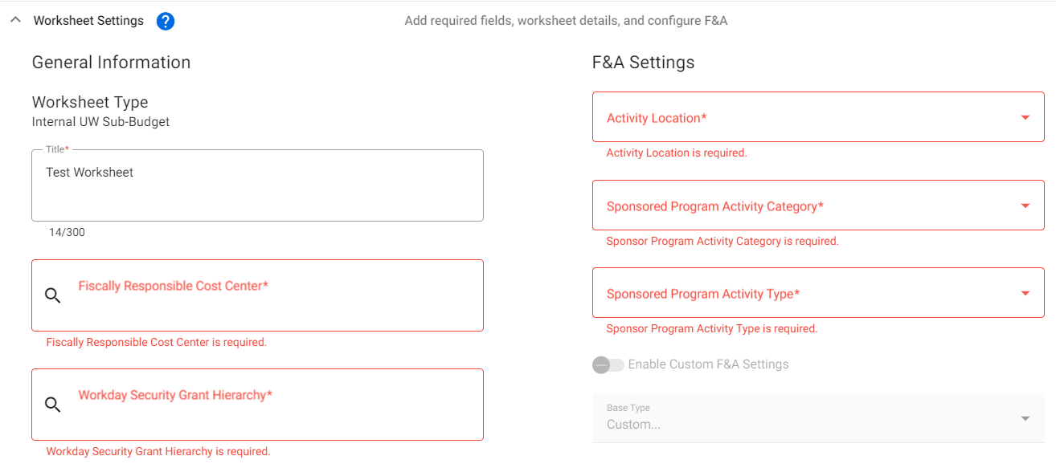
REQUIRED FIELDS: SAGE BUDGET
Required fields in SAGE Budget worksheet settings now display an asterisk and highlighting when left blank.
Notes:
Coming Nov 30 - budget export will include more information GCA requires.

Slide 10
REQUIRED FIELDS: SAGE BUDGET
A validation message now reminds users to add a Principal Investigator to each Worksheet.

Slide 11
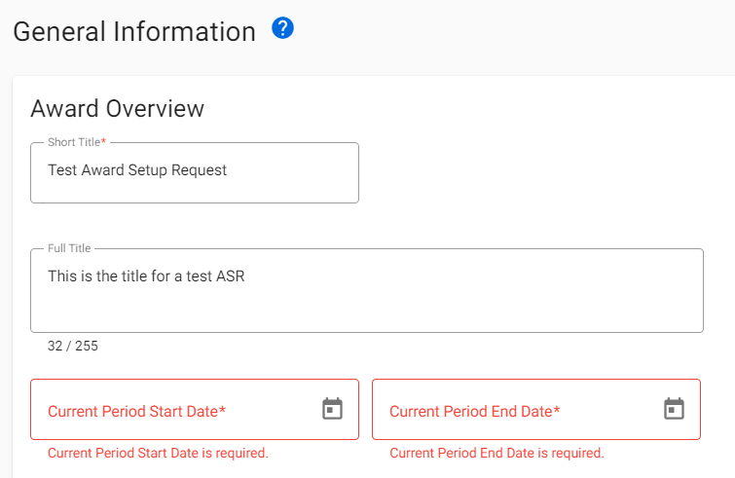
REQUIRED FIELDS: AWARD SETUP REQUESTS
Required ASR information is also now indicated with an asterisk and red highlighting if left blank.
Sample:

Slide 12
MISCELLANEOUS UPDATES
eGC1 status now changes from “Approved” to “Awarded” when an ASR is updated to “Processed.”
Accessibility improvements, including increased font size, implemented.
Various bug fixes addressed.

Slide 13
WHAT’S NEXT?
Additional SAGE release: November 30
Award search and expanded filtering capabilities
Display of more helpful detail in Award Request lists
PI, short title, Workday award number, cost center, sponsor
Advance Extension fix
SAGE Budget export to include cost center, worksheet PI, and security grant hierarchy for worksheets
Infrastructure improvements to improve stability and performance
Reference the SAGE Prioritized Issues & New Features page
Notes:
GCA will share the current workaround for advance extensions in a following presentation.

Slide 14
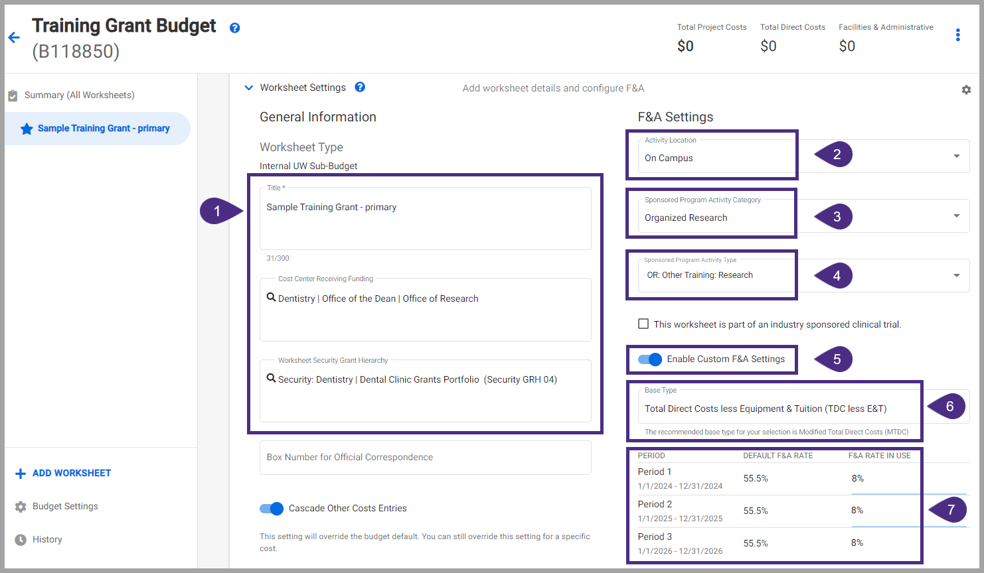
TRAINING UPDATES
New! How to Set Up Training Grants in SAGE Budget Job Aid
Notes:
This job aid walks through setting up a training grant budget in SAGE, including how to set F&A rates, salary and benefit costs, and other direct costs like stipends.

