Slide 1
COMPLIANCE HOT TOPIC: AUDIT UPDATES
MRAM
December 2024
Matt Gardner
Post Award Fiscal Compliance

Slide 2
Audit Updates – NIH Term & Condition
Some NIH institutes are including a specific award condition on the Notice of Award regarding a UW FY2023 Single Audit finding.
This specific language is not directly related to the underlying award, PI, or Department
The condition requires the University to respond to NIH within a specified period of time
MRAM – Matt Gardner – PAFC (1)

Slide 3
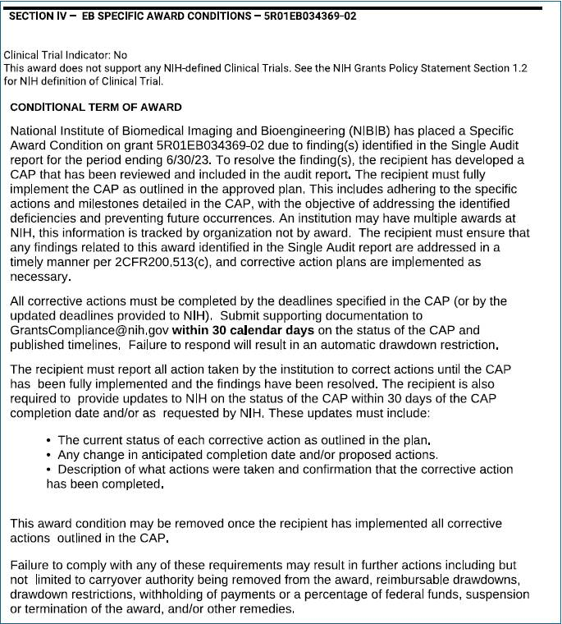
MRAM – Matt Gardner – PAFC (2)
Audit-Related Term and Condition –
NIH Example
Found in Section IV of the Notice of Award; “Specific Award Conditions”
Refers to an audit finding identified in the FY2023 Single Audit
Requires the recipient to submit supporting documentation regarding completion of the Corrective Action Plan to NIH “within 30 calendar days”

Slide 4
MRAM – Matt Gardner – PAFC (3)
Audit NIH Term & Condition –
Required Department Action
Internal Audit, the Office of Sponsored Programs (OSP), and Post Award Fiscal Compliance (PAFC) are all aware of the award condition
NIH is requiring a University, not award-specific, response
Internal Audit, OSP, and PAFC are in communication regarding an official University response
Departments should not respond directly to NIH regarding this condition

Slide 5
Audit-Related Terms & Conditions –
Other Federal Sponsors
Currently, the University is not aware of other federal sponsors including similar conditions in their Notice of Award documents
If you come across audit-related conditions in your Notice of Award, please reach out to Internal Audit or PAFC
Please don’t directly respond to the sponsor before consulting with Internal Audit or PAFC
MRAM – Matt Gardner – PAFC (4)

Slide 6
MRAM – Matt Gardner – PAFC (5)
Audit Terms & Conditions –
What should the Department do?
The audit-related term and condition will either pertain to:
The entire University, or
A specific Award, PI, or Department
Never respond directly to the sponsor in response to an audit-related condition without consultation with UW’s Office of Internal Audit
At a minimum, Internal Audit needs to maintain a record of all audit responses

Slide 7
Audit Contact Information
Internal Audit
iaudit@uw.edu
https://fa.uw.edu/audit/home
Post Award Fiscal Compliance
gcafco@uw.edu
https://finance.uw.edu/pafc/
MRAM – Matt Gardner – PAFC (6)

Slide 8
EFFORT REPORTING: DUE DATES &
OPEN OFFICE HOURS

Slide 9
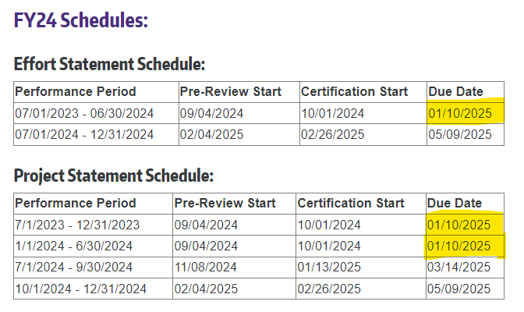
Effort Reporting Schedule and Due Dates
*Due dates for UW Academy and Harborview, not Applied Physics Lab
https://finance.uw.edu/pafc/effort-reporting/effort-reporting-schedule
MRAM – Matt Gardner – PAFC (7)

Slide 10
“Open” Office Hours –
Every Friday @ 10:AM
Friday, December 13th @ 10:00am – 11:00am Friday, December 20th @ 10:00am – 11:00am
No set topic; all questions are welcome
Office Hour info and Zoom links:
https://finance.uw.edu/pafc/effort-reporting/ecc-office-hours
MRAM – Matt Gardner – PAFC (8)

Slide 11
Questions
Post Award Fiscal Compliance (PAFC)
effortreporting@uw.edu (Effort questions)
gcafco@uw.edu (All other compliance questions)
https://finance.uw.edu/pafc/
Matt Gardner
mgard4@uw.edu
David Parks, Effort Compliance Analyst
parksd2@uw.edu
MRAM – Matt Gardner – PAFC (9)

