Slide 1
Disclaimer
The GCA Forum will be recorded and retained for the legally approved retention period under Washington State Policy
It is subject to release under the Washington State Public Records Act or Federal Freedom of Information Act (FOIA)
It will be posted publicly on our GCA YouTube channel
  Slide decks and recordings for this and past Forums are linked on our GCA Forum web page
  https://finance.uw.edu/gca/resources/gca-forum

Slide 2
GCA SUMMER FORUM
August 25, 2021

Slide 3
Welcome
Please make sure you are muted in order to reduce background noise during the presentation.
Please ask us questions using the Chat feature in Zoom. We will pause after each segment to answer them.
We want you to be engaged. This meeting is for you!

Slide 4
Agenda
GCA Announcements
  Training Grants
  GCA ADV Budget Process
Grant Tracker Overview
  Intro
  Budget Information/Open GT Notes
  Financial Information
  Contact Information/Reports/eGC1/Notes/EDMS Attachments
  Invoices/Receipts
  Grant Tracker Etiquette
  Closing/Survey

Slide 5
GCA Announcements
-Azalea Vasquez-

Slide 6
Training Grants
After GCA reconciles your Training Grant you may receive a communication from us via GrantTracker about the following
  Discrepancies discovered during the reconciliation process that require resolution
  Reviewing the draft Outstanding Trainee Obligations (OTO) we created
  Balance of Funds available for tuition obligation
  The deficit balance and transfer options

Slide 7
Training Grants
Please help us submit your report on time
  Make any stipend corrections as necessary
  Remove any unallowable expenditures
  Review the OTO’s
    Obligate tuition for the continuation year
    Submit completed OTO form to GCA via Grant Tracker
  Provide a budget number for a deficit transfer

Slide 8
GCA ADV Budget Process
The new Advance Budget request process no longer requires a specific dollar amount associated with an Advance request.
However GCA allocates $1 to object code 36-00 for all non-FOP 11 Advance budgets.
Why is GCA doing this?

Slide 9
GCA ADV Budget Process
GCA’s systems and databases utilize a $1 allocation in object code 36-00 to flag Advance budgets and exclude them from reports (like LOC draw reports) and specific automated actions (like auto generated financial reports).
This $1 allocation will be removed by GCA upon receipt of a fully executed award agreement, which effectively takes the budget out of advance status.

Slide 10
GCA ADV Budget Process
Please note that with the removal of the budgeted amount for Advance Budgets, these budgets will start appearing on your deficit report.
For more information about Advance Budgets please visit the following webpages:
  https://finance.uw.edu/gca/award-lifecycle/budget-setup/advance
  https://www.washington.edu/research/tools/sage/guide/advances/

Slide 11

Questions?

Slide 12
Grant Tracker Overview
Intro, Budget Information, and Open GT Notes
-Azalea Vasquez-

Slide 13

Accessing Grant Tracker
Left side menu
Search page
Budget Information Section
Open GT Notes Section

Slide 14
Grant Tracker - Intro
How do you get to Grant Tracker?
  GCA Website g Trainings & Outreach g Grant Tracker Webpage
  MyFD g More Systems menu g Grant Tracker Webpage
Overview of the left link menu
  Org Code Reports
  Campus Contacts
  MyTRANSPASUs
  Add New Sub Budget

Slide 15
Grant Tracker - Budget Information
We strongly encourage you to review the Budget Information after your budget has been set up
  UW systems update overnight – Your budget will be viewable the next day
  Take note of your Final Action Date
  Review your Record Retention Date
    Unavailable? This is a known issue and it currently being worked on.
    If you need help estimating your RRD let us know!

Slide 16
Grant Tracker – Contacts and Open GT Notes
Email Contacts
  Please set these up as soon as possible
  The default contact is the PI
  You can add as many contacts as you would like
  UW email addresses only
Open GT Notes
  Inquires that are open under both parent and sub budgets are framed in a red box under the parent budget (at a glance)

Slide 17
Questions?

Slide 18
Grant Tracker Overview
Financial Information
-Michelle Davis-

Slide 19
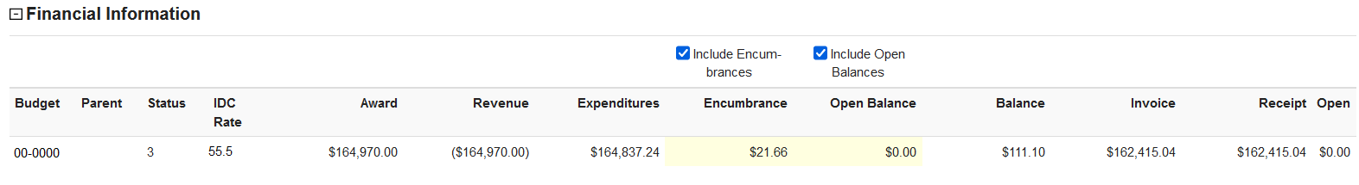
Financial Information Overview
Award/revenue = award total
  If sub budgets are set up, you will see how much is allocated to each budget
  At closeout, budgeted amount be adjusted to match the expenditure total (up to the authorized amount)
Expenditures = total expenditures to date
Encumbrance/Open Balance = outstanding commitments (such as salary, ARIBA orders)
Balance = amount remaining

Slide 20
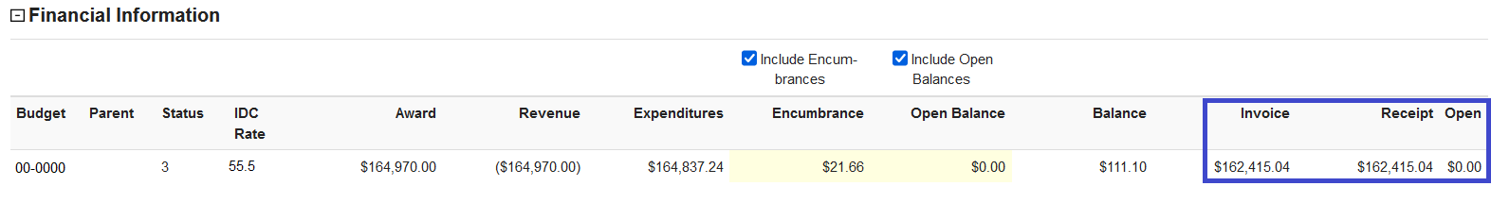
Cost Reimbursable Award Example
Invoices/Receipts
  Invoice = reflects total invoiced to date. Invoices are submitted based on actual expenditures, up to the award amount
  Receipt = total received to date
  Open = unpaid invoice amount

Slide 21
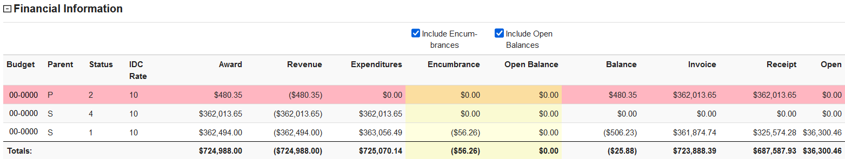
Cost Reimbursable Award with Sub Budgets
If the award has separate billing on the parent and sub budgets, you can see how much has been invoiced/received on each budget

Slide 22
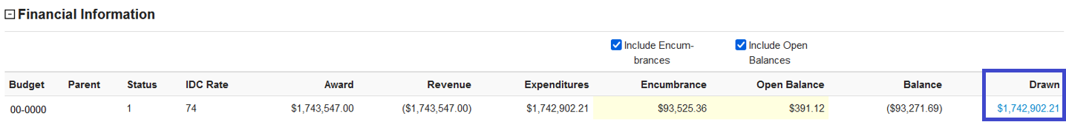
Letter of Credit Award Example
Drawn = total cash drawn
  cash is drawn according to actual expenditures up to the award amount

Slide 23
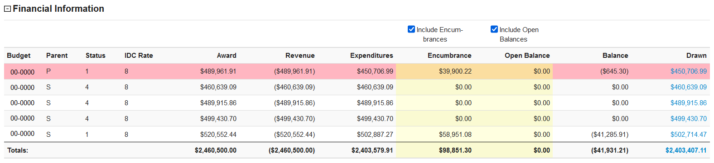
Letter of Credit Award with Sub Budgets
When there are sub budgets, you can view the total drawn on each sub budget and the cumulative drawn amount
If you click on the drawn amount, you can see an overview of the cash draws for that budget

Slide 24
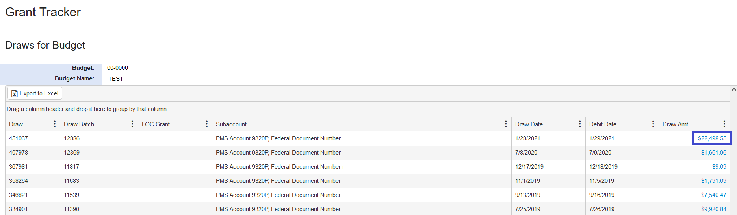
Cash Draw Overview

Slide 25
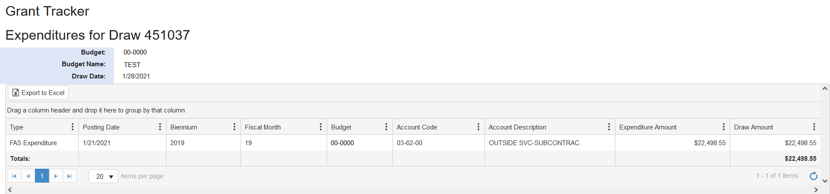
Cash Draw Detail

Slide 26
Questions?

Slide 27
Grant Tracker Overview
Contact Information/Reports/eGC1/Notes/ EDMS Attachments
-Azalea Vasquez-

Slide 28
Contact Information
Reports
eGC1s
Notes
EDMS Attachments

Slide 29
Contact Information/Reports/eGC1/Notes/ EDMS Attachments
Contact Information
  Submit Grant Tracker Questions
    Grant Tracker Topic Glossary
Reports
  Rolling reports vs Separate Year Accountability
eGC1s
  List of associated eGC1s
  Link to My Research

Slide 30
Contact Information/Reports/eGC1/Notes/ EDMS Attachments
Notes
  Submit Grant Tracker Questions
  History of all the notes related to the budget
  Easy access to attachments
EDMS Attachments
  No longer in use
  If you are reviewing an older budget you may notice attachments in this section

Slide 31
Questions?

Slide 32

Invoices and Receipts aka Show Me the Money!
- Susan Wilbanks -

Slide 33
The Basics – Financial Information Line
Notes:
Quick overview of what you can see here—total invoiced to date, how much has been paid, whether there are open invoices.

Slide 34
Invoices Section Overview
Notes:
Go over the basics – mention that each invoice number is a hyperlink that pulls up a PDF of the invoice, the other columns and what they tell you, the codes and what they mean.

Slide 35
Invoices Section Overview continued
Notes:
Describe voided invoices and open amounts

Slide 36
Emailing an Invoice to the Sponsor
Notes:
Review form. Mention that you can add additional attachments if needed, that it creates GT note, that the From defaults to your name and email but can be edited, etc.

Slide 37
Internal Invoices
Notes:
Describe why we create internal invoices and stress importance of NOT emailing them to sponsors.

Slide 38
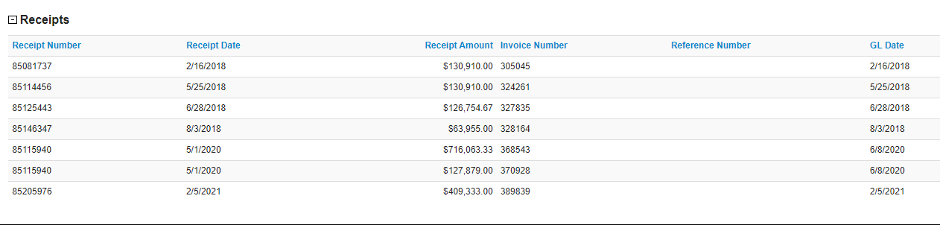
Receipts Section Overview
Notes:
Go over the basics, including difference between receipt date and GL date

Slide 39
Questions?

Slide 40
Grant Tracker Etiquette
-Austin Campbell-

Slide 41
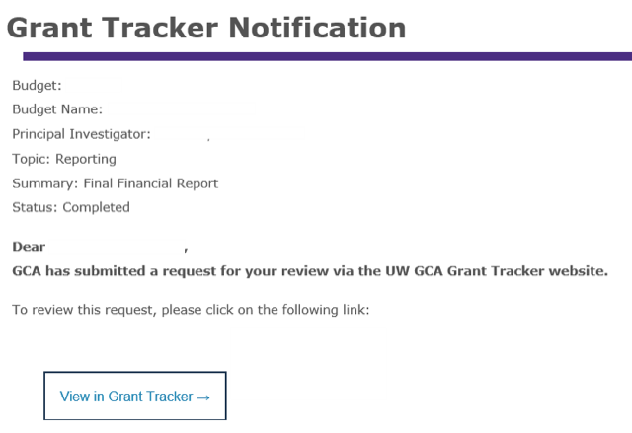
Responding to Grant Tracker Notifications
When a Grant Tracker note is updated, an email is sent out to the contacts listed on that note.
Do not respond to this email!
When you respond to the email notification, the note goes to the gcahelp inbox. This delays the information from getting to the correct GCA recipient.

Slide 42
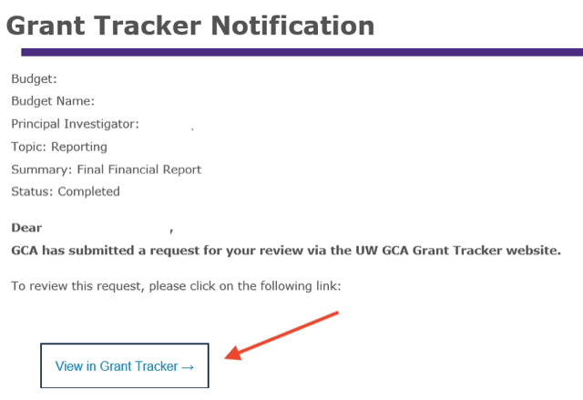
Responding to Grant Tracker Notifications
Select “View in Grant Tracker” to open the note in the Grant Tracker system.

Slide 43
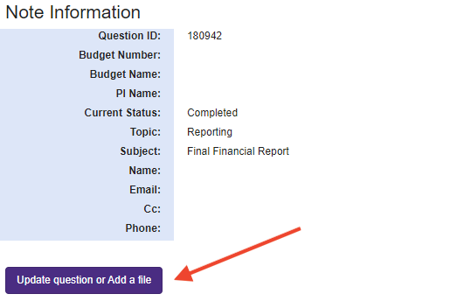
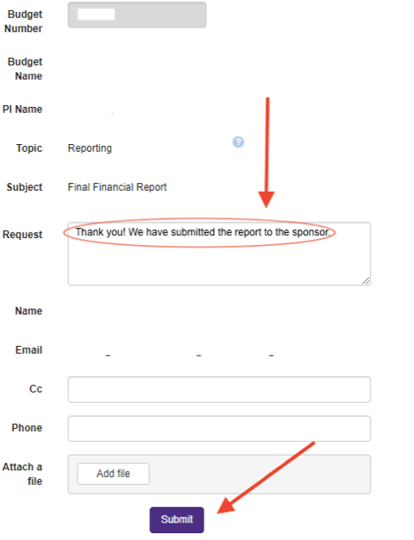
Responding to Grant Tracker Notifications
Once you have opened the note in Grant Tracker, choose “Update question or Add a file” to submit your response via the Note Edit form.

Slide 44
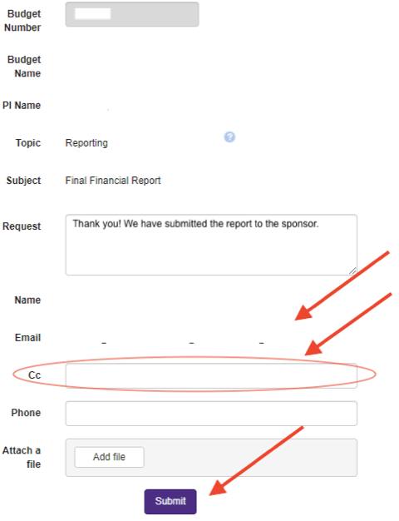
Responding to Grant Tracker Notifications
If editing a Grant Tracker note, confirm you are included in the email or cc list.
  If you edit a note and are not on either list, you will not receive email notifications when the note has been updated.
  This can delay getting information to/from your department.
    Example: PI receives email notification regarding a Grant Tracker note and forwards it to you. You will still be able to view and edit the note in Grant Tracker, but you will not automatically be alerted when GCA responds.
  Emails can be added to the cc line in the Note Edit form.

Slide 45
New Grant Tracker Notes
If GCA opens a Grant Tracker note requiring a response from your department, do not open a new Grant Tracker note to respond.
  Please update the Grant Tracker note opened by GCA for that issue.
  New notes are triaged by the GA team. Opening a new Grant Tracker duplicates and/or creates additional work, delaying your response reaching the requestor.
New Grant Tracker notes should only be submitted for new issues.
  A new note is still appropriate if something similar was requested before, but the prior note was completed.
    Example: An org code change is requested in June, but the org code needs to be changed again. Do not re-open the old note—start a new note.
    Example: Grant Tracker note was completed regarding an interim financial report for the period ending 6/31. GCA submits a new Grant Tracker note for information for the upcoming interim financial report. Respond to the recent, open note with the required information—do not start a new note or respond to the prior, completed note.
    Example: Budget status change was requested changing the budget to status 3. Your department would like to re-open the budget to status 1—send a new note, do not re-open the prior note which requested status 3.

Slide 46
Re-Opening Grant Tracker Notes
Grant Tracker notes are marked “completed” when the issue has been resolved, however there are occasions where re-opening a Grant Tracker note may be appropriate.
  Example: Your department request an org code change. The note is marked completed, but the wrong org code was entered into the system. The note should be re-opened to notify us of the error so we can make the correction.
  Example: GCA sends Grant Tracker notes to campus regarding unbilled milestones/deliverables, which are automatically marked completed. If your department has completed the deliverable and needs to let GCA know to bill, your department should re-open that note to provide an update (instead of sending a new request).
    However, once GCA has billed for that specific deliverable and the request is updated and completed, you should not re-open that note to ask us to bill for another deliverable.
    Example: GCA sends a reminder regarding unbilled deliverable A. Your department lets us know it has been met. Invoice is issued and the note is updated/marked completed. Do not re-open the same note to ask us to bill for deliverable B. If there is not a note for deliverable B yet, you would want to submit a new note.

Slide 47
Re-Opening Grant Tracker Notes
Questions that have been completed for 90 days or longer cannot be modified.
If a Grant Tracker note should be re-opened, but the 90-day window has passed, it is appropriate to submit a new note.
  Grant Tracker will notify you the 90-day window has passed and prompt you to create a new question.

Slide 48
Duplicate Requests
Please choose one method (Grant Tracker or email) when sending a request to GCA.
The Grant Analyst receiving the email request may not be the same Grant Analyst receiving the Grant Tracker note.
  This causes confusion and duplication of work
If you must send an email that is related to an open Grant Tracker note, please reference the note and/or Grant Analyst you have been working with.

Slide 49
Grant Tracker Etiquette - Key Takeaways
When Grant Tracker notes are updated or submitted correctly, the risk of duplicate work and delay in the transmittal of information is reduced.
Grant Tracker notes help GCA and your department by keeping communication in a central place. It is much easier to research and understand the budget’s story if request-specific information is stored within that note.
Please do not send the same request via email and Grant Tracker.

Slide 50
Questions?

Slide 51
Future Forum
November
2021
VIA ZOOM
https://finance.uw.edu/gca/training-outreach/gca-forum
Survey about today’s forum will be sent out soon!

Slide 52
Contact Us
Email
gcahelp@uw.edu
GCA Help Hotline
206-616-9995 (9:00 am to 12:00 pm and 1:00 pm to 4:00 pm)
Grant Tracker
https://www.washington.edu/research/gca/budget/granttracker.html

Slide 53
Questions?

