Slide 1
DISCLAIMER
The GCA Forum will be recorded and retained for the legally approved retention period under Washington State Policy
It is subject to release under the Washington State Public Records Act or Federal Freedom of Information Act (FOIA)
It will be posted publicly on our GCA YouTube channel
Slide decks and recordings for this and past Forums are linked on our GCA Forum web page
https://finance.uw.edu/gca/resources/gca-forum

Slide 2
GCA FALL FORUM
November 18, 2020

Slide 3
Welcome!
We have prepared material for the entire hour.
Please ask us questions using the Chat feature in Zoom. We will pause after each segment to answer them.
We want you to be engaged. This meeting is for you!

Slide 4
Agenda
Final Action Date
Late-Posting Charges and the Pending Transactions Form
Awards Issued in Foreign Currency
FOP 11 Budget Setup
Advance Budget Request Reminder
Mystery Transactions
Common Errors: Invoicing and Grant Tracker

Slide 5
Final Action Date
Susan Wilbanks

Slide 6
What is the Final Action Date?
The Final Action Date (FAD) is the last day a grant or contract budget is open in status 1 in the UW fiscal system
The FAD is therefore the last day the budget is available for expenditures

Slide 7
What happens after the FAD has passed?
The budget will automatically close to status 3 (initial close)
GCA will begin work on the final invoice and/or final financial report

Slide 8
When is the Final Action Date?
It depends on the award’s financial closeout requirements, typically:
3 weeks before the final financial report is due, or
1 week before the final invoice is due
NOTE: If the award has early reporting/invoicing deadlines, it will have an early FAD.

Slide 9
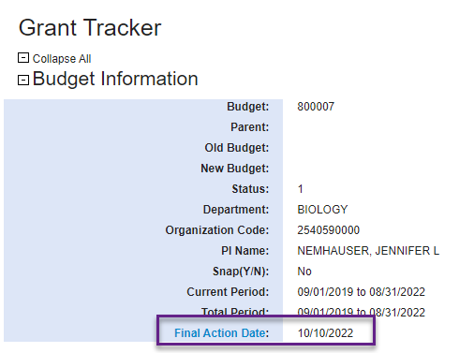
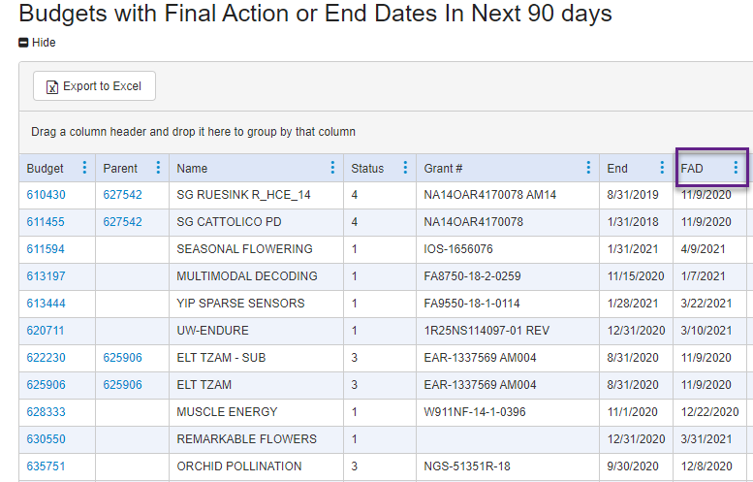
Where can I find a budget’s FAD?
Grant Tracker Budget Information Page Grant Tracker Org Code Reports

Slide 10
Why is the FAD necessary?
In other words, why can’t the award budget just stay open until the day the final report or invoice is due?
Preparing final invoices and reports takes time
GCA issues multiple invoices and reports each month. Note that volumes are especially high 60-90 days after common award end dates such as 6/30 or 12/31.
The window between the FAD and the final due date allows time for GCA to work with the department to correct any errors or problems discovered during final reconciliation of the budget

Slide 11
How can departments use the FAD?
The FAD can be a useful tool in budget management!
As soon as a new award budget is available in Grant Tracker, check its FAD and set up calendar reminders allowing you to complete all financial activities by that point:
Subcontract and vendor invoices
Procard transactions
Expense transfers
Org code reports allow you to sort a budget list by FAD

Slide 12
How can I change the FAD?
The FAD is system-generated based on the award’s financial closeout requirements, and therefore can only change if those requirements do, e.g.:
If the sponsor extends the award end date
If the sponsor provides an award modification changing the invoicing or reporting deadline
But what about late-posting charges?
Hold that thought….

Slide 13
Questions?

Slide 14
Late Posting Charges and the Pending Transaction Form
Michelle Davis

Slide 15
What if I have more charges?
If additional charges are identified after the FAD (and perhaps after we’ve already issued the final invoice and/or report), there are a few things we need before we can re-open the budget and issue a late or revised report/invoice:
Pending Transaction Form with an audit justification
Sponsor approval for a late/revised final report/invoice
The Pending Transaction Form (+ sponsor approval) will need to be reviewed and approved by a GCA manager before the budget can be re-opened
Charges under $200 are generally the responsibility of the department

Slide 16
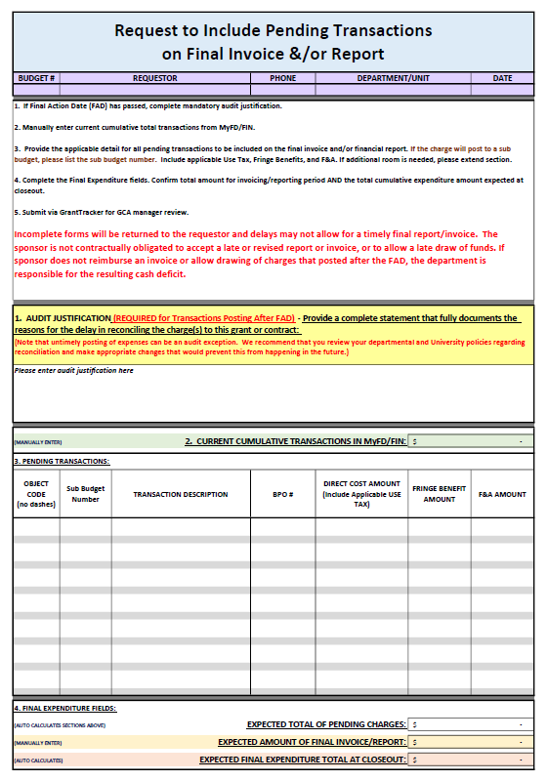
What is the Pending Transaction Form?
The form outlines the charges that still need to post to the budget as well as the expected final expenditure total
In addition to transaction detail, we also ask you to provide an audit justification for the late charges
Late posting charges pose an audit risk and may indicate mismanagement of award funds

Slide 17
Audit justification
What are we looking for?
Why the delay in reconciliation occurred
What measures are being taken by the department to prevent delays in reconciliation
Example:

Slide 18
Sponsor approval
Depending on when we receive the request to re-open the budget for late charges, we may also need the sponsor’s written confirmation that they’ll accept a late or revised invoice/report
If we haven’t issued the final report/invoice yet but it’s due in a few days:
Can the sponsor accept a late report/invoice?
If we’ve already submitted the final report/invoice:
Can the sponsor accept a revised report/invoice?
Or can the sponsor accept a supplemental final invoice instead of a revised final invoice?

Slide 19
Sponsor approval
The sponsor is not contractually obligated to accept late or revised reports and invoices
If the sponsor rejects the late invoice/report the department is responsible for any resulting cash deficit

Slide 20
Additional Resources
Closing Your Award: https://finance.uw.edu/gca/award-lifecycle/closing-your-award
Pending Transaction Detail Form and Instructions: https://finance.uw.edu/gca/award-lifecycle/closing-your-award/pending-transaction-detail-form-instructions
GIM 39 – Closeout of Sponsored Programs: https://www.washington.edu/research/policies/gim-39-closeout-of-sponsored-programs/

Slide 21
Questions?

Slide 22
Awards Issued in Foreign Currency
Cheryl Haycox

Slide 23
Yes, We Have No US Dollars
Awards issued in foreign currency carry additional risk to the departments because the US dollar amount is unknown until the payment comes in.
The party with the most risk is the party whose currency is NOT on the award document-they are at the mercy of the rates.
Because the amount is paid after the award is set up, it’s easy to over-spend.

Slide 24
Foreign award payment types
Pay in Advance
Advantage for the PI because we know exactly how much we have to spend
Scheduled Payment or Milestone
Unknown Award amount until all payments have been received
Fluctuation can move up or down so we may have more or less than the estimated amount
Cost Reimbursable
These SHOULD end up in balance, but rarely do
GCA takes the posted expenditures, converts the total amount to the foreign currency, then issues the invoice. The sponsor pays the requested amount of their currency, which is then converted to USD upon receipt by our bank. The fluctuation in rates will determine if we receive more or less than enough to cover expenses.

Slide 25
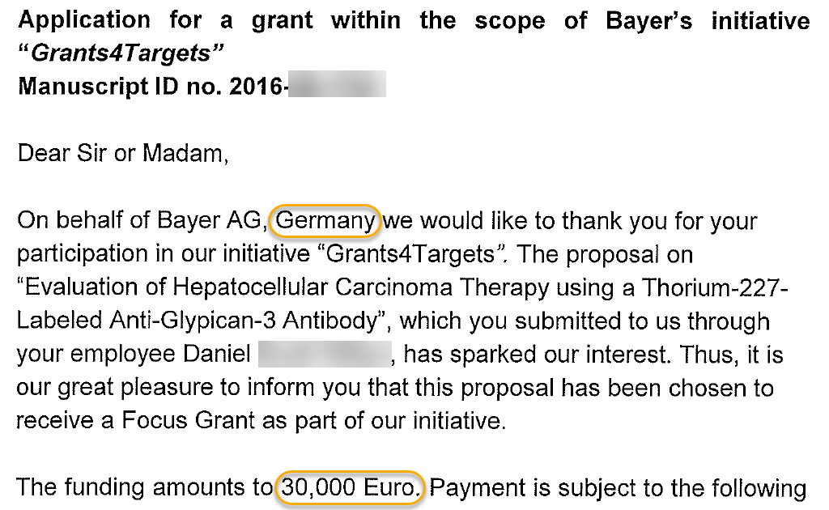
How Are These Awards Set Up?
The UW receives the award document and sees that the funding is in foreign currency:

Slide 26
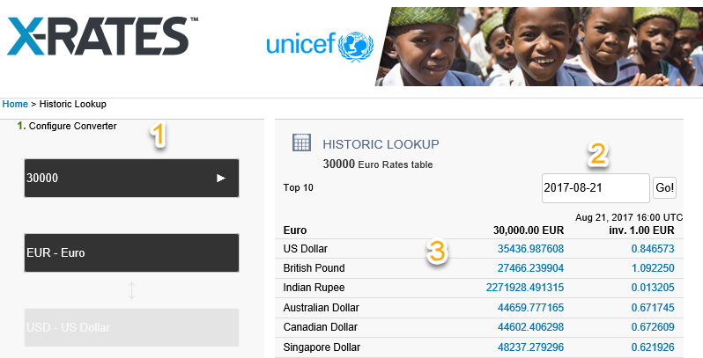
Campus prepares the initial conversion when setting up the eGC1, and OSP updates the Dollar Amount when sending the Funding Action to GCA
Sites like OandA or X-Rates provide general exchange rates
These are outdated within minutes, and do not include bank fees, which are added to the rate, or the rate used by the foreign bank (buying or selling, US versus foreign currency)
In this example, we’re recreating the
scene to show that the average worth
for 30,000 Euros on 8/21/17 is
$35,437

Slide 27
How the FA Came to GCA at Set Up

Slide 28
Actual Funds
The wire was received at the UW on 11/7/2017, 45 days after the eFA was prepared
eFA was for $35,405, actual funding received was $34,191. This ended in a difference of $1,214. If the department spent to the estimated amount, they would have a deficit of $1,214

Slide 29
Post Award
Read your Funding Action! Both OSP and GCA try to put helpful notes on the notification

Slide 30
Post Award
Use the Receipt amount in Grant Tracker to monitor how much money you have

Slide 31
Best Practices
Pre-Award
Negotiate for the award to be in US Dollars
If that fails, negotiate for Pay in Advance or Scheduled Payment as the payment type rather than Cost Reimbursable.
Know when and how payments will be made. The more time between now and the payments, the more opportunity for rate fluctuation or influence by world events.
The stronger the dollar gets, the less money we will get, conversely, the weaker the dollar is against the foreign currency, the more the award receives.

Slide 32
Best Practice
Find a way to track your payments—both expected and actual. This example below is nice and simple

Slide 33
Best Practices
Be concerned if a sponsor asks to change from paying in USD to their currency—it probably means the dollar is strong, and they’ll need to spend more of their currency to buy the number of dollars needed to meet the award amount.
Let GCA know if you’ve received the full amount of the award so we can update the award amount in the system
Resource for more information: https://finance.uw.edu/gca/award-lifecycle/sponsor-payments/foreign-currency

Slide 34
Questions or Comments??

Slide 35
Setting up Budgets with Form of Payment 11
Austin Campbell

Slide 36
Form Of Payment (FOP) 11
Form of Payment type for budgets where departments are responsible for billing and collecting/applying payments
Usually clinical trials/patient costs (grant budgets)
Gifts and some non-grant budgets also fall under this payment type
It is extremely important these budgets are set up correctly
Erroneous billing type usually results in sponsor being billed incorrectly
Sometimes this goes unnoticed for a long period of time
Corrections are time-consuming
Notes:
Awards that GCA does not invoice for are set up in the financial system with Form of Payment or FOP 11. Your department is responsible for billing on these awards, collecting and applying payments. The common types of grants which fall under this category are clinical trials or patient costs. Gifts and some non-grant budgets are also FOP 11. If GCA does not know a budget should be set up with FOP 11, and we set it up in our billing system, it can be tricky and time consuming to correct. When this happens, usually the sponsor is billed incorrectly. Depending on the situation, this may go unnoticed for a long period of time, causing more erroneous billing, and a more complex correction.

Slide 37
How Can This Be Prevented?
Common situations
Award with patient cost rates which appears like a standard milestone-type grant
If patient costs are not clearly called out and/or there is no note on the Funding Action (FA) regarding the billing, this could be set up incorrectly as milestone (GCA invoicing)
Award with split billing
Portion of award is cost reimbursable/milestone (GCA invoicing), portion of award is patient costs (department invoicing)
Requires GCA to set up a FOP 11 sub budget for the patient portion
If you know any of your funding is patient-related (to be billed by your department), let OSP know so they can note it in the comments on the FA
Notes:
One commonly seen situation is an award with a patient cost payment schedule that resembles a standard milestone-type grant payment schedule. If we receive an award like this, and it is not clearly called out that your department should be billing, whether that be in the award itself or on the FA form from OSP, there is a chance this could be set up incorrectly with GCA invoicing.
I think the most common situation I see, and the one that is the most difficult to untangle and correct, is an award with split billing. This is where a portion of the award is cost reimbursable/milestone-style (for GCA to bill) and then another portion is for patient costs which should be invoiced by your department. Awards like this require a parent budget set up with the funds/expenditures for GCA to invoice and a sub budget for the patient or department billed, FOP 11 portion.
If you know any of your funding is patient-related or to be billed by your department, please make sure OSP is aware so they can note it correctly on the FA.

Slide 38
Closing FOP 11 Budgets
Since clinical trial budgets do not follow the same process as other GCA-invoiced budgets, we rely on your department to:
Let us know when the trial has been completed (if early)
Ensure all costs have been billed and any expected sponsor payments have been applied prior to requesting GCA close the budget to status 4
Often, we are asked to close a FOP 11 budget to status 4 before all payments have been received/applied
This requires us to re-open the budget (if it has not been purged) for the cash to be applied, surplus re-processed (if applicable) and then re-close the budget
Reminder: next June is biennium close and budgets in status 4 will be purged at that time.
Notes:
Since GCA does not invoice for FOP 11 budgets, we rely on your department to let us know when the study has been completed (if early – if not, we will close out after the Final Action Date per our standard closing process). It is also important that your department ensures all costs have been billed and all payments reconciled and applied to the budget prior to requesting that GCA close the budget to status 4. If we are asked to close the budget early, before all payments have been received and applied, the process to reverse the closeout to apply the payments is multistep, and if the budget has been purged, we can’t just go and re-open the budget to apply the payment. Please reconcile your FOP 11 budgets prior to requesting a final close.
*** remind campus that next June is biennium close!!!

Slide 39
Questions?

Slide 40
Advance Budget Request Reminder
Austin Campbell

Slide 41
Advance Budget Request Reminder
Multiple components to requesting an Advance Budget
Advance Budget Number Eligibility for your eGC1 (OSP)
Create Advance Budget Request Form (ADV) through SAGE (OSP)
Print the form, obtain signatures, scan and submit to GCA
GCA will not know to process the Advance Budget request until we received the signed form
Forms for New Advance Budgets should be submitted to gcahelp@uw.edu
Forms for Renewal Advance Budgets or Advance Budget Extensions should be submitted via Grant Tracker on the current budget
Turnaround time for an Advance Budget Request is typically 1-2 business days
Notes:
Mention something about PDF electronic signatures/email approval.
Add something to #3 – nothing happens until that form comes in. You have to send us the form for us to know!! The form needs to have signatures and be sent to GCA before the budget # can be established!!
Mention we prefer GT in cases where it works.
** add #4 – turnaround time is usually 1-2 business days

Slide 42
Questions?

Slide 43
Mystery Transactions and Expenditure Backup
Tips and tricks for getting the backup documents you need for reconciliation
Azalea Vasquez

Slide 44
Expenditures and Journal Vouchers - Origins
Where do expenditures come from?
Various external and internal sources from outside and inside the UW
Payroll – Workday
Outside services – Ariba and Procard
Internal services – Central Offices or Cost Centers
Where do Journal Vouchers (JV’s) come from?
Internal transaction
Central Office (Student Fiscal Services, Real Estate, GCA)
Departments

Slide 45
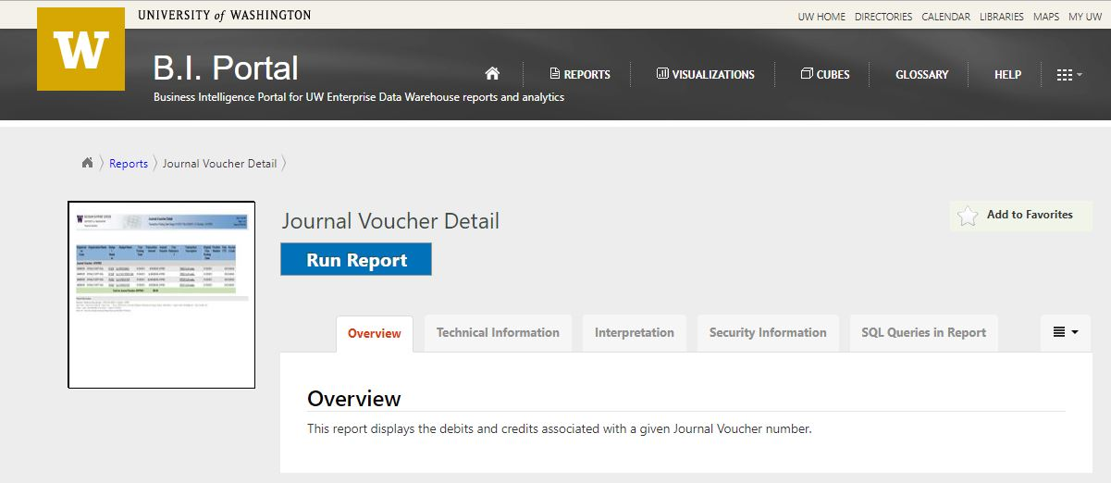
Journal Vouchers – Obtaining a JV Copy
Electronic copies of JV transactions are accessible via the Business Intelligence Portal (B.I. Portal) under the Journal Voucher Detail report

Slide 46
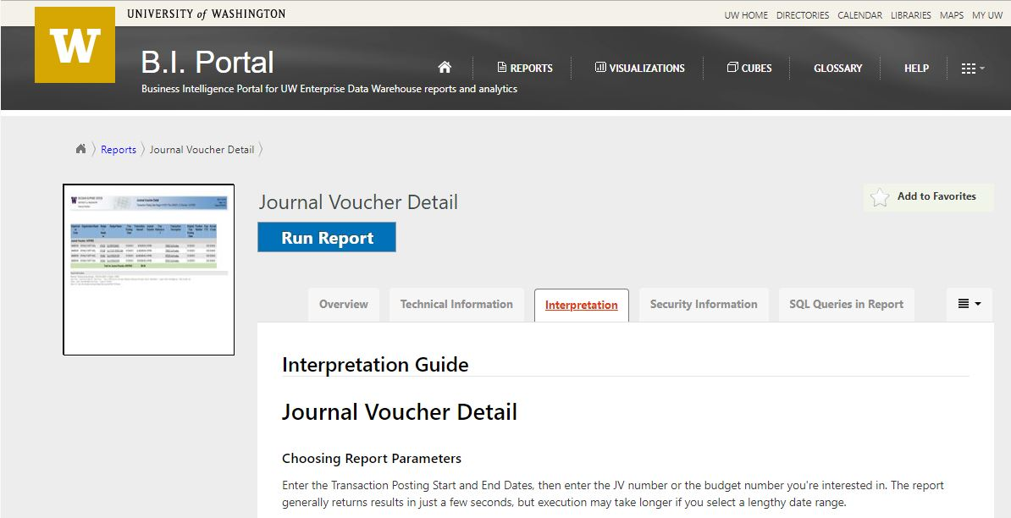
Journal Vouchers – Obtaining a JV Copy
If it is your first time using the report, we recommend that you read the Interpretation Guide first so you get the most out of the tool. Select the tab labeled “Interpretation” before you run the report.

Slide 47
Journal Vouchers – Obtaining a JV Copy
After you click the blue “Run Report” button it will take you to the report page
Just fill in your parameters and click the “View Report” button on the right

Slide 48
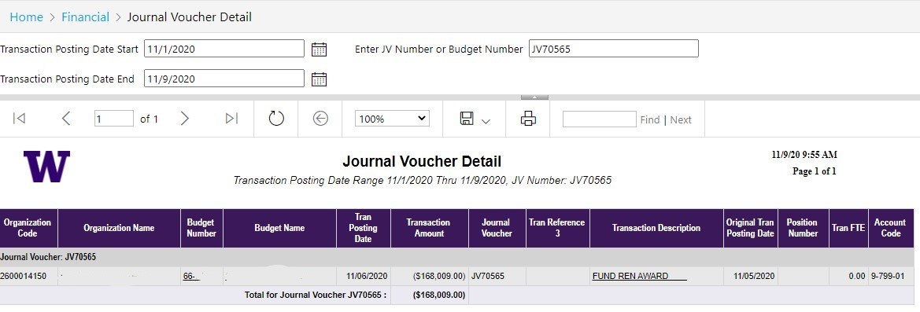
Journal Vouchers – Obtaining a JV Copy

Slide 49
Journal Vouchers – Who Processed It?
If you have questions or need more information about a JV on your budget, you can use the Originating Area Code to find the correct office to contact
Start by clicking the transaction in MyFD:

Slide 50
Journal Vouchers – Who Processed It?
You will be taken to the Transaction Detail
Scroll down to the originating area code
Click the words “Originating Area Code:

Slide 51
Journal Vouchers – Who Processed It?
The MyFD Glossary will open and a list of originating area codes will be displayed that includes contact information

Slide 52
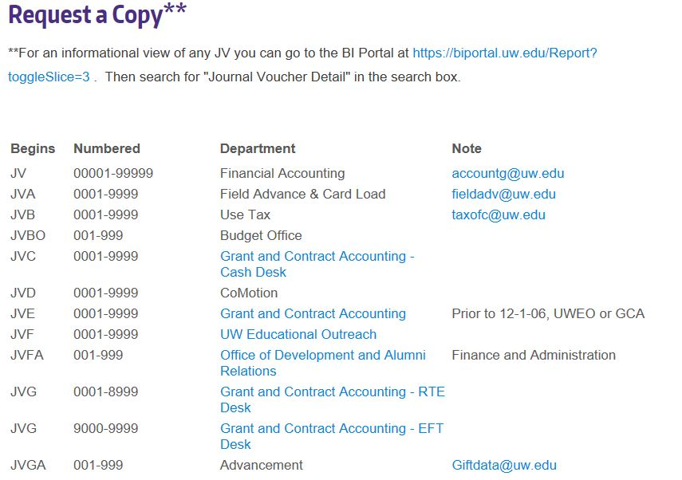
Journal Vouchers – Who Processed It?
If you have questions or need more information about a JV on your budget please visit the Financial Reporting Journal Voucher webpage to find the correct office to contact

Slide 53
Journal Vouchers – MyFinancial.desktop
If the JV was submitted in MyFinancial.desktop, you can drill down to the transaction detail by clicking on the Description field in the Transaction Summary

Slide 54
Journal Vouchers – MyFinancial.desktop
Look for a dark purple button at the top of the page labeled “Show MyFD-JV”.

Slide 55
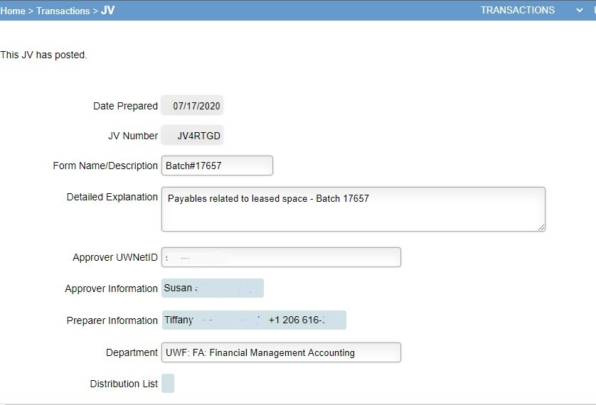
Journal Vouchers – MyFinancial.desktop

Slide 56
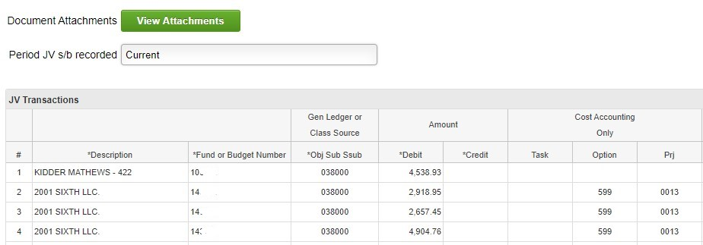
Journal Vouchers – MyFinancial.desktop

Slide 57
Journal Vouchers – MyFinancial.desktop
Alternatively, if the second Reference field contains a clickable link, it will take you directly to the transaction detail.

Slide 58
Internal Sales Document, Cost Transfer Invoice, and Cash Transmittal - Origins
Internal Sales Document (ISD)
Used for recording sales of services or supplies by service centers and auxiliary enterprises to other University of Washington entities.
Cost Transfer Invoice (CTI)
Used for transferring the costs of services or supplies between budget entities at the University of Washington.
Cash Transmittal (CT)
Accounting entry used to record/claim revenue and refunds to your department budget

Slide 59
ISD, CTI, and CTs – Who Processed Them?
Use the information in the Reference fields to look for contact information (phone/email)
Click on the transaction to get to the detail and search by Originating Area Code

Slide 60
Questions?

Slide 61
Common Errors: Invoicing
Liz Lee

Slide 62
Who Submits Invoices? GCA or Me?
Most times – GCA will be responsible for invoicing on your budget
Exceptions: FOP 11/Clinical Trials
Pay close attention to the invoicing information on your Funding Action (FA) and award agreement
If additional required detail/backup is required, please work with GCA to ensure invoices are submitted correctly
Please do not submit your own invoices without notifying GCA. If you have any questions about the invoicing process, please ask at the beginning of the award!

Slide 63
Common Errors: Invoices Not Submitted
Sponsor notifies GCA they have not received an invoice
If backup documentation is required with invoices, GCA will generate an invoice and notify departments via Grant Tracker when it is ready for review and submission

Slide 64
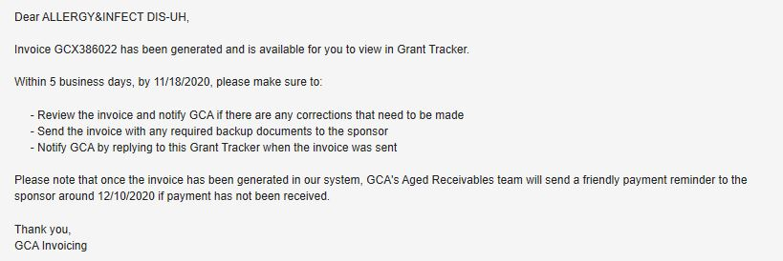
Common Errors: Invoices Not Submitted (cont.)
If you receive this Grant Tracker, please review the invoice and attach any required backup and submit to sponsor
Please update Grant Tracker once invoice has been submitted so we can track payment status
You may also attach backup to GT Note and GCA will submit to sponsor

Slide 65
Common Errors: Milestone Invoices
Milestone invoices are invoiced based on the deliverables outlined in the agreement
Departments are responsible for notifying GCA once deliverables have been completed
Estimated completion dates are entered in our invoicing system at time of award
GCA will check on deliverable status if date has passed, and we have not heard from you
GCA PROCESS CHANGE! GCA will send one Grant Tracker as a courtesy reminder for a deliverable approximately one month prior to the due date.

Slide 66
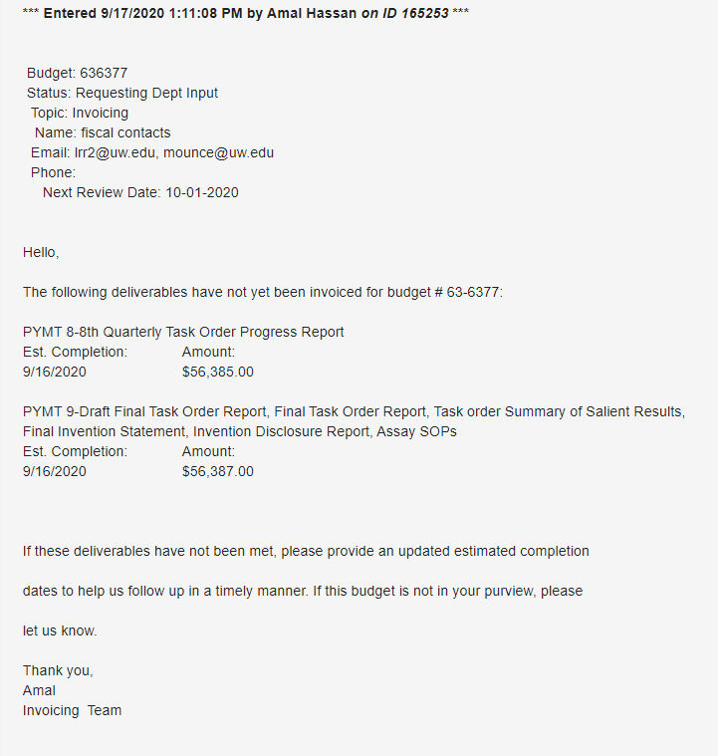
Common Errors: Milestone Invoices (cont.)
Please be sure deliverables are completed when you notify GCA
Invoices for incomplete deliverables will need to be voided in our system

Slide 67
Questions?

Slide 68
Common Errors: Failure to Respond to Grant Tracker Requests
Liz Lee

Slide 69
Common Errors: Grant Tracker Campus Contacts
GCA uses Grant Tracker to communicate with campus about various budget issues/reminders/invoices/reports
It’s important for you to add campus email contacts to your budgets on Grant Tracker. If there are not any contacts, we will use the contacts on the Funding Action (FA)
Failing to respond delays invoices, reports and closeout process

Slide 70
Common Errors: Grant Tracker Campus Contacts

Slide 71
Common Errors: Risks associated with non-response
Reporting:
Unknown information for interim and final reports
Cost share information for reports
Copy of report for you to submit
Invoices:
Unbilled milestone/deliverables
Invoice ready for submission
PO# request
Backup documentation requests
Cost share
Closing:
Surplus balances
Refunds
Deficits
Other Topics:
Award clarification questions

Slide 72
Questions?

Slide 73
Contact us
Email gcahelp@uw.edu
Phone (Message Only) 206-616-9995
Grant Tracker https://www.washington.edu/research/gca/budget/Grant Tracker.html

