Slide 1
Disclaimer
The GCA Forum will be recorded and retained for the legally approved retention period under Washington State Policy
It is subject to release under the Washington State Public Records Act or Federal Freedom of Information Act (FOIA)
It will be posted publicly on our GCA YouTube channel
Slide decks and recordings for this and past Forums are linked on our GCA Forum web page: https://finance.uw.edu/gca/resources/gca-forum

Slide 2
GCA Forum
Fall 2021

Slide 3
Welcome!
We have prepared material for the entire hour
Please ask us questions using the Chat feature in Zoom. We will pause after each segment to answer them
We want you to be engaged. This meeting is for you

Slide 4
Agenda
Budget Setup: OSP to GCA
Invoicing 101
Tracking Award Payments
Obtaining Journal Voucher, CTI, and ISD Copies
Smooth Award Closeout

Slide 5
OSP to Budget Setup
Translating information from an award into the financial system.
Patrick Carney

Slide 6
PACs and FAs
We receive a Post Award Change (PAC) from OSP for an award that has already been funded but some terms on the agreement are being amended without adding additional funding to the award.
A Funding Action (FA) can either be a new award or any amendment that adds additional funds to an existing award.

Slide 7
Flow of Information
Once an eGC1 has been created for a proposal, it is submitted to OSP.
OSP takes the fully executed award and creates a Funding Action.
Information from the eGC1 is pulled into the Funding Action.
Once the Funding Action has been completed by OSP it is sent to GCA where our Budget Setup team will pull it into their workload.

Slide 8
When an Item is in GCA
Once an item is in GCA, our Budget Setup team will begin reviewing the item to verify the information on the item against the terms of the award. This includes:
Billing
Reporting
The PI
The Award Number
The Award Period
Etc.

Slide 9
Inputting Information into the Financial System
Once all the information is verified, Budget Setup will input the new budget into the financial system (or make any updates needed to the existing budget). Within a few days, this information will flow through to update both MyFinancialDesktop and Grant Tracker.

Slide 10
Inputting Information into the Billing System
For invoiceable awards, once the budget has been established, we then input its data into our billing system. We have 3 types of invoiced budgets:
Cost Reimbursable (CR)
Schedule Payment (SP)
Milestones
The two non-invoiceable awards are LOC or Pay in Advance.There are two payment types associated with Pay in Advance
FOP 07
FOP 11

Slide 11
Questions?

Slide 12
Invoicing 101
Susan Wilbanks

Slide 13
Overview
Three standard invoicing types
Scheduled payment
Milestone
Cost reimbursable (interim, final, special handling)
GCA uses a separate system for invoicing
For cost reimbursable awards, we bill the same transactions that show in MyFD
Scheduled payments are entered at budget setup
Milestone payments are either entered at budget setup or reduced as billed
GCA does not invoice while budgets are in advance or temporary extension status

Slide 14
Scheduled Payment
Clear schedule of payments in the award
Invoices are automatically generated 2x a month
Beginning and mid-month, based on the calendar
All payments scheduled for that month are picked up in the batch
(i.e. if your payment is scheduled for 8/30, it will get picked up in the 8/1 batch)
If there are new payments entered or anything missed in the first batch of the month, it will get picked up in the mid-month batch
Invoices are either automatically emailed, mailed, or internal (for us to apply payments in cases where the sponsor does not require an invoice)

Slide 15
Milestone
Payments are contingent on deliverables/progress made on the project
Usually set amounts for different deliverables, but can also be “reduced as billed” which means the payments might be unclear or billed at a per unit rate
(i.e. $4,000 is allocated for sampling, but only 3 samples at $250 each need to be billed)
These are not automatically generated
Department needs to notify GCA when deliverables can be invoiced
GCA does run a report of unbilled milestones to follow-up on each month
Analysis is performed and communication is sent to the department if necessary
Invoices are either emailed, mailed, or internal
Some may require special handling to submit (sponsor format or online submission) or the department submits on behalf of GCA

Slide 16
Cost Reimbursable
Invoicing based on actual expenditures
Must wait for prior month to close
For straightforward invoicing (no special handling required) invoices are generated automatically 3x a month
Starting after the prior month closes and at ~10 day intervals following
These are automatically emailed or mailed to the sponsor
For budgets with special invoicing requirements, invoices are generated automatically 1x a month (mid-month)
These could require a sponsor format invoice, online submission, department backup, or any other special attention prior to submission (or special submission requirements)

Slide 17
Final Invoices
Final invoices are issued for cost reimbursable budgets
Final billing or zero dollar final
Require extra analysis from GCA to ensure budgets are ready for final invoicing
Automatically generated 2x a month (after FAD)
2 day process—review of the budget and submission day
Some need to be removed from the automatic batch and generated manually
i.e. pending supplement/extension, pending transactions, other issues
Unlike interim invoices, we typically bill final invoices through the date generated and a billing period does not show

Slide 18
Additional Information
When invoices are generated, they are visible in Grant Tracker the next day
If GCA is generating a sponsor format invoice, the invoice showing in Grant Tracker may not be what was submitted to the sponsor
You should receive a Grant Tracker note with a copy of what was submitted for your reference
Separate parent/sub budget billing—if the sponsor requires these to be billed separately, please let us know
Much cleaner if handled proactively (less need to void invoices and shuffle transactions in our invoicing system)

Slide 19
Best Practices for Departments
Know your award’s invoice type and whether it has any special requirements (e.g. backup for certain transactions, PI signature, or a breakdown of costs by project)
Review Grant Tracker Notes and respond promptly when requested
If the department is responsible for invoice submission, submit each invoice ASAP
For milestone budgets, notify GCA as soon as each deliverable is complete so we can issue a timely invoice

Slide 20
Questions?

Slide 21
Tracking Award Payments
Michelle Davis

Slide 22
Where can I see award payments?
Payments received are viewable in Grant Tracker
With the exception of FOP 11 budgets (where award/revenue increases based on payments received), payment information is not available in MyFD
Financial Information section: quick overview of total received to date under “Receipt”

Slide 23
Where can I see award payments? (cont’d)
Receipts section: comprehensive overview of individual payments

Slide 24
Paid and unpaid invoices
Determine which invoices have or haven’t been paid under the Invoices section:
Open Amount:
Indicates the total unpaid against the invoice
If $0, it means the invoice has been paid in full

Slide 25
Missing payments?
Our standard payment terms are NET 30
Our Aged and Receivables team will follow up with the sponsor regarding unpaid invoices if payments aren’t received in a timely manner:
>31 days past due: age notification emailed to sponsor
>65 days past due: age notification emailed to sponsor
>90 days past due: age notification emailed to sponsor every week until payment is resolved
If invoices are submitted by the department instead of GCA, our Invoicing team will send you a Grant Tracker note when they see multiple unpaid invoices, just to ensure that they’ve been submitted

Slide 26
Locating payments!
Payments we receive might not be identified right away if they don’t include clear references to the budget/award or invoice
If the sponsor confirms that they’ve paid, we will work with them to determine when and how the payment was issued so we can locate the payment

Slide 27
Locating payments: ACH/Wire
One option is to review the ACH/Wire lists from Banking & Accounting to see if the missing payment is listed:
Total Incoming ACH/Wire List (updated every business day)
Unclaimed ACH/Wire List (updated every 30-45 days)
If you find your payment on one of the lists, let GCA know!
If it’s on the Unclaimed ACH/Wires list, email bankrec@uw.edu to obtain the sequence number first

Slide 28
Mystery payments??
We also recommend reviewing the payments for your budget, particularly for FOP 11 budgets where GCA doesn’t issue the invoices
If you don’t recognize a payment, let us know and we will research the payment further!

Slide 29
Getting payments to the right place
To ensure that payments are received and applied to the correct budget:
Request sponsors to reference the budget (or eGC1/FA) or invoice number on the payment
Direct check payments to our lockbox for processing:
University of Washington
Grant and Contract Accounting
12455 Collections Drive
Chicago, IL 60693-0001

Slide 30
Additional Resources
Subscribe to Total Incoming ACH/Wire List (Daily): https://mailman12.u.washington.edu/mailman/listinfo/bao_daily_ach_wire
Unclaimed Deposits: https://finance.uw.edu/bao/cash-receivables/unclaimed-deposits

Slide 31
Questions?

Slide 32
Obtaining Journal Voucher, CTI, and ISD Copies
Azalea Vasquez

Slide 33
Journal Vouchers and Expenditures - Origins
Where do Journal Vouchers (JV’s) come from?
Internal transactions
Central Offices (Student Fiscal Services, Real Estate, GCA)
Departments
Where do expenditures come from?
Various external and internal sources from outside and inside the UW
Outside services – Ariba and Procard (Procurement)
Payroll – Workday
Internal services – Central offices or Cost Centers
Budgets are charged using either an ISD or CTI

Slide 34
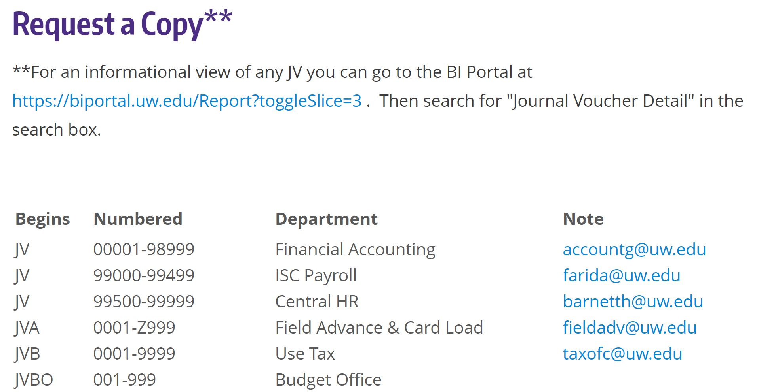
Journal Vouchers – Who Processed It?
If you have questions or need more information about a JV on your budget start by visiting the Financial Reporting Journal Voucher webpage to find the correct office to contact.

Slide 35
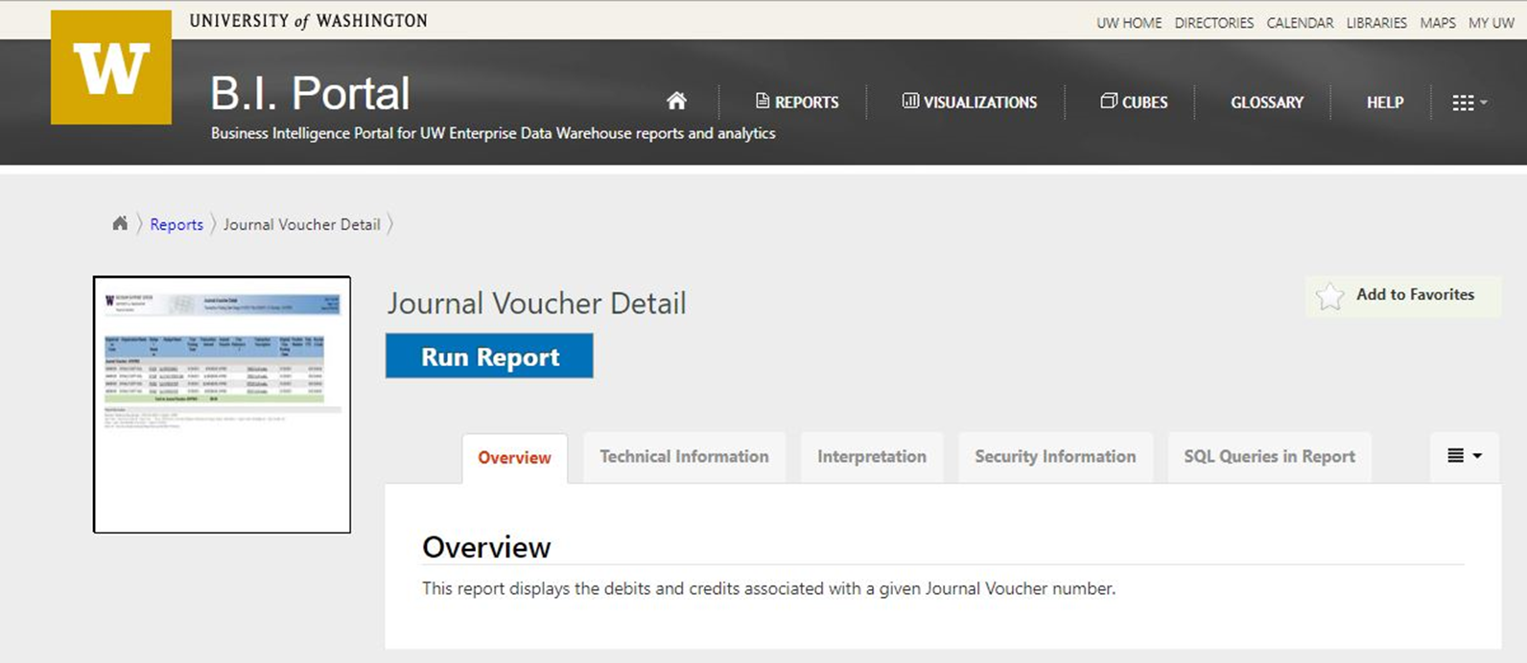
Journal Vouchers – Obtaining a JV Copy
Electronic copies of JV transactions are accessible via the Business Intelligence Portal (B.I. Portal) under the Journal Voucher Detail report

Slide 36
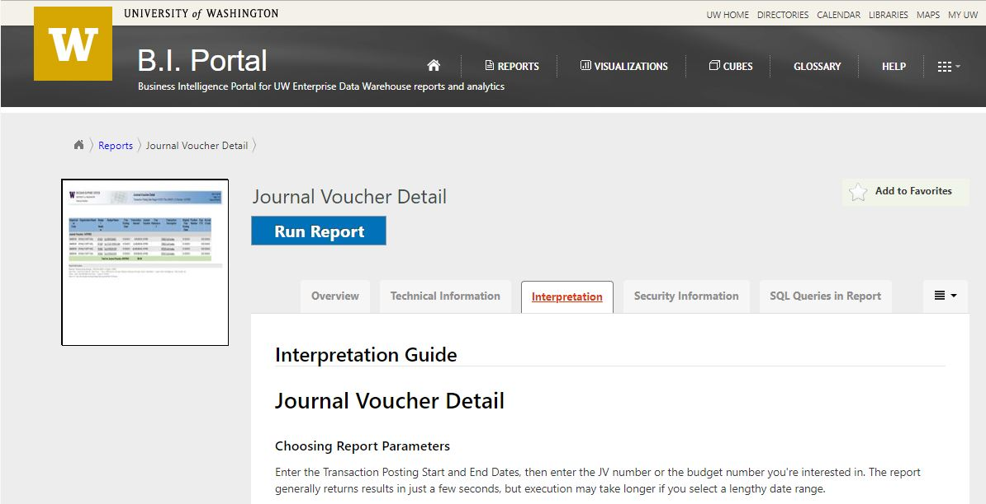
Journal Vouchers – Obtaining a JV Copy
If it is your first time using the report, we recommend reading the Interpretation Guide first to get the most out of the tool. Select the tab labeled “Interpretation” before you run the report.

Slide 37
Journal Vouchers – Obtaining a JV Copy
After you click the blue “Run Report” button it will take you to the report page
Just fill in your parameters and click the “View Report” button on the right

Slide 38
Journal Vouchers – Obtaining a JV Copy

Slide 39
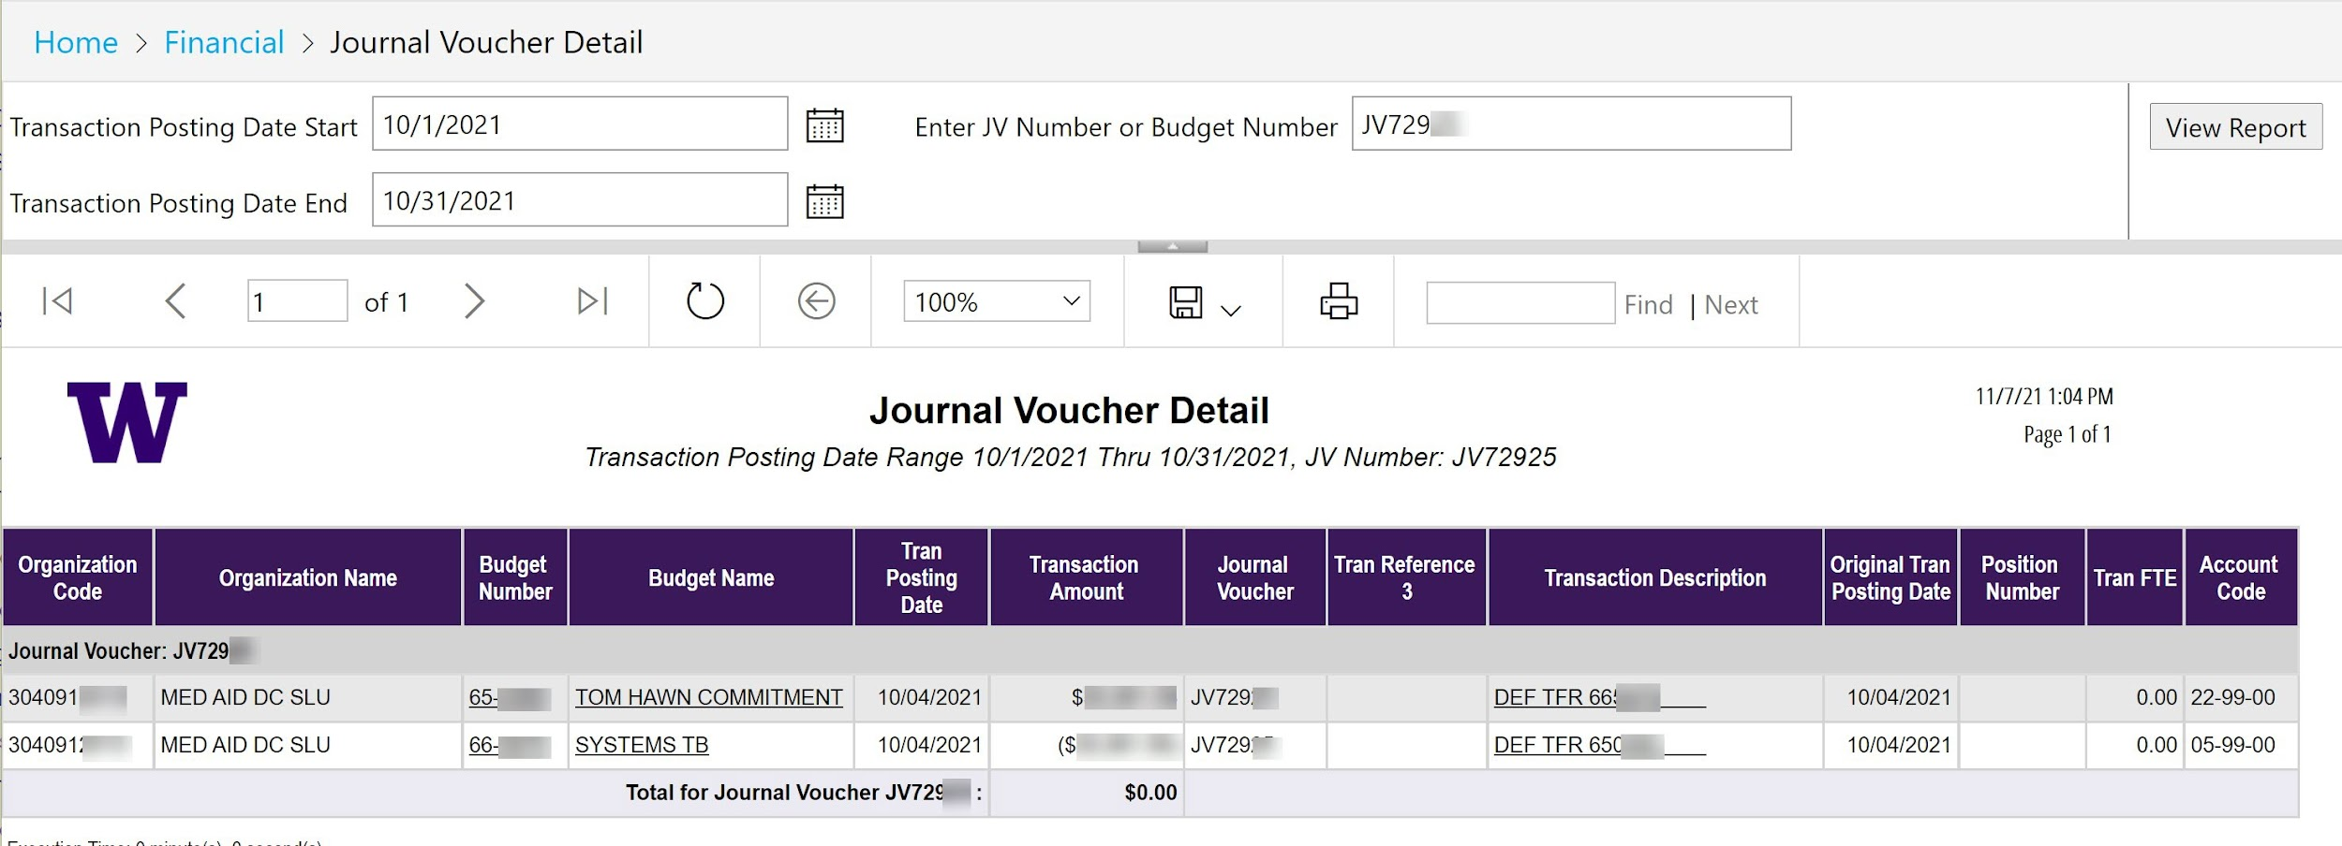
Journal Vouchers – Obtaining a JV Copy

Slide 40
Journal Vouchers – MyFinancial.desktop
If the JV was submitted in MyFinancial.desktop, you can drill down to the transaction detail by clicking on the Description Field in the Transaction Summary

Slide 41
Journal Vouchers – MyFinancial.desktop
Look for a dark purple button at the top of the page labeled “Show MyFD-JV”.

Slide 42
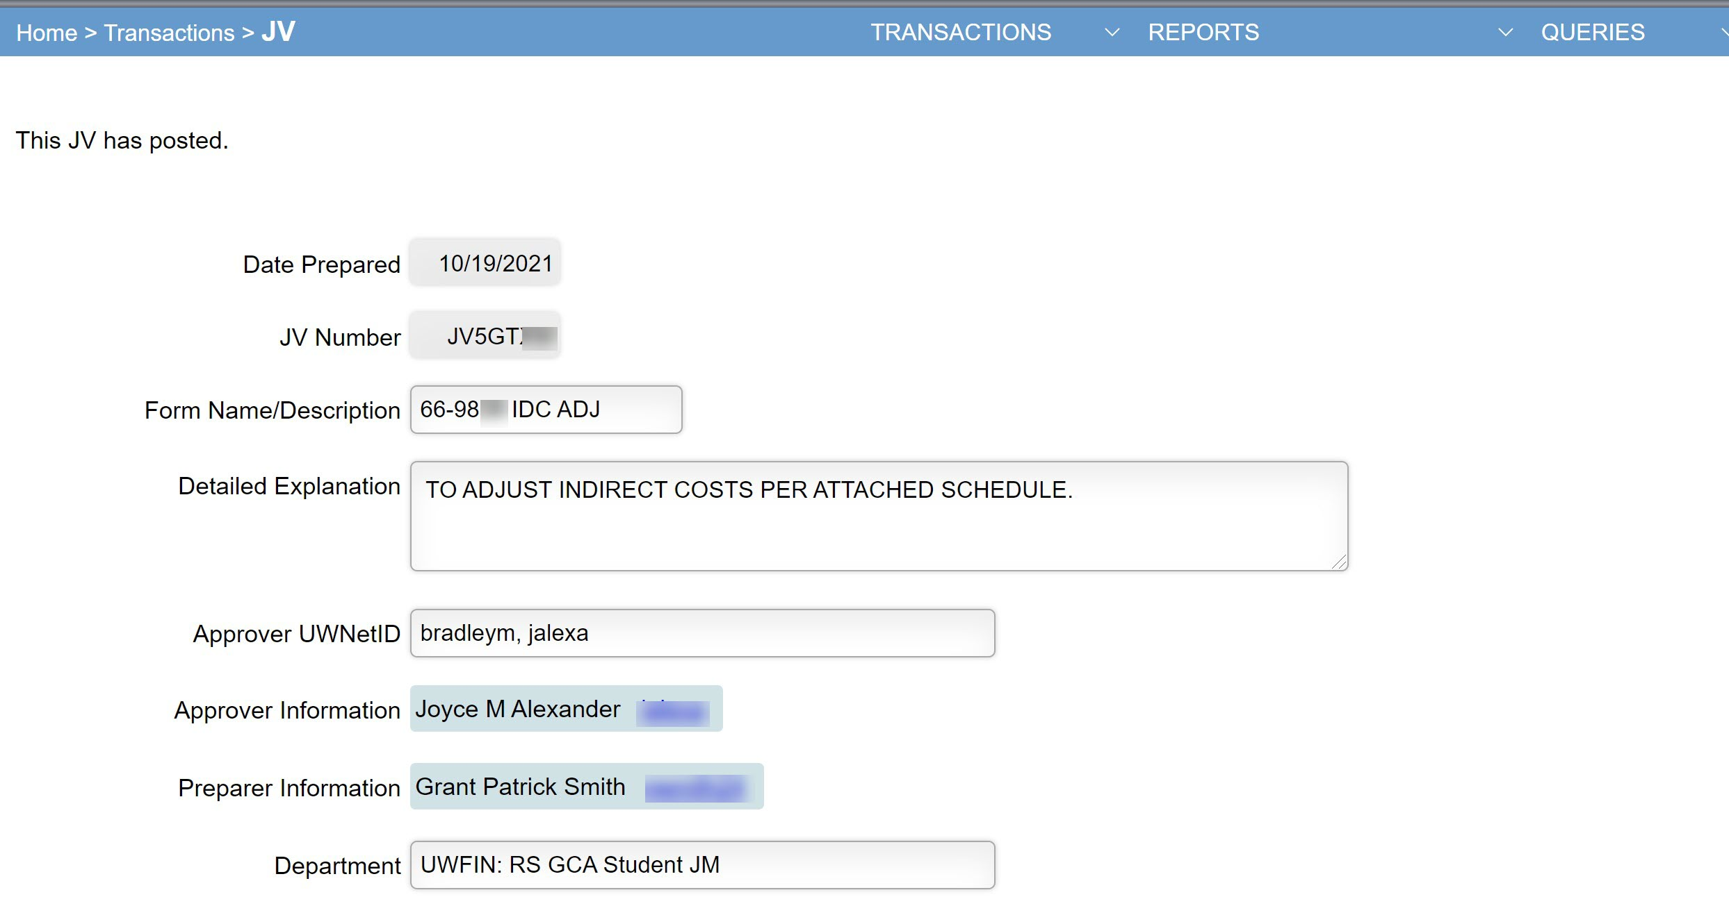
Journal Vouchers – MyFinancial.desktop

Slide 43
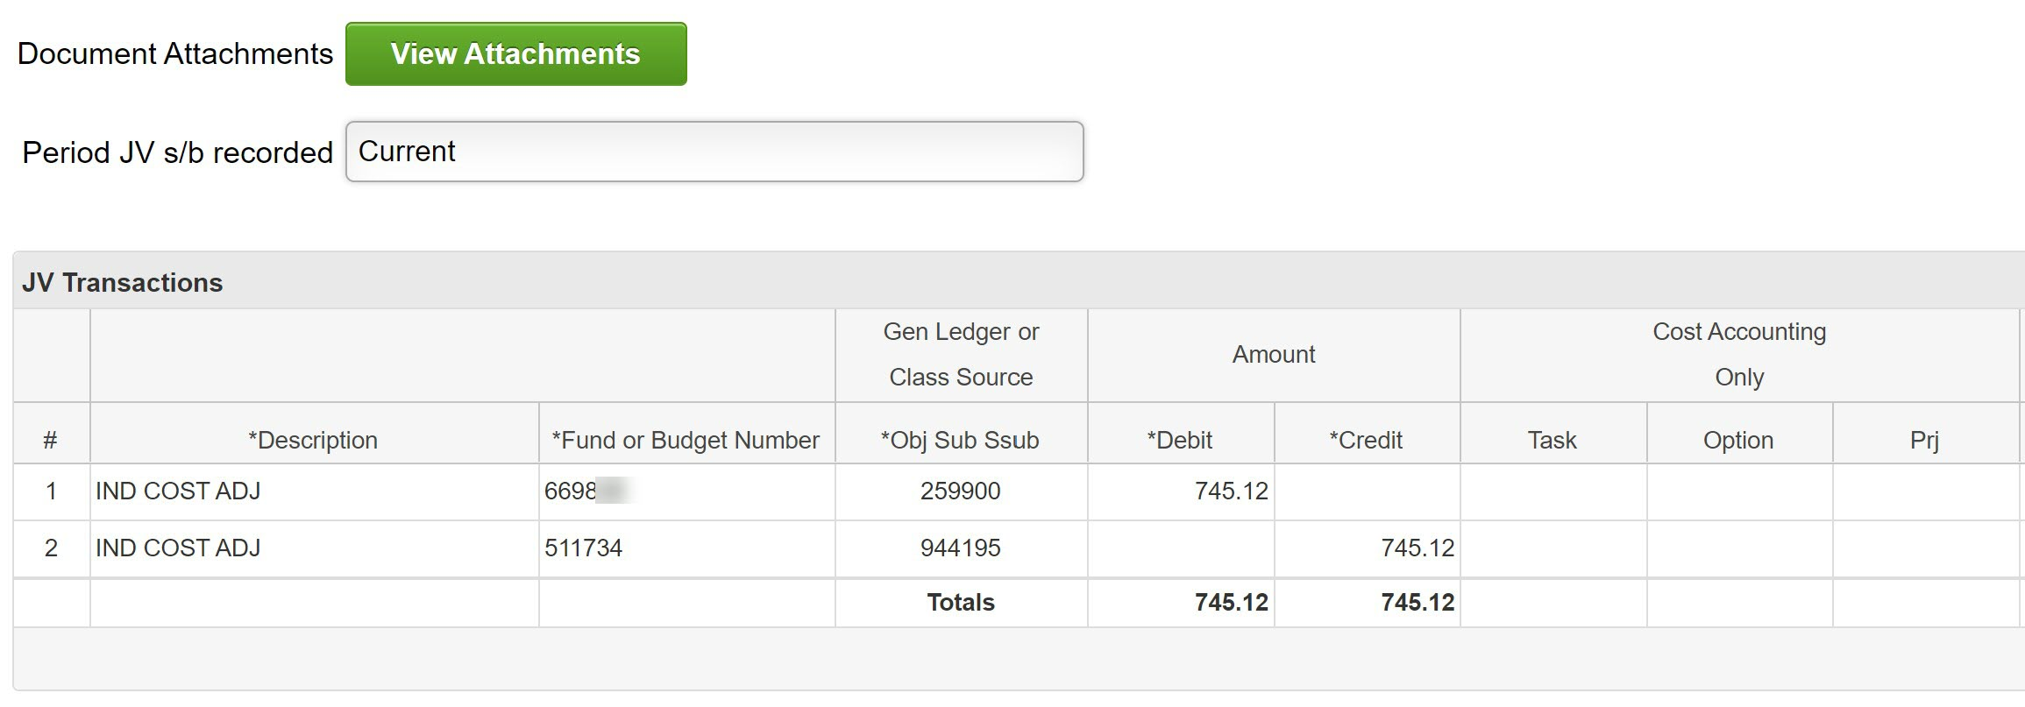
Journal Vouchers – MyFinancial.desktop

Slide 44
Journal Vouchers – MyFinancial.desktop
Alternatively, if the second Reference field contains a clickable link, it will take you directly to the transaction detail.

Slide 45
What are ISDs and CTIs?
Internal Sales Document (ISD)
Used for recording sales of services or supplies by service centers and auxiliary enterprises to other University of Washington entities.
Cost Transfer Invoice (CTI)
Used for transferring the costs of services or supplies between budget entities at the University of Washington.

Slide 46
ISDs and CTIs – Who Processed Them?
Use the information in the Reference fields to look for contact information (phone/email)
Click on the transaction for more details (Originating Area Code)

Slide 47
Using the Originating Area Code in MyFD
If you have questions or need more information about any transaction you see in MyFD, you can use the Originating Area Code to find the correct office to contact.
Start by clicking the transaction in MyFD

Slide 48
Using the Originating Area Code in MyFD
You will be taken to the Transaction Detail page
Under General Fields scroll down to the Originating Area Code
Click the words “Originating Area Code”

Slide 49
Using the Originating Area Code in MyFD
The MyFD Glossary will open, and a list of originating area codes will be displayed that includes contact information:

Slide 50
Questions?

Slide 51
Smooth Award Closeout
Austin Campbell

Slide 52
GIM 39 – Closeout of Sponsored Programs
GIM 39 provides guidance on the closeout of sponsored programs
After the Final Action Date (FAD), GCA is responsible for ensuring the budget is ready for closeout
Before we can close the budget, we need to address the following:
Can we send the final financial report and/or invoice?
Is there unmet cost share?
Have all payments been received?
Is there a deficit? Surplus? Refund required?
Budgets must be closed to status 4 within 120 days of award end date

Slide 53
Final Invoices and Reports
If your award requires a final invoice and/or final financial report, we enter the due dates in the financial system at budget set up
These due dates are what drive the FAD—the date we need all expenditures to be final and the budget switches to status 3 in preparation for closeout. Having the FAD in place ensures that GCA can complete the required closeout documents on time
Please pay attention to your FAD and notify GCA before this date if you expect that expenditures will not be final. Re-opening a budget after the FAD requires GCA manager approval
After the FAD, it should be assumed that GCA is working on closeout, so expenses should not be posted or transferred on/off the award at this time

Slide 54
Unmet Cost Share
Cost share requirements should be met before we close the budget
Reporting non-FEC cost share on a quarterly basis is recommended
FEC cost share should be certified as required by Management Accounting and Analysis’ certification deadlines
If you have FEC cost share that will not be certified prior to the FAD, please request an interim cost share report so that we can include the amount on our final report/invoice

Slide 55
Sponsor Payments
If GCA submits invoices for your award and they remain unpaid, we will send out a delinquency notification to seek payment
All invoices must be paid before we can close the budget
If your department invoices the sponsor directly (Form of Payment 11), please make sure all payments are reconciled and applied to the award before closeout

Slide 56
Disposition of Balance
A negative balance (deficit) needs to be moved to an allowable budget. You may request this via Grant Tracker note or by using the deficit transfer tool in Grant Tracker
Please note: the deficit transfer tool cannot be used to transfer deficits on sub budgets—these must be manually transferred by GCA.

Slide 57
Disposition of Balance
If the budget has a balance that the University is allowed to retain (fixed price grant/contract or clinical trial), we will need to transfer it to your department’s Fixed Price Surplus Account (FPSA)
We transfer it to the FPSA with the nearest F&A rate to the closing budget
If you do not have an FPSA with an F&A rate within 10% of the closing budget, you may request a new FPSA
If the sponsor requires the return of unspent funds, or we have overbilled on a cost reimbursable award, GCA will refund the sponsor

Slide 58
Final Closeout
Once the final financial documents have been submitted to the sponsor, the budget is in balance, and any issues have been resolved, we can close the budget to status 4

Slide 59
Questions?

Slide 60
Future Forum
February
2022
VIA ZOOM
https://finance.uw.edu/gca/training-outreach/gca-forum
Survey about today’s forum will be sent out soon!

Slide 61
Contact Us
Grant Tracker https://www.washington.edu/research/gca/budget/granttracker.html
Email gcahelp@uw.edu
GCA Help Hotline 206-616-9995 (9:00 am to 12:00 pm and 1:00 pm to 4:00 pm)

