Slide 1
Gca forum
SUMMER 2019

Slide 2
welcome
Bathrooms are located around the corner to the right.
We have prepared material for the entire hour.
We want you to be engaged. This meeting is for you!
Please ask us questions!!

Slide 3
SHORT INTRODUCTION
Please introduce yourself!
Name
Department

Slide 4
AGENDA
Invoicing at GCA
Understanding Sponsor Requirements
Deficit and Expense Transfers
Closing Process Refresher
GrantTracker Email Contacts
Training Grant Season
Survey
Next GCA Forum

Slide 5
Invoicing at gca
How do we will bill for different awards?
Austin Campbell

Slide 6
Overview
Three standard invoicing types
Scheduled payment
Milestone
Cost reimbursable (interim, final, special handling)
GCA uses a separate system for invoicing
For cost reimbursable awards, these are the same transactions that show in MyFD
Scheduled payments are entered at budget setup
Milestone payments are either entered at budget setup or reduced as billed (if the payments are unclear or deliverables are variable)
GCA does not invoice while budgets are in advance status
Invoicing is put on hold and charges are billed when the budget is out of advance

Slide 7
scheduled payment
Clear schedule of payments in the award
Invoices are automatically generated 2x a month
Beginning and mid-month, based on the calendar
All payments scheduled for that month are picked up in the batch
(i.e. if your payment is scheduled for 8/30, it will get picked up in the 8/1 batch)
If there are new payments entered or anything missed in the first batch of the month, it will get picked up in the mid-month batch
Invoices are either automatically emailed, mailed, or internal (receivable only, if the sponsor does not require an invoice)

Slide 8
Milestone
Payments are contingent on deliverables/progress made on the project
Usually set amounts for different deliverables, but can also be “reduced as billed” which means the payments might be unclear or billed at a rate
(i.e. $4,000 is allocated for sampling, but only 3 samples at $250 each need to be billed)
These are not automatically generated
Department needs to notify GCA when deliverables can be invoiced for
GCA does run a report of unbilled milestones to follow-up on each month
Analysis is performed and communication is sent to the department if necessary
Question for campus: Is this helpful?
Invoices are either emailed, mailed, or internal (receivable only, if the sponsor does not require an invoice from GCA or after we receive a cash payment)
Some may require special handling to submit (sponsor format or online submission) or the department submits on behalf of GCA

Slide 9
Cost reimbursable
Invoicing based on actual expenditures
Must wait for prior month to close
For straightforward invoicing (no special handling required) invoices are generated automatically 3x a month
Starting after the prior month closes and at ~10 day intervals following
These are either automatically emailed or mailed to the sponsor
For budgets with special invoicing requirements, invoices are generated automatically 1x a month (mid-month)
These could require a sponsor format invoice, online submission, department backup, or any other special attention prior to submission (or special submission requirements)
GCA previously had to manually email invoices to personal emails. Last October, we implemented a new process allowing for automatic billing to individuals. This has saved our invoicing team from having to manually submit over 200 invoices a month!

Slide 10
Final invoices
Final invoices are issued for cost reimbursable budgets
Final billing or zero dollar final
Require extra analysis from GCA to ensure budgets are ready for final invoicing
Automatically generated 2x a month (after FAD)
2 day process—review of the budget and submission day
Some require special handling on day 2
Some need to be removed from the automatic batch and generated manually
i.e. pending supplement/extension, pending transactions, other issues
Unlike interim invoices, we typically bill final invoices through the date generated and a billing period does not show

Slide 11
Additional information
When invoices are generated, they are visible in GrantTracker the next day
If GCA is generating a sponsor format invoice, the invoice showing in GrantTracker may not be what was submitted to the sponsor
You should receive a GrantTracker with a copy of what was submitted for your reference
Separate parent/sub budget billing—if the sponsor requires these to be billed separately, please let us know
Much cleaner if handled proactively (less need to void invoices and shuffle transactions in our invoicing system)

Slide 12
Understanding Sponsor Requirements
AKA know your award!
Cheryl Haycox and Doug Pistoresi

Slide 13
Tips for Compliance
Read the award document
Identify the applicable terms and conditions
Note any special terms and conditions*
Note reporting requirements
Know which systems are needed, and that you have the necessary access
Does the sponsor require their own format or can we use UW forms?
What are the due date for the deliverables?
Be familiar with the sponsor’s terms, conditions and regulations
Understand the applicable regulations and deadlines
Ask for help!

Slide 14
Examples

Slide 15
#1 set limits on the maximum hourly rate they will pay for the Investigators’ time which is tracked in their system:

Slide 16
In this case the sponsor refused to pay our invoices because the hourly rate exceeded the rate in the agreement and because there was an Investigator on the award that wasn’t named in the table.

Slide 17
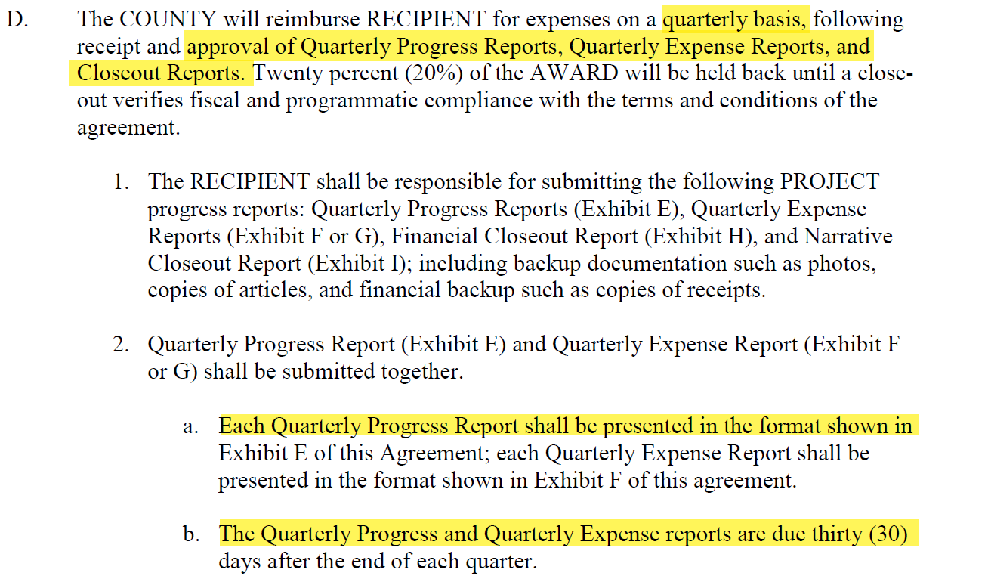
#2
#2
Sponsor has specific deliverables and due dates…lots of them!

Slide 18
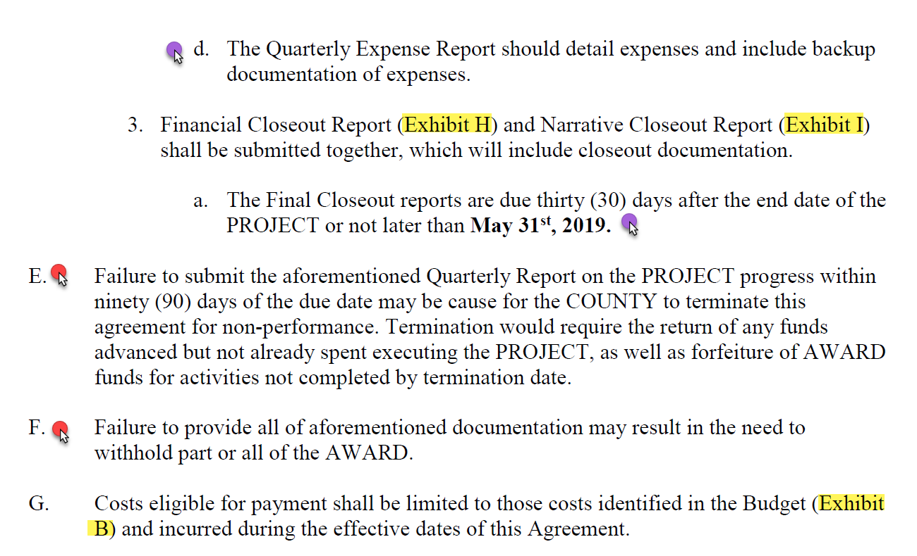

Slide 19
This award is clear in the requirements and included templates for the various reports and invoices. There’s just a lot to know. The department must prepare the invoice and report each quarter.

Slide 20
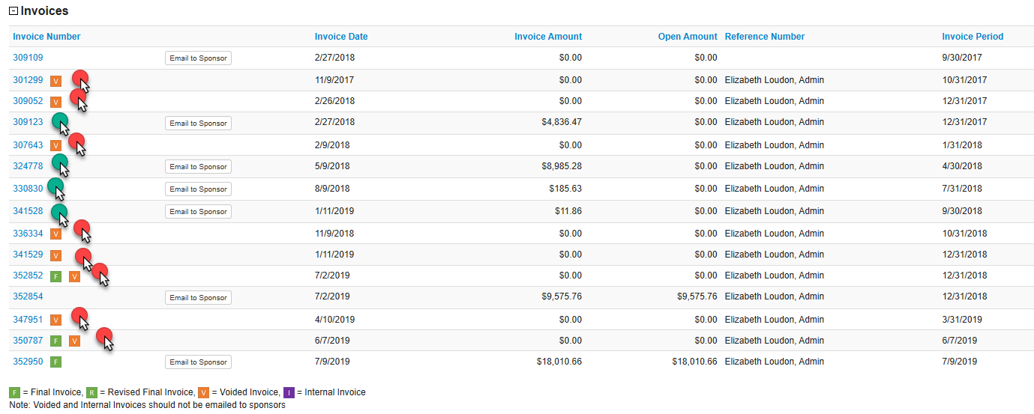
HOW DID WE DO?

Slide 21
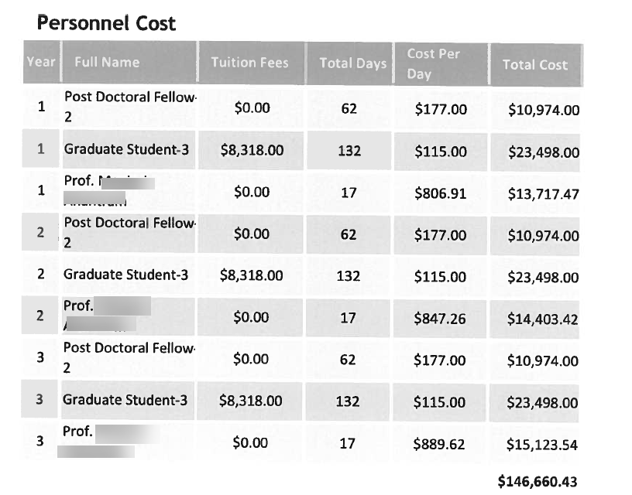
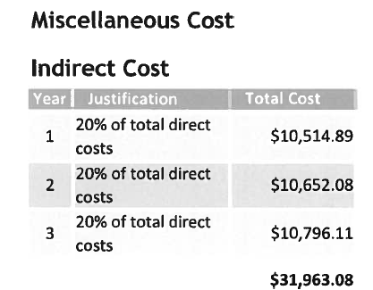
#3 Budgeting Restrictions

Slide 22
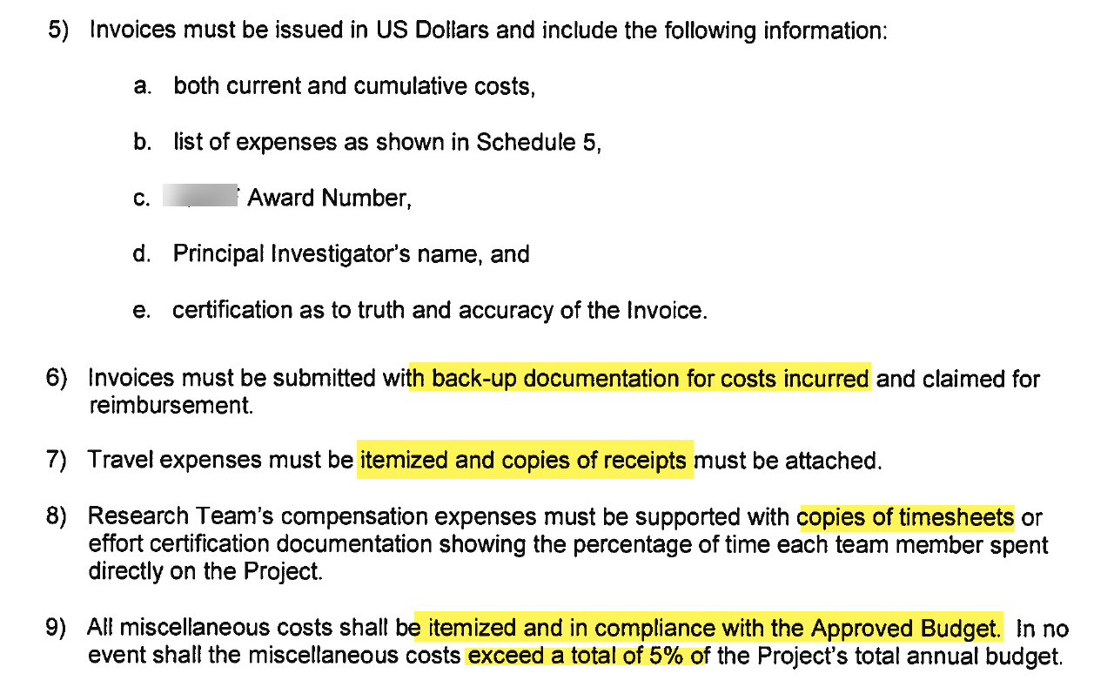

Slide 23
Invoicing due to rebudgeting restrictions

Slide 24
#4 Awards issued in Foreign Currency

Slide 25
Yes, we have no U.S. dollars
Awards issued in foreign currency carry additional risk to the departments because the US dollar amount is unknown until the payment comes in.
The party with the most risk is the party whose currency is NOT on the award document-they are at the mercy of the rates.
Because the amount is paid after the award is set up, it’s easy to over-spend.

Slide 26
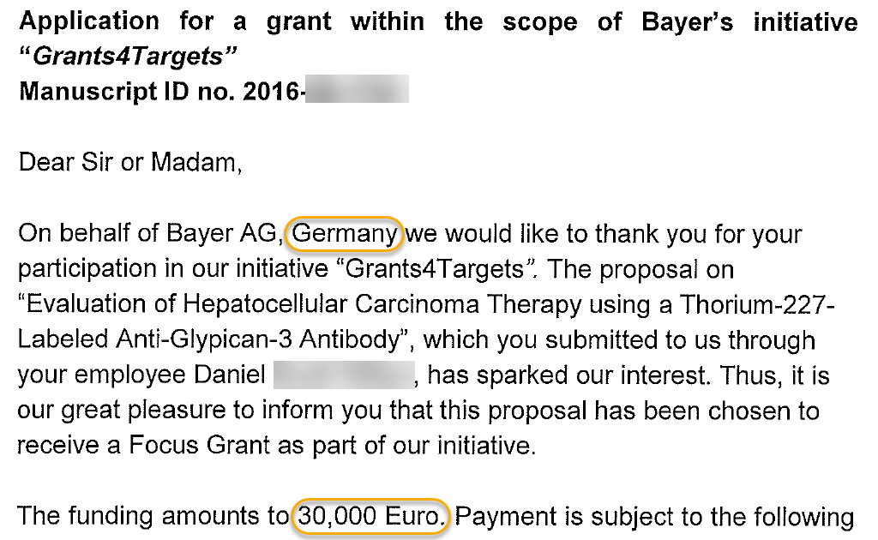
How Are these awards set up?
OSP receives the award document and sees that the funding is in foreign currency:

Slide 27
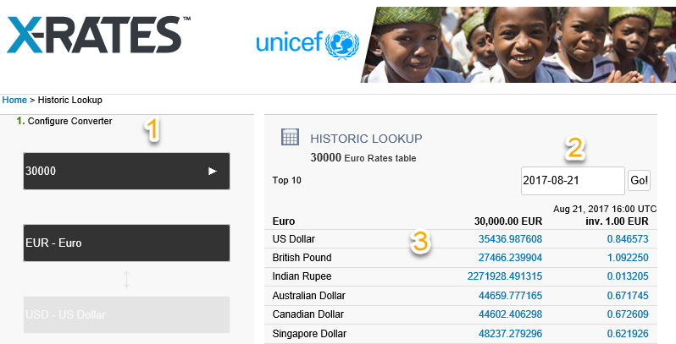
OSP estimates the dollar amount for the eGC1 at the time of award
Sites like OandA or X-Rates provide general exchange rates
These are outdated as soon as 1 day passes, and do not include bank fees, which are added to the rate, or the rate used by the foreign bank (buying US versus selling Euros)
In this example, we’re recreating the
scene to show that the average worth
for 30,000 Euros on 8/21/17 is
$35,437

Slide 28
The estimated amount stays on the eGC1 and subsequent FA

Slide 29
OSP and GCA include notes on the Funding Action Notification

Slide 30
Actual Funds
The wire came in to the UW on 11/7/2017, 45 days after the eFA was prepared
eFA was for $35,405, actual funding received was $34,191. This ended in a difference of $1,214. If the department spent to the estimated amount, they would have a deficit of $1,214

Slide 31
Best practices
Pre-Award
Negotiate for the award to be in US Dollars
Know when and how payments will be made. The more time between now and the payments, the more opportunity for rate fluctuation or influence by world events.
The stronger the dollar gets, the less money you will get
1 Euro on 1/2/2014 was worth $1.34, on 3/6/2016 the same Euro was worth $1.09
Multiply this by 1000 and you have a shortfall of $2,500

Slide 32
Post award
Read your Funding Action! Both OSP and GCA try to put helpful notes on the notification
Use the Receipt amount in GrantTracker to monitor how much money you have

Slide 33
Be concerned if a sponsor asks to change from paying in USD to their currency-it probably means the dollar is strong, and they’ll need to spend more of their currency to buy the number of dollars needed to meet the award amount.
Questions or comments?

Slide 34
Deficit Transfers vs. Expense Transfers
Michelle Davis

Slide 35
When to submit a deficit transfer
All charges are allowable per the award agreement, but budget is overspent.

Slide 36
Where can the deficit go?
Non-sponsored budgets:
Budget is in the current biennium
Budget is in status 1 or 3
And one of the following:
Budget prefix is between 01 and 10, 74, or 75
Budget type is 06
Budget type/class is 05-34, 05-57, 05-54, 05-52
Note: the deficit transfer will be a lump sum transfer – transaction details won’t be retained.

Slide 37
How to submit a deficit transfer
Online transfer tool in GrantTracker:
Note: if transferring the deficit on a sub budget or transferring the deficit to more than one budget, please send a request to GCA with the budget numbers to transfer the deficit to and amounts.

Slide 38
When to submit an expense transfer
Charges intended for the award posted to the wrong budget and need to be transferred on.
To transfer off charges that are entirely or partially unallowable on the award.
Charges are allowable, but posted in the incorrect object/project code.

Slide 39
GIM 15: Transfer of Expenditures Between Budgets
Cost transfers into an award budget must be made within 90 days of when the error was discovered OR 120 days of the transaction.
When making transfers, department must provide sufficient evidence that the charges are allocable to the award:
If within 90 days: provide reason for the transfer and how the charge benefits the grant budget.
If 120 days or more: also include an explanation for why the charge was identified and transferred late.

Slide 40
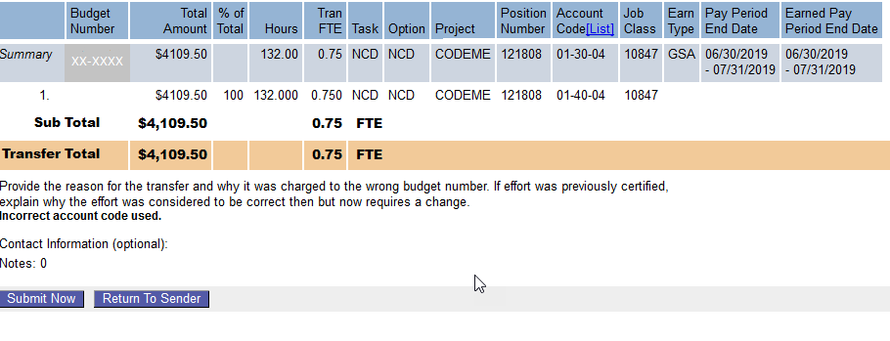
How to submit an expense transfer
Expense Transfer tool in MyFD:
Note: if you need to transfer off just benefits, please send a request to GCA via email or GrantTracker and we will take care of it.

Slide 41
Compliance Risks
Frequent or large transfers raise questions about award management.
In the case of expense transfers, could impact financial/effort reporting and/or invoicing depending on the timing of the transfers.

Slide 42
Light Reading/Learning
Grant and Contract deficit procedures: https://finance.uw.edu/gca/award-lifecycle/closing-your-award/grant-contract-deficit-procedures
University Deficit Policy: http://opb.washington.edu/content/deficit-resolution-policy
Deficit transfer instructions: https://finance.uw.edu/gca/award-lifecycle/closing-your-award/deficit-transfer-instructions
GIM 15: https://www.washington.edu/research/policies/gim-15-transfer-of-expenditures-between-budgets/
eLearning on Cost Transfers: https://f2.washington.edu/fm/pafc/content/cost-transfers-elearning

Slide 43
CLOSING PROCESS REFRESHER
Azalea Vasquez

Slide 44
FINAL ACTION DATE
The final action date of your budget is based on the due date of your final report and/or invoice
We cannot change it unless we receive modifications/amendments from the sponsor
No Cost Extension
Supplement/Extension
It is the last day your budget is open to expenditures

Slide 45
FINAL ACTION DATE
After the FAD, your budget will automatically change from status 1 (open to revenue and expenditures to status 3 (closed to revenue and expenditures, open to expense transfers)
GCA begins work on final invoices and financial reports as soon as the FAD has passed without departmental notification.
Final invoices will go out 2 days after the FAD
Final reports which are more complicated may have a wider cushion between the FAD and submission due date to allow GCA sufficient time to prepare each budget’s final reconciliation

Slide 46
LATE POSTING CHARGES
If you expect late-posting charges or credits, you must inform GCA no later than the Final Action Date, or these charges or credits will not be included in your final invoice or report.
In the future we will more closely scrutinize these requests
Copy of pending invoice
If the sponsor refuses to send us the final payment due to a late invoice/report your department is responsible for the deficit
You put the University of Washington at risk for non-compliance

Slide 47
LATE POSTING CHARGES
If a final invoice or report has already been submitted to the sponsor you will need to follow up with them regarding the late posting charges and get approval for a revised invoice/report
We need the approval in writing and it must be submitted with the Pending Transaction Spreadsheet to GCA

Slide 48
BUDGET TO STATUS 4
Due to Biennium close we were not allowed to put budgets in status 4 in July
GCA was able to resume using status 4 on August 5th
We have a backlog of budget closings from July on

Slide 49
BUDGET TO STATUS 4
If you sent GCA a request to close out your budget please allow up to 4 weeks for us to complete your request
You will be notified once that request has been completed.

Slide 50
GrantTracker Email Contacts
Setup and Updates
Susan Wilbanks

Slide 51
Why should you set up campus contacts?
First place GCA looks when we need to contact someone in the department about a budget-specific issue
Having up-to-date contacts helps us get the right information to the right people, right away
Better service for everyone—departments, GCA, and sponsors too

Slide 52
Where to find existing contact information
Budget with contacts
Budget without contacts

Slide 53
Also here:

Slide 54
Campus Contacts Email Maintenance Page
Update by individual budget, org code, or PI
Use commas to separate addresses
CAREFUL: Using Bulk Edit will OVERWRITE any existing contacts for the selected budgets
Notes:
Can do a live demo of the system here if there’s time and interest

Slide 55
Detailed instructions are available on the GCA website:
https://finance.uw.edu/gca/resources/post-award-help/granttracker-users-guide/updating-campus-contacts-granttracker

Slide 56
TRAINING GRANT SEASON
Doug Pistoresi

Slide 57
RESPOND TO GCA REQUESTS
After GCA reconciles your Training Grant you may receive a communication from us via GrantTracker about the following:
Discrepancies discovered during the reconciliation process that require resolution
Reviewing the draft Outstanding Trainee Obligations (OTO) we created
Balance of Funds available for tuition obligation
The deficit balance and transfer options

Slide 58
DEPARTMENT RECONCILIATION
Review the OTO’s
Obligate tuition for the continuation year
Submit completed OTO form to GCA via GrantTracker

Slide 59
DEPARTMENT RECONCILIATION
If necessary:
Make any stipend corrections
Remove any unallowable expenditures
Provide a budget number for a deficit transfer

Slide 60
SURVEY

Slide 61
GCA/OSP JOINT FORUM OCTOBER 2019 UW TOWER
MORE INFO TO COME!

