Slide 1
RCO Update
MRAM
September 2022
Kirsten DeFries
Research Compliance and Operations

Slide 2
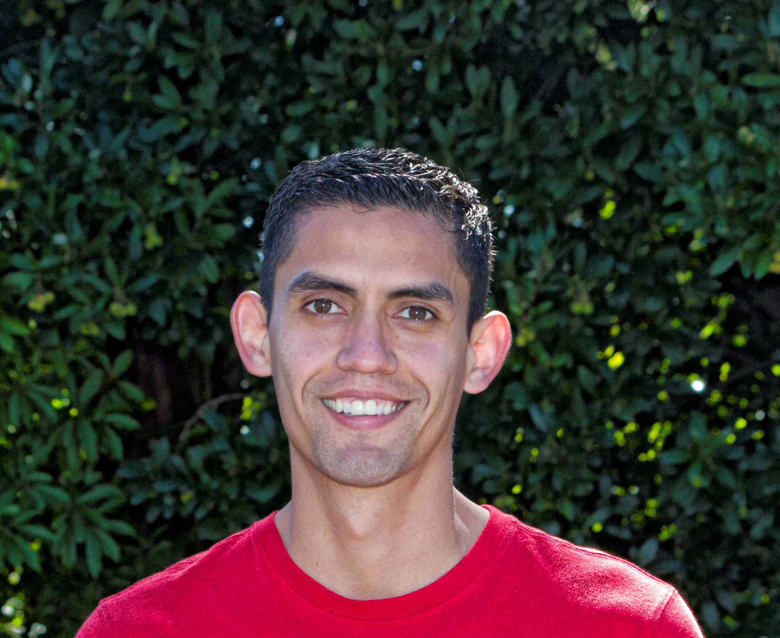
WELCOME TO GCA’s NEW DIRECTOR
Juan Lepez
GCA team member for the last 10 years in a progression of roles with increasing responsibilities
Valuable partner in Finance Transformation efforts
Effective September 2nd, 2022

