Slide 1
MRAM | Monthly Research Administration Meeting
October 13, 2022 9:00 AM – 10:30 AM HOSTED REMOTELY Join the LIVE Webinar: https://washington.zoom.us/j/346891888
TOPIC | PRESENTER | EMAIL | MIN
Welcome | Kirsten DeFries Research Compliance & Operations | kirsten5@uw.edu | 1
Sponsored Programs Finance Update | Kirsten DeFries Research Compliance & Operations | kirsten5@uw.edu | 2
OSP Org Updates | Carol Rhodes Office of Sponsored Programs | carhodes@uw.edu | 3
National Biosafety Month | Haris Malik, Lesley Decker Environmental Health & Safety | hmalik54@uw.edu lldecker@uw.edu | 10
Human Subjects Updates | Maria Savage Human Subjects Division | mcsavage@uw.edu | 5
UW Gift Acceptance Policy | Tobin Eckholt, Susan Hayes-McQueen, Lynn Sullivan Gift Services | teckholt@uw.edu shq@uw.edu lsales@uw.edu | 25
SAGE Award Workflow | Juan Lepez, Amanda Snyder, Judy Chung GCA, OSP, ORIS | acs229@uw.edu jachung@uw.edu kabah12@uw.edu | 15
ECC – UW’s New Effort Reporting Solution | Joe Giffels Office of Research | jgiffels@uw.edu | 5
NEXT MEETING November 10, 2022 9:00 AM - 10:00 AM

Slide 2
Live Closed Captioning is now available
Live transcription and closed captions are enabled via the “CC/Transcript” button in your Zoom window.
Recordings of our sessions, with manually edited closed captions, are typically available within a week after the meeting, and a link is emailed with the post-session Q&A.
If you have any issues or questions, please let us know at mramques@uw.edu

Slide 3
Sponsored Programs Finance – WHO?
October 2022 MRAM
Kirsten DeFries, Research Compliance and Operations

Slide 4
NEW ORGANIZATION NAME: SPONSORED PROGRAMS FINANCE
Formerly Research and Student Accounting (RSA)
Aligns with our Office of Sponsored Programs partners and our larger UW Finance organization
Encompasses Management Accounting & Analysis and Research Compliance & Operations (Grant & Contract Accounting, Post Award Fiscal Compliance, Research & Cash Accounting)
No changes to our contacts or to the services we provide
Changes coming to the UW Finance websites
Notes:
Rebranding from RSA to SPF
A couple of different department names over the years, RAA and more recently RSA when AVP Sue Camber supported SFS
SFS is no longer a part of our AVP’s portfolio
You may notice rebranding to the UW Finance websites

Slide 5
OSP Org. Updates
MRAM
October 2022
Carol Rhodes
Office of Sponsored Programs

Slide 6


NATIONAL BIOSAFETY MONTH
Lesley Decker, Biosafety manager
Haris Malik, Biosafety officer
October 2022

Slide 7


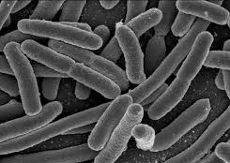


WHAT IS BIOSAFETY?
Framework for containment of biohazards
Includes safe practices, safety equipment, facilities and training
Protects the worker, community and environment
Protects the research product

Slide 8

ABOUT EH&S BIOSAFETY (FY 22)
400 Biological Use Authorizations (BUAs)
22 clinical trial BUAs (recDNA into humans)
302 biosafety inspections performed for 525 individual laboratory rooms
Online trainings completed:
    2749 Biosafety
    4019 Bloodborne pathogens (BBP)
    321 Shipping Regulated Medical Waste

Slide 9

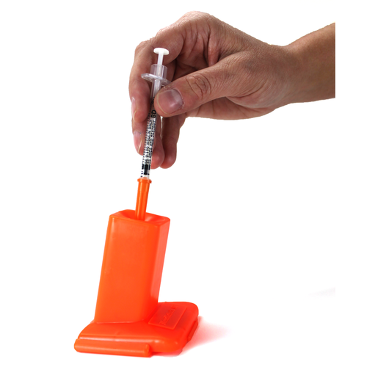
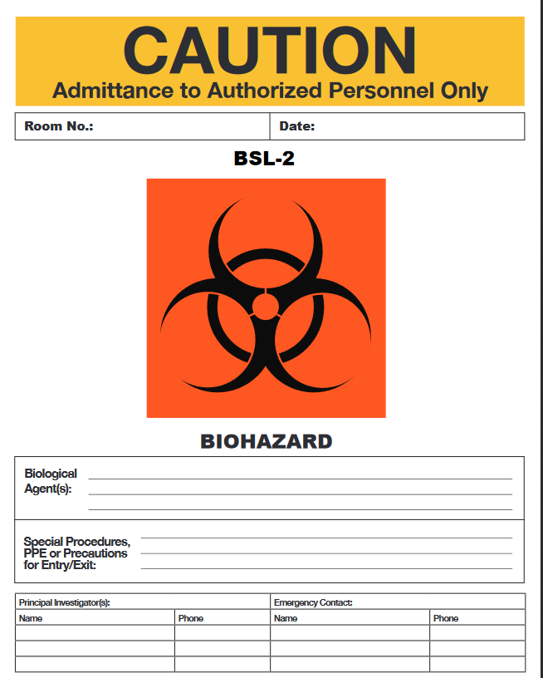
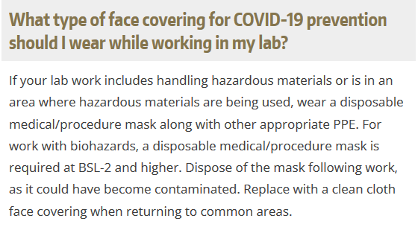
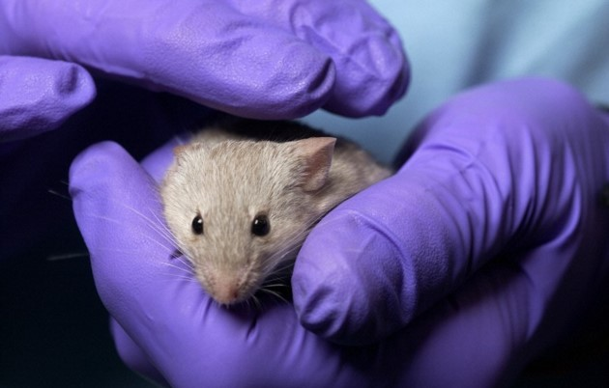
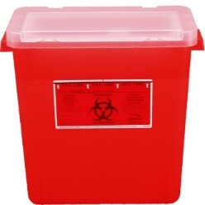

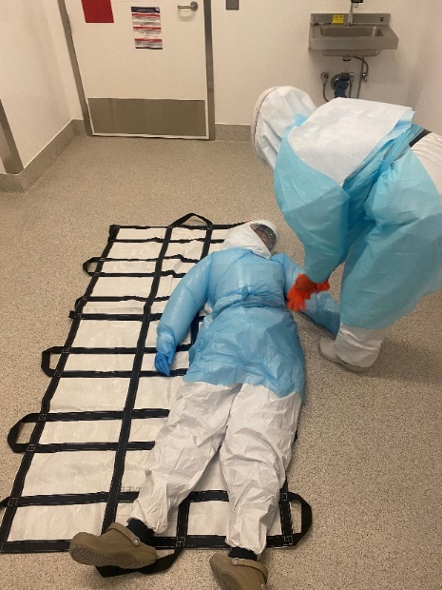
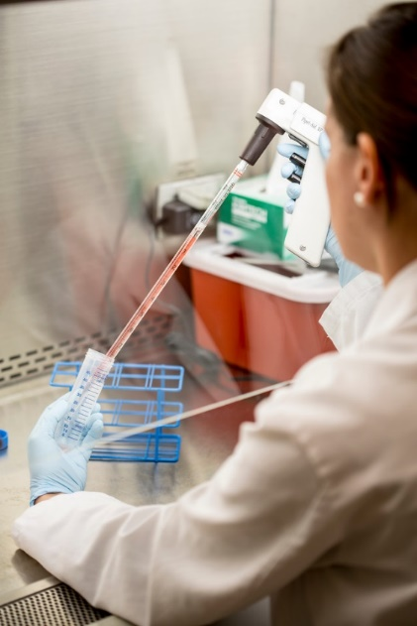
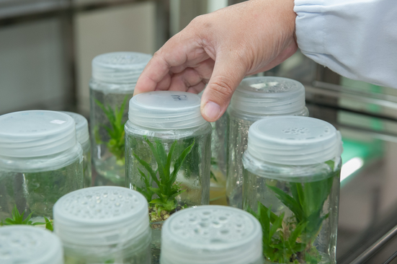


ABOUT EH&S BIOSAFETY

Slide 10
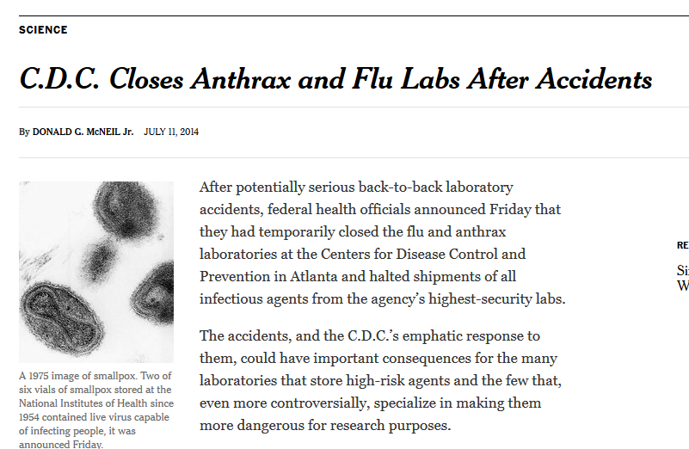
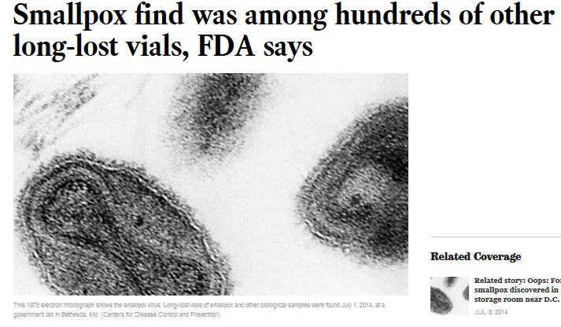
NATIONAL BIOSAFETY MONTH
Started in 2014 by the NIH Office of Science Policy
Time to focus attention to biosafety practices, policies, procedures and inventory

Slide 11

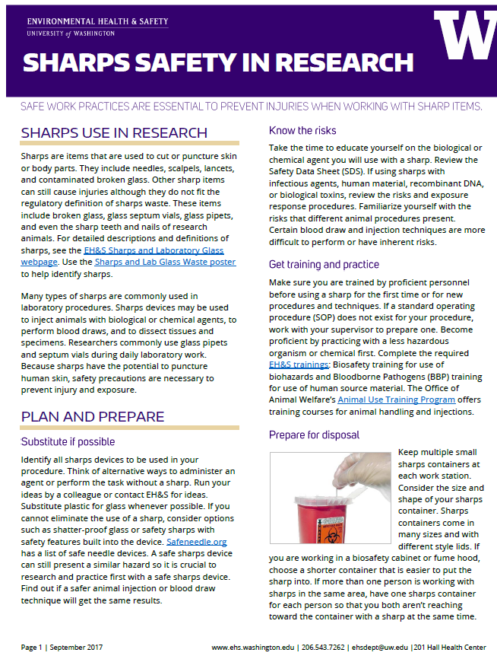
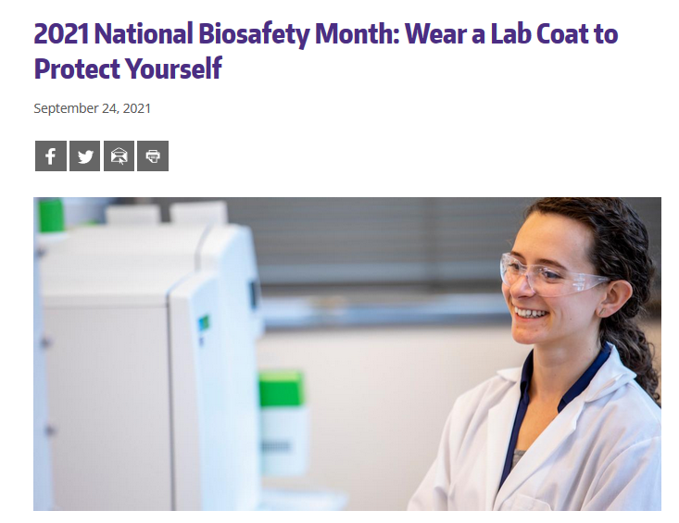
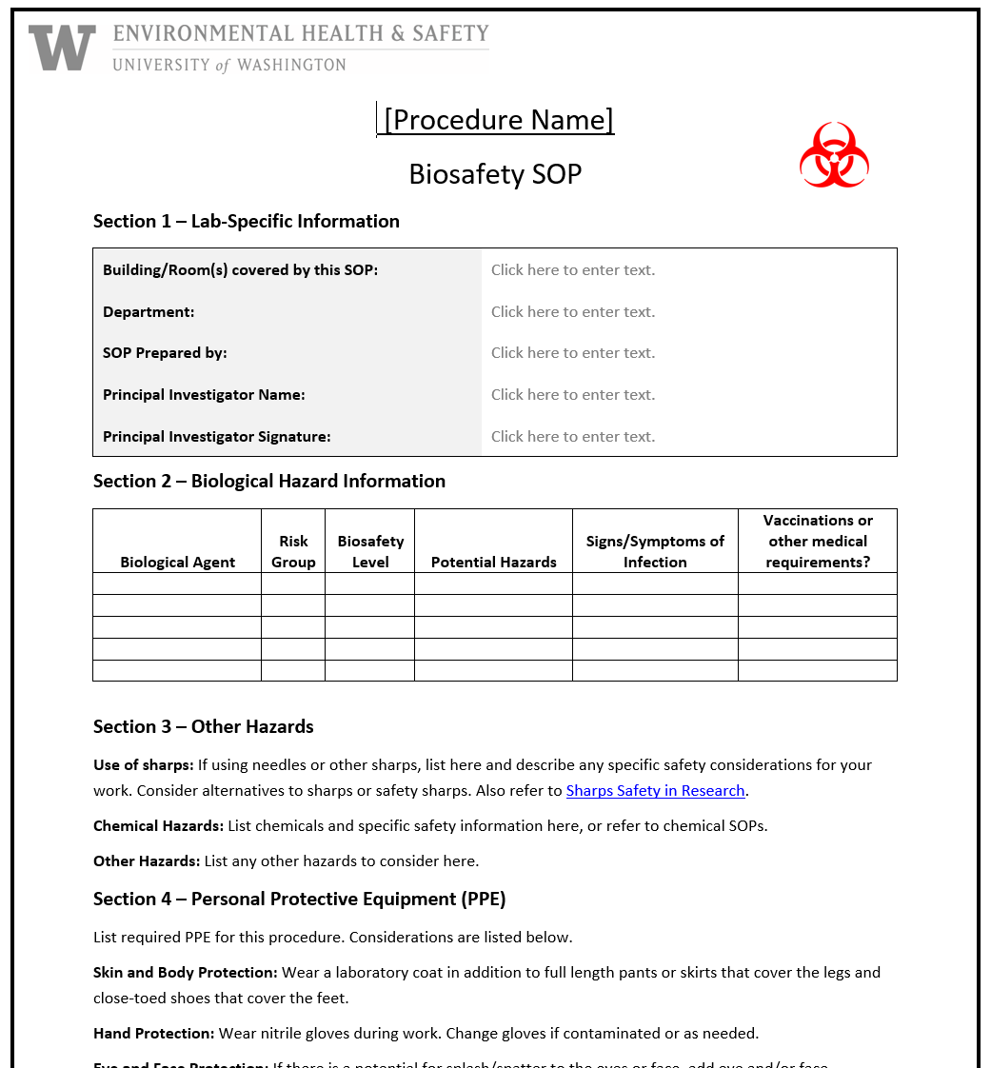

NATIONAL BIOSAFETY MONTH AT UW

Slide 12

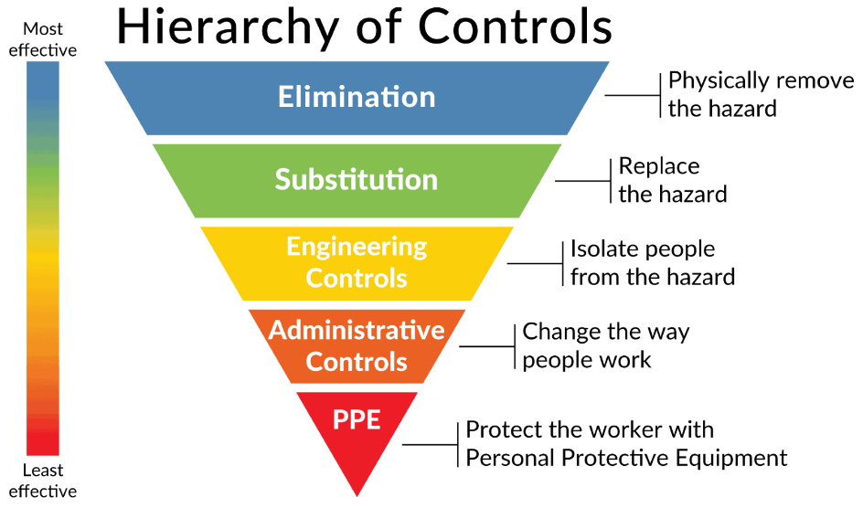
2022 BIOSAFETY MONTH AT UW
Explore opportunities to substitute hazards with safer alternatives!
Replace a hazard with a safer alternative that reduces the potential for harm while performing the same function without introducing new risks.

Slide 13

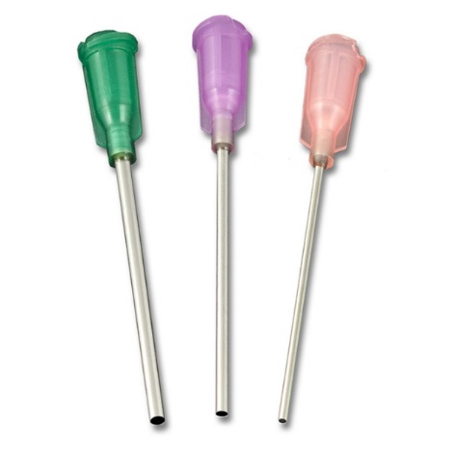
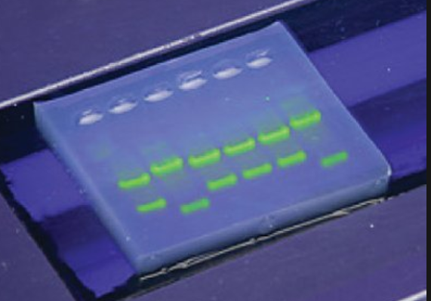


SUBSTITUTIONS YOU CAN MAKE IN THE LAB
Replace needles and razor blades with less sharp items
Replace lab glass with plastic
Use a less hazardous gene delivery method
Use a less pathogenic surrogate organism
Switch to safer chemicals for biological research

Slide 14

BIOSAFETY MONTH OUTREACH
Email to principal investigators and lab managers with BUAs
A news post featured on the EH&S website and in the EH&S newsletter
Featured on the Office of Research webpage
Present to U-WIDE Health and Safety Committee, MRAM (research administrators) and the IBC

Slide 15
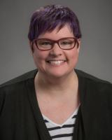
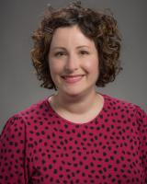
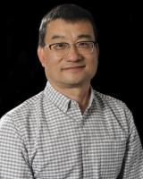
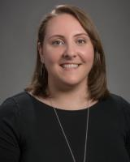
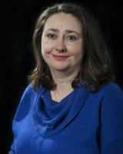
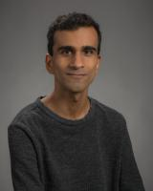
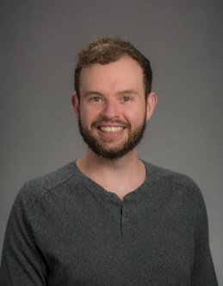
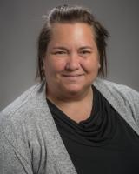
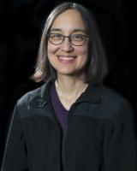
HAPPY BIOSAFETY MONTH!
Questions? Email ehsbio@uw.edu
Thanks to the biosafety team:
Jennifer Cabarrus
Lesley Decker
Tony Han
Kristi Kilgore
Zara Llewellyn
Haris Malik
Devon McMenimen
Esther Pellham
And our occupational health nurse:
Judy Cashman

Slide 16

Highlights from the September 6th issue
Maria Savage, Associate Director, Human Subjects Division

Slide 17

Revised Lapsed IRB Approval Policy
HSD’s policy on research with lapsed IRB approval has been revised!
The revised policy includes more robust follow-up of studies once IRB approval has expired with an emphasis on studies that involve more risk.
This will be in addition to the automated courtesy reminders that are sent by the HSD Zipline system at:
  8 weeks prior to the expiration of IRB approval
  4 weeks prior to the expiration of IRB approval
  When IRB approval has expired.
Highlights from the September 6th issue
Effective September 1st
See section 5.4
SOP IRB Review

Slide 18
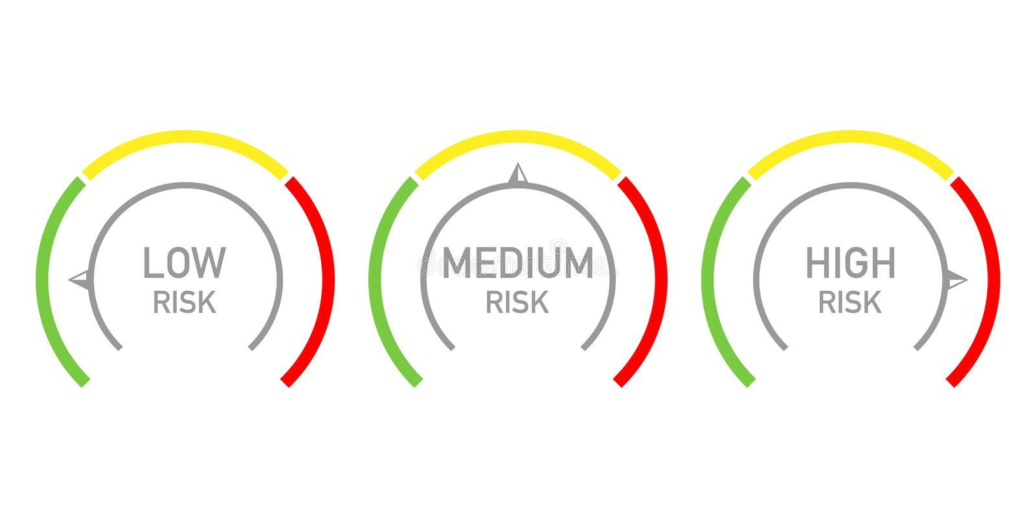
Revised Lapsed IRB Approval Policy
The revised policy describes HSD actions for two categories of expired studies.
Category 1. Studies that cannot be closed without the submission of a status report confirming that all human research activities ceased. These include:
  Studies regulated by the FDA
  Studies that involve more than minimal risk
  Studies initially reviewed by the full board (excluding studies in data analysis).
Highlights from the September 6th issue
Category 2. All remaining studies.

Slide 19
Revised Lapsed IRB Approval Policy
Category 1. Studies that cannot be closed without the submission of a status report
Actions. When no study closure or renewal application is received after IRB approval expires, HSD will:
Within 30 days
  Send an email reminder to the research team
At 60 days
  Send an email reminder to the research team and dept head
  Stop accepting new applications and study modifications from the PI of the lapsed study
At 90 days
  Determine that the study is in continuing noncompliance
  Ask the IRB to consider corrective action. This may include termination of the study and reporting to relevant federal agencies, study sponsors and collaborators.
Highlights from the September 6th issue

Slide 20
Revised Lapsed IRB Approval Policy
Category 2. All remaining studies.
Highlights from the September 6th issue
Actions. When no study closure or renewal application is received after IRB approval expires, HSD will:
Administratively close the Zipline application if no continuing review application or study closure request is received within 90 days after the expiration of approval.
Require submission of a new Zipline application to continue the research.

Slide 21

Zipline Support Survey
HSD needs your help to improve Zipline support resources!
Complete a short survey to tell us what current Zipline help resources you use most and what future resources you would like.
The survey contains 6 questions and should take less than 5 minutes to complete.
You have the option to enter a drawing to receive a coffee gift card as a thank you for your participation.
Highlights from the September 6th issue

Slide 22

October 4th HSD Newsletter
Coming Soon- New Guidance on Reasonably Foreseeable Risks
Complete the Zipline Support Survey
Turnaround Times for HSD and IRB Review
PAVE 2021 Annual Report Findings and Recommendations
New NIH Data Management and Sharing Policy
In the October 4th issue

Slide 23


Questions? Email HSD at: hsdinfo@uw.edu

Slide 24
APS 36.3
UW Gift Acceptance Policy
(effective as of July 1, 2022)

Slide 25
Getting to know the formalized Gift Acceptance Policy
Why now?
What is a gift?
How do you know it is a gift?
What's next?
AGENDA

Slide 26
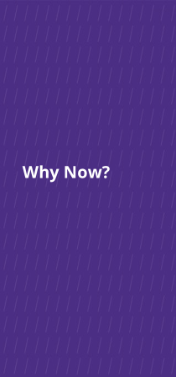
Why Now?
Industry standard and best practice
Risk management
UW’s funding model is evolving
Changes in the nature of fundraising

Slide 27
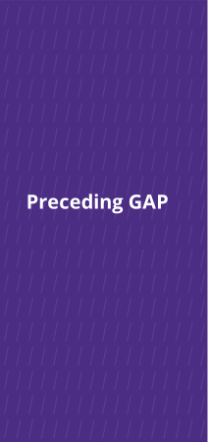
Preceding GAP
Private Gifts and Grants Acceptance Committee updated GIM 34
(rolled out during COVID-19 pandemic)
Internal Audit identified potential risks
Examples of risk across the country
Donors are savvier and demanding
Notes:
Tobin to change this slide and the next:
this is why we did this:
GIM34/PGGA
Auditor
Risk: across the country
Donors are more savvy and demanding
Note that GIM34 happened during COVID

Slide 28
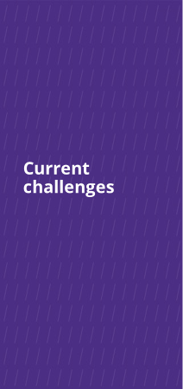
Current challenges
10,000 gift funds; 5,300+ endowments
Challenges of administering these funds effectively and efficiently
Corresponding challenges of stewarding these donors (historically and with new funds being proposed)
Unspent gift balances have doubled over last 10 years
Increased gift complexity driven by philanthropy-savvy donors
"Do the best you can until you know better.
Then once you know better, do better."
- Maya Angelou

Slide 29
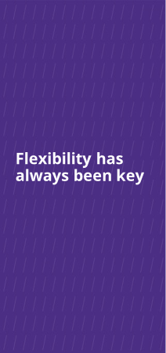
EXECUTIVE ORDER NO. 41 (1972)
“The most useful gift is the flexible one, where sufficient freedom is permitted to meet changing conditions at the University while still meeting the general goals of the donor.”
"Flexible" is not synonymous with "unrestricted"

Slide 30
What is a gift?
"Detached and disinterested generosity"
Philanthropic or charitable intent
Primary beneficiary is the general public (not the donor)
Given for general activities or a new project/initiative
Irrevocable
No quid pro quo
Gifts cannot...
Require detailed financial accountability
Require deliverables
Transfer IP, restrict publications, require indemnification clauses
Require return of funds
Notes:
We were looser on enforcing policy and law in order to get to YES.
Universities across the country are wrestling with these same issues. We, in particular, had gone very far in donor-centricity

Slide 31
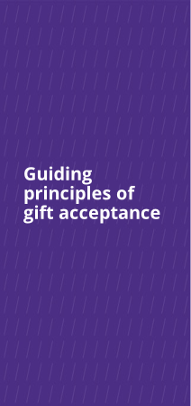
Guiding principles of gift acceptance
UW will seek and accept gifts that:
Will benefit the UW
There must be a reasonable expectation that acceptance of the gift will ultimately benefit the University and its mission.
Will further the donor’s charitable interest
University believes acceptance is consistent with the donor’s expressed philanthropic interest.
Will not put the UW, affiliates, or stakeholders at risk
The gift does not present a current or potential material risk.

Slide 32
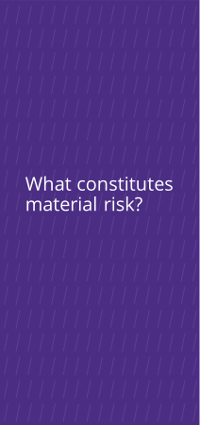
What constitutes material risk?
University will not accept a gift or will consider returning a gift that:
Doesn’t fit its mission & values
Infringes on academic freedom
Potential reputational risk
Too restrictive in purpose or too costly to administer
Prohibited by law (or is funded by property acquired by other than legal means)
Creates unacceptable liability or could lead to future unanticipated expenses
Creates a conflict of interest or potential ethics violation
Includes an exchange for goods/services (unless fair market value is disclosed at time of gift)
Risks our tax-exempt status

Slide 33
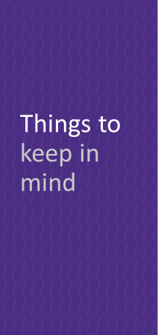
Past treatment of funds is not a determining factor
Neither the donor or faculty member determine whether the UW can receive the funding as a gift
Sometimes the goal is charitable, but the terms and conditions mean it cannot be treated as a gift by UW
Inclusion or exemption of overhead (F&A costs) and/or gift assessments is not a basis for determination

Slide 34
How do you know if it is a gift?
The funder’s requirements determine what flavor of funding it will be
Partner with your unit Advancement team early in the process
Central Advancement are here to help:
  Corporate & Foundation Relations
  Endowment & Donor Services
  Gift Services
Gift Acceptance Committee

Slide 35
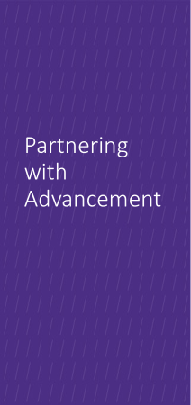
Partnering with
Advancement
Best Practices
  Partner EARLY with your Advancement colleague(s)
  Can help with determination of gift, grant, or contract
  Can help flag potential issues to avoid problems later
  Can assist with sample language
  Partnering early will streamline your process and expedite the funding
Things to Avoid
Over-promising a potential funder things that may have to be walked back later depending on the avenue the funding will follow
Don’t sign anything

Slide 36
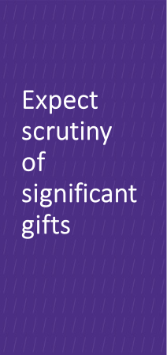
Expect scrutiny of significant gifts
Gifts require documentation that support donor intent and provide an understanding of donor expectations, if any.
Our due diligence is to protect the UW.

Slide 37
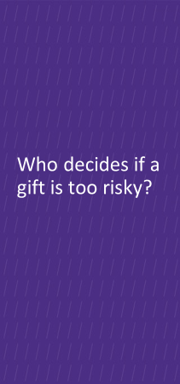
Meet the Gift Acceptance Committee (GAC)
Made up of senior University officials who will undertake an efficient, thorough, and time-sensitive review of proposed gifts to vote and communicate its decisions
Standing members:
  VP of Development (Tamara Josserand)
  SAVP for Development Programs (Stephanie Doyle)
  AVP for Campaigns and Emerging Initiatives (Lisa Thomas)
  AVP for Advancement Operations (Julie Brown)
  Senior Director for Planned Giving (Carl Wayne)
Rotating members (two-year term):
  Two CAOs representing a large and a small school
  For FY23-24: Don Theophilus (UW Medicine) and Alex Haslam (College of Built Environments)

Slide 38
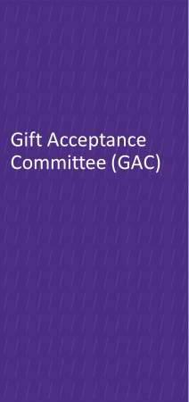
Gifts subject to review are those that pose material risk (including being overly-restrictive or with financial liability), those with unique or special circumstances, etc.
Gifts are referred on a case-by-case basis and require extensive research/documentation prior to presentation for the GAC review
Committee will virtually vote to accept, accept with revision, or reject a proposed gift
Average time to decision: 2 weeks

Slide 39
What's next?
"Getting to yes, and..."
We do not know the answer (yet) on all avenues for revenue, managing risk and obligations.
Non-gift Revenue Committee (potentially)
When working on potential gifts, communicate early and often with your Advancement Team
Be prepared to share all documentation; transparency is key

Slide 40

MIND THE GAP

Slide 41
SAGE AWARD WORKFLOW
UWFT for the Research Community
Juan Lepez, Grant and Contract Accounting (GCA)
Amanda Snyder, Office of Sponsored Programs (OSP)
Notes:
Juan - Good morning. Amanda and I will be presenting on the SAGE award workflow. We’ll have quite a bit of information to get through so questions asked during the presentation will be answered in the post-MRAM Q&A that is sent to the MRAM mailing list next week.

Slide 42
SAGE AWARD: OVERVIEW
As a part of UW Finance Transformation (UWFT), the SAGE Award process is being designed to streamline award setup, provide greater transparency into key award information, and integrate with Workday.
The SAGE Award feature will launch in July 2023.
Notes:
Juan - Read slide as is.

Slide 43
SAGE AWARD: HIGHLIGHTS
Shared Views
  Improves collaboration for award preparers and reviewers
Award Request Form
  Replaces email communications
  Provides a familiar, user friendly experience similar to Advance Requests
  Includes autofill of eGC1 and SAGE Budget information
Award Request List & Summary
  Provides transparency into status and history
Integrations with Workday
  Improves accuracy
Notes:
Juan - Key highlights and expected outcomes include:

Slide 44
BUSINESS PROCESS STREAMLINING TARGETS
Moving From…
To…
Email Intake, Comms
Unclear Status
Duplicate Entry (SAGE & FIN)
SAGE Intake, Messaging
Transparent Status in SAGE
Integrations (SAGE to Workday)
Notes:
Juan
Efficiencies gained include:
Moving from email intake and communication to working directly within SAGE and having that correspondence be in SAGE.
Much clearer way of knowing the status of your award and which office it’s currently assigned to. No longer the need to investigate with OSP or GCA where the award is at as it will be clearly visible in SAGE.
No more duplicate data entry for GCA into the financial systems as SAGE will have a direct integration of data from the Funding Action into Workday. Will help prevent data entry errors.

Slide 45







SAGE AWARD WORKFLOW: HIGH LEVEL
eGC1 Approved
NOA Received
Start SAGE Award Setup Request
Link SAGE eGC1 & Budget
Complete & Submit
OSP
Workday
Create SAGE Award Budget
GCA
Receive Notification that Award is Ready!
Notes:
Juan - This is a simplified/high level version of the SAGE award workflow. The workflow will kick off with an approved eGC1 or receipt of an NOA. This will be followed by the SAGE award setup request and creating the award budget. Once that is done, campus will complete and submit to OSP. OSP will review and approve or return to campus if changes are required. If no changes, OSP will approve and send to GCA. Major change here is that during GCA review and approval, GCA will be able to return to OSP and request corrections or return directly to campus for corrections. Once no more corrections are required, GCA will move forward with integrating the data from SAGE to Workday. This completes the process and you will receive a notification that the award has been setup and ready to begin activities.
Leads to integration in Workday.

Slide 46
SAGE AWARD WORKFLOW: DEEP DIVE
What, who, where, and when?
What is the workflow of a SAGE Award?
Who is responsible for each award action?
Where (or which system) does each award action take place and when?
Notes:
Amanda - The following diagram will give a deeper dive of what the workflow looks like in SAGE and how the data finalizes into WD, who is the party responsible for completing the action, and where and when each award action takes place.

Slide 47
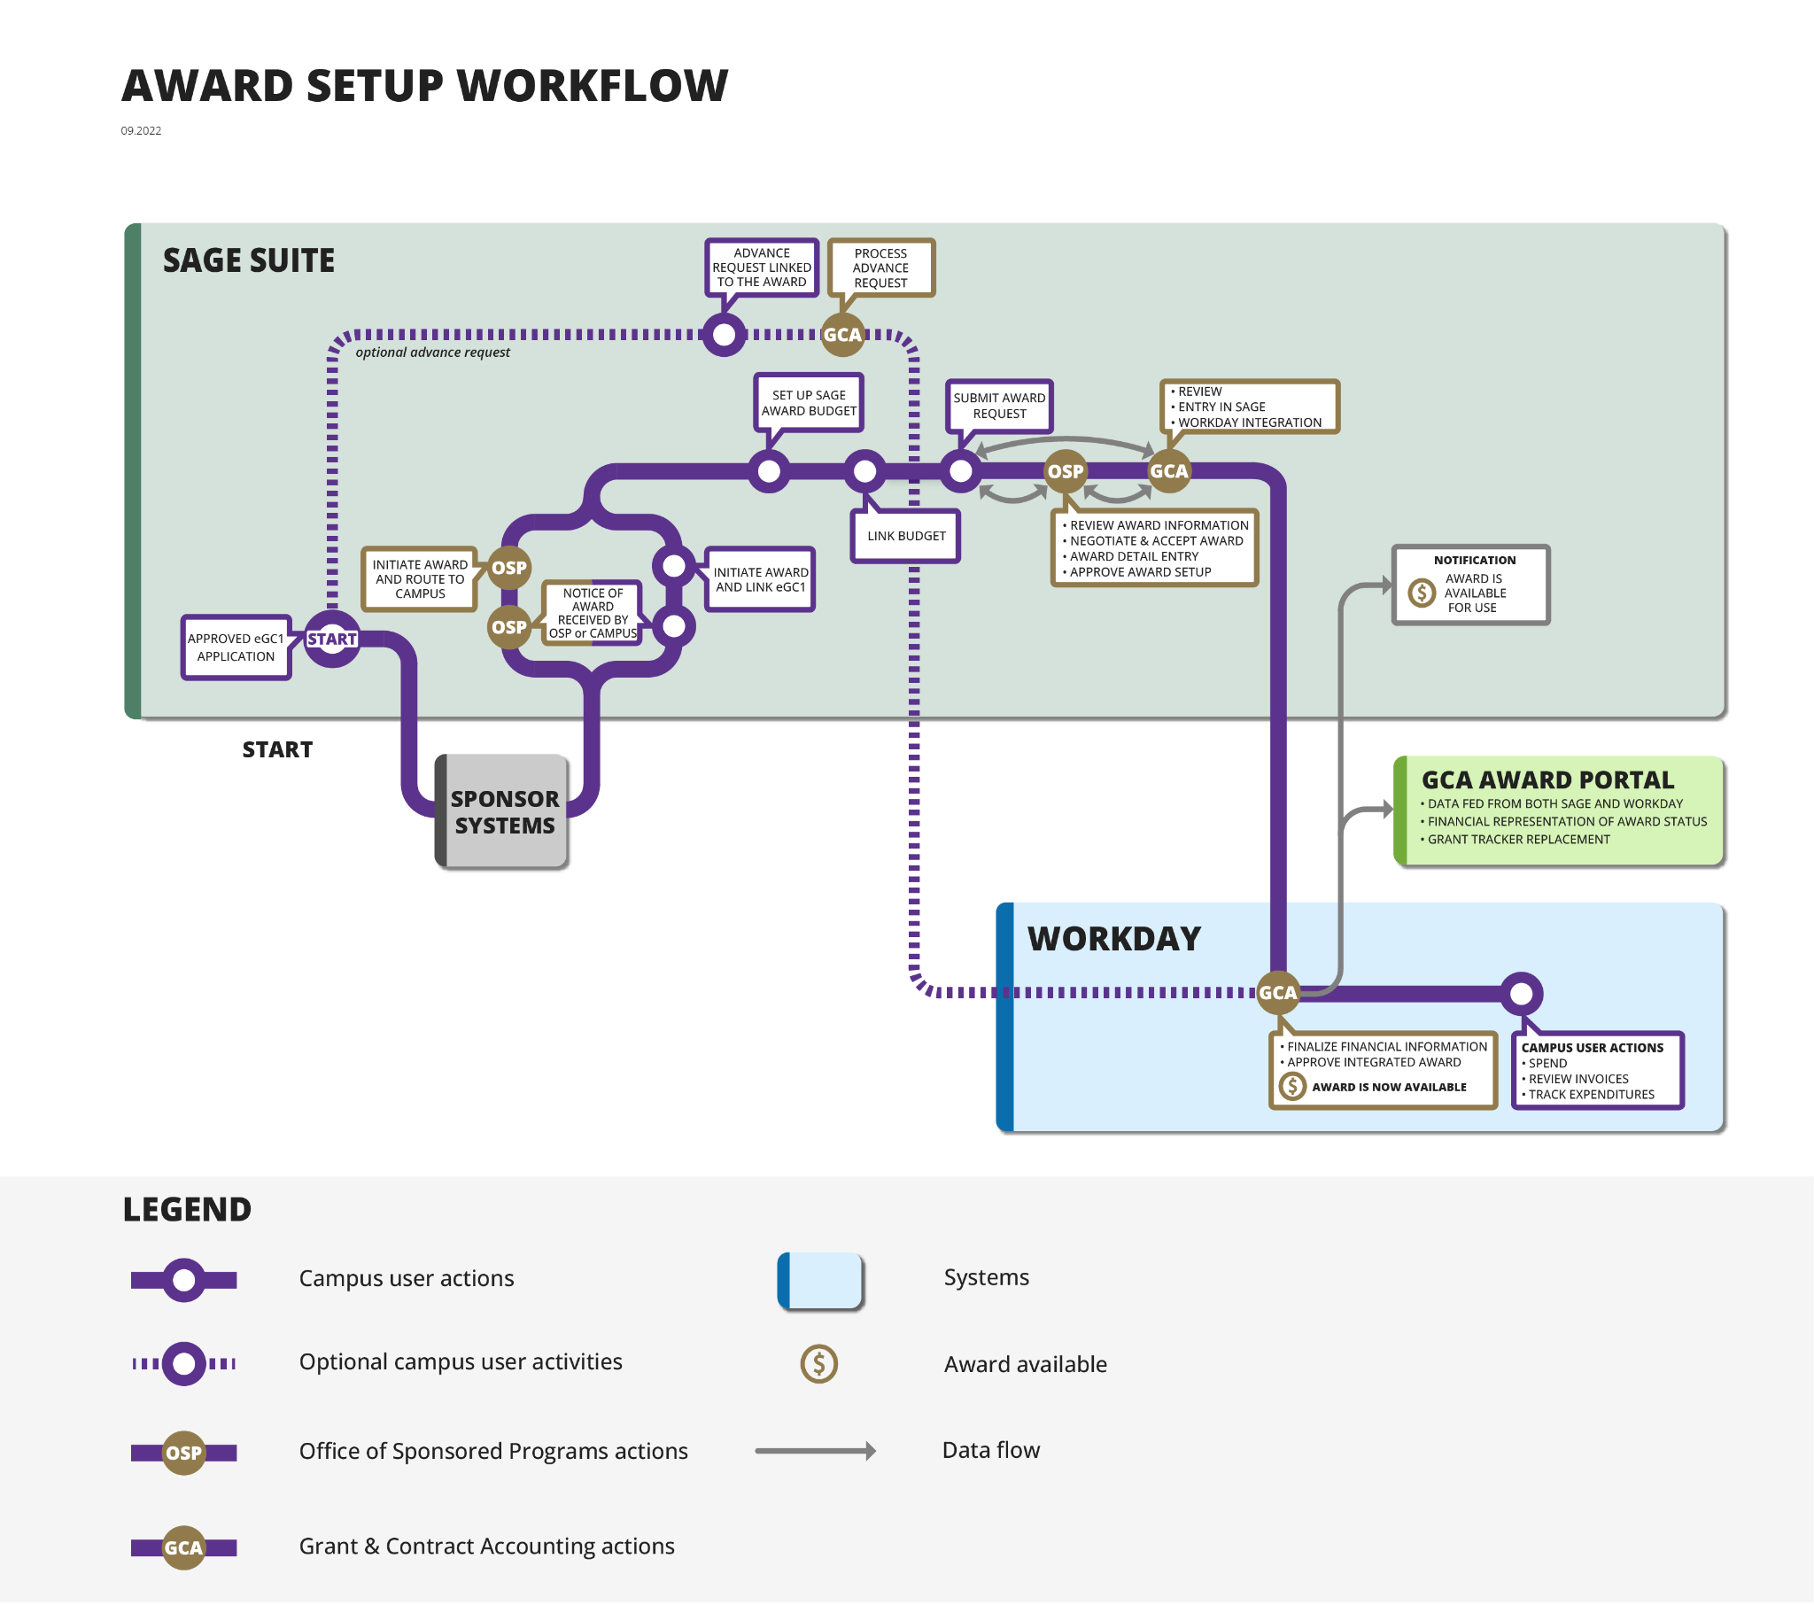
Start SAGE Award Setup Request
Location on workflow
Notes:
Amanda - High level look at the entire process of getting an award all the way through from award receipt to Workday setup . This is happy path for a standard award. Shows the collaboration that will be required between campus, OSP, and GCA. Each of these areas has more details. Foundational. Will be seeing this in different forums.

Slide 48
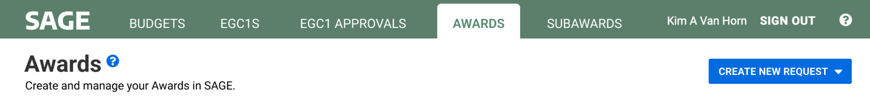
SAGE AWARD SETUP REQUEST
Start SAGE Award Setup Request
When?
  After the eGC1 is submitted and approved
  After the Notice of Award (NOA) is received
Who?
  Grant Managers & OSP receive NOAs. If you receive the NOA, you will initiate the SAGE Award setup request. If OSP receives the NOA, they will initiate the SAGE Award setup request and route it to you for completion.
Where?
  New Awards tab in SAGE
How?
  From Awards Tab, Select CREATE NEW REQUEST
Notes:
Amanda

Slide 49
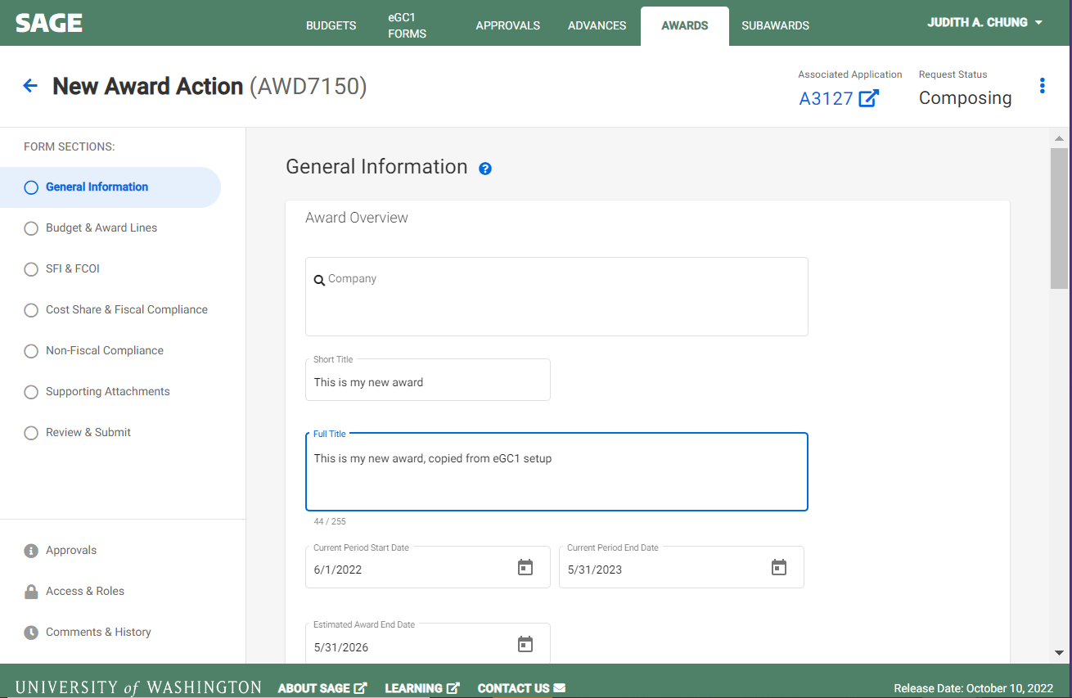
UPDATE GENERAL INFORMATION
Start SAGE Award Setup Request
Information defaults from eGC1
Update as needed
Notes:
Amanda
These will be the headers within SAGE that will need to be completed for successful setup. This will incorporate information from the eGC1 and will allow for some updates.

Slide 50
Create SAGE Award Budget
Location on workflow
Notes:
Amanda

Slide 51
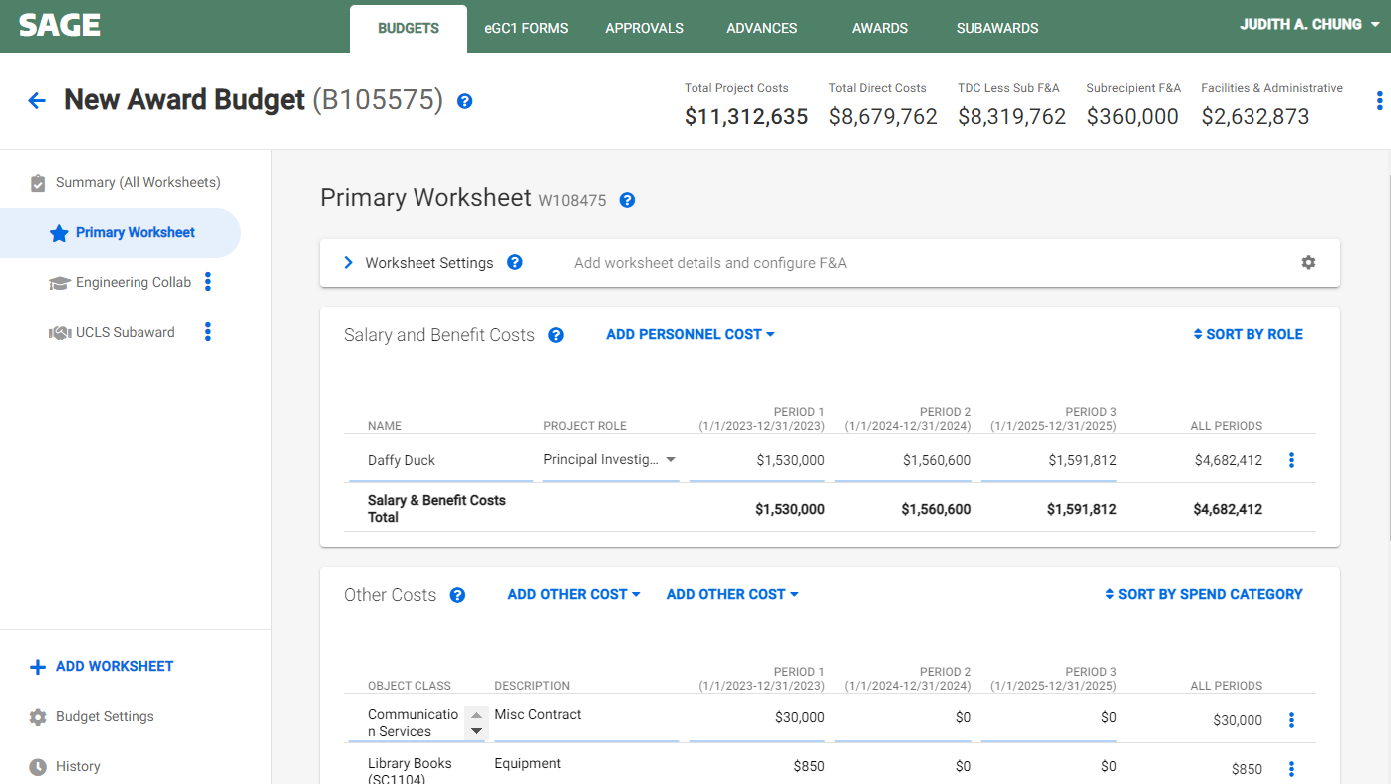
CREATE SAGE AWARD BUDGET
Create SAGE Award Budget
Create new or copy proposal SAGE Budget
Notes:
Amanda
Will either have to create a new award budget budget or copy the proposal SAGE budget at the award setup stage. The budget will be used to populate key fields (Title, F&A, Location….) from SAGE to Workday and budget totals will be validated against the award total prior to integration.

Slide 52
Link SAGE Budget
Location on workflow
Notes:
Amanda

Slide 53
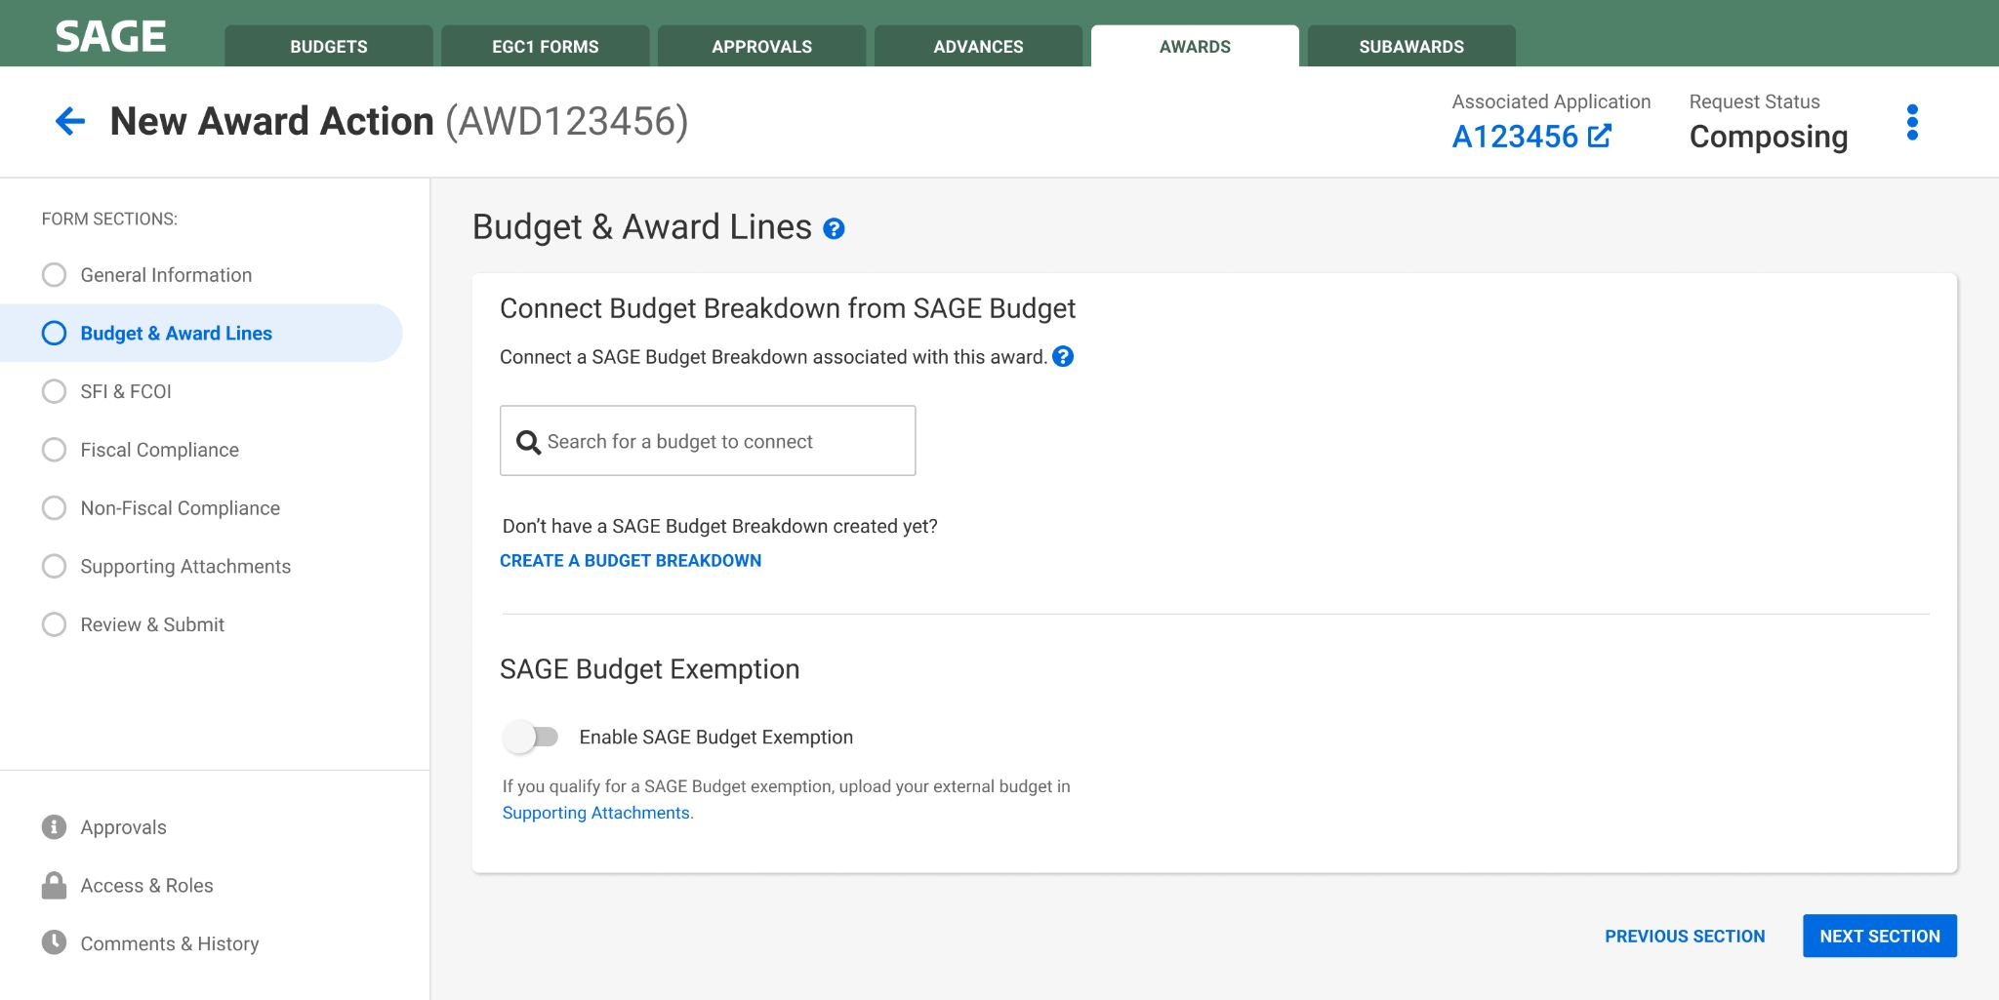
LINK SAGE BUDGET TO AWARD
Link SAGE Budget
Search and select your SAGE Award Budget
Search by eGC1, PI, or short title
Notes:
Amanda
Will have to find the right eGC1 to associate that with the correct award and also link the budget to the award.

Slide 54
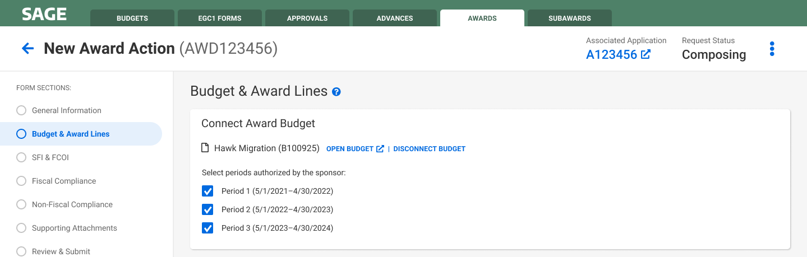
SELECT AUTHORIZED PERIODS
Link SAGE Budget
Select authorized periods
SAGE Budget data synced with Award request
Notes:
Amanda
Select periods authorized by sponsor.

Slide 55
Complete & Submit Award Request
Location on workflow
Notes:
Amanda

Slide 56
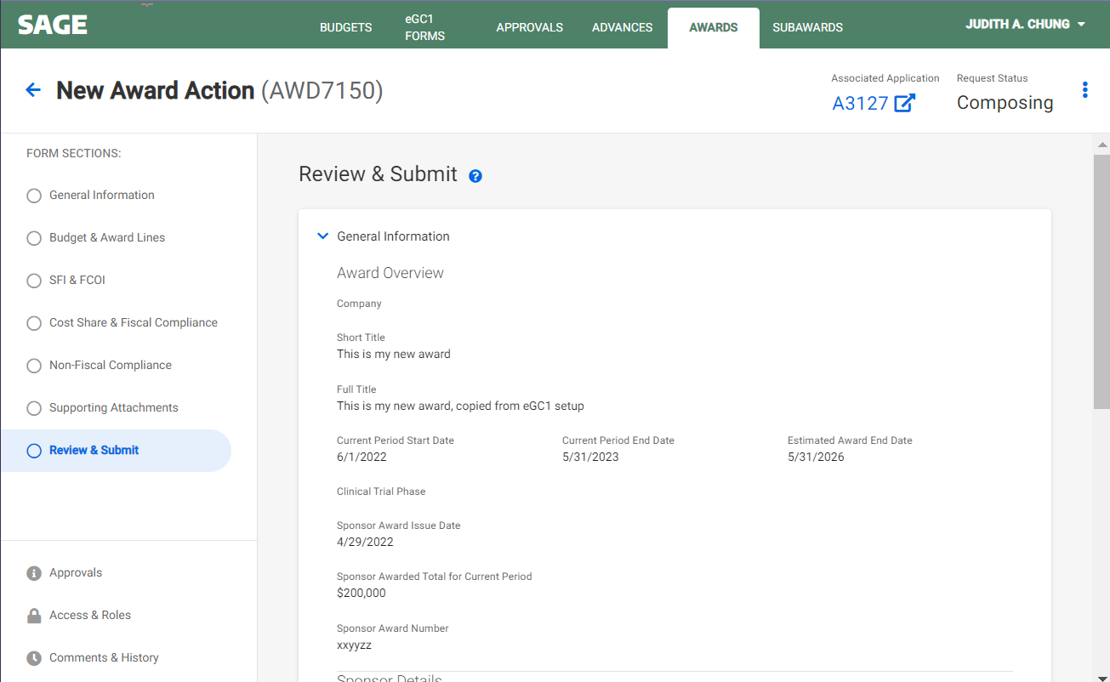
COMPLETE & SUBMIT
Link SAGE Budget
Complete & Submit Award Request
View a complete summary of the Award Setup request
Submit to OSP
Notes:
Amanda
There will also be validations that will help ensure accuracy prior to submitting the request to OSP. This hands off to OSP, which will complete our part of the process prior to approving and submitting to GCA. GCA will have actions to review and edit prior to integration to Workday which completes the setup.

Slide 57
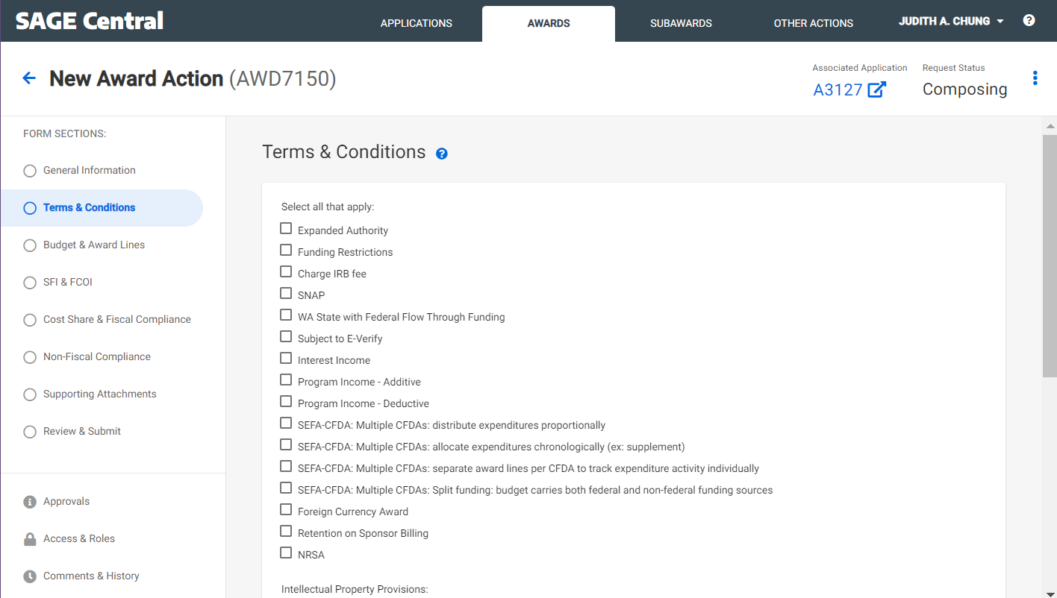
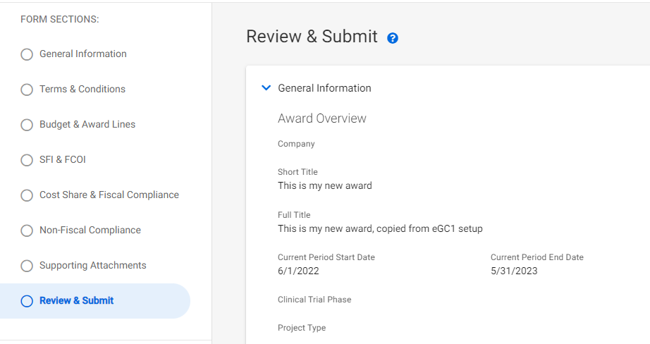
OSP & GCA REVIEW/APPROVE
OSP & GCA Review
OSP & GCA add Terms & Conditions, other setup details
OSP Review & Submit to GCA
GCA initiates integration to Workday
GCA processes award in Workday and SAGE
GCA can send award back to campus if needed
Notes:
Amanda

Slide 58
Receive Notification that Award is Ready
Location on workflow
Notes:
Juan
Campus receives notification when the award is set up and ready to be used.

Slide 59
WORKDAY ACTIONS
Workday Actions
Coming up next!
  November 10 MRAM: The UWFT program will present about the Award once it lands in Workday at the upcoming MRAM on November 10.
  November 15 Office Hours: Join the Research Administration Peer Network (RAPN) meeting on November 15 to ask question about the Award process/actions in Workday.
Notes:
Juan

Slide 60

GET AHEAD OF THE GAME!
Become Familiar with SAGE Budget (required for SAGE Award Setup)
  Attend a SAGE Budget Class: Register to attend the next class is on November 1
  SAGE Budget user guides
  SAGE Budget job aid
Provide feedback on SAGE Budget usability issues, concerns
  Contact us at sagehelp@uw.edu
Notes:
Juan

Slide 61
UWFT FOR THE RESEARCH COMMUNITY WEBPAGE
One-stop-shop for the latest UWFT resources, information, and training
washington.edu/research/uwft-for-the-research-community/
Notes:
Juan

Slide 62
QUESTIONS?
Notes:
If you have questions, please submit them to the Q&A/chat and we will respond in the post-MRAM Q&A email that will be sent to the MRAM mailing list next week.

Slide 63
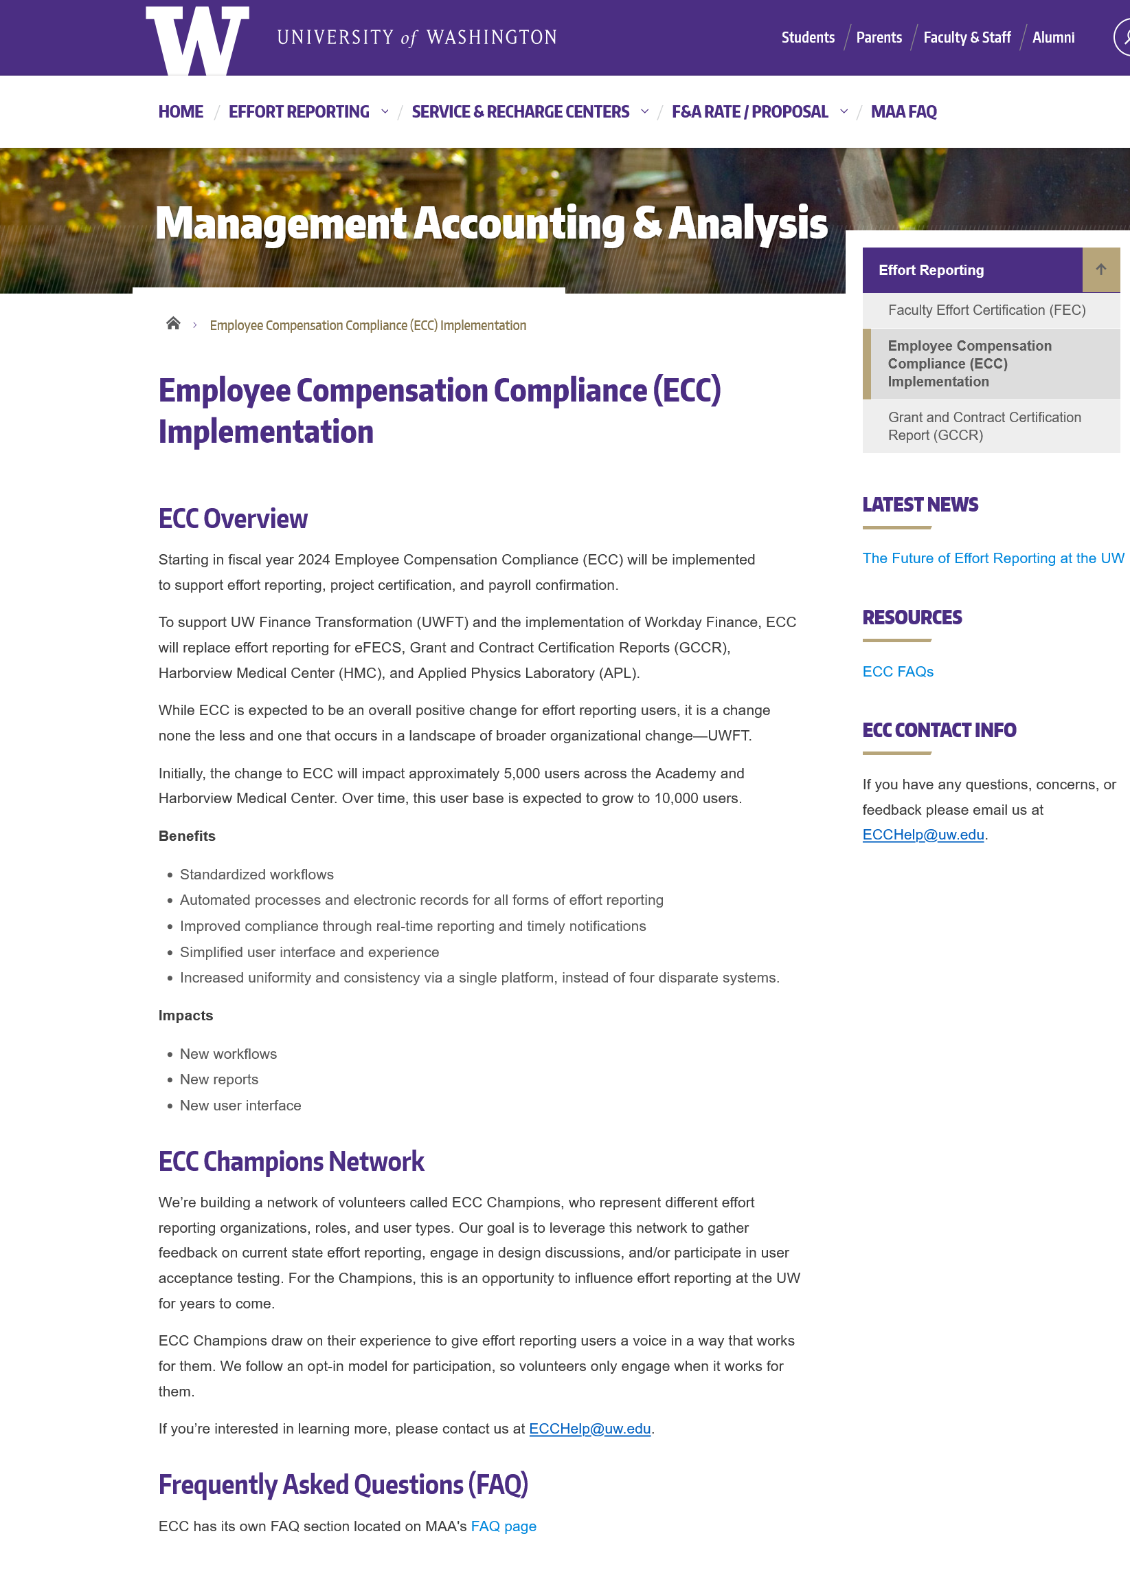
ECC – UW’s New Effort Reporting Solution
MRAM
October, 2022
Joe Giffels
Office of Research
https://finance.uw.edu/maa/ecc

