Slide 1

Highlights from the September 6th issue
Maria Savage, Associate Director, Human Subjects Division

Slide 2

Revised Lapsed IRB Approval Policy
HSD’s policy on research with lapsed IRB approval has been revised!
The revised policy includes more robust follow-up of studies once IRB approval has expired with an emphasis on studies that involve more risk.
This will be in addition to the automated courtesy reminders that are sent by the HSD Zipline system at:
  8 weeks prior to the expiration of IRB approval
  4 weeks prior to the expiration of IRB approval
  When IRB approval has expired.
Highlights from the September 6th issue
Effective September 1st
See section 5.4
SOP IRB Review

Slide 3
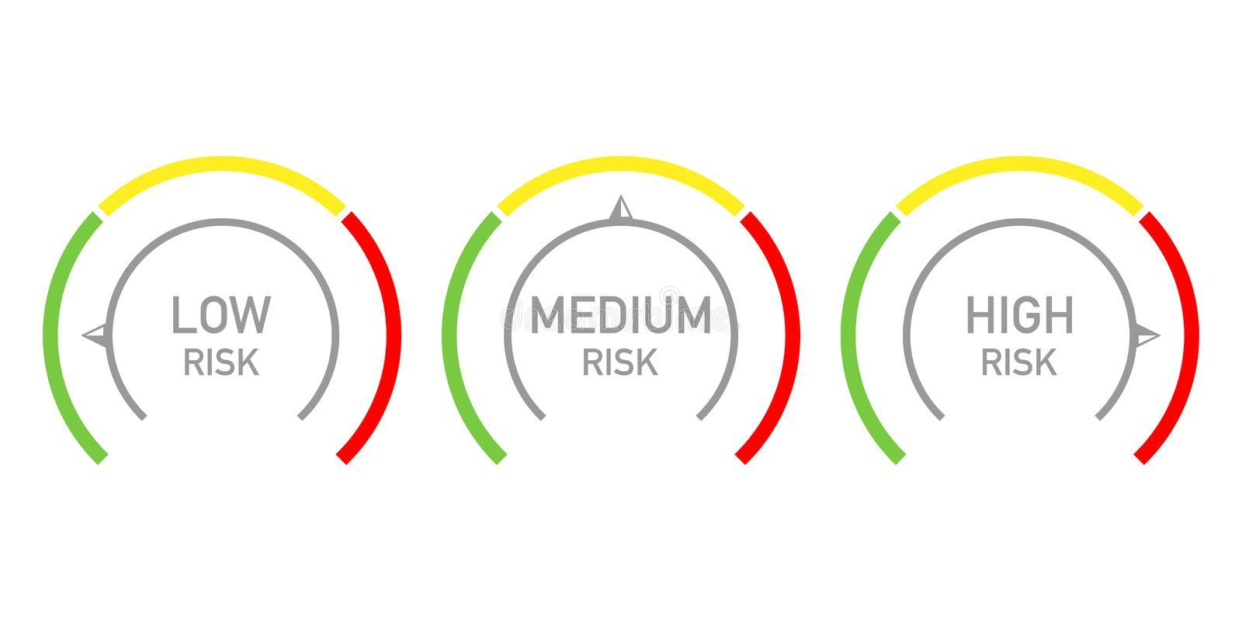
Revised Lapsed IRB Approval Policy
The revised policy describes HSD actions for two categories of expired studies.
Category 1. Studies that cannot be closed without the submission of a status report confirming that all human research activities ceased. These include:
  Studies regulated by the FDA
  Studies that involve more than minimal risk
  Studies initially reviewed by the full board (excluding studies in data analysis).
Highlights from the September 6th issue
Category 2. All remaining studies.

Slide 4
Revised Lapsed IRB Approval Policy
Category 1. Studies that cannot be closed without the submission of a status report
Actions. When no study closure or renewal application is received after IRB approval expires, HSD will:
Within 30 days
  Send an email reminder to the research team
At 60 days
  Send an email reminder to the research team and dept head
  Stop accepting new applications and study modifications from the PI of the lapsed study
At 90 days
  Determine that the study is in continuing noncompliance
  Ask the IRB to consider corrective action. This may include termination of the study and reporting to relevant federal agencies, study sponsors and collaborators.
Highlights from the September 6th issue

Slide 5
Revised Lapsed IRB Approval Policy
Category 2. All remaining studies.
Highlights from the September 6th issue
Actions. When no study closure or renewal application is received after IRB approval expires, HSD will:
Administratively close the Zipline application if no continuing review application or study closure request is received within 90 days after the expiration of approval.
Require submission of a new Zipline application to continue the research.

Slide 6

Zipline Support Survey
HSD needs your help to improve Zipline support resources!
Complete a short survey to tell us what current Zipline help resources you use most and what future resources you would like.
The survey contains 6 questions and should take less than 5 minutes to complete.
You have the option to enter a drawing to receive a coffee gift card as a thank you for your participation.
Highlights from the September 6th issue

Slide 7

October 4th HSD Newsletter
Coming Soon- New Guidance on Reasonably Foreseeable Risks
Complete the Zipline Support Survey
Turnaround Times for HSD and IRB Review
PAVE 2021 Annual Report Findings and Recommendations
New NIH Data Management and Sharing Policy
In the October 4th issue

Slide 8


Questions? Email HSD at: hsdinfo@uw.edu

