Slide 1
APS 36.3
UW Gift Acceptance Policy
(effective as of July 1, 2022)

Slide 2
Getting to know the formalized Gift Acceptance Policy
Why now?
What is a gift?
How do you know it is a gift?
What's next?
AGENDA

Slide 3
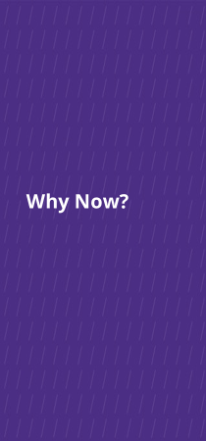
Why Now?
Industry standard and best practice
Risk management
UW’s funding model is evolving
Changes in the nature of fundraising

Slide 4
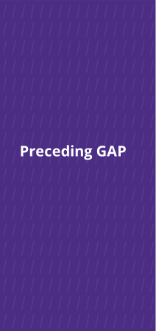
Preceding GAP
Private Gifts and Grants Acceptance Committee updated GIM 34
(rolled out during COVID-19 pandemic)
Internal Audit identified potential risks
Examples of risk across the country
Donors are savvier and demanding
Notes:
Tobin to change this slide and the next:
this is why we did this:
GIM34/PGGA
Auditor
Risk: across the country
Donors are more savvy and demanding
Note that GIM34 happened during COVID

Slide 5
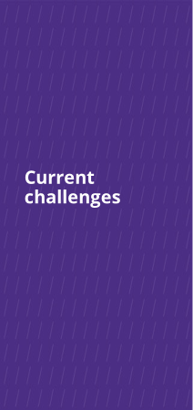
Current challenges
10,000 gift funds; 5,300+ endowments
Challenges of administering these funds effectively and efficiently
Corresponding challenges of stewarding these donors (historically and with new funds being proposed)
Unspent gift balances have doubled over last 10 years
Increased gift complexity driven by philanthropy-savvy donors
"Do the best you can until you know better.
Then once you know better, do better."
- Maya Angelou

Slide 6
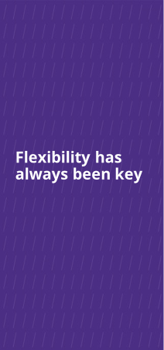
EXECUTIVE ORDER NO. 41 (1972)
“The most useful gift is the flexible one, where sufficient freedom is permitted to meet changing conditions at the University while still meeting the general goals of the donor.”
"Flexible" is not synonymous with "unrestricted"

Slide 7
What is a gift?
"Detached and disinterested generosity"
Philanthropic or charitable intent
Primary beneficiary is the general public (not the donor)
Given for general activities or a new project/initiative
Irrevocable
No quid pro quo
Gifts cannot...
Require detailed financial accountability
Require deliverables
Transfer IP, restrict publications, require indemnification clauses
Require return of funds
Notes:
We were looser on enforcing policy and law in order to get to YES.
Universities across the country are wrestling with these same issues. We, in particular, had gone very far in donor-centricity

Slide 8
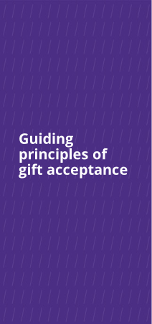
Guiding principles of gift acceptance
UW will seek and accept gifts that:
Will benefit the UW
There must be a reasonable expectation that acceptance of the gift will ultimately benefit the University and its mission.
Will further the donor’s charitable interest
University believes acceptance is consistent with the donor’s expressed philanthropic interest.
Will not put the UW, affiliates, or stakeholders at risk
The gift does not present a current or potential material risk.

Slide 9
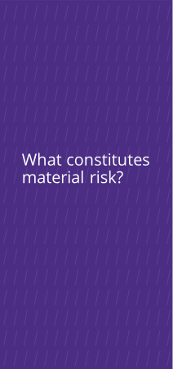
What constitutes material risk?
University will not accept a gift or will consider returning a gift that:
Doesn’t fit its mission & values
Infringes on academic freedom
Potential reputational risk
Too restrictive in purpose or too costly to administer
Prohibited by law (or is funded by property acquired by other than legal means)
Creates unacceptable liability or could lead to future unanticipated expenses
Creates a conflict of interest or potential ethics violation
Includes an exchange for goods/services (unless fair market value is disclosed at time of gift)
Risks our tax-exempt status

Slide 10
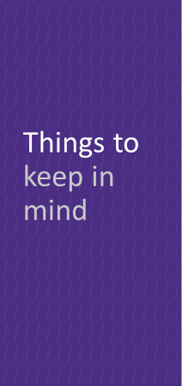
Past treatment of funds is not a determining factor
Neither the donor or faculty member determine whether the UW can receive the funding as a gift
Sometimes the goal is charitable, but the terms and conditions mean it cannot be treated as a gift by UW
Inclusion or exemption of overhead (F&A costs) and/or gift assessments is not a basis for determination

Slide 11
How do you know if it is a gift?
The funder’s requirements determine what flavor of funding it will be
Partner with your unit Advancement team early in the process
Central Advancement are here to help:
  Corporate & Foundation Relations
  Endowment & Donor Services
  Gift Services
Gift Acceptance Committee

Slide 12
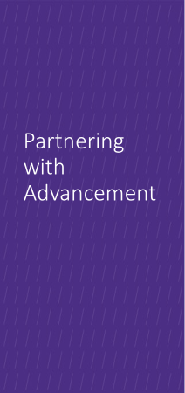
Partnering with
Advancement
Best Practices
  Partner EARLY with your Advancement colleague(s)
  Can help with determination of gift, grant, or contract
  Can help flag potential issues to avoid problems later
  Can assist with sample language
  Partnering early will streamline your process and expedite the funding
Things to Avoid
Over-promising a potential funder things that may have to be walked back later depending on the avenue the funding will follow
Don’t sign anything

Slide 13
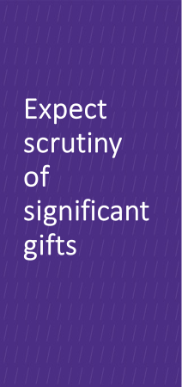
Expect scrutiny of significant gifts
Gifts require documentation that support donor intent and provide an understanding of donor expectations, if any.
Our due diligence is to protect the UW.

Slide 14
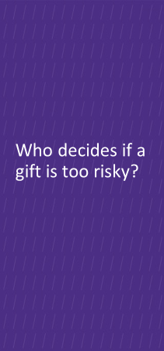
Meet the Gift Acceptance Committee (GAC)
Made up of senior University officials who will undertake an efficient, thorough, and time-sensitive review of proposed gifts to vote and communicate its decisions
Standing members:
  VP of Development (Tamara Josserand)
  SAVP for Development Programs (Stephanie Doyle)
  AVP for Campaigns and Emerging Initiatives (Lisa Thomas)
  AVP for Advancement Operations (Julie Brown)
  Senior Director for Planned Giving (Carl Wayne)
Rotating members (two-year term):
  Two CAOs representing a large and a small school
  For FY23-24: Don Theophilus (UW Medicine) and Alex Haslam (College of Built Environments)

Slide 15
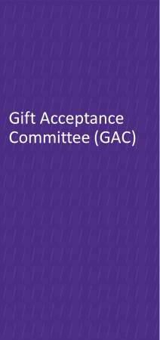
Gifts subject to review are those that pose material risk (including being overly-restrictive or with financial liability), those with unique or special circumstances, etc.
Gifts are referred on a case-by-case basis and require extensive research/documentation prior to presentation for the GAC review
Committee will virtually vote to accept, accept with revision, or reject a proposed gift
Average time to decision: 2 weeks

Slide 16
What's next?
"Getting to yes, and..."
We do not know the answer (yet) on all avenues for revenue, managing risk and obligations.
Non-gift Revenue Committee (potentially)
When working on potential gifts, communicate early and often with your Advancement Team
Be prepared to share all documentation; transparency is key

Slide 17

MIND THE GAP

