Slide 1
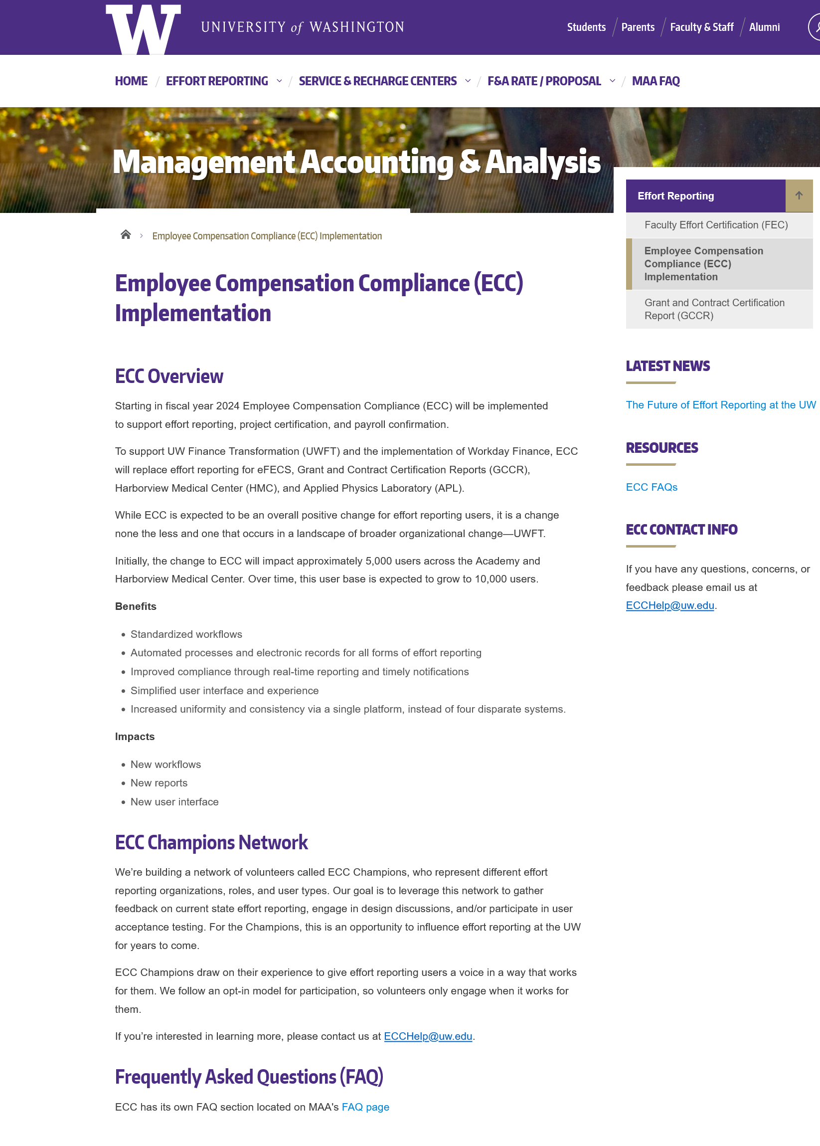
ECC – UW’s New Effort Reporting Solution
MRAM
October, 2022
Joe Giffels
Office of Research
https://finance.uw.edu/maa/ecc

