Slide 1
Monthly Research Administration Meeting
Workday Finance-Grants Focus
November 10, 2022
Amanda Snyder, Associate Director, Office of Sponsored Programs
Nicole Flagg, Grant Award to Close Lead, UW Finance Transformation
Jesse Rice, Grant Award to Close Business Analyst, UW Finance Transformation
Liz Satwicz, Change Manager, UW Finance Transformation

Slide 2
AGENDA
MRAM:
October MRAM Recap-SAGE Workflow
Key Grants-related Systems
MRAM Extension:
Grant Award to Close Overview/Day in the Life: Grants Manager in Workday
Demo
RAPN announcement/Q&A submission
Notes:
Recap of MRAM from Amanda. MRAM likely to run over and push our pres into 30 min extension. Drop full Q&A but let folks know will respond and have opp at RAPN. Make slides accessible in the Appendix. Change Impact Overview

Slide 3
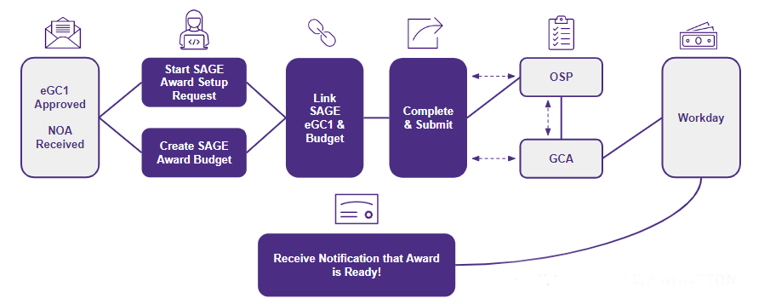
HIGH-LEVEL WORKFLOW
Notes:
In October, will share a flow chart visual to show award intake workflow. May try to depict a two-column who does what where view of actions in SAGE and Workday. Could start with this as an establishing shot/refresher at MRAM.
Amanda or Juan as potential presenters

Slide 4
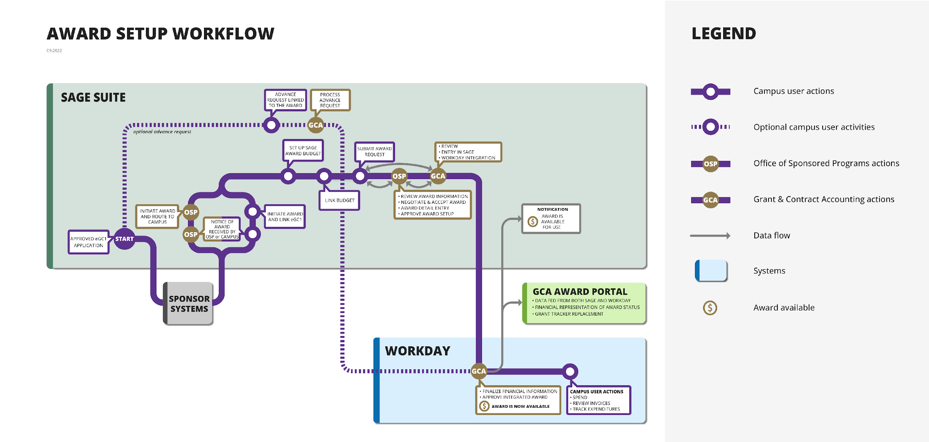
AWARD SETUP WORKFLOW
Notes:
In October, will share a flow chart visual to show award intake workflow. May try to depict a two-column who does what where view of actions in SAGE and Workday. Could start with this as an establishing shot/refresher at MRAM.
Amanda or Juan as potential presenters

Slide 5
KEY GRANTS-RELATED SYSTEMS
Workday
Finance
Replacing FIN/FAS, MyFD, and Ariba​
ECC
(Employee Compensation Compliance)
*Replaces current effort reporting
Award Portal
Replacing Grant Tracker
SAGE
Including the new Award Setup Workflow
UW Connect
Web-based support tool
*Replaces eFECS, Grant & Contract Certification Report and effort reports for HMC and APL
Notes:
You’ve heard about SAGE. List five systems: SAGE, WD, ECC, Award Portal which replaces Grant Tracker, UW Connect. Where am I going to go and how am I going to do my work? What do I do in each system? What are the benefits. What will be different. Appease people's’ fears by explaining the where.

Slide 6
DAY IN THE LIFE: GRANTS MANAGER IN WORKDAY

Slide 7
SPONSORED AWARD COMPONENTS
The sponsor’s Notice of Award (NOA) can be broken down into these main objects.
1
Award
Defines the business rules to correctly bill, collect, and report activities related to the award.
4
Award Budget
Workday automatically builds the periods based on the award schedule.
2
Sponsor, Flow Through Sponsor
Award Line
Manages award details and ties Grant to Award.
Award Date
Reimbursement Method
Award Line Attributes
Award Schedule
Award Schedule
F&A Rule
Budget Breakdown
3
Award Amounts
Grant
Collects costs
Start and End Dates
Grant
(Worktag)
Award Attributes
Sub-recipient
Grant
(Worktag)
Notes:
Remind we won’t have time for questions. Please submit. Explain terms, e.g. a tenant. Orient the audience to where you are and your role in time and space. WD award components:
The Award - is the like the Umbrella it contains information supporting overall award activities - the sponsor, dates, amounts, and a number of attributes
The Award Line - allows us to get more granular with the details of the award and captures additional information and attributes such as reimbursement method (cost reimbursable, Fixed Amount); F&A rules which allow us to manage awards that are issued with multiple F&A rates
The Award Line also links the Grant Worktag with the Award
The Grant Worktag - is used to collect the costs and will be reflected on transactions within the system
Award Budget - used to monitor, reporting, and invoice (sponsors often want financial reports to show expenses compared to the budget.)
Award Schedule defines the periods we want to provide budgets for (Pre-Award, Award Period, Separate years- year 1, year 2) and allows us to define the Contract Start/End dates (Sponsor defined)

Slide 8
DEMO

Slide 9
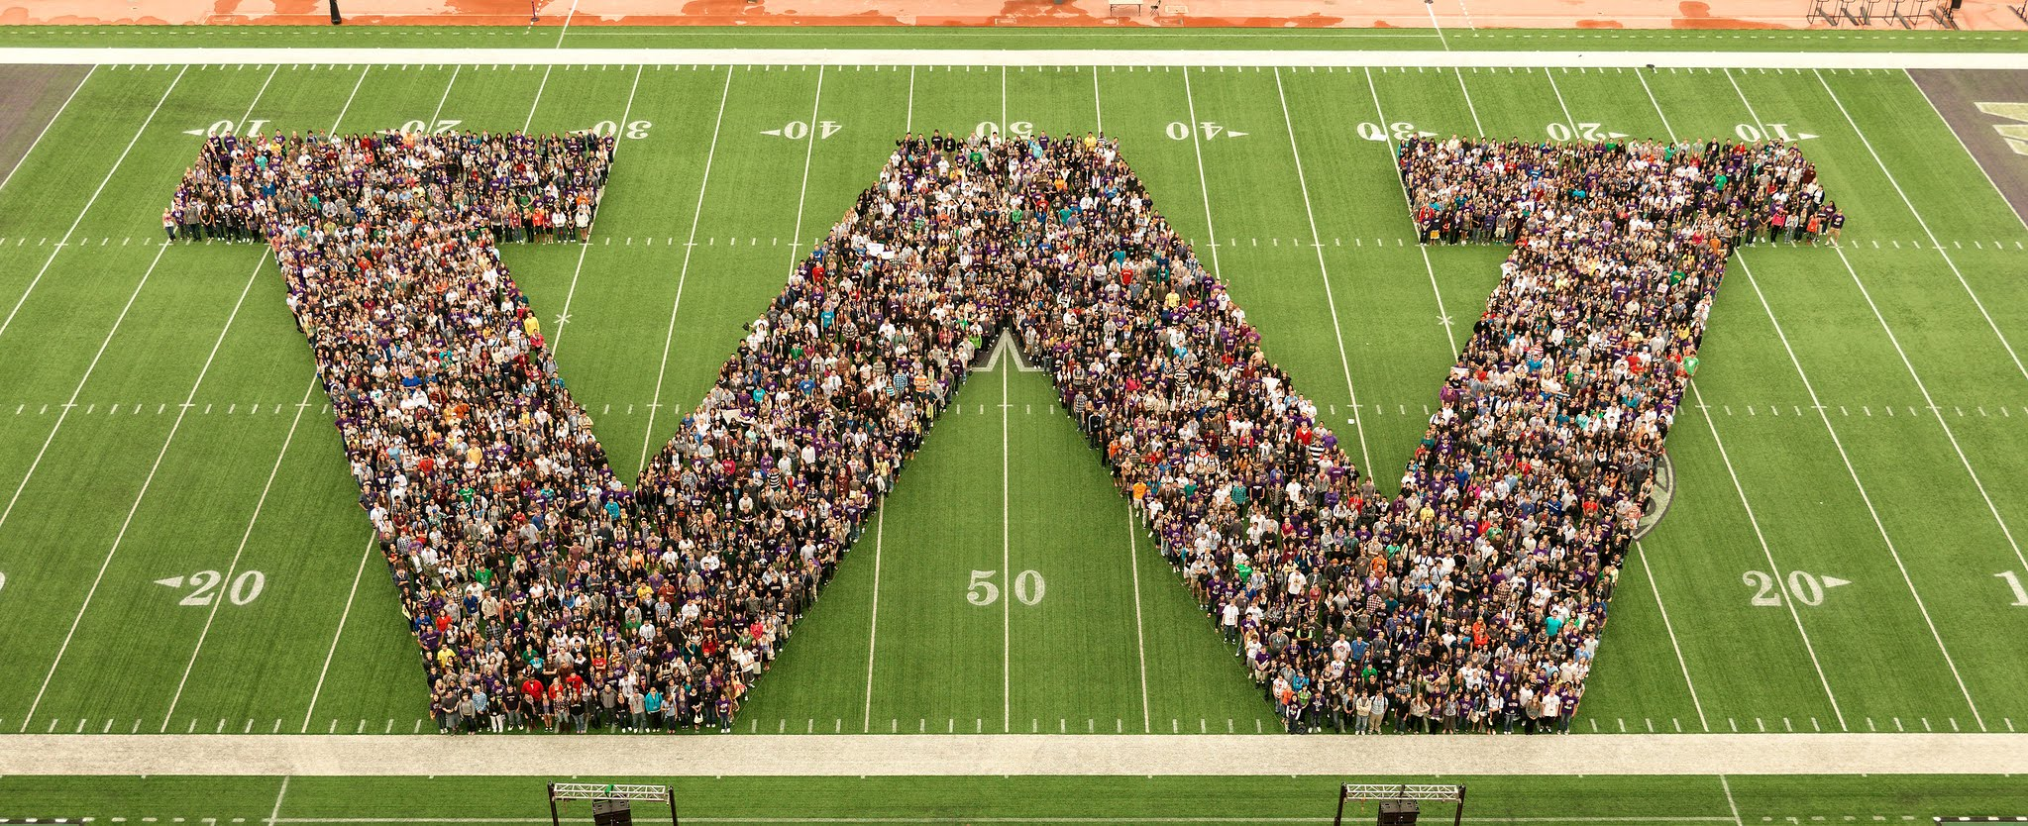
THANK YOU!

Slide 10
RESOURCES/ENGAGEMENT
Notes:
Future video that walks thru sections/tabs in WD
RAPN Q&A promo
Stay tuned for more information
Remind of availability of finance classes – Accting Mechanics, GA
Other communications pushes related to Grants, next Roadshow in January

Slide 11
RESOURCES/ENGAGEMENT
RAPN Session / Q&A submission — November 15
Finance Literacy Seminars — November 15/16
Core Concepts — November 17/29
Future State Focus video
Roadshow #5 — January 18
UWFT for the Research Community
UWFT Newsletter; Transformation Insights blog
Change Network

Slide 12
CONTACTS
UWFT Help: If you have general questions about UWFT and Workday Finance, email the program at UWFTAsk@uw.edu.
SAGE Help: If you have questions or concerns about SAGE Budget or SAGE Awards, please reach out to sagehelp@uw.edu.
Notes:
Qs from managers needing to know where to find reports and how to restructure their units. A lot of this is still under development. Even giving a timeline could allay fears. Training info.

Slide 13
APPENDIX

Slide 14
GRANT AWARD TO CLOSE OVERVIEW
Notes:
Orientation/Context setting.

Slide 15
GRANT AWARD TO CLOSE
What is Grant Award to Close?
Grant Award to Close refers to business processes involved from the time a grant or contract is awarded through grant close-out. This includes facilities and administration (F&A) activities, sub-award and sub-recipient activities, billing and reporting to sponsors, cost-share, effort reporting, and other post-award grant management activities.
Transformation Goals include:
Sponsored agreement data flows automatically from pre-award to post-award systems
Streamline grant/contract set up process
Provide robust grant tracking (financial/administrative) across the enterprise
Consolidate post-award grants management in Workday
Increase granular tracking of expenditure types within a grant
Provide automated exception reporting

Slide 16
CHANGE IMPACT OVERVIEW
Notes:
Orientation/Context setting. We’ve been talking about change impacts. Here’s one that we will follow through. Connect between change impacts we’ve been collecting and walk through/demo.
Can we create a condensed set of slides that intros to the tool and big changes that are coming as context. But jump into demo as quickly as possible.
Benefit of this

Slide 17
CHANGE IMPACT OVERVIEW
Change impacts allow the Organizational Change Management (OCM) team to collect and analyze changes that will impact end users as a result of finance transformation, for use across OCM activities (e.g., stakeholder engagement, training).
A Change Impact…
Is a narrow statement of what will be different as a result of UW Finance Transformation and the associated impact to people, processes, technology and policies
Includes an assessment of the extent to which these impacts affect each stakeholder role and unit (high, medium, or low impact)
Serve as a source of foundational knowledge for the OCM Team to construct tailored communications and training to mitigate impacts and prepare each for go-live and beyond
OCM has been collecting, refining, and validating Change Impacts from stakeholders and the UWFT Design team and their partners for over two years.
Notes:
Direct to change impacts v. these slides – too much to include this. Could book time in Dec MRAM?
Could we condense to a couple of slides. And you will get to hear more about this and see on the Change Network.

Slide 18
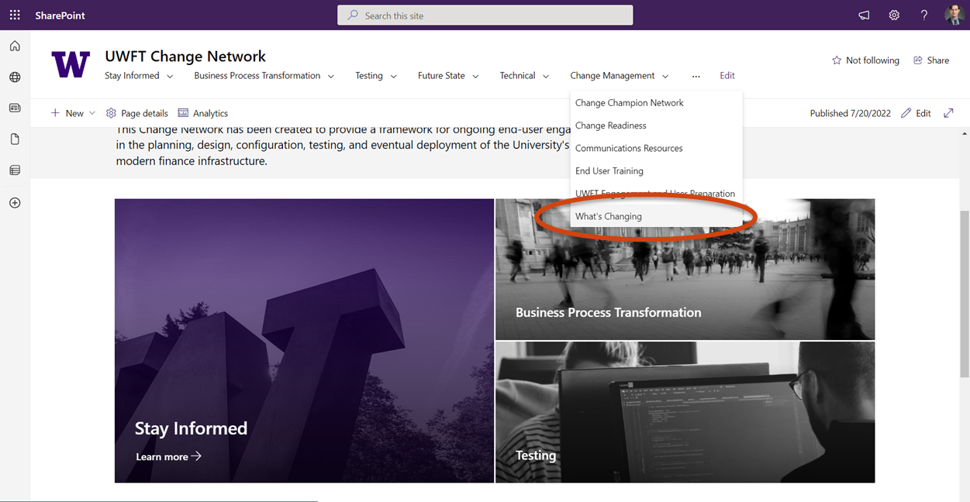
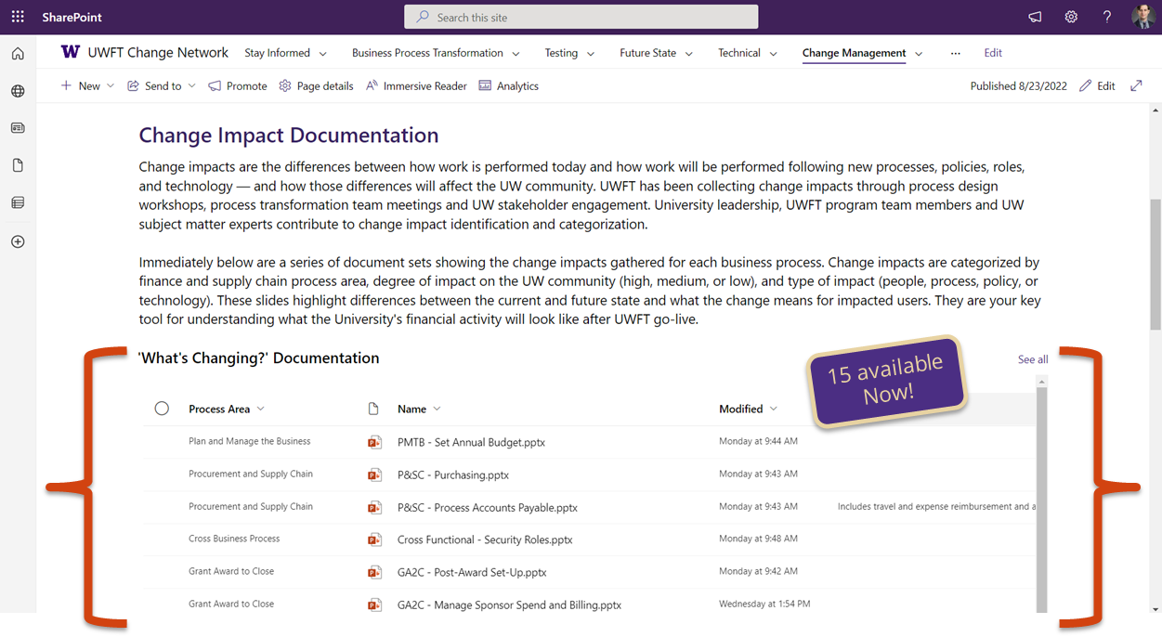
OCM IS CREATING ‘WHAT’S CHANGING’ SLIDE-SETS FOR EACH BUSINESS SUB-PROCESS

Slide 19
GA2C TAXONOMY

Slide 20
GRANT AWARD TO CLOSE Post-Award Set-Up | GA2C-030
KEY
UW Medicine
UW Academy
Updated: 9.02.22
CURRENT STATE
Full information need for set-up requires using a variety of communication methods which do not connect (e.g., email, in-systems communications)
Set-up requires multiple rounds of manual data entry into multiple systems (e.g., SAGE, Grant Tracker, BGT)
Award structure is often complex, and difficult to record
FUTURE STATE
Award setup initiated in SAGE by campus, consolidating data collection and reducing back and forth
SAGE to Workday integration to reduce manual entry
Awards encompass a competitive segment of activity and are visible in both Workday and SAGE
VIEW THE PROCESS FLOW:
WHO IS MOST IMPACTED?
WHAT DOES THIS CHANGE MEAN?
SAGE integration with Workday will reduce manual data entry needs, re-work, and errors/typos, which will lead to increased compliance
Remediation of SAGE & SAGE Budget has new, standardized intake forms for greater visibility of status and consistency regarding how to communicate updated data
Workday allows for greater granularity in recording sponsor details and auto-calculation of F&A
UW Medicine
UW Academy
HMC Grant Accounting
OSP and GCA
Grant Managers
Grant Managers
Principal Investigators
EXPECTED BENEFITS
Increased proactive partnership across the organization
Clearer roles & responsibilities
Increased consistency in global processes, policies, and/or procedures
Elimination of manual steps through Workday automation
Ability to focus on higher complexity transactions with wider business impact
Notes:
Stripped down version of this? What’s Changing series. Liz owns this.

Slide 21
GRANT AWARD TO CLOSE Post-Award Set-Up | GA2C-030
KEY
UW Medicine
UW Academy
Updated: 9.02.22
NEW AWARDS SECTION IN SAGE
SAGE Awards will be the place to go to initiate award activity or view latest award status and details.
Campus units will request new award setup through SAGE Awards
This section will expand over time to include award modification requests and other helpful features informed by you!
RESOLVING DEFICIT (ex. COST TRANSFERS)
Staff in Shared Environments will complete transfers. This shift will improve compliance for UW.
SAGE BUDGET REQUIRED FOR AWARD BUDGETS AT TIME OF AWARD SETUP
Provides a consistent budget format used to support integration and setup in Workday. Will result in increased visibility, data quality, and consistency.
SAGE Budget will not be required for proposal budgeting
Clinical trials that use CTMS for billing will not need to use a SAGE Budget.
TRACKING NON-FINANCIAL TASKS
Grant awardees at the unit level can input ad-hoc non-financial tasks into Workday (e.g. progress and inventory reports). This will allow for fewer side-systems and increased visibility.
SPONSOR ATTRIBUTE FACILITATES REPORTING
Use of new attribute for sponsor identification.
Fewer revenue categories will be needed.
Greater granularity available in reporting.
Sponsor management will be its own discipline.
SUBAWARD F&A WILL BE AUTO-CALCULATED
Workday will apply Facilities and Administration (F&A) on subawards automatically until the remainder of the F&A basis limit is consumed.
Different award lines for each subaward will improve F&A management.
This will result in a reduction in manual work and use of side systems
Notes:
Could delete first two SAGE ones. Could be in the Appendix.

Slide 22
Grant Award to Close Post-Award Set-Up | GA2C-030
KEY
UW Medicine
UW Academy
Updated: 9.2.22
COST-SHARE TRACKING IN REAL TIME
A unique award line will be established in the financial system to track cost share expenses instead of tagging after the fact.
CONSOLIDATED SUB-RECIPIENT COST-SHARE TRACKING
There will only be one system (both technology and process) for cost-share so there will no longer be an issue keeping them in sync.
A unique Spend Category will be created for Subrecipient Cost-Share.
Notes:
DELETE – Jan or Feb timeframe

Slide 23
KEY CHANGES IN POST-AWARD PROCESSES
* Full scope of activities not shown, to see more information on the levels of shared and future state processes, please see the individual business process sections
**Processes differ across units in the current state, these notes may apply differently to various units
KEY STEPS IN POST-AWARD – IMPACTS TO CURRENT UNIT ACTIVITIES*
Process Notes Specific to UWA
Receive Notice of Award
Award Set Up and Award Maintenance
Manage Sponsored Program Spend
Sponsor Billing and Financial Reporting
Effort
Reporting
Award
Closeout
Work Changing
Work Automated
Work Moving to Shared
Work Automated
Work Changing
Work Automated
All award intake within SAGE
SAGE Integration to initiate Awards, Award Lines, Award Schedules, Award Budgets, and to create Grant worktags
Receive, review, and process requests for non-payroll cost transfers
Cost Reimbursable transactions outside award period not eligible for Sponsor Billing
All cost share will be in Workday, and we will use a new third-party solution for effort reporting
Award Closeout Task Notifications and Lifecycle status updates
Work Changing
Use of SAGE budget to standardize and facilitate Award integrations
Work Changing
Work Changing
Work Changing
Work Moving to Shared
Cost share established as a unique award line (companion account); Cost Share funding sources identified at time of award
All cost transfers completed in Workday and payroll accounting adjustments (payroll expense transfers) completed by units
Visibility into Award Billing Information in Workday Award (also visible in Award Portal)
Work Moving to Shared
Work Changing
Review all effort reports for compliance before certification
Assist local units with the final award reconciliation before working with Grant and Contract Accounting to close out the award in Workday
Award structure is changing – an award will equal a SAGE cycle, which is equal to a sponsor-awarded competitive segment
Work Changing
Work Changing
Work Changing
Ability to connect milestone -based Sponsor billing with award tasks to facilitate task completion communication and timely billing
Work Changing
Unique award line for each subaward with spend restrictions to allow only subaward related spend and to support automated F&A with basis limits
Each eligible direct cost will generate an individual F&A cost transaction, rather than one summary per day
Faculty effort cost share requires costing allocations as it is no longer assumed within the pool of non-sponsored support
Work Automated
F&A calculations subject to F&A basis limit (1st $25k on subaward posting real-time)
Key
Work Changing**
Work Moving to Shared
Work Automated
Notes:
APPENDIX

Slide 24
GRANT AWARD TO CLOSE Post-Award Set-Up | GA2C-030
Current State
Future State
Full information needed for set-up requires using a variety of communication methods which do not connect (e.g., email, in-systems communications)​
Award setup initiated in SAGE by campus, consolidating data collection and reducing back and forth
Set-up requires multiple rounds of manual data entry into multiple systems (e.g., SAGE, Grant Tracker, BGT)​
SAGE to Workday integration will reduce manual entry
Award structure is often complex, and difficult to record
Awards encompass a competitive segment of activity and are visible in both Workday and SAGE
Notes:
Stripped down version of this? What’s Changing series. Liz owns this.
Some benefits of these changes are:
SAGE integration with Workday will reduce manual data entry needs, re-work, and errors/typos, which will lead to increased compliance
Remediation of SAGE & SAGE Budget has new, standardized intake forms for greater visibility of status and consistency regarding how to communicate updated data
Workday allows for greater granularity in recording sponsor details and auto-calculation of F&A

Slide 25
GRANT AWARD TO CLOSE Post-Award Set-Up | GA2C-030
SUBAWARD F&A WILL BE AUTO-CALCULATED
Workday will apply Facilities and Administration (F&A) on subawards automatically until the remainder of the F&A basis limit is consumed.
Different award lines for each subaward will improve F&A management.
This will result in a reduction in manual work and use of side systems
RESOLVING DEFICIT (ex. COST TRANSFERS)
Staff in Shared Environments will complete transfers. This shift will improve compliance for UW.
TRACKING NON-FINANCIAL TASKS
Grant awardees at the unit level can input ad-hoc non-financial tasks into Workday (e.g. progress and inventory reports). This will allow for fewer side-systems and increased visibility.
SPONSOR ATTRIBUTE FACILITATES REPORTING
Use of new attribute for sponsor identification.
Fewer revenue categories will be needed.
Greater granularity available in reporting.
Sponsor management will be its own discipline.
Notes:
Could delete first two SAGE ones. Could be in the Appendix.

Slide 26
KEY GRANTS-RELATED SYSTEMS
Notes:
Orientation/Context setting. We’ve been talking about change impacts. Here’s one that we will follow through. Connect between change impacts we’ve been collecting and walk through/demo.
Can we create a condensed set of slides that intros to the tool and big changes that are coming as context. But jump into demo as quickly as possible.
Benefit of this

Slide 27
GRANT SYSTEM LANDSCAPE
The following two tables provide details of the future state grants related systems, what they are and how PIs and Grant Managers will use them.
 | SAGE | Workday | ECC | Award Portal | UW Connect
System Description | The System to Administer Grants Electronically (SAGE) is the web-based system used to submit and route funding applications for consideration and approval, create accurate and detailed budgets, request advance budgets, and initiate subawards. With UWFT launch in July 2023, SAGE will also host the award setup request form, to be completed after the Notice of Award (NOA) is received. | Workday is a cloud-based finance and supply chain system UW will use to manage all financial processes and procurement and inventory management activities. It allows for transactions and analytics to be unified in a single system, where all data is stored in-memory, enabling real-time transaction processing, consolidation, and reporting of financial data in one place. | Employee Compensation Compliance (ECC) is a third-party solution, provided by Huron Consulting, which supports the effective management of effort reporting, project certification, and payroll confirmation. | The Award Portal will replace functionality for current state system Grant Tracker. Award Portal will be used for grant management and communications tasks by users across campus and the Grant Contract and Accounting team within UW Finance. Award Portal is a resource for UW depts. working with grant and contract budgets. Award Portal is a custom-built application that will interface with Workday sourced data and provide rich links that fill Workday “gaps”, maintain the current fast response rate and provide an authoritative source for grant data. | UW Connect Finance is the web-based ServiceNow tool in use at UW today. Workday Finance users will find Workday Finance self-help content: process documentation, job aids, training videos, etc. Users will be able to submit forms to request support and initiation of processes. Shared Environments and UW Finance central offices will be UW Connect licensed users to enable routing and resolution of customer support tickets
What is it replacing or is it changing? | NEW: A new Awards section in SAGE will be introduced in July 2023. Users will be able to request setup of a new award, and monitor award details, status, terms and conditions, and history of award activity. The award setup request form will replace email communication, provide a familiar user experience (similar to advances), autofill of eGC1 and SAGE Budget information, and integration with Workday for streamlined setup. NEW: A new sponsor lookup and request process will be implemented in SAGE prior to UWFT launch, connecting SAGE to a new sponsor/donor database. The new simplified form improves data quality, allows for a connection between the sponsor and donor, and tracking of previous and related sponsor names. CHANGING: The Advanced Budget Request process in SAGE was launched in June 2021 in preparation for UWFT and will be updated in 2023 to streamline the transition from Advance to Award. | REPLACING: FAS My Financial Desktop eFECS Cost Share Summary Ariba (for outgoing Subawards) | REPLACING: eFECS Effort Reporting GCCR reports | REPLACING: Grant Tracker Aged Database (GCA only) Workflow Sheets (GCA only) | REPLACING: Some email accounts (not external) Phone calls Potentially other ticketing and routing systems used by units for unit-level approvals (e.g. TREQ, Purchase Path)

Slide 28
GRANT SYSTEM LANDSCAPE (cont.)
The following two tables provide details of the future state grants related systems, what they are and how PIs and Grant Managers will use them.
 | SAGE | Workday | ECC | Award Portal | UW Connect
What tasks will a PI do in this system? | PIs with administrative staff will review and approve applications and complete SFI disclosures as usual. The existing SFI disclosure requirements will continue to apply via FIDS. PIs who do not have administrative staff will communicate their award budget setup using SAGE Budget and will complete the Award Setup Request form in SAGE. | Standard for all PIs: Review award setup upon notification Approve receipt of subrecipient invoices prior to payment (varies by PI) Run Grant related reports Varies by unit: Approve additional procurement related transactions (ad hoc approvals added by unit Grant Managers, includes high risk/sensitive items and items where PIs have not delegated authority per GIM 02) Approve award tasks (ad hoc award tasks added by unit Grant Managers, includes non-financial award tasks such as programmatic reports) PIs without administrative staff: PIs who do not have administrative staff are assigned the Grant Manager role to perform Grant Manager tasks in the system. Approve all procurement related spend transactions on Grants Create and Complete award tasks Run Grant related reports | Review and certify project effort | Self service view grant financial information Submit tickets to Grant Contract and Accounting Monitor tasks assigned in Award Portal (e.x. progress and scientific reports) | Self-help content Get help for general Workday Finance questions Request that Workday Finance processes be initiated by SEs or other individuals/units will address
This system interfaces with… | NEW: SAGE will integrate with Workday Existing SAGE integrations will be maintained | Integration from SAGE to Create award in Workday Integration to ECC Integration from OnCore (Clinical Trial Management System) for clinical trial Sponsor invoicing | Interfaces with Workday | Interfaces with Workday

Slide 29
PI JOURNEY MAP
Plan / Propose
Setup
Manage
Closeout
Create an eGC1
Create a SAGE Budget
Complete compliance questions
Submit an application for routing and approval
Approve an eGC1 or SAGE Budget
Complete FCOI disclosure (FIDS)
Submit an advance budget request
Submit an award setup request
Submit a subaward request
Update investigators list as needed
Update SAGE Award Budget
Update FCOI/SFI as needed (FIDS)
Update compliance responses if changed (may be post release)
Update investigators list as needed
Request award modifications, including renewals (may be post release)
Update investigators list as needed
Request award modifications, including renewals (may be post release)
SAGE
Workday
Review award setup upon notification
Approve receipt of subrecipient invoices prior to payment
(varies by unit) Approve additional procurement related transactions
(varies by unit) Complete award tasks
(optional) Run Grant related reports
(varies by unit) Complete award tasks
(optional) Run Grant related reports
Review own effort report
Notify Coordinator/Grant Manager of issues (PAA, Proxy, etc.) – outside ECC
Certify own effort report
Review Project statement (others charging time to their grant)
Notify Coordinator/Grant Manager of issues (PAA, Designee, etc.) – outside ECC
Certify Project statement
Run reports on their projects
ECC
Award
Portal
Submit ticket communications and view its history to/from GCA
See up-to-date status on outstanding requests
View of outstanding Award Tasks by due date
Links to Pre-award systems
Links to invoice PDFs in EDMS
Links to sponsor/financial reports
View of outstanding Award Tasks by due date
UW
Connect
Submit an intake form (structured case) to request initiation of various E2E Workday Finance processes, including requests to set up cost centers, awards, etc. Note that intake forms are not required if PIs choose to use Award Portal to make these requests.
Submit an intake form (structured case) to request initiation of variousE2E Workday Finance processes, including funds transfer requests. Note that intake forms are not required if PIs choose to use Award Portal to make these requests.
Notes:
Hard to read. Disjointed in placement in pres.

