Slide 1
MRAM | Monthly Research Administration Meeting
April 13, 2023 9:00 AM – 10:30 AM Join Webinar: https://washington.zoom.us/j/346891888
TOPIC | PRESENTER | EMAIL | MIN
Welcome | Carol Rhodes Office of Sponsored Programs | carhodes@uw.edu | 2
Future of Effort Reporting | Matt Gardner Post Award Fiscal Compliance | efecs@uw.edu | 15
TrustArc and Research Data | Ann Nagel UW Privacy Office | awalchuk@uw.edu | 10
Workday Conversion Issue: Inactive PIs | Lily Gebrenegus Grant & Contract Accounting | lgebren@uw.edu | 5
UWFT Transitions - Sponsored Program Cutover Round Two | Carol Rhodes & Vince Gonzalez Office of Sponsored Programs | Grant & Contract Accounting | carhodes@uw.edu vinceg@uw.edu | 15
SAGE Training Resources | Kim Halstead Office of Research Information Services | sagehelp@uw.edu | 5
Award Portal Update | Juan Lepez Grant & Contract Accounting | kabah12@uw.edu | 10
CORE Update | Laurie Stephan Collaborative On Research Education (CORE) | corehelp@uw.edu | 10
Workday Reports | Jesse Rice, Stepanka Sirotek UW Finance Transformation | jrice19@uw.edu sr8@uw.edu | 10
NEXT MEETING May 11, 2023 9:00 AM - 10:00 AM

Slide 2
Live Closed Captioning is now available
Live transcription and closed captions are enabled via the “CC/Transcript” button in your Zoom window.
Recordings of our sessions, with manually edited closed captions, are typically available within a week after the meeting, and a link is emailed with the post-session Q&A.
If you have any issues or questions, please let us know at mramques@uw.edu

Slide 3
FUTURE OF EFFORT REPORTING
MRAM
April 2023
Matt Gardner
Post Award Fiscal Compliance

Slide 4
Today’s Topics
A New Effort Reporting System:
  Employee Compensation Compliance (“ECC”)
Retiring eFECS / Cutover
Resources and Questions
MRAM – Matt Gardner – PAFC

Slide 5
Changes to Effort Reporting
eFECS will be retired and a new system (ECC) will take its place to document effort reporting
eFECS: Faculty Effort thru June 30, 2023
GCCRs: Payroll certifications thru June 30, 2023
ECC: Effort and payroll certifications for periods starting on or after July 1, 2023
MRAM – Matt Gardner – PAFC

Slide 6
Employee Compensation Compliance (ECC)
ECC will replace the current eFECS system and the GCCR process
ECC terminology:
  Effort Statements (currently called “FECs”)
  Project Statements (currently called “GCCRs”)
All statements, certifications, and records retention will occur within ECC
  Currently, GCCRs are retained at the unit level
  In ECC, Project Statements will be retained in the system
MRAM – Matt Gardner – PAFC

Slide 7
Effort Statement Reporting Cycles
Effort Statement (FEC) reporting cycles will be unified
  Current practice:
    Academic Cycle
      3/16 – 9/15
      9/16 – 3/15
    Calendar Cycle
      1/1 – 6/30
      7/1 – 12/31
  Future reporting cycle
    1/1 – 6/30
    7/1 – 12/31
MRAM – Matt Gardner – PAFC

Slide 8
Effort Statement Reporting Cycles
The first Effort Statements certified in ECC will be for the period of 7/1/2023 – 12/31/2023
Deadline for certification likely early March 2024
Change from current system:
  Don’t have to wait for the Statements to be “released” in order to view in the system
  Certification won’t be available under after the cycle closes, but there is no longer a “wait period” to view the Statements
MRAM – Matt Gardner – PAFC

Slide 9
Project Statement Reporting Cycles
Project Statements (GCCRs) will maintain the same reporting cycles
  1/1 – 3/31
  4/1 – 6/30
  7/1 – 9/30
  10/1 – 12/31
The first Project Statements certified in ECC will be for the 7/1/2023 – 9/30/2023 period in the fall of 2023
  Due in December of 2023
MRAM – Matt Gardner – PAFC

Slide 10
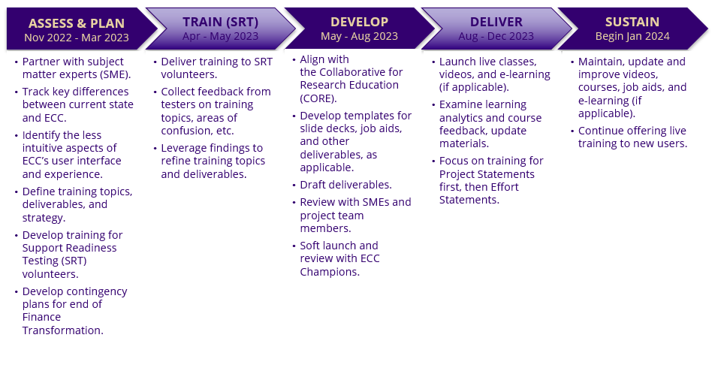
ECC Testing and Training Timeline
MRAM – Matt Gardner – PAFC

Slide 11
eFECS Retirement / Effort Reporting Cutover
All current FEC cycles will end on June 30, 2023, in order to “close out” reporting in eFECS
  Calendar cycle: 1/1/2023 – 6/30/2023
  Academic cycle: 3/16/2023 – 6/30/2023
FECs will be available on late July 2023
FECs will be due in early October 2023
After early October 2023, eFECS will be retired
MRAM – Matt Gardner – PAFC

Slide 12
Impacts from eFECS Cutover / Retirement
After eFECS is retired, any certifications or re-certifications for periods prior to 7/1/2023 will be done via a manual process
Recommendation: If your Department currently has outstanding or late FECs, now is the time to resolve issues
After eFECS is retired, that does not relieve or eliminate the requirement to certify/recertify FECs for periods prior to 7/1/2023
MRAM – Matt Gardner – PAFC

Slide 13
Payroll adjustments impacting Effort Reporting
Can be done via the current process in MyFD through Dean’s Day
After Dean’s Day: manual process to adjust effort on the FEC
Example
  November of 2023, - Dept. realizes faculty salary charged to an Award in May and June 2023 needs to be transferred
  The Payroll Adjustment will occur in Workday
  A manual process is required to adjust and certify the FEC
MRAM – Matt Gardner – PAFC

Slide 14
Tips and Recommendations
Review payroll allocations for:
  Salary cap compliance
  K-Award compliance
  Cost share compliance
Review early: After Dean’s Day, adjustments will occur in Workday but are not updated in eFECS
There will be a manual process to correct/update FECs
MRAM – Matt Gardner – PAFC

Slide 15
Resources
ECC Information
https://finance.uw.edu/maa/ecc
ECC FAQs:
https://finance.uw.edu/maa/faq/202
ECC Project Updates:
https://finance.uw.edu/maa/ecc_march_update
MRAM – Matt Gardner – PAFC

Slide 16
Questions
Post Award Fiscal Compliance (PAFC)
  efecs@uw.edu (Effort questions)
  gcafco@uw.edu (Non-Effort questions)
  https://finance.uw.edu/pafc/
Matt Gardner
  mgard4@uw.edu
  206-543-2610
David Parks, Effort Compliance Analyst
  ECCHelp@uw.edu (ECC-specific questions)
MRAM – Matt Gardner – PAFC

Slide 17
UW PRIVACY OFFICE
DATA INVENTORY INITIATIVE
MRAM
April 13, 2023
Ann Nagel
Chief Privacy Officer, UW Privacy Office

Slide 18
UW PRIVACY OFFICE
DATA INVENTORY INITIATIVE
Why does the Privacy Office exist?
  To ensure a cohesive approach to the purpose and appropriate use of personal data. An approach that:
    Upholds trusted relationships with constituents; and
    Focuses on the philosophical, social, technological, and legal aspects associated with the use of personal data at the UW.
How do UW values relate to purpose
  Inform strategic priorities.
How privacy principles supplement values and relate to purpose
  Considerations for making informed decisions about the tactical and operational collection and use of personal data.
VALUES
Respect
Integrity
Diversity
Excellence
Collaboration
Innovation
PRIVACY PRINCIPLES
Minimization
Accountability
Protection
Awareness
INFORMED
DATA PRIVACY DECISION MAKING
  MRAM – Ann Nagel – UW Privacy Office

Slide 19
UW PRIVACY OFFICE
DATA INVENTORY INITIATIVE
What is the data inventory initiative?
  Strategic priority endorsed by the Privacy Steering Committee.
What is the data inventory?
  System and process for categorizing the purpose and use of personal data and identifying data privacy requirements and potential risks or harm to people.
How does it help researchers, research administrators, etc.?
  Identifies commonality of data privacy requirements, risks, and harms as well as next steps in a more efficient manner.
  Reduces time spent gathering essential information for data privacy advising and decision making in back-and-forth emails and meetings.
  MRAM – Ann Nagel – UW Privacy Office

Slide 20

UW PRIVACY OFFICE
DATA INVENTORY INITIATIVE
How is the Privacy Office implementing the data inventory?
  Adopted TrustArc Privacy Management Platform to:
    Establish a central location for colleagues to create and maintain data inventory records.
    Allow colleagues to collaboratively collect information.
    Create transparency about accountability, risk, etc.
    Streamline workflows with Privacy Office, researchers, and other UW colleagues.
  MRAM – Ann Nagel – UW Privacy Office

Slide 21
UW PRIVACY OFFICE
DATA INVENTORY INITIATIVE
What needs to be inventoried?
  Third-party relationships
    Partner: Generally, any third party that is not a vendor (such as a sponsor or affiliate)
    Vendor: Supplier or service provider that provides technology or expertise to an organization for a given business purpose (e.g., Salesforce)
  Systems
    An application, database, or other technological system or process that processes data for a particular business purpose (e.g., Tableau)
  Business Process
    An operation that processes data for a specific business purpose by using one or more systems to process data
    (e.g., research, academic service or activity, business service or activity, reporting, or data analysis)
Third party relationships
Systems
Business processes
  MRAM – Ann Nagel – UW Privacy Office

Slide 22
UW PRIVACY OFFICE
DATA INVENTORY INITIATIVE
How do researchers, research administrators engage in the initiative?
  Two pathways to create inventory records
Business Process Questionnaire
Via TrustArc
Does not require TrustArc access
Requires TrustArc access
Works well for fewer records
Works well if there is lots to inventory
Limited functionality
Access to robust risk profile and aggregated information
  MRAM – Ann Nagel – UW Privacy Office

Slide 23
UW PRIVACY OFFICE
DATA INVENTORY INITIATIVE
Additional information
  https://privacy.uw.edu/take-action/inventory-data/
Training
  https://privacy.uw.edu/education/
Contact information
  uwprivacy@uw.edu
  Questions
  MRAM – Ann Nagel – UW Privacy Office

Slide 24
Workday Conversion Issue: Inactive PIs
Lily Gebrenegus
Analyst, Grant & Contract Accounting
April 2023 MRAM

Slide 25
THE ISSUE
When a PI on a converted award is “inactive” in Workday HRP at June 16, the Workday Finance PI field for that award will be blank
This will create delays after go-live if a PI’s approval is needed to complete a Workday business process

Slide 26
“INACTIVE” v. “ACTIVE”
INACTIVE:
Retired
Terminated
Contract Ended
ACTIVE:
On Leave
Retired – Active
Retired - On Leave

Slide 27
CALL TO ACTION
If you have a PI who is planning to retire or leave the UW, submit a Change of PI Request for each Award under that PI to OSP by Friday, May 19
Monitor the status of your PIs between now and go-live on July 6
Notes:
This will give OSP time to assist in getting sponsor approval

Slide 28
NOTE
This is a conversion issue only and will not happen if a PI becomes inactive after go-live in July.
After go-live, a PI Change will be treated as an Award Modification in SAGE. Please continue to use the Change of PI Request Form and attach to the Award Modification.

Slide 29
RESOURCES
Change of PI Request Form:
https://www.washington.edu/research/forms-and-templates/request-a-change-of-pi/
Review Change of PI guidance and instructions for more information:
https://www.washington.edu/research/myresearch-lifecycle/manage/award-changes/#change-pi

Slide 30
QUESTIONS
Please contact Lily Gebrenegus at lgebren@uw.edu

Slide 31
UWFT Transition Planning
Sponsored Programs
(part 2 - continued from March)
April 2023 MRAM
Carol Rhodes, Vince Gonzalez, Kim Halstead
Office of Sponsored Programs | Grant & Contract Accounting | Office of Research Information Services

Slide 32
Important Dates for Sponsored Programs
Prepping for Workday Go-live (1 of 2)
5/19: Last day to submit Change of PI Requests to OSP for PIs in “inactive” status in Workday HRP
5/31: Recommended date to submit Advance Budget Requests for awards with anticipated start dates between 6/09 and 8/01
6/07: Last day to submit Advance Extension Requests and No-Cost Extension or Temporary Budget Extension Requests for awards that end between 6/09 and 8/01
  Please submit these requests no earlier than April 15th
6/08: Final Action Date for financial reports due end of June
6/09: Last day for OSP approvals of completed Funding Actions and financial related Post Award Changes
Important dates for Sponsored Programs announcement
Notes:
CAROL - Following an email we shared on xx/xx

Slide 33
Important Dates for Sponsored Programs
Prepping for Workday Go-live (2 of 2)
6/13: Last day to submit requests to GCA. Types of requests include:
  Transpasus
  Journal vouchers (deficit transfers, F&A cost adjustments, closeout adjustments)
  Advance Budget Requests for awards with anticipated start dates between 6/09 and 8/01
  Changes in the financial system (e.g. organization codes changes, FIN status changes)
  Cost Share additions and changes in eFECS
6/15 after 5PM: Deferred Items: Items that could not be processed will be processed after Workday Go-Live
6/22: Final Action Date for sponsor invoices due at the end of June
6/09-7/31: GCA will continue to prepare sponsor invoices and financial reports using legacy systems to ensure that sponsor deadlines are met
Important dates for Sponsored Programs announcement
Notes:
VINCE

Slide 34
How will OSP & GCA Prioritize Requests after Go-Live
Notes:
VINCE

Slide 35
Prioritization of Requests after Go-Live
High Priority Items
Advance Budget Requests: New, Renewal, Extensions
Award Setup Requests: New, start date of 7/15 & earlier
Modifications:
  Supplement - awards ending between 5/1-6/30
  Renewal - start date of 7/15 & earlier
  Extension
  Temporary Budget Extension
  Restriction Release - awards ending between 5/1-6/30
  Start Date Change
  Addition of Equipment or Gov't Property
  Change in Cost Center
Other Actions: New award lines (formerly sub budgets) with start date of 7/15 & earlier
Notes:
VINCE
After Go-Live, OSP and GCA will have many awards and modifications to process.
Our two offices have created this priority list to ensure the most time sensitive and impactful items receive attention they deserve:

Slide 36
Prioritization of Requests
Medium Priority Items
Cost Share Change
Cost Share Change - requires sponsor approval
Non-competing Continuation Funding - start date of 7/16 or later
Notes:
VINCE

Slide 37
Prioritization of Requests
Low Priority Items
Schedule Changes:
Early Termination
Relinquishment
Funding & Budgeting Changes:
Subaward Addition
Supplement
Carry-over
Rebudgeting
De-obligation
F&A Rate Change
Programmatic Changes to:
Award Line type or other award line changes
Personnel
Key Personnel or effort
  including change in PI
Work Scope
Non-Fiscal Compliance
Other Changes to:
Location
Payment schedule
Notes:
VINCE

Slide 38
What to expect from OSP during Cutover: 6/09-7/06
Business as Usual for Proposals, PANs, non-fiscal PACs, NAAs
OSP Staff training in SAGE Central
Tracking/collection of awards received from sponsor and retrieved from sponsor systems, fiscal award modifications
What if you receive an award between 6/09 -7/06?
Hang onto these and create Award Setup Requests after go-live unless the award requires acceptance during the cutover time frame
Notes:
CAROL

Slide 39
What you can expect from OSP after Go-Live
All awards and modifications in SAGE Awards
You will have Award Setup Requests and Modification requests sent from OSP that need to be completed and sent back to OSP
SAGE will notify eGC1 owners when this happens
You will create Award Setup Requests and modifications and send them to OSP
Research website updates (including GIMs)
Notes:
CAROL

Slide 40
GCA - Leading up to 6/15
5/1: Communicating to departments with grants expiring in the next 60 days
5/19: Last day for GCA to initiate refunds
5/31: Soft deadline for campus to submit advance budget requests
6/8: Final Action Date for financial reports due at the end of June
6/9: Last day OSP will send final and ready to be approved Funding Actions, financial-related Post Award Changes
6/12 – 6/15: Push to process FAs, PACs, JVs, and finalize as many award closeouts as possible
Notes:
VINCE

Slide 41
GCA - During Cutover 6/16-7/06
GCA will be:
Running exception reports to make sure data is ready before freeze
Conducting staff training
Validating data for cutover
Updating web content
Invoicing, Reporting, Grant Tracker and GCA Help are business as usual
Notes:
VINCE

Slide 42
GCA - After Go-Live
GCA will be:
Entering catch-up data into Workday
Identifying and addressing any gaps in process
Developing new Key Performance Indicators
Update existing turnaround times to reflect new processes
Transitioning from GrantTracker to Award Portal
Notes:
VINCE
GT/AP dates will not be confirmed until after April MRAM so we should be vague if questions come up i.e. “mid-July”

Slide 43
ORIS: Building New Functionality in SAGE
SAGE will continue to function as usual in all areas up until the SAGE release.
SAGE Release Dates:
SAGE operational through 7/5 at 5:30 p.m. to meet the NIH deadline
7/5 starting at 5:35 p.m.: SAGE unavailable
7/6 all day: SAGE unavailable
7/7 at 6 a.m.: SAGE back online - new features available!
Key Post Go-Live Changes:
After 7/7, new awards (formerly new Funding Actions) will be entered into the SAGE Award Setup Request form
SAGE Advances will move to new SAGE Awards tab
And more! Visit UWFT for the Research Community
Notes:
EMILY or KIM will present -

Slide 44
Resources
Important Dates for Sponsored Programs: prepping for July 6th
UWFT for the Research Community
April MRAM Materials including Q&A
UWFT Change Network - Cutover Planning
Requesting:
Change of PI
Advance Budget
No-Cost Extension or Temporary Budget Extension
NEW SAGE Training Resources:
What’s Changing in SAGE? Video
SAGE Award Setup Workflow Video
SAGE Budget eLearning
Notes:
EMILY or KIM will present -

Slide 45
SAGE TRAINING RESOURCES
April 13, 2023
Kim Halstead
Office of Research Information Services

Slide 46

WHAT’S CHANGING IN SAGE? VIDEO
New!
Provides a high-level overview of changes coming to SAGE with UWFT, including:
  SAGE Award Setup Requests
  Cost Centers
  SAGE Budget and Award Lines

Slide 47
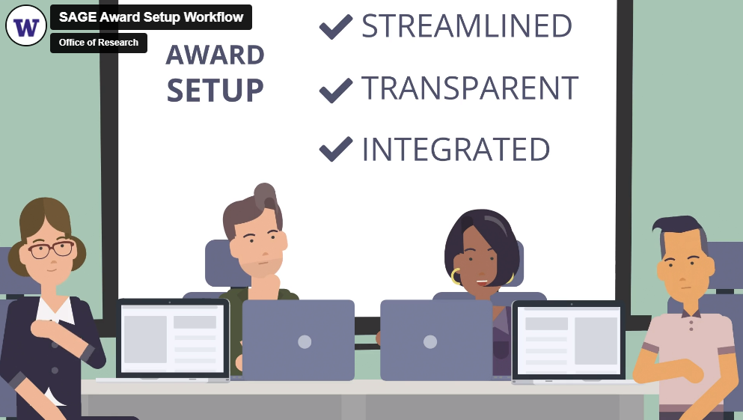
SAGE AWARD SETUP WORKFLOW VIDEO
New!
Provides an overview of the future of the award setup workflow in SAGE

Slide 48
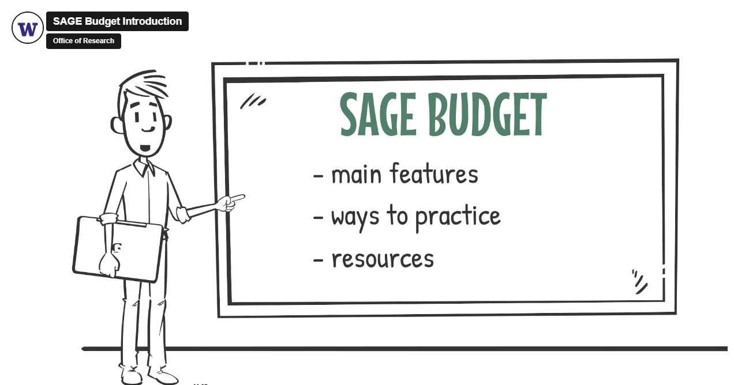
SAGE BUDGET ELEARNING
Launched January 2023
Provides on-demand instruction in SAGE Budget when you need it!
Notes:
This resource is not a substitute for the live course and does not count toward fulfilling certificate requirements.

Slide 49



ADDITIONAL SAGE TRAINING
Available Now
SAGE Budget Instructor-led Classes
04/11
05/18
06/13
SAGE Budget Virtual Office Hours
04/20
05/04
05/18
More SAGE resources are accessible through the UWFT for the Research Community webpage.
In Development
SAGE Awards eLearning and user guides

Slide 50
Award Portal Update
Juan Lepez
Director, Grant & Contract Accounting
APRIL 2023 MRAM

Slide 51
AWARD PORTAL IS…
Replacing GrantTracker as your one-stop grant shop

Slide 52
WHAT’S NOT CHANGING
One-stop view of a sponsored award/grants
Communication system between campus units/ shared environments and GCA
One day delay from Workday
Not used by any other central office
Access to sponsor invoices and financial reports
Just need a UW netID to access AP

Slide 53
WHAT’S CHANGING WITH AP
New look
GrantTracker Notes → Award Portal Tickets
Organized based on Workday award structure
Workday terminology
No more deficit transfer functionality

Slide 54
THE TRANSITION FROM GT TO AP
GrantTracker will be left online for previous biennium/closed budgets, but read only
Communication for awards that aren’t converted to Workday should be sent to gcahelp@uw.edu

Slide 55
TIMELINE
April-June 2023
Campus user testing
Complete system remediation
Create and release training documents
Mid-July 2023
Award Portal launches
GrantTracker goes into read-only mode

Slide 56

CALL TO ACTION
Bookmark GCA’s new Finance Transformation webpage for more information about how FT is changing GCA’s processes, Award Portal, and communication to sponsors
https://finance.uw.edu/gca/finance-transformation

Slide 57
QUESTIONS
Please contact Juan Lepez at kabah12@uw.edu

Slide 58



Updates
FT and the CORE curriculum
Compliance focused courses little change
  Process/systems courses significant change
    Setup and Manage Your Award
    Processes at Award Closeout
    Managing Cost Share
    Salary and Cost Transfers
    Internal Controls in Purchasing
CORE Registration
https://uwresearch.gosignmeup.com/public/course/browse
CORE Home https://www.washington.edu/research/training/core/

Slide 59
Recognition!
Certificate in Research Administration Graduates
  579 enrolled in the certificate
  151 graduates since August 2020
    11 graduates in sixth group
Notes:
Thank you!
As is obvious from today’s meeting content, and the Financial Transformation presentation that follows, our work in research administration is complex and nuanced. All of you doing this work know the value and necessity of continuing to learn as we work together keep the UW’s 1.6 billion dollar research enterprise running compliantly and effectively. The CORE Certificate in Research Administration is one pathway we can all take to help us share common knowledge and practices in our work at the UW.
Today we are recognizing folks who have taken advantage of learning by completing the CORE certificate in research administration This is the sixth group of graduates since CORE launched this certificate in the fall of 2019. To date, 579 people have enrolled in the certificate and as today 151 of them have met all requirements to receive the certificate.
We recognize the recipients on a semi-annual basis in the MRAM venue and today we are going to take a moment to recognize the achievements in this last round completers. Not all of them chose to include their names in today’s announcement but you all know who you are!

Slide 60



Certificate in Research Administration Program Graduates
Notes:
Today let’s give a shout out to these who have taken advantage of learning available to them by completing the CORE Certificate in Research Administration!
Let’s give a shout out to some of our most recent graduates and give them a hand!

Slide 61
Maggie Fenwood Hughes
Research Manager
CoLab for Community & Behavioral Health Policy
Department of Psychiatry & Behavioral Sciences
School of Medicine
Congratulations!

Slide 62
Jacob Lemmon
Budget/Fiscal Analyst
Department of Laboratory Medicine & Pathology
School of Medicine
Congratulations!

Slide 63
Will Patrone
Research Coordinator
Department of Urology
School of Medicine/Fred Hutchinson Cancer Center
Congratulations!

Slide 64
Hunter Robbins
Program Coordinator
Department of Bioengineering
School of Medicine
Congratulations!

Slide 65
Ivory Smith
Program Operations Specialist
Department of Pediatrics
School of Medicine
Congratulations!

Slide 66
Alyssa Williamson
Senior Director, Clinical Programs
Department of Medicine
School of Medicine
Congratulations!

Slide 67
Thank You!
A big thank you in supporting the UW research enterprise. We are stronger together!
Notes:
And a big thank you to all who support the ongoing professional development of our research administration staff!

Slide 68
REPORTING IN WORKDAY
Presenters:
Stepanka Sirotek, Business Systems Analyst, UWFT
Jesse Rice, Business Systems Analyst, UWFT

Slide 69
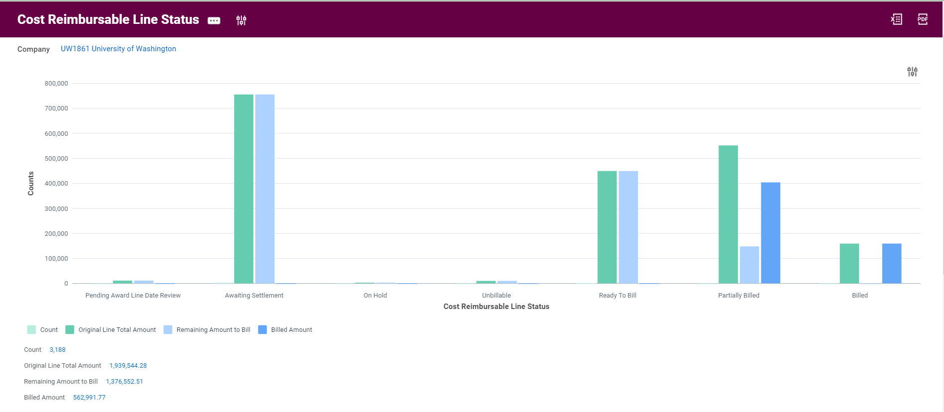
Cost Reimbursable Line Status Sample

Slide 70
Cost Reimbursable Line Status definitions
Pending Award Line Date Review:
  Transactions with Budget dates outside award dates – cannot be pulled into a Sponsor Invoice unless the budget date is reviewed and corrected
Awaiting Settlement:
  Transactions not yet paid by UW to Suppliers – cannot be pulled into a Sponsor Invoice until paid
On Hold:
  Transactions manually placed on hold - cannot be pulled into a Sponsor Invoice until hold is removed
Unbillable:
  Contains spend over prepaid installment when set to not bill over prepaid amount; retention; transactions not associated with an approved billing schedule (advance spend)

Slide 71
Cost Reimbursable Line Status Definitions continued
Ready To Bill:
  Transactions which can be pulled into a Sponsor Invoice
Partially Billed:
  Split transactions due to billing limits or exceeding Authorized Amount (deficit spend)
Billed:
  Transactions already billed to Sponsor

Slide 72
Reporting Demo

Slide 73
Q&A

