Slide 1
FUTURE OF EFFORT REPORTING
MRAM
April 2023
Matt Gardner
Post Award Fiscal Compliance

Slide 2
Today’s Topics
A New Effort Reporting System:
  Employee Compensation Compliance (“ECC”)
Retiring eFECS / Cutover
Resources and Questions
MRAM – Matt Gardner – PAFC

Slide 3
Changes to Effort Reporting
eFECS will be retired and a new system (ECC) will take its place to document effort reporting
eFECS: Faculty Effort thru June 30, 2023
GCCRs: Payroll certifications thru June 30, 2023
ECC: Effort and payroll certifications for periods starting on or after July 1, 2023
MRAM – Matt Gardner – PAFC

Slide 4
Employee Compensation Compliance (ECC)
ECC will replace the current eFECS system and the GCCR process
ECC terminology:
  Effort Statements (currently called “FECs”)
  Project Statements (currently called “GCCRs”)
All statements, certifications, and records retention will occur within ECC
  Currently, GCCRs are retained at the unit level
  In ECC, Project Statements will be retained in the system
MRAM – Matt Gardner – PAFC

Slide 5
Effort Statement Reporting Cycles
Effort Statement (FEC) reporting cycles will be unified
  Current practice:
    Academic Cycle
      3/16 – 9/15
      9/16 – 3/15
    Calendar Cycle
      1/1 – 6/30
      7/1 – 12/31
  Future reporting cycle
    1/1 – 6/30
    7/1 – 12/31
MRAM – Matt Gardner – PAFC

Slide 6
Effort Statement Reporting Cycles
The first Effort Statements certified in ECC will be for the period of 7/1/2023 – 12/31/2023
Deadline for certification likely early March 2024
Change from current system:
  Don’t have to wait for the Statements to be “released” in order to view in the system
  Certification won’t be available under after the cycle closes, but there is no longer a “wait period” to view the Statements
MRAM – Matt Gardner – PAFC

Slide 7
Project Statement Reporting Cycles
Project Statements (GCCRs) will maintain the same reporting cycles
  1/1 – 3/31
  4/1 – 6/30
  7/1 – 9/30
  10/1 – 12/31
The first Project Statements certified in ECC will be for the 7/1/2023 – 9/30/2023 period in the fall of 2023
  Due in December of 2023
MRAM – Matt Gardner – PAFC

Slide 8
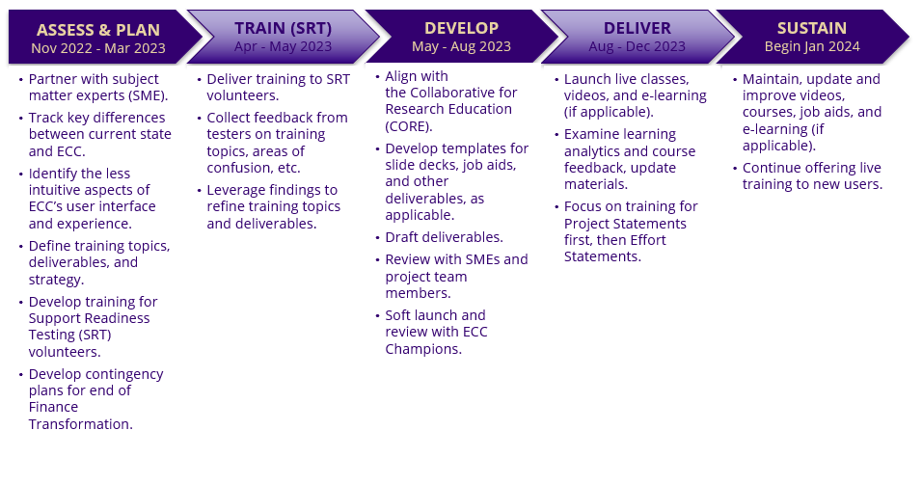
ECC Testing and Training Timeline
MRAM – Matt Gardner – PAFC

Slide 9
eFECS Retirement / Effort Reporting Cutover
All current FEC cycles will end on June 30, 2023, in order to “close out” reporting in eFECS
  Calendar cycle: 1/1/2023 – 6/30/2023
  Academic cycle: 3/16/2023 – 6/30/2023
FECs will be available on late July 2023
FECs will be due in early October 2023
After early October 2023, eFECS will be retired
MRAM – Matt Gardner – PAFC

Slide 10
Impacts from eFECS Cutover / Retirement
After eFECS is retired, any certifications or re-certifications for periods prior to 7/1/2023 will be done via a manual process
Recommendation: If your Department currently has outstanding or late FECs, now is the time to resolve issues
After eFECS is retired, that does not relieve or eliminate the requirement to certify/recertify FECs for periods prior to 7/1/2023
MRAM – Matt Gardner – PAFC

Slide 11
Payroll adjustments impacting Effort Reporting
Can be done via the current process in MyFD through Dean’s Day
After Dean’s Day: manual process to adjust effort on the FEC
Example
  November of 2023, - Dept. realizes faculty salary charged to an Award in May and June 2023 needs to be transferred
  The Payroll Adjustment will occur in Workday
  A manual process is required to adjust and certify the FEC
MRAM – Matt Gardner – PAFC

Slide 12
Tips and Recommendations
Review payroll allocations for:
  Salary cap compliance
  K-Award compliance
  Cost share compliance
Review early: After Dean’s Day, adjustments will occur in Workday but are not updated in eFECS
There will be a manual process to correct/update FECs
MRAM – Matt Gardner – PAFC

Slide 13
Resources
ECC Information
https://finance.uw.edu/maa/ecc
ECC FAQs:
https://finance.uw.edu/maa/faq/202
ECC Project Updates:
https://finance.uw.edu/maa/ecc_march_update
MRAM – Matt Gardner – PAFC

Slide 14
Questions
Post Award Fiscal Compliance (PAFC)
  efecs@uw.edu (Effort questions)
  gcafco@uw.edu (Non-Effort questions)
  https://finance.uw.edu/pafc/
Matt Gardner
  mgard4@uw.edu
  206-543-2610
David Parks, Effort Compliance Analyst
  ECCHelp@uw.edu (ECC-specific questions)
MRAM – Matt Gardner – PAFC

