Slide 1

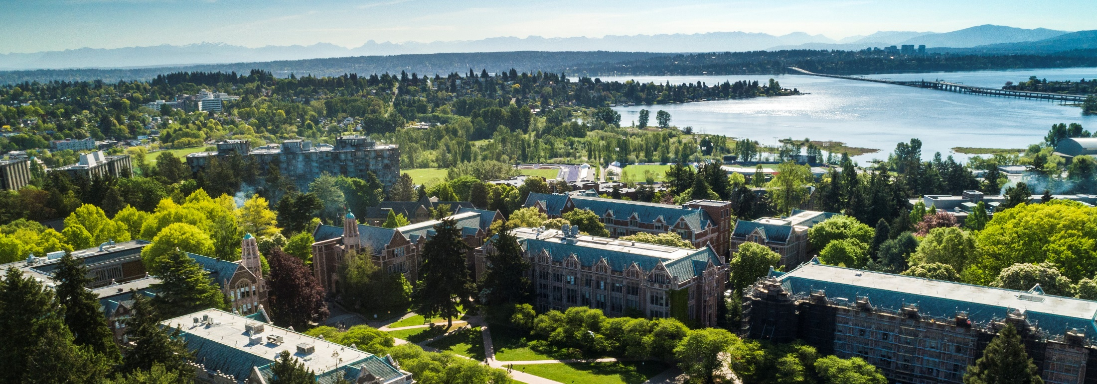

Updates
FT and the CORE curriculum
Compliance focused courses little change
  Process/systems courses significant change
    Setup and Manage Your Award
    Processes at Award Closeout
    Managing Cost Share
    Salary and Cost Transfers
    Internal Controls in Purchasing
CORE Registration
https://uwresearch.gosignmeup.com/public/course/browse
CORE Home https://www.washington.edu/research/training/core/

Slide 2
Recognition!
Certificate in Research Administration Graduates
  579 enrolled in the certificate
  151 graduates since August 2020
    11 graduates in sixth group
Notes:
Thank you!
As is obvious from today’s meeting content, and the Financial Transformation presentation that follows, our work in research administration is complex and nuanced. All of you doing this work know the value and necessity of continuing to learn as we work together keep the UW’s 1.6 billion dollar research enterprise running compliantly and effectively. The CORE Certificate in Research Administration is one pathway we can all take to help us share common knowledge and practices in our work at the UW.
Today we are recognizing folks who have taken advantage of learning by completing the CORE certificate in research administration This is the sixth group of graduates since CORE launched this certificate in the fall of 2019. To date, 579 people have enrolled in the certificate and as today 151 of them have met all requirements to receive the certificate.
We recognize the recipients on a semi-annual basis in the MRAM venue and today we are going to take a moment to recognize the achievements in this last round completers. Not all of them chose to include their names in today’s announcement but you all know who you are!

Slide 3



Certificate in Research Administration Program Graduates
Notes:
Today let’s give a shout out to these who have taken advantage of learning available to them by completing the CORE Certificate in Research Administration!
Let’s give a shout out to some of our most recent graduates and give them a hand!

Slide 4
Maggie Fenwood Hughes
Research Manager
CoLab for Community & Behavioral Health Policy
Department of Psychiatry & Behavioral Sciences
School of Medicine
Congratulations!

Slide 5
Jacob Lemmon
Budget/Fiscal Analyst
Department of Laboratory Medicine & Pathology
School of Medicine
Congratulations!

Slide 6
Will Patrone
Research Coordinator
Department of Urology
School of Medicine/Fred Hutchinson Cancer Center
Congratulations!

Slide 7
Hunter Robbins
Program Coordinator
Department of Bioengineering
School of Medicine
Congratulations!

Slide 8
Ivory Smith
Program Operations Specialist
Department of Pediatrics
School of Medicine
Congratulations!

Slide 9
Alyssa Williamson
Senior Director, Clinical Programs
Department of Medicine
School of Medicine
Congratulations!

Slide 10
Thank You!
A big thank you in supporting the UW research enterprise. We are stronger together!
Notes:
And a big thank you to all who support the ongoing professional development of our research administration staff!

