Slide 1
BONUS UWFT SESSION Monthly Research Administration Meeting - MRAM
May 19, 2023, 9:00 AM – 10:30 AM Click “CC” to Show Captions in your Zoom Controls
TOPIC | PRESENTER | EMAIL | MIN
Welcome | Carol Rhodes Office of Sponsored Programs | carhodes@uw.edu | 2
Subawards - Preparing for Workday Finance Go-Live | Amanda Snyder & Josy Combs Office of Sponsored Programs | acs229@uw.edu combsj@uw.edu | 10
Org Codes to Cost Centers | Tom Watson Office of Research Information Services | watsont7@uw.edu | 10
ORIS: Changes coming to MyResearch & RAD | Tom Watson Office of Research Information Services | watsont7@uw.edu | 10
SAGE Budget - Clinical Trials Do I Need a SAGE Budget? | Carol Rhodes Office of Sponsored Programs | carhodes@uw.edu | 10
Advance Budgets Conversion | Juan Lepez Grant & Contract Accounting | kabah12@uw.edu | 2
Award Portal | Cheryl Haycox Grant & Contract Accounting | gcahelp@uw.edu | 15
Cost Share Cutover at Workday Finance Go-Live | Matt Gardner Post Award Fiscal Compliance | gcafco@uw.edu | 10
Role Based Training - Workday Finance | Liz Satwicz UWFT | lsatwicz@uw.edu | 5
SAGE Training | Breona Gutschmidt Office of Research Information Services | breona@uw.edu | 2
NEXT MRAM Jun 8, 2023 9:00 AM - 10:00 AM NEXT BONUS UWFT MRAM Jun 16, 2023 9:00 AM - 10:30 AM
Notes:
Current length: 77 minutes.

Slide 2
Subawards
Preparing for Workday Finance Go-Live
May 2023 MRAM
Amanda Snyder & Josy Combs
Office of Sponsored Programs

Slide 3
Workday Finance:
Changes for Subawards
You will still use SAGE to request a subaward and subaward modification.
Subaward steps currently in Ariba will no longer be part of the process.
Note: All Blanket Purchase Orders (BPOs), including Subaward BPOs, follow the same deadlines Procurement has previously communicated.
Notes:
Amanda

Slide 4
Steps to take before 6/12
Review all open subaward Blanket Purchase Orders (BPOs) in Ariba
Follow UW Procurement guidance on Open Orders from their March newsletter
Receive all invoices in Ariba
  Invoices not received in Ariba by 6/12 will need to be re-entered into Workday Finance via Procurement’s Supplier Invoice Request (SIR) process after go-live

Slide 5
During Cutover
OSP will continue to receive, review, and negotiate Subaward requests associated with fully processed Funding Actions and Post-Award Changes (PACs) in SAGE.
Do not submit a subaward or modification requests to OSP in SAGE if funding action or post-award changes are not fully processed in SAGE.
OSP will return subaward and subaward modification requests. You will have to resubmit these after the award has been processed post go-live.
Notes:
Josy

Slide 6
Subaward Requests Between 6/05-7/05
New & Monetary or Period of Performance
For new subaward requests & monetary or period of performance modification requests in SAGE Subawards between 6/05-7/05:
Enter “00000” in the SAGE Purchase Order CR/BPO # field
Complete the rest of your request as usual
OSP will review & negotiate with subrecipients as usual during cutover
Any fully negotiated items will be placed on hold until the Purchase Order in Workday Finance is available
Notes:
Josy

Slide 7
Subaward Requests Between 6/05-7/05
Non-monetary & Period of Performance Not Impacted
Usual process:
Complete your non-monetary request as usual, entering the most current Ariba BPO # within the SAGE Purchase Order CR/BPO # field
OSP will continue to process these requests
NOTE:
SAGE will be unavailable after 5:35 p.m. on 7/05 until 7/07 at 6 a.m. while new features are added to SAGE.
Notes:
Josy

Slide 8
Future State: Steps for Subawards
Setting the Foundation
When there is a going to be a subaward on an award
You will need to have a SAGE budget worksheet submitted for each subaward with your Award Setup Requests
This creates the necessary award line for each subaward
If that did not happen, you will have to submit an Award Modification Request in SAGE Award to add any new subawards
Notes:
Amanda

Slide 9
Future State: Steps for Subawards
Supplier as Subrecipient in Workday?
Confirm “Supplier” exists in Workday as a subrecipient
If supplier exists but is not also subrecipient
  Submit a request to create supplier as subrecipient in Award Portal
If supplier does not exist at all in Workday:
Follow procurement steps to request a new supplier
After supplier is in Workday, submit a request in Award Portal to create supplier as subrecipient

Slide 10
Future State: Steps for Subawards
Making a Request
Once subrecipient exists in Workday
Submit Subaward or Subaward Modification request in SAGE
  Enter “00000” in the SAGE Purchase Order CR/BPO # field
  Complete the rest of your request as usual
OSP will:
Review & negotiate the subaward agreement or modification

Slide 11
Purchase Order Process
OSP will initiate the Purchase Order Process after the subaward agreement or modification is finalized
Procurement:
  creates a supplier contract & the purchase order in Workday
  submits purchase order to the campus unit’s Grants Manager for approval
Campus:
  review & approve PO in Workday
OSP will need to know PO#s before returning subaward agreements to our subrecipients.
Notes:
logistics on how OSP gets the PO#

Slide 12
Resources
Important Dates for Sponsored Programs…
Preparing for Subaward Process Changes
Procurement - March Newsletter: Open Orders
Procurement Newsflash: Workday Cutover Q&A
UWFT for the Research Community

Slide 13
Questions

Slide 14
ORG CODE TO COST CENTER
May 19, 2023
Tom Watson
Office of Research Information Services
Notes:
If you have questions feel free to bring them up and there will also be time at the end.

Slide 15
ORG CODE TO COST CENTER | KEY CHANGES
Workday uses the term Cost Center instead of Org Code
Research departments applying for or receiving funding in SAGE will be represented by a numerical code and naming convention that differs from today’s Org Code
Cost Centers will replace Org Codes and Org Names in all areas where Org Codes are currently found in SAGE, FIDS, and AUMS
Item in SAGE | Pre-Workday Release | Post-Workday Release
Name of Org. Receiving Funding | Bioengineering | Engineering | Bioengineering - Research Administration
Numerical Code | 2600014000 | CC100950

Slide 16
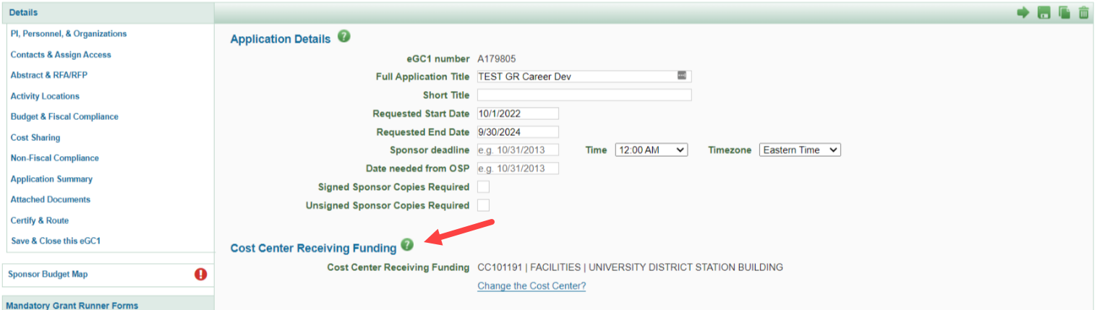
ORG CODE TO COST CENTER | KEY CHANGES
Cost Centers will appear for:
  SAGE eGC1 applications
  SAGE eGC1 contacts and personnel
  SAGE Advances
  SAGE Awards
  SAGE Subawards
  FIDS
  AUMS

Slide 17
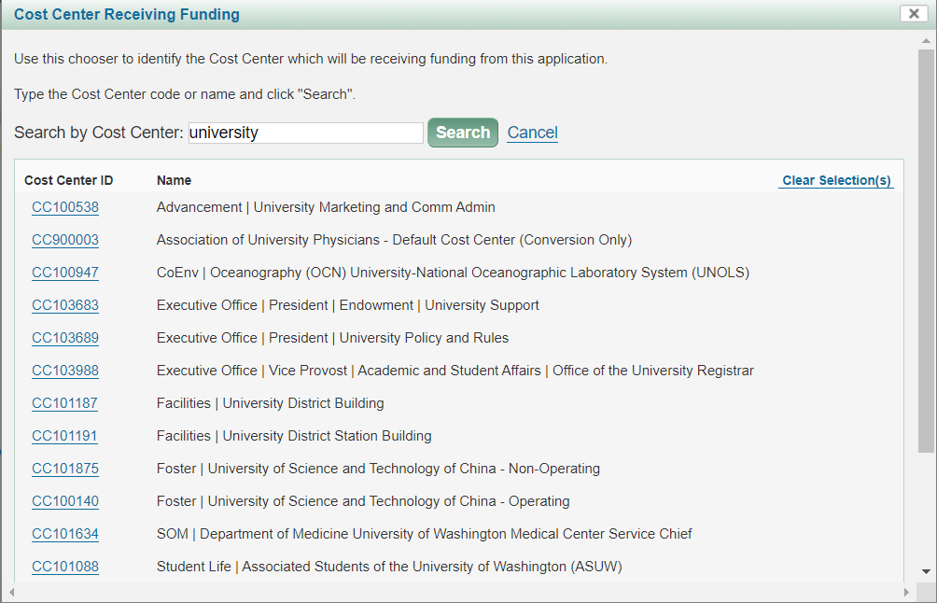
ORG CODE TO COST CENTER | KEY CHANGES
New Cost Center Chooser enables searches on both Cost Center ID and name
Cost Center names match to Workday

Slide 18
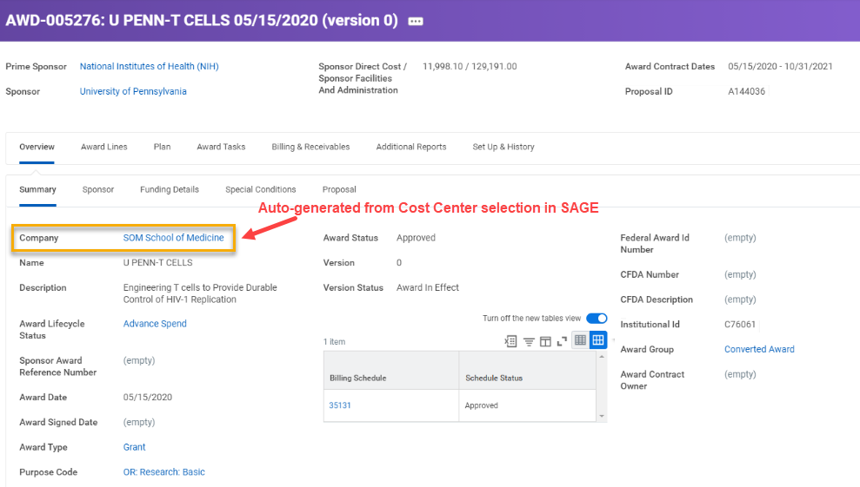
ORG CODE TO COST CENTER | KEY CHANGES
Cost Center defaults from the eGC1 to the Award Setup Request
Cost Centers in SAGE will be linked to the following records in Workday:
  Award Contract
  Award Schedule
  Award Budget
  Award Lines
  Subawards
  Billing Schedule
  Grant and Award Roles

Slide 19
ORG CODE TO COST CENTER | CHANGE BENEFITS
Reporting hierarchies that allow all reporting on different levels, such as division, department, school, etc.
Transparent and flexible financial reporting and management
Efficient accounting and financial reporting
Automatic flow from pre- to post-award systems, including Workday, reducing the amount of manual data entry
Robust grant tracking across the enterprise, increasing ease of management and decision-making

Slide 20
ORG CODE TO COST CENTER | TIMELINE
End of April: System remediation to convert Org Code fields to Cost Centers begins for:
  SAGE
  MyResearch (MR)
  RAD
  FIDS
  AUMS
June 2023: SAGE ASTRA role validation required from campus by launch
7/5 at 5:35 p.m. - 7/6: SAGE unavailable
7/7 at 6 a.m.: SAGE back online with Cost Centers integrated

Slide 21
ORG CODE TO COST CENTER | ACTION NEEDED
July 6: SAGE ASTRA roles will be aligned with Cost Centers
  Existing roles in ASTRA that rely on Org Codes for authorization will change
June SAGE ASTRA role validation: Campus Authorizers will receive an email from ORIS by June 1 with an attached spreadsheet that includes
  Your department’s current eGC1 ASTRA roles
  Any SAGE ASTRA eGC1 roles that will be assigned at go-live
Confirm this information is accurate. Changes can be made after launch of the new Cost Centers.
For questions on SAGE ASTRA roles, contact sagehelp@uw.edu.
Notes:
Roles in ASTRA that use org code as SOC will change

Slide 22
ORG CODE TO COST CENTER | SAGE ASTRA Examples
SAGE roles Pre-Workday
SAGE roles Post-Workday
Role | Dept. | Org Code
Advance Reviewer | Physics | 2540574000
Dept. Reviewer | Physics | 2540574000
Global Edit | Physics | 2540574000
Role | Dept. | Research Hierarchy Identifier
Advance Reviewer | Physics | RSRCH:000171
Advance Reviewer | Physics | 2540574000 (legacy advances)
Department Reviewer | Physics | RSRCH:000171
SAGE Read-only | Physics | 2540574000 (legacy eGC1s)
Global Edit | Physics | RSRCH:000171
Global Edit | Physics | 2540574000 (legacy eGC1s)
Notes:
Roles in ASTRA that use org code as SOC will change

Slide 23
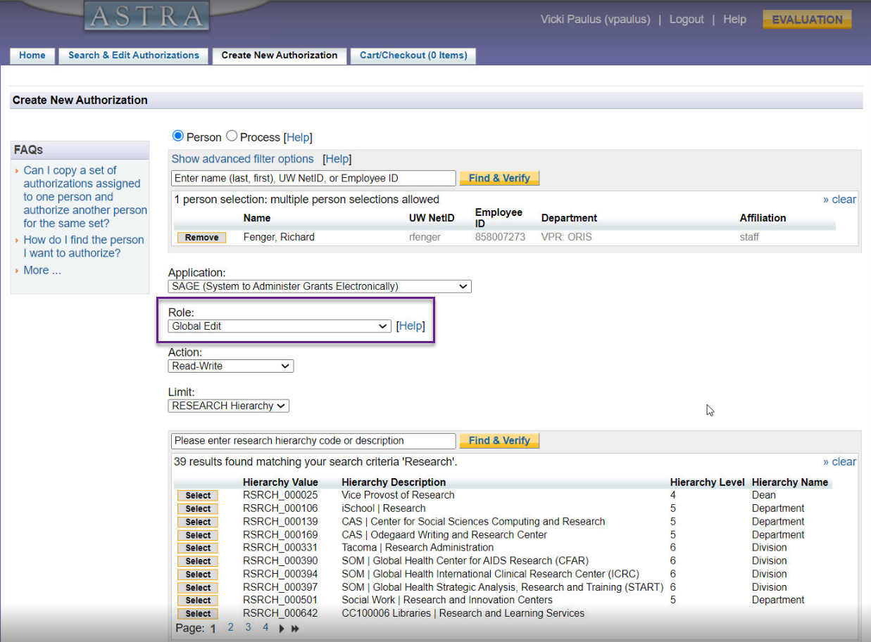
ORG CODE TO COST CENTER | ASTRA PREVIEW
“Global Edit” roles will be maintained
Cost Centers to assign roles to will display in the search
Notes:
Roles in ASTRA that use org code as SOC will change

Slide 24
ORG CODE TO COST CENTER | Training & Support
UWFT for the Research Community Newsletter
End of May: Reminder of changes
Job Aids & User Guides
June: Job aid (SAGE ASTRA roles validation required by campus)
By July: SAGE support & user guide updates
Notes:
Does not include details around existing outreach that has already taken place to power users

Slide 25
THANK YOU!
Notes:
If you have questions feel free to bring them up and there will also be time at the end.

Slide 26
CHANGES COMING TO MYRESEARCH AND RAD
May 19, 2023
Tom Watson
Office of Research Information Services
Notes:
If you have questions feel free to bring them up and there will also be time at the end.

Slide 27
MYRESEARCH | KEY CHANGES
Key Changes
  MyResearch is not being retired; however,
    Funding Status - Award data will be stale as of finance freeze EOD 6/15
    Any additional impacts will be identified in June
  Award status will be available in SAGE
Key Dates
  Now - EOD June 15: MyResearch functions as normal
  Mid-June: MyResearch banner with stale data reminder
  Beginning EOD June 15: Funding Status data remains accessible but stale
  July 5 at 5:35 p.m. - July 6: SAGE unavailable
  July 7 at 6 a.m.: SAGE back online with award status available in SAGE
Notes:
Funding Status award data will be available in the new SAGE Award View to help centralize campus and central office views of information

Slide 28
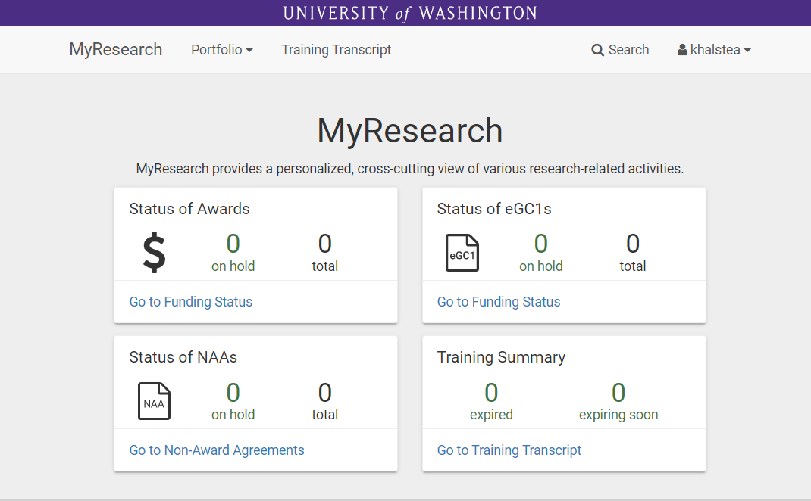
MYRESEARCH | HOMEPAGE
Banner this summer with stale data reminder
Stale award data as of EOD 6/15
Data remains up to date (pending more info coming in June)

Slide 29
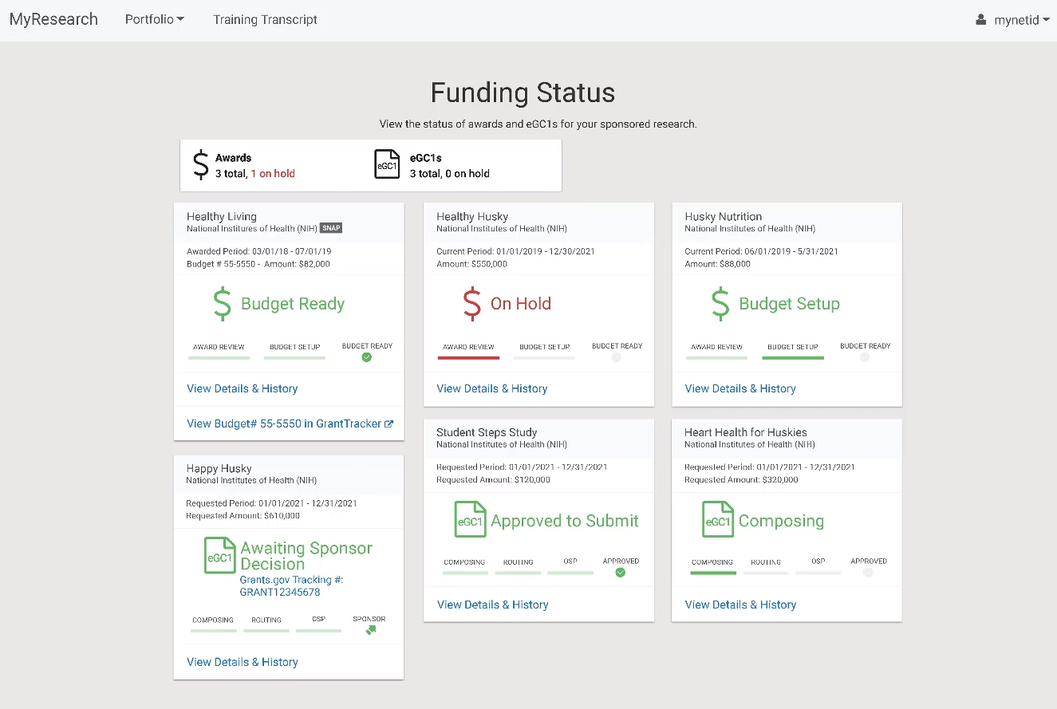
MYRESEARCH | FUNDING STATUS
> Stale award data
as of EOD 6/15

Slide 30
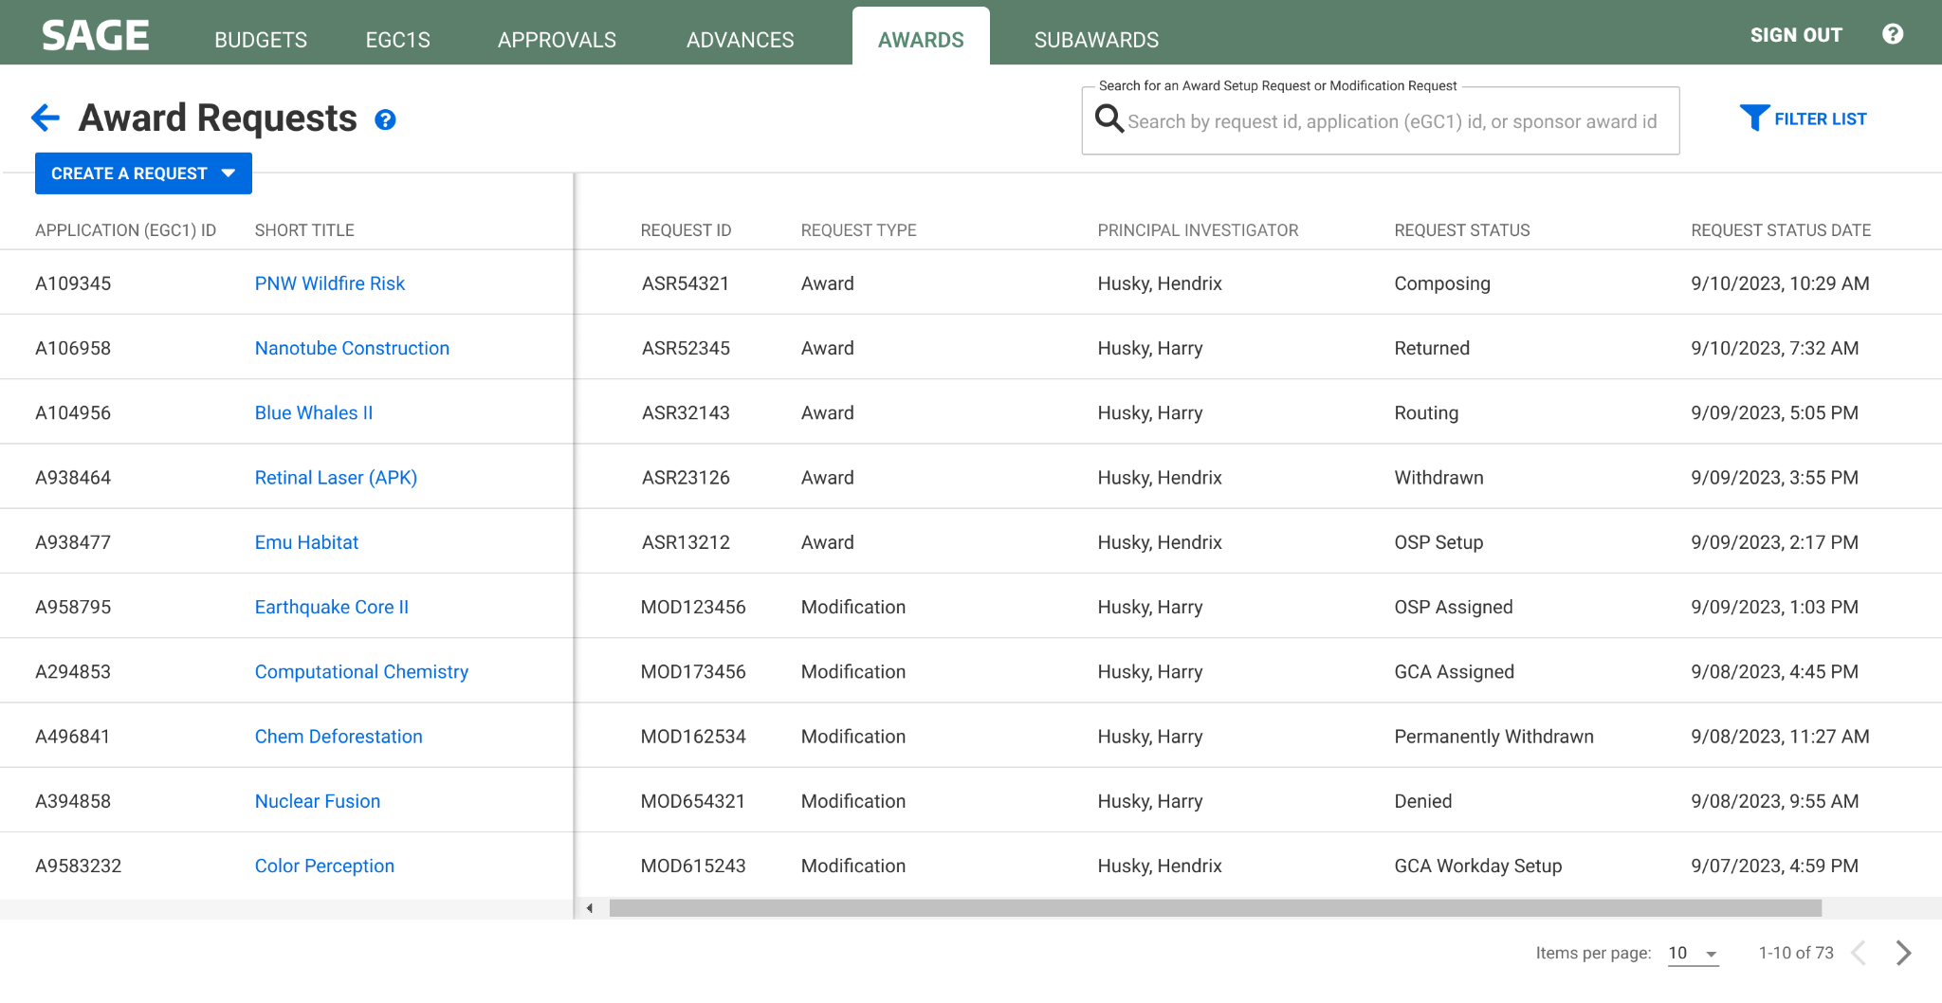
MYRESEARCH | REQUEST STATUS IN SAGE AWARDS
Provides award status information

Slide 31
RESEARCH (RAD) REPORTS & DATA

Slide 32
RESEARCH (RAD) REPORTS | KEY CHANGES
Key Changes
  Beginning EOD June 15, with the finance transaction freeze, award data will become stale in all RAD-based reporting solutions. This includes:
    BI Portal assets, RAD Cube, and various reports and visualizations
  Following cutover on July 6, all existing RAD-based reporting solutions will be frozen
    Data will remain available for historical reporting
  Until new RAD 2.0-based reporting solutions are available, we encourage you to request data from grantrpt@uw.edu until further notice.
    ORIS is planning for your reporting needs!

Slide 33
RESEARCH (RAD) REPORTS | CHANGE BENEFITS
Improved Self Service:
New RAD 2.0 will include new Workday and SAGE Award data
The Research Integration Platform (RIP) data store will be available, including SAGE proposal and award data
Catalog of data will eventually be available through RIP data store

Slide 34
RESEARCH (RAD) REPORTS | TIMELINE
Now - EOD June 15: RAD-based reports accessible via BI Portal as usual
EOD June 15 - July 5: FIN (Award) data is frozen; existing RAD reports are accessible but historical
  Data for NAAs, eGC1s, and Subawards will remain up-to-date, pending more information in June
July 6 - TBD: Until new RAD 2.0 based reporting solutions are available, we encourage you to request data from grantrpt@uw.edu until further notice

Slide 35
RESOURCES & SUPPORT
ORIS is planning to support you during this transition!
Research (RAD) Data Requests: Starting July 6, request data via grantrpt@uw.edu until further notice
Reminders & More Information:
  Subscribe to the MRAM mailing list where we will share the latest on MyResearch and RAD (keep a look out for our Research Community Guide to UWFT newsletter)
  System banners in MyResearch and the BI Portal this summer
Courses & Training
  Updates to MyResearch and RAD courses and training materials will be shared via MRAM as materials are developed

Slide 36
THANK YOU!
Notes:
If you have questions feel free to bring them up and there will also be time at the end.

Slide 37

SAGE Budget - Clinical Trials
Do I Need a SAGE Budget?
MRAM
May 19, 2023
Carol Rhodes, Office of Sponsored Programs

Slide 38
CTO Budget Approval Scope
Interventional trials or observational studies, where:
  Services, items, or tests are provided by a hospital facility (UWMC, HMC, or FHCC) that bills through Epic; OR
  Services, items, or tests are furnished by a provider who bills through UW Physicians regardless of the site of practice; AND
  Funding is provided to UW via fixed-price contract
Additionally:
  After 31 May 2023, all of these studies will generate sponsor invoices directly in OnCore CTMS
  OnCore will integrate with Workday starting 6 July 2023

Slide 39
Future State - Workday Finance Go-Live
SAGE Budget required on all Award Setup Requests
Use SAGE Budget for all Award Setup Requests, including budgets reviewed by CTO
For study budgets that will run through CTO review and Oncore billing
  Enter minimum information only in a single SAGE budget worksheet with $0 amount
This will help with Award Line and Award period setup in Workday Finance

Slide 40
SAGE Budget Entry for CTO Budgets
What is the minimum information?
Budget Settings
Budget Title
Budget Start Date
Total number of periods (defaults to 1)
Worksheet Settings
Create a single SAGE budget worksheet
Primary Worksheet Title
Cost Center
Activity Location
Sponsored Program Activity Category
Sponsored Program Activity Type
Base Type
Budget Entry
Add a Principal Investigator in personnel section for each worksheet, PI salary=$0
  only one worksheet is needed for CTO budgets
No other line item entry required in the budget
Notes:
JC notes if helpful:
It was originally conceived that CTO would be exempt from using SAGE Budget. In order to collect all of the line and period setup necessary for basic Workday awards for CTO, and given time constraints as we approach go-live, it was determined that pivoting to a SAGE Budget requirement for all ASRs would be the most stable approach going into 1st release. After go live, and with input from CTO budget preparers, we will re-asses whether an exemption would still be beneficial in the future or if data collection through SAGE Budget is acceptable. (Note that the fields of information needed are the same, regardless of whether SAGE Budget is used or an alternate approach to collecting the data).

Slide 41
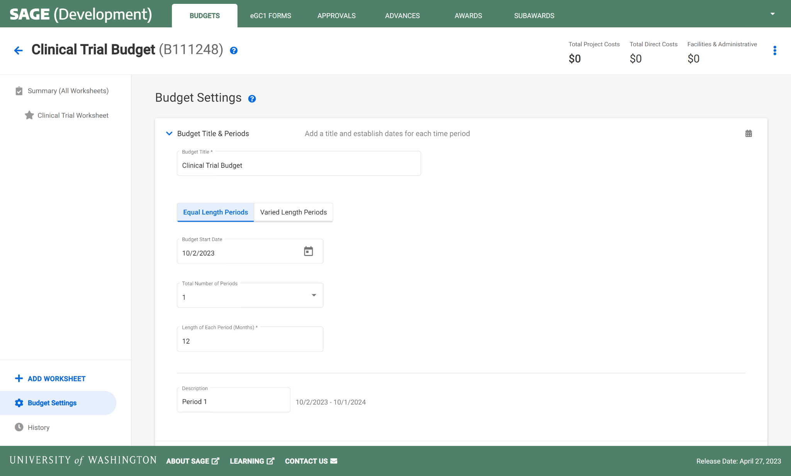
CLINICAL TRIALS | BUDGET SETTINGS
Budget Title
> Dotted fields are required for a Clinical Trials SAGE Budget
Budget Start Date
Total Number of Periods
Notes:
Naming conventions are in development.

Slide 42
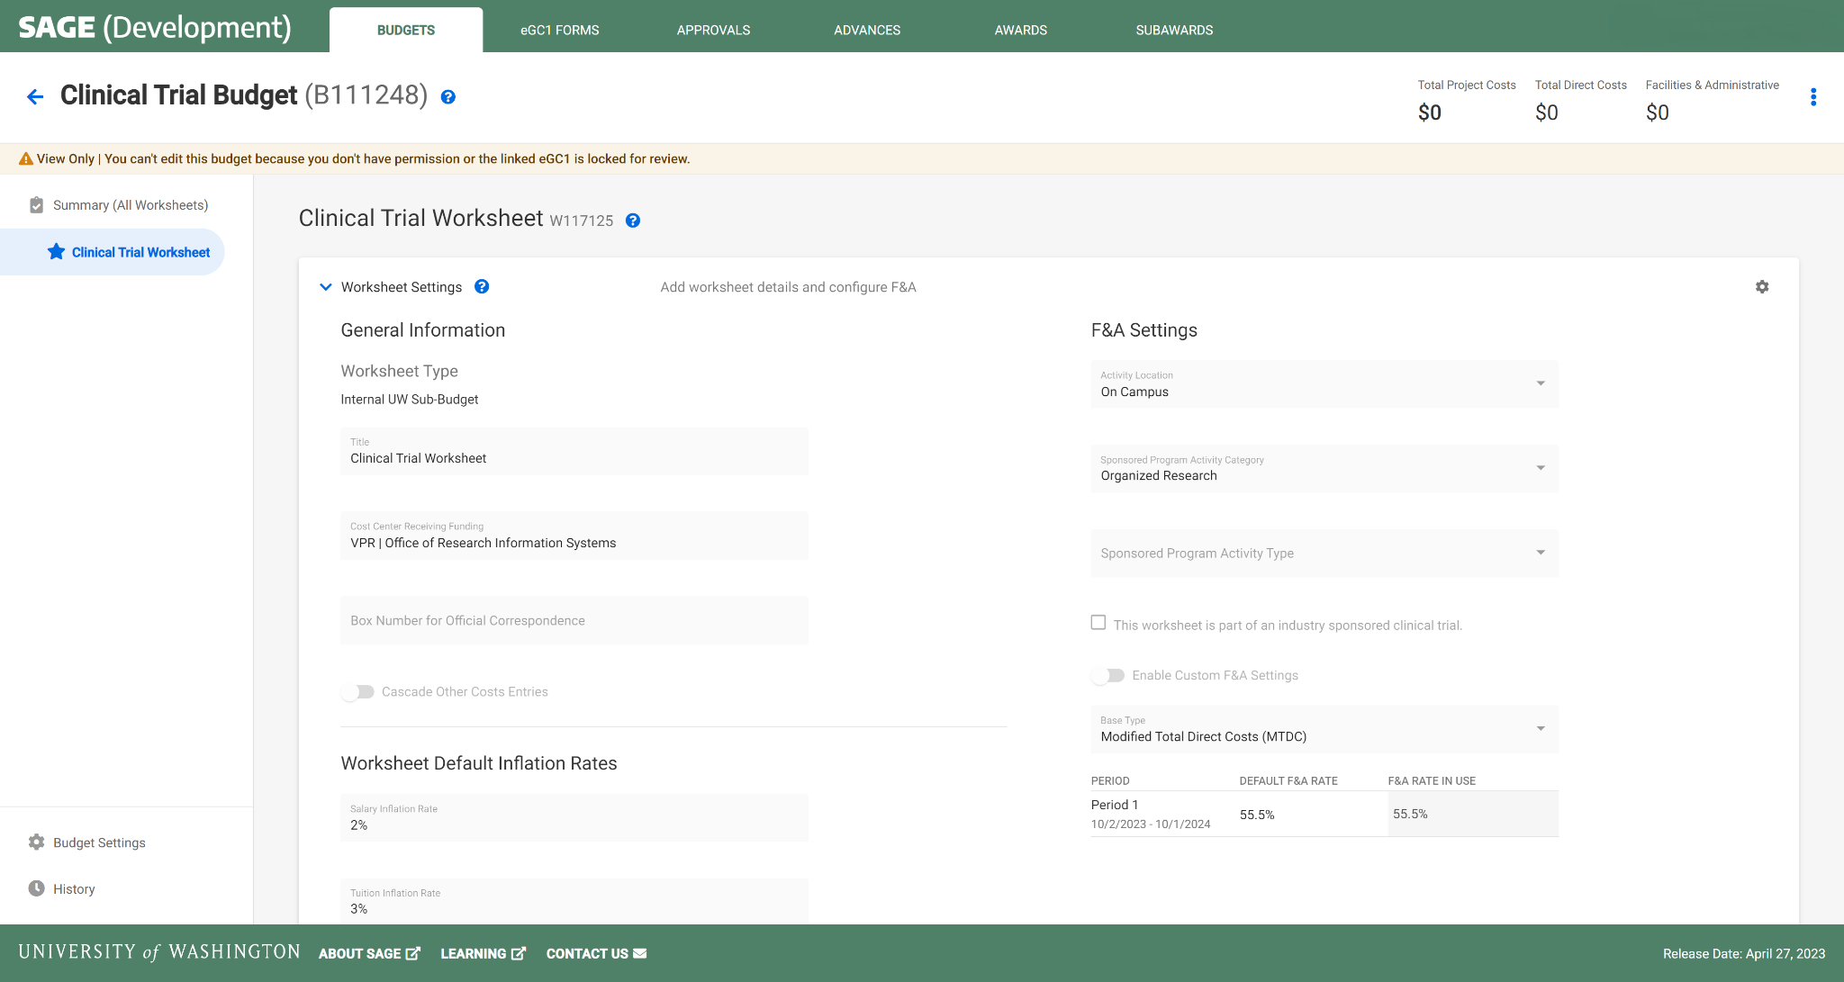
CLINICAL TRIALS | WORKSHEET SETTINGS
1 Worksheet
Activity Location
Primary Worksheet Title
SPA Activity Category
Cost Center
SPA Activity Type
Base Type
Notes:
Naming conventions are in development.

Slide 43
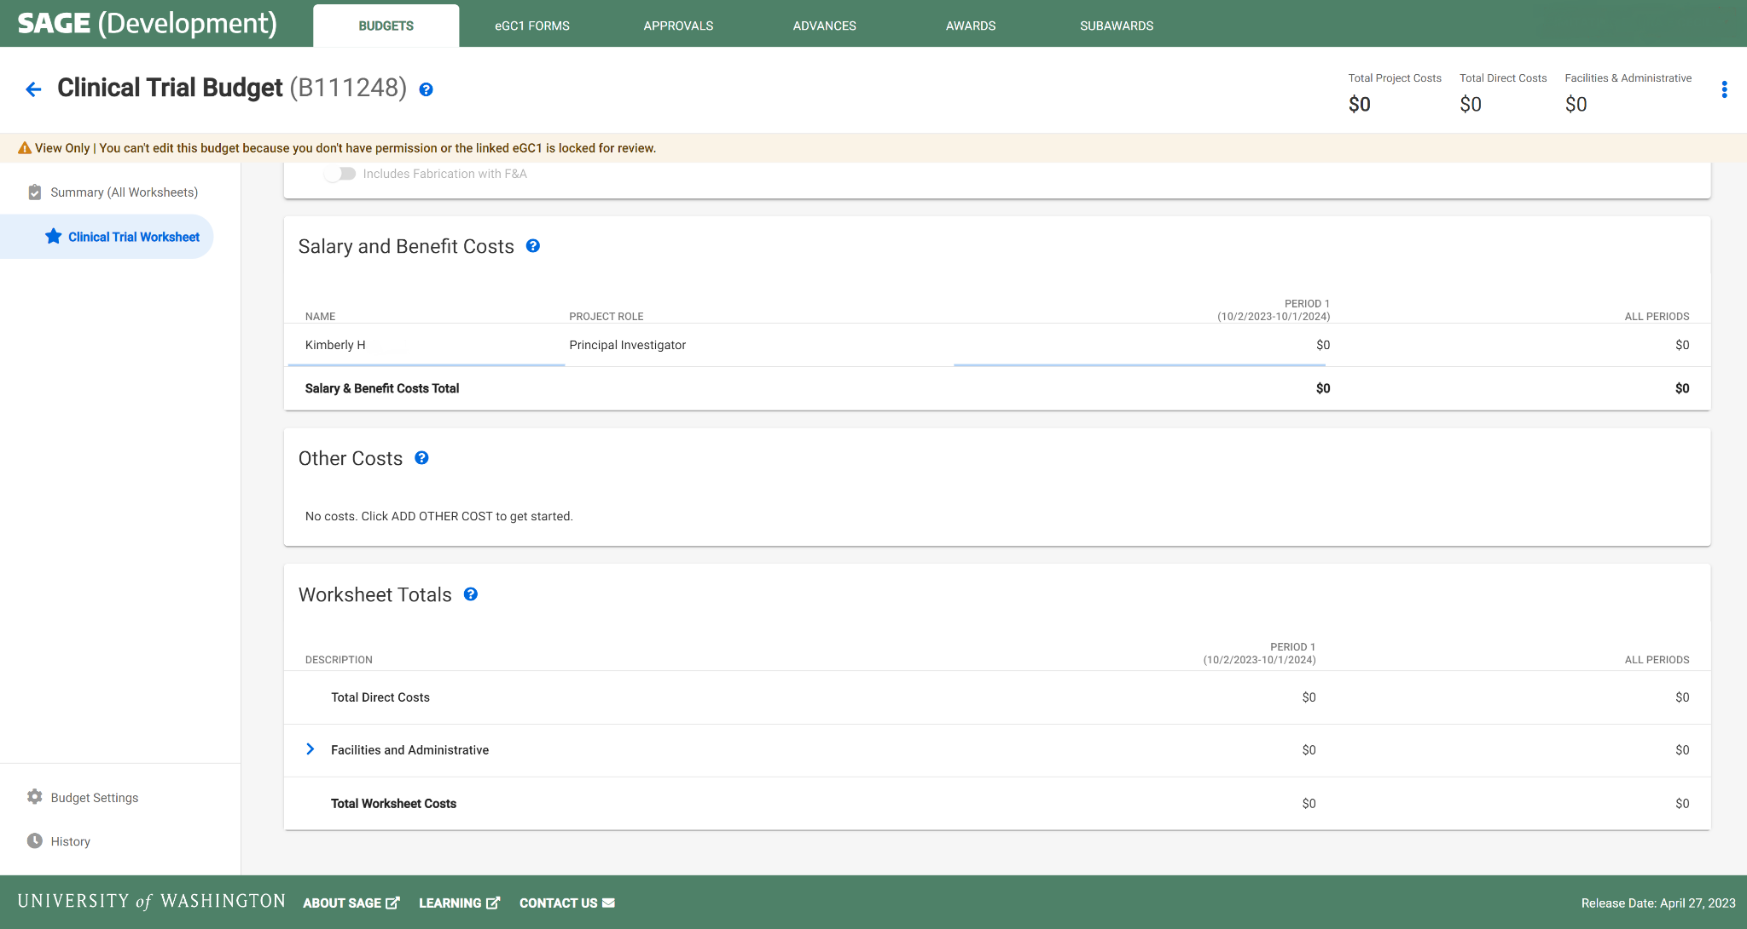
CLINICAL TRIALS | BUDGET ENTRY
1 PI per Worksheet
Leave default of $0 amount salary
No other line item entry required
Notes:
Each worksheet will need one row of personnel at minimum who is assigned as PI.

Slide 44
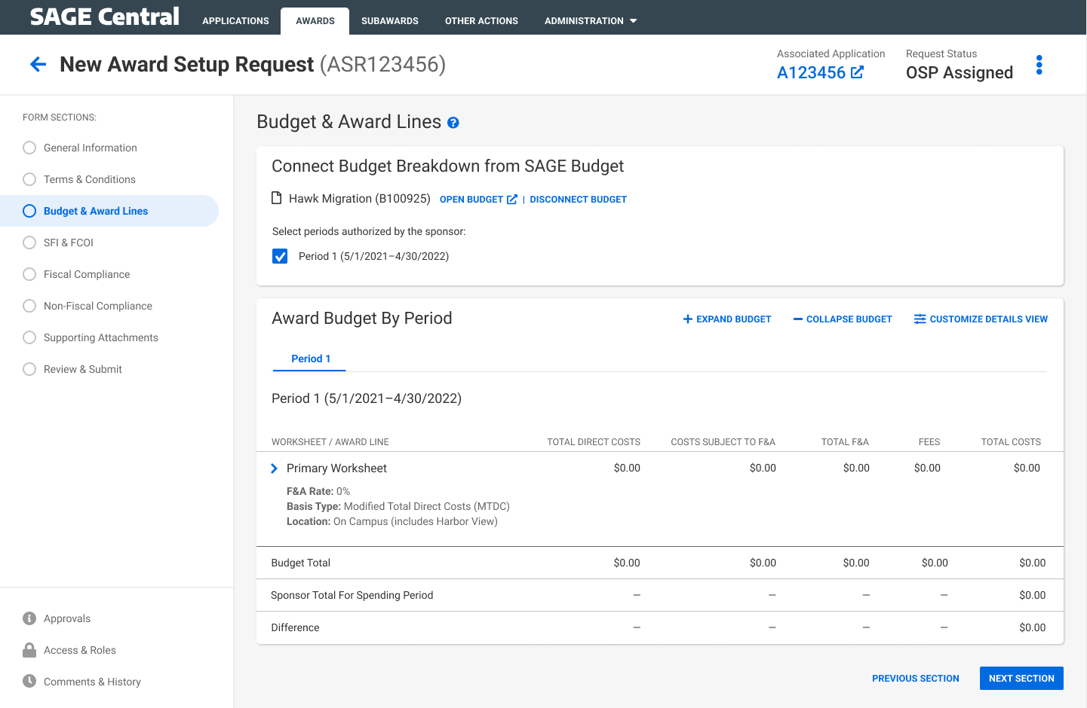
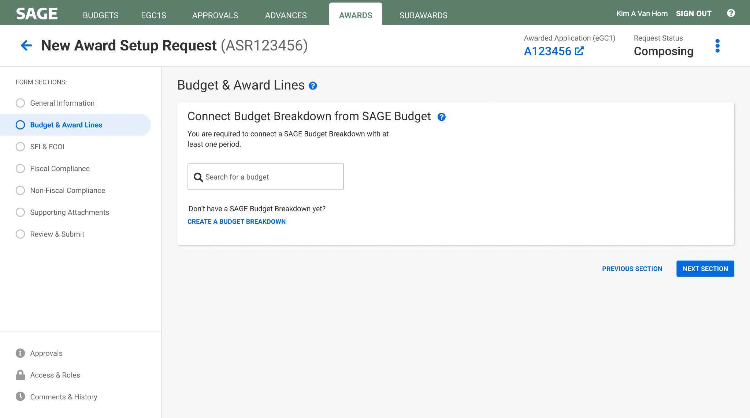
CLINICAL TRIALS AWARD SETUP | CREATE & LINK BUDGET
Select Period 1
Automatic display of budget setup flowing to the award request

Slide 45
SETTING UP MULTI-YEAR BUDGETS
Functionality:
In the Award Setup Request, the periods selected will be used to create the award schedule periods in Workday.
SAGE will send the first start date and last end date of the selected periods as the Workday Award Line Start and End dates.
SAGE will be able to handle Campus units entering multiple periods, or one long period in SAGE Budget for all scenarios.
Notes:
Often you may not know how many periods a clinical trial will last, so you can choose 5 years in order to prevent having to repeatedly request extensions.

Slide 46
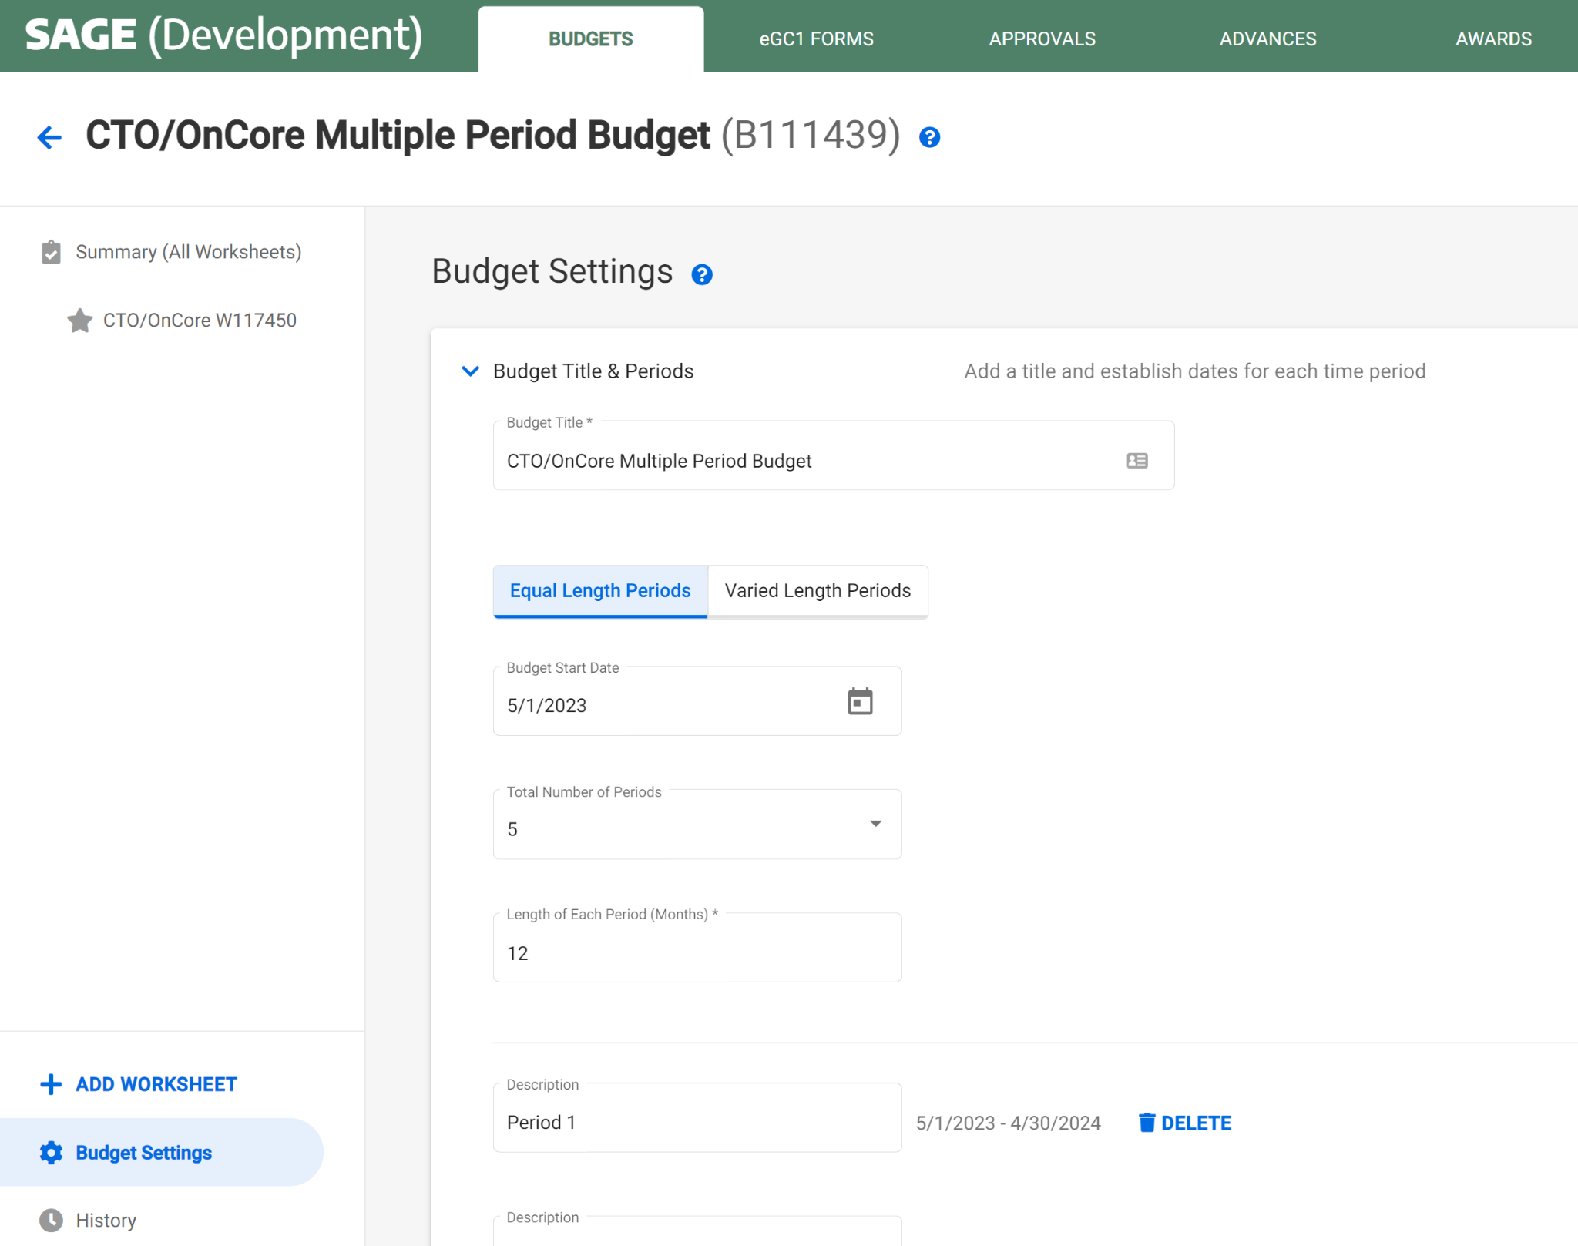
EXAMPLE 1:
MULTI-YEAR BUDGET | MULTIPLE PERIODS
Select any number of periods
Notes:
From the dropdown, users can select 1-10 periods, or custom (any amount)

Slide 47
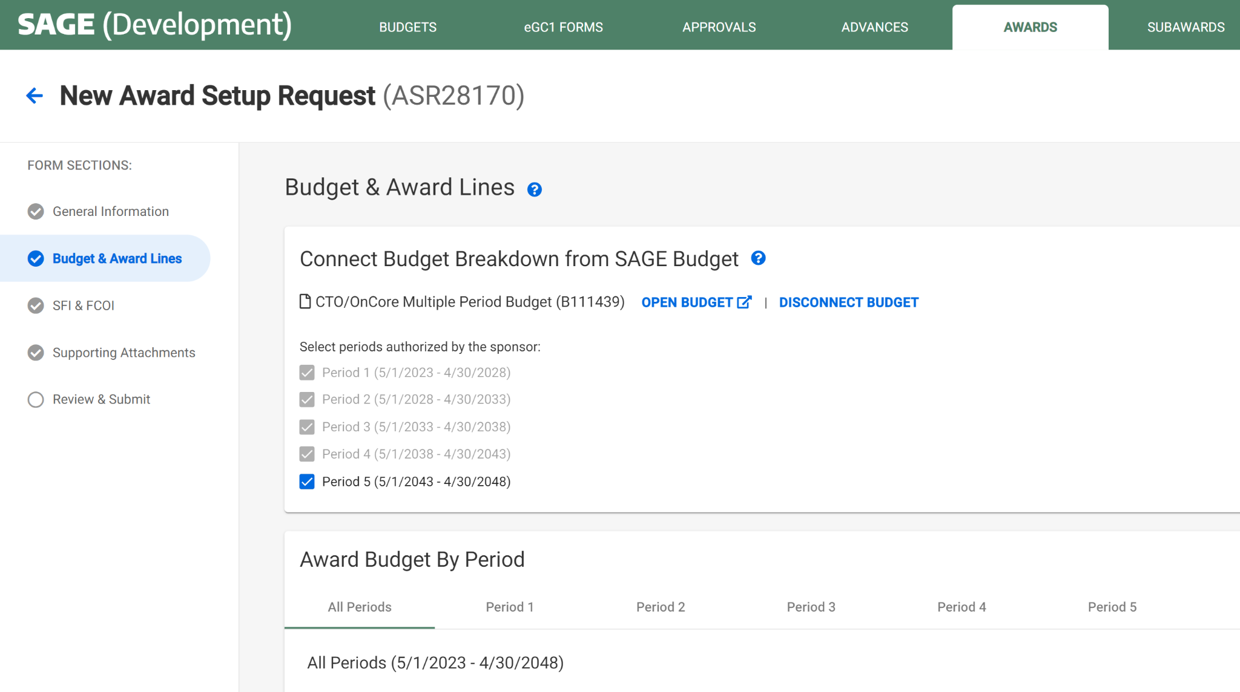
EXAMPLE 1:
MULTIPLE PERIODS | AWARD SETUP REQUEST
Selected periods become award schedule periods
Start and end date will be used for the award line start and end date in Workday

Slide 48
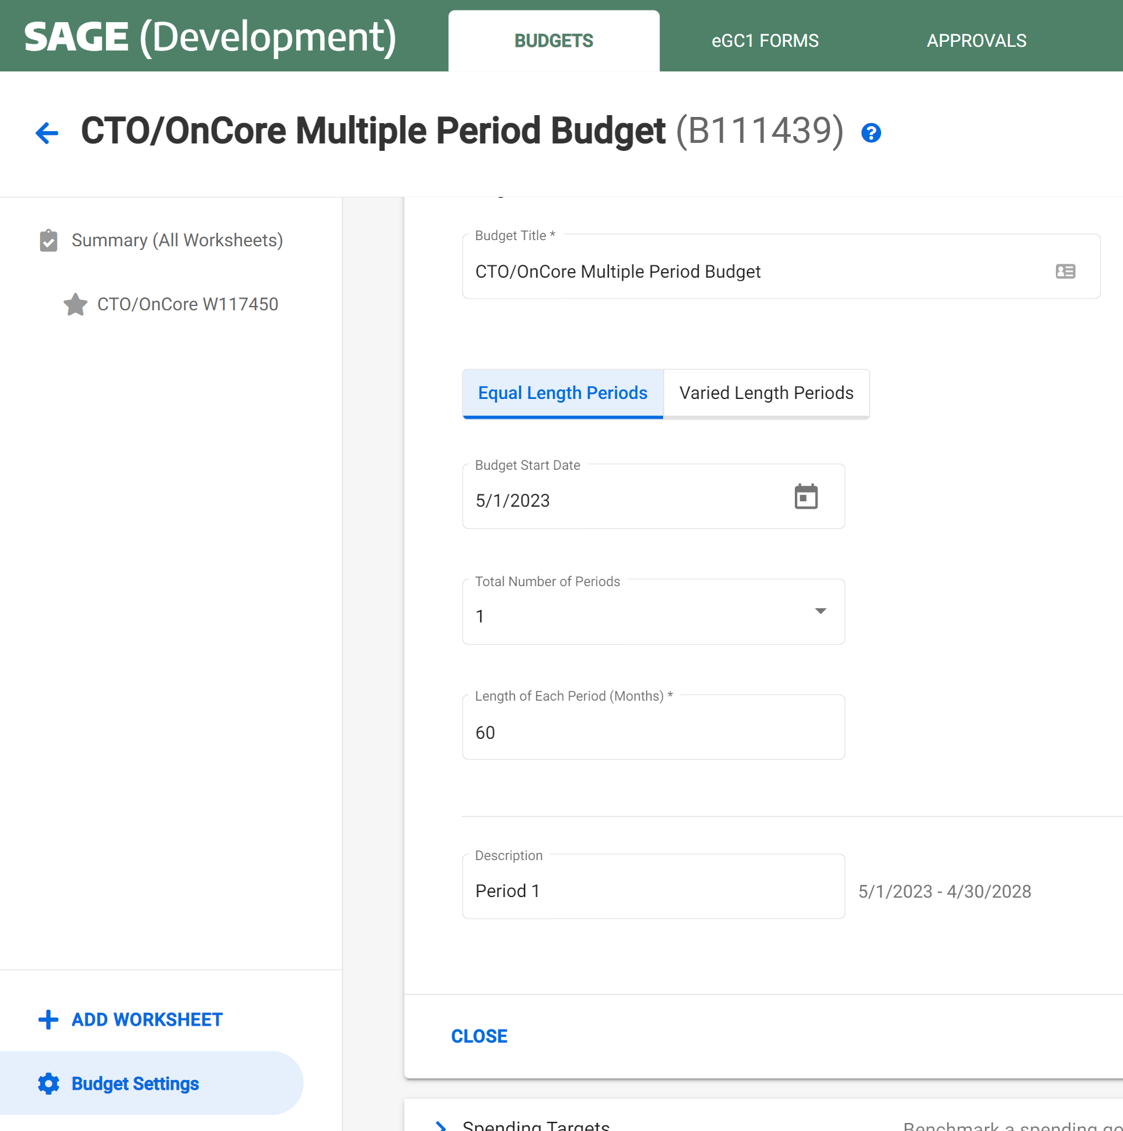
EXAMPLE 2:
SINGLE PERIOD BUDGET | 60 MONTH (5 YRS)
Select 1 period with any length (in months)

Slide 49
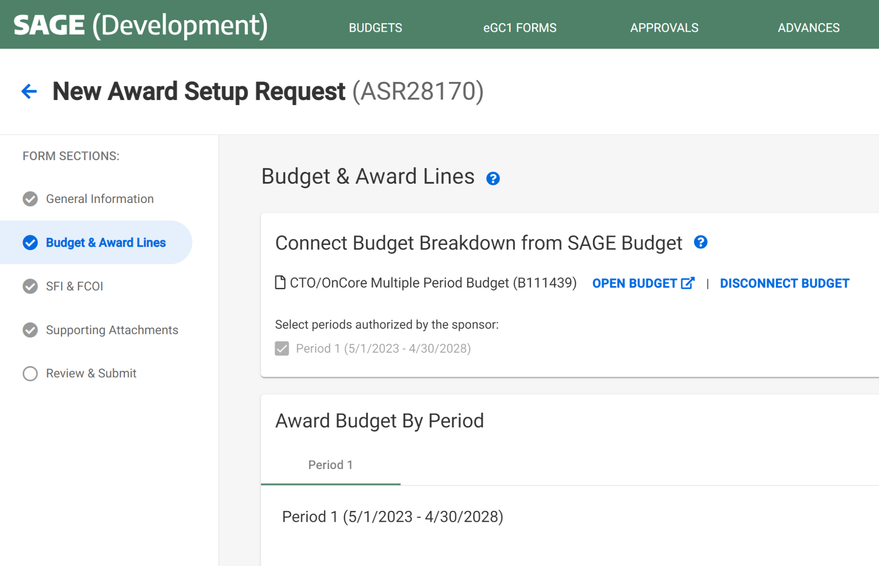
EXAMPLE 2:
60 MONTH PERIOD | AWARD SETUP REQUEST
Selected periods become award schedule periods
Start and end date will be used for the award line start and end date in Workday

Slide 50
Notes on SAGE Budget Requirement
Allows necessary integration/mapping to Workday.
Setting up SAGE Budgets with basic information with $0 should take only a few minutes.
GCA will know budget detail is not needed & they will not handle invoicing.
If there are other SAGE Budget requirements we will let you know as soon as possible.

Slide 51
How will correct Award Worktag correspond with the study billing in Oncore?
Existing studies:
Clinical Trial Management System (CTMS) team will receive the new grant worktags for converted budget numbers and will update OnCore.
New studies after go-live:
Study teams provide a worktag either with the study intake form or update directly in OnCore at any point during start-up.
CTO will not open the study until the number is in OnCore.
Questions? contact uwcto@uw.edu
Notes:
The OnCore billing system for Clinical Trials will integrate with WD Finance with go-live.

Slide 52
Resources
CTO questions? contact uwcto@uw.edu
SAGE Budget Classes
  Thursday, May 18, 1-3 p.m.
  Thursday, June 13, 1-3 p.m.
Drop-in SAGE Office Hours
  Twice a month, every other Thursday. All dates/Zoom links on UWFT for the Research Community webpage
UWFT for the Research Community Webpage
  Important dates, information, and training resources!
Questions about SAGE Budget?
  Contact sagehelp@uw.edu

Slide 53
Workday Conversion Process: Future Advances and Awards
May 19, 2023 MRAM
Juan Lepez, Director
Grant & Contract Accounting

Slide 54
Conversion for Budgets with Future Start Dates
Current State
  GCA places advances and awards with start dates in the future in a closed status to prevent unallowable charges from posting
Conversion Process
  Converted advance budget numbers will be in an active status called "Advance Spend" in Workday and awards will be in an active status called "Open", regardless of the start date to ensure that units have ability to spend
MRAM – Juan Lepez – Grant & Contract Accounting
Notes:
Placing in an inactive status made it easier to not have any pre-award costs be disallowed when the start date on the fully executed agreement differed from the start date of the Advance.
All costs incurred prior to the acceptance of an award must be in compliance with GIM 9 and GIM 23

Slide 55
What Does This Mean for Units?
Units will need to monitor Workday transaction dates closely to make sure the expense falls within the award line start and end dates
Units can use the following Workday reports to monitor:
Cost Reimbursable Line Status report or
Fixed Amount Line Status report
MRAM – Juan Lepez – Grant & Contract Accounting
Notes:
The Workday report depends on the award line's line type.

Slide 56
Resources
GIM 09 – Advance Budget Numbers
GIM 23 – Sponsored Program Costing Policy
PAFC: Four Cost Principles
SAGE: Create an Advance Budget Request
GCA: Advance Budget Setup and Extension
MRAM – Juan Lepez – Grant & Contract Accounting

Slide 57
Questions
Please contact GCA at gcahelp@uw.edu
MRAM – Juan Lepez – Grant & Contract Accounting

Slide 58
Award Portal Overview
Cheryl Haycox
Grant & Contract Accounting
May 19, 2023 MRAM

Slide 59
WHAT IS AWARD PORTAL?
Replaces Grant Tracker
Designed to provide an ‘at-a-glance’ view of an award
Mirrors the layout in Workday
Everyone with a UW netID will have access
The system is still a work in progress!
We expect to continue refining award portal past go-live

Slide 60
POINTS OF INTEREST
Completed sponsor financial reports will show in Tasks in both Workday Finance and Award Portal
Deficit Transfer link discontinued
  Deficit transfers will be manually processed by GCA.
  Departments will need to provide the appropriate worktag for GCA to use to clear a deficit.
Grant Tracker will retire on Monday, July 10th, Award Portal will go-live Tuesday, July 11th
  Job aids and e-learning will be available closer to launch date.
Notes:
access is not controlled by Workday security role

Slide 61
SHAMELESS PLUGS
Award Portal information available on GCA Finance Transformation webpage:
  https://finance.uw.edu/gca/finance-transformation#Award%20Portal
GCA Forum is on Tuesday, May 23 at 11:00:
  https://finance.uw.edu/gca/node/1666

Slide 62
COST SHARE CUTOVER
MRAM
May 2023
Matt Gardner
Post Award Fiscal Compliance

Slide 63
Cost Share Cutover – Important Dates
June 13 – GCA stops entering commitments in eFECS
July 6 – GCA resumes entering commitments in Workday
July 14 – Cost transfer deadline in MyFD
July 24 – eFECS Cost Share data (commitments and actuals) imported into Workday
MRAM – Matt Gardner – PAFC

Slide 64
Cost Share Cutover – Important Dates (cont’d)
July 31 – Last day for campus to tag expenditures in the Non-FEC Tagging System
October 11: Deadline to certify FECs for the period ending 6/30/2023
October 12: Catch-up load will update Workday cost share with FEC and non-FEC cost share actuals not included in initial upload
MRAM – Matt Gardner – PAFC

Slide 65
Cost Share Cutover –
Commitment Changes in eFECS Cost Share Module
No changes to Cost Share commitments in eFECS will be possible after June 13
If Cost Share commitments need to be adjusted after June 13th, the adjustment can occur in Workday beginning on July 6
  Example: If on July 15 an additional $10,000 in cost share commitments need to be added to the Award, the revision will occur in Workday, not the eFECS Cost Share Module
MRAM – Matt Gardner – PAFC

Slide 66
Cost Share Cutover –
Non-FEC Cost Share Contributions
Cost Share contributions for incurred expenditures prior to June 30, 2023, are still “tagged” in the Non-FEC Tagging System
  The system will be available to tag those costs until July 31
  After July 31, updating the Cost Share actuals will require a transaction in Workday
  Tip: If you haven’t tagged cost share expenses in a while, now is a good time to get caught up
MRAM – Matt Gardner – PAFC

Slide 67
Cost Share Cutover –
Faculty Effort Cost Share Contributions
All FEC cycles will be “cut off” as of June 30, 2023, regardless of the reporting cycle (Calendar or Academic)
FECs are due by October 11
A “catch-up” load of the final Faculty Effort Cost Share after certification (and any tagged items not in the original balance transfer) will be updated in Workday on October 12th
MRAM – Matt Gardner – PAFC

Slide 68
Cost Share Cutover –
Interim Cost Share Report
Awards requiring a final invoice or financial report with Faculty Effort Cost Share commitments will still require an Interim Cost Share report
GCA will reach out if an Interim Cost Share report is required (No change in this process)
Contact efecs@uw.edu
Resources:
  GCA Web: https://finance.uw.edu/gca/cost-share#Interim_Cost_Share
MRAM – Matt Gardner – PAFC

Slide 69
Resources
GCA Cost Share Webpage:
https://finance.uw.edu/gca/cost-share
Non-FEC Tagging Instructions:
https://finance.uw.edu/gca/cost-share/ste-by-step-instructions-non-fec-contributions
MRAM – Matt Gardner – PAFC

Slide 70
Questions
Post Award Fiscal Compliance (PAFC)
  gcafco@uw.edu
  https://finance.uw.edu/pafc/
Matt Gardner
  mgard4@uw.edu
  206-543-2610
MRAM – Matt Gardner – PAFC

Slide 71
Workday Role Based Training
Bonus UWFT-Focused MRAM
May, 2023
Liz Satwicz
UWFT

Slide 72
TRAINING METHODS
Your Workday training will utilize a variety of training methods, or modalities. Training will be a blend of self-paced and virtual live training. We will be using the Bridge Learning Management System (LMS) for course registration, course catalog, and completion tracking.
Modality
Description
Virtual Instructor Led Courses (VILT)
Training delivered in a virtual classroom by a trainer that has completed the Train-the-Trainer program — trainer demos and student hands-on exercises in a live Workday tenant
Virtual Live training – VILT courses: 35%
Self-paced training – eLearning, NanoLearning, Recorded Demos: 65%
Job Aids – Quick Reference Guides (QRGs), Work Instructions, Fact Sheets: 133 documents
eLearning
Interactive, self-paced or recorded training that learners can access online when most convenient for them
Nanolearning
Self-paced bite-sized trainings (target length 5-15 minutes), typically in video format; similar to a shortened, less interactive eLearning
Recorded Demo
Trainer-delivered course via a video recording and similar to a less interactive VILT; these may include some production elements such as videos or pre-recorded demos
Job Aids
Reference materials focusing on instructions to complete a business process on Workday
Clinics
Self-paced, hands-on practice sessions in the sandbox tenant to build familiarity with Workday functionality – also available post go-live (defined time)
Bonus UWFT-Focused MRAM – Liz Satwicz - UWFT
Notes:
All Foundational job aids are available
Waiting on:
GA2C eleanrings,
Inventory-specific journeys for UWM
Functional job aids, including ProCard verification and expense reimbursement

Slide 73
Workday Testing & Training Timing
April 2023 | May 2023 | June 2023 | July 2023
Train-the-Trainer (TTT)
UWFT Go Live
Select Power Users attend TTT to prepare to deliver select courses to unit employees.
Take Self-Paced Training
Online training (eLearning, videos, recorded demos) and job aids can be accessed directly via Bridge LMS
4/17-21: Workday “Foundational” self-paced courses launched on Bridge – ALL users take these courses
5/1: Workday “Functional” courses launched on Bridge – Specific to a user’s security roles
Training
Attend Virtual Instructor-led Training (vILT)
Pause
vILT Resumes
Register for vILTs via Bridge LMS - Zoom & logistics will be sent via email after registration
5/1-8:
Register for vILT sessions thru Bridge
5/8: vILT live sessions start
7/10-14: Makeup week of EUT
Learners practice in Workday Sandbox system
Access “sandbox” tenant on their own and/or attend Practice Clinics (QAs and guided practice with UWFT team). Register for Practice Clinics via Bridge LMS, details to be sent in a future email.
UAT (4 weeks)
UAT Fix
UAT
Select Power Users, PTT members, Design Team and other Unit users
4/24:
UAT begins
Bonus UWFT-Focused MRAM – Liz Satwicz - UWFT
Notes:
Here is the current timeline for all Workday Finance training to be conducted and completed by.
You can see that we have started training communications already.
As we head into the middle to end of April timeframe, online training will begin rolling out to learners.
Beginning in May, learners will be able to choose their courses. Anticipate receiving finalized documentation prior to live training classes begin. As we know, change is inevitable as we work through the final details of go-live. We will make every effort to provide you with all updates to materials in a timely manner.
Once training is underway, you can expect learners to finish their online training and attend practice clinics or practice on their own.

Slide 74
Employee-as-Self: Definitions
Employee as Self is a role every employee is defaulted to in Workday to perform personal and job-related activities.
You already know the role from the task of requesting time off in Workday.
As an employee, you can perform numerous transactions in the Workday you already know, and in Workday Finance starting in July.
In Workday Finance, expect to create and view expense reports, such as when you travel to a conference.
Bonus UWFT-Focused MRAM – Liz Satwicz - UWFT

Slide 75
Employee-as-Self: Training Timeline
SOMEONE WHO…. | TRAINING TIMELINE | FORMAT
Has a Workday Finance Security Role | Available now | Combination of eLearning and Job Aids
Has not been assigned a Workday Finance Security Role | Training will be available, and notifications will be sent post go-live, in July. This includes Travel/Expense Reimbursement. | Combination of eLearning and Job Aids
Has a ProCard | By June 1st | Job aid
Bonus UWFT-Focused MRAM – Liz Satwicz - UWFT

Slide 76
Workday Training Courses For Faculty
UWA faculty will receive courses based on how they will interact with the Workday system.
For Faculty Who Are… | Course Description | Training Method | Time Length
…Principal Investigators | Workday Finance Grants for Principal Investigators Understand how to view, access, and read reports, and delegate tasks in Workday; understand ad-hoc subrecipient invoice approval task | Nano-learning | 10 mins
…Expense Report Submitters and/or Approvers | Workday Expense and Reimbursement Understand the expense and reimbursement process in Workday; understand how to manage expense reports after submitting, including locating, editing, checking on approval flow and printing | Collection of 7 Job Aids | 40 mins
…Requisition Submitters and/or Approvers | Workday Requisition to Purchase Order Understand the requisitions process in Workday and types of requisitions | Job Aid (with optional supplemental nano-learning) | 10 mins
The following Workday General courses are optional, but recommended for all Faculty:
Workday Navigation (eLearning, 20 minutes),
Introduction to Foundational Data Model (FDM) (eLearning, 75 minutes)
Workday Reporting (job aid only)
Workday Finance for Awards and Grants (nano-learning, 15 minutes)
Bonus UWFT-Focused MRAM – Liz Satwicz - UWFT

Slide 77
TENANT vs. SANDBOX
Training Practice Tenant
  Only for practicing transactions in vILTs
  Will be refreshed every two weeks for staged transactions to be repurposed
Training Sandbox
  Access granted to users assigned any specific Workday security role after completing first functional course
  Does not include those with only “Employee-as-self” security role
  Will not contain integrations
Bonus UWFT-Focused MRAM – Liz Satwicz - UWFT

Slide 78

What is a Sandbox, and What Can I Do With It?
The sandbox is a copy of our configured Workday Financials software environment
  It has the same look and feel as the “real” Workday system that you’ll log into after go-live
  It has the same security roles and business process routing
The sandbox doesn’t have any systems integrations
  It doesn’t connect with the EDW, with J.P. Morgan Chase, with SAGE, or with any locally-owned systems
You can use the sandbox to practice your future-state work
  Get comfortable with Workday navigation
  Practice submitting requisitions, ISDs, journals, or any other in-Workday task
  Partner with others in your department to practice approvals
  Work as a team! Coordinate your activities!
Bonus UWFT-Focused MRAM – Liz Satwicz - UWFT

Slide 79
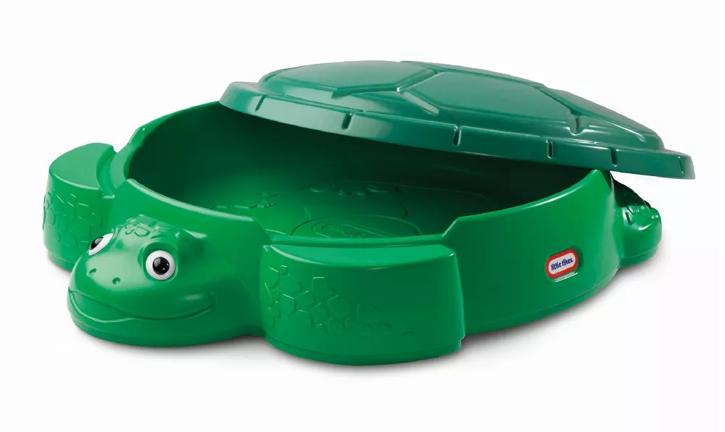
What Data and Information Will be Available in the Sandbox When I Log In?
All Reference Data will be loaded and available
  Worktag values, like Cost Center, Balancing Unit, Award, etc.
  Customers, Suppliers, Catalogs
Some Staged Data will be loaded and available
  Details in-progress, but likely to include some “dummy data” created for support of either End User Training or User Acceptance Testing
Data will be refreshed bi-weekly
  Transactions you create and data you enter in the Sandbox will be wiped clean
  This will occur every other Saturday, starting May 6
Bonus UWFT-Focused MRAM – Liz Satwicz - UWFT

Slide 80

How Do I Get Access to the Sandbox? How Long Will it Remain Available?
All users with a Workday Financials security role will be able to access the sandbox
  But not users who only have an Employee-as-Self security role
Users will get access to the sandbox after they complete their first Functional Training
  Reminder: “Functional Trainings” are trainings rooted in a financial business process, like “Grant Award to Close” or “Manage Cash and Financial Assets”
  The type of training doesn’t matter for sandbox access; it can be an eLearning, a Nano-Learning, or a vILT (virtual instructor-led training)
Access to the sandbox will be granted with a link included in a weekly training email; it’s not an automatic process
  The UWFT training team will send this email once a week, on Fridays, and it will include a link to the sandbox and access instructions
  Learners in a vILT course get access on completing the survey at the end of that course
The sandbox will be closed for general use shortly after go-live
  Reminder: go-live is July 6!
  The reason for this is that UW needs to re-purpose the sandbox as a tool for configuring, testing, and deploying continuing Workday software releases
Bonus UWFT-Focused MRAM – Liz Satwicz - UWFT

Slide 81
THANK YOU!
Bonus UWFT-Focused MRAM – Liz Satwicz - UWFT

Slide 82
SAGE TRAINING
May 19, 2023
Breona Gutschmidt
Office of Research Information Services

Slide 83
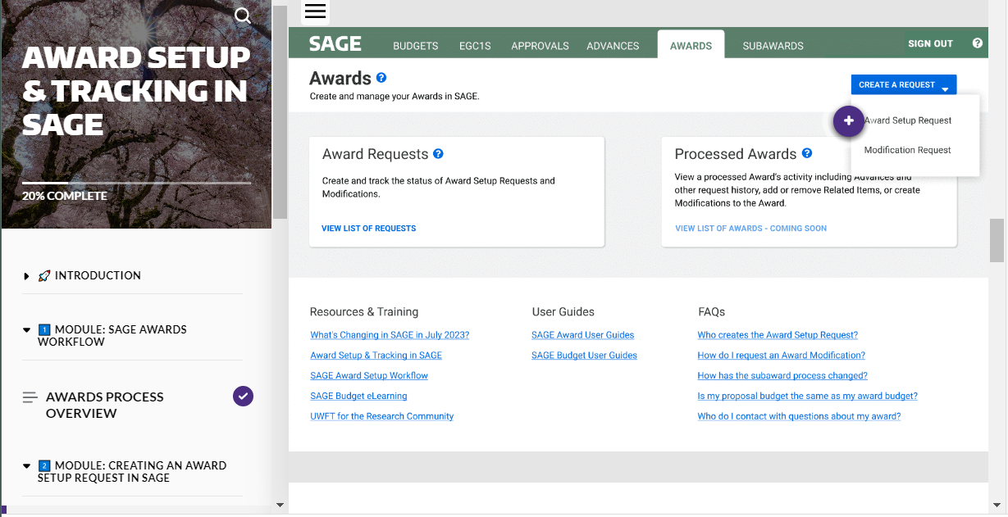
AWARD SETUP & TRACKING IN SAGE ELEARNING
New!
Provides in depth instruction on SAGE Awards usage, including:
  Creating Award Setup Requests
  Monitoring Award Requests
  Access the eLearning

Slide 84
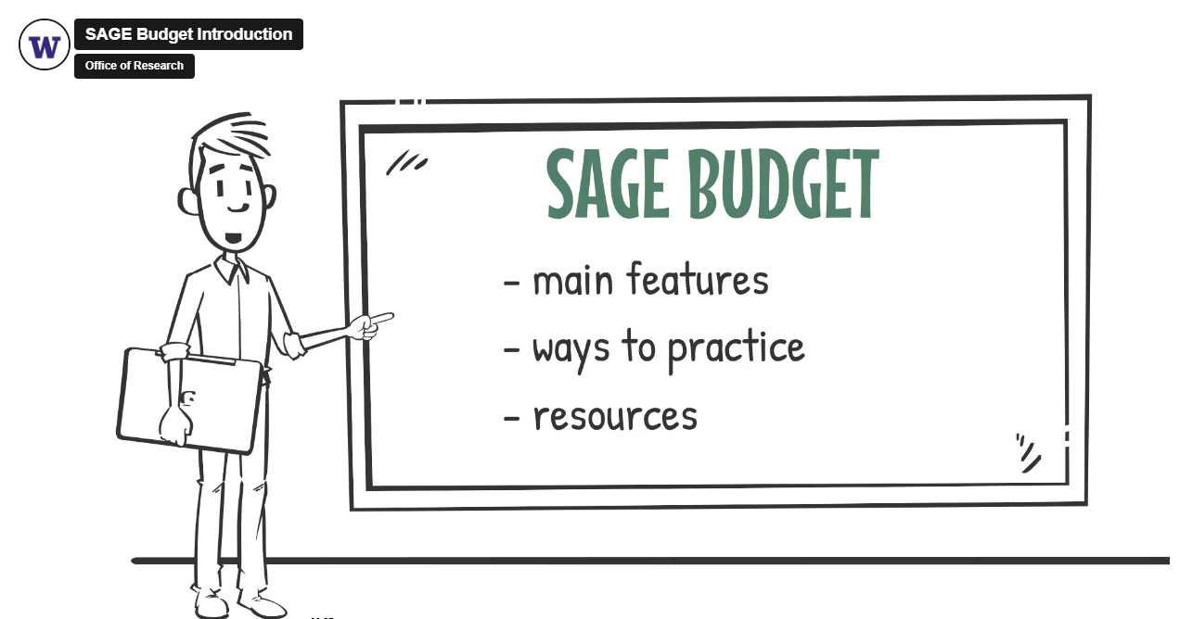
SAGE BUDGET TRAINING
Virtual Instructor-led Class
Live class with SAGE experts to walk you through each step in the Budget process
Upcoming classes:
  6/13, 1 - 3 p.m.
SAGE Budget eLearning
Provides on-demand instruction in SAGE Budget when you need it

Slide 85

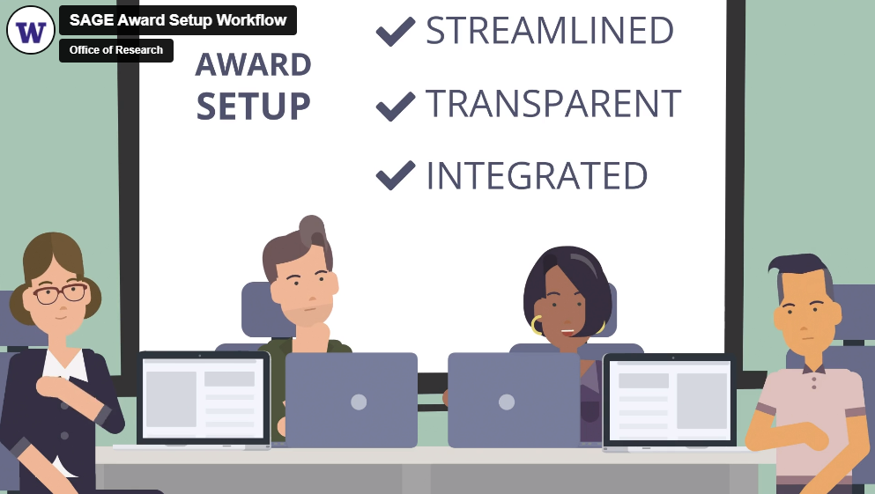
ADDITIONAL SAGE TRAINING
What’s Changing in SAGE? Video
Provides a high-level overview of changes coming to SAGE with UWFT (job aid version)
SAGE Award Setup Workflow Video
Provides an in-depth overview of the Award Setup workflow in SAGE

