Slide 1
MRAM | Monthly Research Administration Meeting
May 11, 2023 9:00 AM – 10:00 AM Join Webinar: https://washington.zoom.us/j/346891888
TOPIC | PRESENTER | EMAIL | MIN
Welcome | Kirsten DeFries Research Compliance & Operations | kirsten5@uw.edu | 2
PAFC Hot Topic: Travel on Federal Awards | Matt Gardner Post Award Fiscal Compliance | gcafco@uw.edu | 10
Scope of UW Clinical Trial Office Budget Review | Pavel Kruchek & Carol Rhodes Clinical Trials Office & Office of Sponsored Programs | carhodes@uw.edu uwcto@uw.edu | 15
CT.gov registration and reporting | Jason Malone & Carol Rhodes Human Subjects Division, Office of Sponsored | jmmalone@uw.edu carhodes@uw.ed | 15
Upcoming Changes to HSD Administrative Fee and Processes | Jason Malone Human Subjects Division | jmmalone@uw.edu | 10
Fixed Price Surplus Budgets | Vince Gonzalez Grant & Contract Accounting | vinceg@uw.edu | 5
CORE Update | Laurie Stephan Collaborative On Research Education (CORE) | corehelp@uw.edu | 2
Bonus MRAM agenda highlight - 5/19 | Carol Rhodes Office of Sponsored Programs | carhodes@uw.ed | 2
NEXT MEETING June 8, 2023 9:00 AM - 10:00 AM

Slide 2
Live Closed Captioning is now available
Live transcription and closed captions are enabled via the “CC/Transcript” button in your Zoom window.
Recordings of our sessions, with manually edited closed captions, are typically available within a week after the meeting, and a link is emailed with the post-session Q&A.
If you have any issues or questions, please let us know at mramques@uw.edu

Slide 3
COMPLIANCE HOT TOPIC:
TRAVEL ON FEDERAL AWARDS
MRAM
May 2023
Matt Gardner
Post Award Fiscal Compliance

Slide 4
Travel on Federal Sponsored Awards
Federal regulations require recipients to follow the “written travel reimbursement policies” of the institution… with two specific exceptions:
  Class of commercial air travel, and
  Use of a U.S.-flag carrier (Fly America Act)
An individual federal agency or award may include additional restrictions or limitations
Always read your award and sponsor terms and conditions
MRAM – Matt Gardner – PAFC

Slide 5
Class of Travel on Federal Awards
Regulations require purchasing the least expensive class of travel – typically called “economy”
  Exceptions may be found in 2 CFR 200.475(e)
The “least expensive unrestricted airfare” is allowable
  Refundable tickets are an allowable cost
  Non-refundable tickets are allowable if the ticket is used
  If a non-refundable ticket is purchased and the travel does not occur, the cost may not be charged to the Award
MRAM – Matt Gardner – PAFC

Slide 6
Airfare on Federal Awards – Scenario #1
A PI purchases a non-refundable ticket for a conference in New York related to a federal award. A month before the conference, the PI has a conflict and cannot attend. The ticket was non-refundable, so no credit is provided by the airline.
Is the cost of the ticket an allowable charge on the federal award?
No. If a non-refundable ticket is purchased, and the travel doesn’t occur, the cost of the ticket must be charged to non-sponsored funding as it is not an allowable charge on the federal award.
MRAM – Matt Gardner – PAFC

Slide 7
Airfare on Federal Awards – Scenario #2
Same facts as #1 except the airline provides a voucher (but not a refund) for use on a future flight.
Is the cost of the ticket an allowable charge on the federal award?
If the voucher is used for a travel related to the current award, yes, the cost is allowable. If not…
No. The cost of the ticket must be transferred to a non-sponsored budget/funding until such time the voucher is used for a future flight.
When the voucher is used, the cost of the ticket may be transferred to the funding source that benefits from the travel at that time.
MRAM – Matt Gardner – PAFC

Slide 8
Airfare on Federal Awards – Business Class
The Uniform Guidance requires the purchase of the “least expensive” class (aka – “Economy”). Business Class (or an upgraded class) is only allowable if the Economy ticket would:
Require circuitous routing
Require travel during unreasonable hours
Excessively prolonged travel
Result in additional costs that would offset savings
Not meet the traveler’s medical needs
The use of any exception must be documented
MRAM – Matt Gardner – PAFC

Slide 9
Airfare on Federal Awards –
Business Class Exceptions: Examples
Require circuitous routing
  Require multiple legs of the trip
Require travel during unreasonable hours
  Red eye flights, etc.
Excessively prolonged travel
  Having to wait until an economy flight is available
Result in additional costs that would offset savings
  Staying overnight to catch the next flight which would require hotel/meal costs
Not meet the traveler’s medical needs
  Must be documented by a doctor
Note: The length of the flight is not an exception to flying Economy class
MRAM – Matt Gardner – PAFC

Slide 10
Airfare on Federal Awards – Scenario #3
PI purchases a business class ticket to New York to attend a conference related to a federal award. The PI does not meet any of the exceptions for the purchase of a business class ticket.
Is the cost of the business class ticket an allowable charge on the federal award?
The difference in the cost between the economy class and the business class ticket is unallowable and must be charged to non-sponsored funding or covered by the PI.
The cost of the economy class ticket is allowable.
MRAM – Matt Gardner – PAFC

Slide 11
Timing of Travel
For travel to be an allowable cost, the travel must occur during the period of performance (start/end dates) of the award.
Example:
Ticket purchased on June 1, 2023
Award ends on June 30, 2023
Travel occurs on July 1, 2023
This travel would not benefit the Award and is not an allowable cost.
The travel must occur between the start/end dates of the Award.
MRAM – Matt Gardner – PAFC

Slide 12
Questions
Post Award Fiscal Compliance (PAFC)
  gcafco@uw.edu
  https://finance.uw.edu/pafc/
  https://finance.uw.edu/pafc/travel#federal-travel
Matt Gardner
  mgard4@uw.edu
  206-543-2610
MRAM – Matt Gardner – PAFC

Slide 13

Scope of
UW Clinical Trial Office Budget Review
MRAM
May 11, 2023
Pavel Kruchek, Clinical Trials Office
Carol Rhodes, Office of Sponsored Programs

Slide 14
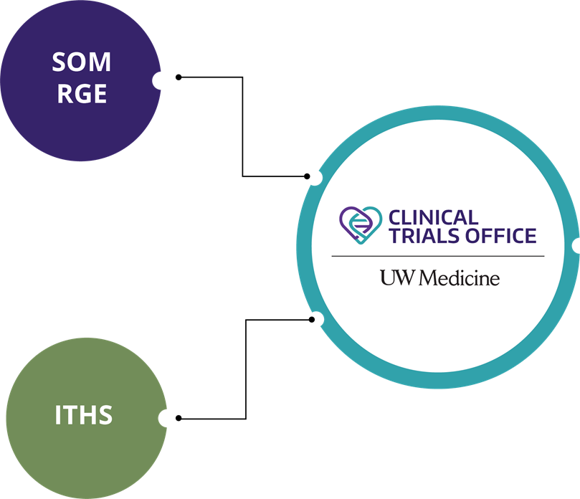
Clinical Trials Office: Background

Slide 15
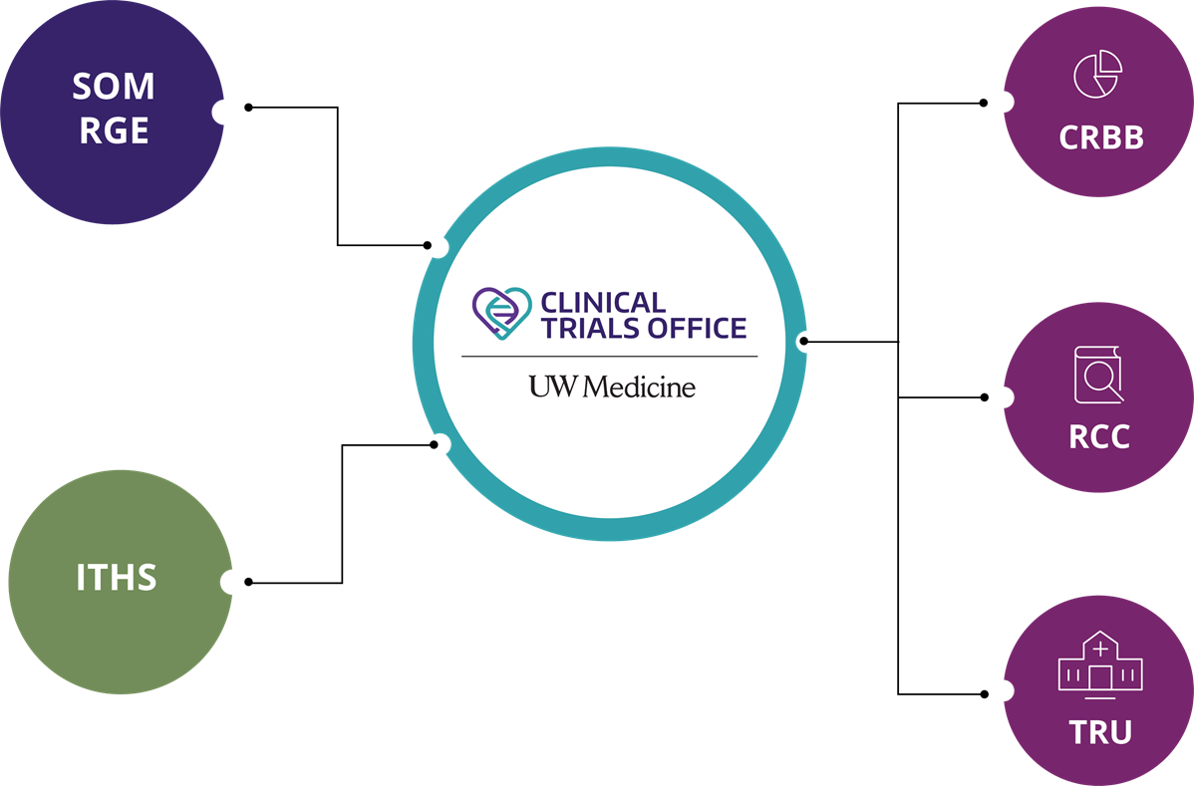
Clinical Trials Office: Background

Slide 16
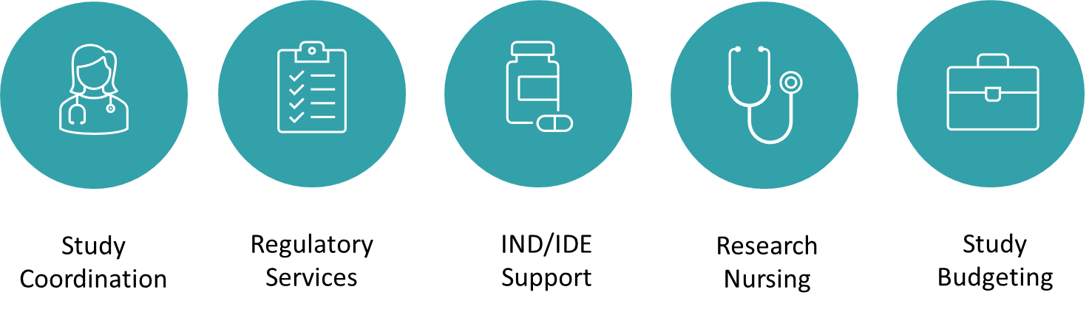
CTO Services

Slide 17
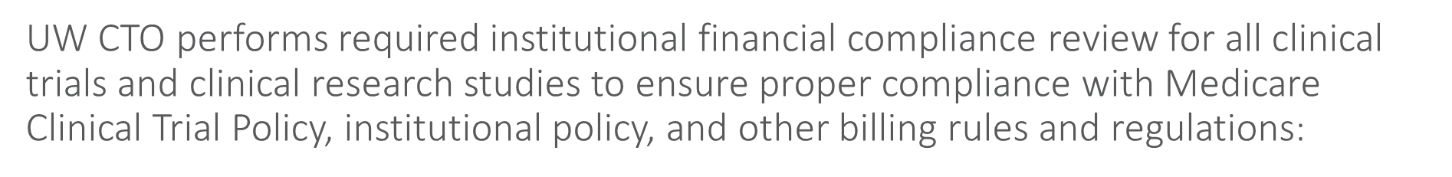

CTO Compliance Functions

Slide 18
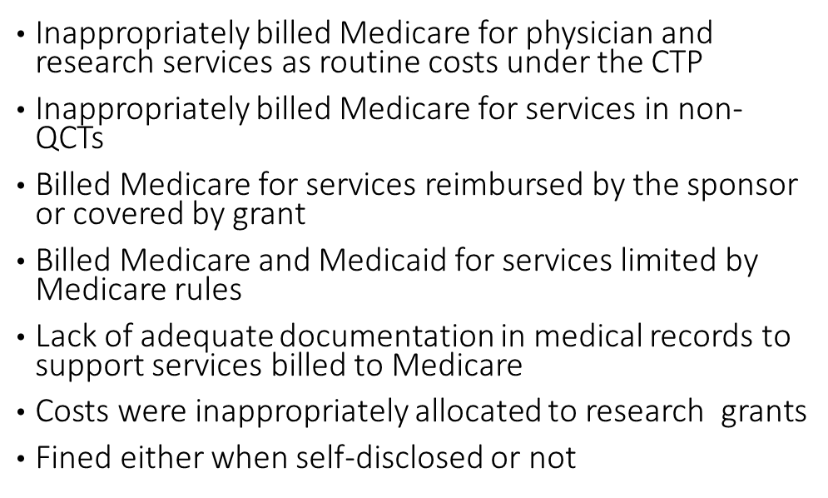
Institutional Financial Review: The Why
Consider these examples:
Rush UMC ($1.1M)
Emory ($1.5M)
USC Norris CC ($1.9M)
Beth Israel ($2.4M)
Johns Hopkins ($2.6M)
UAB ($3.4M)
Yale ($3.8M)
Cornell ($4.3M)
Northwestern ($5.5M)
Mayo Clinic ($6.5M)

Slide 19
Institutional Financial Review: The Why
Federal fines are not the only cost of non-compliance:
Monetary impact is at least double when adding legal fees
Criminal charges may be added in cases of deliberate fraud
Potential loss of federal funding
Severe reputational damage impacting jobs, patient trust, funding, subject enrollment, etc.

Slide 20
Institutional Financial Review
Billing compliance is governed by federal and state regulations and the institutional policy COMP.202 (https://depts.washington.edu/comply/docs/comp_202.pdf)
Coverage analysis and billing grid production
Document congruence (Summary Review):
  Billing grid
  Final budget
  Informed consent form
  Contractual terms
Final budget approval prior to contract execution

Slide 21
CTO Budget Approval Scope
Interventional trials or observational studies, where:
  Services, items, or tests are provided by a hospital facility (UWMC, HMC, or FHCC) that bills through Epic; OR
  Services, items, or tests are furnished by a provider who bills through UW Physicians regardless of the site of practice; AND
  Funding is provided to UW via fixed-price contract
Additionally:
  After 31 May 2023, all of these studies will generate sponsor invoices directly in OnCore CTMS
  OnCore will integrate with Workday starting 6 July 2023

Slide 22
Future State - Workday Finance Go-Live
SAGE Budget required on all Award Setup Requests
Use SAGE Budget for all Award Setup Requests, including budgets reviewed by CTO
For study budgets that will run through CTO review and Oncore billing
  Enter minimum information only in a single SAGE budget worksheet with $0 amount
This will help with Award Line and Award period setup in Workday Finance

Slide 23
SAGE Budget Entry for CTO Budgets
What is the minimum information?
Budget Settings
Budget Title
Budget Start Date
Total number of periods (defaults to 1)
Worksheet Settings
Create a single SAGE budget worksheet
Primary Worksheet Title
Cost Center
Activity Location
Sponsored Program Activity Category
Sponsored Program Activity Type
Base Type
Budget Entry
Add a Principal Investigator in personnel section for each worksheet, PI salary=$0
  only one worksheet is needed for CTO budgets
No other line item entry required in the budget
Notes:
JC notes if helpful:
It was originally conceived that CTO would be exempt from using SAGE Budget. In order to collect all of the line and period setup necessary for basic Workday awards for CTO, and given time constraints as we approach go-live, it was determined that pivoting to a SAGE Budget requirement for all ASRs would be the most stable approach going into 1st release. After go live, and with input from CTO budget preparers, we will re-asses whether an exemption would still be beneficial in the future or if data collection through SAGE Budget is acceptable. (Note that the fields of information needed are the same, regardless of whether SAGE Budget is used or an alternate approach to collecting the data).

Slide 24
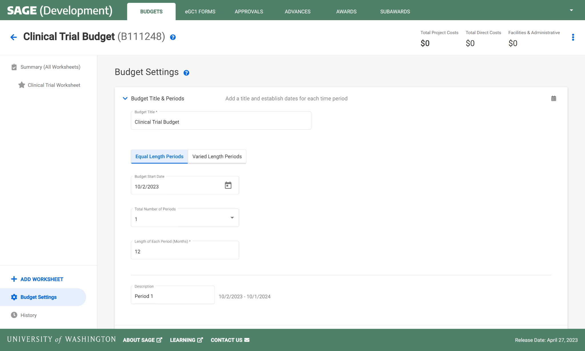
CLINICAL TRIALS | BUDGET SETTINGS
Budget Title
> Dotted fields are required for a Clinical Trials SAGE Budget
Budget Start Date
Total Number of Periods
Notes:
Naming conventions are in development.

Slide 25
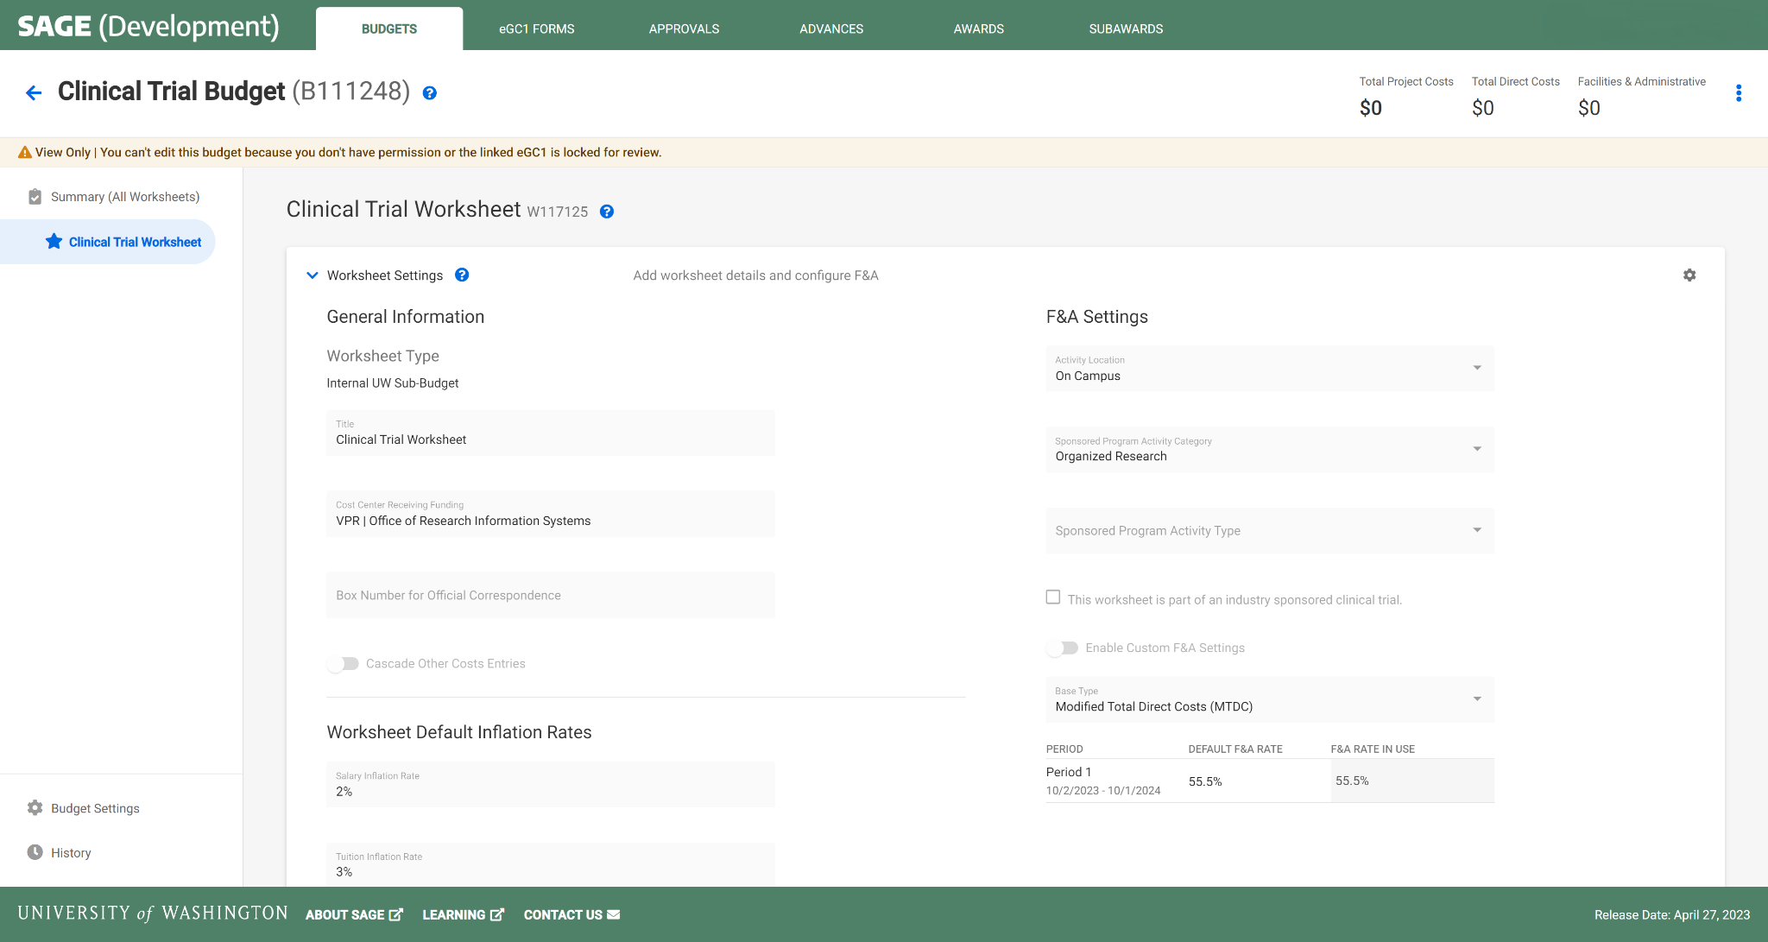
CLINICAL TRIALS | WORKSHEET SETTINGS
1 Worksheet
Activity Location
Primary Worksheet Title
SPA Activity Category
Cost Center
SPA Activity Type
Base Type
Notes:
Naming conventions are in development.

Slide 26
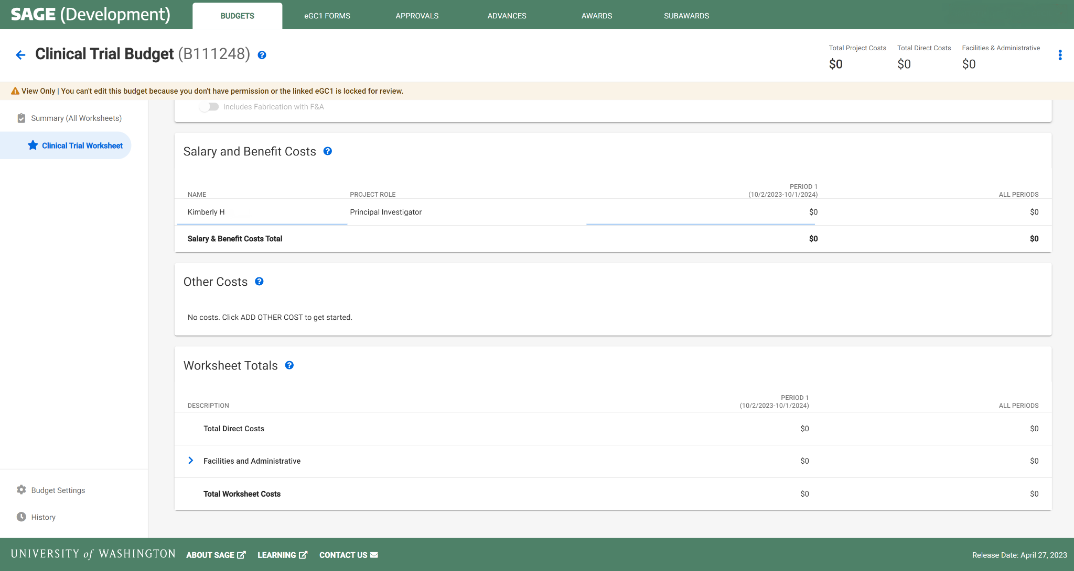
CLINICAL TRIALS | BUDGET ENTRY
1 PI per Worksheet
Leave default of $0 amount salary
No other line item entry required
Notes:
Each worksheet will need one row of personnel at minimum who is assigned as PI.

Slide 27
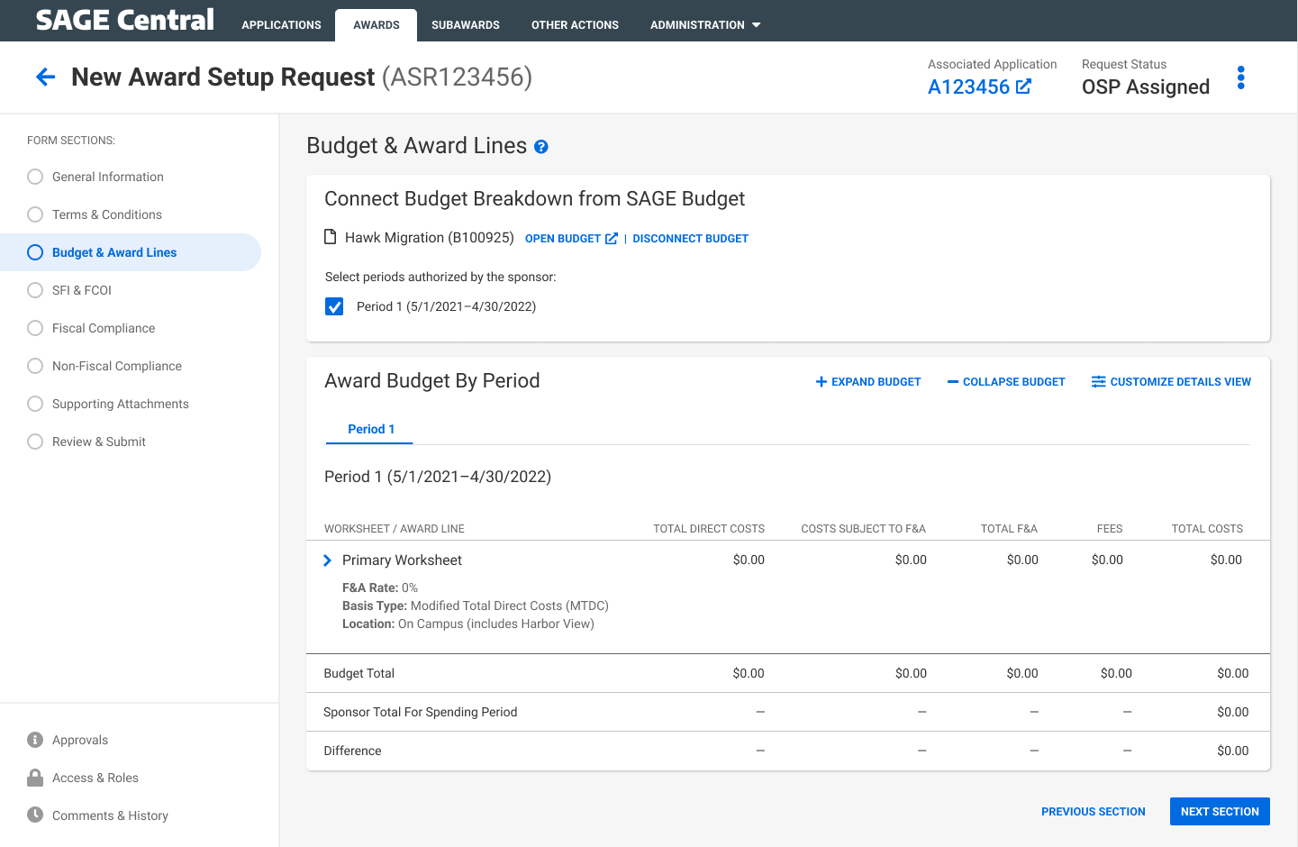
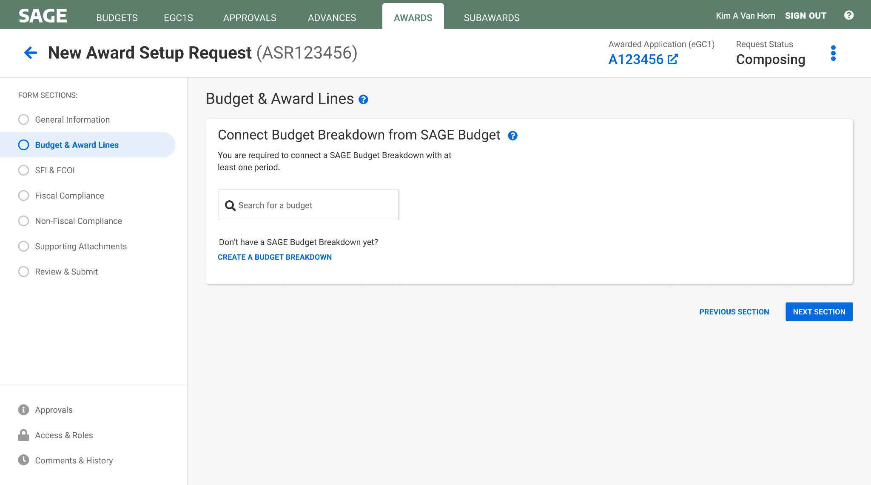
CLINICAL TRIALS AWARD SETUP | CREATE & LINK BUDGET
Select Period 1
Automatic display of budget setup flowing to the award request

Slide 28
Notes on SAGE Budget Requirement
Allows necessary integration/mapping to Workday.
Setting up SAGE Budgets with basic information with $0 should take only a few minutes.
GCA will know budget detail is not needed & they will not handle invoicing.
If there are other SAGE Budget requirements we will let you know as soon as possible.

Slide 29
Resources
SAGE Budget Classes
  Thursday, May 18, 1-3 p.m.
  Thursday, June 13, 1-3 p.m.
Drop-in SAGE Office Hours
  Twice a month, every other Thursday. All dates/Zoom links on UWFT for the Research Community webpage
UWFT for the Research Community Webpage
  Important dates, information, and training resources!
Questions about SAGE Budget?
  Contact sagehelp@uw.edu

Slide 30

CLINICAL TRIALS REGISTRATION & RESULTS REPORTING REQUIREMENTS
Jason Malone, Director, UW Human Subjects Division
MRAM
May 11, 2023

Slide 31

Federal Law & NIH Policy
2007 Implementation FDA Amendments Act (FDAAA) Section 801
Register clinical trials & report results
At public website ClinicalTrials.gov
2017 Expansion of the law (42 CFR 11)
More clinical trials, including behavioral trials
More study info & results required
Non-compliance penalties
2017 NIH Policy (NOT-OD-16-049)
All clinical trials funded and initiated on or after 1/18/2017 must register and report results on ClinicalTrials.gov
Notes:
The scope of what is required by federal law and NIH policy has expanded over the years but is from these that the requirements for public registration and results reporting of applicable clinical trials stems from.
I won’t go into detail on these, but you can review them directly online if you wish.

Slide 32

What is a Clinical Trial?
HSD applies the NIH Definition:
A research study in which one or more human subjects are prospectively assigned to one or more interventions (which may include placebo or other control) to evaluate the effects of those interventions on health-related biomedical or behavioral outcomes.
Notes:
The first step in determine if a research study requires public registration and results reporting is to determine if it is a clinical trial. [REVIEW Slide]

Slide 33

What is an Applicable Clinical Trial (ACT)?
Study is funded by NIH grant
    Includes pass through funding from another institution
    Includes smaller grants from a larger center grant (e.g., ITHS)
The study is evaluating at least one drug, biologic, or device product that is regulated by the FDA
    Different than study being subject to FDA regulations
    Some exceptions
3. Pediatric postmarket surveillance
Notes:
Once you determine a study is a clinical trial you next need to determine if it is an “applicable” clinical trial that requires public registration and results reporting.
These are the three main reasons a study may be an ACT and the ones HSD uses in our assessment. [REVIEW Slide]
NOTE – This is not an exhaustive list. Other funders may require registration as terms of the grant or contract and many publications/journals require it. Outside of these main 3 reasons, individual investigators are responsible for knowing if there might be other requirements for registration.

Slide 34
What’s required?
Applicable Clinical Trials where the UW PI is the “responsible party” must:
  Register their study on ClinicalTrials.gov
    Within 21 days of first study participant enrollment or within 1 year of initial IRB approval or HSD authorization to use an external IRB (whichever occurs first)
  Make periodic updates (e.g., recruitment status, site status, study modifications)
  Report study results
    Within 1 year of study primary completion date (as registered on ClinicalTrials.gov)
Notes:
At a high level there are 3 main requirements for ACTs [REVIEW Slide]

Slide 35

Who determines if a study is an ACT?
HSD assesses each study at time of initial submission (and certain modifications) to determine if a study is a clinical trial and applicable clinical trial.
HSD also assesses and determines if the UW PI is the “responsible party” for registration and reporting results on ClinicalTrials.gov.
HSD’s assessment is communicated to the researcher in Zipline
Notes:
[REVIEW Slide]

Slide 36

What support is available?
HSD has guidance on our website for how to register or update a study, and report results on Clinical Trials.gov
  https://www.washington.edu/research/hsd/clinical-trials/clinical-trials-registration-and-reporting/
HSD staff support including email reminders about registration and results reporting deadlines
Other UW resources (e.g., ITHS Biostatistics, Research Coordination Support Services)
Notes:
[REVIEW Slide]

Slide 37

Consequences for noncompliance: UW
Halt to all HSD reviews (e.g., new submissions, modifications)
Notification to department chairperson
Notification to school or college Vice Dean for Research, Compliance Officer
Hold on study funding (revised GIM 39)
Notes:
There are consequences for not complying the requirements to register and report results. UW imposed penalties include: [REVIEW Slide]

Slide 38

Consequences for noncompliance: external
Halt to study-specific funding (NIH)
Halt to institutional funding (NIH)
FDA-imposed fines (up to ~$13k per day)
FDA injunction or criminal prosecution
Inability to publish (ICMJE)
Notes:
There are also external consequences that may be imposed. These include: [REVIEW Slide]
NOTE - NIH has started to step up enforcement and begun issuing noncompliance letters via emails directly to researchers with copies to OSP
HSD has published several enews over the past 2 years about increased scrutiny on late results reporting by advocacy groups, federal agencies, and congress. While the penalties have been around for awhile, we anticipate increased potential for their use in the near future.
HSD has been working closely with leadership in SOM, SPH, SOD, and others to address studies with significant noncompliance. Thank you to those who have assisted!
ICMJE = International Committee of Medical Journal Editors

Slide 39


Slide 40
HSD ADMINISTRATIVE FEE CHANGES FOR INDUSTRY SPONSORED & INITIATED CLINICAL TRIALS
Jason Malone, Director, UW Human Subjects Division
MRAM
May 11, 2023

Slide 41
Industry Clinical Trial Fee – Current Process
The fee amount. HSD currently charges a one-time $1500 administrative fee for fulfilling mandatory regulatory and administrative responsibilities for industry-sponsored-and-initiated clinical trials reviewed by a non-UW IRB where the contract has been negotiated by UW’s Office of Sponsored Programs (OSP).
  This fee is charged because this type of research has an indirect cost rate that does not cover HSD’s costs for these activities. It is common for universities and research institutes to charge these fees for industry research.
The billing process. The billing of the fee to the study budget is currently handled by UW Grant & Contract Accounting (GCA). HSD has no role in billing the fee.
  The charge for this expense is posted by GCA when the fully executed agreement is set up and will be notated as "TFR TO 14-0106" in MyFD under object code 03-49.
Notes:
[REVIEW Slide]

Slide 42
Industry Clinical Trials: Fee Amount
What is changing?
Why is it changing?
Beginning July 1, 2023, all new authorization requests submitted to HSD to use a non-UW IRB will be charged $1933.70.
HSD anticipates that this fee will change on an annual basis commensurate with HSD’s costs.
HSD has not reassessed its costs since 2010.
HSD completed a recent assessment through UW Management Accounting & Analysis (MAA) to establish the current cost rate for performing these activities.
Notes:
NOTE - The change in fee is based on the date of submission to HSD via Zipline, not the date HSD grants authorization. If you submit a request prior to July 1st, you will be charged the old rate of $1500.
Clinical Research Budget & Billing Support (CRBB) in the Clinical Trials Office has been provided the new rate and effective date and will use this for preparing budgets associated with industry contracts.

Slide 43
Industry Clinical Trials: Fee Billing Process
What is changing?
Why is it changing?
After June 13, 2023, GCA will no longer be involved in collecting the fee.
Instead, HSD will work with the UW Office of Research to charge the fee using a researcher-provided budget number (i.e., Worktag post UW FT).
This budget number/worktag must be provided as part of the authorization request in Zipline (beginning July 1, 2023) before HSD will authorize the study for review.
UW’s transition to Workday as part of UW’s Finance Transformation is necessitating this change.
Notes:
[REVIEW Slide]

Slide 44
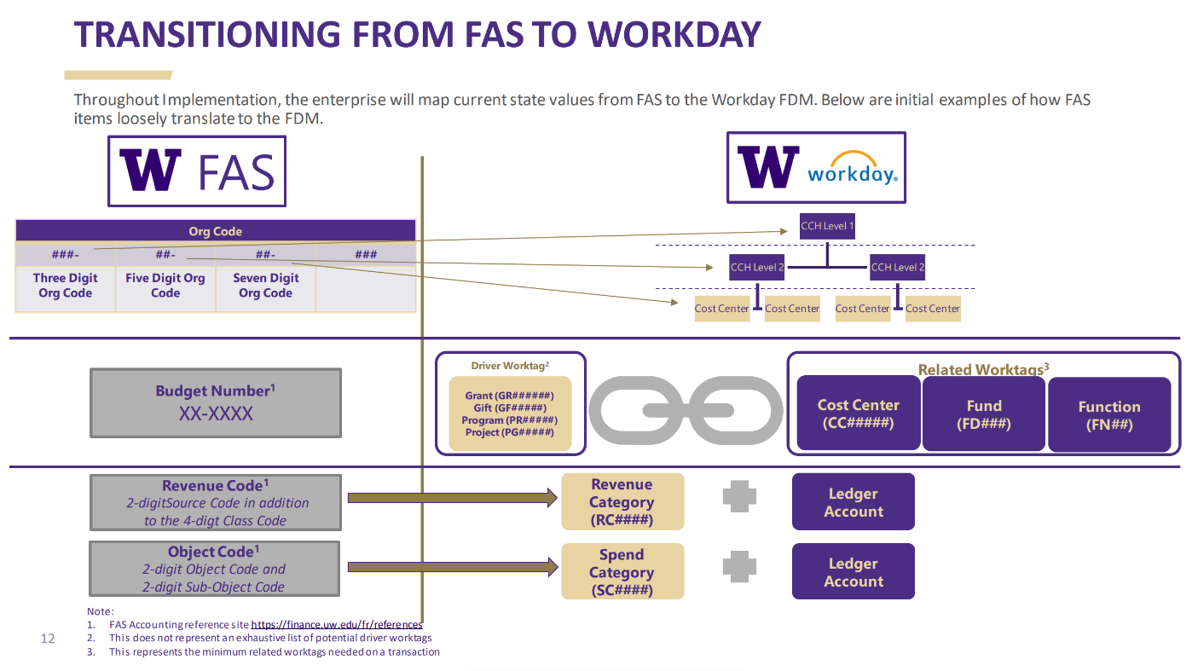
Notes:
As you know, the UW Finance Transformation represents a complete overhaul of the University’s finance system.
[CLICK for Fly-in] Under our current system we use a budget #.
[CLICK for Fly-in] After Workday is implemented, the terminology used will be “worktags”. For most industry trials, that will take the form of a driver Worktag called a Grant worktag. It will have a GR prefix with a 6 digit #.
[CLICK for Fly-in] Driver worktags will auto-populate these three related fields. Researchers who don’t have a driver worktag can alternatively provide these 3 separate pieces of information. For example, a department might provide these if a study-specific driver worktag has not yet been established.

Slide 45
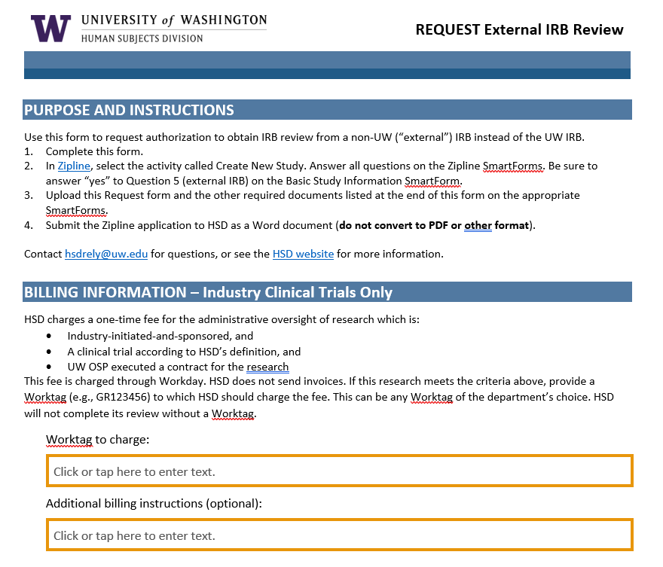
Notes:
We will be updating our Request External IRB Review form with a new section to collect this information [CLICK for Fly-in].
Remember, this is only required for industry-initiated and sponsored clinical trials where the UW OSP negotiated the contract. All other requests for authorization don’t come with a fee so billing information does not need to be provided.

Slide 46
What researchers need to do
Scenario 1 – Researcher has fully executed agreement and OSP has submitted a Funding Action (FA) in SAGE by June 9, 2023. Researcher has or will submit request for HSD authorization prior to July 1, 2023.
  ACTION – None. GCA will process the HSD administrative fee ($1500) per current state.
Scenario 2 – Researcher anticipates executed agreement after June 9, 2023, but will submit application in Zipline for HSD Authorization prior to July 1, 2023.
  ACTION – Ensure you have a study worktag by August 1, 2023. HSD will follow-up directly with individual investigators to request this worktag and charge the HSD administrative fee ($1500) in the new UW finance system (sometime in August 2023).
Notes:
So, what should researchers being doing in preparation for these changes? It depends on their circumstances but there are 3 main situations researchers are likely to find themselves in: [REVIEW Slide]

Slide 47
What researchers need to do
Scenario 3 – Researcher anticipates executed agreement after June 9, 2023, and will submit for HSD Authorization in Zipline on or after July 1, 2023.
  ACTION – Ensure you have an advanced budget # request submitted under the current system by June 13, 2023 (preferably by May 31st). This will be converted over to the appropriate study worktag with WorkDay go-live (on or after July 6th). Provide the worktag # to HSD so that the new fee rate ($1933.70) may be charged.
  NOTE – HSD Authorization will not be granted until a worktag is provided. However, HSD will begin the review process.
Notes:
[REVIEW Slide]
This is the scenario where we need your help the most in getting word out to researchers about the importance of obtaining an advanced budget #. [CLICK for Fly-in]. If researchers don’t have an advanced budget request submitted in our current system by June 13th at the latest (preferably May 31st) they will have to wait until UW FT goes live on July 6th to submit a request. It’s possible this could take awhile to obtain (weeks or longer), delaying the ability of the researcher to get HSD authorization and external IRB approval.
Alternatively, they could provide a department worktag (e.g., cost center, fund and function #) from the department but this creates extra work for department administrators who will later have to transfer funds back onto that cost center once the study grant worktag is established.

Slide 48


Slide 49
Fixed Price Surplus Budgets Conversion Process
MRAM
May 2023
Vince Gonzalez, Associate Director
Grant & Contract Accounting

Slide 50
FPS Budgets: Current State
Current State
  Fixed Price Surplus (FPS) budgets are set up when the University is allowed to retain an unspent balance after an award is closed.
  They are identified by their FAS Budget Type/Class of 05/34.
  At closeout, GCA transfers the total unspent balance to the FPS budget with an F&A rate that most closely aligns with the F&A rate of the award being closed.
MRAM – Vince Gonzalez – Grant & Contract Accounting

Slide 51
Converting FPS to Workday Finance
All Fixed Price Surplus (FPS) budgets that are in status 1 or 3 will be converted to a residual balance worktag with a 0% F&A rate.
MRAM – Vince Gonzalez – Grant & Contract Accounting

Slide 52
FPS Conversion Scenarios
  1. If your unit has already mapped your FPS budgets in the UWFT Budget to Worktag Mapping Workbook, the conversion will follow the values that you have mapped.
  2. If your unit has not mapped your FPS budgets, the deadline to complete the mapping is May 31, 2023. Please reference the FDM Change Request process of the Foundational Data Model to complete.
  3. If your unit has not mapped your FPS budgets and does not complete the mapping by May 31, 2023, the budget will convert with the Cost Center already mapped in the UWFT Budget to Worktag Mapping Workbook.
MRAM – Vince Gonzalez – Grant & Contract Accounting

Slide 53
After Workday Finance Go-Live
Future State
  If multiple residual balance worktags exist per unit, GCA will reach out to the unit to determine where the balance should be transferred at time of closeout.
  Recommendation – Consolidate to One Worktag: We recommend that units with multiple residual balance worktags consider consolidating them into one worktag, which will:
    Reduce administrative burden within the unit
    Streamline the award closeout process
MRAM – Vince Gonzalez – Grant & Contract Accounting

Slide 54
Resources
GCA Fixed Price Surplus Webpage - Current State
UWFT Budget to Worktag Mapping Workbook
FDM Change Request Process - Foundational Data Model
MRAM – Vince Gonzalez – Grant & Contract Accounting

Slide 55
Questions
Please contact Vince Gonzalez at vinceg@uw.edu
MRAM – Vince Gonzalez – Grant & Contract Accounting

Slide 56



Updates
Upcoming Classes
May 18 SAGE Budget
May 23 Compliance Case Studies: Financial Conflict of Interest, Export Controls, and Research Integrity
June 13 SAGE Budget
FT and the CORE certificate
    Some required classes on hold for a few months until updates clarified
    Some required and elective classes may be retired
Changes coming to the certificate 2024
CORE Registration
https://uwresearch.gosignmeup.com/public/course/browse
CORE Home https://www.washington.edu/research/training/core/

Slide 57



Certificate in Research Administration Program Graduates
Notes:
Today let’s give a shout out to these who have taken advantage of learning available to them by completing the CORE Certificate in Research Administration!
Let’s give a shout out to some of our most recent graduates and give them a hand!

Slide 58
Lauren M. Wood
Compliance Analyst
Office of Sponsored Programs
Office of Research
Congratulations!

Slide 59
Reminder -
BONUS UWFT MRAM Sessions

Slide 60
Two Bonus UWFT Focused MRAM
9 a.m. - 10:30 a.m., May 19 and June 16
Webinar link will be unique to those two sessions.
Stay tuned for email invitation with links & agendas

