Slide 1
CHANGES COMING TO MYRESEARCH AND RAD
May 19, 2023
Tom Watson
Office of Research Information Services
Notes:
If you have questions feel free to bring them up and there will also be time at the end.

Slide 2
MYRESEARCH | KEY CHANGES
Key Changes
  MyResearch is not being retired; however,
    Funding Status - Award data will be stale as of finance freeze EOD 6/15
    Any additional impacts will be identified in June
  Award status will be available in SAGE
Key Dates
  Now - EOD June 15: MyResearch functions as normal
  Mid-June: MyResearch banner with stale data reminder
  Beginning EOD June 15: Funding Status data remains accessible but stale
  July 5 at 5:35 p.m. - July 6: SAGE unavailable
  July 7 at 6 a.m.: SAGE back online with award status available in SAGE
Notes:
Funding Status award data will be available in the new SAGE Award View to help centralize campus and central office views of information

Slide 3
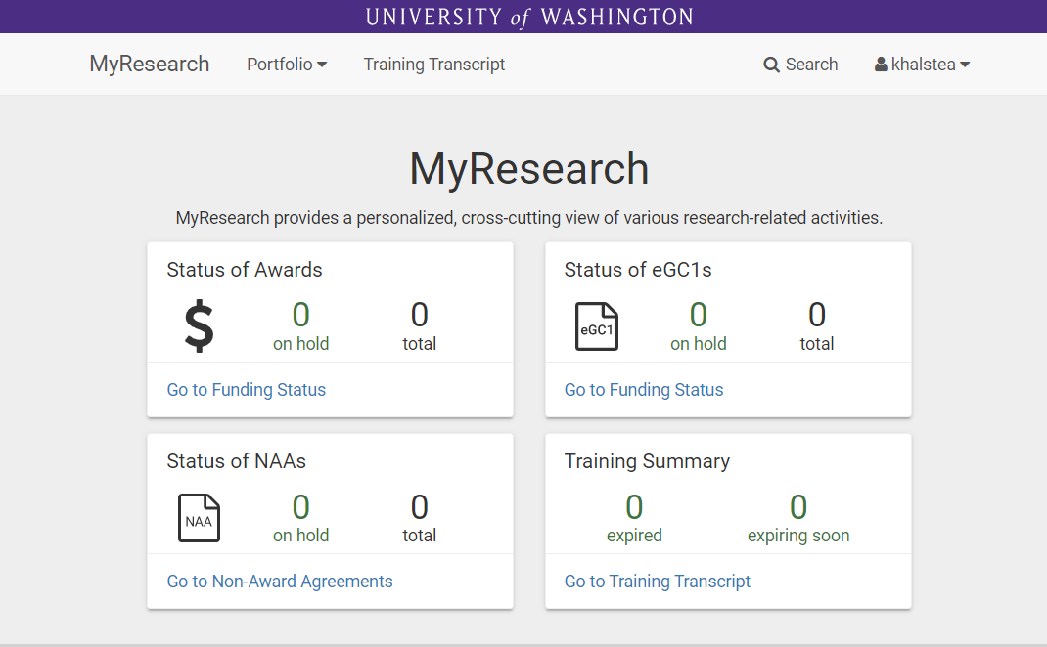
MYRESEARCH | HOMEPAGE
Banner this summer with stale data reminder
Stale award data as of EOD 6/15
Data remains up to date (pending more info coming in June)

Slide 4
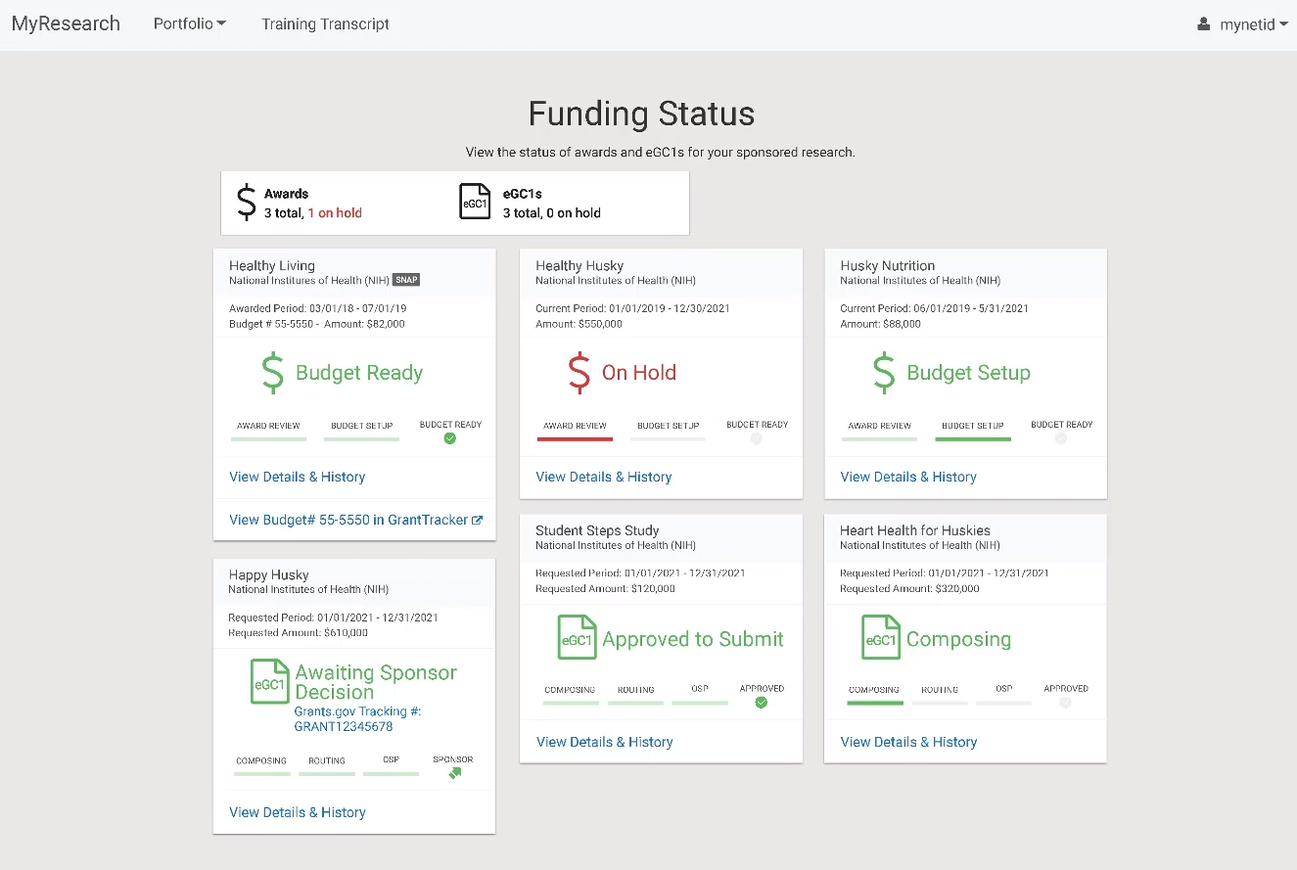
MYRESEARCH | FUNDING STATUS
> Stale award data
as of EOD 6/15

Slide 5
RESEARCH (RAD) REPORTS & DATA

Slide 6
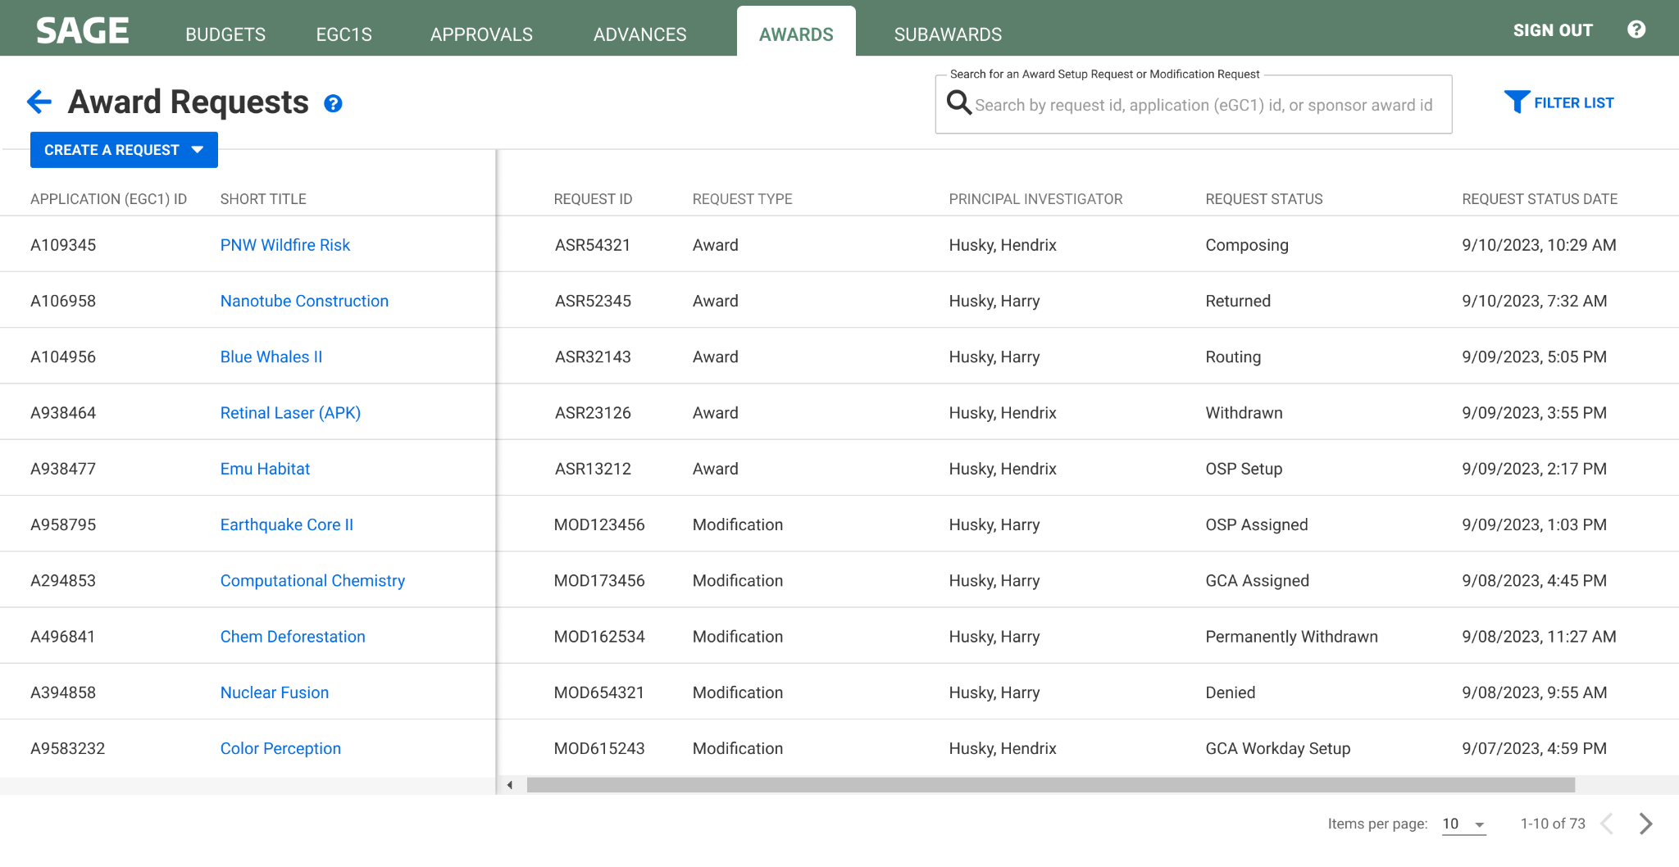
MYRESEARCH | REQUEST STATUS IN SAGE AWARDS
Provides award status information

Slide 7
RESEARCH (RAD) REPORTS | KEY CHANGES
Key Changes
  Beginning EOD June 15, with the finance transaction freeze, award data will become stale in all RAD-based reporting solutions. This includes:
    BI Portal assets, RAD Cube, and various reports and visualizations
  Following cutover on July 6, all existing RAD-based reporting solutions will be frozen
    Data will remain available for historical reporting
  Until new RAD 2.0-based reporting solutions are available, we encourage you to request data from grantrpt@uw.edu until further notice.
    ORIS is planning for your reporting needs!

Slide 8
RESEARCH (RAD) REPORTS | CHANGE BENEFITS
Improved Self Service:
New RAD 2.0 will include new Workday and SAGE Award data
The Research Integration Platform (RIP) data store will be available, including SAGE proposal and award data
Catalog of data will eventually be available through RIP data store

Slide 9
RESEARCH (RAD) REPORTS | TIMELINE
Now - EOD June 15: RAD-based reports accessible via BI Portal as usual
EOD June 15 - July 5: FIN (Award) data is frozen; existing RAD reports are accessible but historical
  Data for NAAs, eGC1s, and Subawards will remain up-to-date, pending more information in June
July 6 - TBD: Until new RAD 2.0 based reporting solutions are available, we encourage you to request data from grantrpt@uw.edu until further notice

Slide 10
RESOURCES & SUPPORT
ORIS is planning to support you during this transition!
Research (RAD) Data Requests: Starting July 6, request data via grantrpt@uw.edu until further notice
Reminders & More Information:
  Subscribe to the MRAM mailing list where we will share the latest on MyResearch and RAD (keep a look out for our Research Community Guide to UWFT newsletter)
  System banners in MyResearch and the BI Portal this summer
Courses & Training
  Updates to MyResearch and RAD courses and training materials will be shared via MRAM as materials are developed

Slide 11
THANK YOU!
Notes:
If you have questions feel free to bring them up and there will also be time at the end.

