Slide 1

SAGE Budget - Clinical Trials
Do I Need a SAGE Budget?
MRAM
May 19, 2023
Carol Rhodes, Office of Sponsored Programs

Slide 2
CTO Budget Approval Scope
Interventional trials or observational studies, where:
  Services, items, or tests are provided by a hospital facility (UWMC, HMC, or FHCC) that bills through Epic; OR
  Services, items, or tests are furnished by a provider who bills through UW Physicians regardless of the site of practice; AND
  Funding is provided to UW via fixed-price contract
Additionally:
  After 31 May 2023, all of these studies will generate sponsor invoices directly in OnCore CTMS
  OnCore will integrate with Workday starting 6 July 2023

Slide 3
Future State - Workday Finance Go-Live
SAGE Budget required on all Award Setup Requests
Use SAGE Budget for all Award Setup Requests, including budgets reviewed by CTO
For study budgets that will run through CTO review and Oncore billing
  Enter minimum information only in a single SAGE budget worksheet with $0 amount
This will help with Award Line and Award period setup in Workday Finance

Slide 4
SAGE Budget Entry for CTO Budgets
What is the minimum information?
Budget Settings
Budget Title
Budget Start Date
Total number of periods (defaults to 1)
Worksheet Settings
Create a single SAGE budget worksheet
Primary Worksheet Title
Cost Center
Activity Location
Sponsored Program Activity Category
Sponsored Program Activity Type
Base Type
Budget Entry
Add a Principal Investigator in personnel section for each worksheet, PI salary=$0
  only one worksheet is needed for CTO budgets
No other line item entry required in the budget
Notes:
JC notes if helpful:
It was originally conceived that CTO would be exempt from using SAGE Budget. In order to collect all of the line and period setup necessary for basic Workday awards for CTO, and given time constraints as we approach go-live, it was determined that pivoting to a SAGE Budget requirement for all ASRs would be the most stable approach going into 1st release. After go live, and with input from CTO budget preparers, we will re-asses whether an exemption would still be beneficial in the future or if data collection through SAGE Budget is acceptable. (Note that the fields of information needed are the same, regardless of whether SAGE Budget is used or an alternate approach to collecting the data).

Slide 5
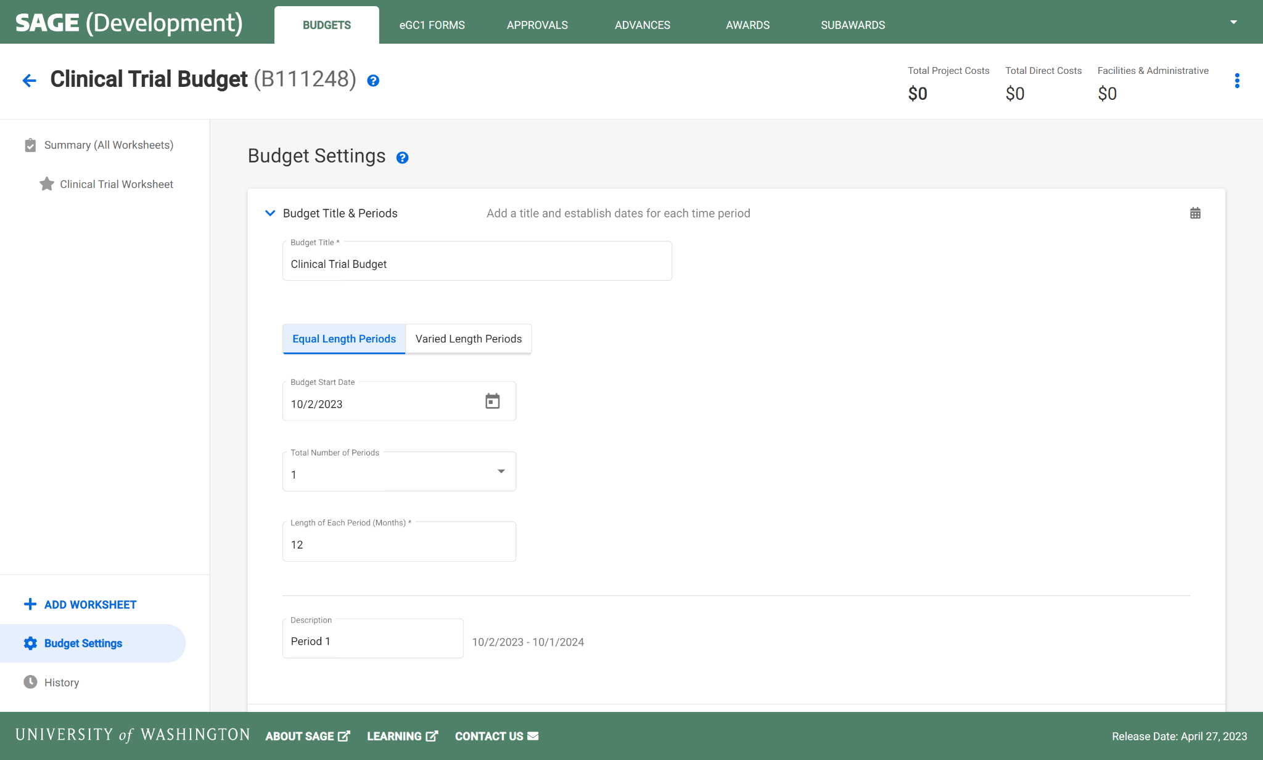
CLINICAL TRIALS | BUDGET SETTINGS
Budget Title
> Dotted fields are required for a Clinical Trials SAGE Budget
Budget Start Date
Total Number of Periods
Notes:
Naming conventions are in development.

Slide 6
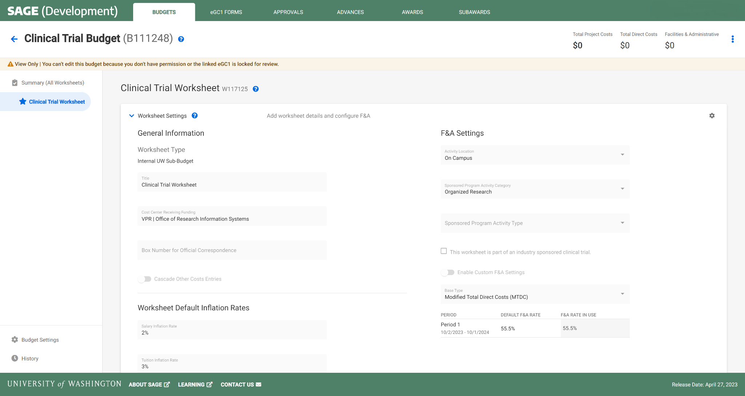
CLINICAL TRIALS | WORKSHEET SETTINGS
1 Worksheet
Activity Location
Primary Worksheet Title
SPA Activity Category
Cost Center
SPA Activity Type
Base Type
Notes:
Naming conventions are in development.

Slide 7
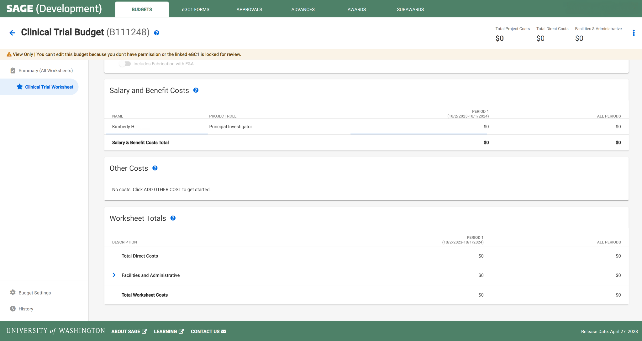
CLINICAL TRIALS | BUDGET ENTRY
1 PI per Worksheet
Leave default of $0 amount salary
No other line item entry required
Notes:
Each worksheet will need one row of personnel at minimum who is assigned as PI.

Slide 8
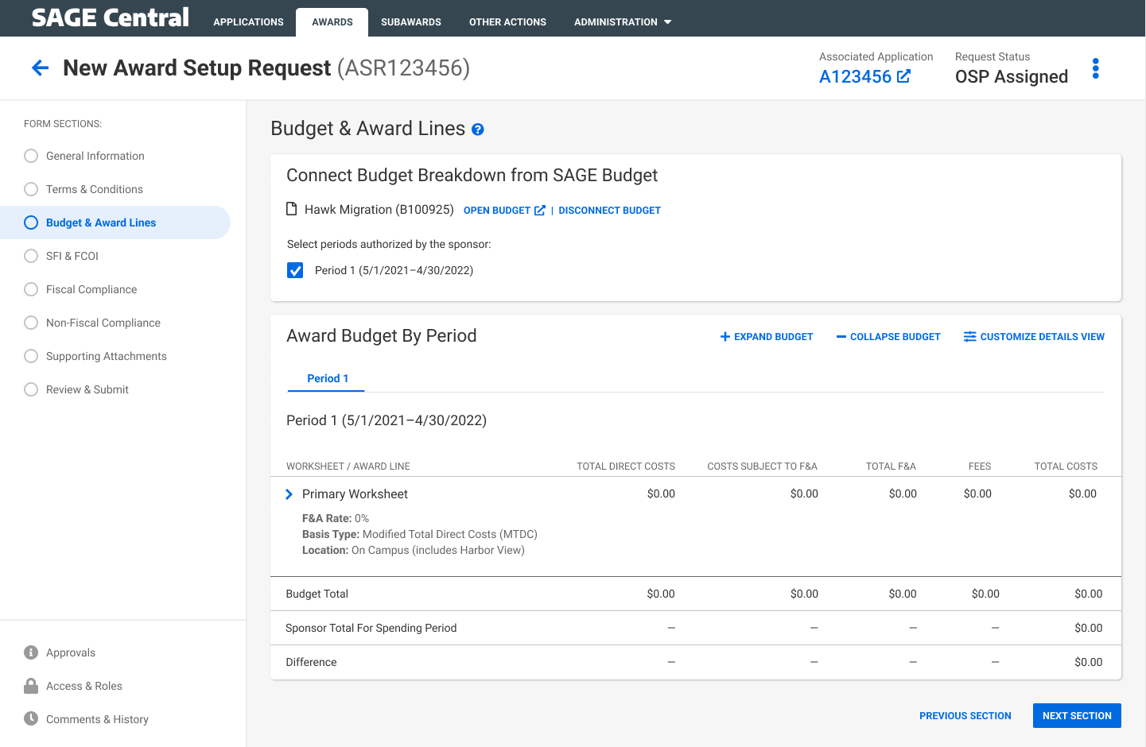
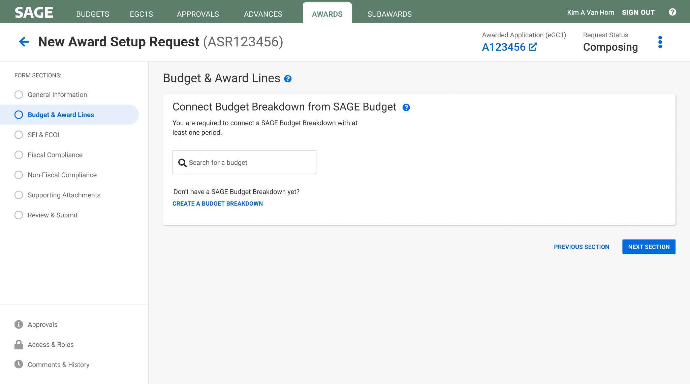
CLINICAL TRIALS AWARD SETUP | CREATE & LINK BUDGET
Select Period 1
Automatic display of budget setup flowing to the award request

Slide 9
SETTING UP MULTI-YEAR BUDGETS
Functionality:
In the Award Setup Request, the periods selected will be used to create the award schedule periods in Workday.
SAGE will send the first start date and last end date of the selected periods as the Workday Award Line Start and End dates.
SAGE will be able to handle Campus units entering multiple periods, or one long period in SAGE Budget for all scenarios.
Notes:
Often you may not know how many periods a clinical trial will last, so you can choose 5 years in order to prevent having to repeatedly request extensions.

Slide 10
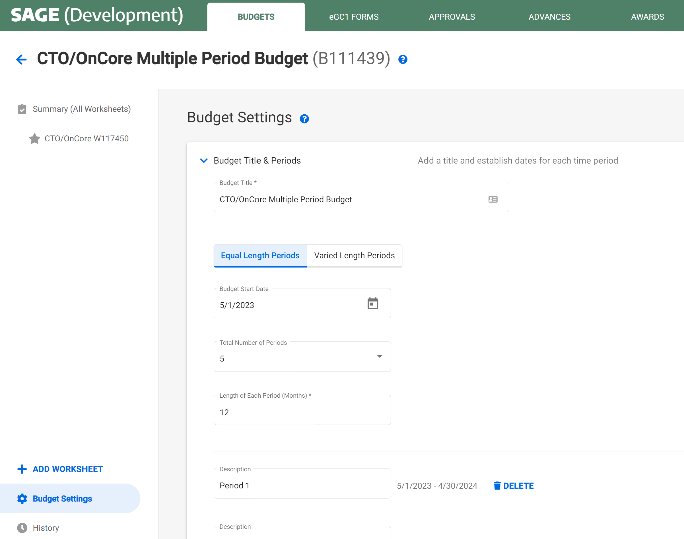
EXAMPLE 1:
MULTI-YEAR BUDGET | MULTIPLE PERIODS
Select any number of periods
Notes:
From the dropdown, users can select 1-10 periods, or custom (any amount)

Slide 11
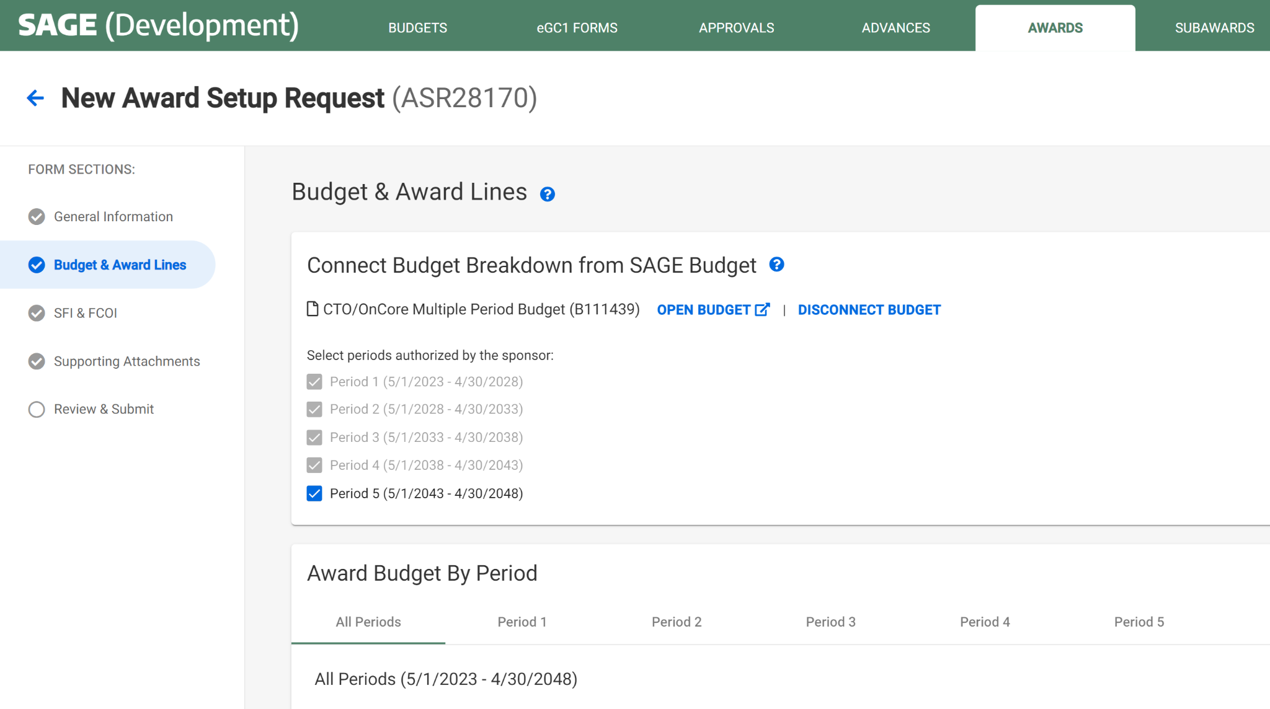
EXAMPLE 1:
MULTIPLE PERIODS | AWARD SETUP REQUEST
Selected periods become award schedule periods
Start and end date will be used for the award line start and end date in Workday

Slide 12
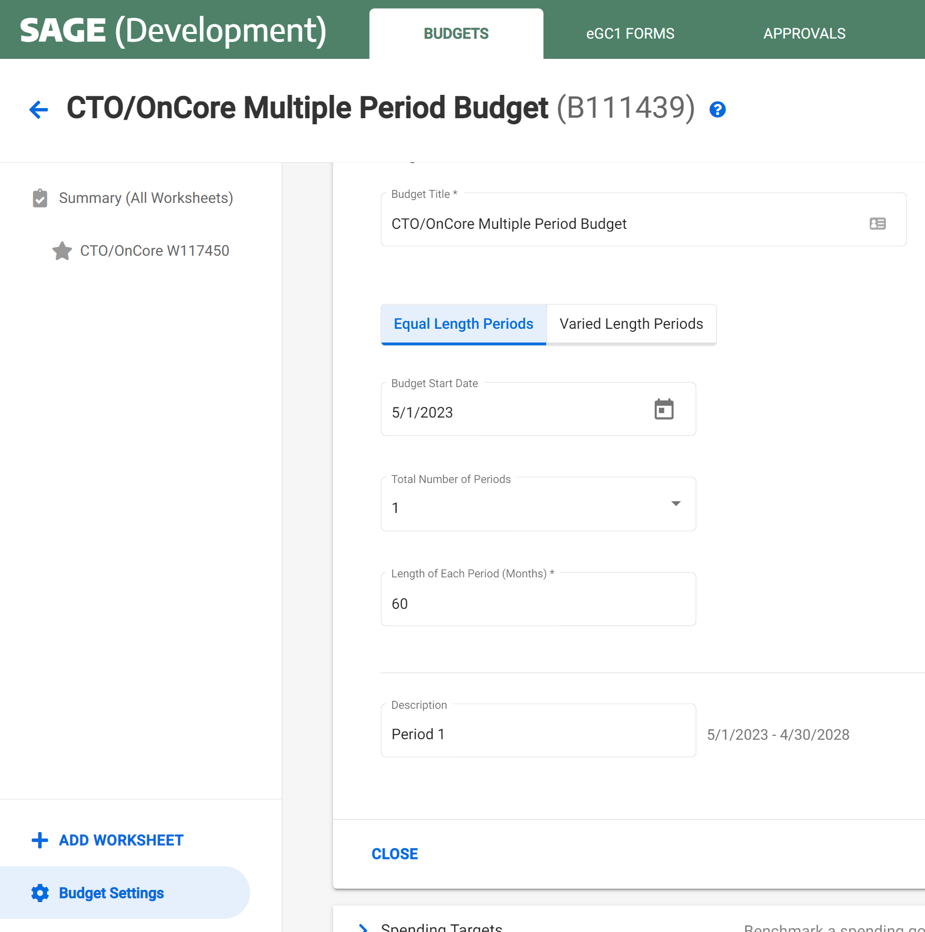
EXAMPLE 2:
SINGLE PERIOD BUDGET | 60 MONTH (5 YRS)
Select 1 period with any length (in months)

Slide 13
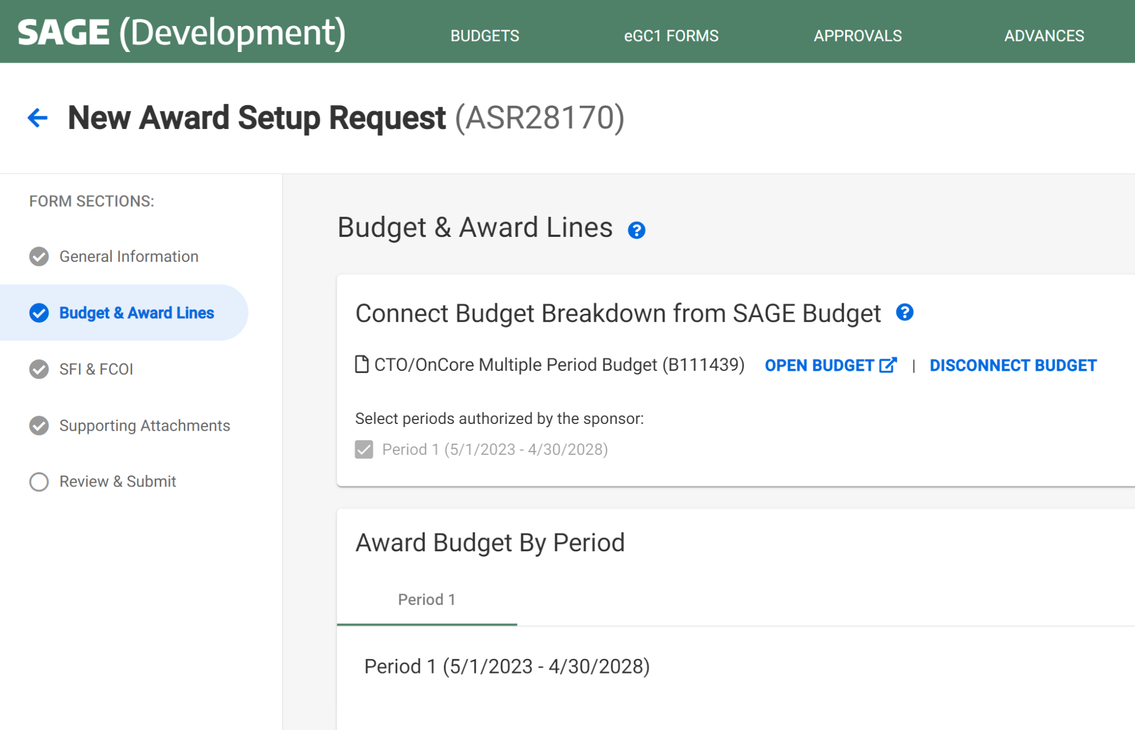
EXAMPLE 2:
60 MONTH PERIOD | AWARD SETUP REQUEST
Selected periods become award schedule periods
Start and end date will be used for the award line start and end date in Workday

Slide 14
Notes on SAGE Budget Requirement
Allows necessary integration/mapping to Workday.
Setting up SAGE Budgets with basic information with $0 should take only a few minutes.
GCA will know budget detail is not needed & they will not handle invoicing.
If there are other SAGE Budget requirements we will let you know as soon as possible.

Slide 15
How will correct Award Worktag correspond with the study billing in Oncore?
Existing studies:
Clinical Trial Management System (CTMS) team will receive the new grant worktags for converted budget numbers and will update OnCore.
New studies after go-live:
Study teams provide a worktag either with the study intake form or update directly in OnCore at any point during start-up.
CTO will not open the study until the number is in OnCore.
Questions? contact uwcto@uw.edu
Notes:
The OnCore billing system for Clinical Trials wil integrate with WD Finance with go-live.

Slide 16
Resources
CTO questions? contact uwcto@uw.edu
SAGE Budget Classes
  Thursday, May 18, 1-3 p.m.
  Thursday, June 13, 1-3 p.m.
Drop-in SAGE Office Hours
  Twice a month, every other Thursday. All dates/Zoom links on UWFT for the Research Community webpage
UWFT for the Research Community Webpage
  Important dates, information, and training resources!
Questions about SAGE Budget?
  Contact sagehelp@uw.edu

