Slide 1
HSD ADMINISTRATIVE FEE CHANGES FOR INDUSTRY SPONSORED & INITIATED CLINICAL TRIALS
Jason Malone, Director, UW Human Subjects Division
MRAM
May 11, 2023

Slide 2
Industry Clinical Trial Fee – Current Process
The fee amount. HSD currently charges a one-time $1500 administrative fee for fulfilling mandatory regulatory and administrative responsibilities for industry-sponsored-and-initiated clinical trials reviewed by a non-UW IRB where the contract has been negotiated by UW’s Office of Sponsored Programs (OSP).
This fee is charged because this type of research has an indirect cost rate that does not cover HSD’s costs for these activities. It is common for universities and research institutes to charge these fees for industry research.
The billing process. The billing of the fee to the study budget is currently handled by UW Grant & Contract Accounting (GCA). HSD has no role in billing the fee.
The charge for this expense is posted by GCA when the fully executed agreement is set up and will be notated as "TFR TO 14-0106" in MyFD under object code 03-49.
Notes:
[REVIEW Slide]

Slide 3
Industry Clinical Trials: Fee Amount
What is changing?
Why is it changing?
Beginning July 1, 2023, all new authorization requests submitted to HSD to use a non-UW IRB will be charged $1933.70.
HSD anticipates that this fee will change on an annual basis commensurate with HSD’s costs.
HSD has not reassessed its costs since 2010.
HSD completed a recent assessment through UW Management Accounting & Analysis (MAA) to establish the current cost rate for performing these activities.
Notes:
NOTE - The change in fee is based on the date of submission to HSD via Zipline, not the date HSD grants authorization. If you submit a request prior to July 1st, you will be charged the old rate of $1500.
Clinical Research Budget & Billing Support (CRBB) in the Clinical Trials Office has been provided the new rate and effective date and will use this for preparing budgets associated with industry contracts.

Slide 4
Industry Clinical Trials: Fee Billing Process
What is changing?
Why is it changing?
After June 13, 2023, GCA will no longer be involved in collecting the fee.
Instead, HSD will work with the UW Office of Research to charge the fee using a researcher-provided budget number (i.e., Worktag post UW FT).
This budget number/worktag must be provided as part of the authorization request in Zipline (beginning July 1, 2023) before HSD will authorize the study for review.
UW’s transition to Workday as part of UW’s Finance Transformation is necessitating this change.
Notes:
[REVIEW Slide]

Slide 5
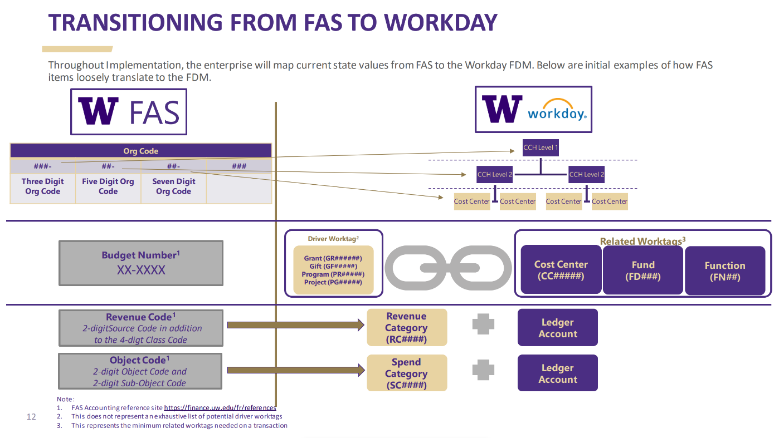
Notes:
As you know, the UW Finance Transformation represents a complete overhaul of the University’s finance system.
[CLICK for Fly-in] Under our current system we use a budget #.
[CLICK for Fly-in] After Workday is implemented, the terminology used will be “worktags”. For most industry trials, that will take the form of a driver Worktag called a Grant worktag. It will have a GR prefix with a 6 digit #.
[CLICK for Fly-in] Driver worktags will auto-populate these three related fields. Researchers who don’t have a driver worktag can alternatively provide these 3 separate pieces of information. For example, a department might provide these if a study-specific driver worktag has not yet been established.

Slide 6
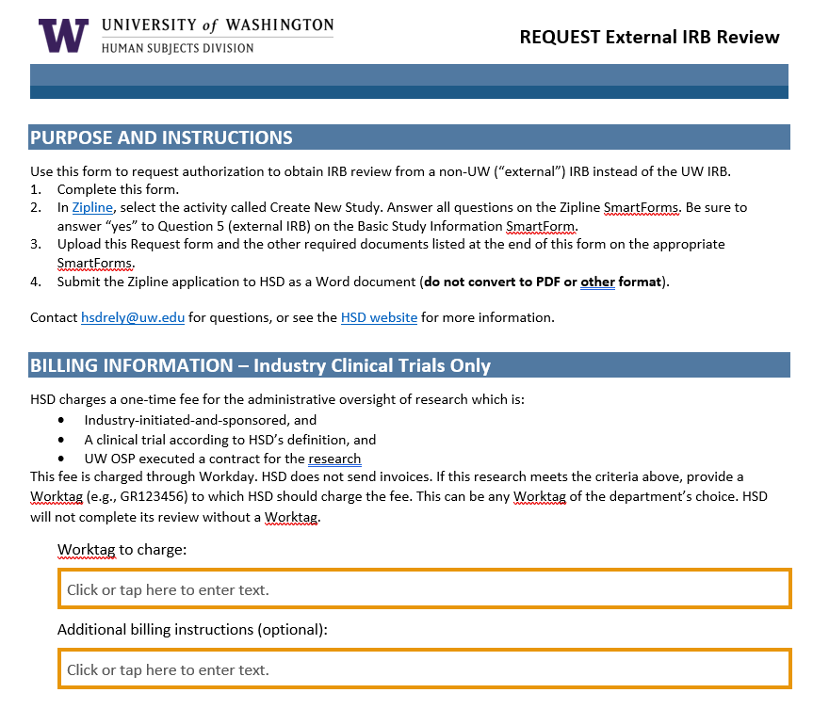
Notes:
We will be updating our Request External IRB Review form with a new section to collect this information [CLICK for Fly-in].
Remember, this is only required for industry-initiated and sponsored clinical trials where the UW OSP negotiated the contract. All other requests for authorization don’t come with a fee so billing information does not need to be provided.

Slide 7
What researchers need to do
Scenario 1 – Researcher has fully executed agreement and OSP has submitted a Funding Action (FA) in SAGE by June 9, 2023. Researcher has or will submit request for HSD authorization prior to July 1, 2023.
ACTION – None. GCA will process the HSD administrative fee ($1500) per current state.
Scenario 2 – Researcher anticipates executed agreement after June 9, 2023, but will submit application in Zipline for HSD Authorization prior to July 1, 2023.
ACTION – Ensure you have a study worktag by August 1, 2023. HSD will follow-up directly with individual investigators to request this worktag and charge the HSD administrative fee ($1500) in the new UW finance system (sometime in August 2023).
Notes:
So, what should researchers being doing in preparation for these changes? It depends on their circumstances but there are 3 main situations researchers are likely to find themselves in: [REVIEW Slide]

Slide 8
What researchers need to do
Scenario 3 – Researcher anticipates executed agreement after June 9, 2023, and will submit for HSD Authorization in Zipline on or after July 1, 2023.
ACTION – Ensure you have an advanced budget # request submitted under the current system by June 13, 2023 (preferably by May 31st). This will be converted over to the appropriate study worktag with WorkDay go-live (on or after July 6th). Provide the worktag # to HSD so that the new fee rate ($1933.70) may be charged.
NOTE – HSD Authorization will not be granted until a worktag is provided. However, HSD will begin the review process.
Notes:
[REVIEW Slide]
This is the scenario where we need your help the most in getting word out to researchers about the importance of obtaining an advanced budget #. [CLICK for Fly-in]. If researchers don’t have an advanced budget request submitted in our current system by June 13th at the latest (preferably May 31st) they will have to wait until UW FT goes live on July 6th to submit a request. It’s possible this could take awhile to obtain (weeks or longer), delaying the ability of the researcher to get HSD authorization and external IRB approval.
Alternatively, they could provide a department worktag (e.g., cost center, fund and function #) from the department but this creates extra work for department administrators who will later have to transfer funds back onto that cost center once the study grant worktag is established.

