Slide 1
SAGE TRAINING
May 19, 2023
Breona Gutschmidt
Office of Research Information Services

Slide 2
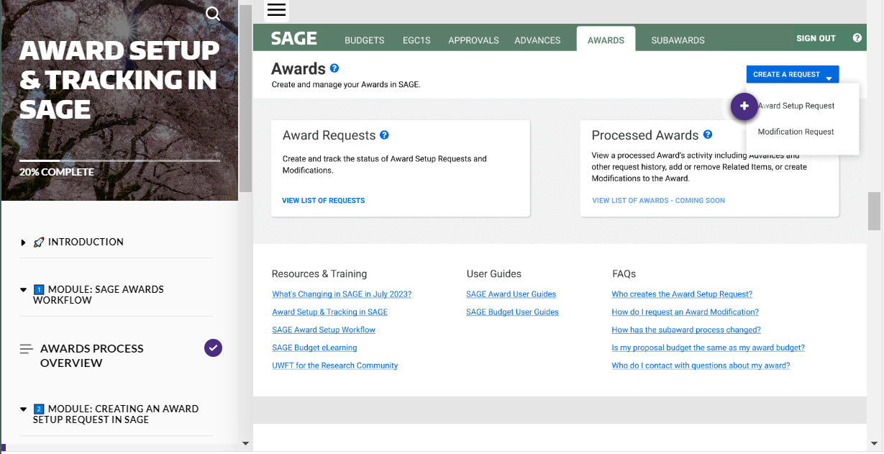
AWARD SETUP & TRACKING IN SAGE ELEARNING
New!
Provides in depth instruction on SAGE Awards usage, including:
Creating Award Setup Requests
Monitoring Award Requests
Access the eLearning

Slide 3
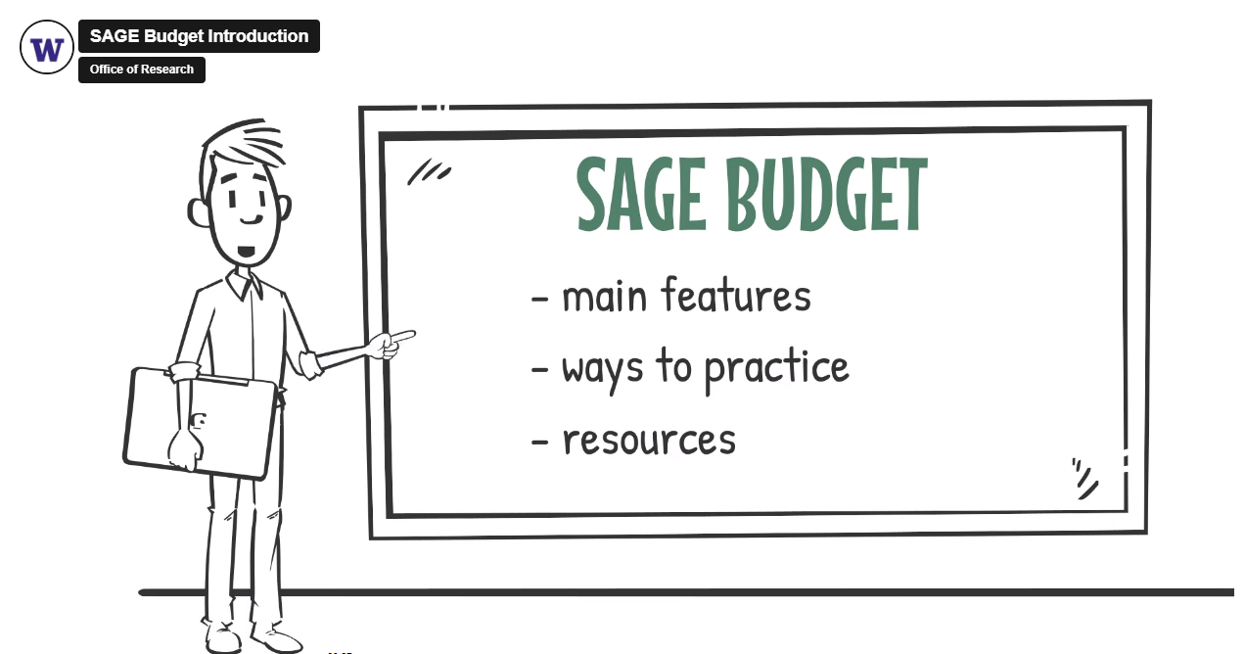
SAGE BUDGET TRAINING
Virtual Instructor-led Class
Live class with SAGE experts to walk you through each step in the Budget process
Upcoming classes:
6/13, 1 - 3 p.m.
SAGE Budget eLearning
Provides on-demand instruction in SAGE Budget when you need it

Slide 4
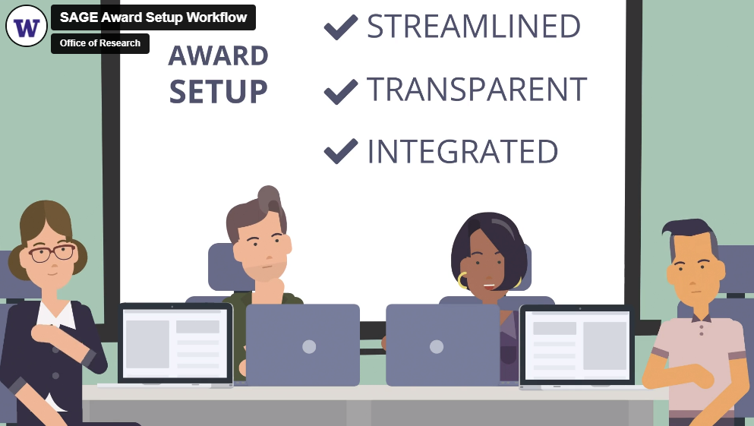
ADDITIONAL SAGE TRAINING
What’s Changing in SAGE? Video
Provides a high-level overview of changes coming to SAGE with UWFT (job aid version)
SAGE Award Setup Workflow Video
Provides an in-depth overview of the Award Setup workflow in SAGE

