Slide 1

Closer look at Future State:
When do I need an eGC1?
& Modifications
June 16, 2023 MRAM
Carol Rhodes
Office of Sponsored Programs

Slide 2
Award Modification Handling - what we used to do
Award Changes without funding were handled as Post-Award Changes (PACs).
Examples:
Change in budget (no additional funding)
Extensions
When the Award Change involved funding:
If funding above the current eGC1 amount, you’d route an eGC1 for the additional amount.
OSP would create a funding action under that eGC1.
Examples:
Supplemental funding
Amount of award exceeded the original proposed amount by 25% or more

Slide 3

Future State Award Modification Handling
After Award is established, all changes are processed via a Modification (MOD).
Some features:
  You can decide to route to OSP or to GCA only
  Ability to choose categories
  Submission button with assurance language
  Ability to add ad-hoc approvers
  and more to come…
This means adjusting eGC1 Requirements.
Notes:
Post-Award Changes (PACs) or Funding Actions (FAs) will no longer be used to reflect changes.

Slide 4
Future State eGC1 Requirements
Keeping eGC1 requirement for:
Pre-applications, Pre-proposals, Letters of Intent / Interest requiring authorized official (AO) submission/sign-off or that contain budget details.
Proposals (competing and application stage for supplemental)
Revised applications
Resubmission
Transfer from Another Institution
After-the-Fact awards:
Non-award agreements (NAAs) and NAA continuations
OSP will determine if unique situations not described require an eGC1.

Slide 5
Updates to eGC1 Requirements
These will no longer require an eGC1:
Change in scope of work (change in direction, aims, objectives, purpose)
Additional compliance requirements not in an earlier eGC1, such as animal or human subjects or cost share.
When award exceeds 25% or more of original eGC1 amount
Non-SNAP RPPRs

Slide 6
Examples to consider in our future state
Modification to change Key Personnel (MOD)
Modification awarding additional funding, even when additional funding exceeds amount on original eGC1 (MOD)
Your PI is applying for additional funding for year 3 (eGC1)
Your PI is applying for an administrative supplement (eGC1)
Your PI needs additional time added to end of project (MOD)

Slide 7
Modifications Guidance
What you need to include on MODs will be listed in Award Changes guidance (coming soon!)
Modifications will be requested according to Categories.
We are keeping forms we require, and recommended concurrence letter form:
Change of PI form
Extension form
End of Award Request form
F&A Waiver form
Concurrence letter
What about changes you used to process via TRANSPASU?
Those will be handled as MODs as well! They will go straight to GCA and bypass OSP.

Slide 8

We will have smooth sailing soon!

Slide 9
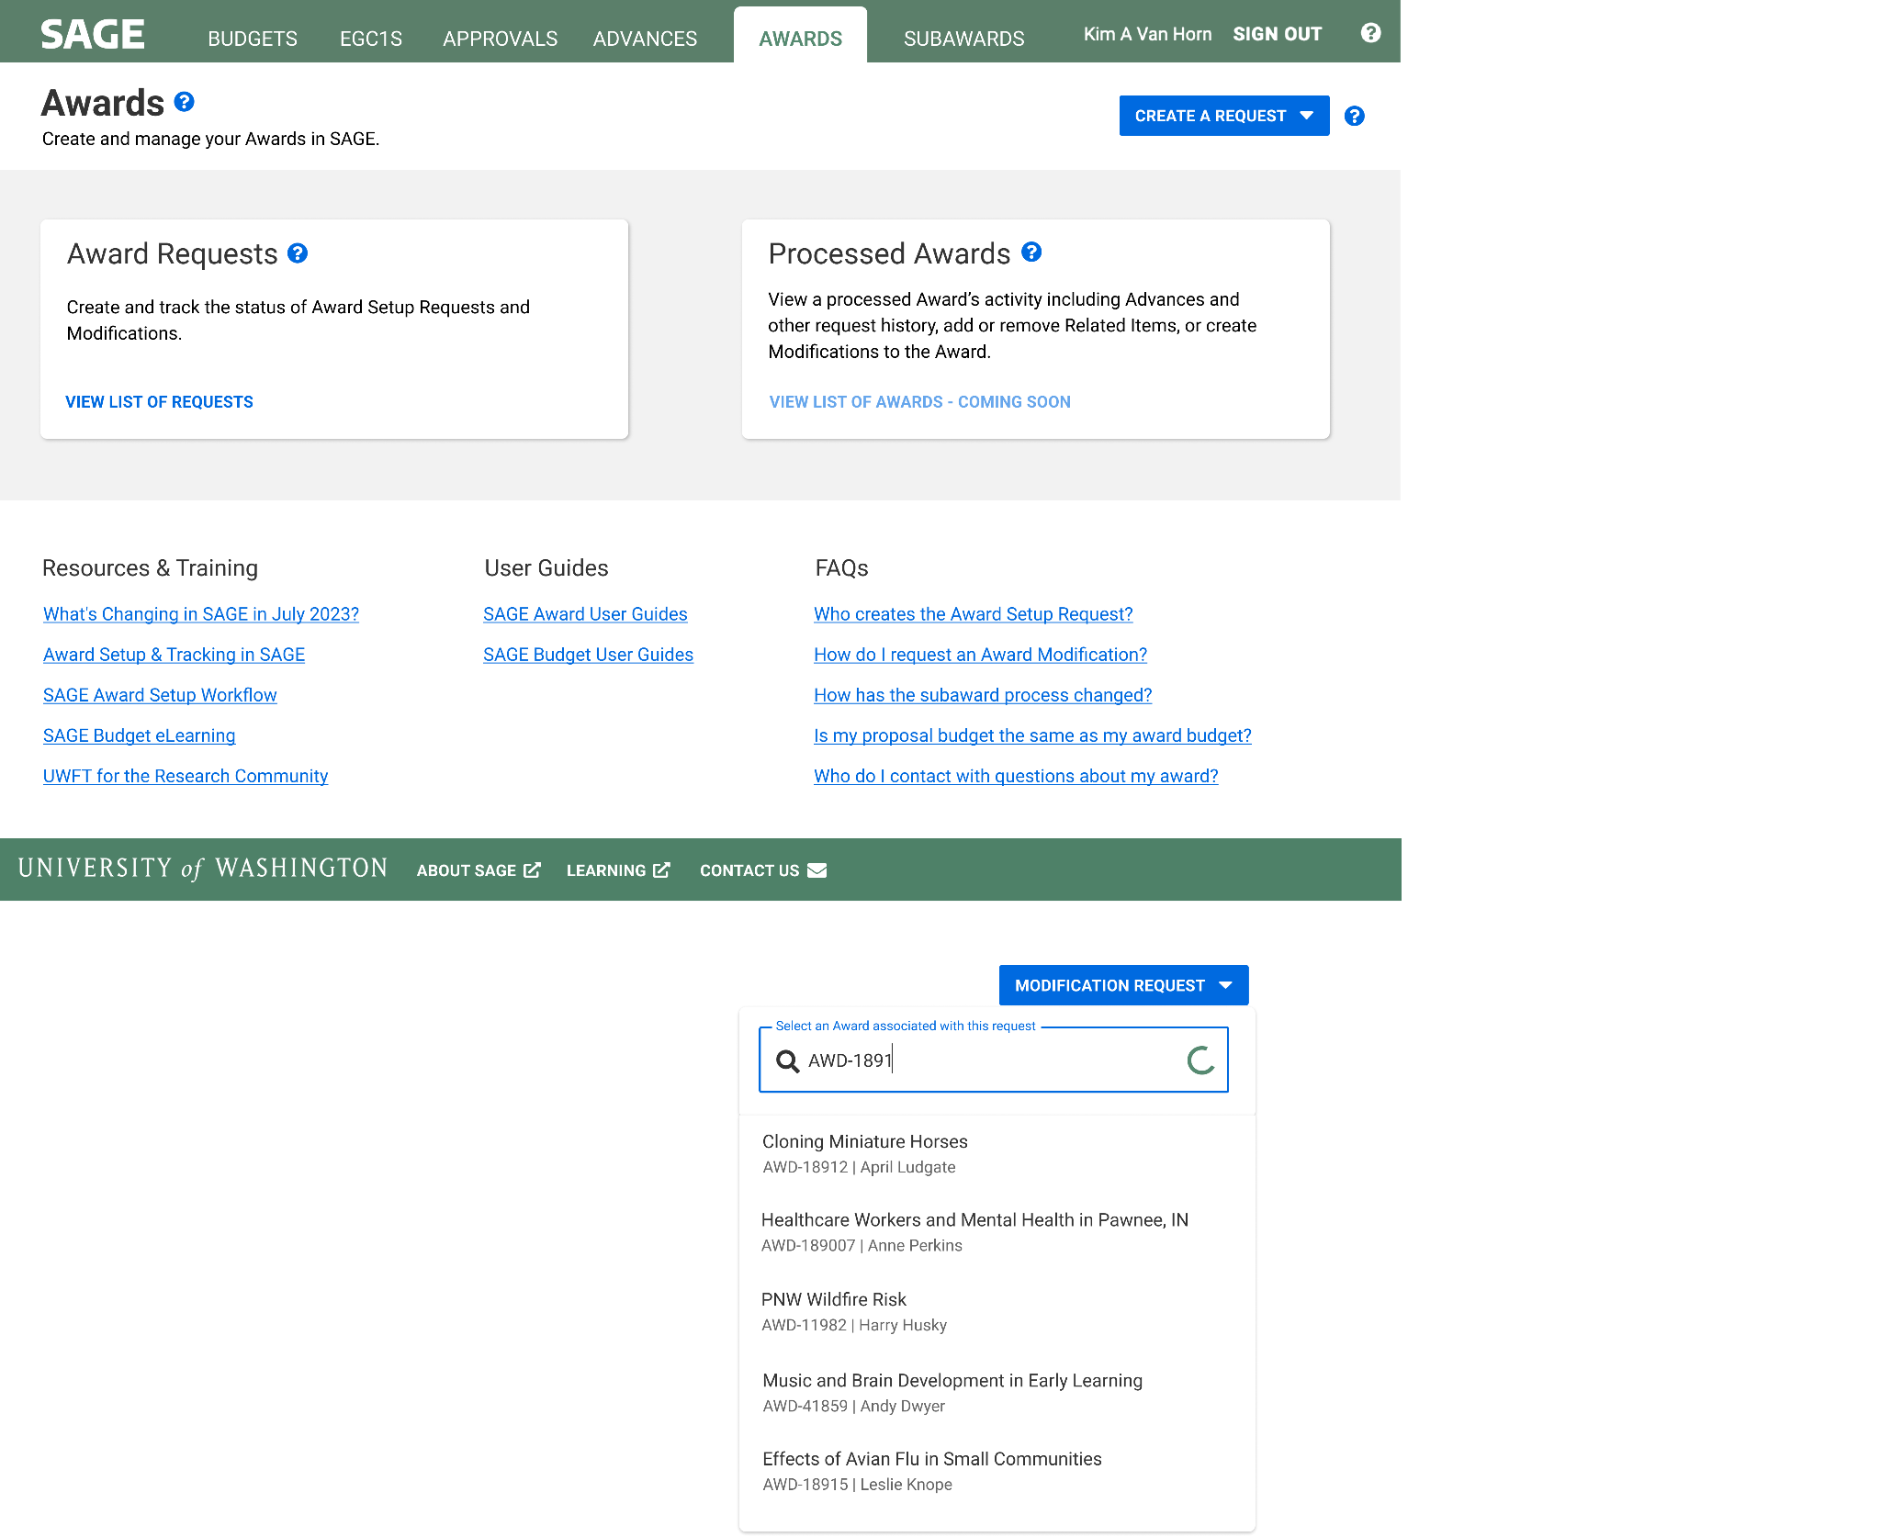
How to Create an Award Modification
Create an Award Modification
Help icon links to guidance on selecting the correct modification type

Slide 10
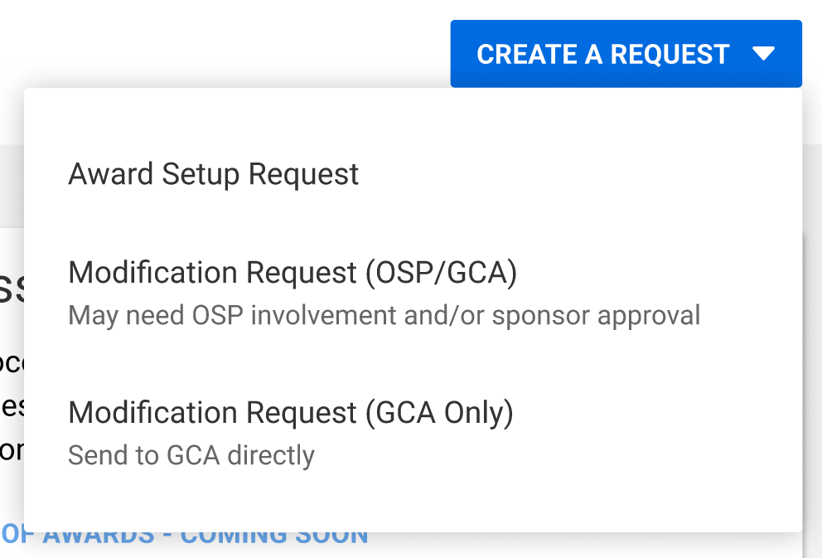
How to Create an Award Modification:
Select Modification Request & offices involved
Select Modification Request and offices that need to be involved
Notes:
if Campus selects the one Mod Request (i.e. they choose it to be only reviewed by GCA, when it has to be reviewed by both teams) then GCA will send it back to Campus and they'll need to delete this Mod request and start over.

Slide 11
How to Create an Award Modification:
Search for award
Search for award that requires modification
Notes:
Searching by Award ID is confirmed for R1. The team is unsure if they'll be able to get searching by PI or Short Title in by R1.

Slide 12
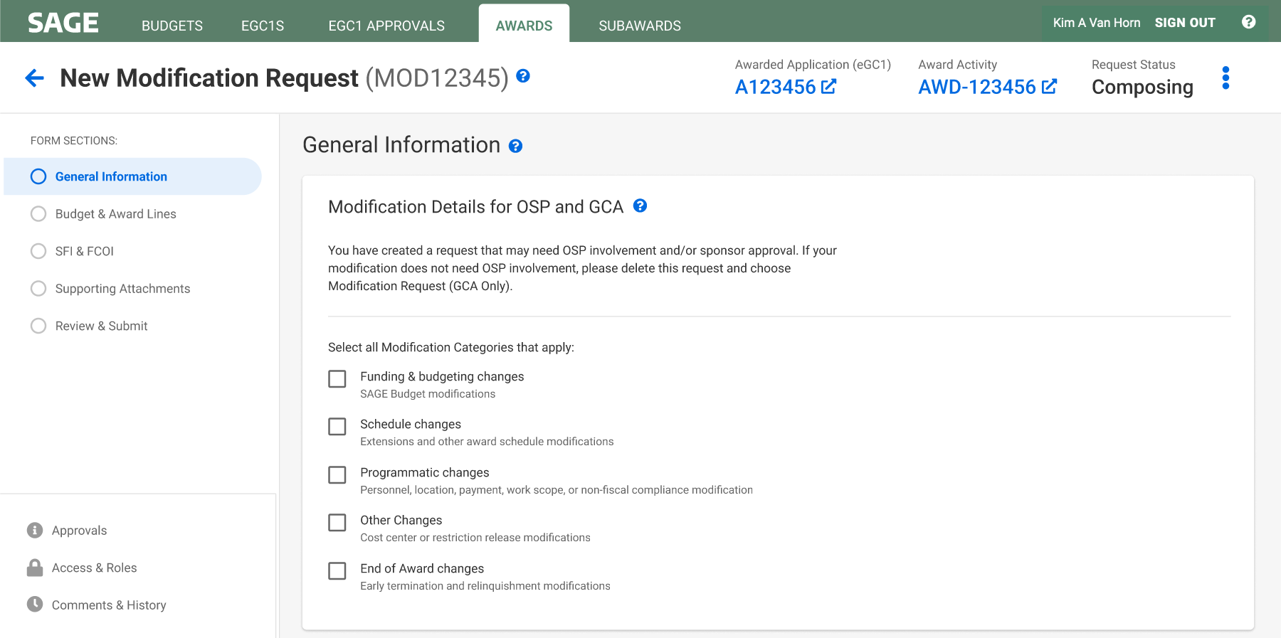
How to Create an Award Modification:
Select categories
Select all modification categories that apply

Slide 13
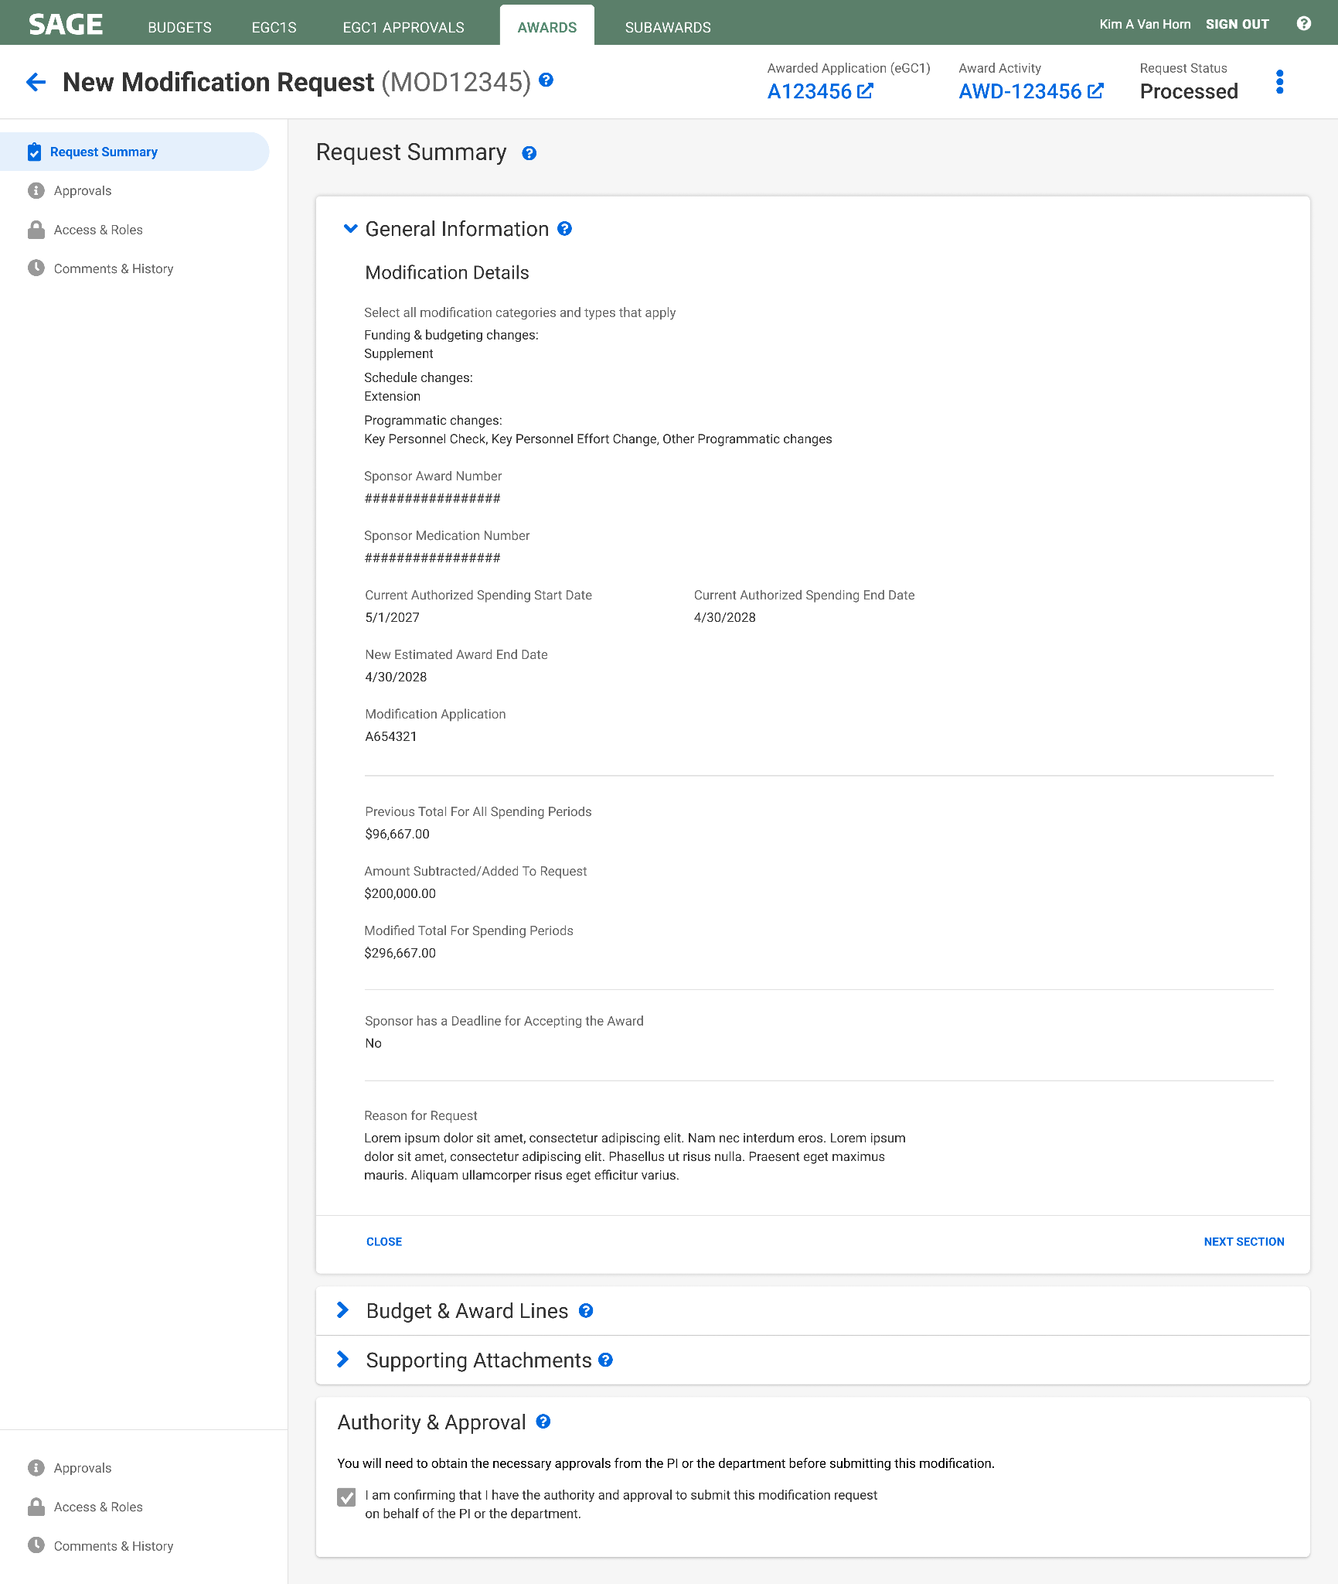
How to Create an Award Modification:
Review request summary
Review your Modification request summary
Screenshot 1 of 2. Image continues on next slide.

Slide 14
How to Create an Award Modification:
Review authority & approval statement
Review the authority & approval statement
Screenshot 2 of 2.

Slide 15
Resources
When will I need to route an eGC1 vs. create a Modification Request?
More details and instructions will be published as we get closer to launch in early July on our Award Changes web page - Stay tuned!

Slide 16
Questions?

