Slide 1
Agreements
June, 2023 MRAM
Jennifer Lopez
Office of Sponsored Programs

Slide 2
Contracts Team
Assistant Director:
Jennifer Lopez
Senior Contracts Specialist Lead:
Elizabeth Walker-Tilley
Senior Contracts Specialists:
Autumn Eck, Vali Gazula, Vanessa Mendoza, Karl Neumann, Rebecca Parisi, Hogan Ricks, Claire Stamm
Contracts Specialists:
Dahra Latham, Jerri McKellar, Michelle Monroe

Slide 3
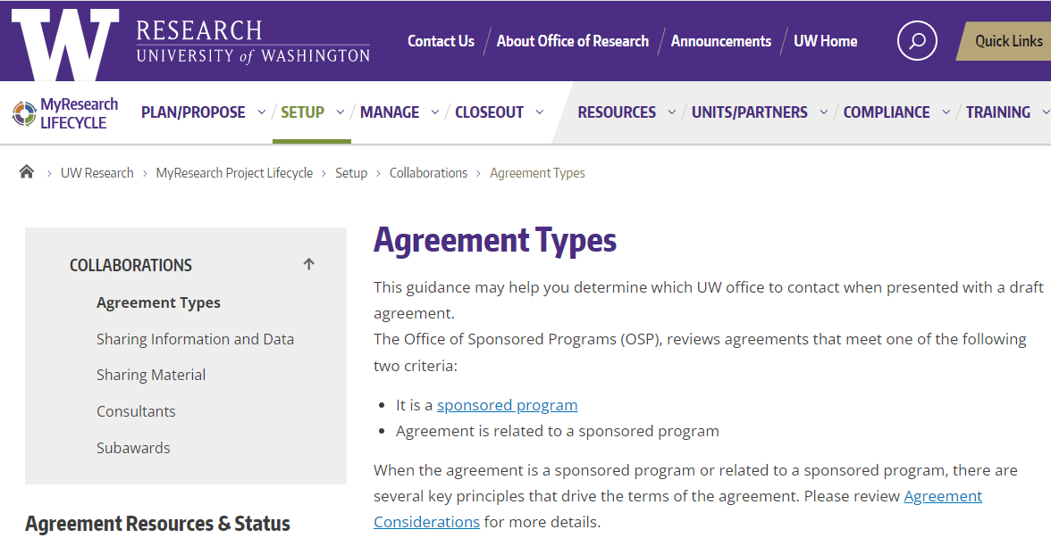
Web Updates
Refreshed Agreement Types
https://www.washington.edu/research/myresearch-lifecycle/setup/collaborations/agreement-types/
Notes:
Updated descriptions, more agreement type information & a new decision tree tool
https://www.washington.edu/research/myresearch-lifecycle/setup/collaborations/agreement-types/

Slide 4
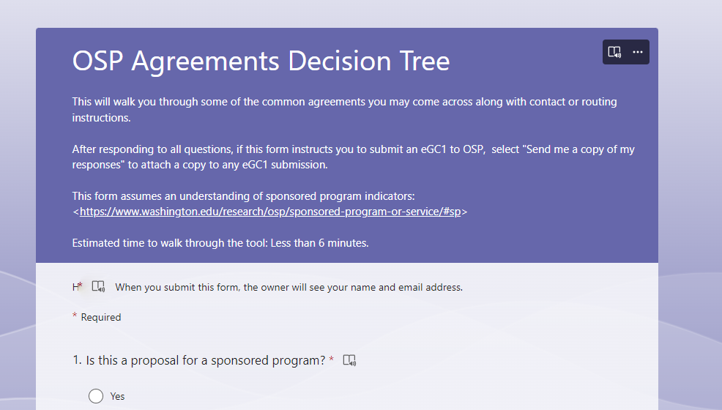
New Agreements Decision Tree
https://forms.office.com/r/3tGMiuTKG0
Notes:
https://forms.office.com/r/3tGMiuTKG0

Slide 5
Questions

