Slide 1
Updates
FT and the CORE certificate
Some required classes on hold for a few months until updates clarified
Some required and elective classes may be retired
Courses will be pulled effective July 6, registration no longer available
Completing courses prior to July 6 still encouraged
Go to the Curriculum Guide webpage to get most up-to-date information about course status
ALL on-demand courses will be republished in the fall and will require learners to restart if have not completed prior to July 6
CORE Registration
https://uwresearch.gosignmeup.com/public/course/browse
CORE Home https://www.washington.edu/research/training/core/
Notes:
People are continuing to take courses up to this point which is not a waste of time for learning concepts and compliance, but understand that any systems information you are learning will be outdated. Allowing this leeway because there is still so much valuable information in them, but they do need to be updated once systems information becomes obvious.

Slide 2
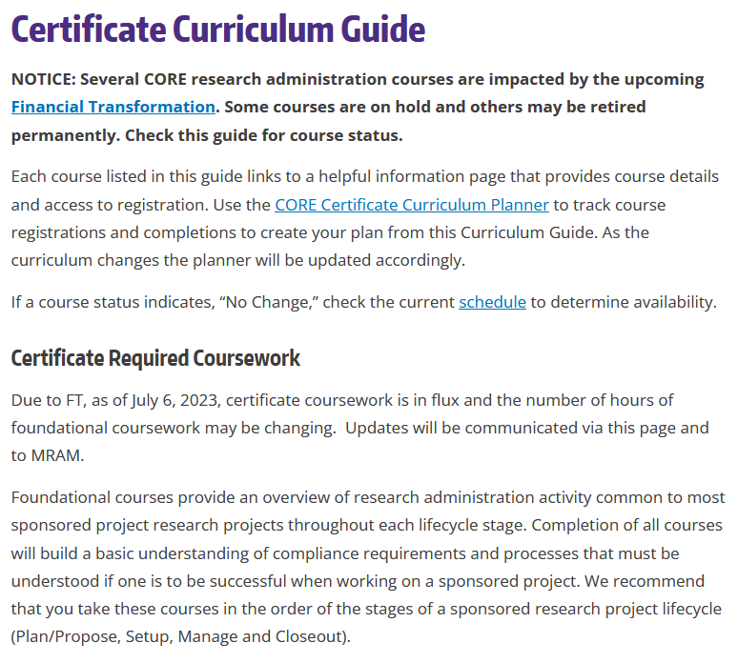
Changes coming to the certificate
CORE Registration
https://uwresearch.gosignmeup.com/public/course/browse
CORE Home https://www.washington.edu/research/training/core/
Notes:
Note that after July 6 several courses will become inaccessible. Some courses may not return and this will impact the required coursework. All of this is in flux right now so please stay tuned. Check this page for updates. Updates will also be sent to the MRAM email list.

Slide 3
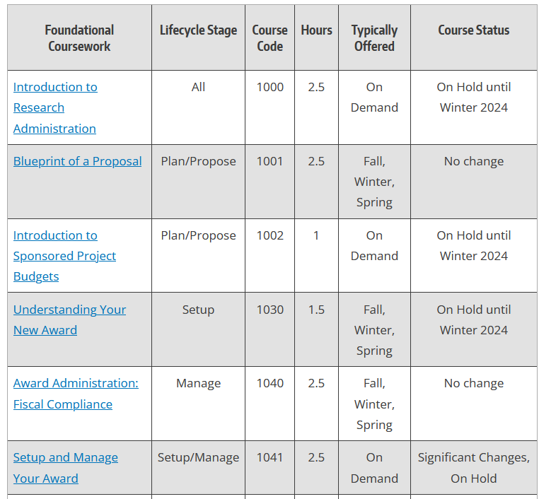
Changes coming to the certificate
CORE Registration
https://uwresearch.gosignmeup.com/public/course/browse
CORE Home https://www.washington.edu/research/training/core/
Notes:
On hold with target release date are courses we increasingly know what the updates are and can make them relatively quickly once transparency is reach with go-live. The courses with no change status indicate course where any changes required are minor and should be able to be completed by fall quarter. These course should be republished and ready to take in the fall, or will be offered live, depending on instructor availability. Course with significant changes, on hold indicate courses that may be replaced or totally retired, depending on what systems remediation brings to light in the next year.

Slide 4
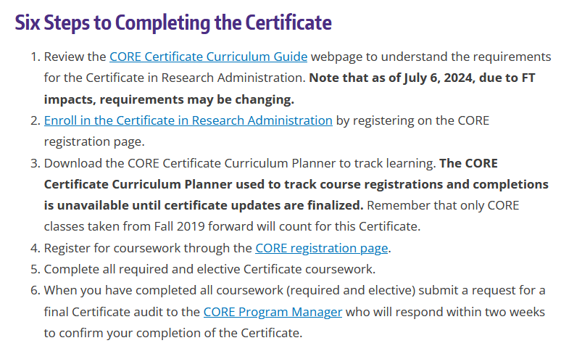
Changes coming to the certificate
CORE Registration
https://uwresearch.gosignmeup.com/public/course/browse
CORE Home https://www.washington.edu/research/training/core/
Notes:
Changes notes have been made to the process for completing the certificate. We will be finalizing certificate changes in early 2024.

