Slide 1
HYPERCARE & THE CUSTOMER SUPPORT MODEL FOR WORKDAY FINANCE
June 2023 MRAM
Sarah Thomas
UWFT Operating Model

Slide 2
WHAT IS HYPERCARE?
Dedicated support period immediately after go-live that includes:
  Additional layers of support for our customer support teams
  Special escalation paths and teams to troubleshoot and resolve issues
  UWFT program team there to support stabilization and minimize business disruption
Notes:
Amanda

Slide 3
WHAT IS THE CUSTOMER SUPPORT MODEL?
Customer support refers to the infrastructure and tools to support Workday Finance end users including where and how to get help.
UW Connect Finance (UW-branded ServiceNow) will be the common tool for submitting help requests to central offices.
Shared Environments are the first point of support for Workday Finance within each unit/department.
We will be here to help!
Notes:
Amanda

Slide 4
WHERE TO GET HELP
Workday Finance: Reach out to your unit's Shared Environment via UW Connect or their defined methods
  Security Role Questions: Contact the Integrated Service Center (ISC)
SAGE: Contact sagehelp@uw.edu
OSP: Contact osp@uw.edu
GCA & Award Portal: Contact gcahelp@uw.edu
ECC: Contact ECCHelp@uw.edu

Slide 5
WHAT IS UW CONNECT?
UW Connect (the UW-branded ServiceNow) is a customer support platform, already used across the University.
A new module, UW Connect Finance, will be the primary support system used for Workday finance and procurement.
UW Connect Finance includes a self-help portal with knowledge articles and training links and will allow campus users to submit help tickets.
You can find more information here: UW Connect Finance Overview (sharepoint.com)

Slide 6
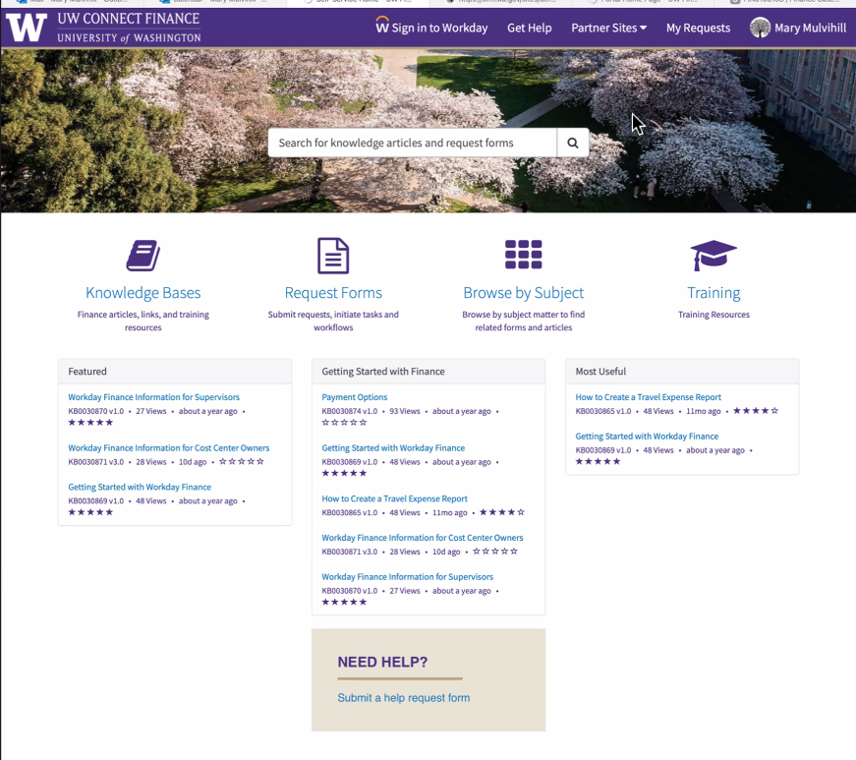
UW CONNECT FINANCE PORTAL

Slide 7
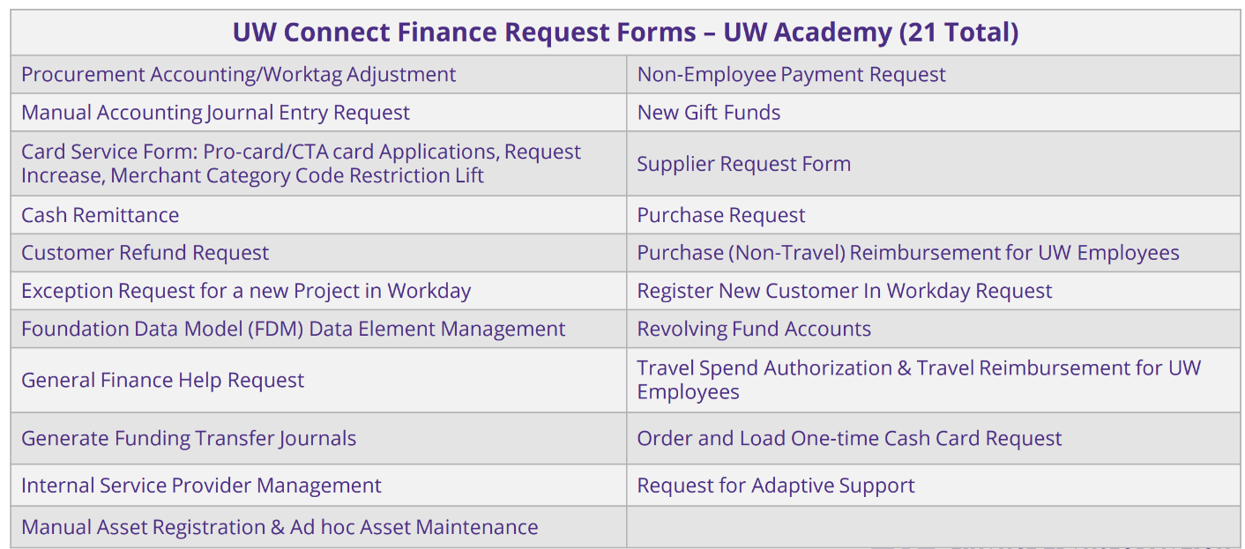
WHEN TO SUBMIT A UW CONNECT TICKET
More details here: UWFT Change Network - UWCF Request Forms

Slide 8
WHERE TO GET HELP – SHARED ENVIRONMENTS
A Shared Environment is a pooled group of staff, conducting finance and procurement activities on behalf of one or more local units.
Shared Environments enhance efficiency and compliance by pooling specific transactions that had previously been performed separately by local entities. By serving one or more units, Shared Environment specialists with Workday expertise will ensure standardization and ease the administrative burden of local staff who were previously tasked with transactional work that was not core to their job functions.
Shared Environments are specific to UW Academy and live at the Dean or VP-equivalent level office of each unit.
Shared Environments complete tasks within four defined business process areas:
Shared Environments are the first point of contact for units for all
support questions.
Misc. Accounts Receivables | Procurement
General Accounting | Post-Award Research Administration

Slide 9
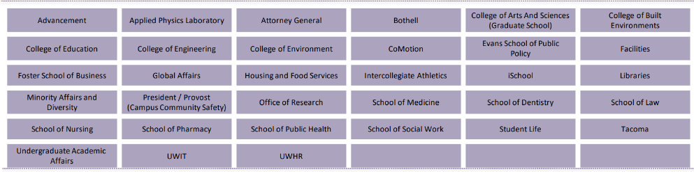
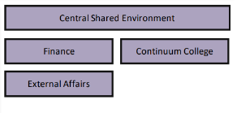
SHARED ENVIRONMENTS
34 Shared Environments, including the Central Shared Environment
Located in Dean, or VP-equivalent level, office of each unit
Some smaller units are serviced by the Shared Environment in a larger unit
UW Connect help tickets will auto-route to submitter's assigned Shared Environment

