Slide 1
COSTING ALLOCATIONS: SALARY OVER THE CAP AND EFFORT COST SHARE
Stepanka Sirotek
Business Analyst, UW Finance Transformation
June 16, 2023 MRAM

Slide 2
Salary Cap – Current State Example
Faculty – 12.6% effort on grant 61-0000
Total Base Pay: $21,825/monthly
Salary cap = $17,325/monthly
Department will enter costing allocations into WD:
  10% to the grant
  2.6% to a non-grant salary source

Slide 3
FUTURE STATE

Slide 4
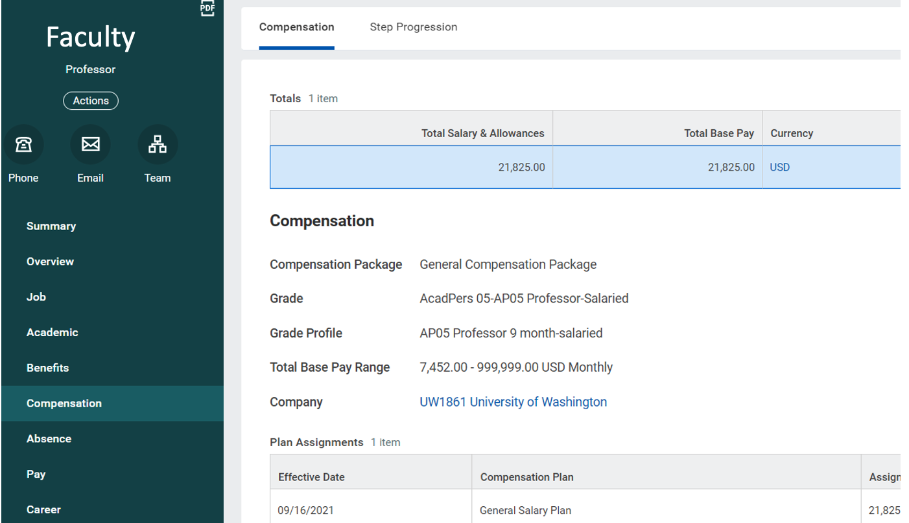
WORKDAY
Notes:
do you need this slide?

Slide 5
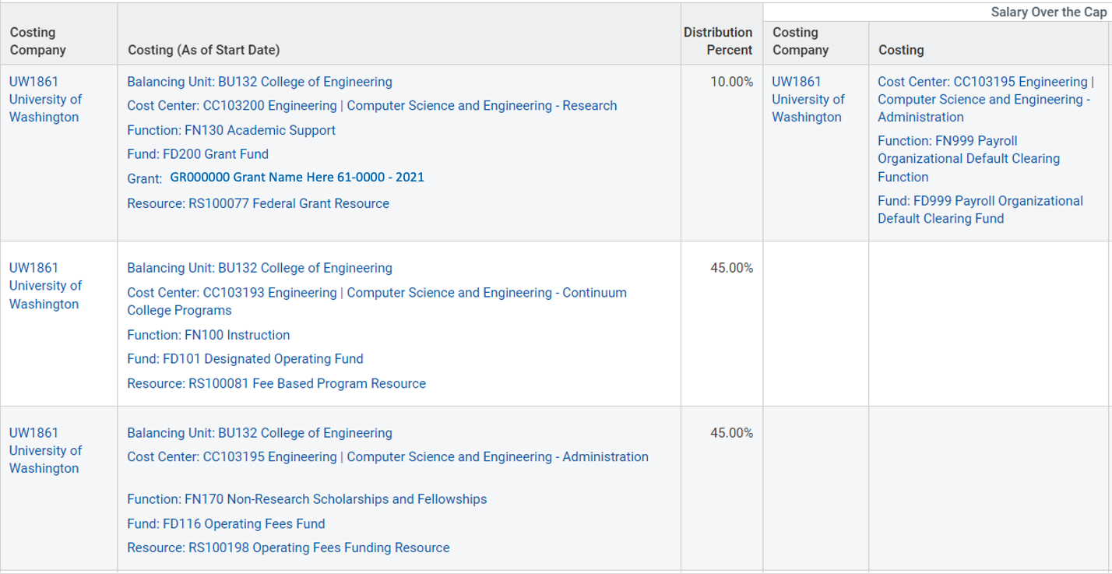
WORKDAY Costing Allocations – Future State

Slide 6
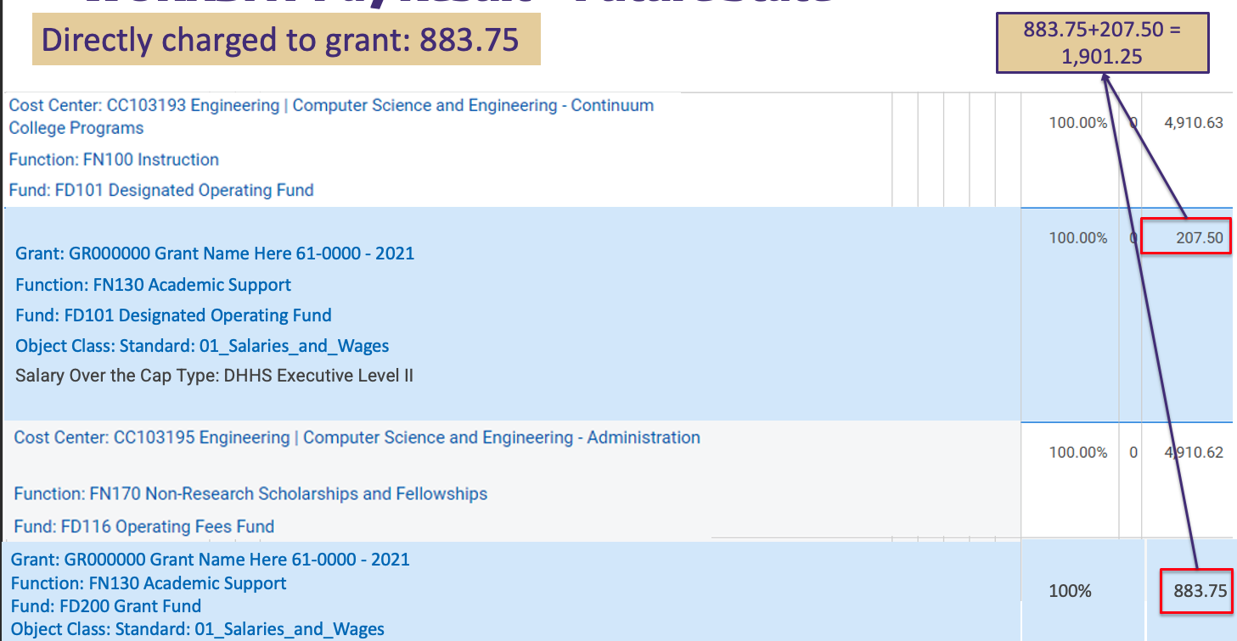
WORKDAY Pay Result – Future State

Slide 7
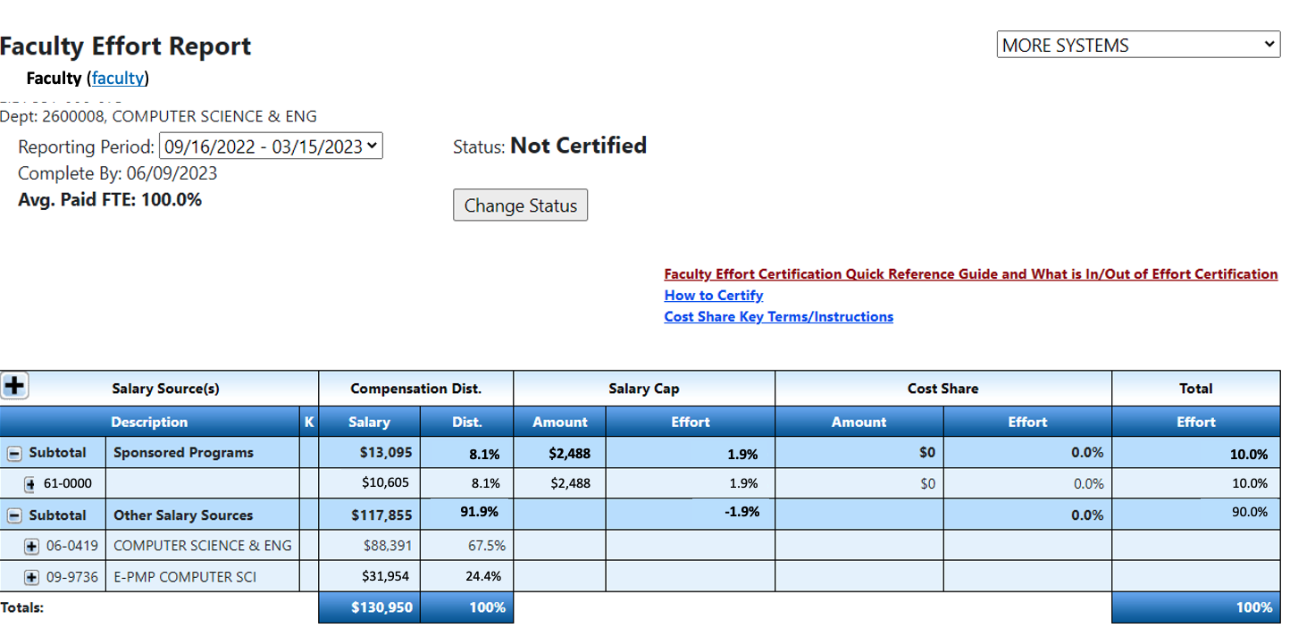
Effort Report - Future state

Slide 8
COMMITTED COST SHARE

Slide 9
Cost Share – Current State Example
Faculty – 100% effort on grant 62-0000
90% is directly charged to the grant
10% is cost shared, paid from 06-1030
Costing allocation current state:
90% costed to 62-0000
10% costed to 06-1030
Cost Share is recorded outside of WD, in the eFECS Cost Share Summary application and eFECS Effort Reporting application

Slide 10
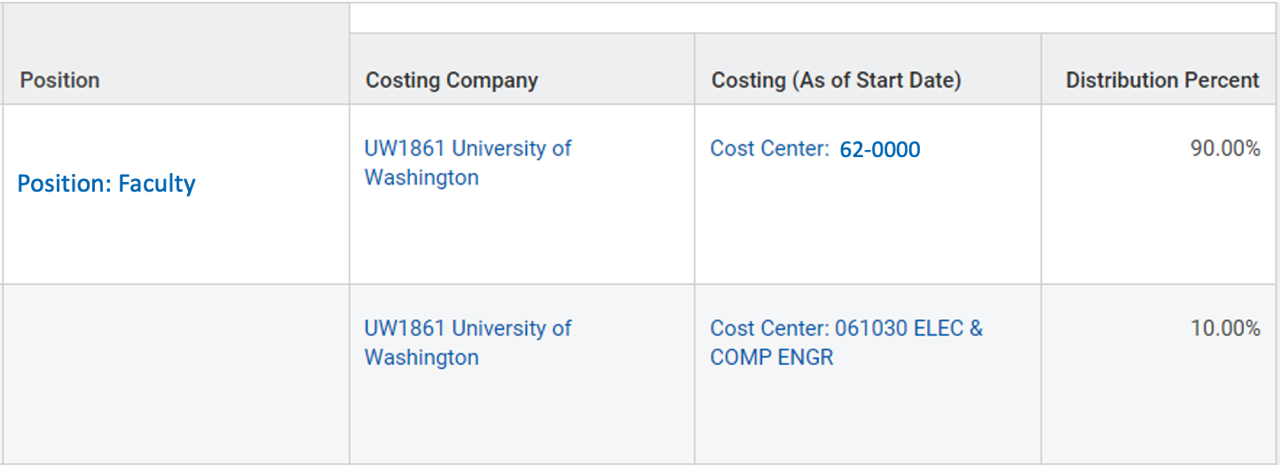
WORKDAY Costing Allocations – Current State

Slide 11
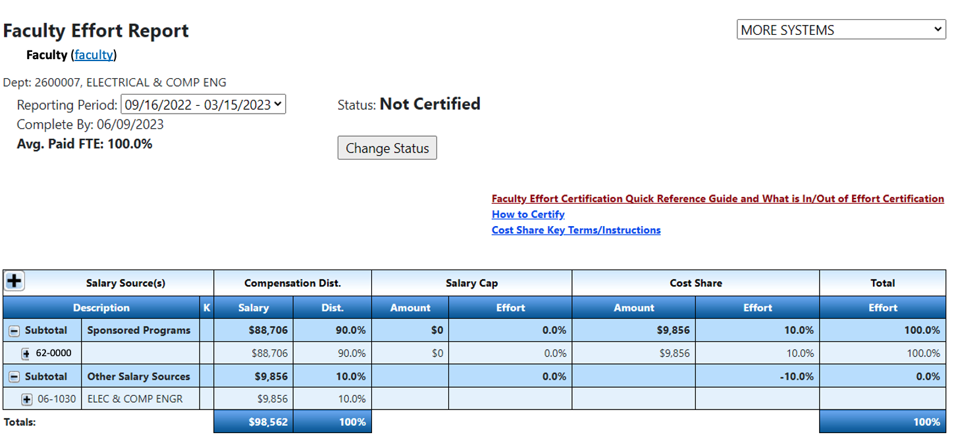
Effort Report - Current State

Slide 12
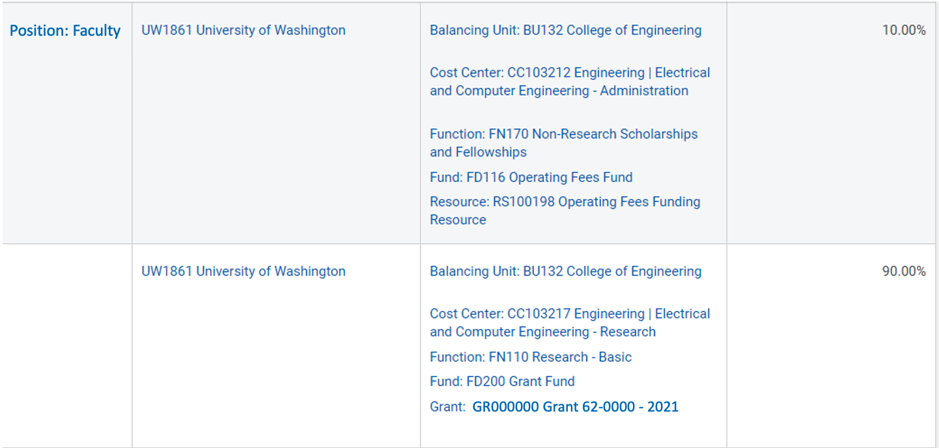
WORKDAY Costing Allocations – Future State (now)
Non-sponsored funding resource
The grant

Slide 13
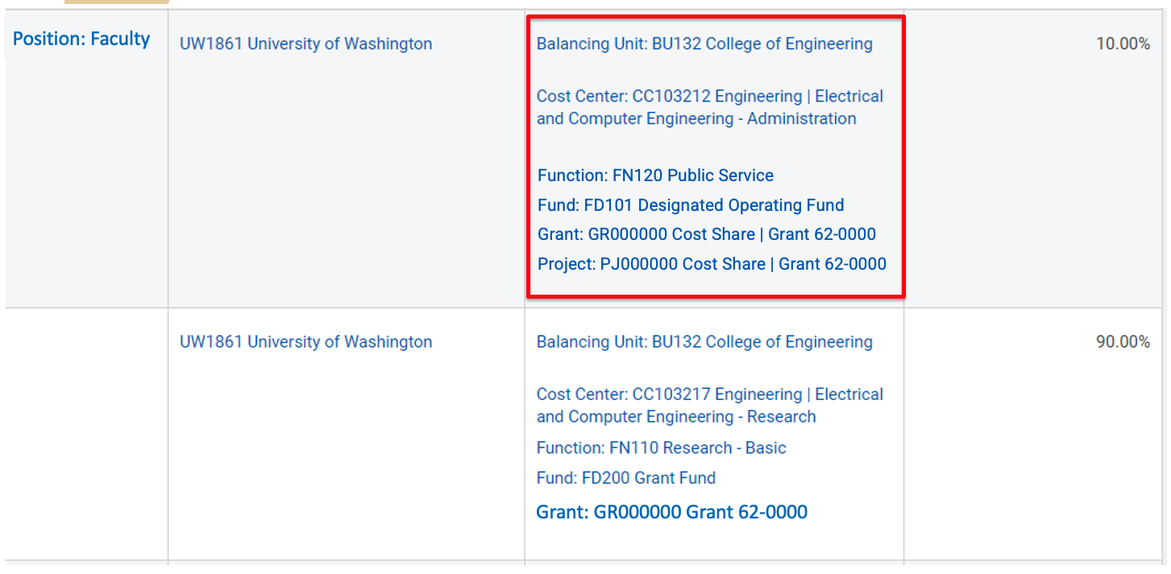
WORKDAY Costing Allocations – Future State (desired)
Non-sponsored funding resource
The grant

Slide 14
RETROACTIVE ADJUSTMENTS
Retro adjustments will not calculate SOC accurately and will require additional corrections
PAAs will not calculate the SOC
Corrections will require supplemental documentation (inclusion of a salary cap calculator)

Slide 15
HANDLING SPECIAL CASES
X/Y Salary Components
Continue to adjust manually at time of entry
SOC will be handled by ECC
ECC will calculate and display how much over the cap has not been covered yet
Allocations on awards with salary limitations
Continue to adjust manually at time of entry
“Co-funding” of effort (e.g., use of non-federal grant to offset salary limitations of K award) will require a salary allocation in the Workday payroll module and manual adjustments in ECC

Slide 16
THINGS TO KEEP IN MIND
Don’t prorate costing allocations in Workday Finance
Create costing allocations for committed cost share
SOC designated cost centers will need to be proactively added or the charges will end up on the individual’s default cost center
An updated costing allocation user guide is being developed to address new process requirements
Accrued charges can be reviewed after each pay period in the Employee Compensation Compliance (ECC) system
Watch out for outreach from UWFT HRP Remediation Team

Slide 17
Questions
Please email Stepanka Sirotek with questions at sr8@uw.edu

Slide 18
ADDENDUM:
SALARY CAP - CURRENT STATE

Slide 19
Salary Cap – Current State
Capped award is set up by GCA with grant flag 08
Department calculates cap using the Salary Cap Calculators
Department enters costing allocation into WD (adjusted for the cap)
  Over the cap amount goes to a non-grant salary source
  No need to specify salary source for over the cap
  Need to have enough Other Salary Sources to cover all salary over the cap obligations

Slide 20
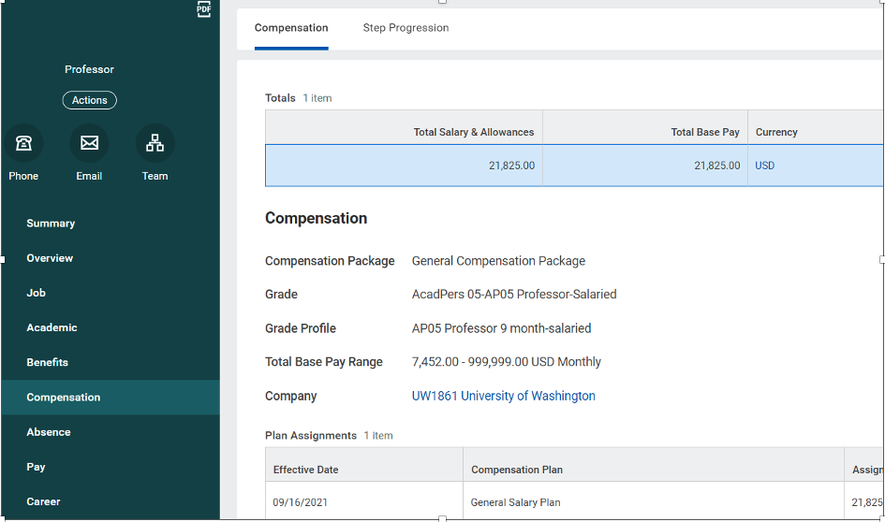
WORKDAY
Notes:
do you need this slide?

Slide 21
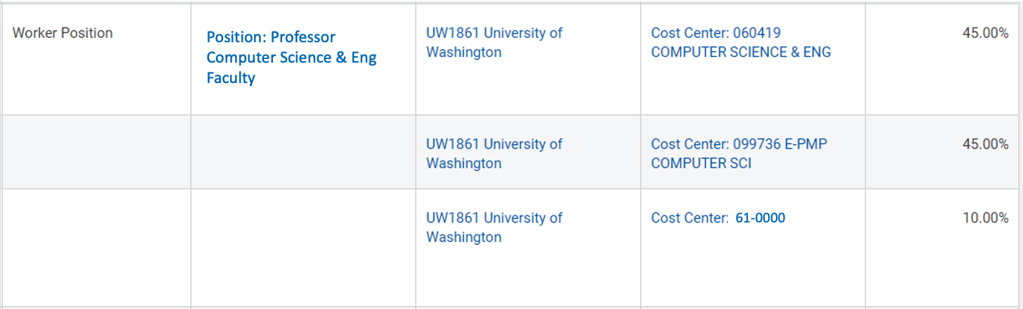
WORKDAY Costing Allocations – Current State

Slide 22
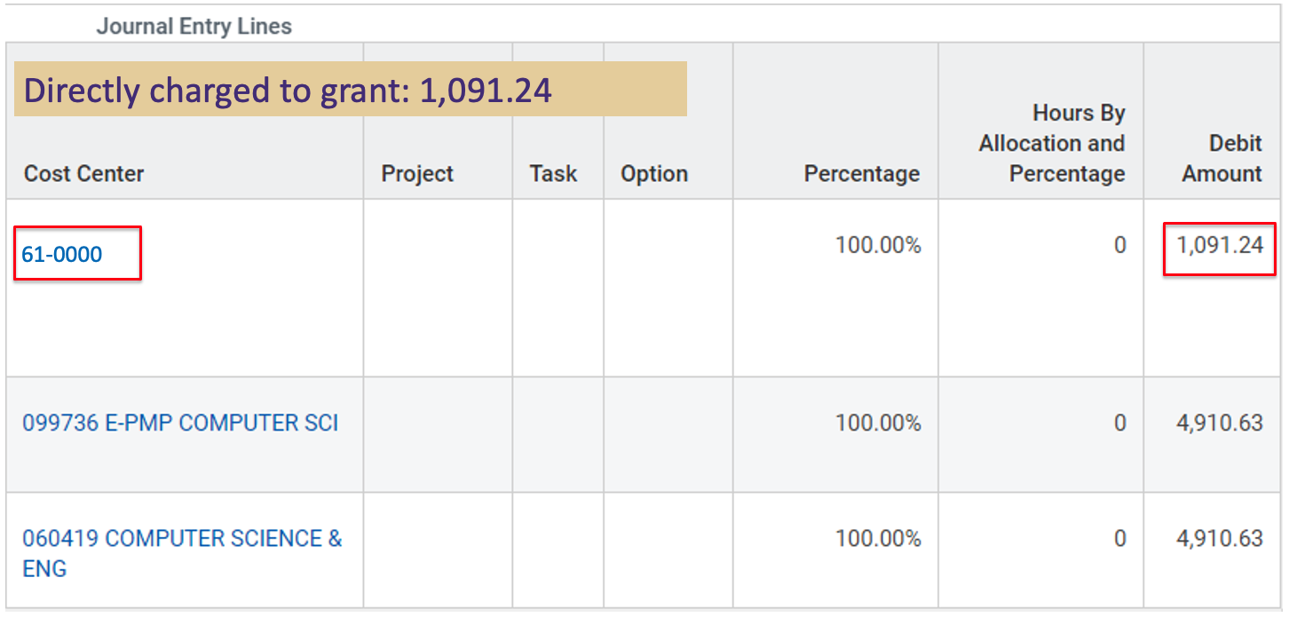
WORKDAY Pay Result – Current State

Slide 23
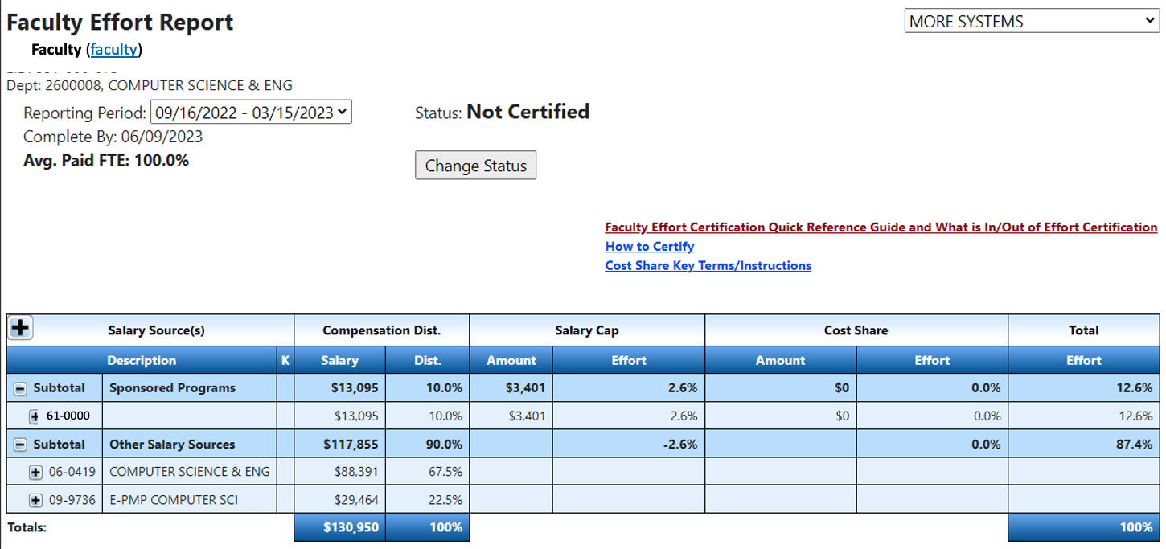
Effort Report - Current State

